Slide 2


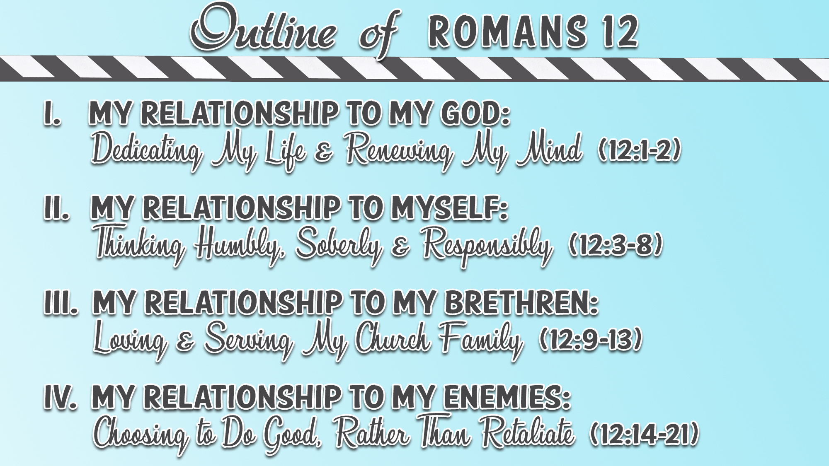

Slide 3
Choose to Do Good (12:14-16)
Bless those who persecute you (12:14)
Bless and do not curse (12:14)
Rejoice with those who rejoice (12:15)
Weep with those who weep (12:15)
Be of the same mind toward one another (12:16)
Do not set your mind on high things (12:16)
Associate with the humble (12:16)
Do not be wise in your own opinion (12:16)

Slide 4
Choose to Not Retaliate (12:17-21)
Never pay back evil for evil to anyone (12:17)
Have regard for good things in the sight of all men (12:17)
Live peaceably with all men (12:18)

Slide 5
Choose to Not Retaliate (12:17-21)
Never take your own revenge (12:19)
  The Greek word means “to vindicate a person’s right, to exact justice, to avenge”
  The human nature tries to get even
  The Divine nature remembers the “love” of God (“Beloved”) and lets it go
    1 Cor. 13:7; Prov. 10:12; 19:11; 1 Pet. 4:8; Eph. 4:32; Jas. 1:19-20
  Jesus did not seek to avenge Himself (Luke 23:34; 1 Pet. 2:22-23)
  We must refuse to vindicate and punish those who mistreat us
  Present tense verb emphasizes continual behavior and choices

Slide 6
Choose to Not Retaliate (12:17-21)
Leave room for the wrath of God (12:19)
  The Greek lit. says, “give a place unto the wrath”
  God tells us to give room for Him to work and let Him take care of the situation
  Vengeance belongs to God (cf. Deut. 32:35; Heb. 10:30)
    The Greek word “ekdikesis” means “a revenging, vengeance, punishment”
  God will repay
    The Greek word “antapodidomi” is different than the “repay” in verse 17
    Verse 17 is “apodidomi” = “to give back, to pay back, to recompense”
    Verse 19 is “antapodidomi” = “to give back as an equivalent, in return for”
    Verse 19 adds the prefix “anti” to express the idea of complete return

Slide 7
Choose to Not Retaliate (12:17-21)
Leave room for the wrath of God (12:19)
  The two activities which are prohibited to us are now said to belong to God
    Retaliation and punishment of evildoers is God’s prerogative and NOT ours
    Sometimes the state’s administration of justice will handle this (Rom. 13:4)
    If no justice in this life, leave it to the Judge – God will make things right eventually (cf. Luke 18:7)
    God’s wrath will be finally expressed on “the day of God’s wrath” (Rom. 2:5)
    Thanks be to God that “we shall be saved from wrath through Him” (Rom. 5:9)
  The verb tenses are significant
    “Leave room for the wrath of God” is an aorist imperative – urgency & finality to the command
    “It is written” is a Greek perfect passive – has been written and remains written
    “Says the Lord” is present tense – the Lord is saying this even now

