Slide 1
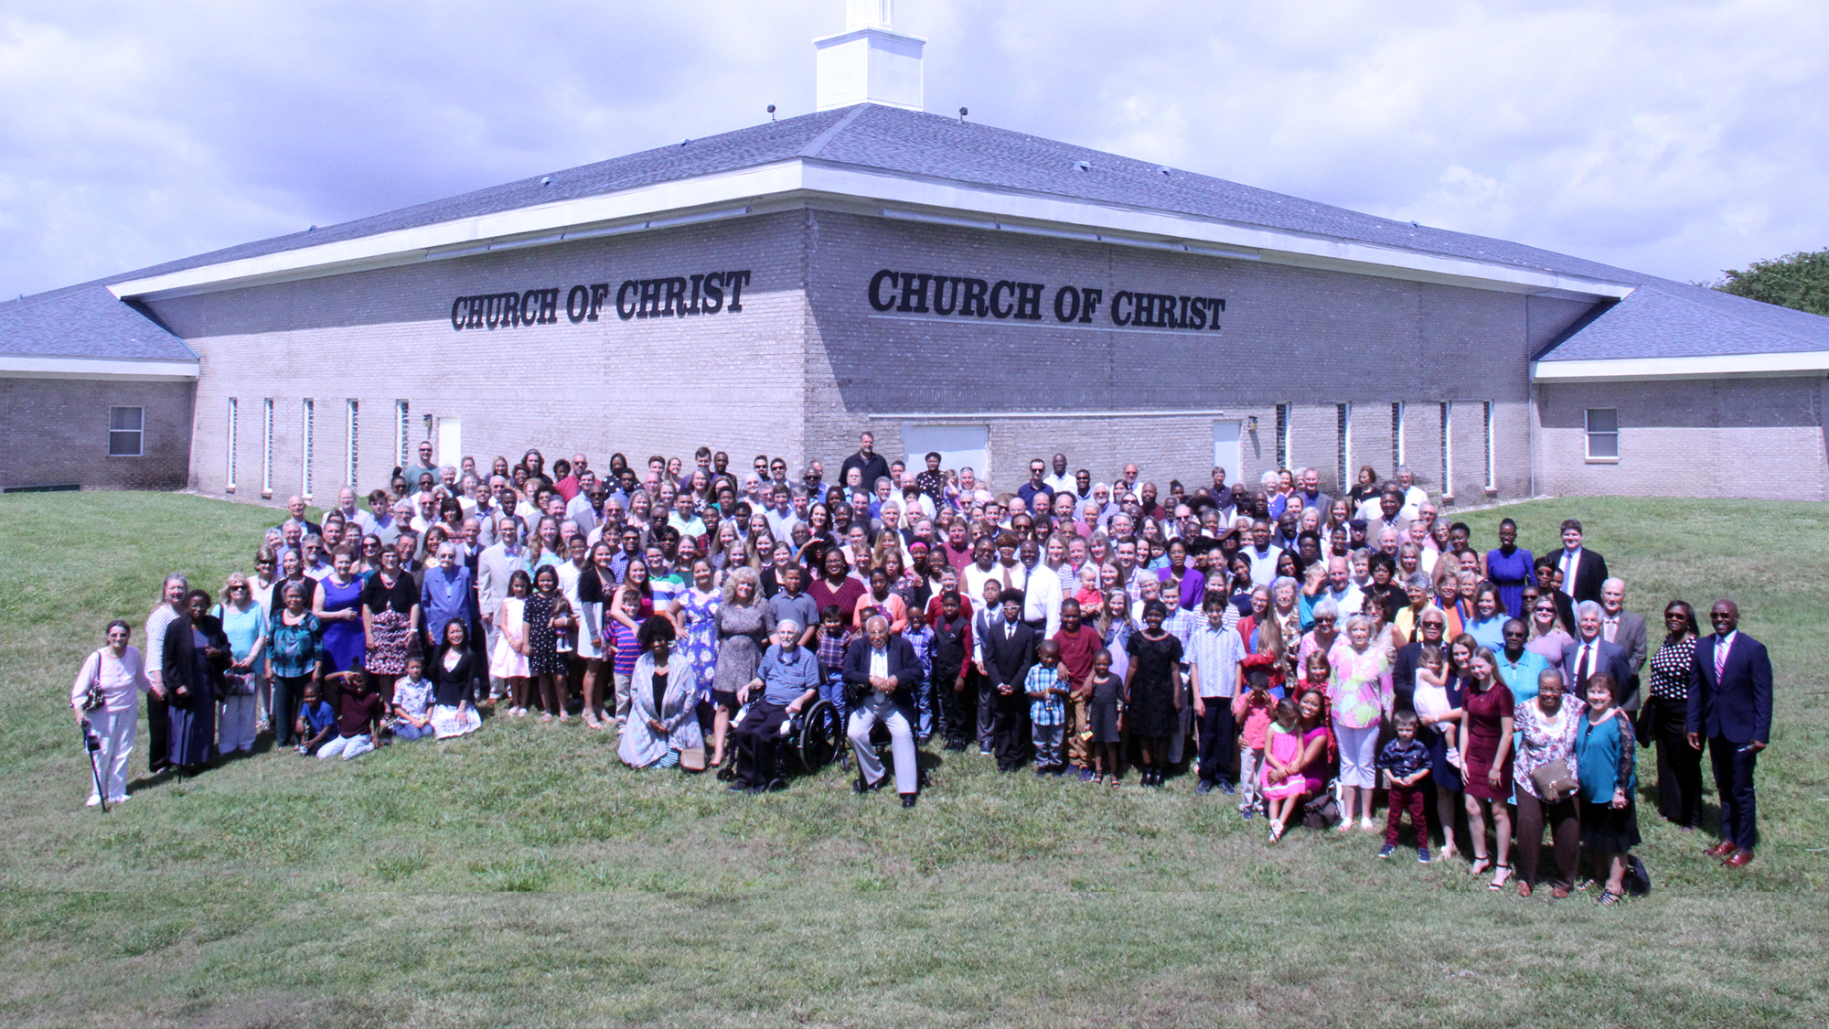

Slide 2
All have God as their Father (3:26)
All are “in Christ” (3:27)
All are clothed with Christ (3:27)
Because all put their faith in Christ Jesus (3:26)
Because all were immersed into Christ (3:27)
All did the same thing to become the same thing

Slide 3
We are “all one in Christ” – THERE IS NO INFERIOR/SUPERIOR
All persons get “into Christ” in exactly the same way (Gal. 3:27)
All who are “in Christ” receive exactly the same blessings (Eph. 1:3)
All who are “in Christ” wear exactly the same name (Acts 11:26; 1 Pet. 4:16)
All who are “in Christ” are “one”!
We are “all one in Christ” – THERE IS EQUALITY
We are all EQUAL in our need for salvation (Rom. 3:23)
We are all EQUAL in our access to God’s free gift of redemption (Tit. 2:11)
We are all EQUAL in our ability to obtain it (Heb. 5:9)
We are all EQUAL in our requirements to obtain it (Mark 16:15-16)
We are all EQUAL in our standing before God (Col. 3:11)
We are all EQUAL in our personal access to the Father (Eph. 2:18)

Slide 4
We are “all one in Christ” – THERE IS ACCEPTANCE
In Christ, we are all ACCEPTED BY & ACCEPTABLE TO GOD for the same reasons
Based upon the same GROUNDS = the blood of Christ (Rom. 3:24-25)
Based upon the same CONDITIONS = Faithful obedience (Acts 10:34-35; 2:37-41)
Acceptance by God requires acceptance by His children (Acts 10:27-36)
We are “all one in Christ” – THERE IS UNITY
We have unity of mind (Phil. 2:2)
We have unity of identity (1 Cor. 12:27)
We have unity of doctrine (1 Cor. 1:10; 2 John 9)
We are “all one in Christ” – THERE IS BELONGING
We all belong to God, as His children (1 Pet. 2:9-10)
We all belong to Christ, by means of purchase (1 Cor. 6:19-20)
We all belong to each other, as brothers and sisters in Christ (Rom. 12:4-5)
We have unity of purpose (Col. 1:27-29)
We have unity of aim (Tit. 2:13)

Slide 5
We are “all one in Christ” – THERE IS “NEITHER”
IN CHRIST, one’s relationship with God, standing with God, acceptability to God, AND therefore one’s relationship with me, standing with me, acceptability to me has NOTHING to do with:
Their nationality – there is neither Jew nor Greek
Their social position – there is neither slave nor free, slave nor master
Their gender – there is neither male nor female
Their age – there is neither old fogey nor young whippersnapper
Their birthplace – there is neither northerner nor southerner / this side of the tracks nor that side
Their economic status – there is neither upper class nor lower class / rich nor poor
Their political views – there is neither Democrat nor Republican
Their education level – there is neither Ph.D. nor 7th grade education
Their native language – there is neither English speakers nor non-English
Their skin color – there is neither black nor white
God shows NO partiality (1 Pet. 1:17)
Therefore, His children must NOT show ANY partiality (Jas. 2:9)

Slide 6
We are “all one in Christ” – THERE IS NO INFERIOR/SUPERIOR
We are “all one in Christ” – THERE IS EQUALITY
We are “all one in Christ” – THERE IS ACCEPTANCE
We are “all one in Christ” – THERE IS UNITY
We are “all one in Christ” – THERE IS BELONGING
We are “all one in Christ” – THERE IS “NEITHER”
In Christ, “old” things passed away; “ALL” have become “NEW” (2 Cor. 5:17)
Those discriminations of “old” no longer exist “in Christ”!
Each one stands “new” in Christ, and each one stands on the same level!

Slide 7
As an integral part of God’s eternal plan, He made a key promise to Abraham: “In your seed all the nations of the earth shall be blessed” (Gen. 22:18; 12:3)
“Blessed” involves salvation from sin
“Blessed” involves eternal life with God
Christ is the “Seed” of Abraham, according to the promise of God (Gal. 3:16)
All who are “in Christ” are:
Abraham’s spiritual descendants by obedient faith (Gal. 3:7, 29)
Blessed with justification/salvation from sin (Eph. 1:7)
Blessed with the promise of eternal life (1 John 5:11; 2:25; Heb. 9:15)

Slide 8
Believe Jesus is God’s Son (Acts 16:31)
Repent of your sins and turn to God (Acts 17:30)
Confess your faith in Jesus Christ (Romans 10:9)
Be immersed into Christ (Galatians 3:27)
God will forgive all of your sins (Acts 2:38)
God will add you to His family (Acts 2:47)
God will enroll you in heaven (Hebrews 12:23)
Be faithful to your Father in heaven (Matthew 7:21)
If you’ve strayed, repent and turn away from your sins (Acts 8:22)
If you’ve strayed, confess your sins and ask for forgiveness (1 John 1:9)

