Slide 1
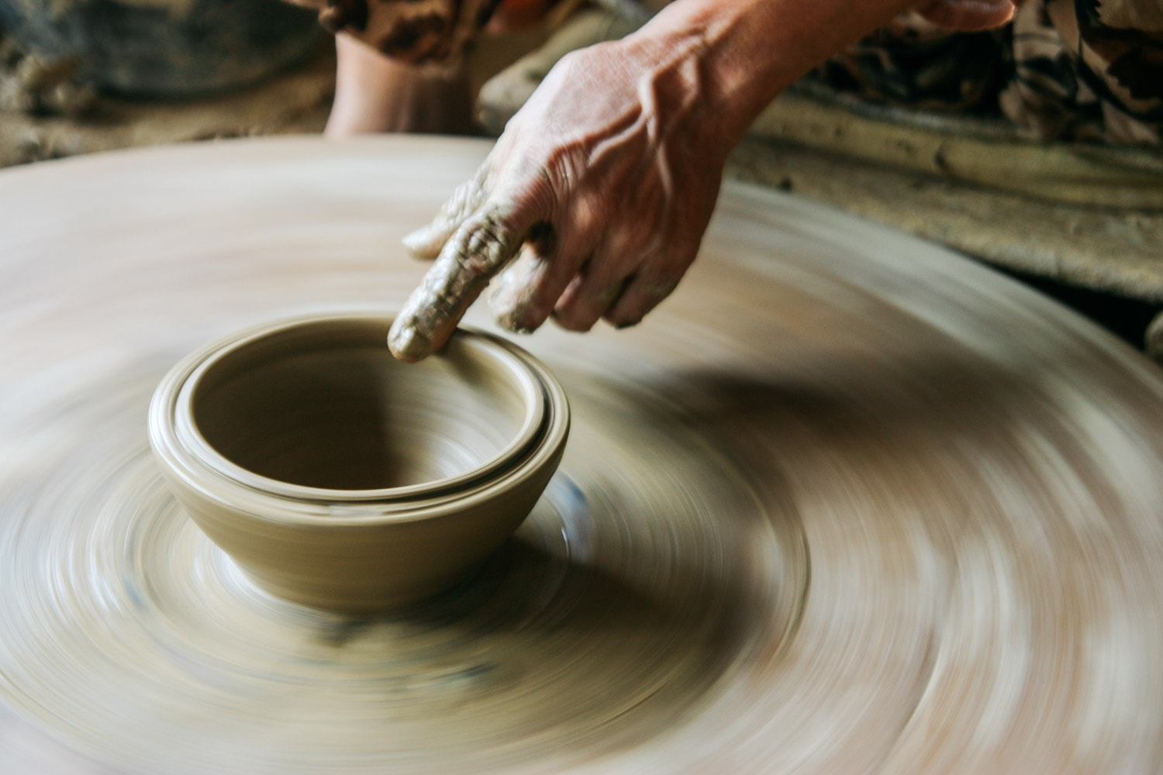
Living Every Day
with a Christ-Centered Life
Josh Blackmer
Palm Beach Lakes church of Christ

Slide 2
Paul’s Life Was Christ-Centered
Before we can begin to get our lives centered we have to die:
John 12:24-25
Truly, truly, I say to you, unless a grain of wheat falls into the earth and dies, it remains alone; but if it dies, it bears much fruit. "He who loves his life loses it, and he who hates his life in this world will keep it to life eternal.

Slide 3
Paul’s Life Was Christ-Centered
Before we can begin to get our lives centered we have to die:
Die to self: Galatians 2:20
I have been crucified with Christ; and it is no longer I who live, but Christ lives in me; and the life which I now live in the flesh I live by faith in the Son of God, who loved me and gave Himself up for me.

Slide 4
Paul’s Life Was Christ-Centered
Before we can begin to get our lives centered we have to die:
Die to sin: Romans 6:1-4
What shall we say then? Are we to continue in sin so that grace may increase? May it never be! How shall we who died to sin still live in it? Or do you not know that all of us who have been baptized into Christ Jesus have been baptized into His death? Therefore, we have been buried with Him through baptism into death, so that as Christ was raised from the dead through the glory of the Father, so we too might walk in newness of life.

Slide 5
Paul’s Life Was Christ-Centered
Before we can begin to get our lives centered, we have to die:
Die to the world: Galatians 6:14
But may it never be that I would boast, except in the cross of our Lord Jesus Christ, through which the world has been crucified to me, and I to the world.

Slide 6
Paul’s Life Was Christ-Centered
Before we can begin to get our lives centered we have to die:
Die daily: 1 Corinthians 15:31
I affirm, brethren, by the boasting in you which I have in Christ Jesus our Lord, I die daily.

Slide 7
Staying Centered
We Must Live “IN” Christ
Christ is the sphere of a spiritual life.
Ephesians. 1:3
Blessed be the God and Father of our Lord Jesus Christ, who has blessed us with every spiritual blessing in the heavenly places in Christ.

Slide 8
Staying Centered
We Must Live “IN” Christ
The branch must abide in the vine.
John 15:4-5
Abide in Me, and I in you. As the branch cannot bear fruit of itself unless it abides in the vine, so neither can you unless you abide in Me. "I am the vine, you are the branches; he who abides in Me and I in him, he bears much fruit, for apart from Me you can do nothing.

Slide 9
Staying Centered
We Must Live “IN” Christ
Living in Christ is living in the church.
Ephesians 5:25-30
Husbands, love your wives, just as Christ also loved the church and gave Himself up for her, so that He might sanctify her, having cleansed her by the washing of water with the word, that He might present to Himself the church in all her glory, having no spot or wrinkle or any such thing; but that she would be holy and blameless. So, husbands ought also to love their own wives as their own bodies. He who loves his own wife loves himself; for no one ever hated his own flesh, but nourishes and cherishes it, just as Christ also does the church, because we are members of His body.

Slide 10
Staying Centered
We Must Live “WITH” Christ
Paul was forsaken by many, but not by the lord
2 Timothy. 4:16, 17
At my first defense no one supported me, but all deserted me; may it not be counted against them. But the Lord stood with me and strengthened me, so that through me the proclamation might be fully accomplished, and that all the Gentiles might hear; and I was rescued out of the lion's mouth.

Slide 11
Staying Centered
We Must Live “WITH” Christ
“He who is not with me is against me” (Matthew 12:30)
Paul had lived contrary to Christ
Acts 9:4-5
He fell to the ground and heard a voice saying to him, “Saul, Saul, why are you persecuting Me?” And he said, “Who are You, Lord?” And He said, "I am Jesus whom you are persecuting.”

Slide 12
Staying Centered
We Must Live “WITH” Christ
“He who is not with me is against me” (Matthew 12:30)
His conversion was complete, quick, and he didn’t turn back.
Acts 9:20-22
And immediately he began to proclaim Jesus in the synagogues, saying, "He is the Son of God." All those hearing him continued to be amazed, and were saying, "Is this not he who in Jerusalem destroyed those who called on this name, and who had come here for the purpose of bringing them bound before the chief priests?" But Saul kept increasing in strength and confounding the Jews who lived at Damascus by proving that this Jesus is the Christ.

Slide 13
Staying Centered
We Must Live “FOR” Christ
Paul lived and thought this way…
Ephesians. 3:21
To Him be the glory in the church and in Christ Jesus to all generations forever and ever. Amen

Slide 14
Staying Centered
We Must Live “FOR” Christ
Paul lived and thought this way…
Colossians 3:23
Whatever you do, do your work heartily, as for the Lord rather than for men.

Slide 15
Staying Centered
We Must Live “FOR” Christ
Paul lived and thought this way…
Romans 12:1
I beseech you therefore, brethren, by the mercies of God, to present your bodies a living sacrifice, holy, acceptable to God, which is your spiritual service.

Slide 16
Paul’s Life Was Christ-Centered
Because Christ the Lord
Lived for us.
John 1:4
In him was life; and the life was the light of men

Slide 17
Paul’s Life Was Christ-Centered
Because Christ the Lord
Suffered for us.
Matthew 27:26-31
Then released he unto them Barabbas; but Jesus he scourged and delivered to be crucified. Then the soldiers of the governor took Jesus into the Praetorium, and gathered unto him the whole band. And they stripped him, and put on him a scarlet robe. And they platted a crown of thorns and put it upon his head, and a reed in his right hand; and they kneeled down before him, and mocked him, saying, Hail, King of the Jews! And they spat upon him, and took the reed and smote him on the head. And when they had mocked him, they took off from him the robe, and put on him his garments, and led him away to crucify him.

Slide 18
Paul’s Life Was Christ-Centered
Because Christ the Lord
Died for us.
Romans 5:8
But God demonstrates His own love toward us, in that while we were yet sinners, Christ died for us.

Slide 19
Will You Live Every Day
With A Christ-Centered Life?
Philippians 1:21
For to me, to live is Christ and to die is gain.

