Slide 2
Speaker: The Apostle Paul
Date: 50-51 A.D.
Place: Mars Hill in Idol-Filled Athens
Audience: Epicurean and Stoic Philosophers
Title: The One True God (Is Not Unknown)
Passage: Acts 17:22-31

Slide 3
The One True God: He Is Distinct from All (17:22-24a)
  It Is Not Enough to Be “Religious” (17:22)
  It Is Not Enough to “Cover Your Bases” Religiously (17:23)
  It Is Not Enough to Worship God, But in Ignorance (17:23)
  “The God” – The One True God – Is Not to Be Treated Like “a God” (17:24a)

Slide 4
The One True God: He Is Distinct from All (17:22-24a)
The One True God: He Is Creator of All (17:24-26)
  The God Created All – Out of Nothing (17:24)
  The God Rules Over All – Exercising Sole Authority As Lord (17:24)
  The God Transcends All – Not Housed Like a Finite Idol (17:24)
  The God Self-Sufficiently Sustains All – Not Dependent on Human Service (17:25)
  The God Gives Life to All – Life Always Comes from Life (17:25)
  The God Made All People from One Male – Unity of All Mankind (17:26)
  The God Made All the Earth for Mankind – To Dwell and to Have Dominion (17:26)
  The God Is Sovereign Over World Powers – Providentially Rules Among Men (17:26)

Slide 5
The One True God: He Is Distinct from All (17:22-24a)
The One True God: He Is Creator of All (17:24-26)
The One True God: He Is Findable By All (17:27-29)
  The God Created and Sustains Man in Order to Have a Relationship with Man (17:27)
  The God Revealed Himself in Creation in Order That Man Might Seek Him (17:27)
  The God Revealed Himself in Scripture in Order That Man Might Find Him (17:27)
  The God So Sustains Man That Mankind Cannot Exist Independently of Him (17:28)
  The God Is Not Material Made By Man But Is the Very Origin of Mankind (17:29)

Slide 6
The One True God: He Is Distinct from All (17:22-24a)
The One True God: He Is Creator of All (17:24-26)
The One True God: He Is Findable By All (17:27-29)
The One True God: He Wants to Save All (17:30-31)
  The God Will Not Overlook Man’s Ignorance of Him and His Truth (17:30)
  The God Desires All Men Everywhere to Be Saved (17:30)
  The God Reveals That All Can Be Saved Through Repentance (17:30)
  The God Provides Strong Motivation to Repent Through Judgment of All (17:31)
  The God Provides Guarantee of Judgment By Raising Jesus from the Dead (17:31)

Slide 7
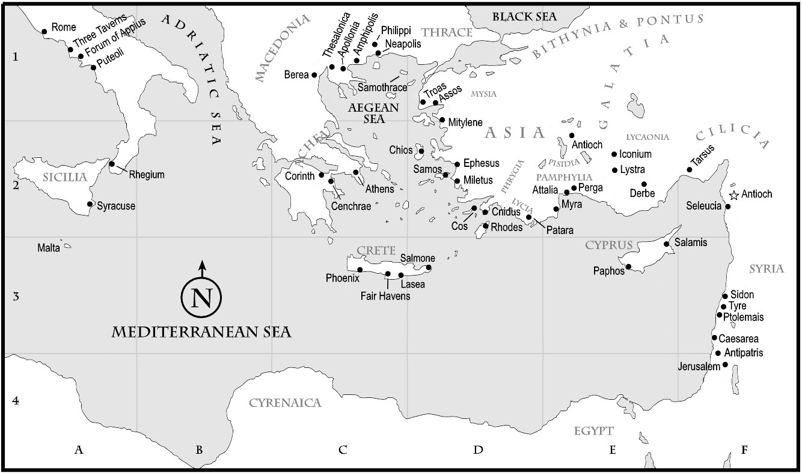

Slide 8
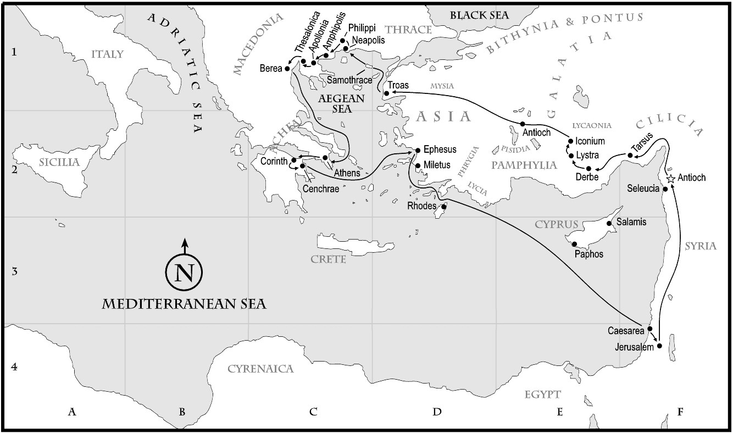

Slide 9
Service Times for This Coming Week
SUNDAY
Online Bible Classes
8:45 a.m. Zoom Bible Classes for Grades 5 & Under
9:15 a.m. Zoom Bible Class for Jr. High & Sr. High
Livestream Webcast Bible Class for Adults
Worship Services
11:00 a.m. Last Names: A – K
4:30 p.m. Last Names: L – Z
Bible Classes at the Church Building
7:00 p.m. Everyone will go directly to Bible classes (adults & children)
WEDNESDAY

