Slide 2
Speaker: The Apostle Paul
Date: 47-48 A.D.
Place: Synagogue in Antioch of Pisidia
Audience: Jews and Gentiles
Title: Jesus Is the Promised Messiah
Passage: Acts 13:16-41

Slide 3
Jesus Is the Messiah: The Promise (13:16-25)
  The Promise and Preparation through Israel (13:16-21)
  The Promise and Preparation through David (13:22-23)
  The Promise and Preparation through John (13:24-25)
Jesus Is the Messiah: The Proof (13:26-37)
  Proven By His Rejection (13:26-28)
  Proven By His Death (13:29)
  Proven By His Resurrection (13:30-37)
    His Resurrection Was By the Power of God (13:30)
    His Resurrection Had Many Witnesses (13:31)
    His Resurrection Fulfilled God’s Promises (13:32-33)
    His Resurrection Was Permanent (13:34)
    His Resurrection Is the Zenith of the Gospel (13:30-37)

Slide 4
Jesus Is the Messiah: The Promise (13:16-25)
Jesus Is the Messiah: The Proof (13:26-37)
Jesus Is the Messiah: The Point (13:38-41)
  Through Christ Alone Is Full Forgiveness of Sins (13:38)
  Through Christ Alone Is Justification from All Sins (13:39)
  Through Christ Alone Everyone Who Obeys Be Saved (13:39)
  Rejection of Jesus As the Messiah Has Severe Consequences (13:40-41)

Slide 5
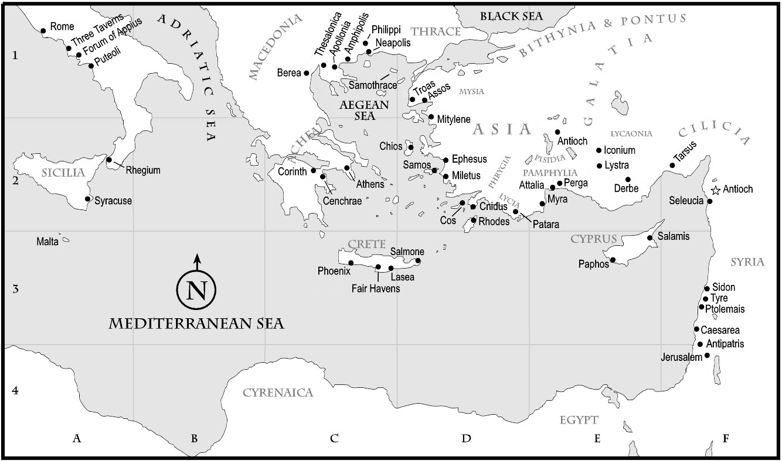

Slide 6
