Slide 2
Began in Acts 18:23 (in the city of Antioch of Syria)
Ended in Acts 21:17 (in the city of Jerusalem)
Approximate Travel Dates = 53-57 A.D.
Estimated Mileage = 2,700 miles
Known Travel Companions = Timothy, Titus, Luke & Erastus (plus 20:4)
On a Bible map, you can trace Paul’s journey and learn Bible geography
Paul wrote four inspired letters (still preserved) while on this journey:
  1 Corinthians (~55-56 A.D. from Ephesus; Acts 19:10)
  2 Corinthians (~56 A.D. from Macedonia; Acts 20:1-2)
  Romans (~57 A.D. from Corinth; Acts 20:3)
  Galatians (~53-57 A.D. from Corinth [20:3] or Ephesus [19:10])

Slide 3
Began in Acts 18:23 (in the city of Antioch of Syria)
Ended in Acts 21:17 (in the city of Jerusalem)
This third consecutive preaching journey involved strengthening Christians (18:23+20:2; 14:22; 15:41)
Paul worked in Ephesus for three years (longest stay anywhere) (19:10; 20:31)
  A great and effectual door was opened to him there (19:8; 1 Cor. 16:8-9 ~ Acts 16:6)
  The word was spread throughout all Asia during this time, to J&G (19:10, 20, 26)
  Paul reasoned every day from Scripture about the kingdom (19:8-10; 20:25)
  Paul also worked as a tentmaker to provide for himself (20:34)
  God worked miracles through Paul’s hands to confirm his authenticity (19:11-12)
  Many were being converted to Christ through the gospel (19:17-18)
  The Ephesian church became a strong and influential congregation in Asia Minor

Slide 4
Began in Acts 18:23 (in the city of Antioch of Syria)
Ended in Acts 21:17 (in the city of Jerusalem)
Bible baptism must include all required components to be valid (19:1-7; 18:24-28)
The miraculous gift of the Spirit could only be imparted through an apostle’s hands (19:6-7; 8:18)

Slide 5
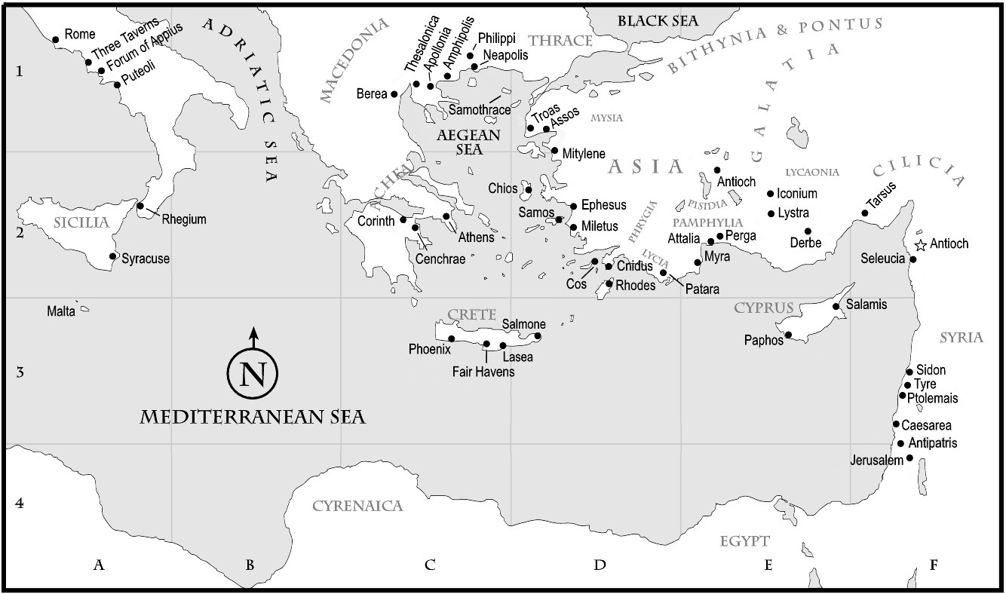

Slide 6
