Slide 2
Began in Acts 15:36 (in the city of Antioch of Syria)
Ended in Acts 18:22 (in the city of Antioch of Syria)
Approximate Travel Dates = 50-53 A.D.
Estimated Mileage = 2,800 miles
Known Travel Companions = Silas, Luke & Timothy
Paul took the gospel to Europe on this journey
On a Bible map, you can trace Paul’s journey and learn Bible geography
Paul wrote two inspired letters (still preserved) while on this journey:
  First Thessalonians (~51 A.D. from Corinth; Acts 18:5)
  Second Thessalonians (~51-52 A.D. from Corinth; Acts 18:11)

Slide 3
Began in Acts 15:36 (in the city of Antioch of Syria)
Ended in Acts 18:22 (in the city of Antioch of Syria)
Paul & Barnabas didn’t let their differences hinder the Lord’s work (15:36-40)
Paul selected Silas and set out to strengthen new converts (15:36, 41; 16:5)
  As the church was strengthened spiritually, the church also grew numerically (16:5)
Timothy joined Paul in Lystra and became a constant companion (16:1-3)
While some doors were closed for the gospel, others were opened (16:6-10)
  The Macedonian call is still ringing out from lost souls today, longing for the gospel (16:9-10)
Luke joined Paul in Troas and became a constant companion (16:8-10)

Slide 4
Began in Acts 15:36 (in the city of Antioch of Syria)
Ended in Acts 18:22 (in the city of Antioch of Syria)
Lydia and her household were the first converts in Europe (16:14-15)
Paul found peace and even joy in the midst of severe trials (16:22-25)
The jailer was converted as a result of Paul’s faith and his teaching (16:23-34)
  The timing and urgency of his baptism proves its essentiality for salvation (16:30-33)
  Biblically, “having believed” was a comprehensive expression encompassing his baptism (16:34)
Paul was a Roman citizen, granting him certain rights (16:37-38; 22:23-29; 23:27)
Paul’s custom was to preach to the Jews first and reason from the Scriptures, proving Jesus is the Christ (17:3-4, 10-11, 17-18, 31-32; 18:4, 19)
Paul established the church in Philippi, Thessalonica, Berea, Athens and Corinth with Jews and Gentiles in the same congregations (16:14-34; 17:4, 12, 34; 18:4)
Paul stayed and preached in Corinth for 18 months (18:11)

Slide 5
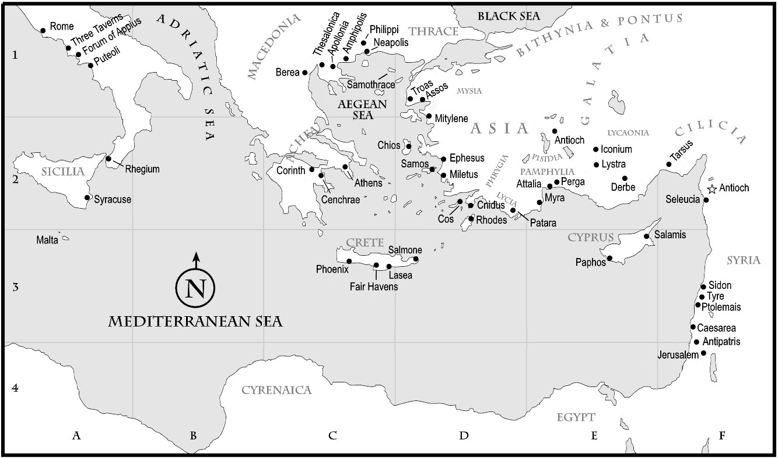

Slide 6
