Slide 1



Slide 2
Doubts can lead you away from the Lord (Jas. 1:6-8)
Doubts can cause you to disregard the Lord’s will (Acts 10:20)
Doubts can cause you to sink in your faith (Matt. 14:30-31)
Doubts can cause you to give in to fears (Judg. 6:11-13; Luke 24:37-38)
Doubts can cause you to turn inward (John 20:25)

Slide 3


Remember that He knows more than I do (Isa. 55:8-9)
Remember that He knows better than I do (Matt. 6:8)
Remember that He wants the best for me (1 John 4:8-9)
Remember that He will do the best for me (Rom. 8:28)

Slide 4
These doctrines are not of God (Mark 7:6-13; 1 Tim. 4:1)
These doctrines are often substituted for God’s Word (Mark 7:7)
These doctrines lead men to vain practices (Mark 7:7)
These doctrines lead men to lay aside God’s Word (Mark 7:8-9)
These doctrines lead men to undermine God’s Word (Mark 7:13)
These doctrines lead to hell, not heaven (Matt. 15:13-14; 2 Pet. 2:1-2)

Slide 5

Ask if it is from God or from man (1 John 4:1)
Use the Bible as the only standard of truth (Acts 17:11; Col. 3:17)
Don’t take for granted that preachers teach the truth (Acts 17:11)
Hold fast to God’s truth and reject all human doctrine (2 Tim. 1:13)

Slide 6
They tend to leave out God (1 Sam. 13:9-13)
They tend to be based upon feelings (2 Kgs. 5:11)
They tend to satisfy personal wishes (2 Sam. 11:2-4)
They tend to seek justification in irrational ways (1 Sam. 15:19-21)
They tend to be regretted (Matt. 27:5)

Slide 7

Pray to God and ask for wisdom (Jas. 1:5; Matt. 7:7)
Take steps that only align with the will of the Lord (Heb. 6:3)
Give God time to answer your prayers (1 John 5:14-15; Psa. 27:13-14)
Seek wise counsel from multiple trusted persons (Prov. 11:14; 15:22)

Slide 8
It can cause us to be deceived into thinking, “I’m okay” (Gal. 6:7)
It can cause us to become worldly in our thinking (Jas. 4:4)
It can cause us to focus on selfish desires (Jas. 4:3)
It can cause us to lose sight of our true purpose (1 Cor. 6:19-20)
It can cause us to fail to grow and mature in Christ (Heb. 5:12-14)
It can cause us to forget the sacrifice of Christ (2 Pet. 1:9)
It can cause us to crucify again the Son of God (Heb. 6:6)
It can (and will) lead to eternal damnation (Matt. 25:26)

Slide 9

Start every day resolving to grow stronger in the Lord (2 Pet. 1:5-11)
Start every day seeking to abound in the Lord’s work (1 Cor. 15:58)
Start every day meditating on the sacrifice of Christ (2 Cor. 5:14)
Start every day refusing to allow the world to steer or interfere (Rom. 12:2)
Start every day telling the Lord what you’ll do for Him that day (Mark 1:35)
Start every day identifying one person you can encourage (Jude 20)
Start every day determining to see lost souls around you (Acts 8:4)
Finish every day reflecting and thanking God (1 Tim. 1:12-16)

Slide 10
Distancing can lead to self-focusing (John 20:25)
Distancing can lead to being hardened (Heb. 3:13)
Distancing can lead to complete disconnect from brethren (John 20:19, 24)
Distancing does not allow me to worship “with” my brethren (Matt. 26:29)
Distancing does not allow me to sing “to” my brethren (Eph. 5:19)
Distancing does not allow me to “exhort” my brethren (Heb. 10:24-25)
Distancing can lead to poor habits (Gal. 6:1)

Slide 11

Make intentional, specific plans when you will assemble (Acts 20:6-7)
Make assembling a greater desire and priority than anything else (Matt. 6:33)
Look forward to seeing, being with and encouraging brethren (Heb. 10:24-25)
Examine the “reasons” why I am not assembling (2 Cor. 13:5)
  Are they rational or irrational?
  Are they consistent or inconsistent?
  Are they God-centered or me-centered?
  Do they reflect a heart of devotion to the Lord?

Slide 12
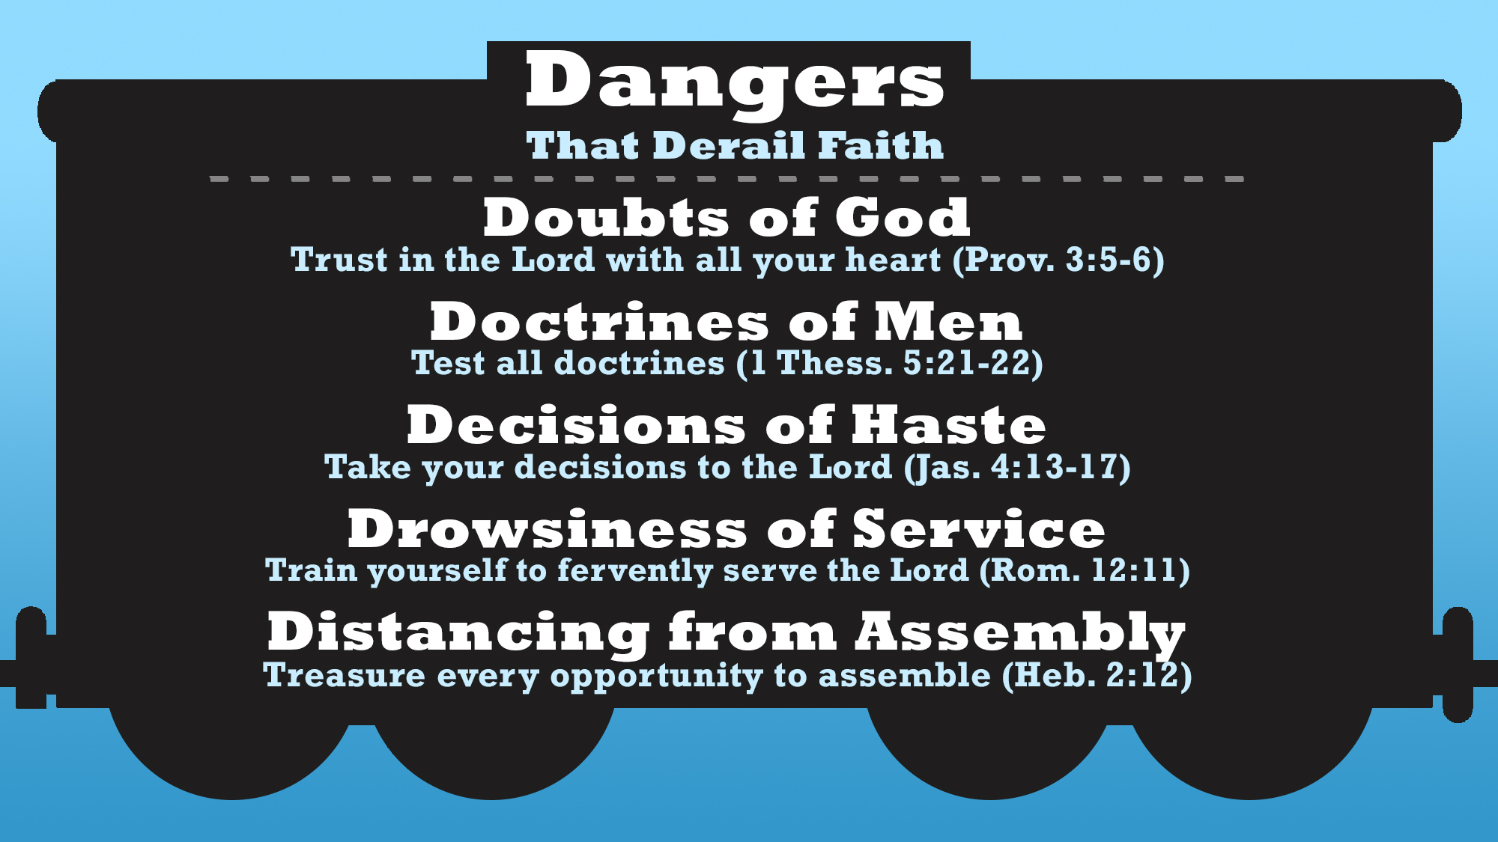

Slide 13
Believe Jesus is God’s Son – Hebrews 11:6
Repent of your sins and turn to God – Acts 17:30
Confess your faith in Jesus Christ – Romans 10:9
Be immersed into Christ – Acts 22:16
  God will forgive you and add you to His church – Acts 2:38, 47
Stay on track in serving the Lord faithfully – 1 John 1:7

