Slide 2
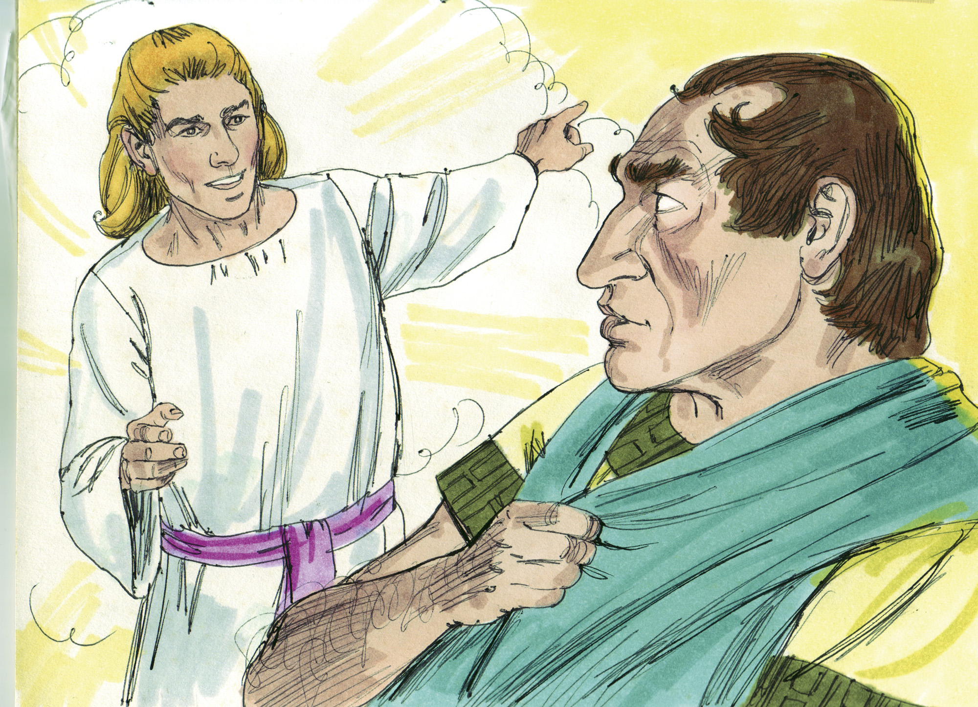

Slide 3
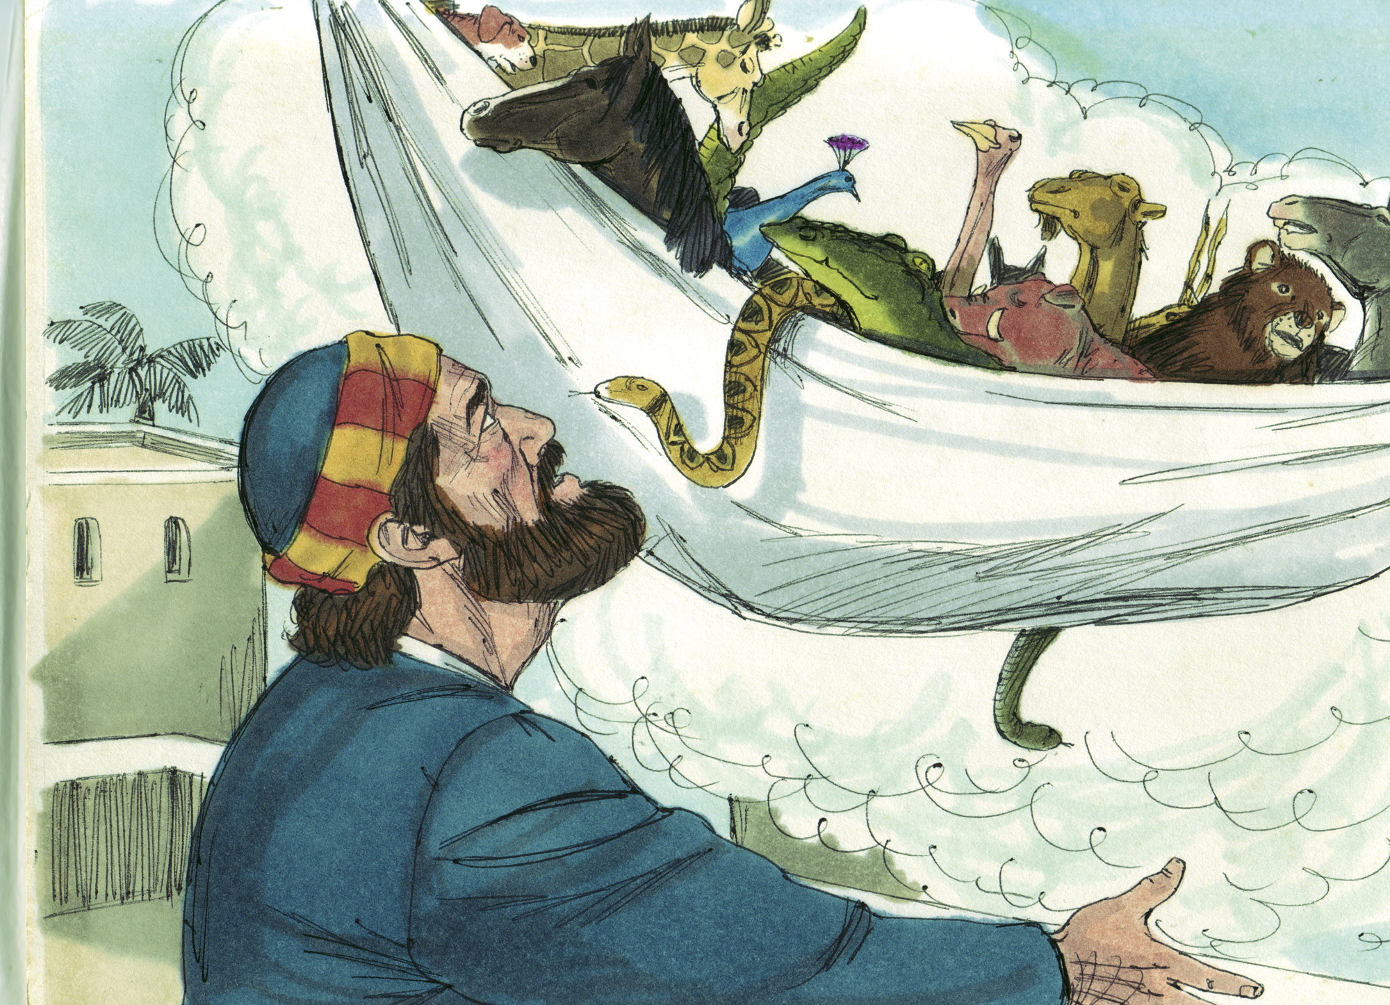

Slide 4
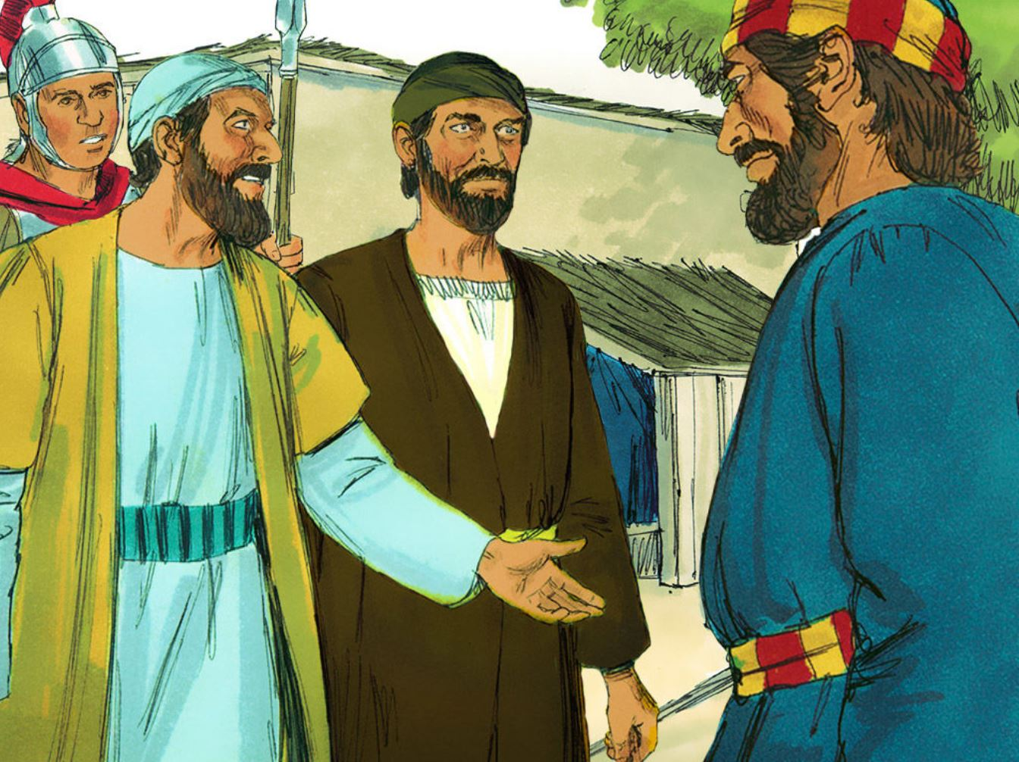

Slide 5
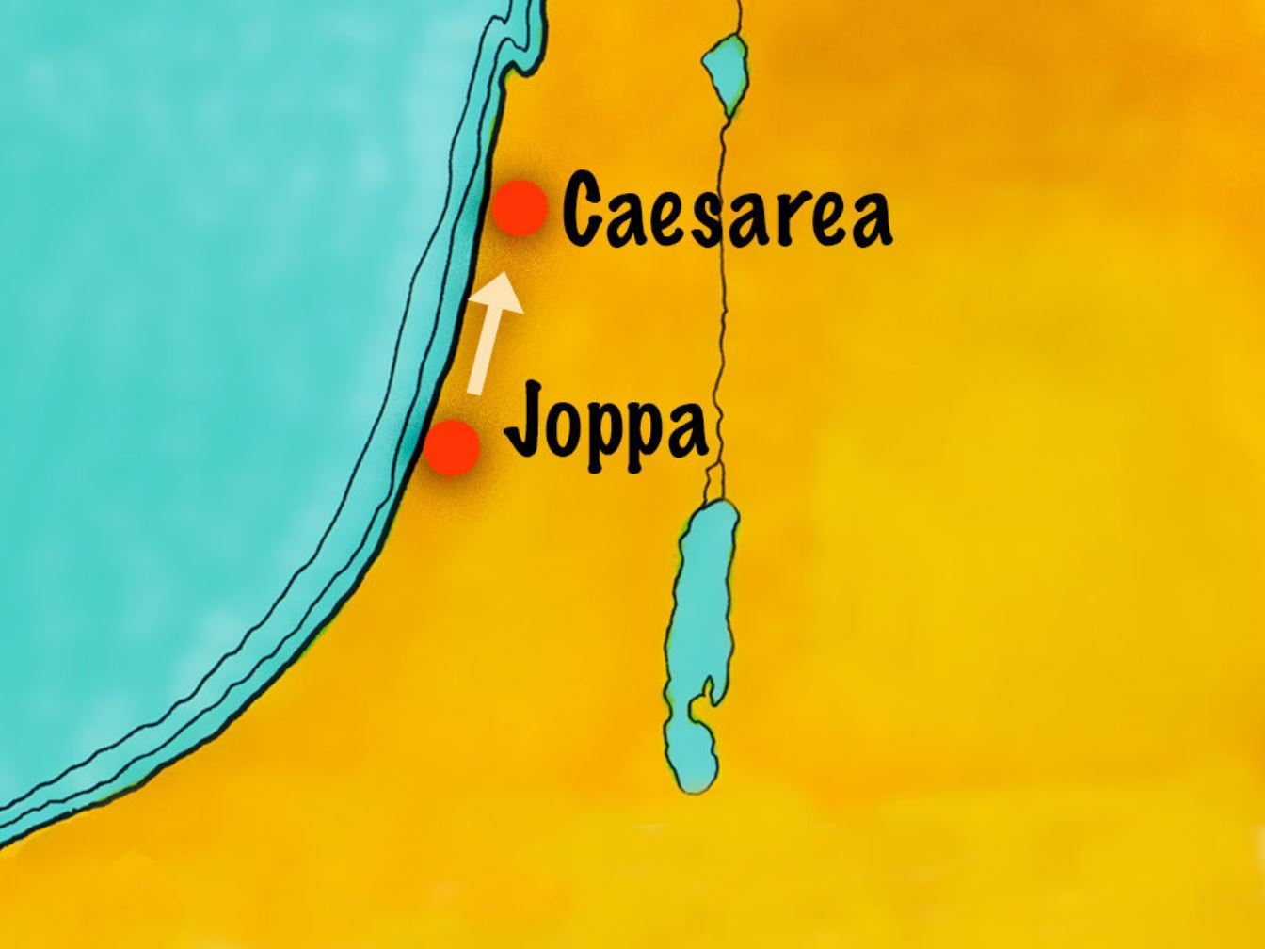

Slide 6
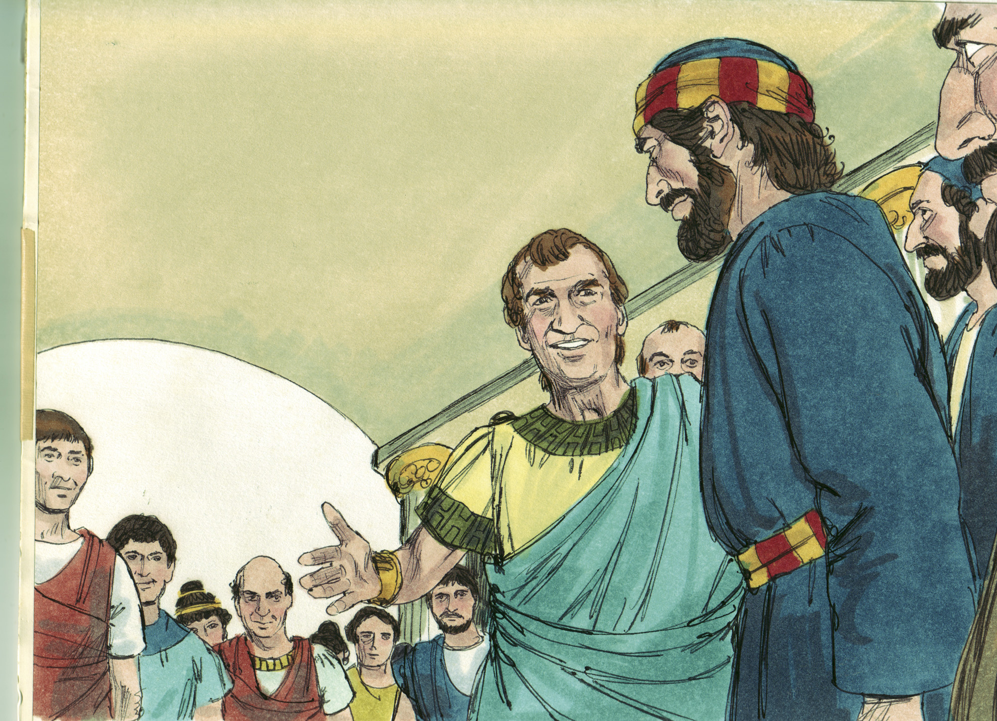

Slide 7
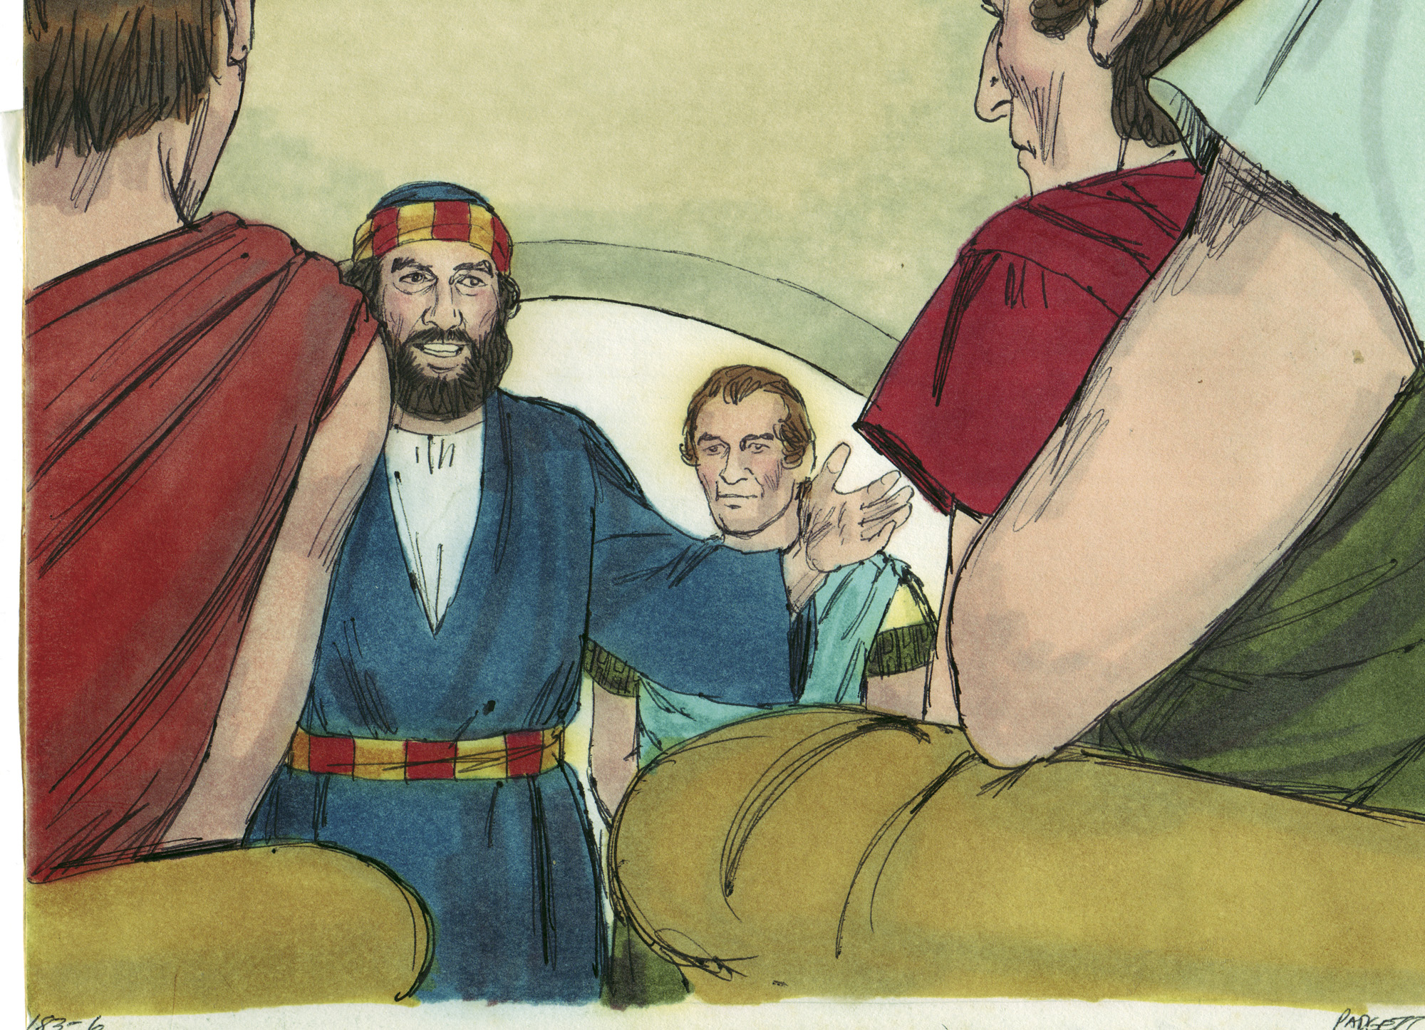

Slide 8
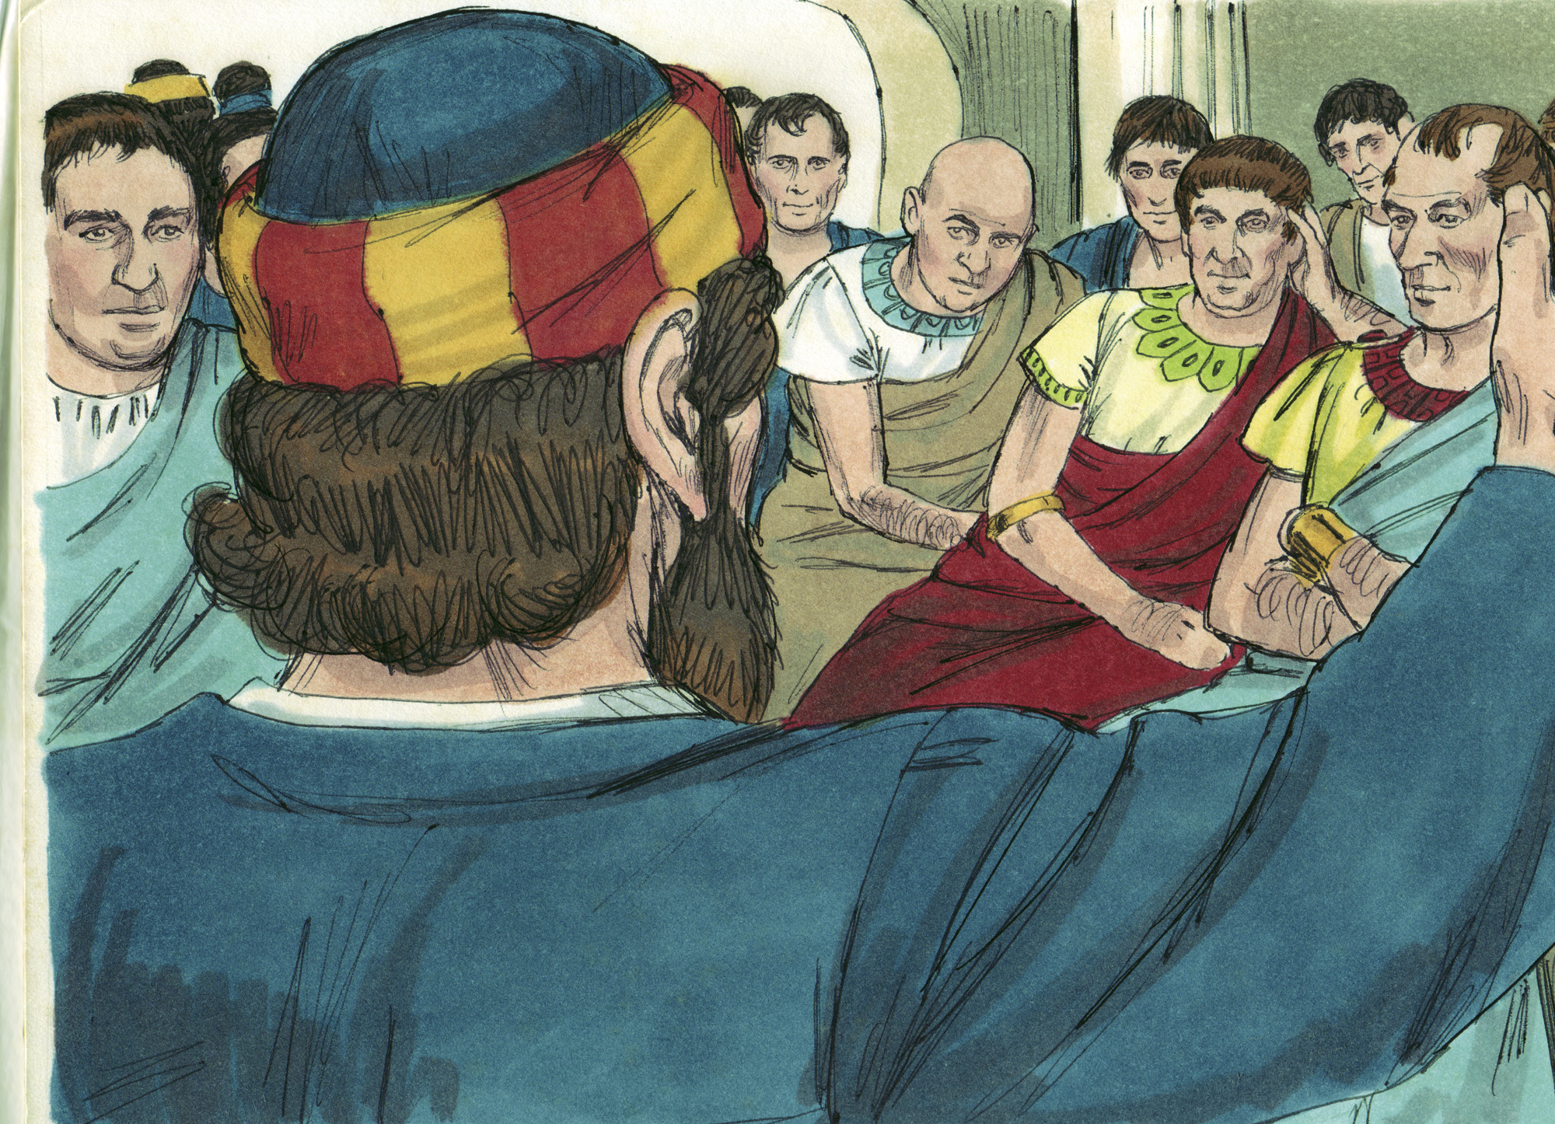

Slide 9
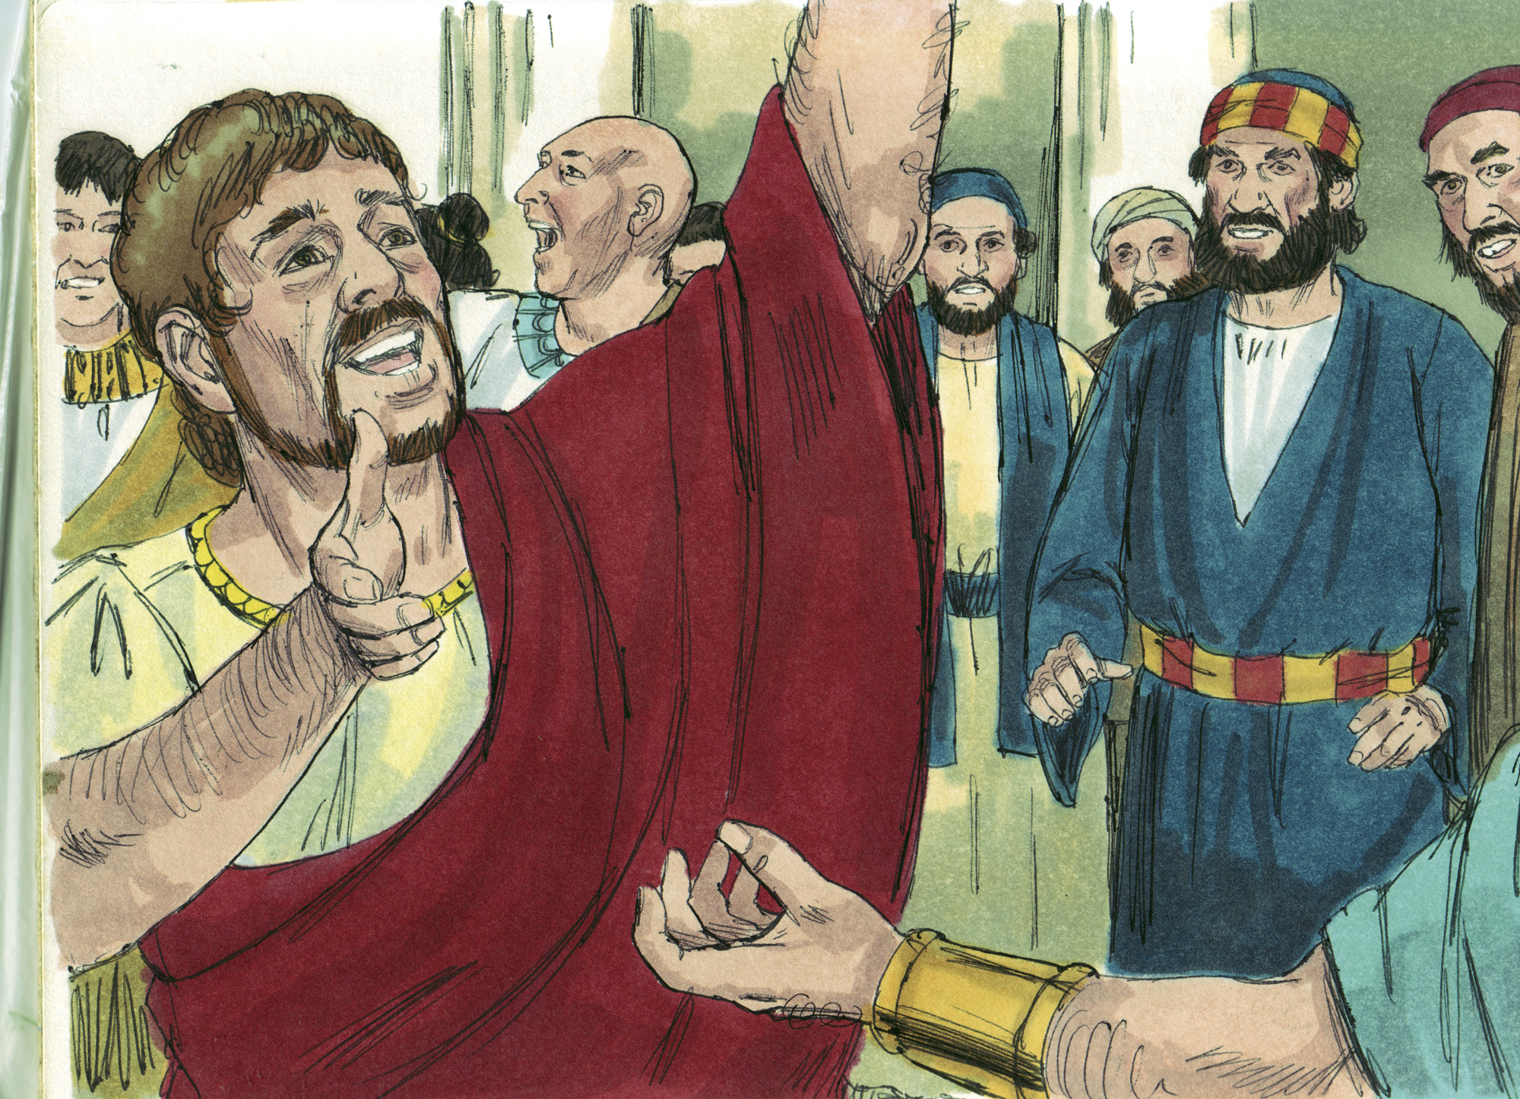

Slide 10
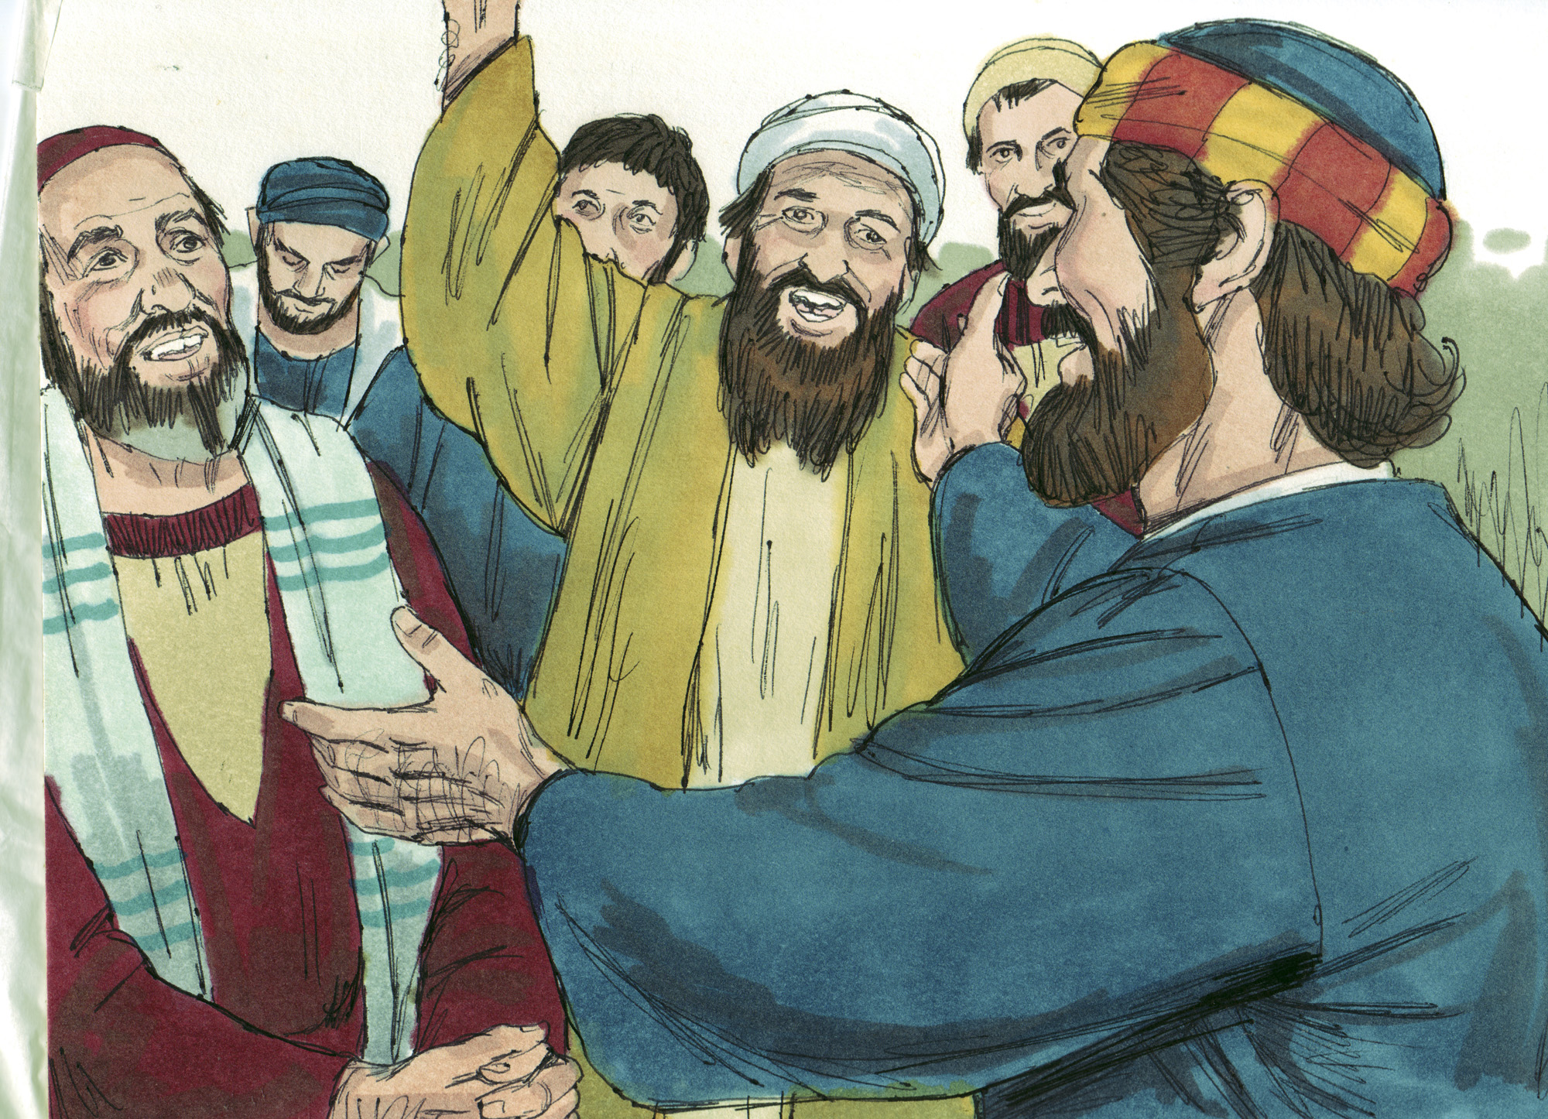

Slide 11
Jews and Gentiles practiced distancing from each other (10:28; 11:1-3; John 4:9)
Gentiles practiced distancing from the gospel of Christ (10:1-2; Eph. 2:11-12)
Peter practiced distancing from divine impartiality (10:10-17; 11:4-11)

Slide 12
Peter (of Jewish background) took the gospel to Cornelius (a Gentile) (10:36-43, 48)
Cornelius gathered his relatives and friends to hear the gospel (10:24-27, 33; 11:14)
Peter stopped showing partiality (10:28b-29, 34-35; 11:17)

Slide 13
Do not “distance” yourself because of partiality (10:15, 20; 11:9, 12; Jas. 2:1, 9)
Do see every person of every kind as a soul needing Christ = success!
Do not “distance” yourself from the power that is the gospel (11:14; Rom. 1:16)
Do trust that the gospel has the power to save anyone = success!
Do not “distance” yourself from telling others about Jesus Christ (10:22, 32, 33, 36, 44; 11:14)
Do find joy and unparalleled satisfaction in talking about Jesus = success!
Do not “distance” yourself from God’s desire for impartiality in His church (Gal. 3:26-28; Eph. 2:11-22)
Do see each one as equal in Christ = success!

