Slide 1
Ezekiel
The Watchman of Israel

Slide 2
Ezekiel: Outline
Judgement on Judah and Jerusalem (1-24)
Oracles against foreign nations (25-32)
Blessing for Judah and Jerusalem (33-48)

Slide 3
Judgement on Judah and Jerusalem (1-24)
Chapter 7
1-4: The End is Coming!
5-9: A Unique Disaster
10-13: A Rod of Wickedness
14-19: Sword Outside, Plague and Famine Within
20-27: Profaned Temple

Slide 4
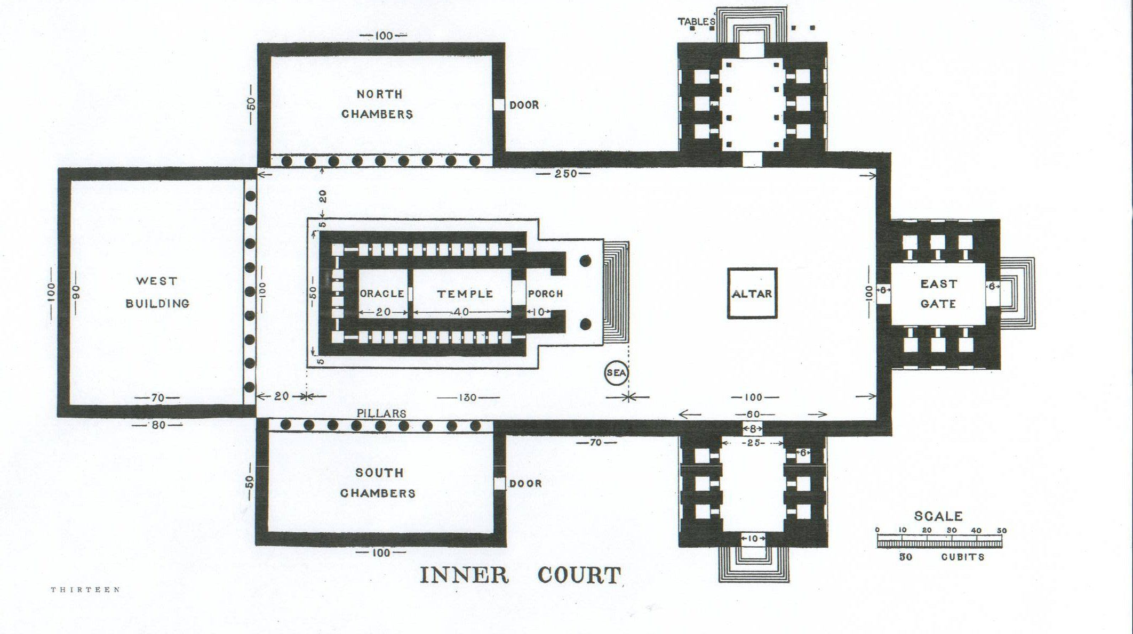
Judgement on Judah and Jerusalem (1-24)
Chapter 8
1-4: The Glory of God!
5-6: Idol of Jealousy
7-13: Sin In the Dark
14-15: Idol Tammuz
16-18: Worship of the Sun

Slide 5
Judgement on Judah and Jerusalem (1-24)
Chapter 9
1-2: The Executioners
3-8: The Execution
9-11: The Sin of Israel

Slide 6
Judgement on Judah and Jerusalem (1-24)
Chapter 10
1-8: Coals of Fire
9-14: The Whirling Wheels
15-22: The Living Beings

Slide 7
Judgement on Judah and Jerusalem (1-24)
Chapter 11
1-4: Men Who Devise Iniquity
5-13: God’s Judgement
14-21: Future Restoration
21-25: The Vision Ends

Slide 8
Judgement on Judah and Jerusalem (1-24)
Chapter 12
1-16: The Sign of Exile
17-20: The Sign of Desolation
21-28: Proverbs Among the People

