Slide 1
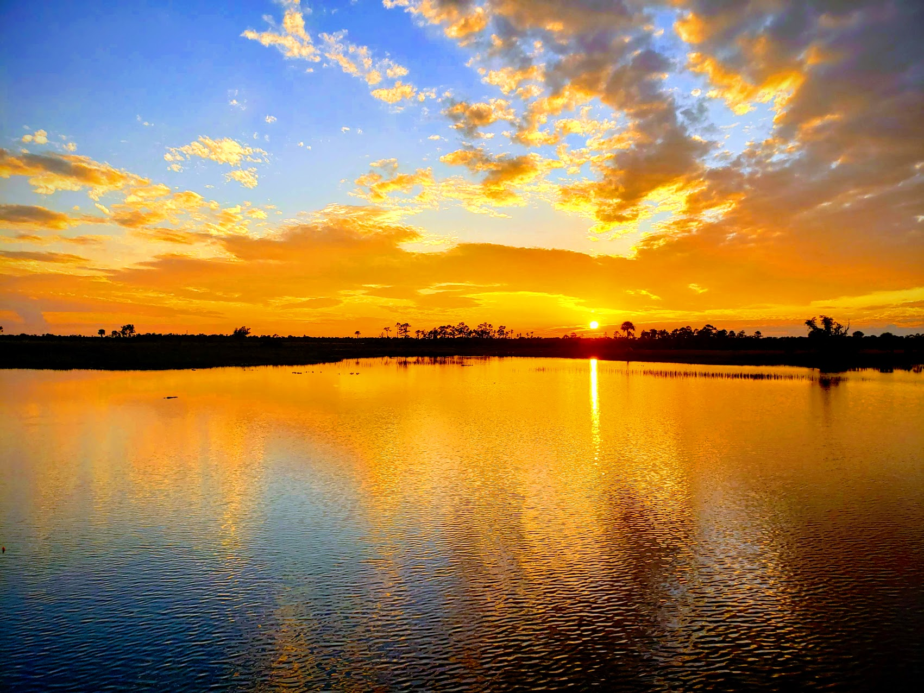
Malachi
His Message for Today (Part 3)
Josh Blackmer
Palm Beach Lakes church of Christ

Slide 2

Malachi: Outline
God’s Sovereign Love (1:1-5)
Priests Sin Against God’s Love (1:6-2:9)
People Sin Against God’s Love (2:10-4:3)
Final Exhortation (4:4-6)

Slide 3

People Sin Against God’s Love
Future Judgement 3:1-6
“My messenger”
“And the Lord”
“Who can stand?”
“Then”
“I, the Lord, do not change.”

Slide 4
People Sin Against God’s Love
Offering 3:7-12
“Return to Me”
“You are robbing Me”
“Bring the whole tithe”
“Test Me”
“Then”

Slide 5
People Sin Against God’s Love
Arrogance Against God 3:13-15
“Your words”
“It is vain to serve God”
“So now…”

