Slide 1
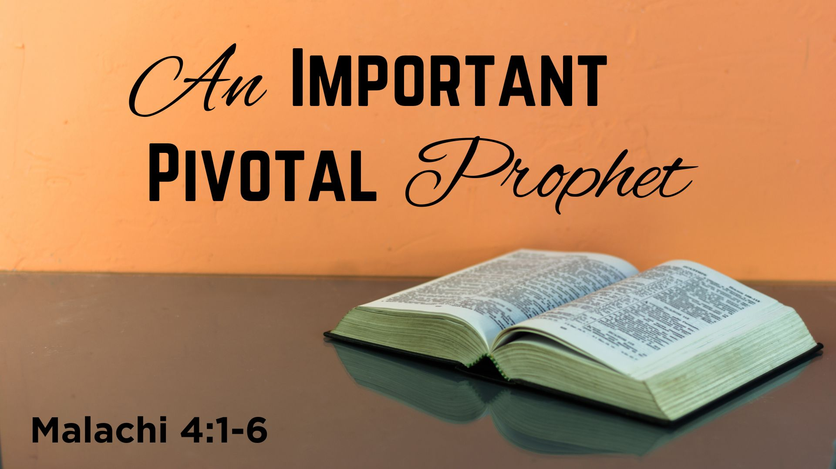

Slide 2
The Text—Malachi 4:1-6
1 For behold, the day is coming, Burning like an oven, And all the proud, yes, all who do wickedly will be stubble. And the day which is coming shall burn them up, Says the Lord of hosts, That will leave them neither root nor branch.
2 But to you who fear My name The Sun of Righteousness shall arise With healing in His wings; And you shall go out And grow fat like stall-fed calves.
3 You shall trample the wicked, For they shall be ashes under the soles of your feet On the day that I do this, Says the LORD of hosts.
4 Remember the Law of Moses, My servant, Which I commanded him in Horeb for all Israel, With the statutes and judgments.
5 Behold, I will send you Elijah the prophet Before the coming of the great and dreadful day of the Lord.
6 And he will turn The hearts of the fathers to the children, And the hearts of the children to their fathers, Lest I come and strike the earth with a curse.

Slide 3
Definitions: Pivotal & Prophet
Definition of a prophet, contrasted with definition of a priest

Slide 4
Definitions: Pivotal & Prophet
Definition of a prophet, contrasted with definition of a priest
  Man TO God—A priest looks and serves Upward

Slide 5
Definitions: Pivotal & Prophet
Definition of a prophet, contrasted with definition of a priest
  Man TO God—A priest looks and serves Upward
  God TO man—A prophet looks and serves Downward

Slide 6
Definitions: Pivotal & Prophet
Definition of a prophet, contrasted with definition of a priest
  Man TO God—A priest looks and serves Upward
  God to Man—A prophet looks and serves Downward
Definition of pivotal:

Slide 7
Definitions: Pivotal & Prophet
Definition of a prophet, contrasted with definition of a priest
  Man TO God—A priest looks and serves Upward
  God to Man—A prophet looks and serves Downward
Definition of pivotal:
  An event, an action or a man which changes direction

Slide 8
Definitions: Pivotal & Prophet
Definition of a prophet, contrasted with definition of a priest
  Man TO God—A priest looks and serves Upward
  God to Man—A prophet looks and serves Downward
Definition of pivotal:
  An event, an action or a man which changes direction
  Moses was a pivotal prophet—Religious change from Abraham

Slide 9
Definitions: Pivotal & Prophet
Definition of a prophet, contrasted with definition of a priest
  Man TO God—A priest looks and serves Upward
  God to Man—A prophet looks and serves Downward
Definition of pivotal:
  An event, an action or a man which changes direction
  Moses was a pivotal prophet—Religious change from Abraham
  Jesus, like Moses, was pivotal changed directions history

Slide 10
Definitions: Pivotal & Prophet
Definition of a prophet, contrasted with definition of a priest
  Man TO God—A priest looks and serves Upward
  God to Man—A prophet looks and serves Downward
Definition of pivotal:
  An event, an action or a man which changes direction
  Moses was a pivotal prophet—Religious change from Abraham
  Jesus, like Moses, was pivotal changed directions history
  Almost from the beginning there were prophets

Slide 11
Definitions: Pivotal & Prophet
Definition of a prophet, contrasted with definition of a priest
  Man TO God—A priest looks and serves Upward
  God to Man—A prophet looks and serves Downward
Definition of pivotal:
  An event, an action or a man which changes direction
  Moses was a pivotal prophet—Religious change from Abraham
  Jesus, like Moses, was pivotal changed directions history
  Almost from the beginning there were prophets
  Who would you suggest might be another pivotal prophet?

Slide 12
Identifying Tonight’s Pivotal Prophet

Slide 13
Identifying Tonight’s Pivotal Prophet
He fled from the wrath of the king, went to Mt. Sinai
He later confronted the king with miracles

Slide 14
Identifying Tonight’s Pivotal Prophet
He fled from the wrath of the king, went to Mt. Sinai
He later confronted the king with miracles
He parted the waters so people could pass through
At Sinai he saw and felt fire, earthquake and heard God speak

Slide 15
Identifying Tonight’s Pivotal Prophet
He fled from the wrath of the king, went to Mt. Sinai
He later confronted the king with miracles
He parted the waters so people could pass through
At Sinai he saw and felt fire, earthquake and heard God speak
He gave food to the hungry and chose his successor

Slide 16
Identifying Tonight’s Pivotal Prophet
He fled from the wrath of the king, went to Mt. Sinai
He later confronted the king with miracles
He parted the waters so people could pass through
At Sinai he saw and felt fire, earthquake and heard God speak
He gave food to the hungry and chose his successor
He lived after Solomon, during Divided Kingdom

Slide 17
Identifying Tonight’s Pivotal Prophet
He fled from the wrath of the king, went to Mt. Sinai
He later confronted the king with miracles
He parted the waters so people could pass through
At Sinai he saw and felt fire, earthquake and heard God speak
He gave food to the hungry and chose his successor
He lived after Solomon, during Divided Kingdom
He was from the “Northern” Israel and prophesied to them

Slide 18
Identifying Tonight’s Pivotal Prophet
He fled from the wrath of the king, went to Mt. Sinai
He later confronted the king with miracles
He parted the waters so people could pass through
At Sinai he saw and felt fire, earthquake and heard God speak
He gave food to the hungry and chose his successor
He lived after Solomon, during Divided Kingdom
He was from the “Northern” Israel and prophesied to them
Like Moses, many miracles connected with his life

Slide 19
Identifying Tonight’s Pivotal Prophet
He fled from the wrath of the king, went to Mt. Sinai
He later confronted the king with miracles
He parted the waters so people could pass through
At Sinai he saw and felt fire, earthquake and heard God speak
He gave food to the hungry and chose his successor
He lived after Solomon, during Divided Kingdom
He was from the “Northern” Israel and prophesied to them
Like Moses, many miracles connected with his life
At the end of his life, he “ascended” toward heaven

Slide 20
Identifying Tonight’s Pivotal Prophet
He fled from the wrath of the king, went to Mt. Sinai
He later confronted the king with miracles
He parted the waters so people could pass through
At Sinai he saw and felt fire, earthquake and heard God speak
He gave food to the hungry and chose his successor
He lived after Solomon, during Divided Kingdom
He was from the “Northern” Israel and prophesied to them
Like Moses, many miracles connected with his life
At the end of his life, he “ascended” toward heaven
Tonight’s lesson focuses on Elijah, the pivotal prophet

Slide 21
Events that “Pivot” Around Elijah

Slide 22
Events that “Pivot” Around Elijah
“Pivotal” in authenticating the “office” of prophets

Slide 23
Events that “Pivot” Around Elijah
“Pivotal” in authenticating the “office” of prophets
  Fewer prophets from Samuel to Elijah, so many afterwards

Slide 24
Events that “Pivot” Around Elijah
“Pivotal” in authenticating the “office” of prophets
  Fewer prophets from Samuel to Elijah, so many afterwards
  His miracles authenticate the “office” of prophets after him

Slide 25
Events that “Pivot” Around Elijah
“Pivotal” in authenticating the “office” of prophets
“Pivotal” in ending OT prophets, and beginning NT ones

Slide 26
Events that “Pivot” Around Elijah
“Pivotal” in authenticating the “office” of prophets
“Pivotal” in ending OT prophets, and beginning NT ones
  Mentioned early in OT prophets; mentioned in last words of OT

Slide 27
Events that “Pivot” Around Elijah
“Pivotal” in authenticating the “office” of prophets
“Pivotal” in ending OT prophets, and beginning NT ones
  Mentioned early in OT prophets; mentioned in last words of OT
  “Elijah” is coming again, but after 400+ years of silence

Slide 28
Events that “Pivot” Around Elijah
“Pivotal” in authenticating the “office” of prophets
“Pivotal” in ending OT prophets, and beginning NT ones
  Mentioned early in OT prophets; mentioned in last words of OT
  “Elijah” is coming again, but after 400+ years of silence
  God was sending NT prophets—First His son then NT ones

Slide 29
Events that “Pivot” Around Elijah
“Pivotal” in authenticating the “office” of prophets
“Pivotal” in ending OT prophets, and beginning NT ones
“Pivotal” in announcing the coming of Jesus (through John)

Slide 30
Events that “Pivot” Around Elijah
“Pivotal” in authenticating the “office” of prophets
“Pivotal” in ending OT prophets, and beginning NT ones
“Pivotal” in announcing the coming of Jesus (through John)
  John the Baptist came in “spirit and power of Elijah”

Slide 31
Events that “Pivot” Around Elijah
“Pivotal” in authenticating the “office” of prophets
“Pivotal” in ending OT prophets, and beginning NT ones
“Pivotal” in announcing the coming of Jesus (through John)
  John the Baptist came in “spirit and power of Elijah”
  Jesus said John the Baptist was the “Elijah” who was to come

Slide 32
Events that “Pivot” Around Elijah
“Pivotal” in authenticating the “office” of prophets
“Pivotal” in ending OT prophets, and beginning NT ones
“Pivotal” in announcing the coming of Jesus (through John)
  John the Baptist came in “spirit and power of Elijah”
  Jesus said John the Baptist was the “Elijah” who was to come
  If no “ coming of Elijah” then God’s final message—a curse!

Slide 33
Events that “Pivot” Around Elijah
“Pivotal” in authenticating the “office” of prophets
“Pivotal” in ending OT prophets, and beginning NT ones
“Pivotal” in announcing the coming of Jesus (through John)
“Pivotal” in showing end of OT law and Prophets

Slide 34
Events that “Pivot” Around Elijah
“Pivotal” in authenticating the “office” of prophets
“Pivotal” in ending OT prophets, and beginning NT ones
“Pivotal” in announcing the coming of Jesus (through John)
“Pivotal” in showing end of OT law and Prophets
  OT “Law and Prophets” (Moses and Elijah) @ transfiguration

Slide 35
Hearing the Son of God
      Believe John 8:24
      Repent Luke 13:3
      Confess Your Faith Romans 10:9
      Baptized/Immersed Acts 2:38
      When You Do These, He Adds You to His Flock, His Church
      As a Christian, Live Faithfully Until You Die Rev. 2:10

