Slide 2
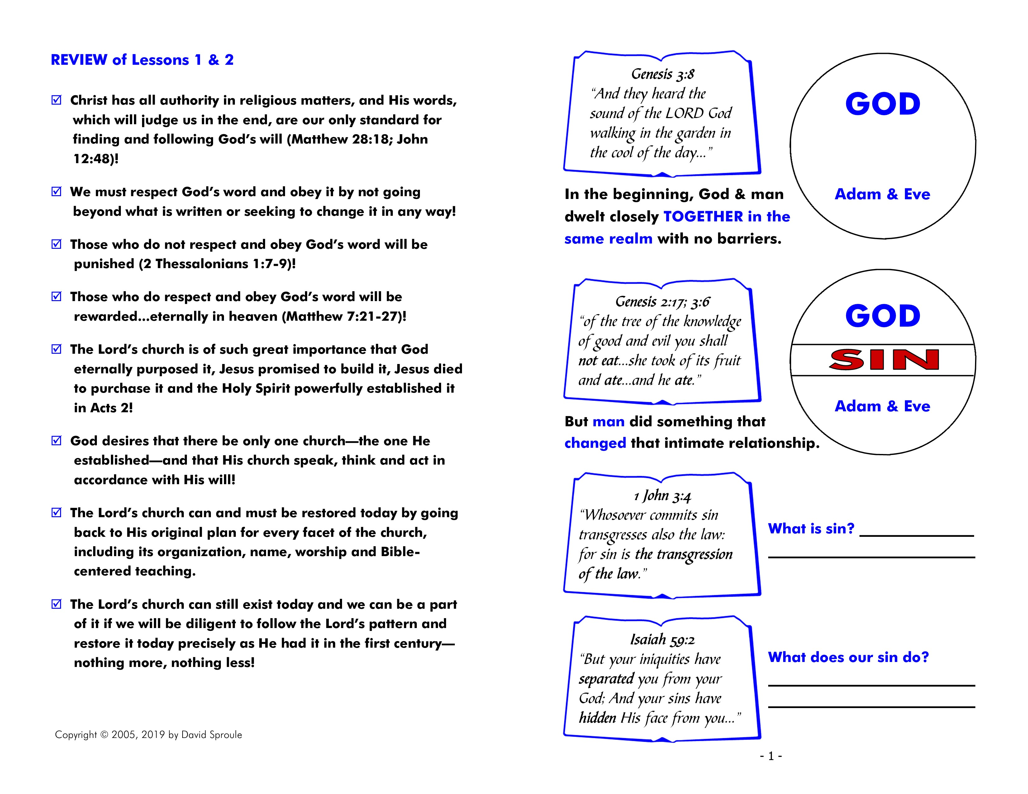

Slide 3
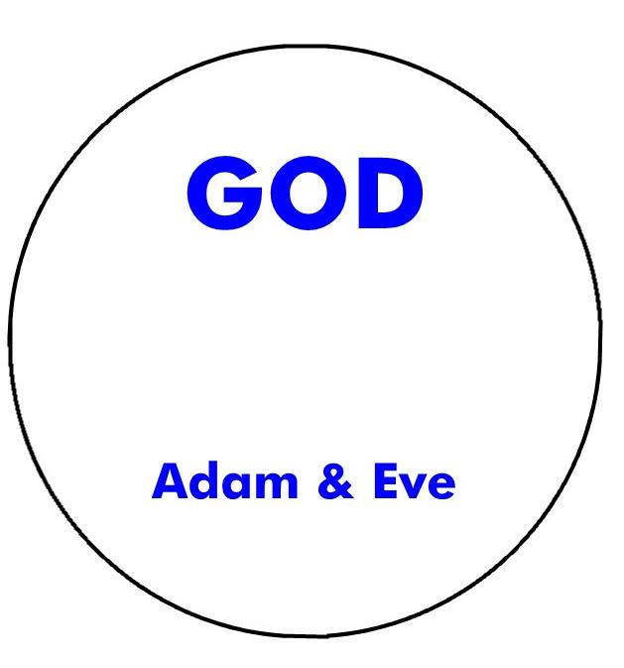

Slide 5
breaking
the law of God
separates us
from God

Slide 7
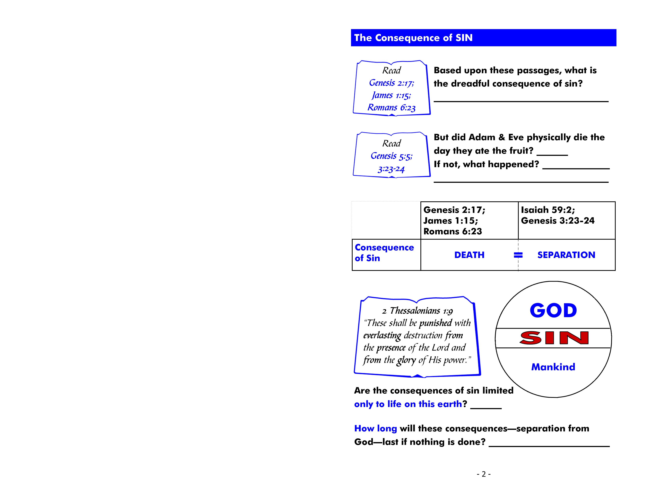
death
Gen. 2:17 – “But of the tree of the knowledge of good and evil you shall not eat, for in the day that you eat of it you shall surely die.”

Slide 8
death
Jas. 1:15 - Then, when desire has conceived, it gives birth to sin; and sin, when it is full-grown, brings forth death.

Slide 9
death
Rom. 6:23 - For the wages of sin is death, but the gift of God is eternal life in Christ Jesus our Lord.

Slide 10
No
5:5 - So all the days that Adam lived were nine hundred and thirty years; and he died.

Slide 11
No
they were
separated from God
3:23 - Therefore the LORD God sent him out of the garden of Eden to till the ground from which he was taken.
24 So He drove out the man…

Slide 12
No
they were
separated from God

Slide 13
No
forever

Slide 15
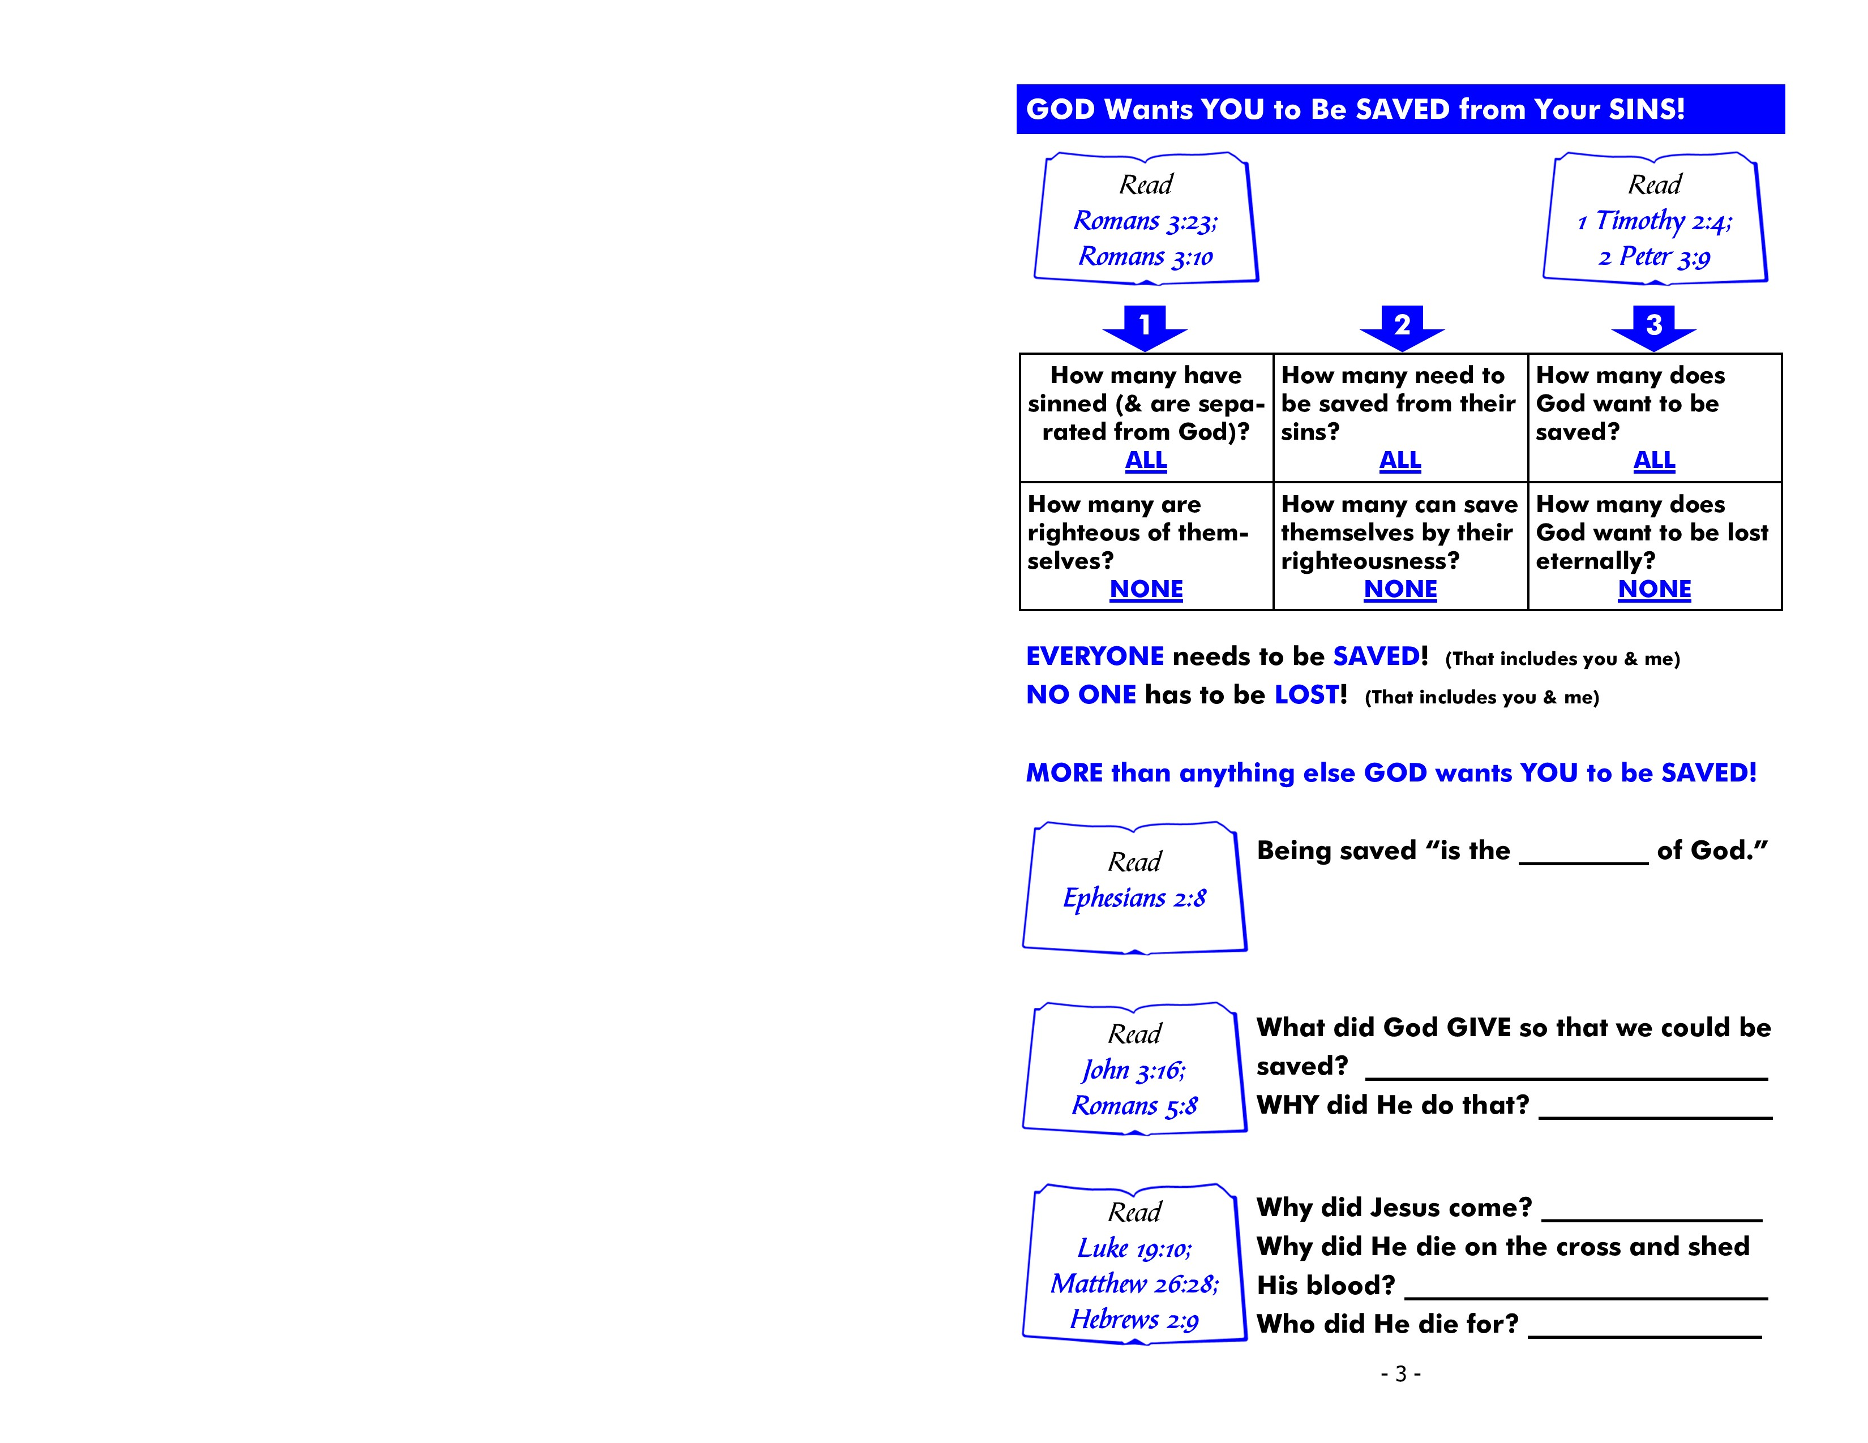
3:23 - For all have sinned and fall short of the glory of God.
3:10 – There is none righteous, no, not one.
1 Tim. 2:4 - Who desires all men to be saved and to come to the knowledge of the truth.
2 Pet. 3:9 - The Lord is … longsuffering toward us, not willing that any should perish but that all should come to repentance.

Slide 18
gift
8 For by grace you have been saved through faith, and that not of yourselves; it is the gift of God…

Slide 19
His own Son
He loves us
John 3:16 - “For God so loved the world that He gave His only begotten Son, that whoever believes in Him should not perish but have everlasting life.”

Slide 20
His own Son
He loves us
Rom. 5:8 - But God demonstrates His own love toward us, in that while we were still sinners, Christ died for us.

Slide 21
to save man
Luke 19:10 - “For the Son of Man has come to seek and to save that which was lost.”

Slide 22
to save man
forgiveness of our sins
Matt. 26:28 - “For this is My blood of the new covenant, which is shed for many for the remission of sins.”

Slide 23
to save man
forgiveness of our sins
everyone
Heb. 2:9 - But we see Jesus, who was made a little lower than the angels, for the suffering of death… that He, by the grace of God, might taste death for everyone.

Slide 24
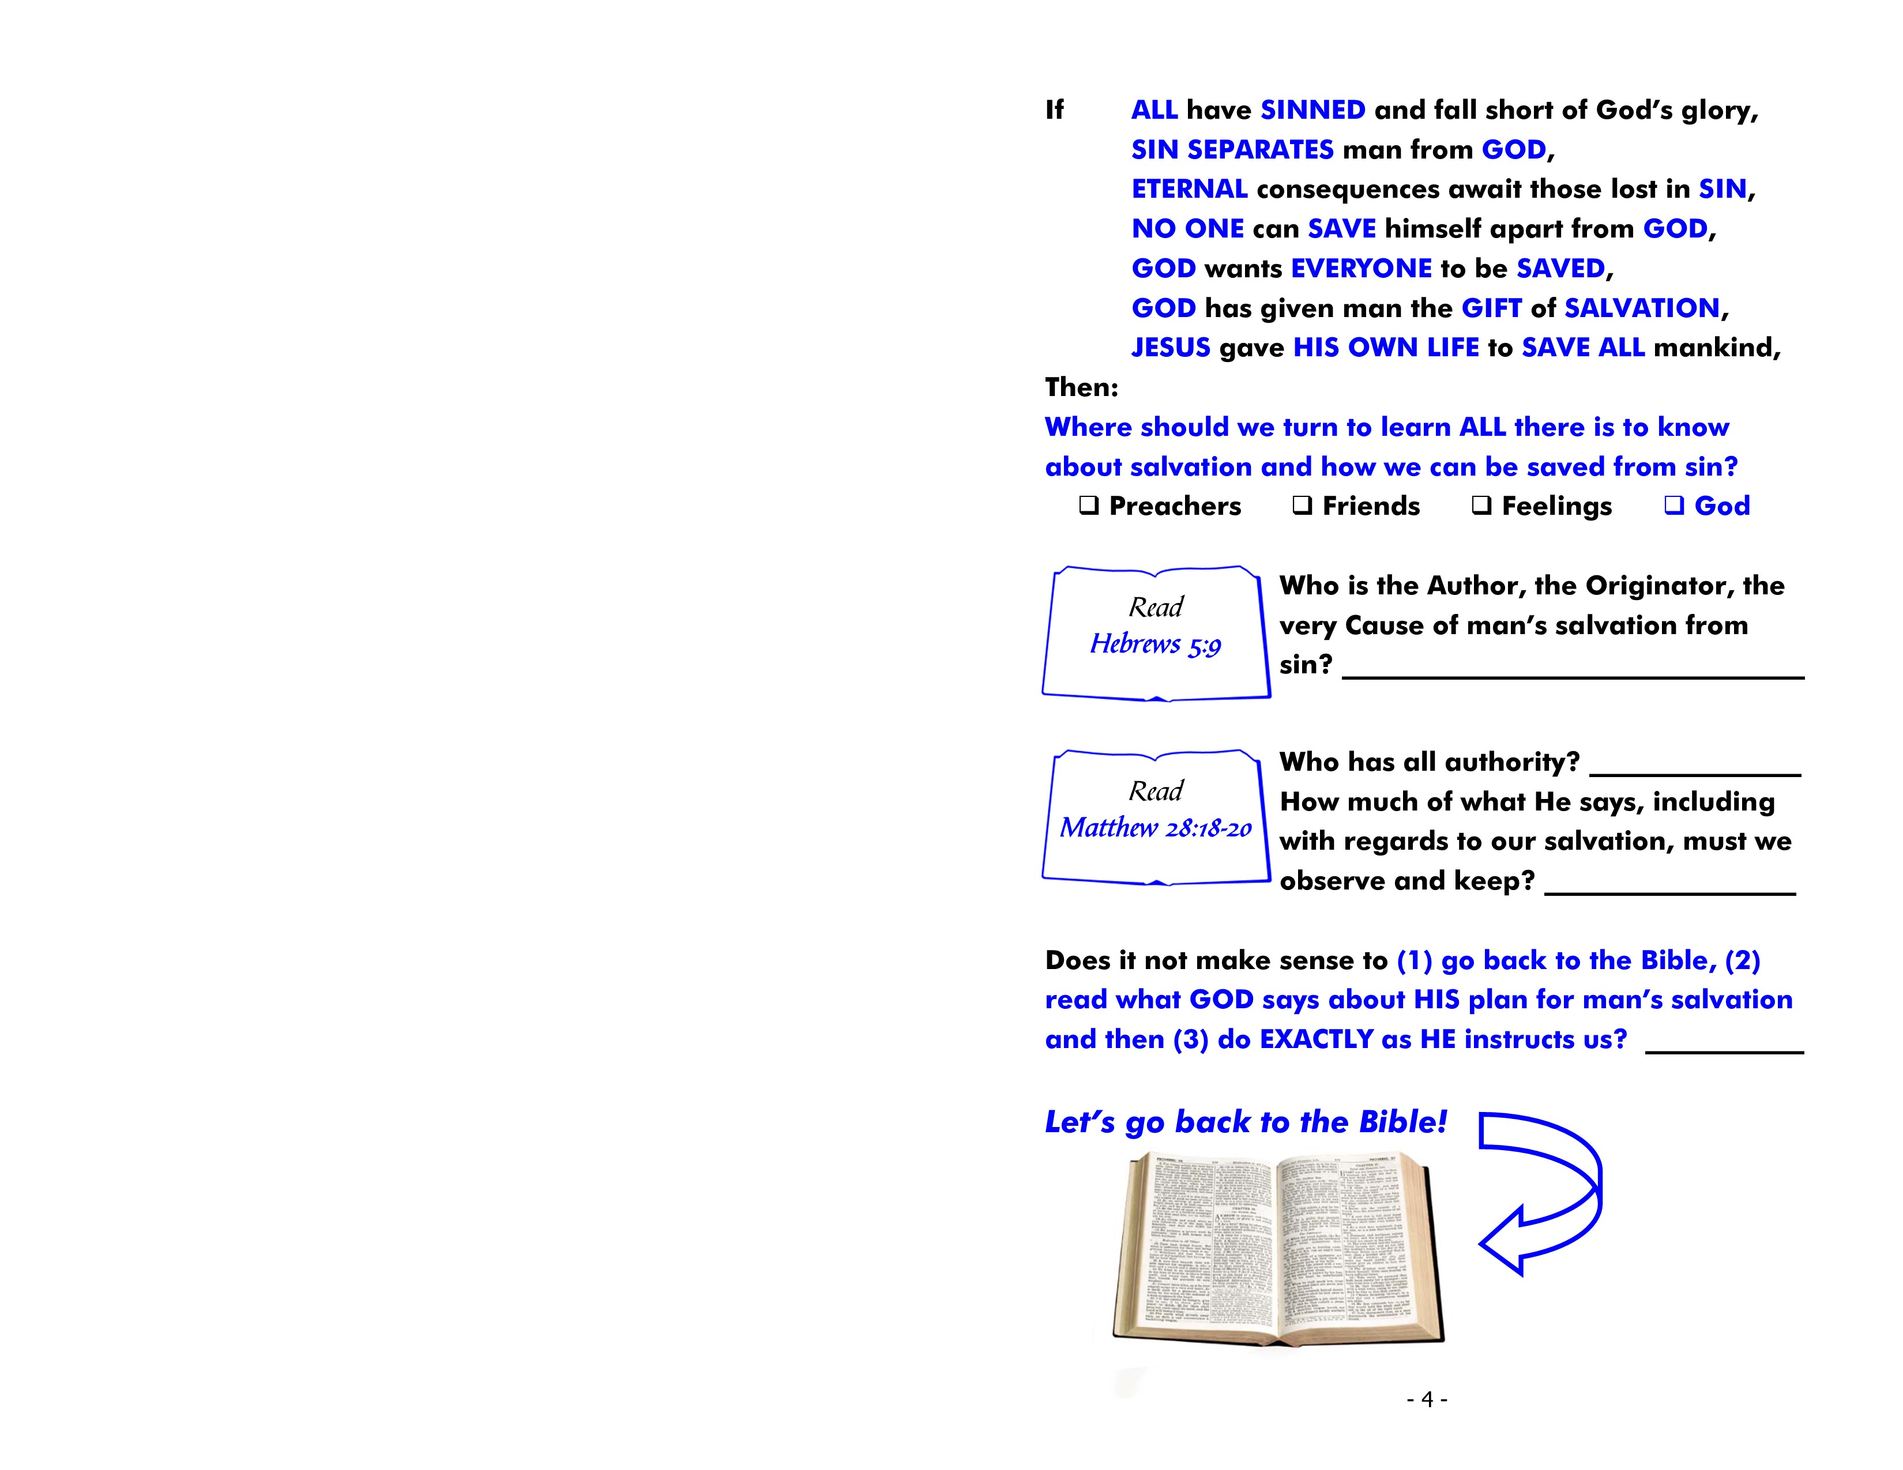
X

Slide 25
Jesus Christ
9 And having been perfected, He became the author of eternal salvation to all who obey Him.

Slide 26
Jesus Christ
all things
18 And Jesus came and spoke to them, saying, “All authority has been given to Me in heaven and on earth.
19 “Go therefore and make disciples of all the nations, baptizing them in the name of the Father and of the Son and of the Holy Spirit,
20 “teaching them to observe all things that I have commanded you; and lo, I am with you always, even to the end of the age.” Amen.

Slide 27
Yes

Slide 29
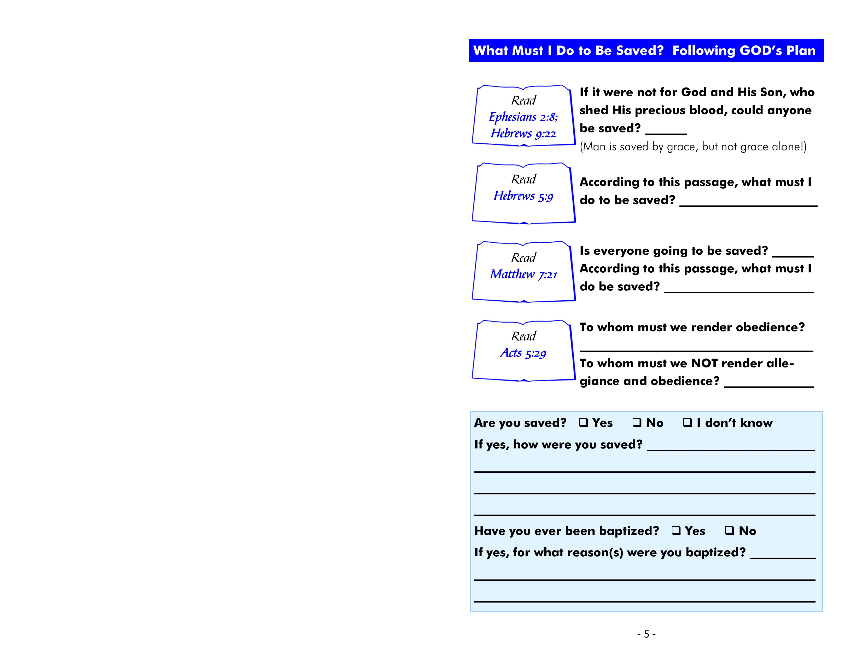
Eph. 2:8 - For by grace you have been saved through faith, and that not of yourselves; it is the gift of God…

Slide 30
No
Heb. 9:22 - …without shedding of blood there is no remission.

Slide 31
obey Christ
9 And having been perfected, He became the author of eternal salvation to all who obey Him.

Slide 32
No
obey God’s will
21 “Not everyone who says to Me, ‘Lord, Lord,’ shall enter the kingdom of heaven, but he who does the will of My Father in heaven.”

Slide 33
God
man
29 But Peter and the other apostles answered and said: “We ought to obey God rather than men.”

Slide 34
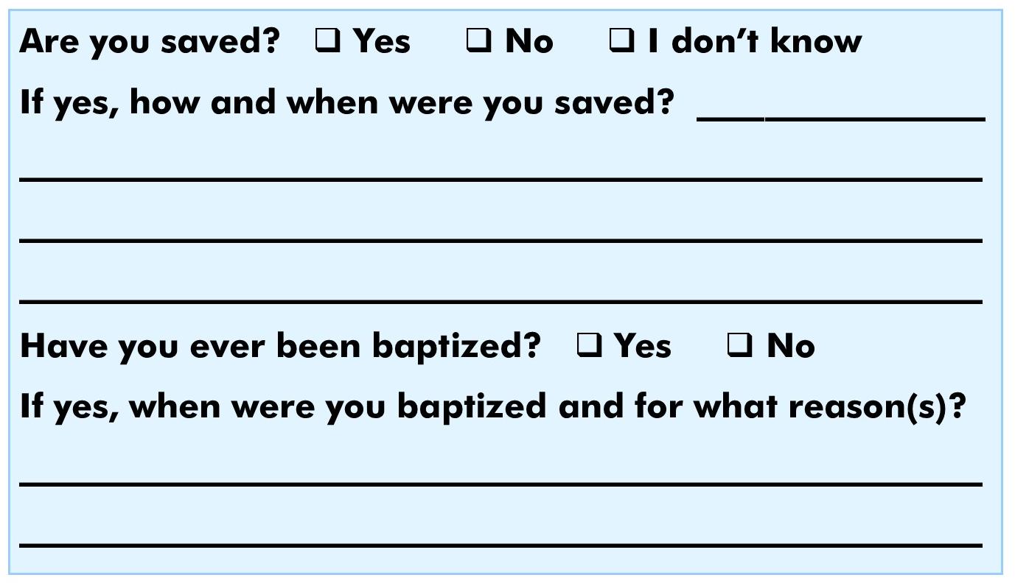

Slide 36
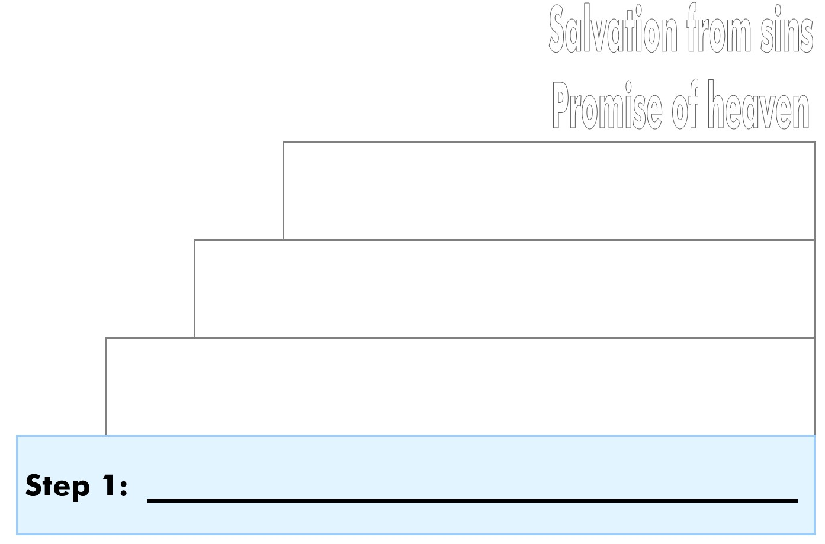

Slide 37
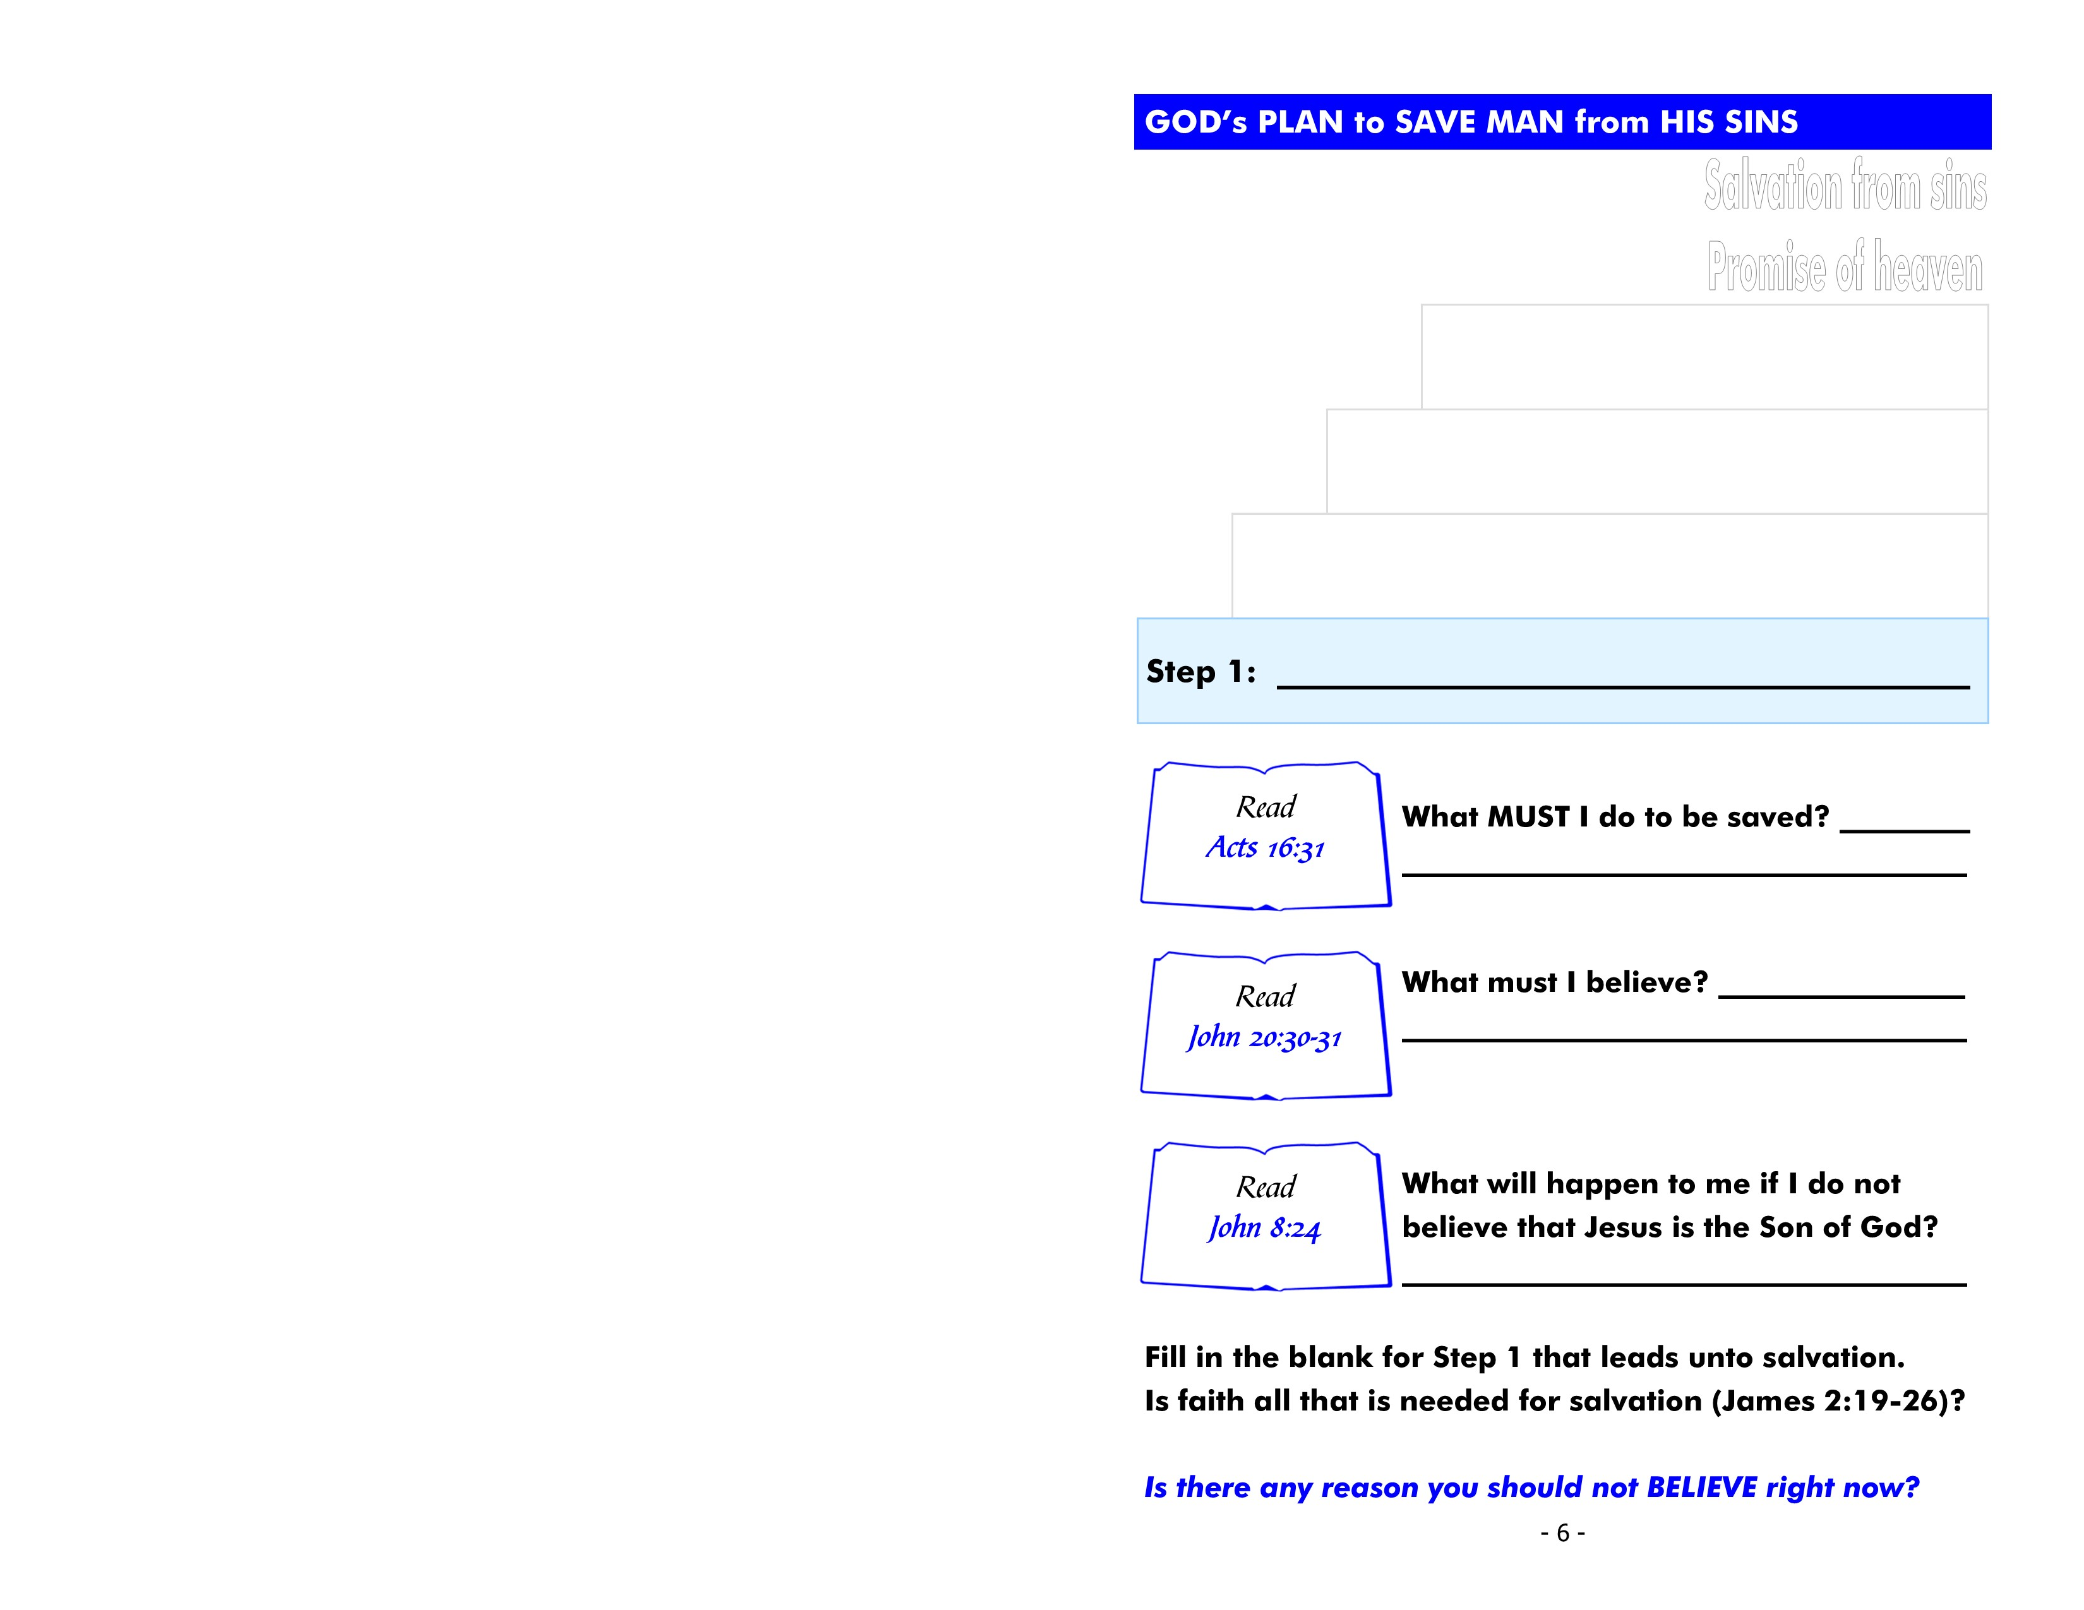
believe
31 So they said, “Believe on the Lord Jesus Christ, and you will be saved, you and your household.”

Slide 38
Jesus Christ is God’s Son
30 And truly Jesus did many other signs in the presence of His disciples, which are not written in this book;
31 but these are written that you may believe that Jesus is the Christ, the Son of God, and that believing you may have life in His name.

Slide 39
die in my sins
24 “Therefore I said to you that you will die in your sins; for if you do not believe that I am He, you will die in your sins.”

Slide 40
19 You believe that there is one God. You do well. Even the demons believe—and tremble!
20 But do you want to know, O foolish man, that faith without works is dead?
21 Was not Abraham our father justified by works when he offered Isaac his son on the altar?
22 Do you see that faith was working
together with his works, and by works
faith was made perfect?
…24 You see then that a man is justified
by works, and not by faith only.

Slide 41
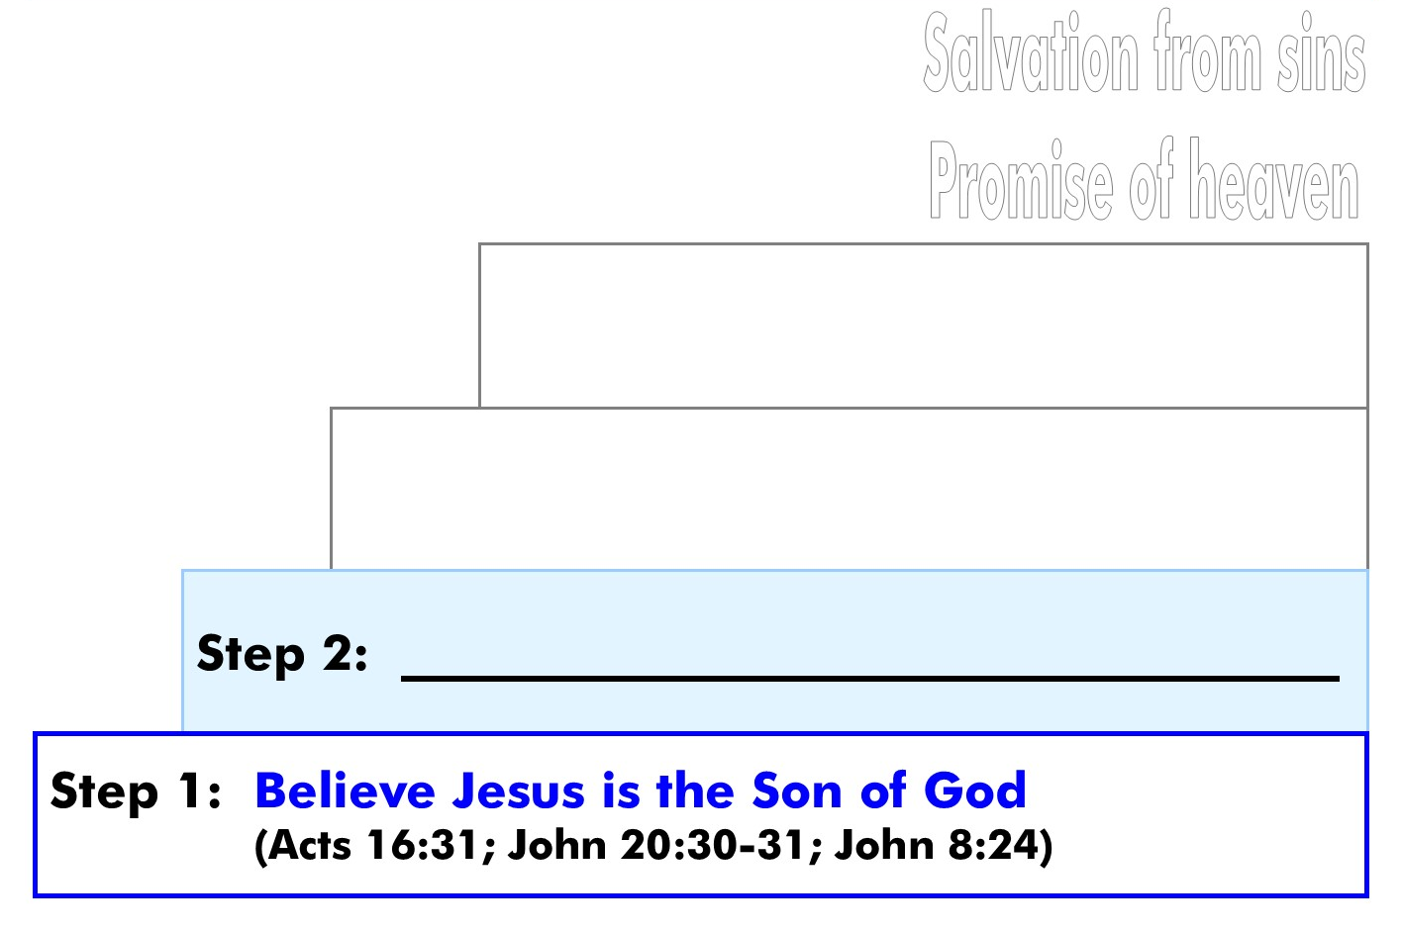

Slide 42
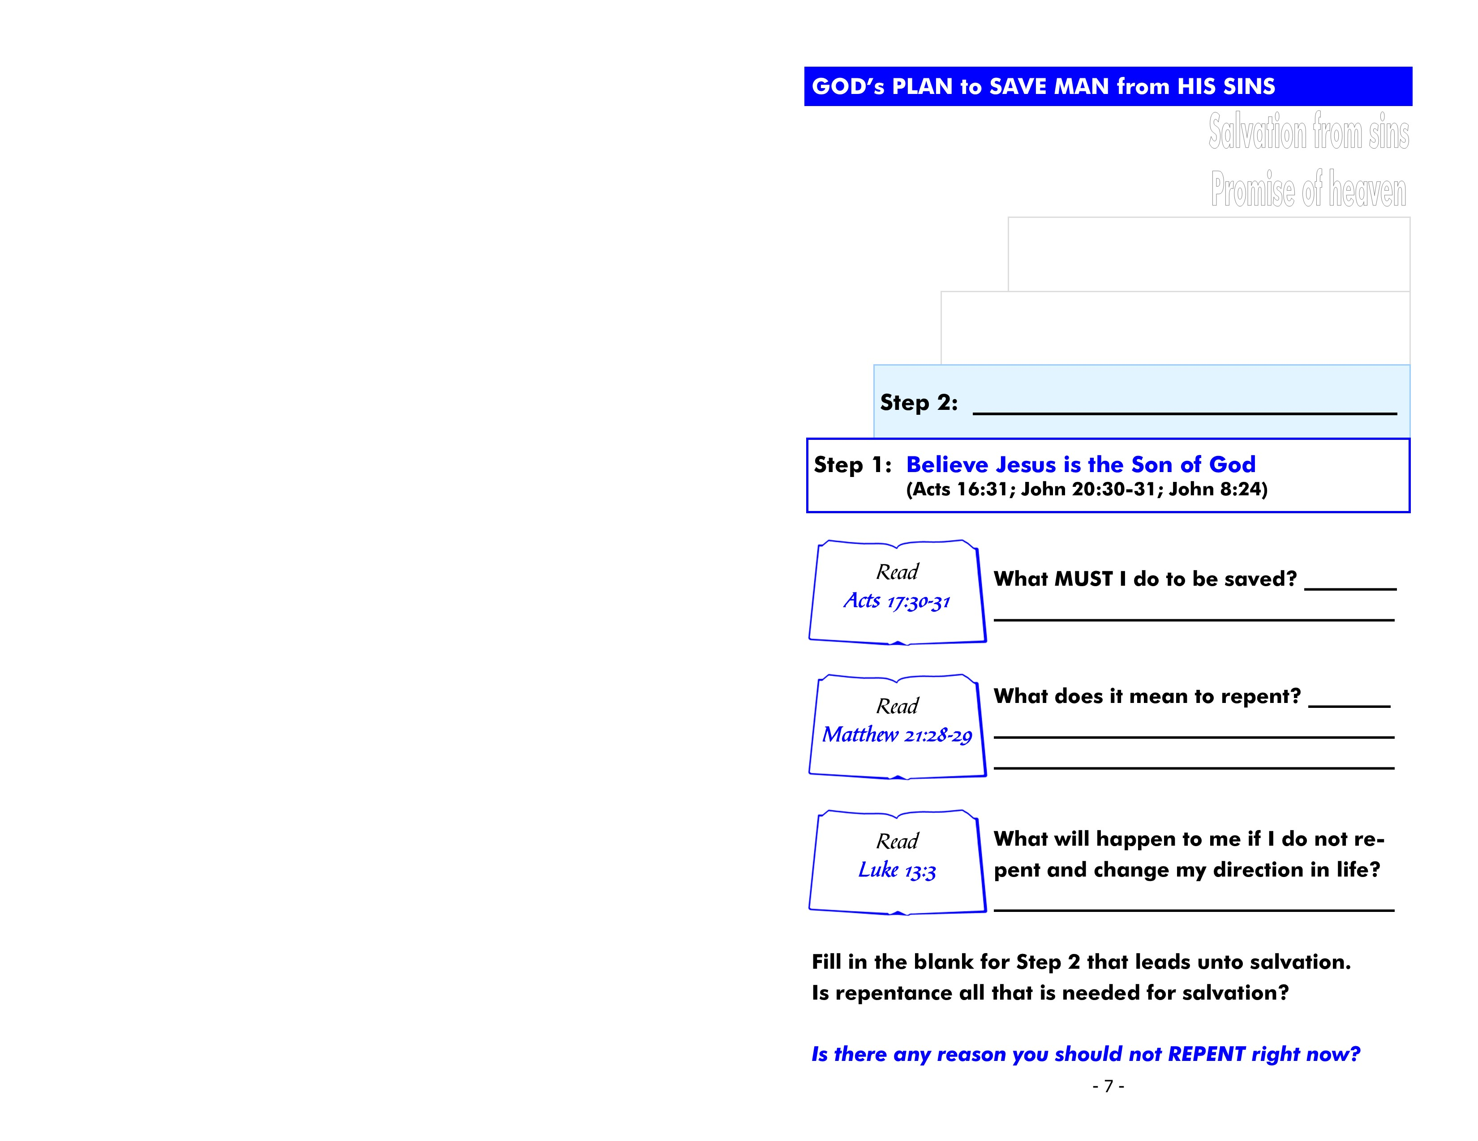
repent
30 Truly, these times of ignorance God overlooked, but now commands all men everywhere to repent…

Slide 43
regret doing wrong and
decide to turn away from sin
28 “But what do you think? A man had two sons, and he came to the first and said, ‘Son, go, work today in my vineyard.’
29 “He answered and said, ‘I will not,’ but afterward he regretted it and went.”

Slide 44
perish
3 “I tell you, no; but unless you repent you will all likewise perish.”

Slide 46
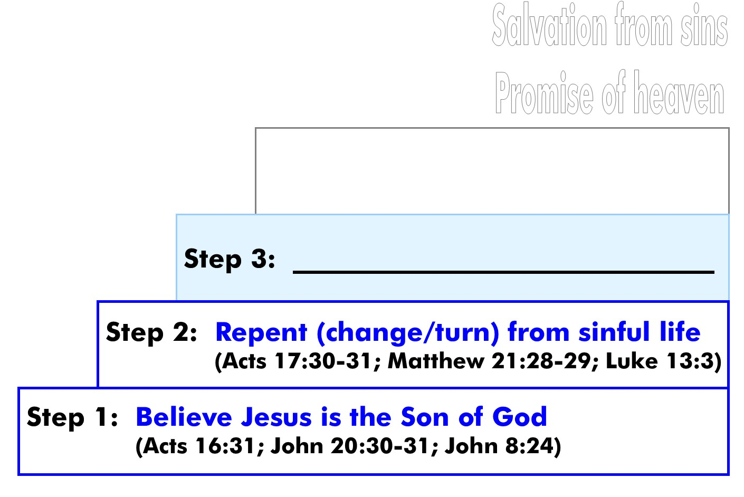

Slide 47

confess
9 that if you confess with your mouth the Lord Jesus and believe in your heart that God has raised Him from the dead, you will be saved.
10 For with the heart one believes unto righteousness, and with the mouth confession is made unto salvation.

Slide 48
I believe Jesus is God’s Son
16 Simon Peter answered and said, “You are the Christ, the Son of the living God.”

Slide 49
be denied by Jesus
32 “Therefore whoever confesses Me before men, him I will also confess before My Father who is in heaven.
33 “But whoever denies Me before men, him I will also deny before My Father who is in heaven.”

Slide 51
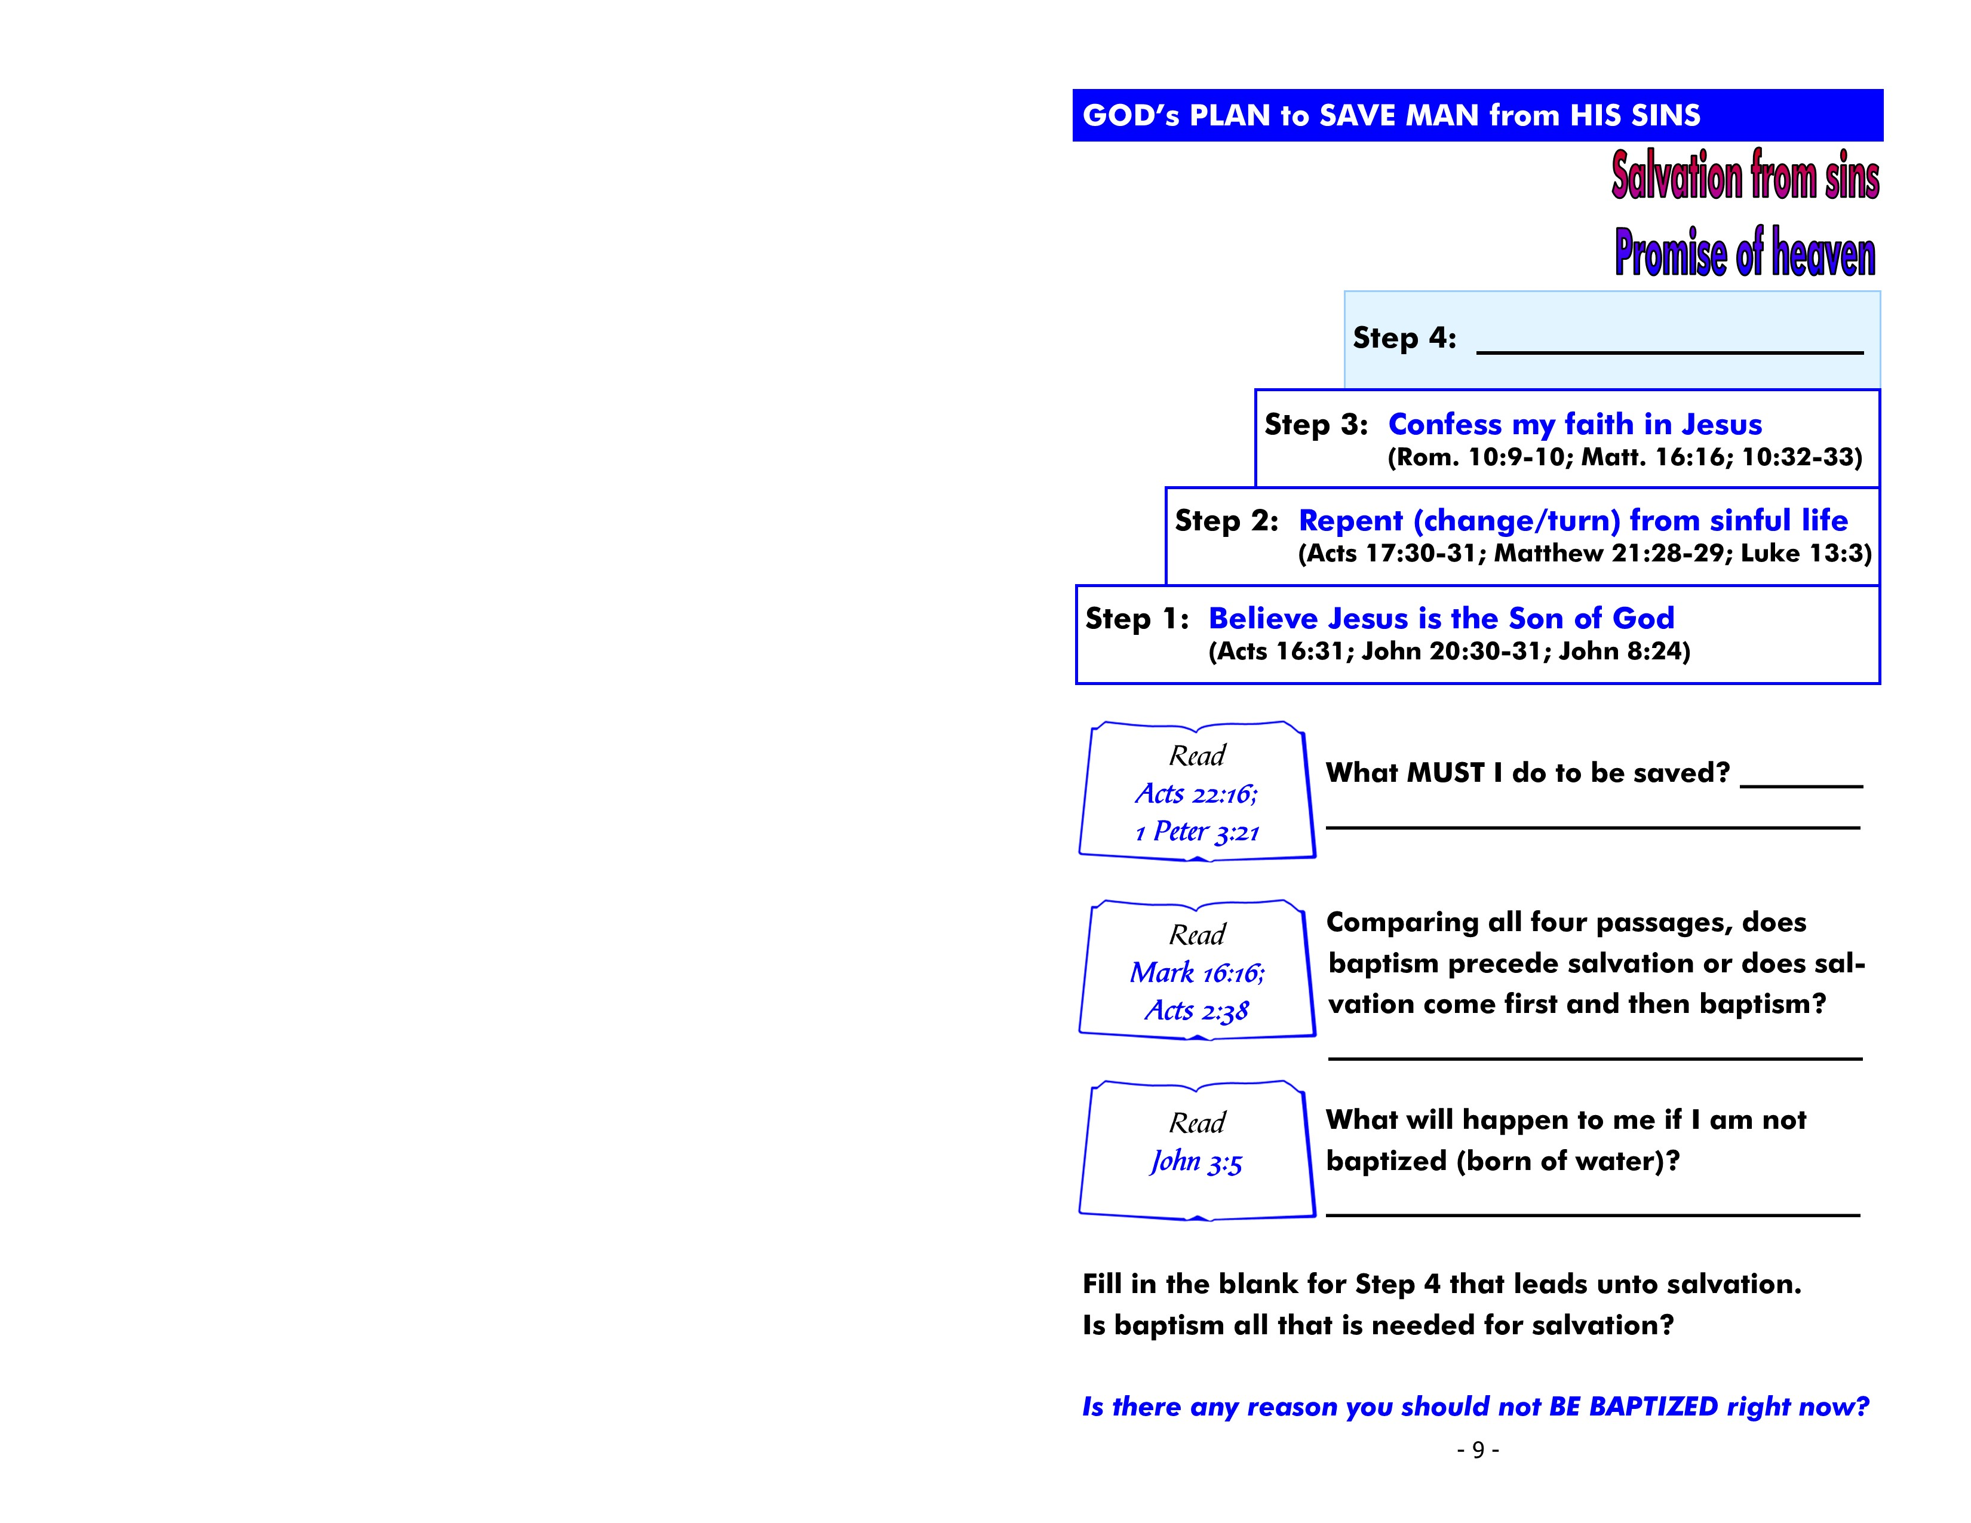

Slide 52
Acts 22:16 - “And now why are you waiting? Arise and be baptized, and wash away your sins, calling on the name of the Lord.”

Slide 53
1 Pet. 3:21 - There is also an antitype which now saves us—baptism (not the removal of the filth of the flesh, but the answer of a good conscience toward God), through the resurrection of Jesus Christ.

Slide 54
Mark 16:16 - “He who believes and is baptized will be saved; but he who does not believe will be condemned.”

Slide 55
be baptized
Acts 2:38 - Then Peter said to them, “Repent, and let every one of you be baptized in the name of Jesus Christ for the remission of sins; and you shall receive the gift of the Holy Spirit.”

Slide 57
Acts 22:16
Arise + Baptized = Wash away sins
1 Pet. 3:21
Baptism = Saves
Mark 16:16
Believes + Baptized = Saved
Acts 2:38
Repent + Baptized = Forgiveness of sins

Slide 58
baptism precedes salvation

Slide 59
Mark 16:16
Man:
Baptized = Saved + Believe
Man:
Believes = Saved + Baptized
Jesus:
Believes + Baptized = Saved

Slide 60
not enter the kingdom of God
5 Jesus answered, “Most assuredly, I say to you, unless one is born of water and the Spirit, he cannot enter the kingdom of God.”

Slide 63
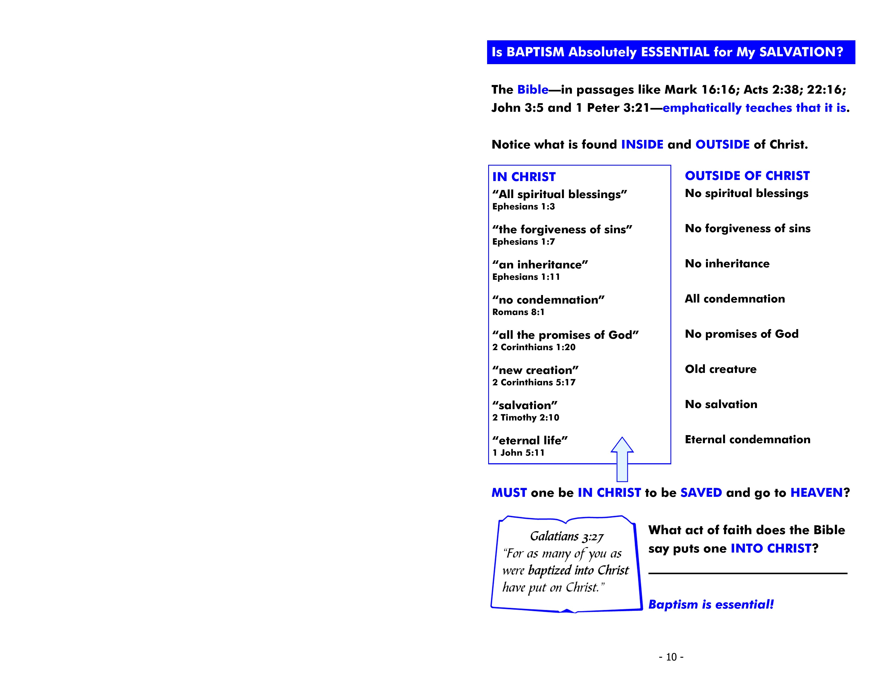

Slide 64
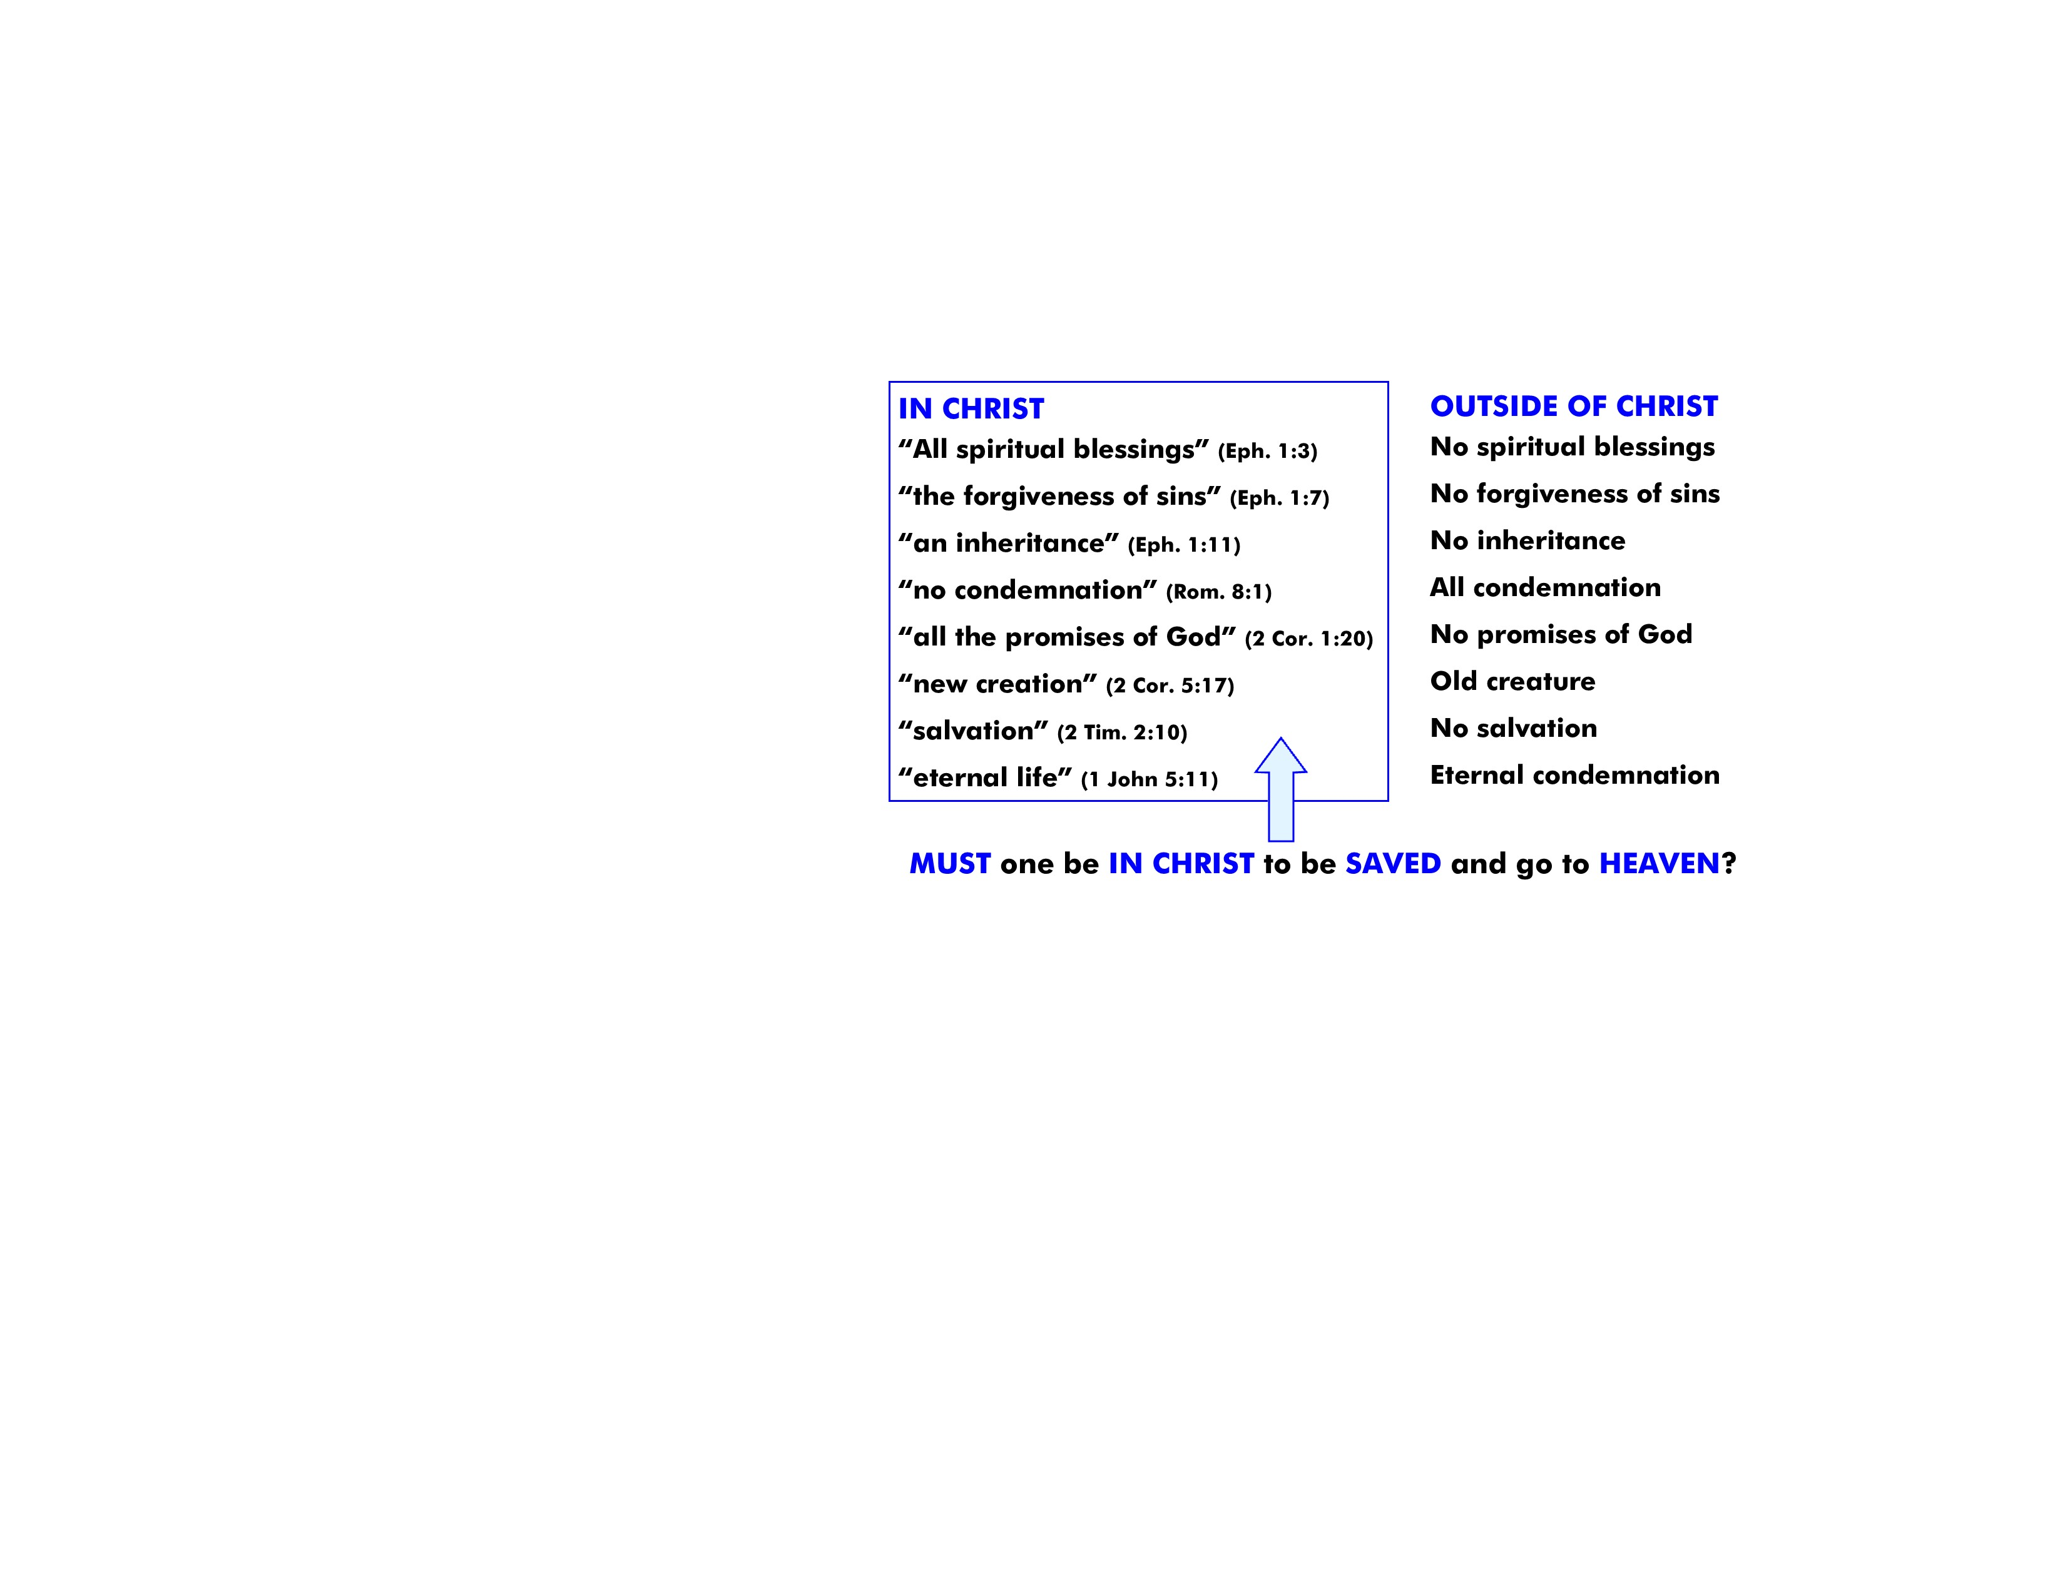

Slide 65
baptism

Slide 67
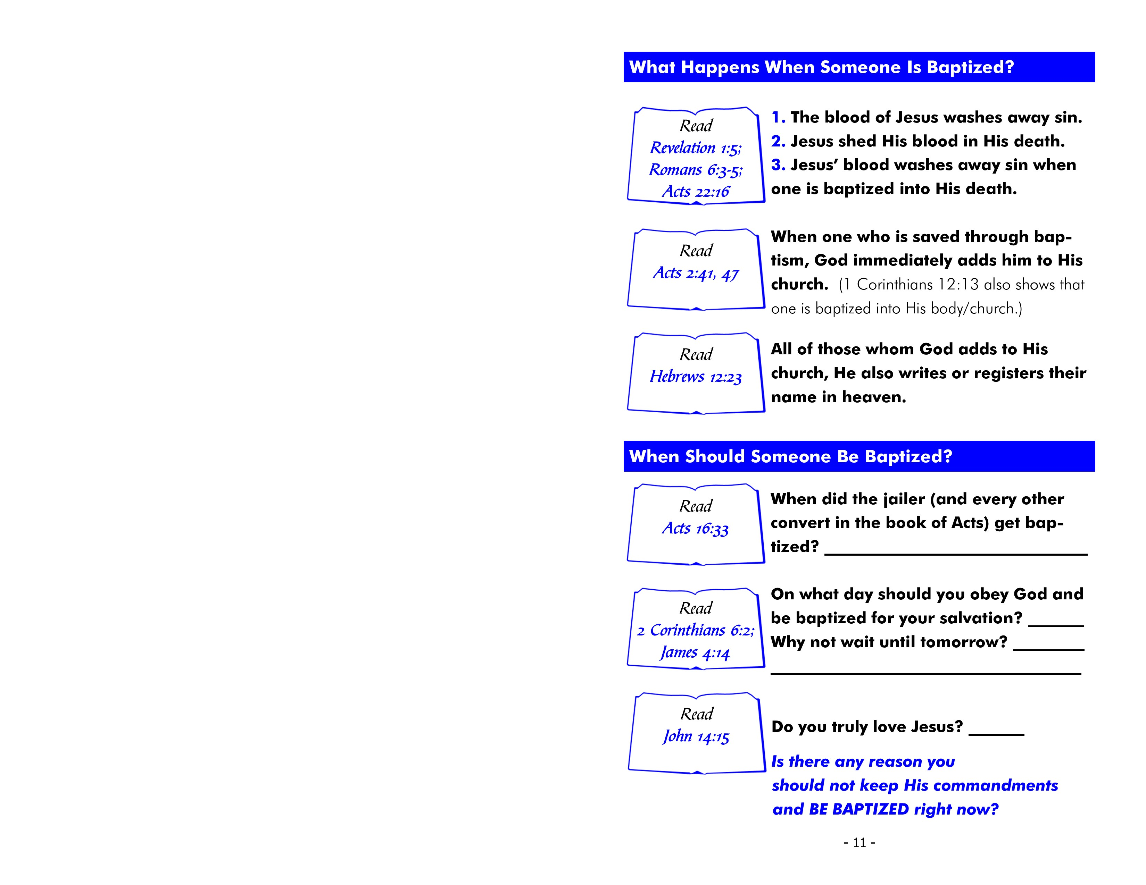
Rev. 1:5 - To Him who loved us and washed us from our sins in His own blood.

Slide 68
Rom. 6:3 - Or do you not know that as many of us as were baptized into Christ Jesus were baptized into His death?
4 Therefore we were buried with Him through baptism into death, that just as Christ was raised from the dead by the glory of the Father, even so we also should walk in newness of life.

Slide 69
Acts 22:16 - “And now why are you waiting? Arise and be baptized, and wash away your sins, calling on the name of the Lord.”

Slide 70
41 Then those who gladly received his word were baptized; and that day about three thousand souls were added to them.
…47 And the Lord added to the church daily those who were being saved.

Slide 71
23 …to the general assembly and church of the firstborn who are registered in heaven, to God the Judge of all, to the spirits of just men made perfect…

Slide 73
immediately
33 And he took them the same hour of the night and washed their stripes. And immediately he and all his family were baptized.

Slide 74
today
2 Cor. 6:2 - For He says: “In an acceptable time I have heard you, And in the day of salvation I have helped you.” Behold, now is the accepted time; behold, now is the day of salvation.

Slide 75
today
may not be a tomorrow
Jas. 4:14 - Whereas you do not know what will happen tomorrow. For what is your life? It is even a vapor that appears for a little time and then vanishes away.

Slide 76
15 “If you love Me, keep My commandments.”

Slide 77
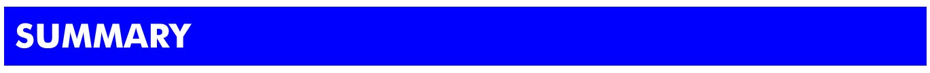
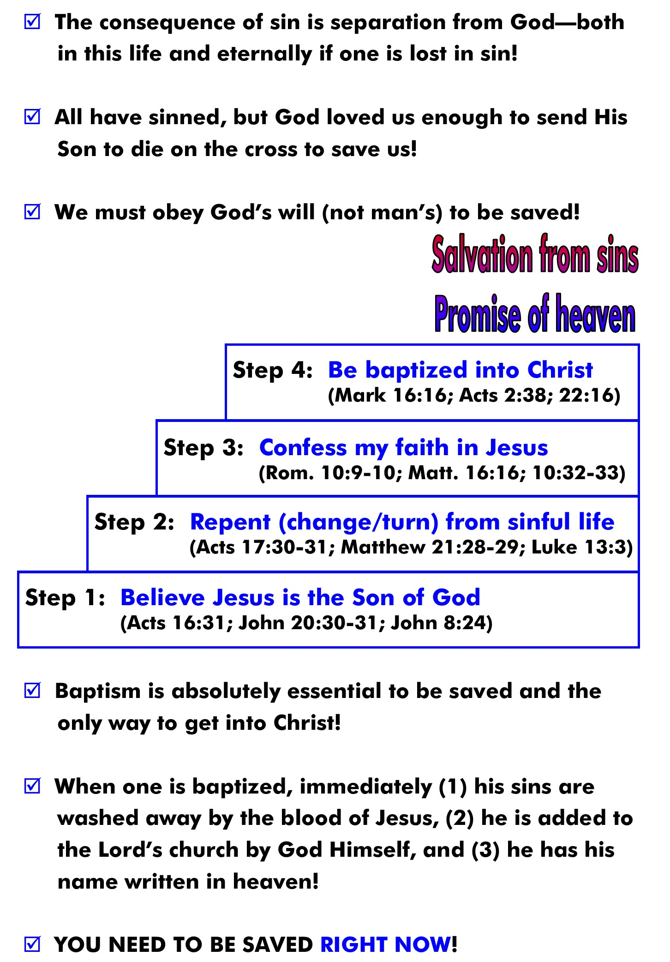

Slide 78


