Slide 3
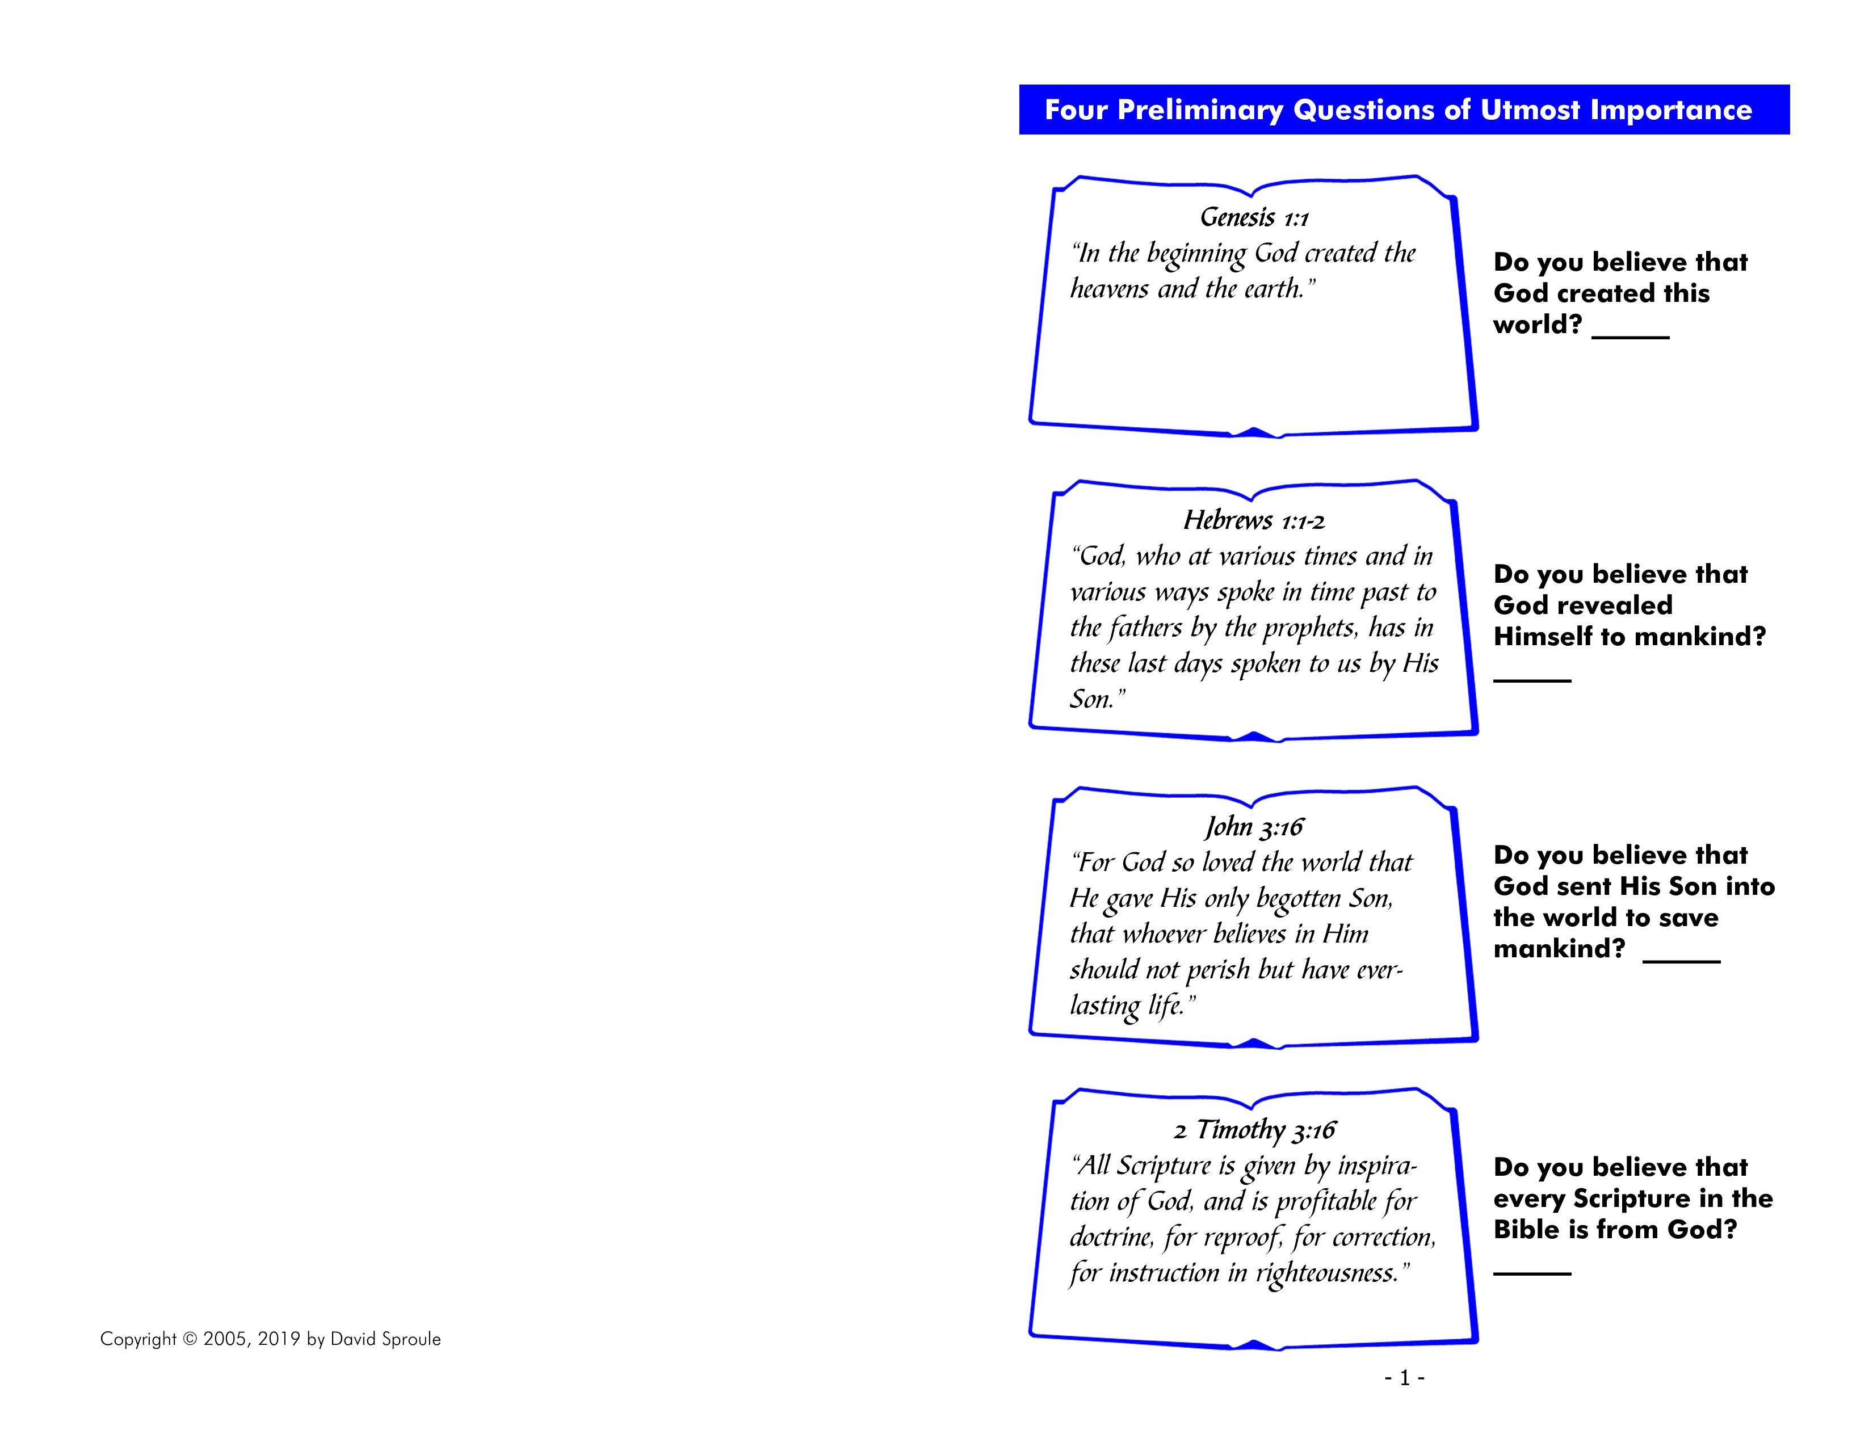
Yes
To study this topic, visit pblcoc.org or ApologeticsPress.org

Slide 4
Yes
To study this topic, visit pblcoc.org or ApologeticsPress.org

Slide 5
Yes
To study this topic, visit pblcoc.org or ApologeticsPress.org

Slide 6
Yes
To study this topic, visit pblcoc.org or ApologeticsPress.org

Slide 7
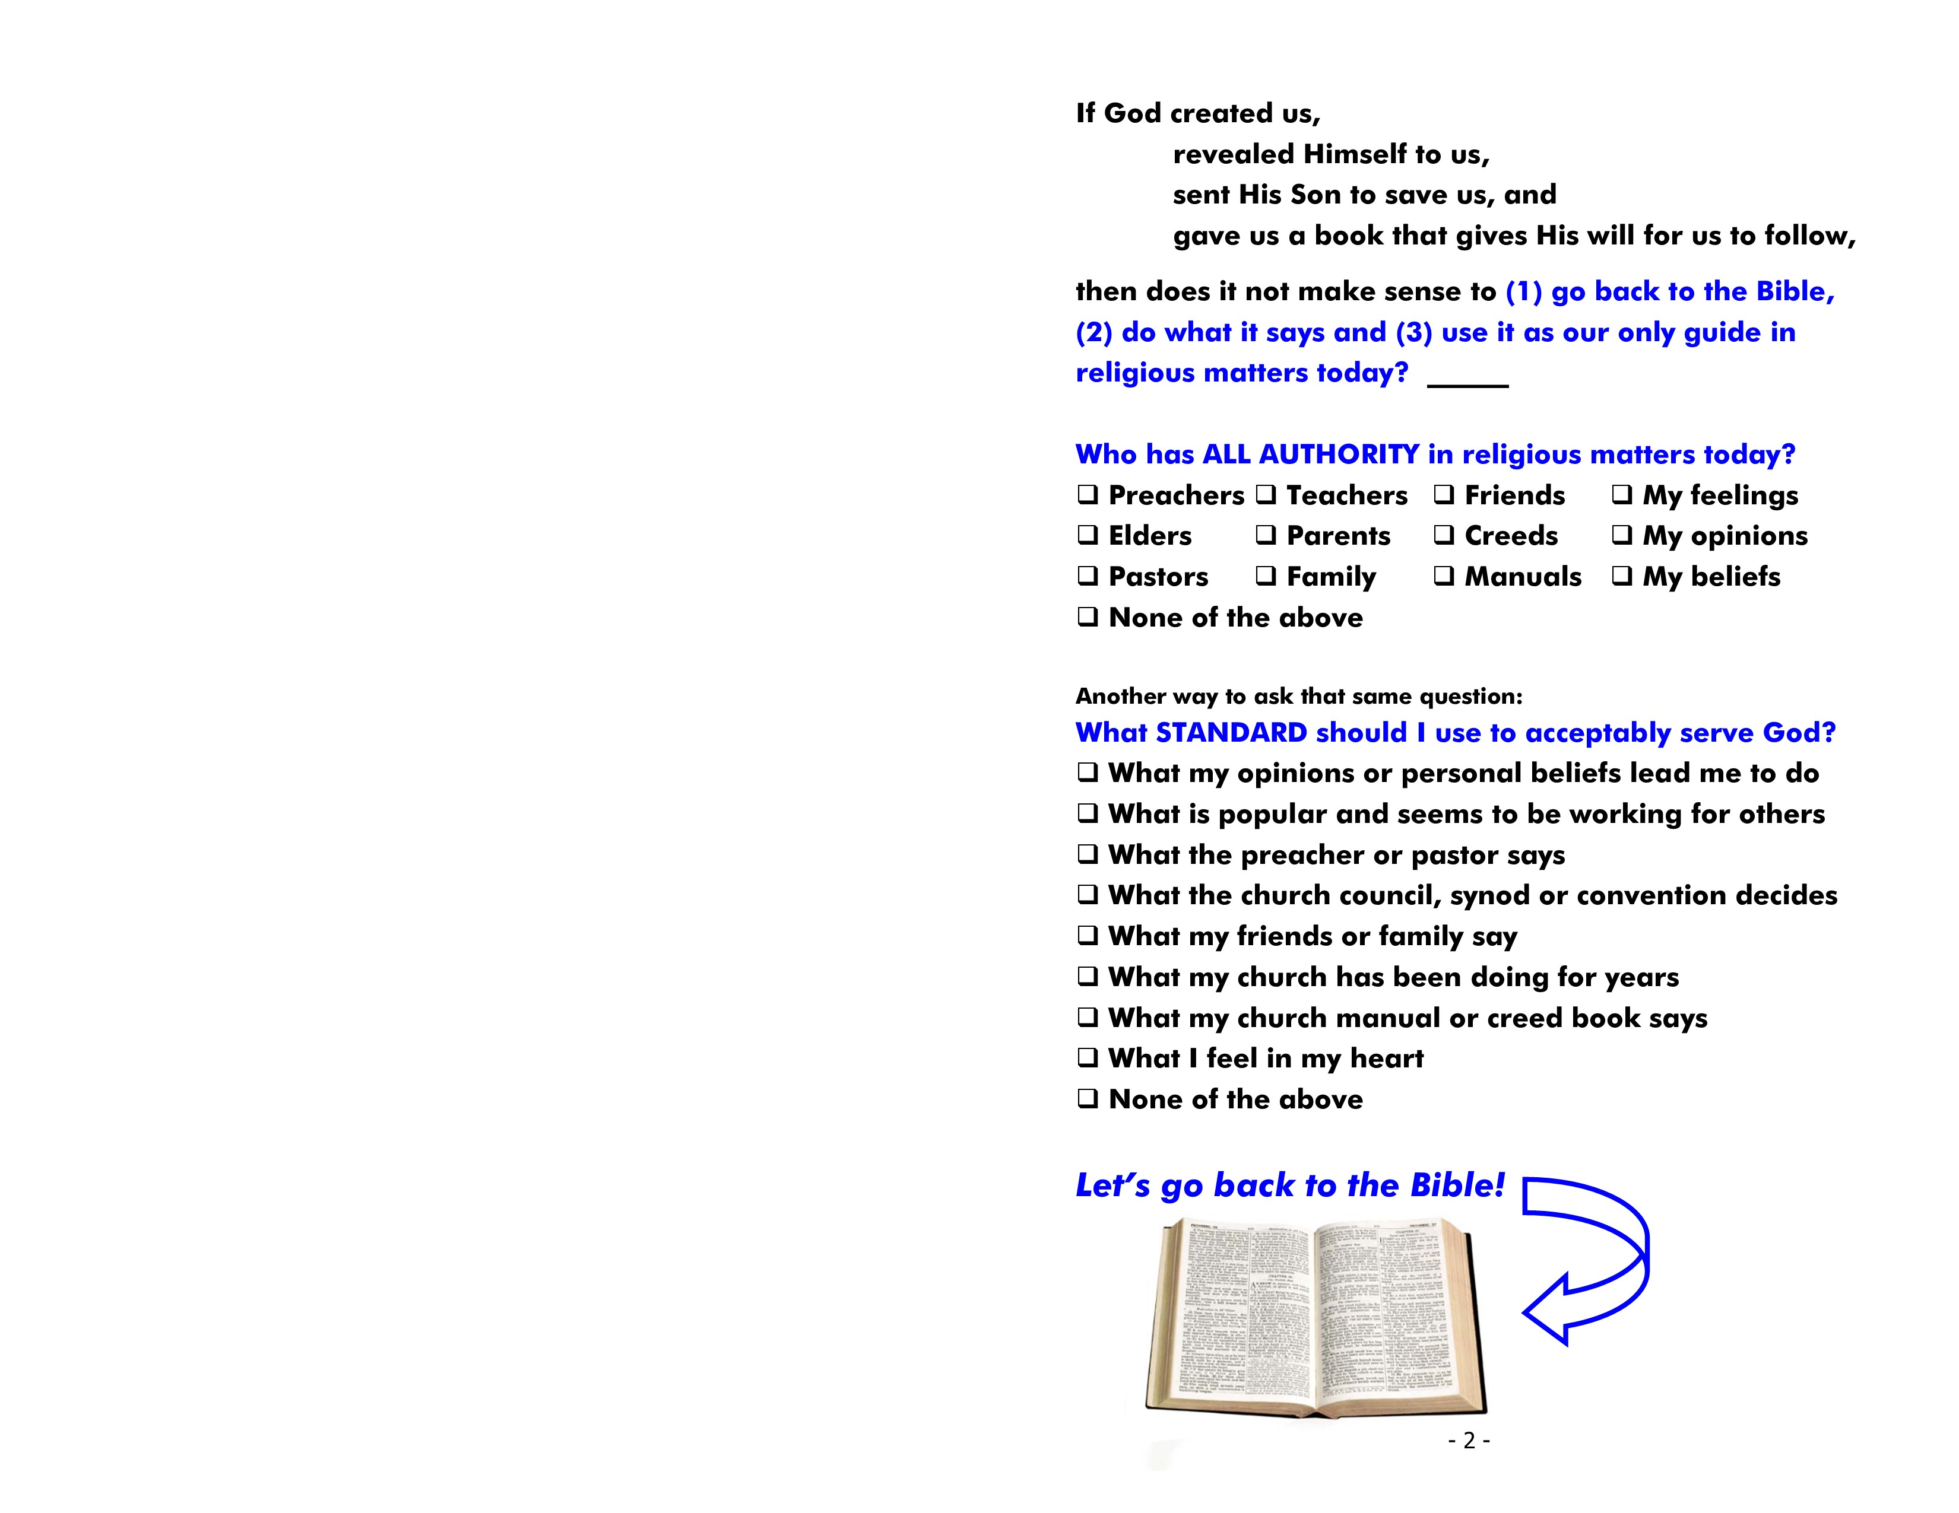
Yes
X

Slide 8
X

Slide 10
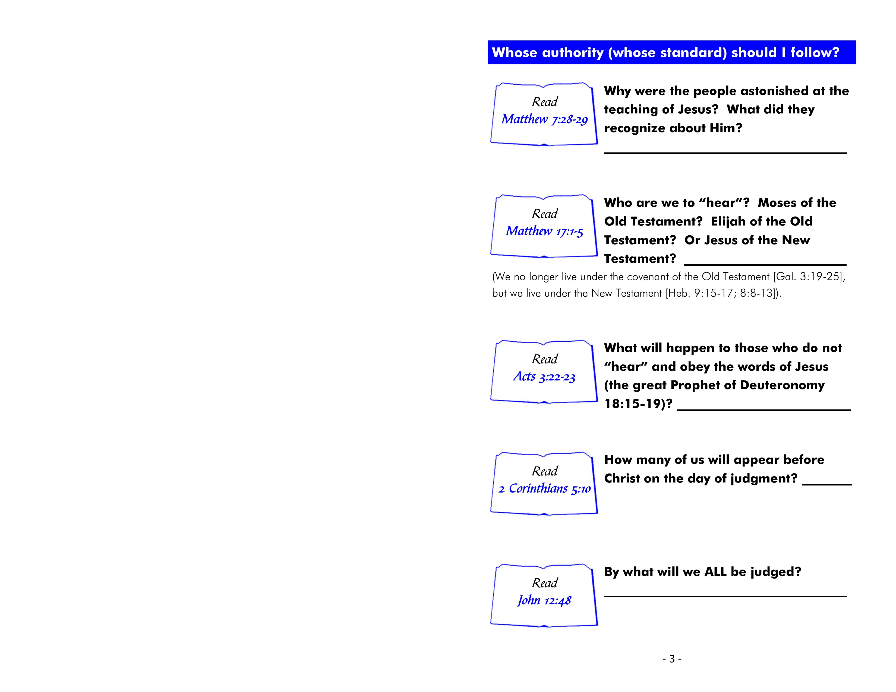
He taught as one having authority
28 And so it was, when Jesus had ended these sayings, that the people were astonished at His teaching,
29 for He taught them as one having authority, and not as the scribes.

Slide 11
1 Now after six days Jesus took Peter, James, and John his brother, led them up on a high mountain by themselves;
2 and He was transfigured before them. His face shone like the sun, and His clothes became as white as the light.
3 And behold, Moses and Elijah appeared to them, talking with Him.
4 Then Peter answered and said to Jesus, “Lord, it is good for us to be here; if You wish, let us make here three tabernacles: one for You, one for Moses, and one for Elijah.”

Slide 12
Jesus, the New Testament
5 While he was still speaking, behold, a bright cloud overshadowed them; and suddenly a voice came out of the cloud, saying, “This is My beloved Son, in whom I am well pleased. Hear Him!”

Slide 13
Utterly destroyed
22 “For Moses truly said to the fathers, ‘The LORD your God will raise up for you a Prophet like me from your brethren. Him you shall hear in all things, whatever He says to you.
23 ‘And it shall be that every soul who will not hear that Prophet shall be utterly destroyed from among the people.’”

Slide 14
All
10 For we must all appear before the judgment seat of Christ, that each one may receive the things done in the body, according to what he has done, whether good or bad.

Slide 15
Jesus’ word
48 “He who rejects Me, and does not receive My words, has that which judges him—the word that I have spoken will judge him in the last day.”

Slide 16
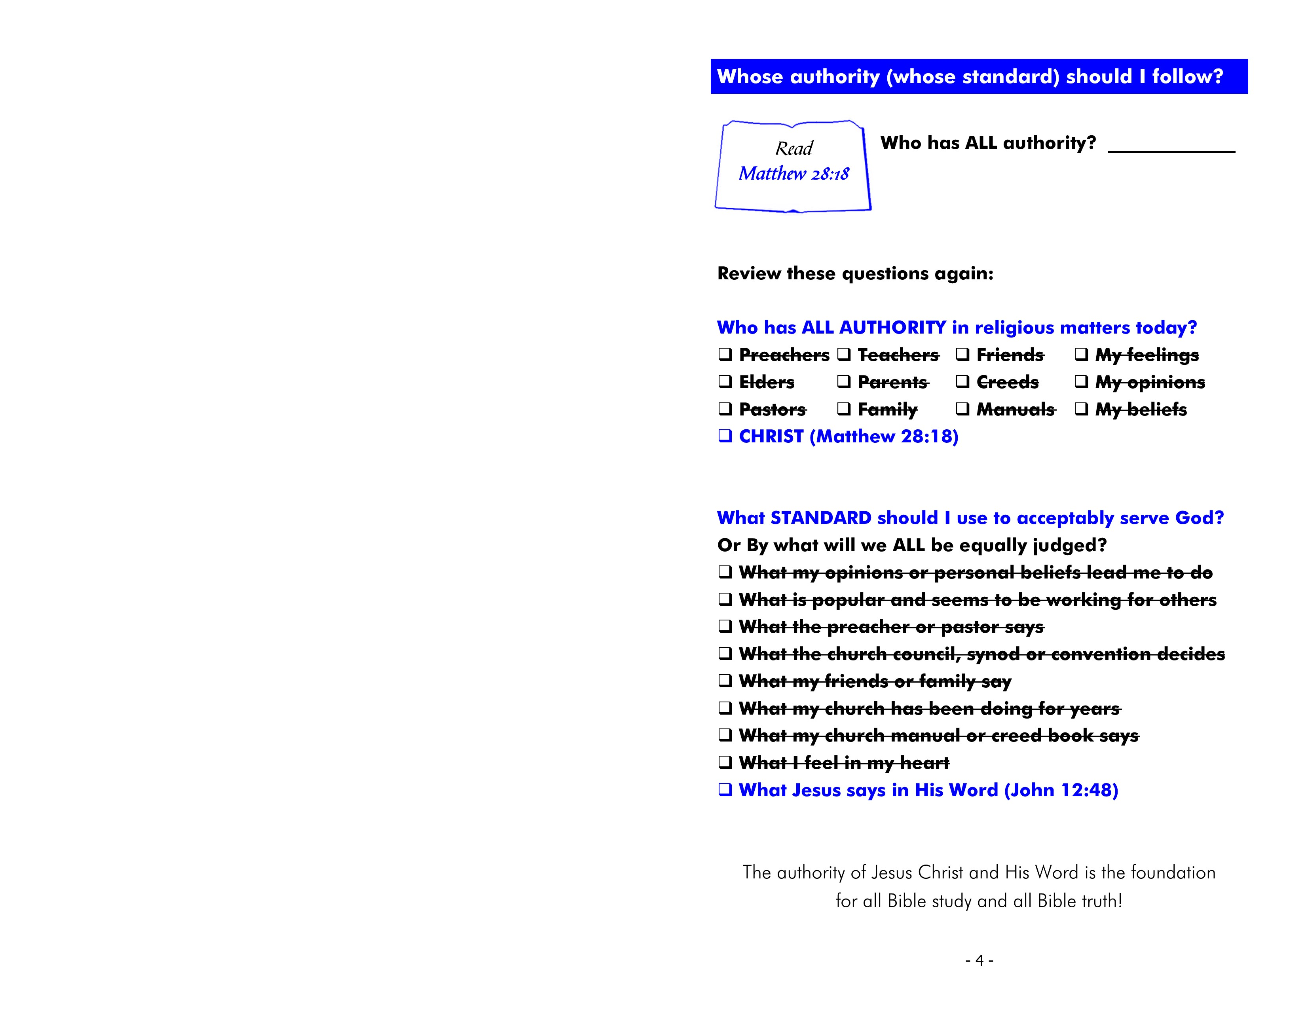
Jesus Christ
18 And Jesus came and spoke to them, saying, “All authority has been given to Me in heaven and on earth.”

Slide 17
X

Slide 18
X

Slide 20
Acts 17:10-11
10 Then the brethren immediately sent Paul and Silas away by night to Berea. When they arrived, they went into the synagogue of the Jews.
11 These were more fair-minded than those in Thessalonica, in that they received the word with all readiness,
and searched the Scriptures daily
to find out whether these things
were so.

Slide 21
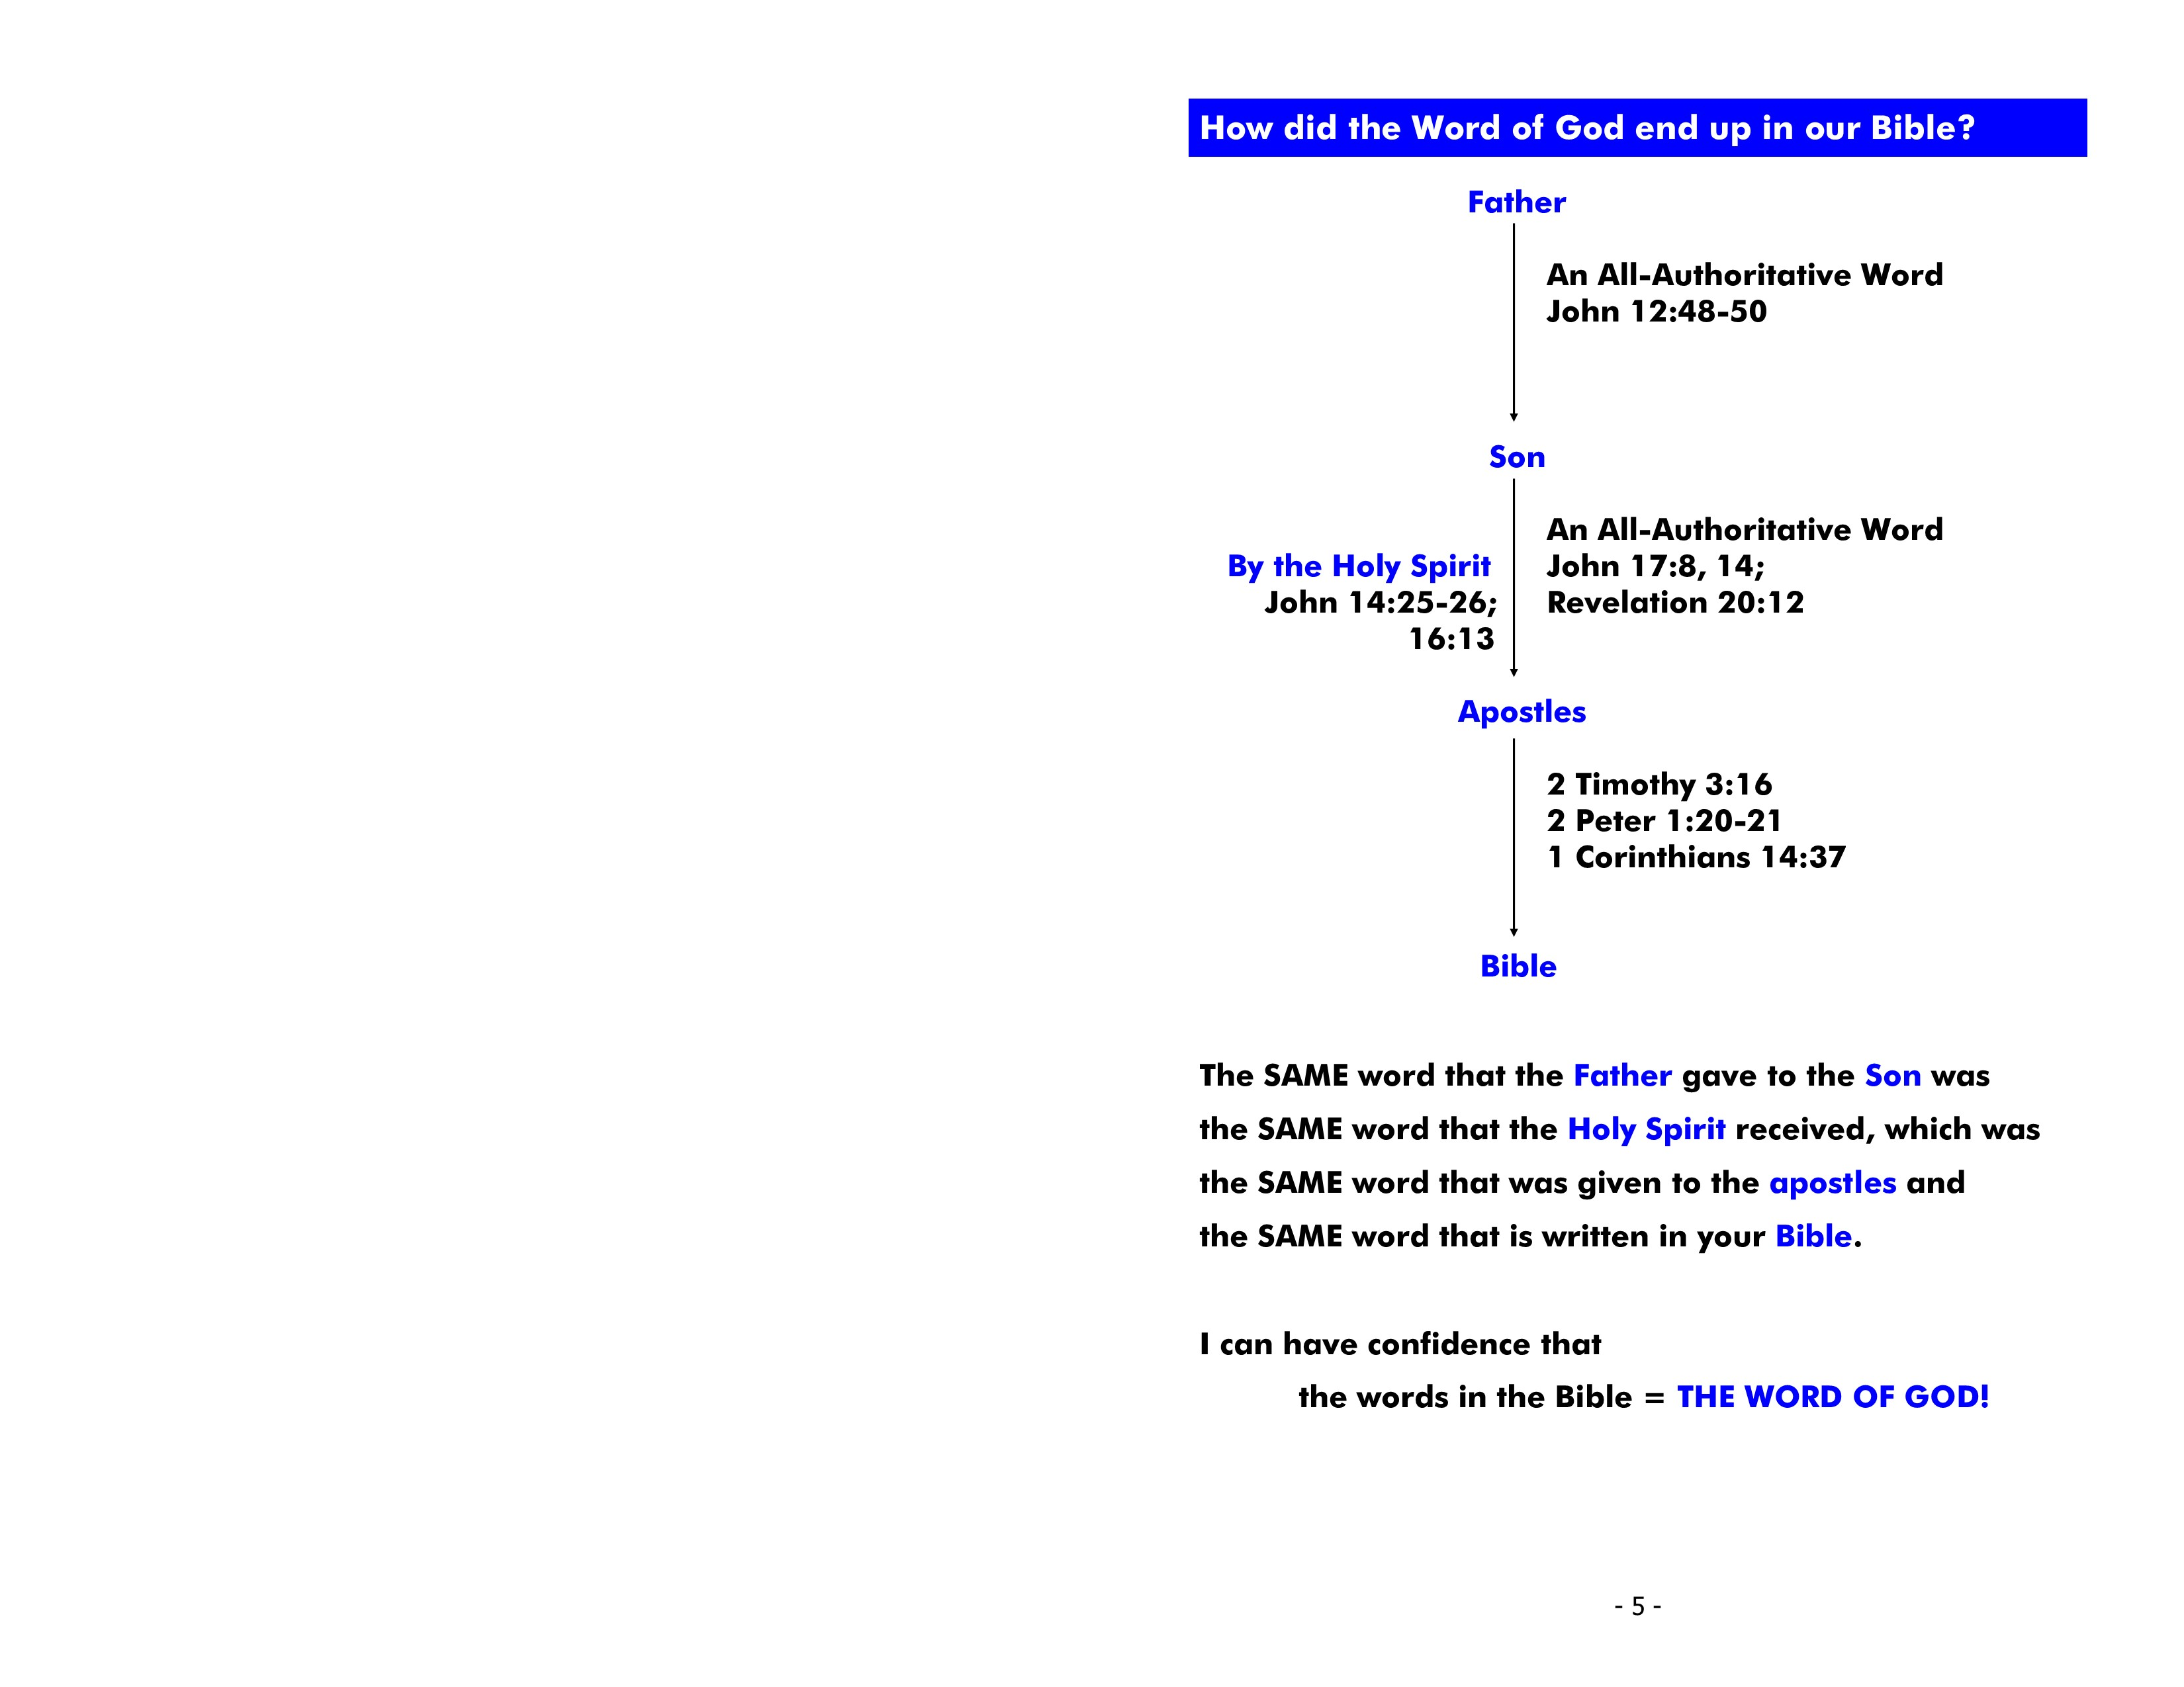

Slide 23
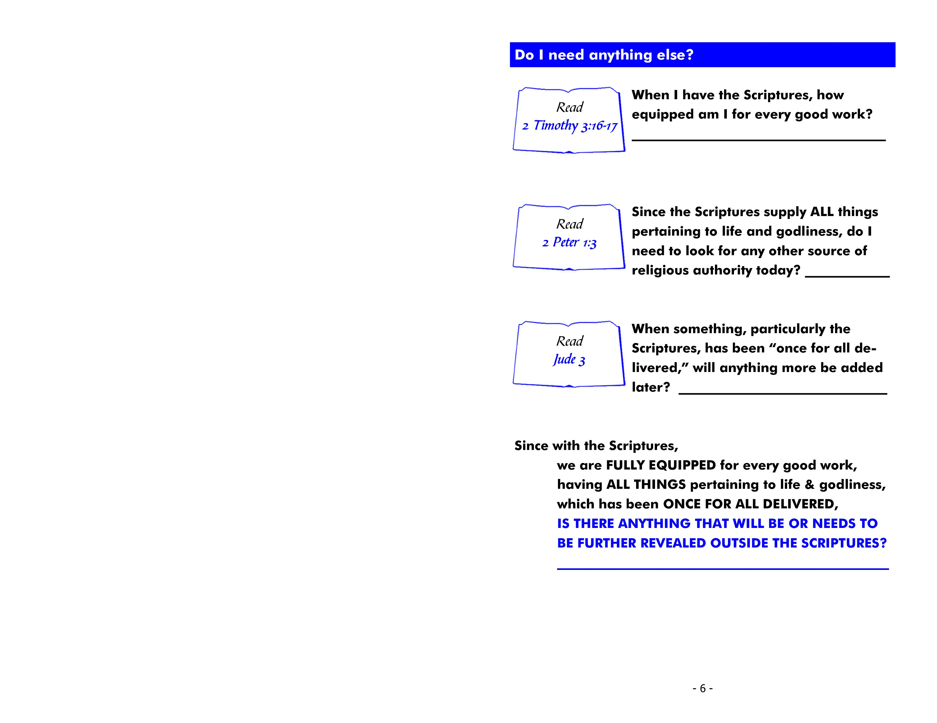
Complete, thoroughly equipped
16 All Scripture is given by inspiration of God, and is profitable for doctrine, for reproof, for correction, for instruction in righteousness,
17 that the man of God may be complete, thoroughly equipped for every good work.

Slide 24
No
3 as His divine power has given to us all things that pertain to life and godliness, through the knowledge of Him who called us by glory and virtue.

Slide 25
No
3 Beloved, while I was very diligent to write to you concerning our common salvation, I found it necessary to write to you exhorting you to contend earnestly for the faith which was once for all delivered to the saints.

Slide 26
No

Slide 28
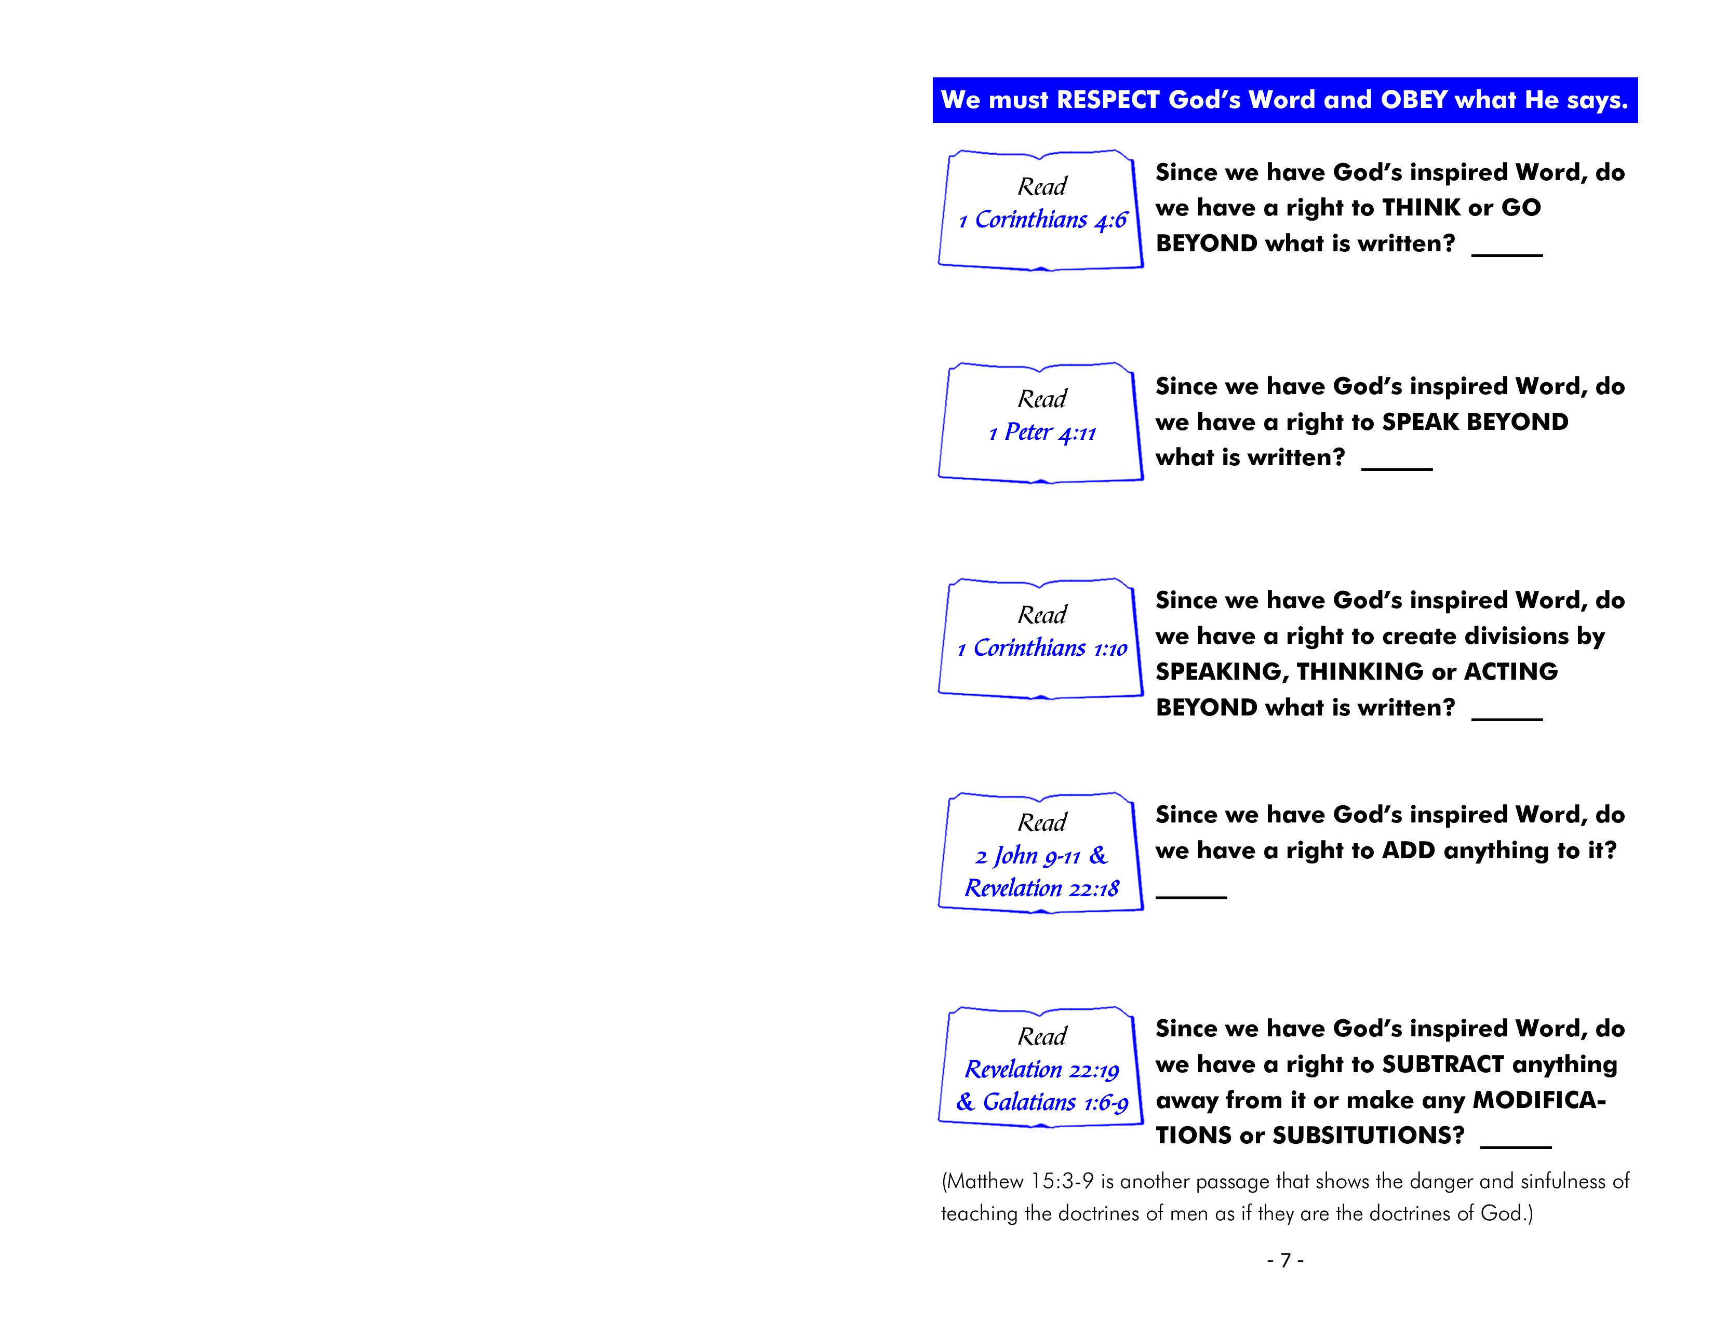
No
6 Now these things, brethren, I have figuratively transferred to myself and Apollos for your sakes, that you may learn in us not to think beyond what is written, that none of you may be puffed up on behalf of one against the other.

Slide 29
No
11 If anyone speaks, let him speak as the oracles of God.

Slide 30
No
10 Now I plead with you, brethren, by the name of our Lord Jesus Christ, that you all speak the same thing, and that there be no divisions among you, but that you be perfectly joined together in the same mind and in the same judgment.

Slide 31
2 John 9
Whoever transgresses and does not abide in the doctrine of Christ does not have God. He who abides in the doctrine of Christ has both the Father and the Son.

Slide 32
No
Revelation 22:18
For I testify to everyone who hears the words of the prophecy of this book: If anyone adds to these things, God will add to him the plagues that are written in this book;

Slide 33
No
Revelation 22:19 – and if anyone takes away from the words of the book of this prophecy, God shall take away his part from the Book of Life, from the holy city, and from the things which are written in this book.

Slide 35
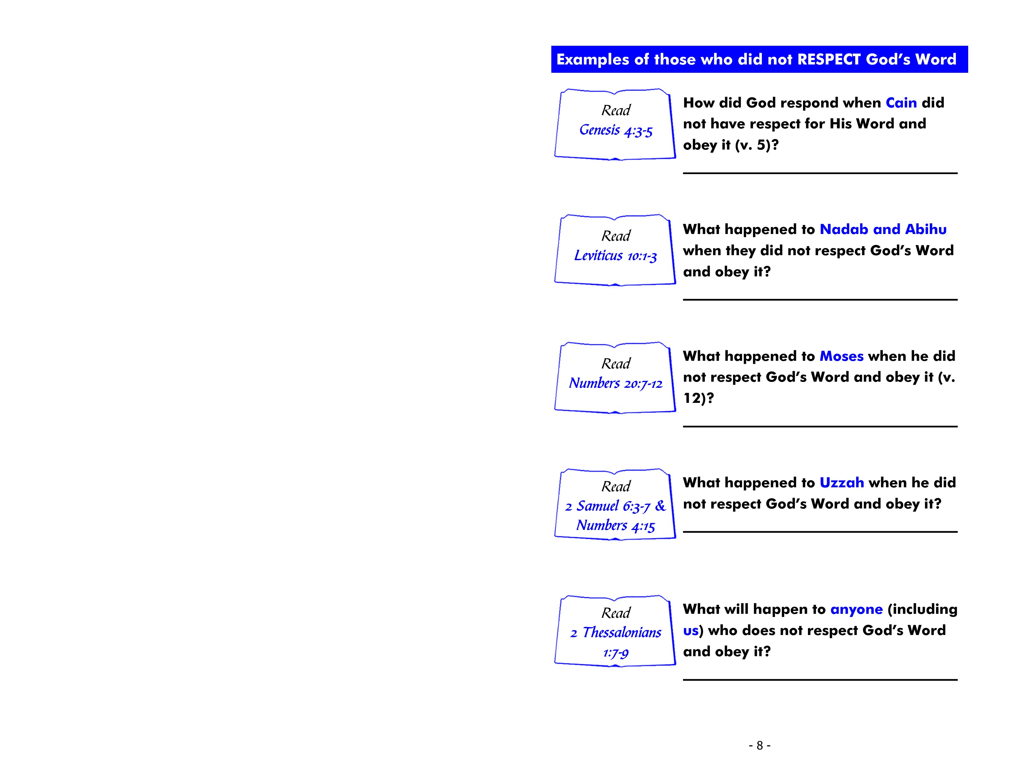
(See also Hebrews 11:4)
God did not respect Cain
3 And in the process of time it came to pass that Cain brought an offering of the fruit of the ground to the LORD.
4 Abel also brought of the firstborn of his flock and of their fat. And the LORD respected Abel and his offering,
5 but He did not respect Cain and his offering. And Cain was very angry, and his countenance fell.

Slide 36
Devoured by fire
1 Then Nadab and Abihu, the sons of Aaron, each took his censer and put fire in it, put incense on it, and offered profane fire before the LORD, which He had not commanded them.
2 So fire went out from the LORD and devoured them, and they died before the LORD.

Slide 37
Not enter the Promised Land
Struck dead

Slide 38
Everlasting punishment
away from God
7 …when the Lord Jesus is revealed from heaven with His mighty angels,
8 in flaming fire taking vengeance on those who do not know God, and on those who do not obey the gospel of our Lord Jesus Christ.
9 These shall be punished with everlasting destruction from the presence of the Lord and from the glory of His power.

Slide 40
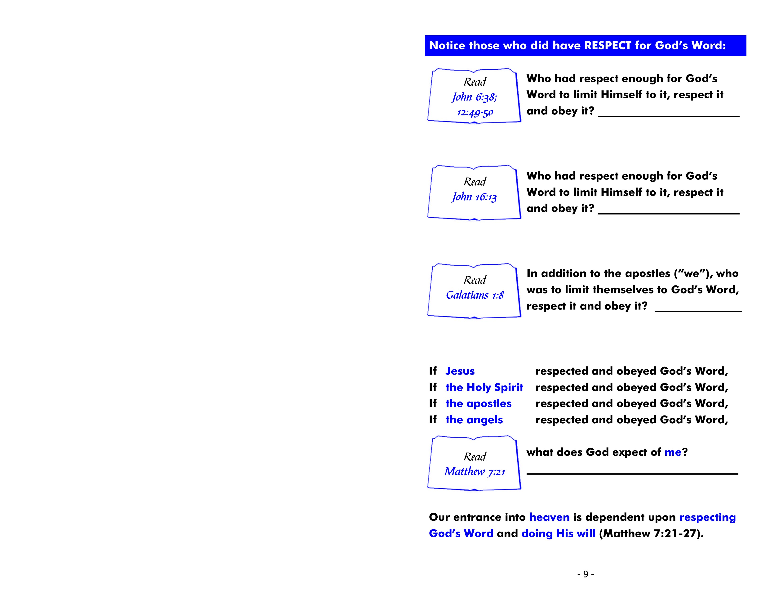
Jesus Christ
49 “For I have not spoken on My own authority; but the Father who sent Me gave Me a command, what I should say and what I should speak.
50 “And I know that His command is everlasting life. Therefore, whatever I speak, just as the Father has told Me, so I speak.”

Slide 41
The Holy Spirit
13 “However, when He, the Spirit of truth, has come, He will guide you into all truth; for He will not speak on His own authority, but whatever He hears He will speak; and He will tell you things to come.”

Slide 42
Angels
8 But even if we, or an angel from heaven, preach any other gospel to you than what we have preached to you, let him be accursed.

Slide 43
Do the will of God
21 “Not everyone who says to Me, ‘Lord, Lord,’ shall enter the kingdom of heaven, but he who does the will of My Father in heaven.”

Slide 44
Do the will of God

Slide 45
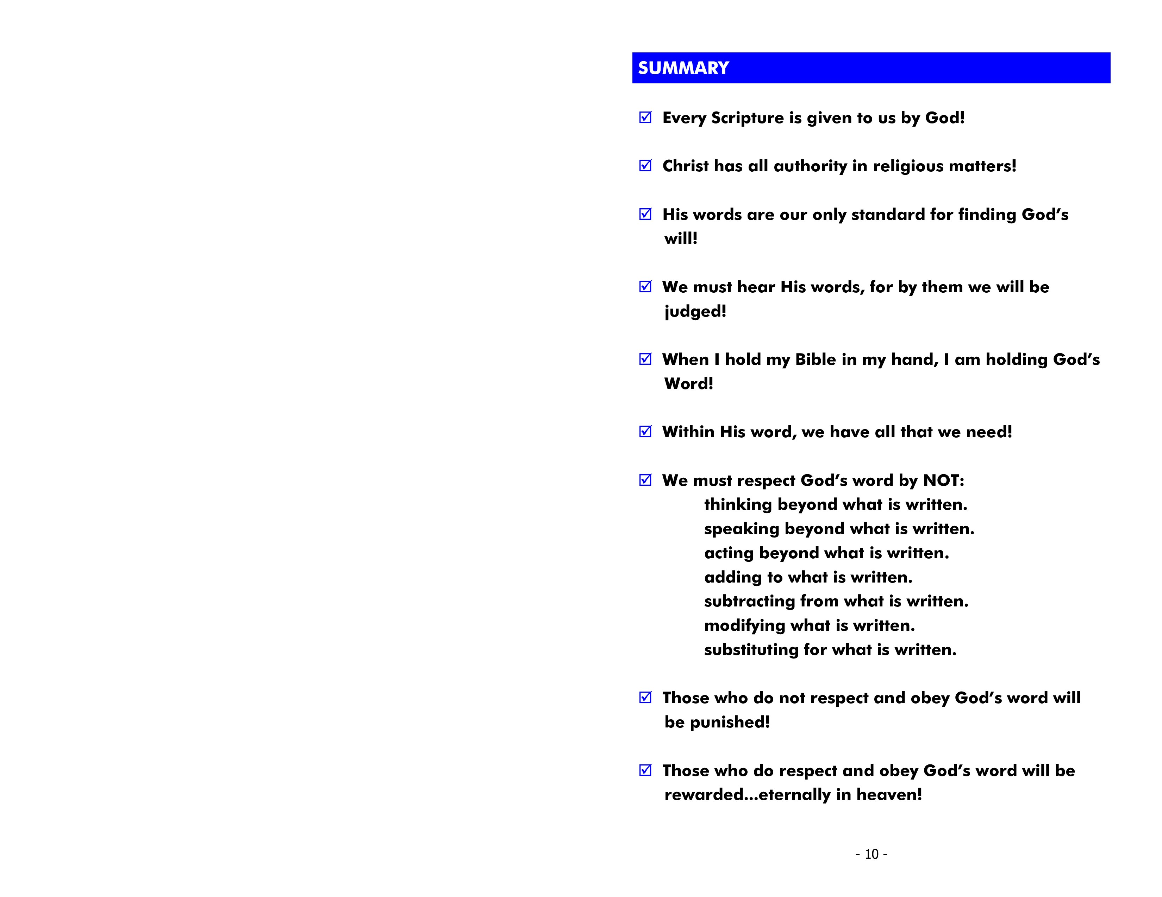

Slide 49


