Slide 2
Giving is an act of worship (Num. 18:11+Heb. 5:1; Matt. 2:11; Phil. 4:18)
Giving in worship is a command of God
It is a Divine “order/directive” (1 Cor. 16:1)
It is a universal obligation for all churches to “do” (1 Cor. 16:1)
But I don’t give merely because I have to (2 Cor. 9:7)
Giving is an individual responsibility
“Each one of you” Christians is obligated to give (1 Cor. 16:2)
We each share responsibility in giving to the Lord and His work
Every Christian must express devotion to God through this grace (2 Cor. 8:1-7)

Slide 3
There is a specified time
Every first day of the week (1 Cor. 16:2)
There is a specified place
The church was assembling together to worship on the first day of the week (Acts 20:7; 2:42)
Christians were to “lay by in store” = literally, “put into the treasury”
Greek word for “contribution” is koinonia = means “fellowship” (Acts 2:42; Rom. 15:26)
There is a specified purpose
To help those in need (1 Cor. 16:1-2; Rom. 15:26)
To help preach the gospel (1 Cor. 9:1-14; Phil. 4:14-18)
To support the work of the church, the local congregation (only authorized way of financing His work)
There is a specified proportion
As one “may prosper” (1 Cor. 16:2) + “Each according to his ability” (Acts 11:29; 2 Cor. 8:3; Ezra 2:69)
Giving is to be done liberally (Rom. 12:8; 2 Cor. 8:2) and cheerfully (2 Cor. 9:7)
There is a specified process
Give as you purpose, plan, predetermine to give in your heart (2 Cor. 9:7)
Worship is the determination to set aside on Lord’s Day and then following through

Slide 4
Cash
Personal check
Electronic giving
Our banking systems are moving away from checks to electronic transactions
Paying online is the new norm
When done right, this can definitely fulfill the Scriptural guidelines
And it can help many Christians to be able to give as they want/need
It is essential to maintain the koinonia/fellowship/joint-participation aspect of giving

Slide 5
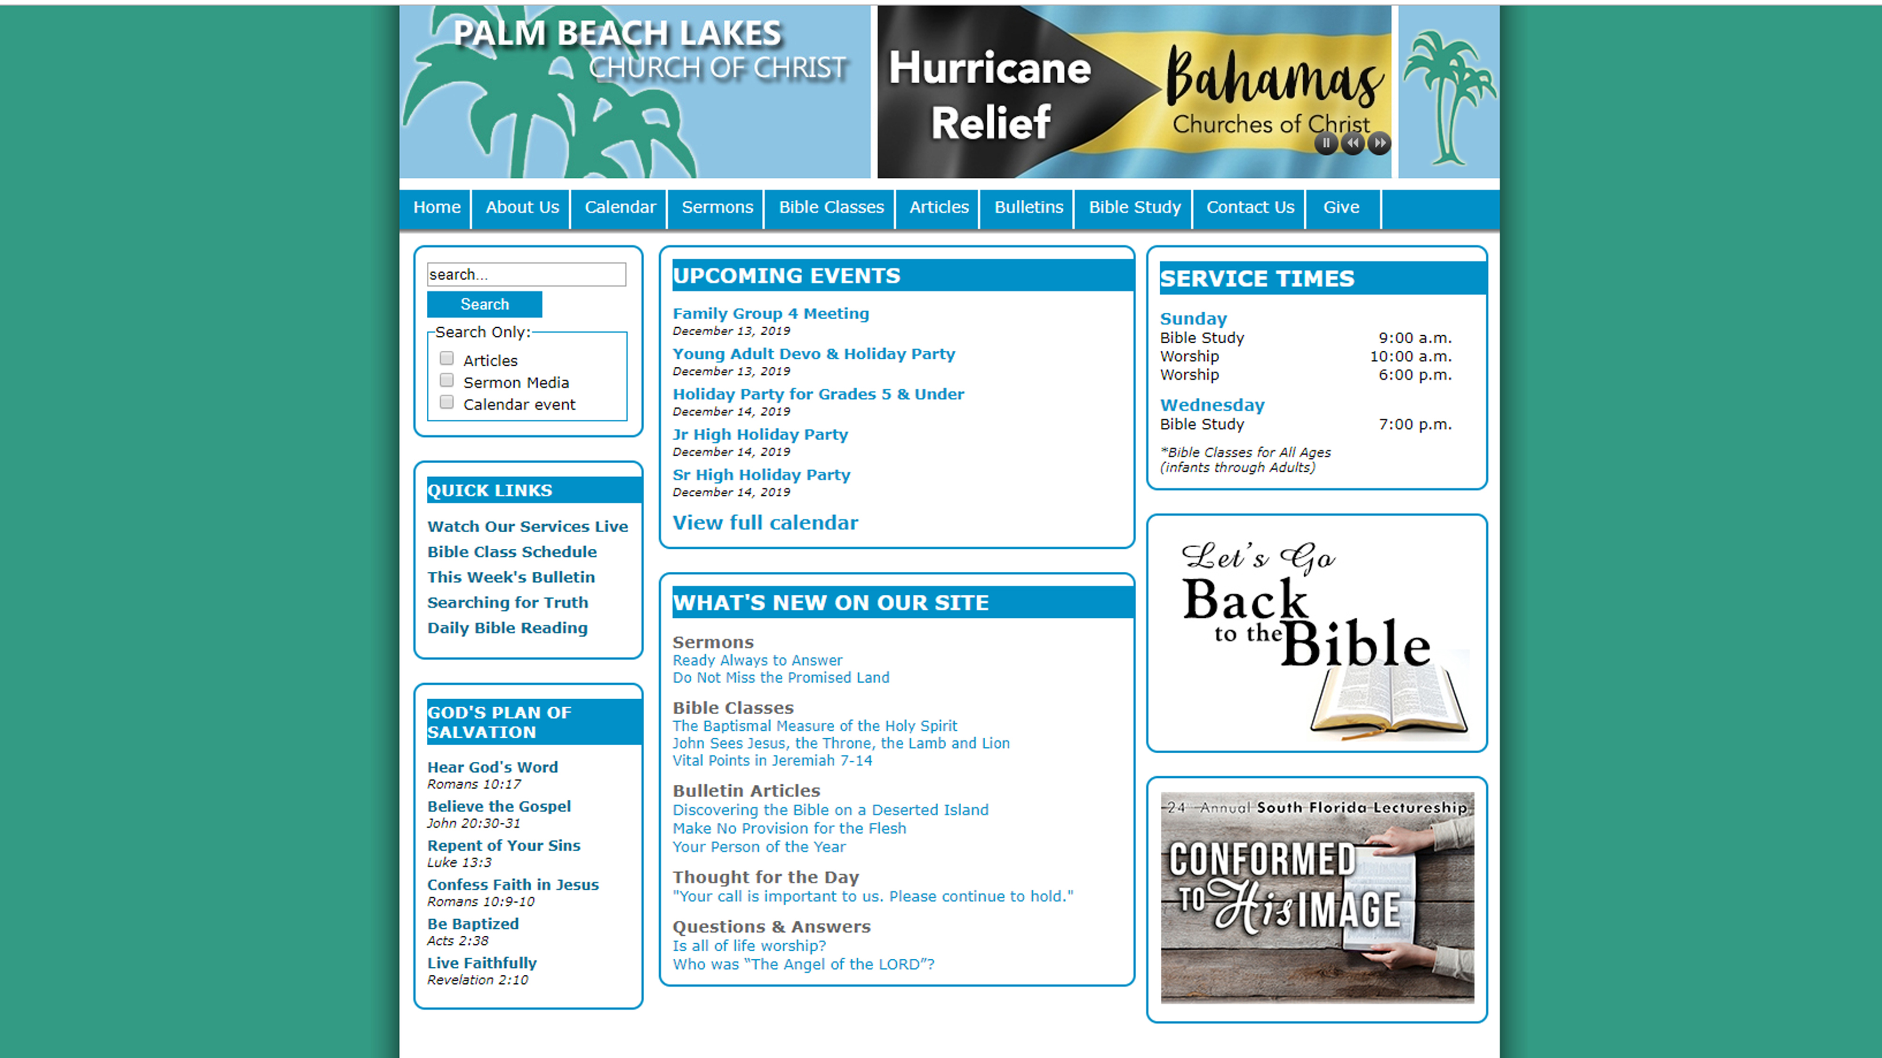

Slide 6
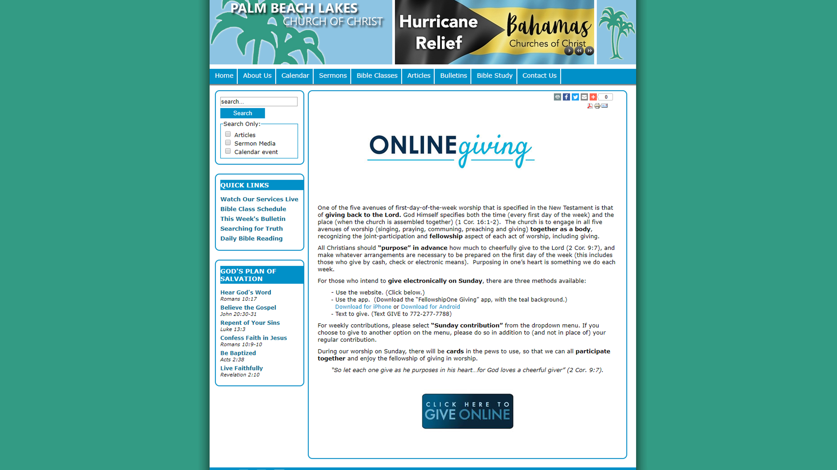

Slide 7
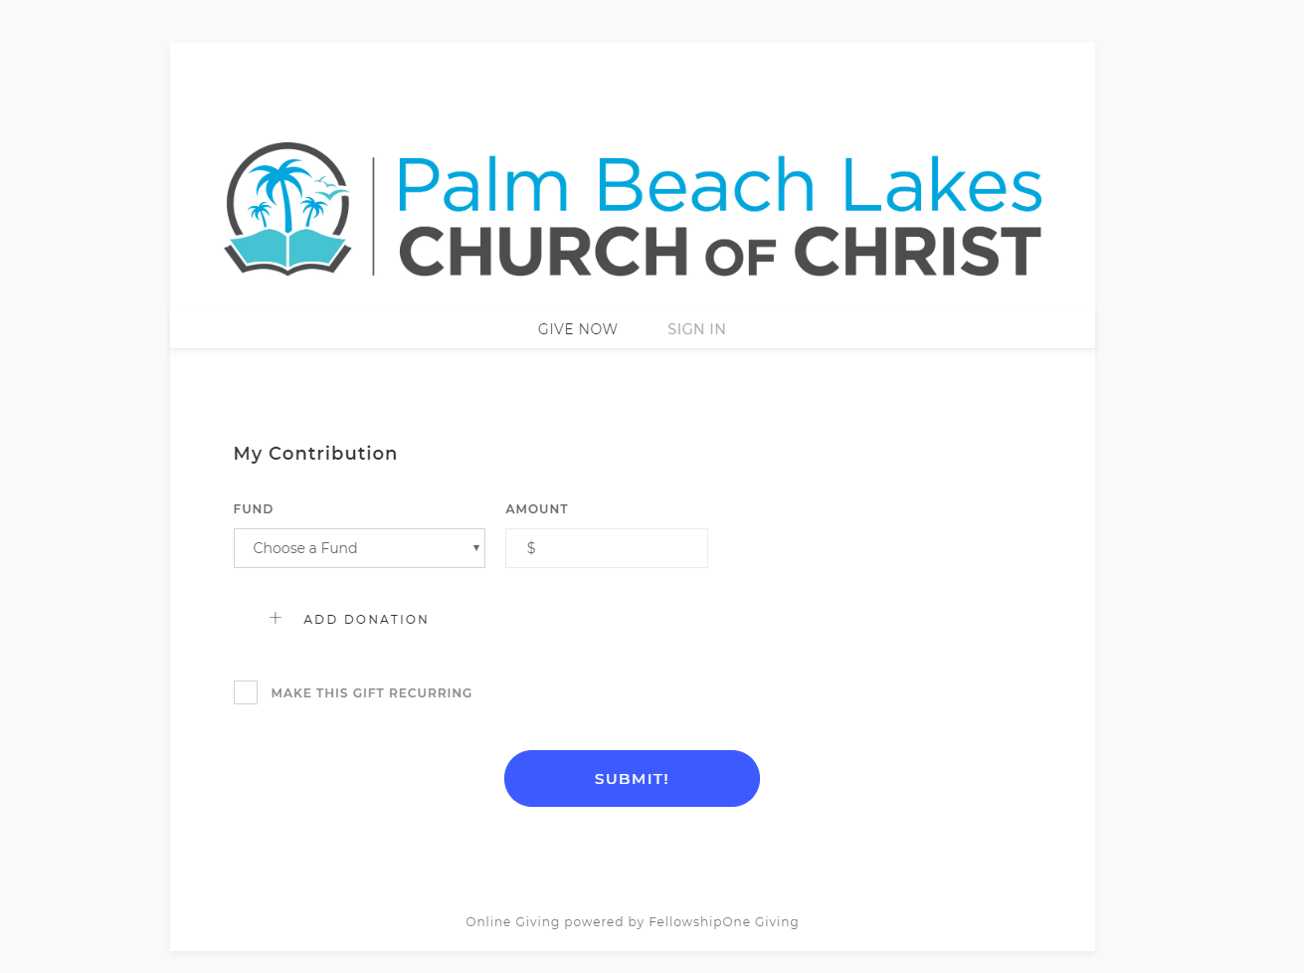

Slide 8
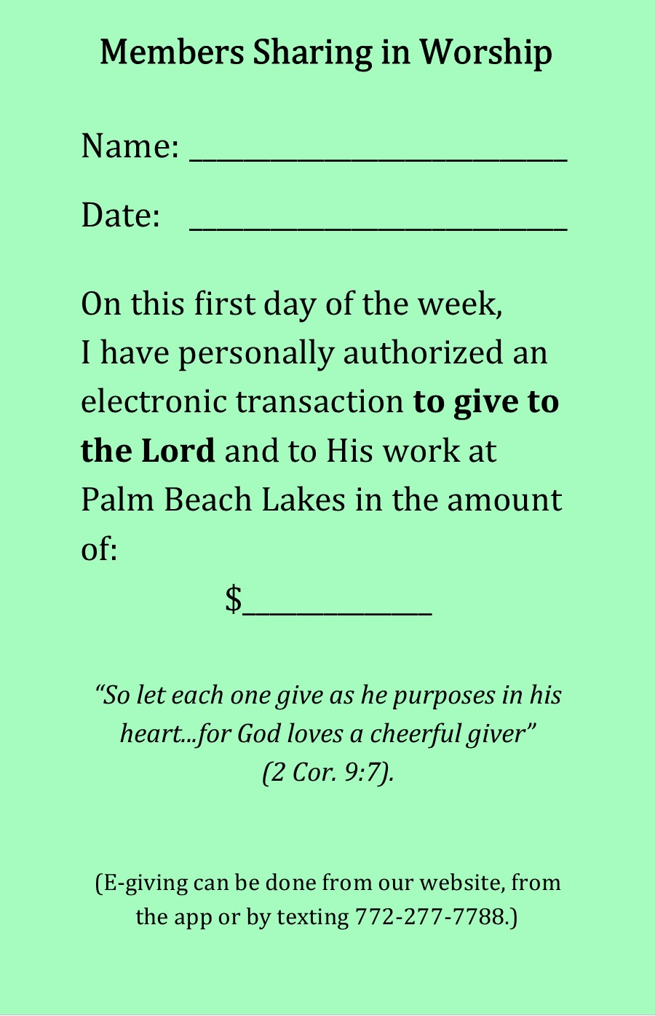

Slide 9
Believe Jesus is God’s Son – John 8:24
Repent of your sins and turn to God – Luke 13:3
Confess your faith in Jesus Christ – Romans 10:9
Be immersed into Christ – Mark 16:16
God will forgive all of your sins – Acts 2:38
God will add you to His church – Acts 2:47
God will register you in heaven – Hebrews 12:23
Present yourself as a living sacrifice to the Lord – Romans 12:1

