Slide 1
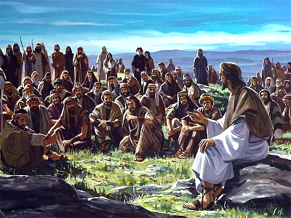
GOOD TIDINGS FOR THE WORLD
Isaiah 61:1-3
Robert Martin
Palm Beach Lakes church of Christ

Slide 2
Isaiah 61:1-3> 1 “The Spirit of the Lord God is upon Me, Because the Lord has anointed Me To preach good tidings to the poor; He has sent Me to heal the brokenhearted, To proclaim liberty to the captives, And the opening of the prison to those who are bound; 2 To proclaim the acceptable year of the Lord, And the day of vengeance of our God;
To comfort all who mourn, 3 To console those who mourn in Zion, To give them beauty for ashes, The oil of joy for mourning, The garment of praise for the spirit of heaviness; That they may be called trees of righteousness, The planting of the Lord, that He may be glorified.”

Slide 3
Luke 4:16-18> 16 So He came to Nazareth, where He had been brought up. And as His custom was, He went into the synagogue on the Sabbath day, and stood up to read. 17 And He was handed the book of the prophet Isaiah. And when He had opened the book, He found the place where it was written: 18 "The Spirit of the Lord is upon Me, Because He has anointed Me To preach the gospel to the poor; He has sent Me to heal the brokenhearted, To proclaim liberty to the captives And recovery of sight to the blind, To set at liberty those who are oppressed.

Slide 4
TO HEAL THE BROKEN- HEARTED (VERSE 1)

Slide 5
Psalm 147:3> 3 He heals the brokenhearted
And binds up their wounds.
Acts 28:27> 27 For the hearts of this people have grown dull. Their ears are hard of hearing, And their eyes they have closed, Lest they should see with their eyes and hear with their ears, Lest they should understand with their hearts and turn, So that I should heal them.

Slide 6
TO GIVE LIBERTY TO THOSE IN CAPTIVITY (VERSE 1)

Slide 7
John 8:31,32> 31 Then Jesus said to those Jews who believed Him, "If you abide in My word, you are My disciples indeed. 32 And you shall know the truth, and the truth shall make you free."
Galatians 5:1> 1 Stand fast therefore in the liberty by which Christ has made us free, and do not be entangled again with a yoke of bondage.

Slide 8
TO COMFORT THOSE WHO MOURN (VERSE 2)

Slide 9
2 Corinthians 1:3-5> 3 Blessed be the God and Father of our Lord Jesus Christ, the Father of mercies and God of all comfort, 4 who comforts us in all our tribulation, that we may be able to comfort those who are in any trouble, with the comfort with which we ourselves are comforted by God. 5 For as the sufferings of Christ abound in us, so our consolation also abounds through Christ.
1 Thessalonians 5:11> 11 Therefore comfort each other and edify one another, just as you also are doing.

Slide 10
TO GIVE THEM BEAUTY (VERSE 3)

Slide 11
Romans 10:15> 15 And how shall they preach unless they are sent? As it is written: "How beautiful are the feet of those who preach the gospel of peace, Who bring glad tidings of good things!"
2 Corinthians 5:17 > 17 Therefore, if anyone is in Christ, he is a new creation; old things have passed away; behold, all things have become new.

Slide 12
“To heal the sin sick soul”.
“To make the wounded whole”.

