Slide 1



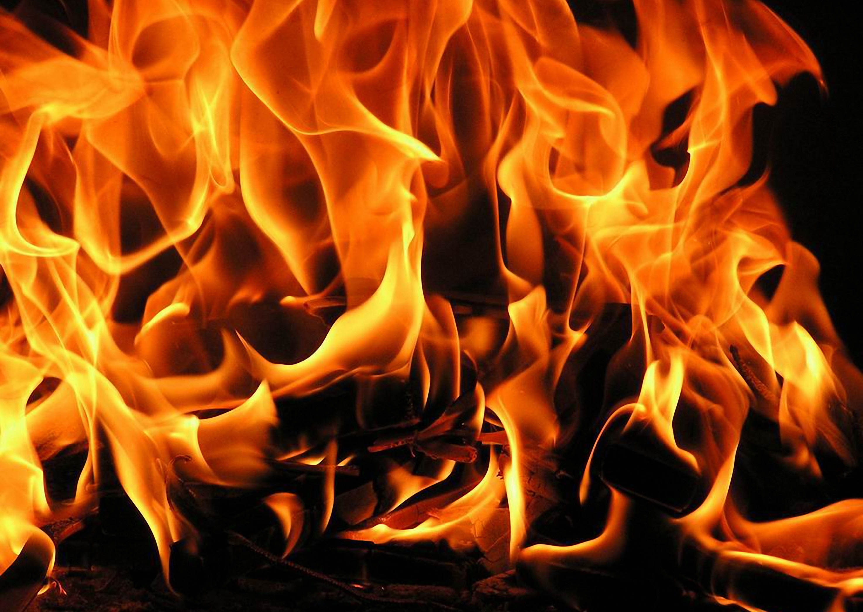
HEAVEN
A REAL PLACE
John 14:1-3; Rev. 22:1-5
AN ETERNAL PLACE
Eternal life (Matt. 19:29; 25:46; John 3:15-16; Rom. 6:23)
Eternal salvation (Heb. 5:9)
Eternal redemption (Heb. 9:12)
Eternal inheritance (Heb. 9:15)
RIGHT NOW
DEATH
You are on a path (right now!) to ONE of those two places (Matt. 7:13-14)
You can KNOW if you have ETERNAL LIFE
(1 John 5:13)
Believe on Jesus (John 3:15-16, 36)
Obey Him (John 3:36; Heb. 5:9)
Are freed from sin (Rom. 6:22)
Are righteous (Matt. 25:46; Rom. 5:21)
Keep believing (1 John 5:13)
Keep doing good (Rom. 2:7)
Keep fighting for Him (1 Tim. 6:12)
Live a holy life (Rom. 6:22)
Sacrifice self (Mark 10:29-30)
If you KNOW you do NOT have eternal life, THEN you KNOW you have ETERNAL DAMNATION (Eph. 5:5; Ro. 2:2; 2 Th. 1:8-9)
CAN COME TO ANYONE
Old age (Gen. 47:28)
Disease (2 Kgs. 13:14)
Accident (Acts 20:9)
Children (2 Sam. 12:18)
CAN COME AT ANY TIME
Jas. 4:14; Psa. 90:6;
Job 14:2
WILL COME TO EVERYONE
Heb. 9:27; 1 Cor. 15:22; Ecc. 9:5
DEATH IS SEPARATION
Jas. 2:26; Ecc. 12:7
, if you…
HELL
A REAL PLACE
Matt. 10:28; Mark 9:43-48
AN ETERNAL PLACE
Eternal fire (Mt. 25:41; Jude 7)
Eternal punishment (Mt. 25:46)
Eternal torment (Rev. 14:11)
Eternal destruction (2 Th. 1:9)
Eternal judgment (Heb. 6:2)
Eternal chains (Jude 6)

