Slide 2
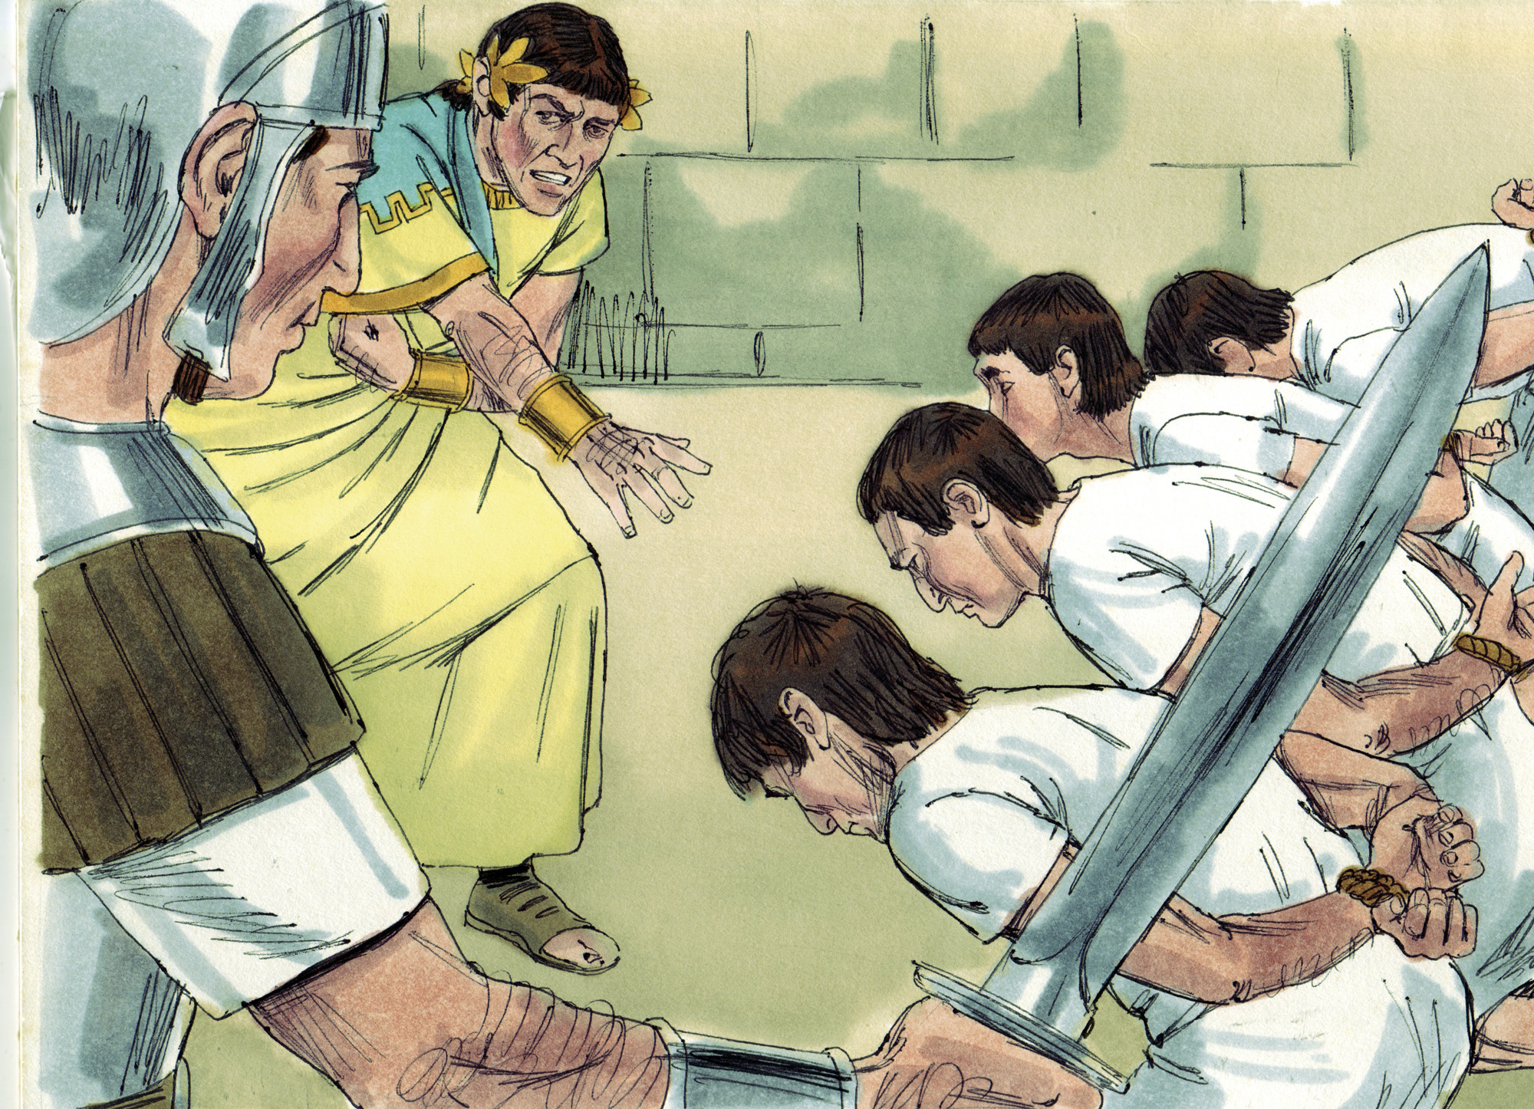

Slide 3
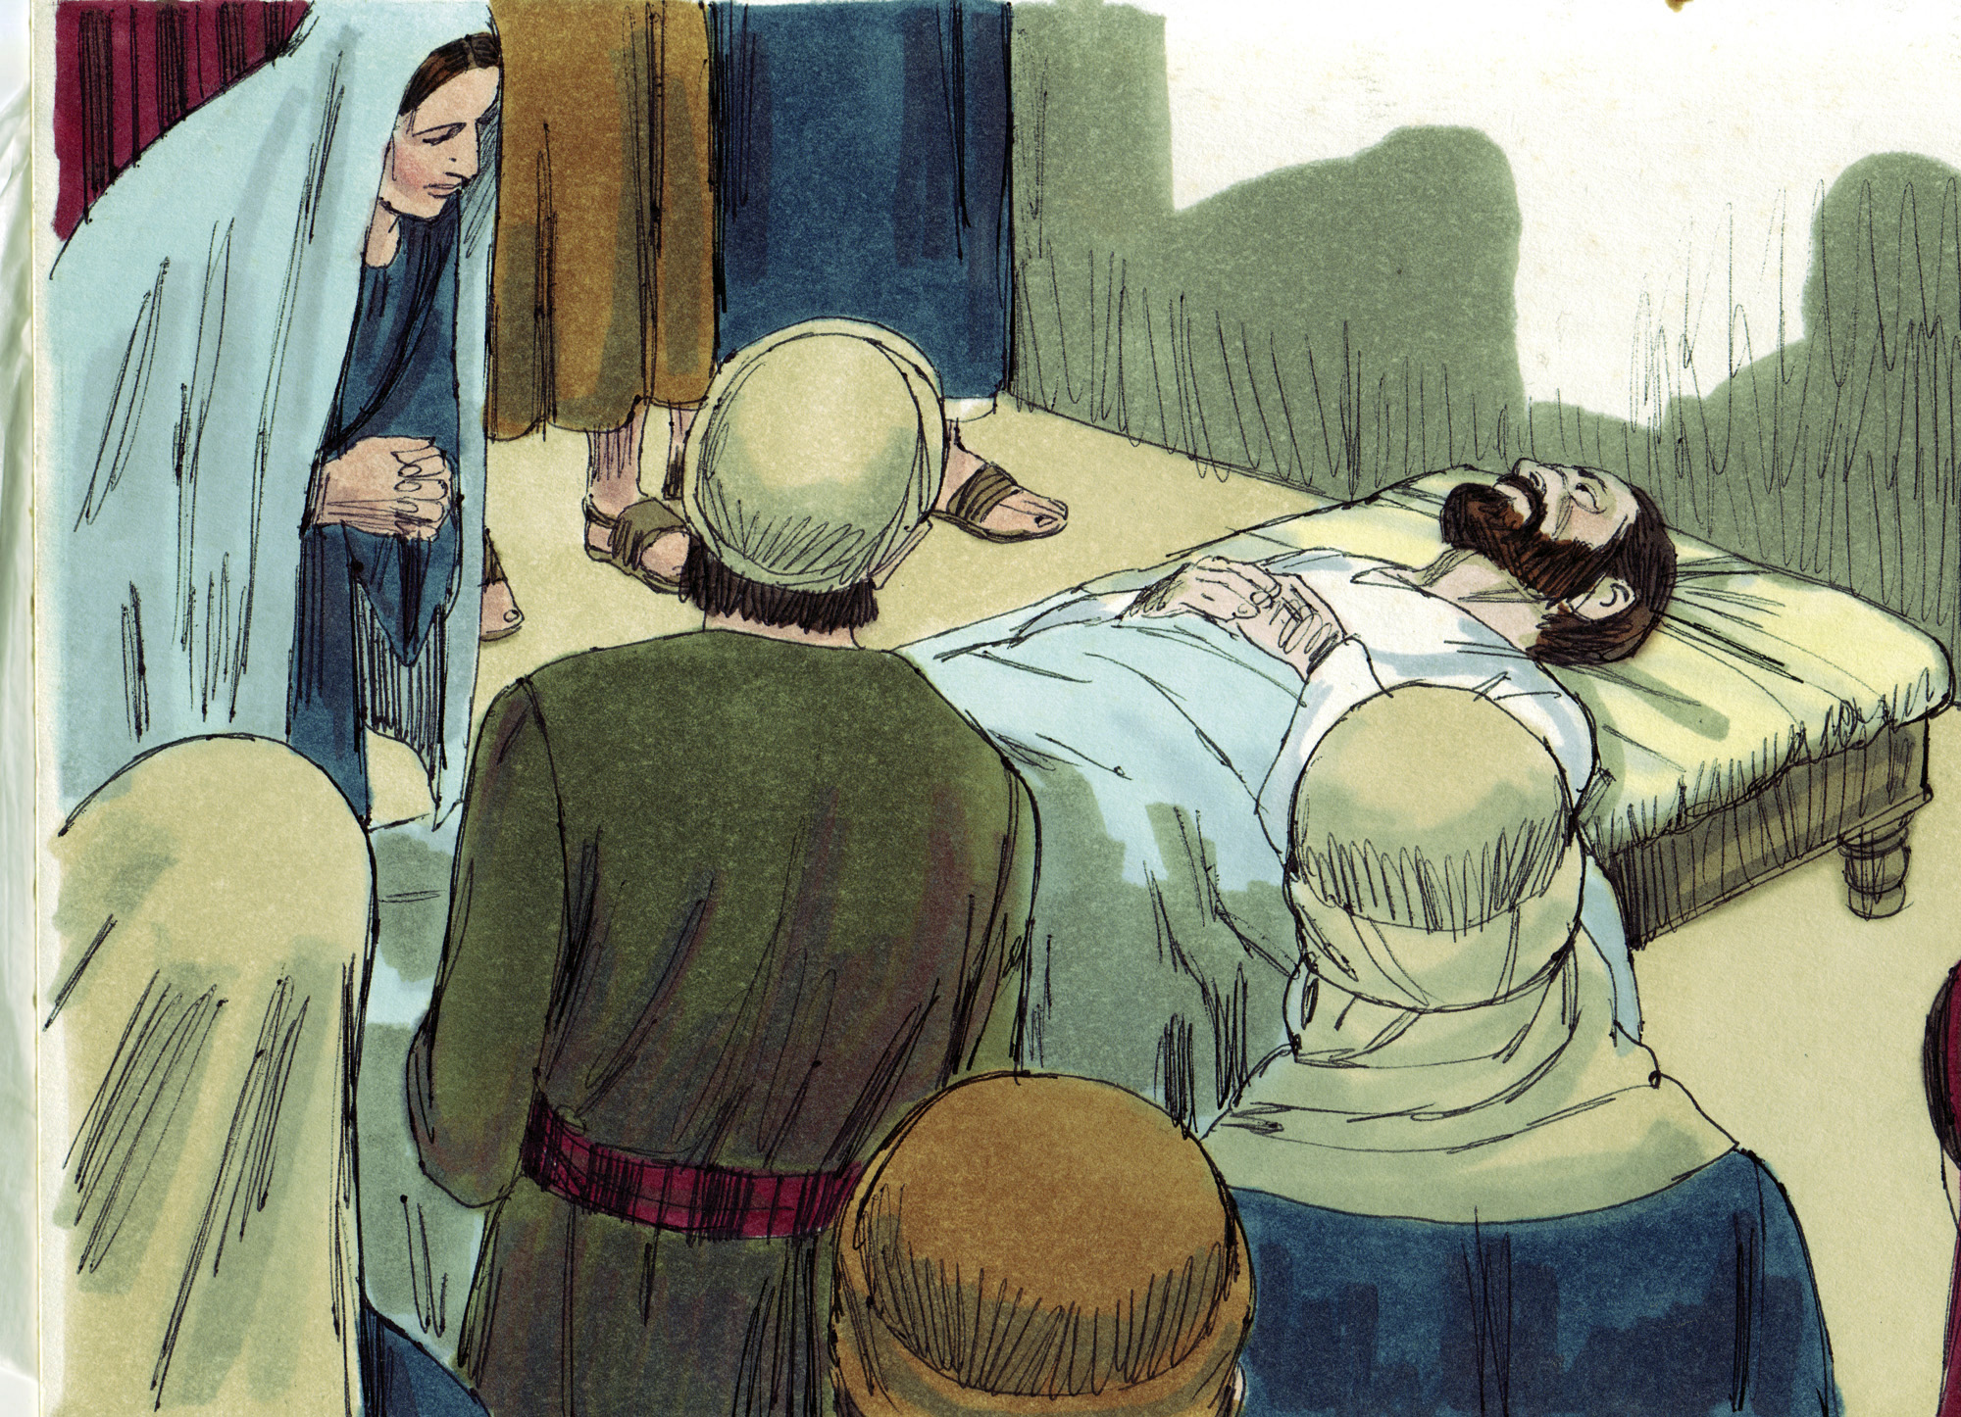

Slide 4
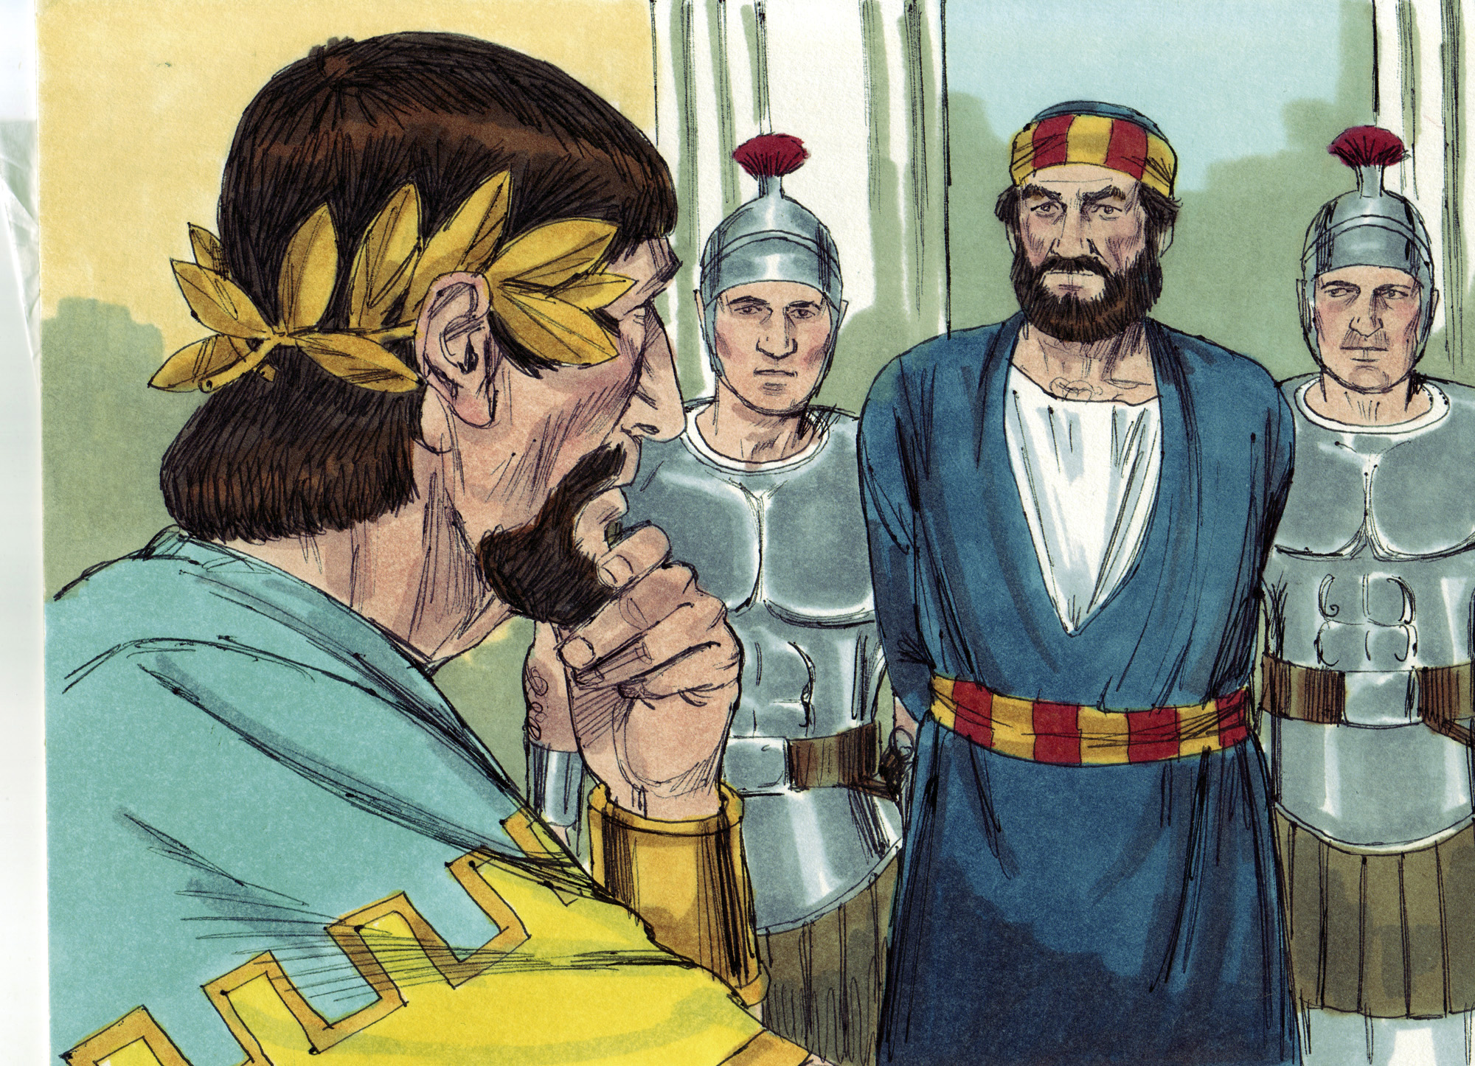

Slide 6
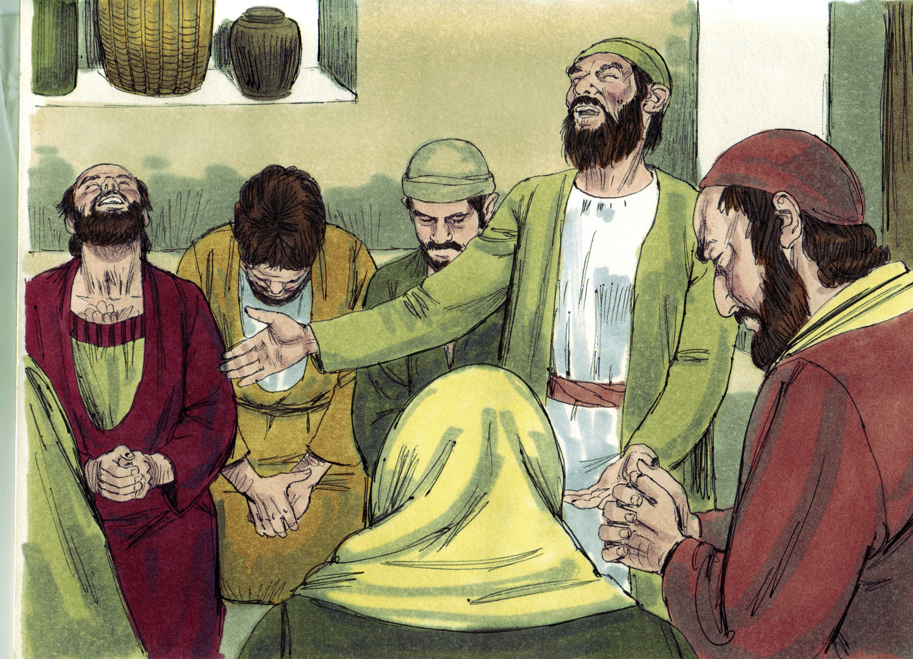

Slide 7
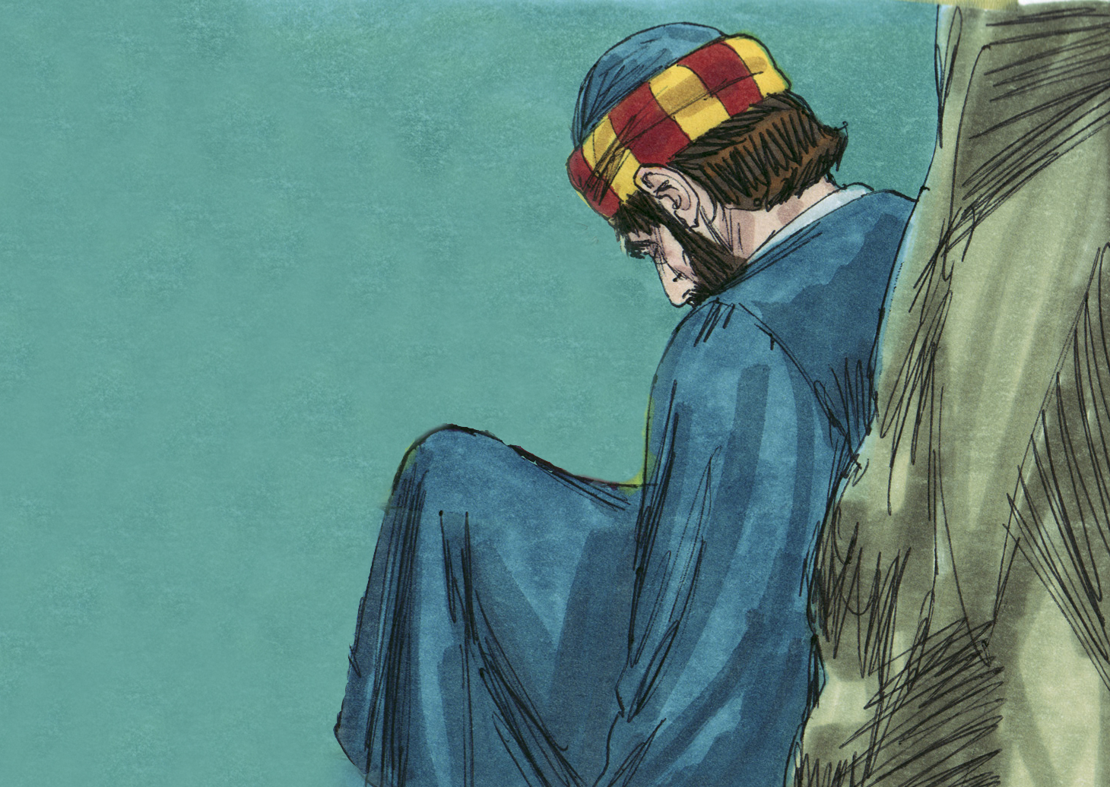

Slide 8
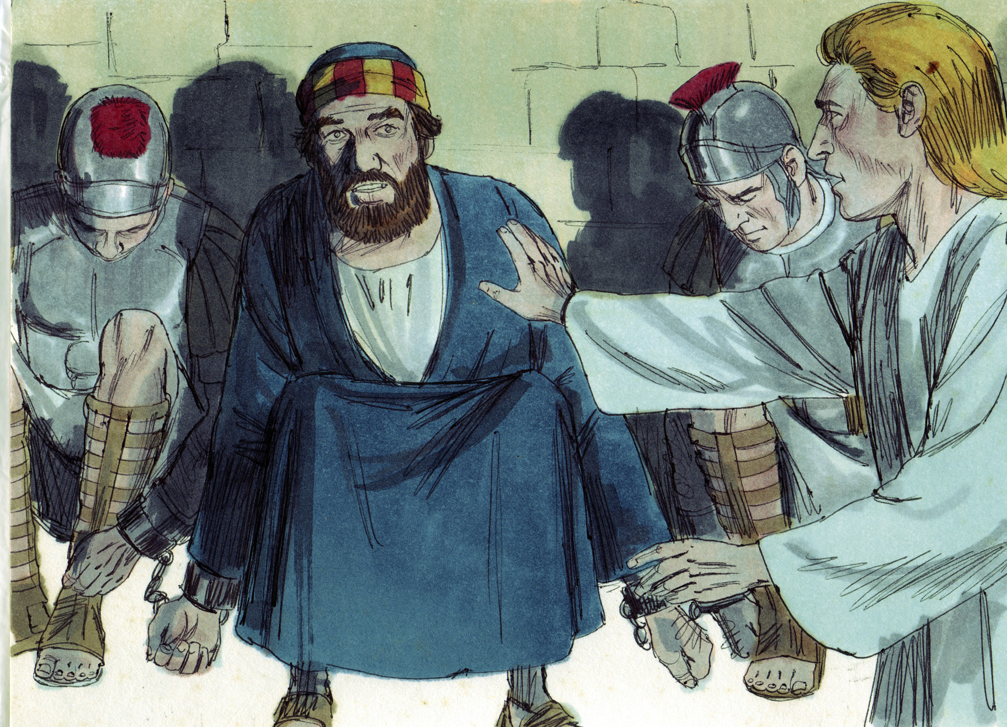

Slide 9
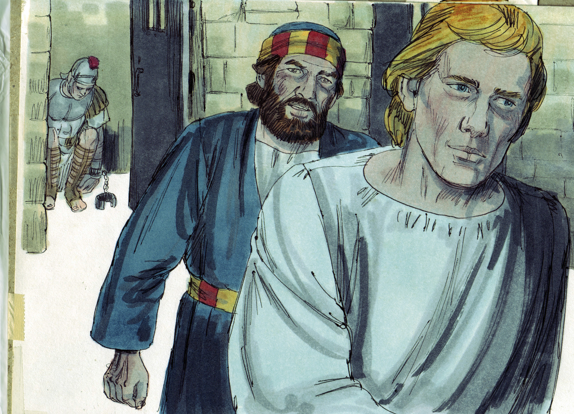

Slide 10
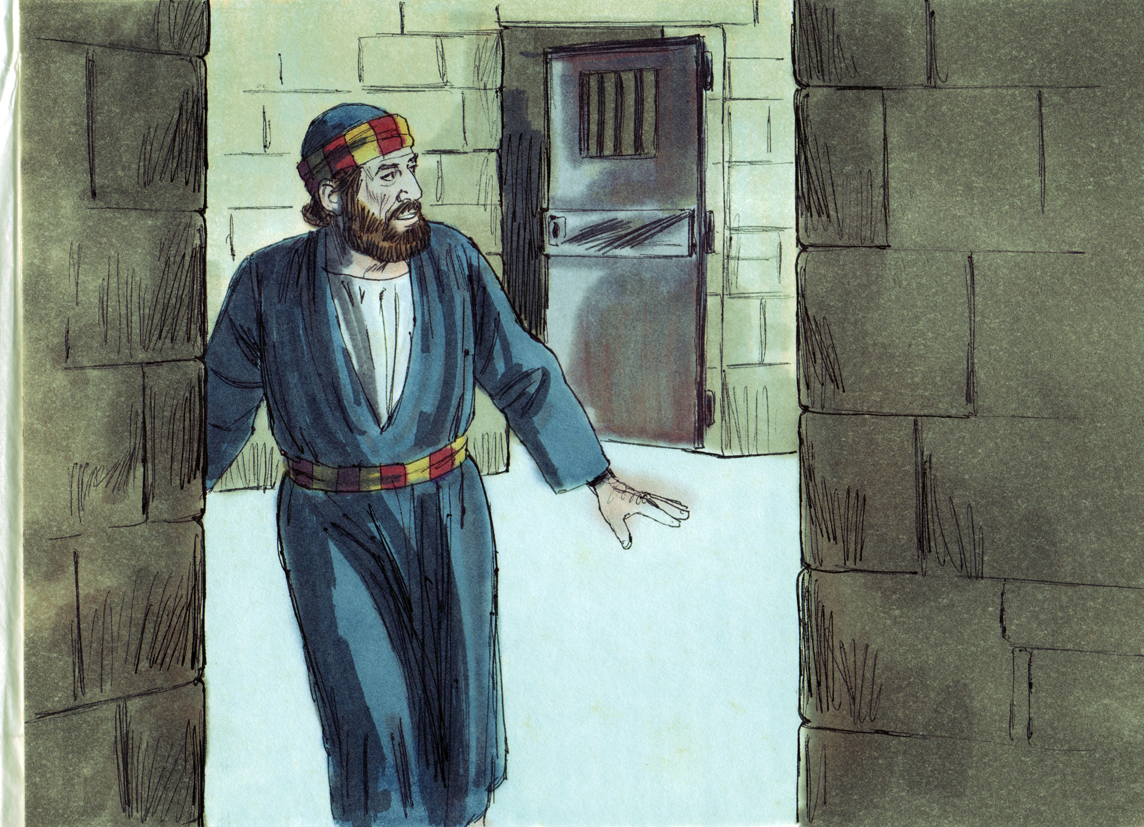

Slide 11
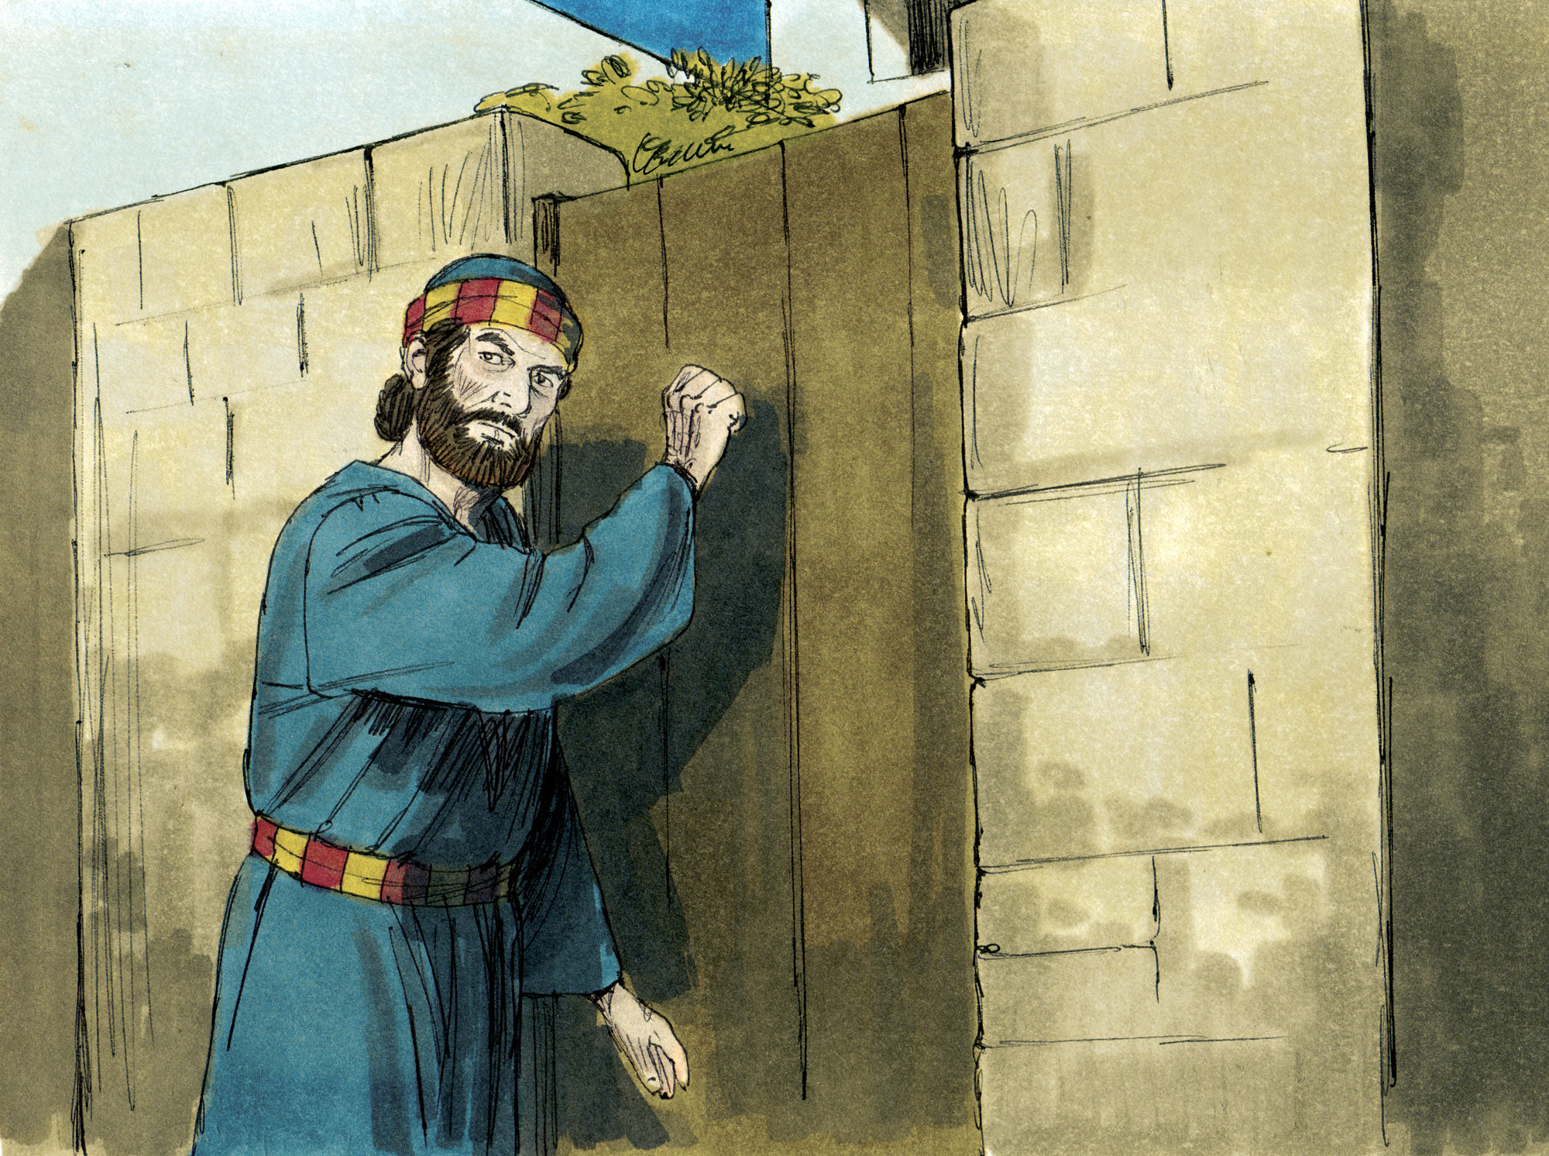

Slide 12
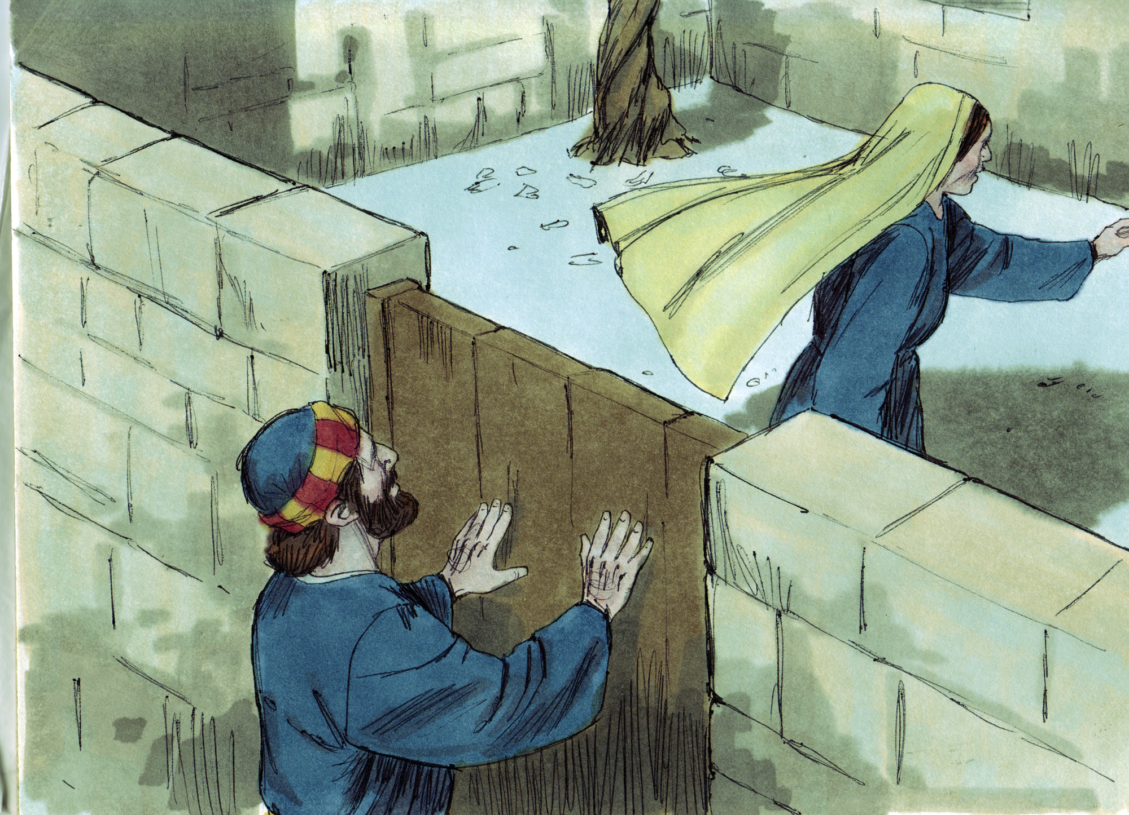

Slide 14
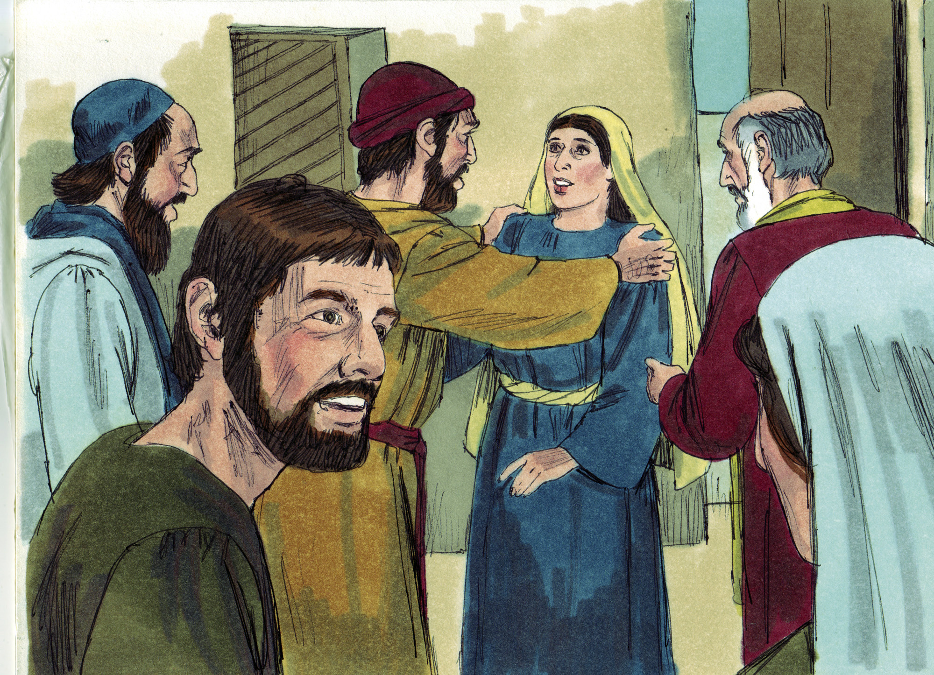

Slide 16
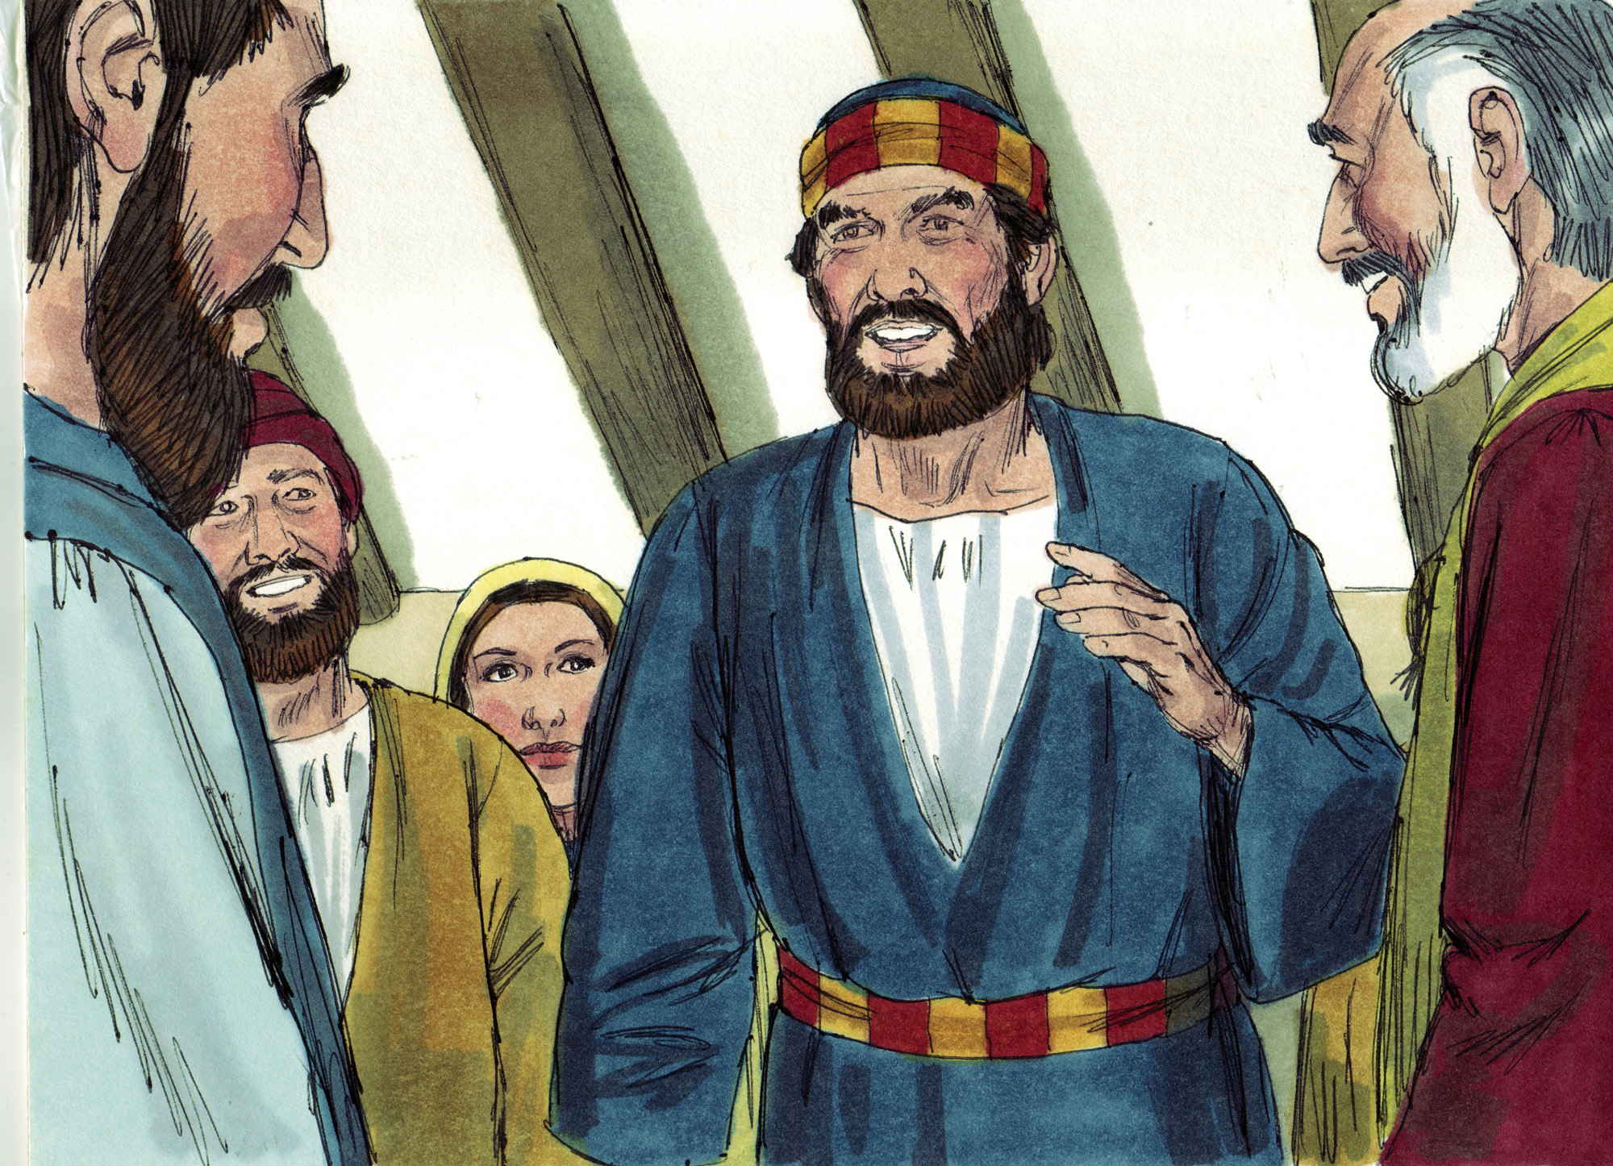

Slide 18
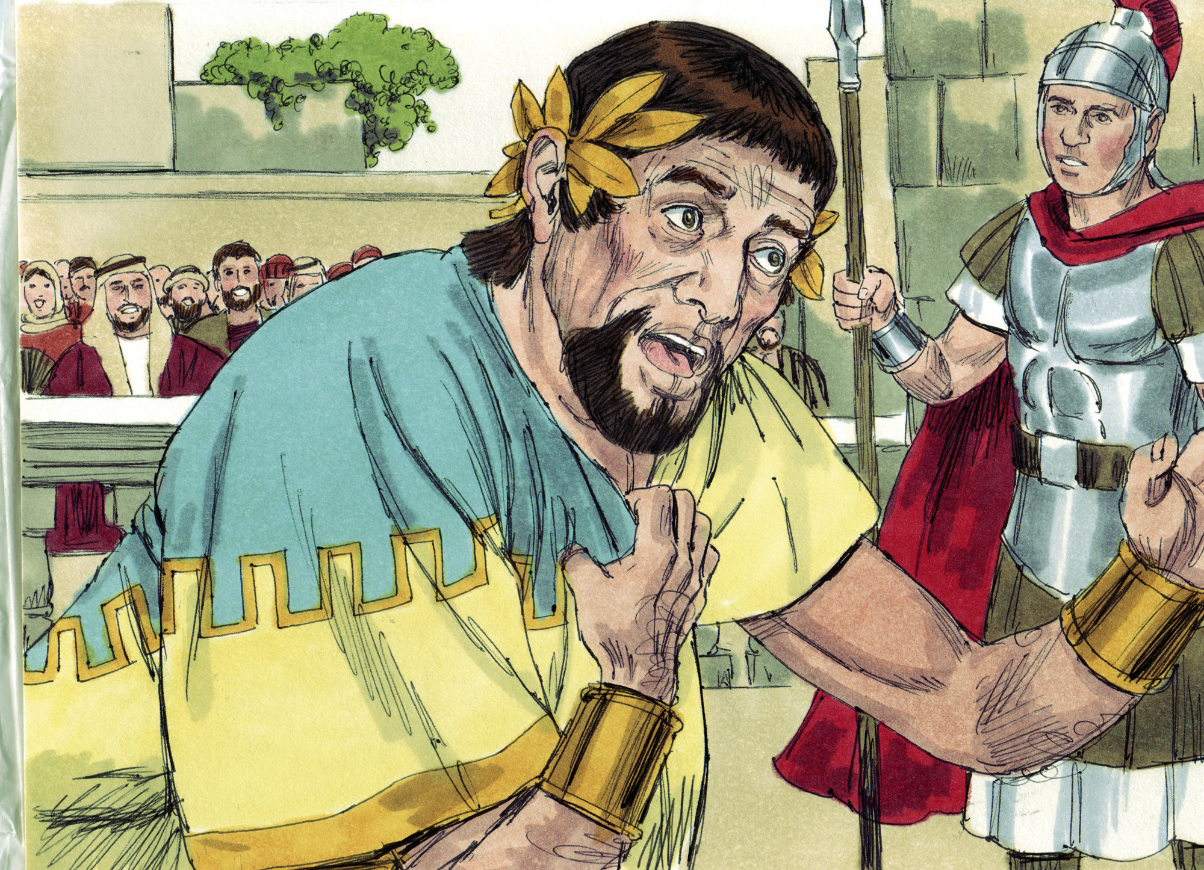

Slide 19
A Lesson About Prayer
The early church believed in prayer (Acts 2:42; 4:31; 13:3; 14:23; 20:36; 21:5)
The church had a prayer meeting…with many members…in the middle of night…at a member’s home…engaging in constant prayer (12:5, 12; Jas. 5:16; Phil. 4:6)
Peter knew where to go in the middle of the night (Rom. 15:7; 12:13b; 3 John 5-8)
Our homes influence our children (12:12+13:5+2 Tim. 4:11; cf. Matt. 21:13)
We must do more than pray! We must believe in the power of prayer (12:14-16; cf. 1 John 3:22; John 15:7; Eph. 3:20-21)!
The church that prays together grows together (12:24)

Slide 20
A Lesson About Peace
Peter was at complete peace in his relationship with God (12:6)
Impending death did not rattle his faith (Psa. 23:4; 2 Tim. 4:17; Phil. 1:21-23)
Horrible circumstances did not rob his peace (Col. 3:15; Prov. 14:26)
Trusting God implicitly leads to a lifetime of peace (Phil. 4:4-7; Rom. 5:1)
Sometimes the reality of God’s blessings are too good to be true (12:9-11; John 10:10; Eph. 1:3; 2 Pet. 1:11)

Slide 21
A Lesson About Providence
God took care of Peter, because He takes care of His people (12:17, 11; cf. 1 Pet. 3:12; Eph. 3:20-21; Rom. 8:28; Isa. 41:10; Heb. 13:5-6)
God took care of the church, because He takes care of His church (12:1+24; cf. Matt. 16:18b; Rev. 3:11-12)
God “took care” of Herod, because He “takes care” of His enemies (12:1-4+23; cf. Gal. 6:7; 2 Pet. 2:9; Jer. 20:11; 17:18; Psa. 25:2)

Slide 22
Believe Jesus is God’s Son – John 8:24
Repent of your sins and turn to God – 2 Peter 3:9
Confess your faith in Jesus Christ – Matthew 16:16
Be immersed into Christ – Mark 16:16
God will forgive all of your sins – Acts 2:38
God will add you to His church – Acts 2:47
God will register you in heaven – Hebrews 12:23
Serve Him faithfully – 1 Corinthians 15:58

