Slide 1
Open Doors to Help Others
Acts 11:26-30

Slide 2
Text—Acts 11:26-30 Open Doors to Help Others
26 And when he had found him, he brought him to Antioch. So it was that for a whole year they assembled with the church and taught a great many people. And the disciples were first called Christians in Antioch.
27 And in these days prophets came from Jerusalem to Antioch.
28 Then one of them, named Agabus, stood up and showed by the Spirit that there was going to be a great famine throughout all the world, which also happened in the days of Claudius Caesar.
29 Then the disciples, each according to his ability, determined to send relief to the brethren dwelling in Judea.
30 This they also did, and sent it to the elders by the hands of Barnabas and Saul.
Acts 11:26-30
25 But now I am going to Jerusalem to minister to the saints.
26 For it pleased those from Macedonia and Achaia to make a certain contribution for the poor among the saints who are in Jerusalem.
27 It pleased them indeed, and they are their debtors. For if the Gentiles have been partakers of their spiritual things, their duty is also to minister to them in material things.
Rom. 15:25-27

Slide 3
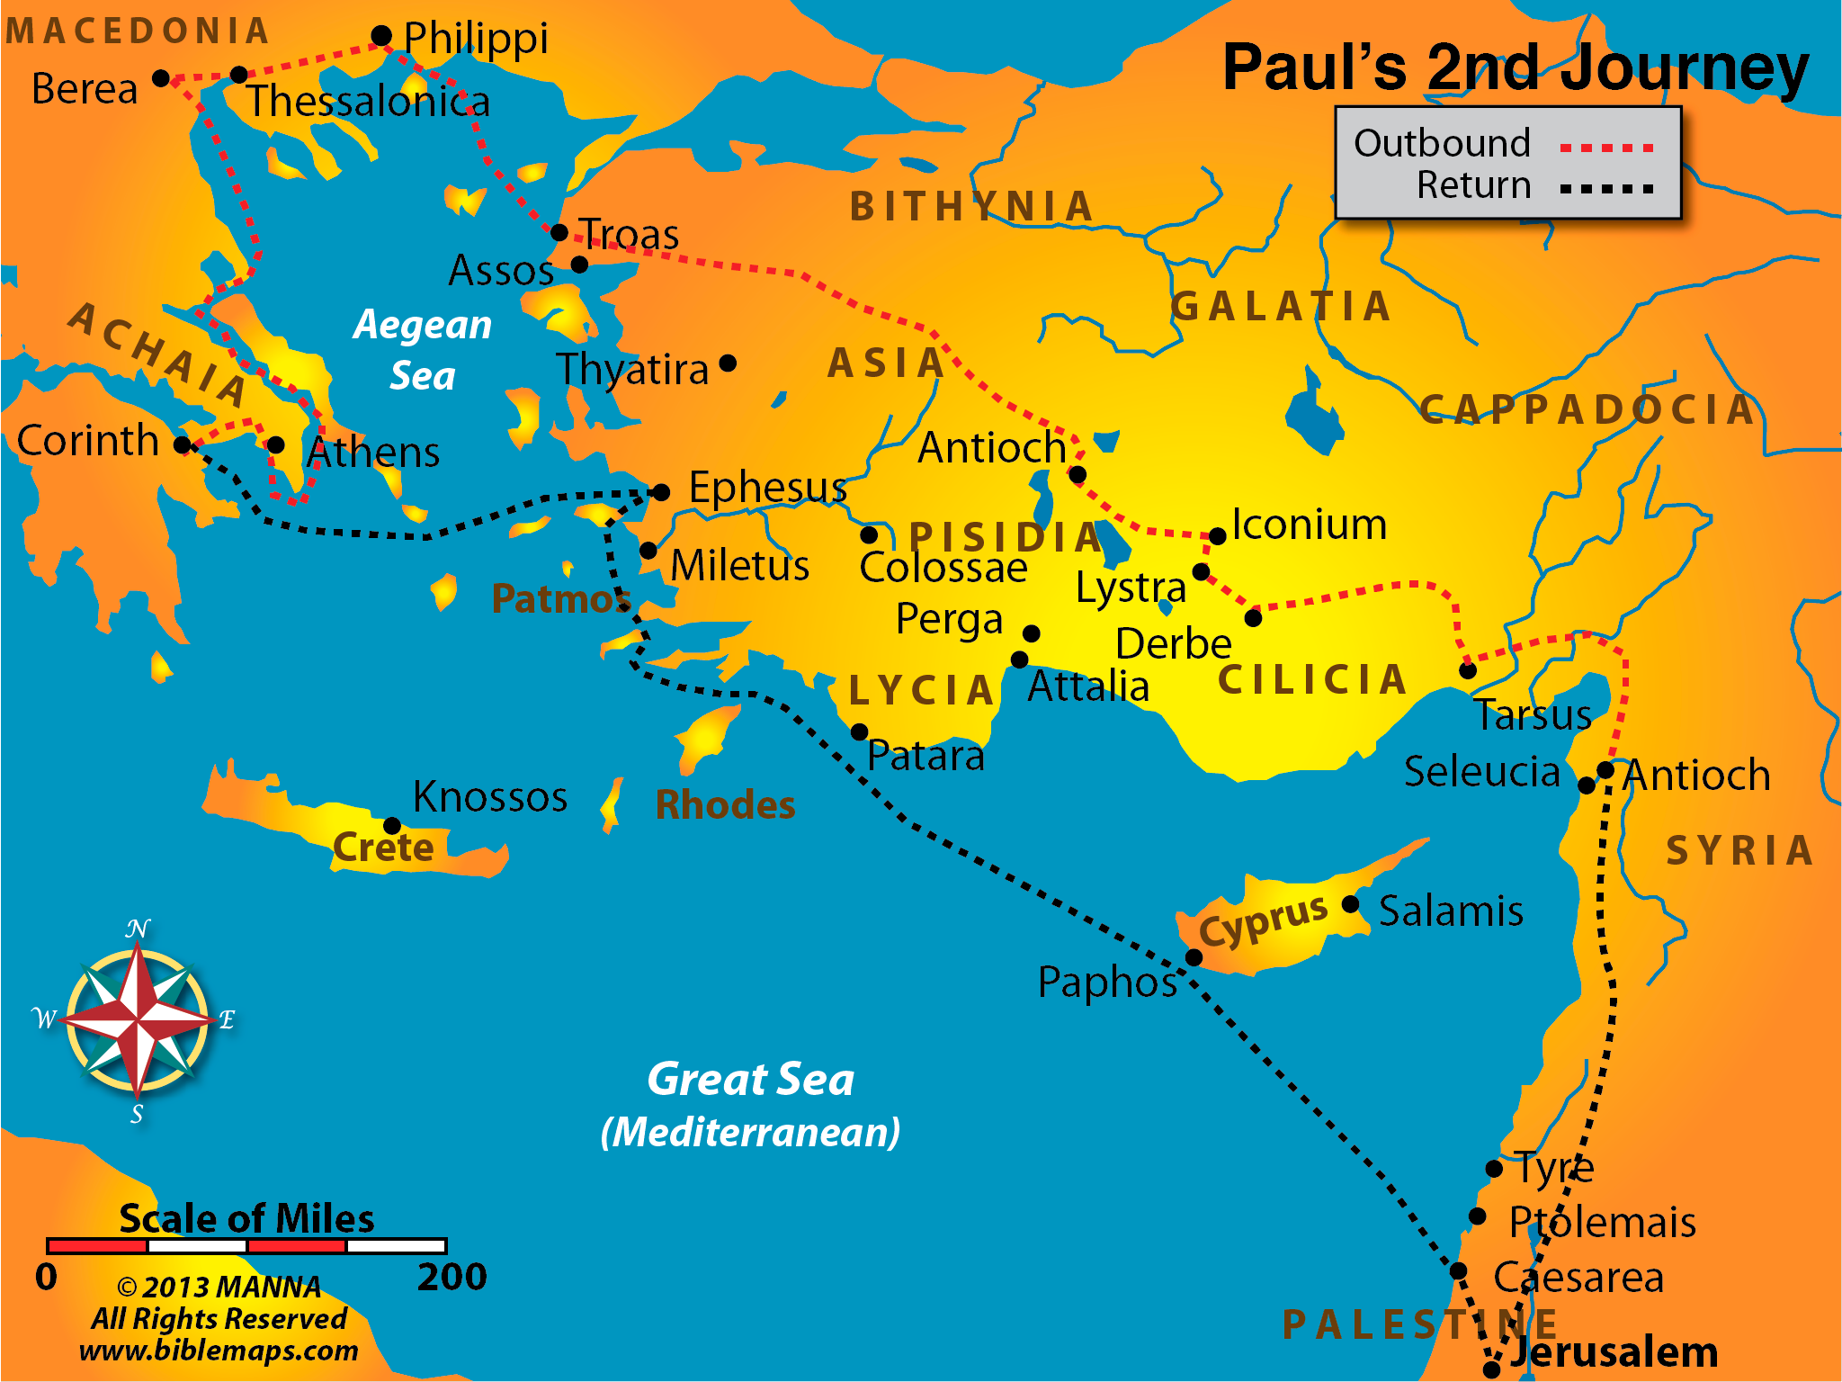

Slide 4
Open Doors to Helping Others The Churches of Galatia
9 and when James, Cephas, and John, who seemed to be pillars, perceived the grace that had been given to me, they gave me and Barnabas the right hand of fellowship, that we should go to the Gentiles and they to the circumcised.
10 They desired only that we should remember the poor, the very thing which I also was eager to do.
Gal. 2:9-10
9 And let us not grow weary while doing good, for in due season we shall reap if we do not lose heart.
10 Therefore, as we have opportunity, let us do good to all, especially to those who are of the household of faith.
Gal. 6:9-10

Slide 6
The Churches of Macedonia
1 Moreover, brethren, we make known to you the grace of God bestowed on the churches of Macedonia:
2 that in a great trial of affliction the abundance of their joy and their deep poverty abounded in the riches of their liberality.
3 For I bear witness that according to their ability, yes, and beyond their ability, they were freely willing,
4 imploring us with much urgency that we would receive the gift and the fellowship of the ministering to the saints.
5 And not only as we had hoped, but they first gave themselves to the Lord, and then to us by the will of God.
2 Cor. 8:1-5

Slide 8
The Churches of Achaia--Corinth
1 Now concerning the ministering to the saints, it is superfluous for me to write to you;
2 for I know your willingness, about which I boast of you to the Macedonians, that Achaia was ready a year ago; and your zeal has stirred up the majority.
3 Yet I have sent the brethren, lest our boasting of you should be in vain in this respect, that, as I said, you may be ready;
4 lest if some Macedonians come with me and find you unprepared, we (not to mention you!) should be ashamed of this confident boasting.
5 Therefore I thought it necessary to exhort the brethren to go to you ahead of time, and prepare your generous gift beforehand, which you had previously promised, that it may be ready as a matter of generosity and not as a grudging obligation.
2 Cor. 9:5

Slide 9
Lessons to be Learned & Applied
Brethren need to help others
Everyone has an ability, do not underestimate yourself
Opportunities arise from unusual circumstances
When opportunities arise, serve in whatever way you can
It all starts with us first giving ourselves to the Lord
We can be examples to encourage others
Others are helping and the Lord needs your help for a long time
Palm Beach Lakes—letting God use us
And it starts today—baskets, important meeting & loading trucks

Slide 10
Purchasers of supplies
Interface with other churches about sending supplies and money
Organizers of supplies – Food, water, building materials, medical, baby supplies and whatever our brethren ask
Administration of family room, many workers in the family room
Preparing supplies to be shipped
Delivery of supplies to shipper
Advertising – Facebook and webpage
Interface with individuals and congregations
Record keepers – finances (book-keepers), contributors, workers in Bahamas
Reports to members at Palm Beach Lakes
Workers to go to the Bahamas—carpenters, tradesmen, “distributors"
Temporary housing of displaced Bahamians
Counselling help, legal help, transportation help for displaced people
Trip planners to Bahamas

Slide 11
Becoming a Leader for Christ
Believe John 8:24
Repent Acts 17:30
Confess Faith in Him Rom. 10:9
Be Baptized Into Him Rom. 6:3-4
Added to His Church, His Kingdom, His Family, His One Body
Be Faithful Rev. 2:10

