Slide 2
The Human Composition of the Lord’s Church
Those Once Lost, Now Saved in Christ (2:1-10)
Those Once Estranged, Now Reconciled in One Body (2:11-22)

Slide 3
Reflection: Every Christian Has a Past Before Christ & Before His Church

Slide 4
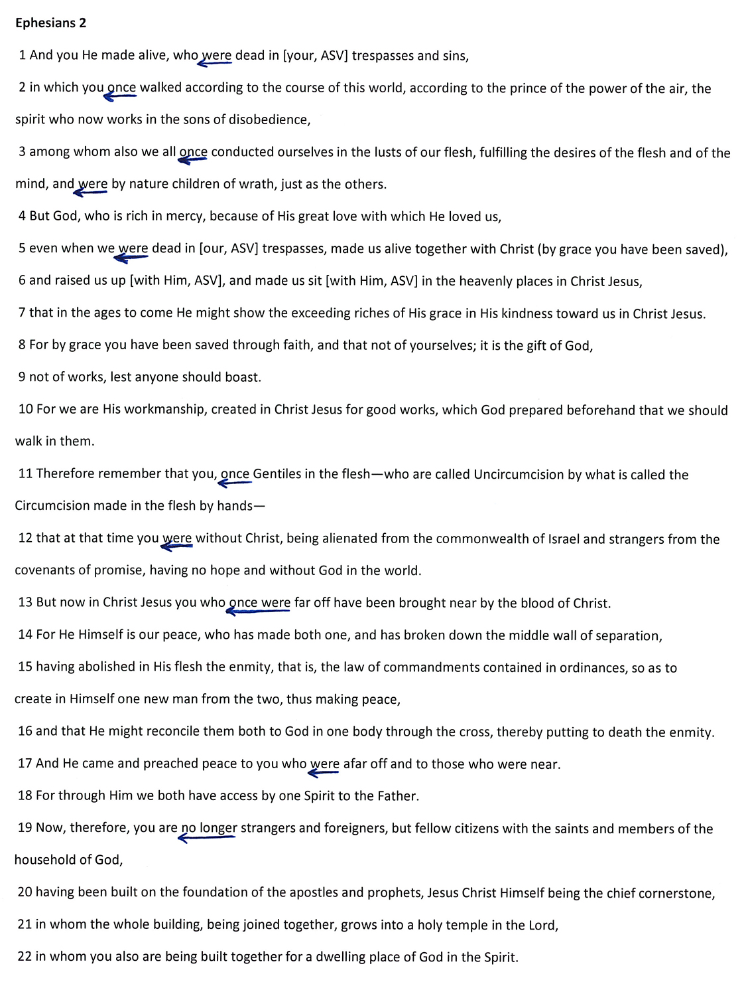

Slide 5
Separation: Life Before Christ & Before His Church Was Dark & Doomed

Slide 6
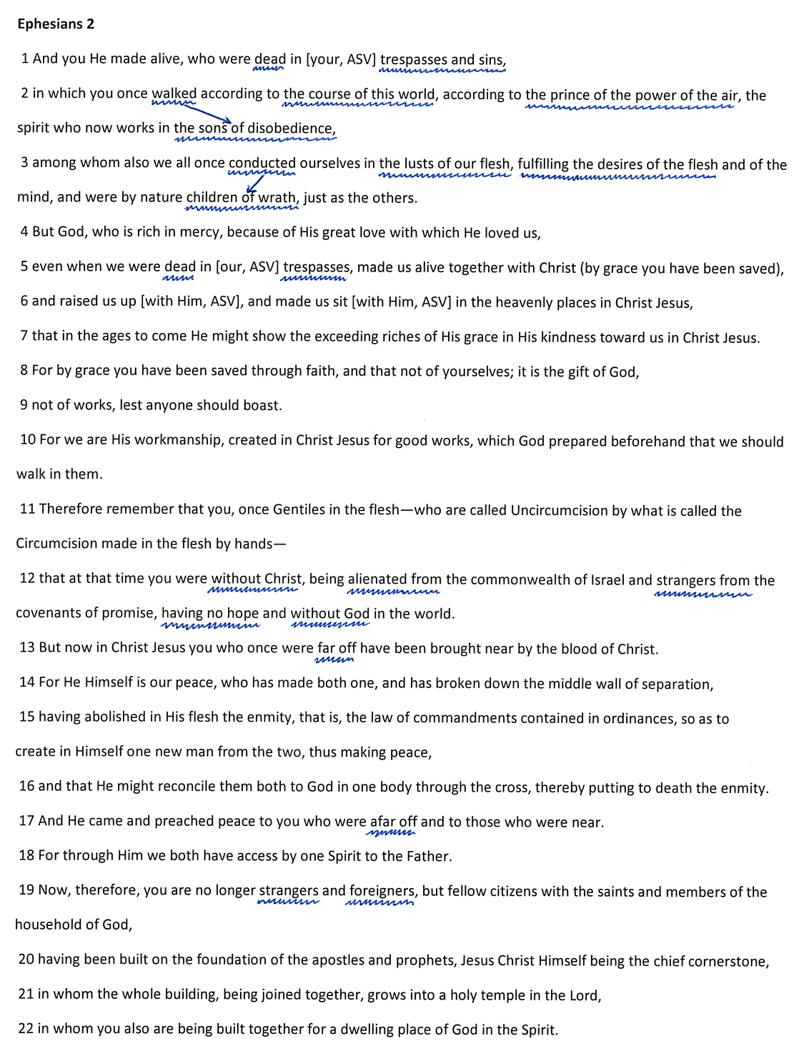

Slide 7
Transition: One’s Past Does Not Have to Remain His Present or His Future

Slide 8
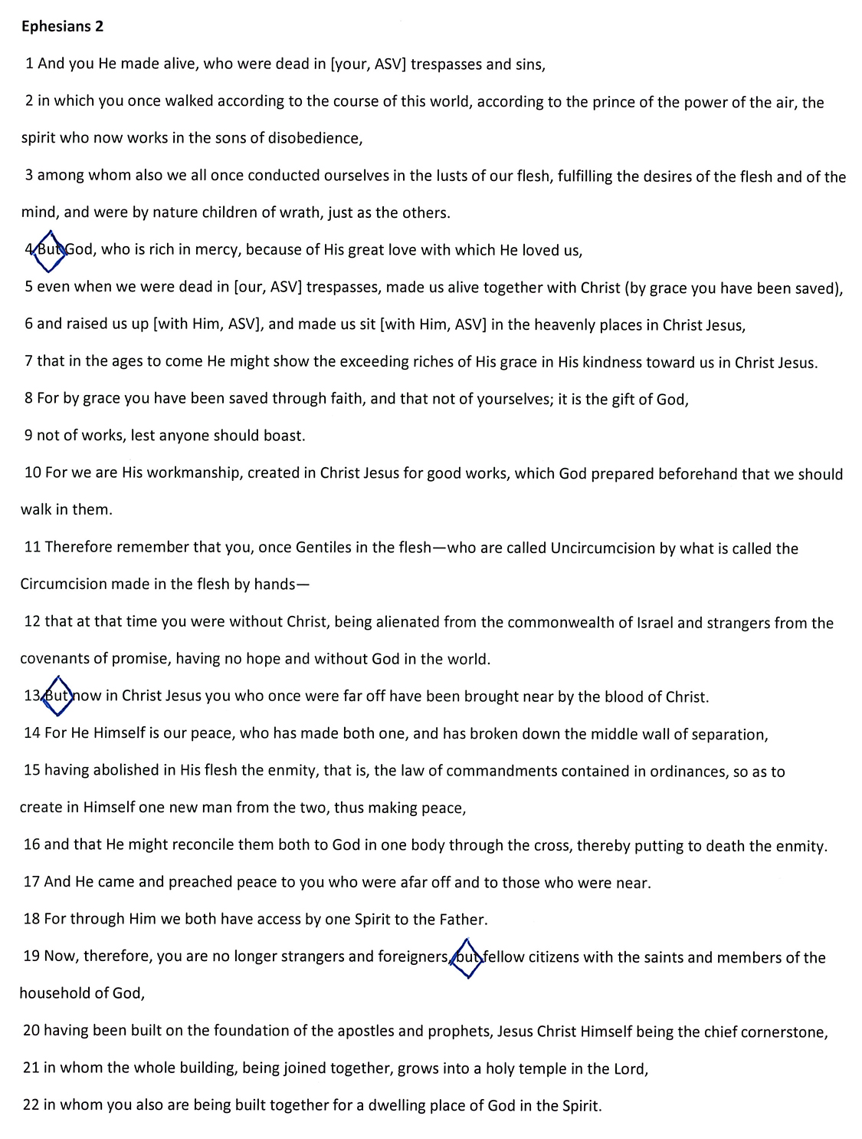

Slide 9
Intervention: Only Because of God & Christ Can Our Past Be Overcome

Slide 10
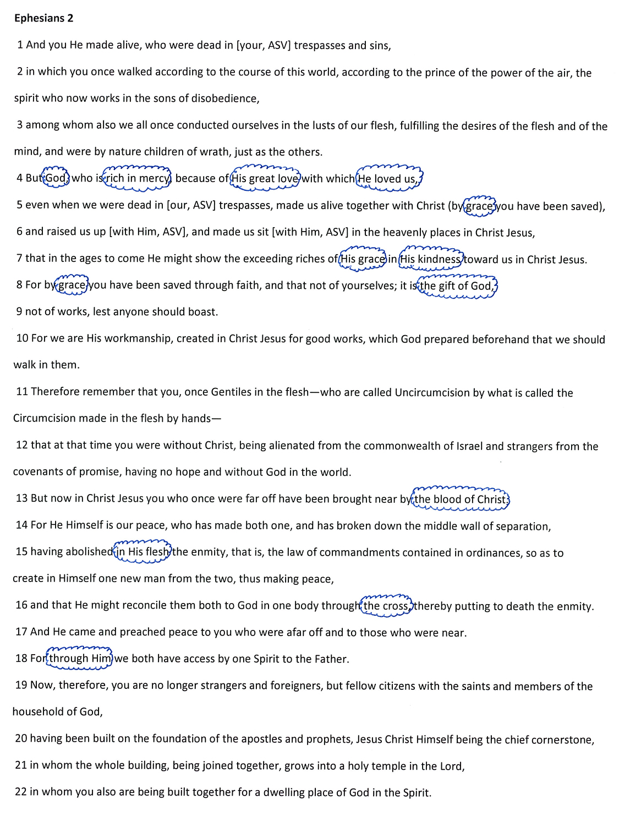

Slide 11
Relocation: To Overcome One’s Past and Secure God’s Gift, One Must Change Where He Is

Slide 12
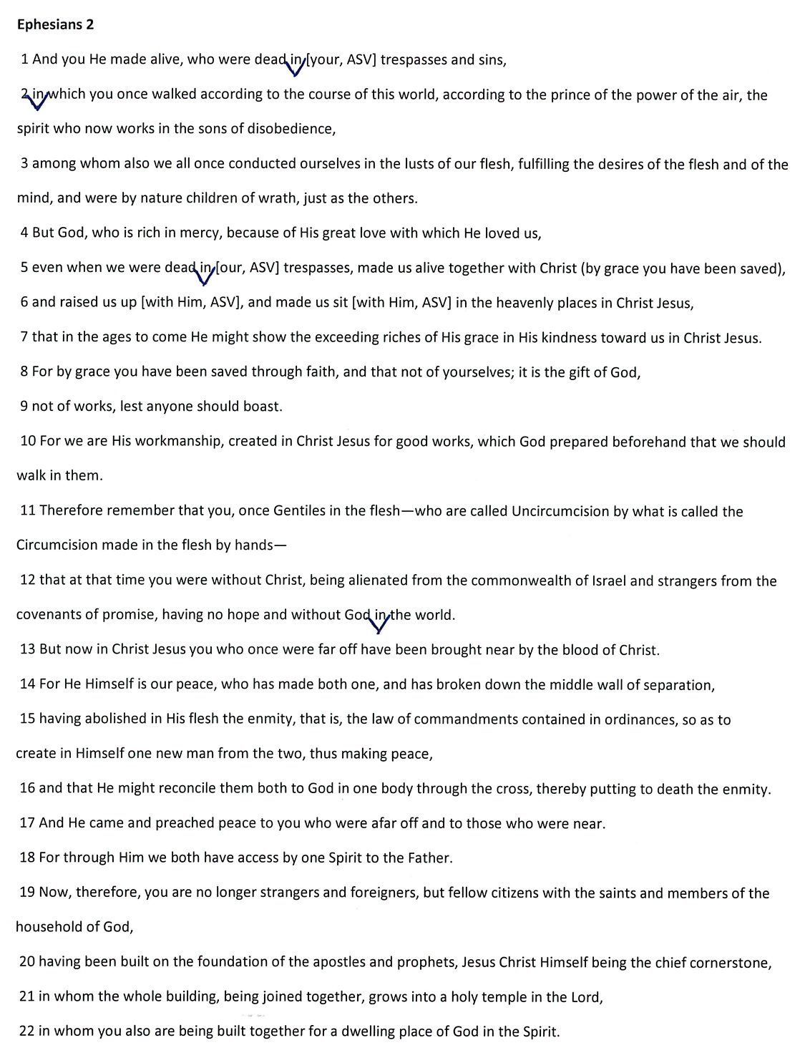

Slide 13
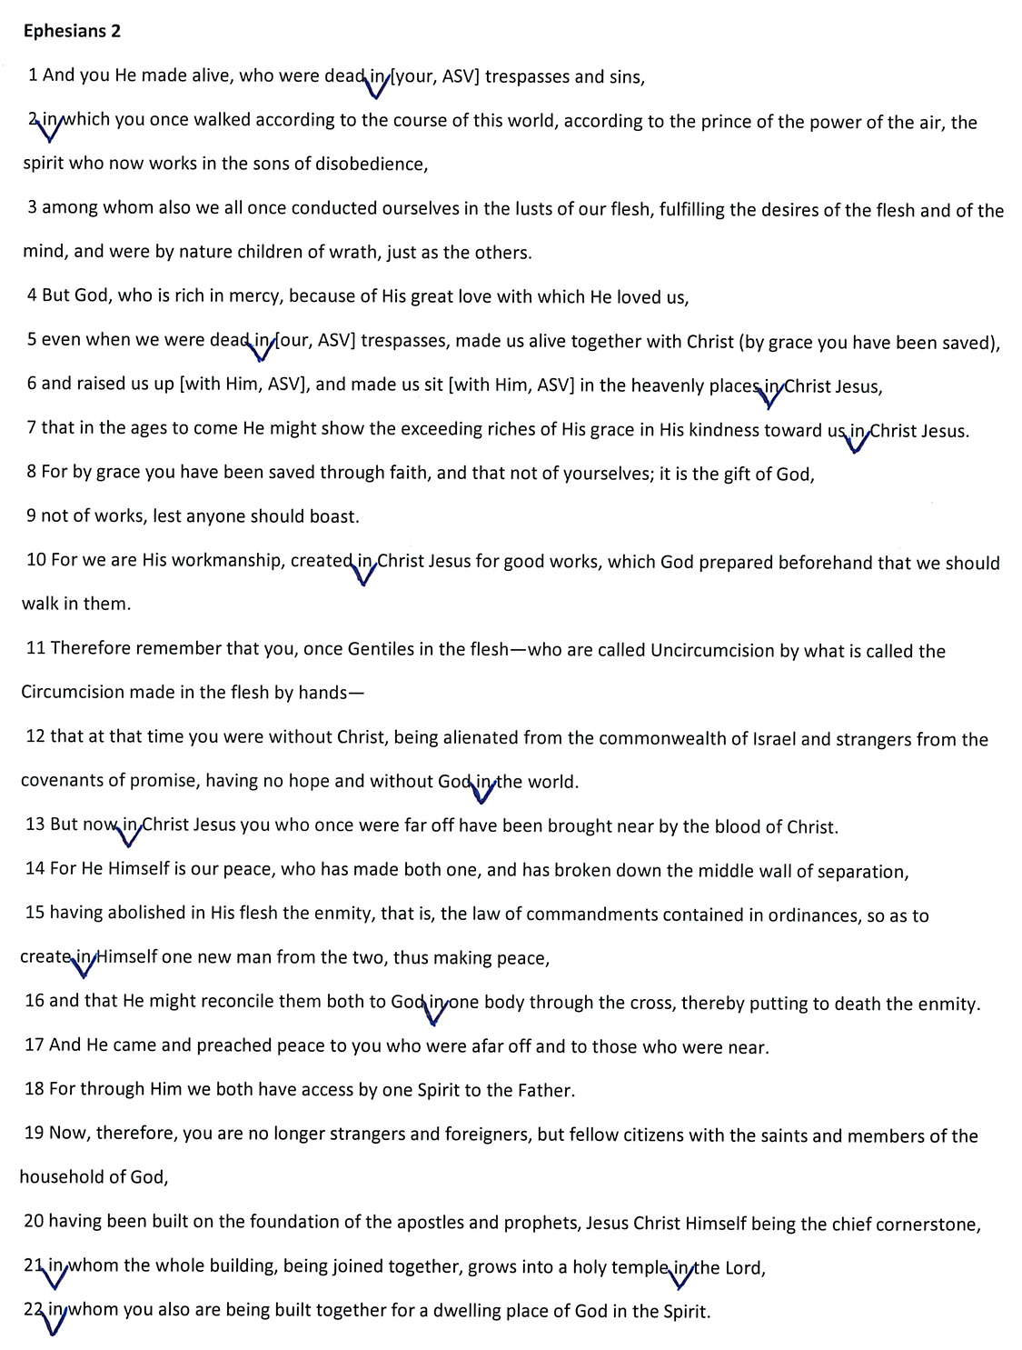

Slide 14
Celebration: When By God’s Grace One Enters into Christ, He Finds All Spiritual Blessings

Slide 15
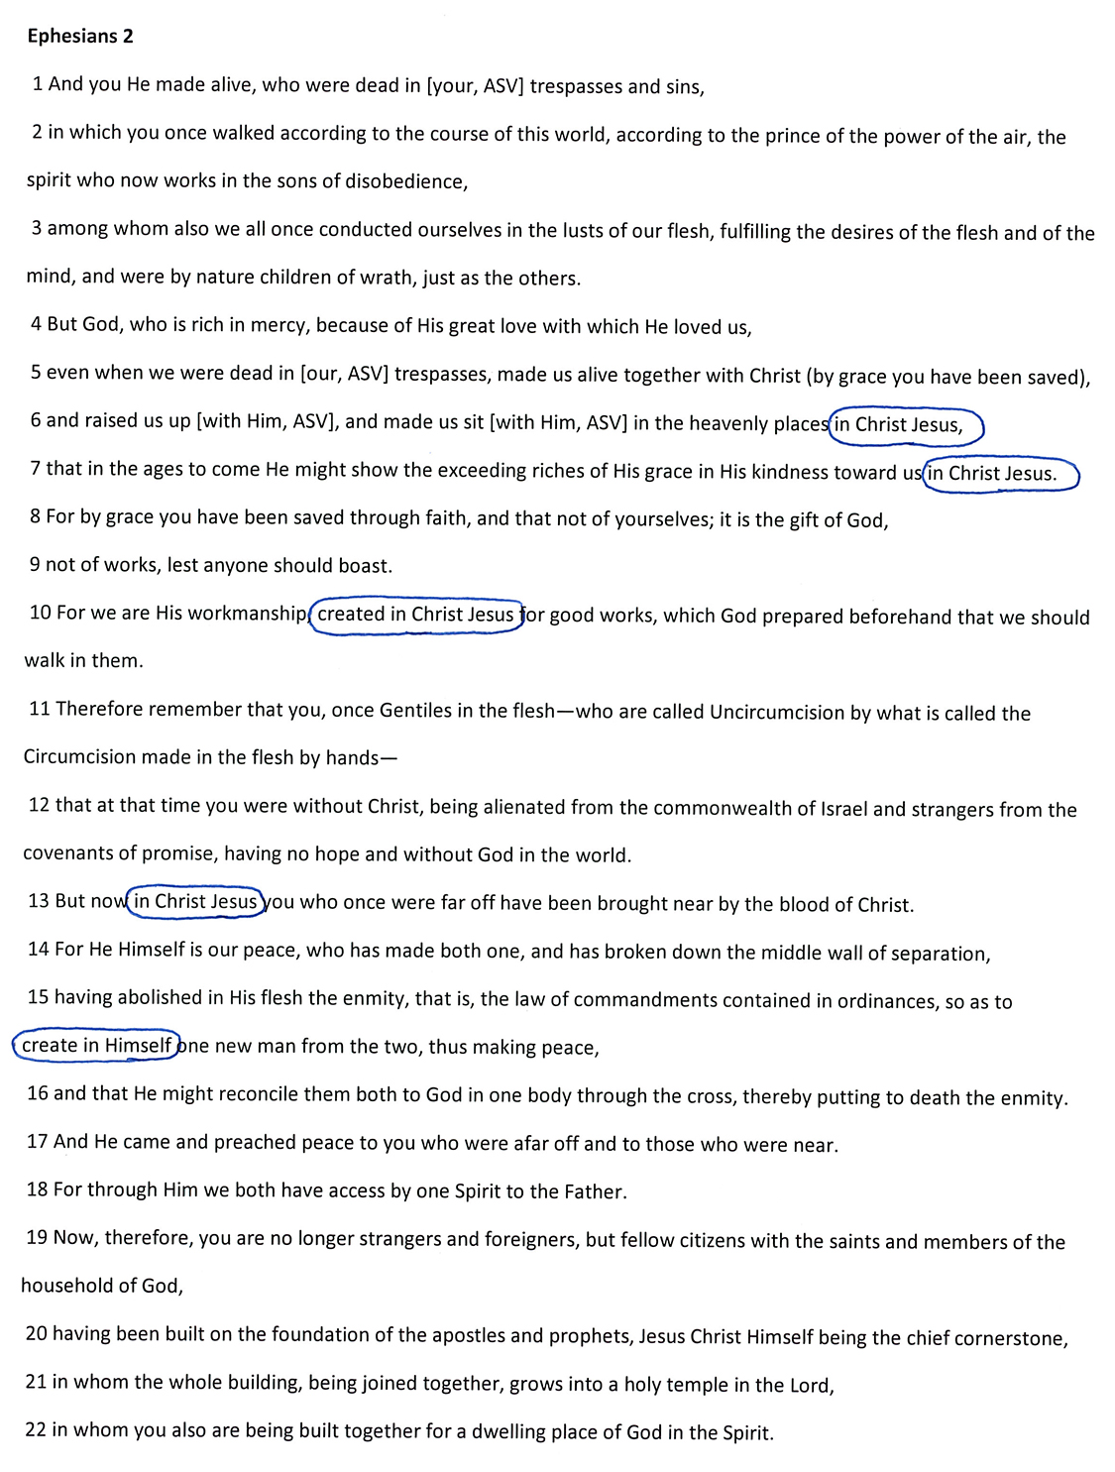

Slide 16
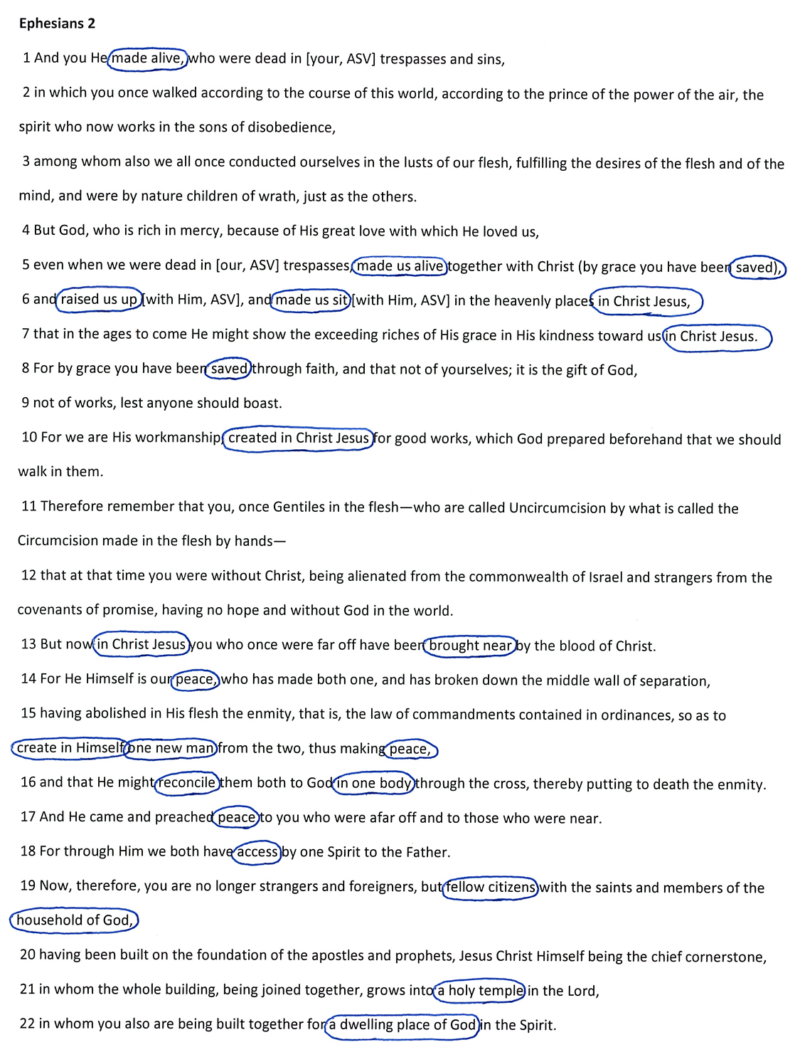

Slide 17
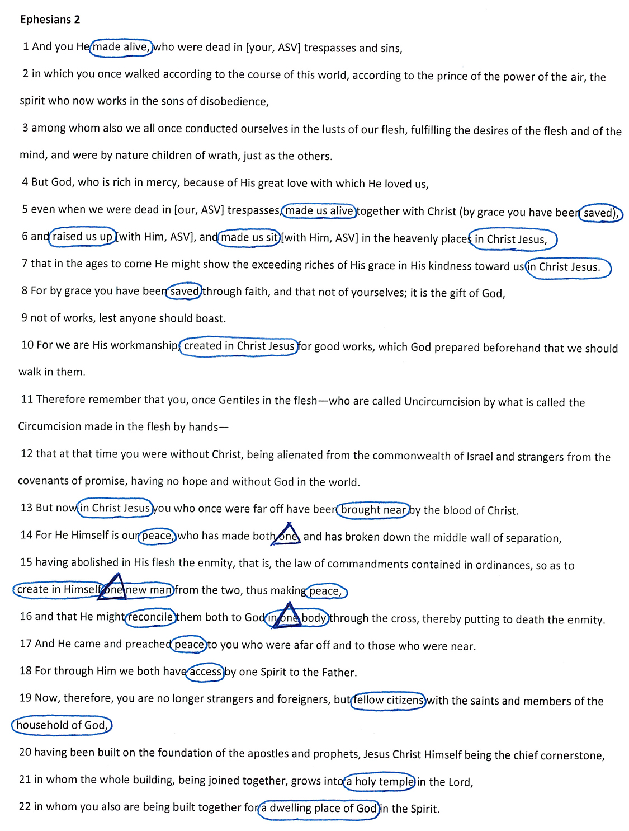

Slide 18
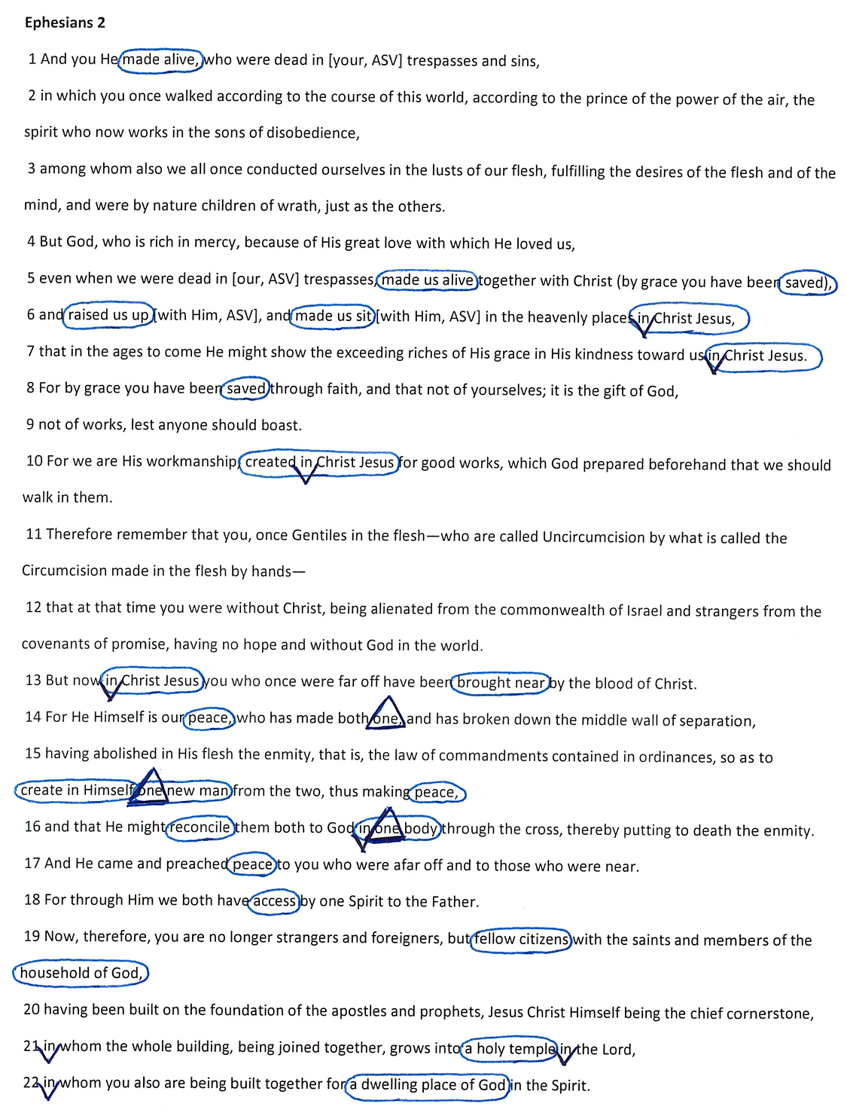

Slide 19
Operation: The Means By/Through Which One Leaves His Past Sins Behind and Enters into Christ Is Clear

Slide 20
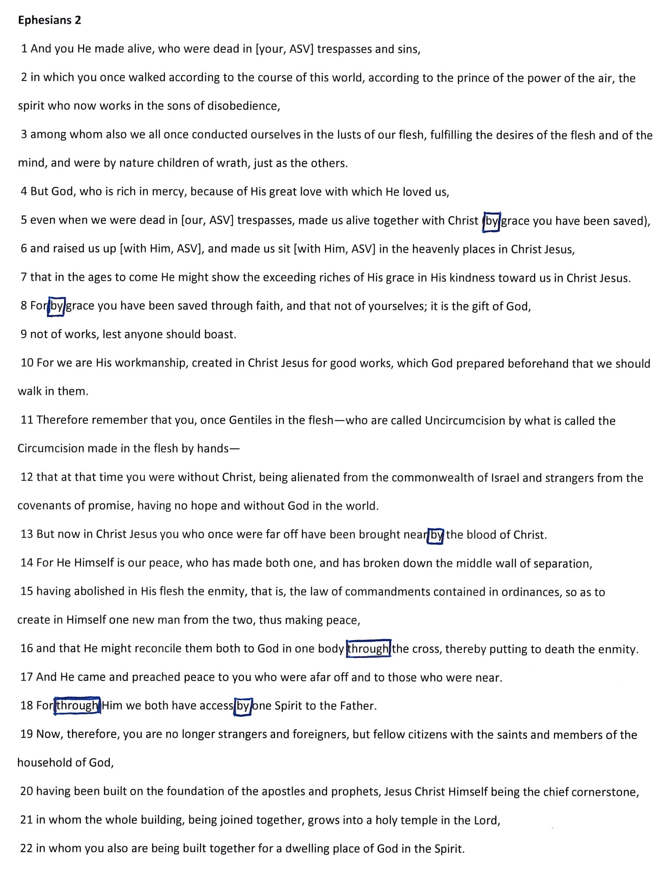

Slide 22
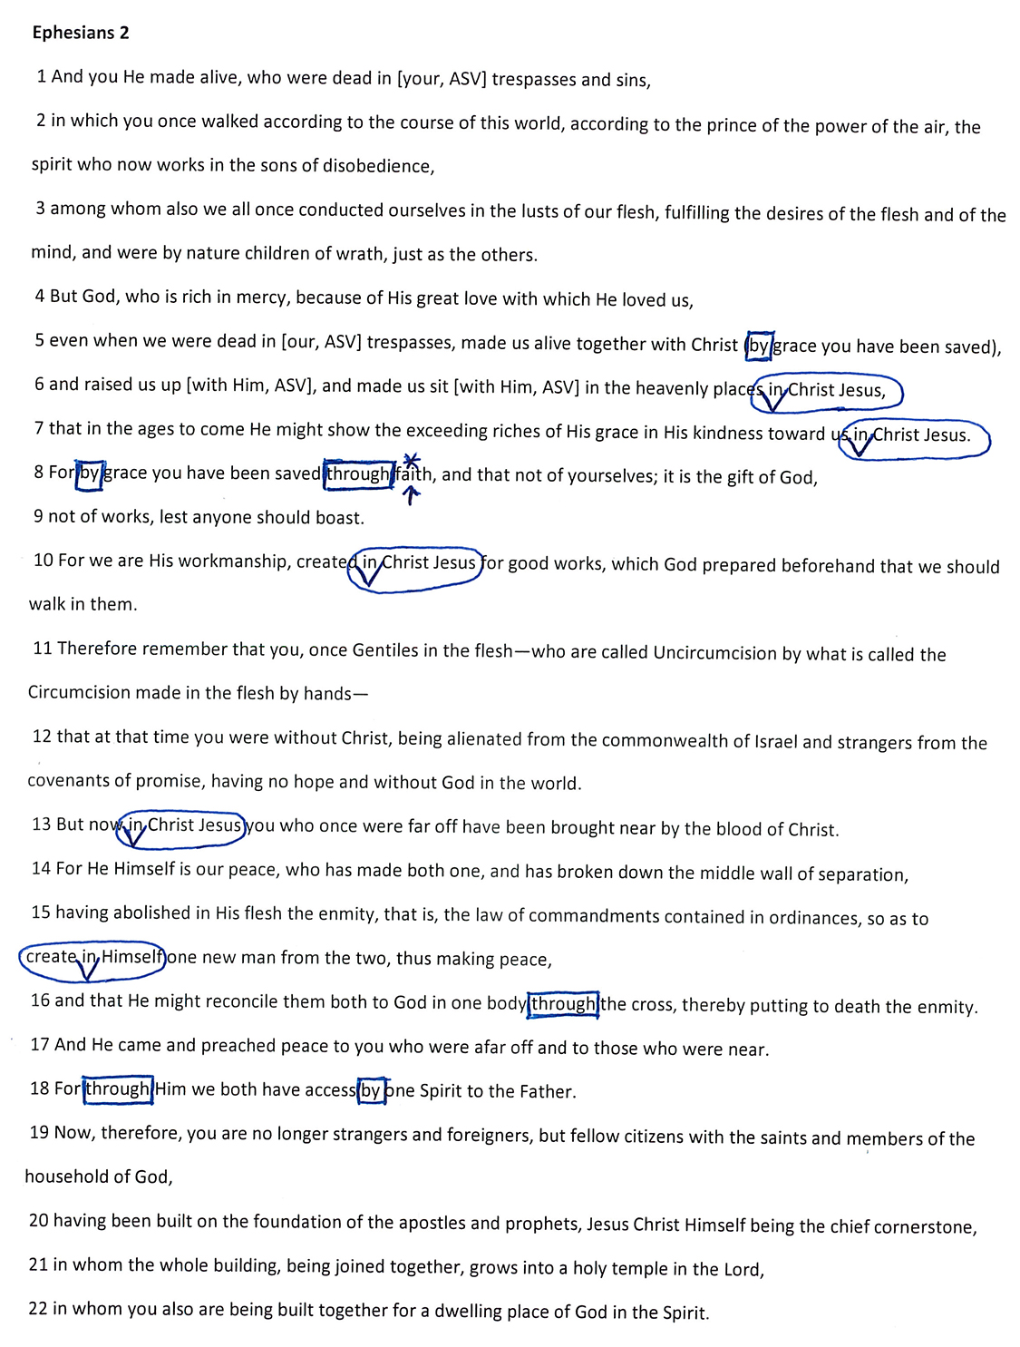
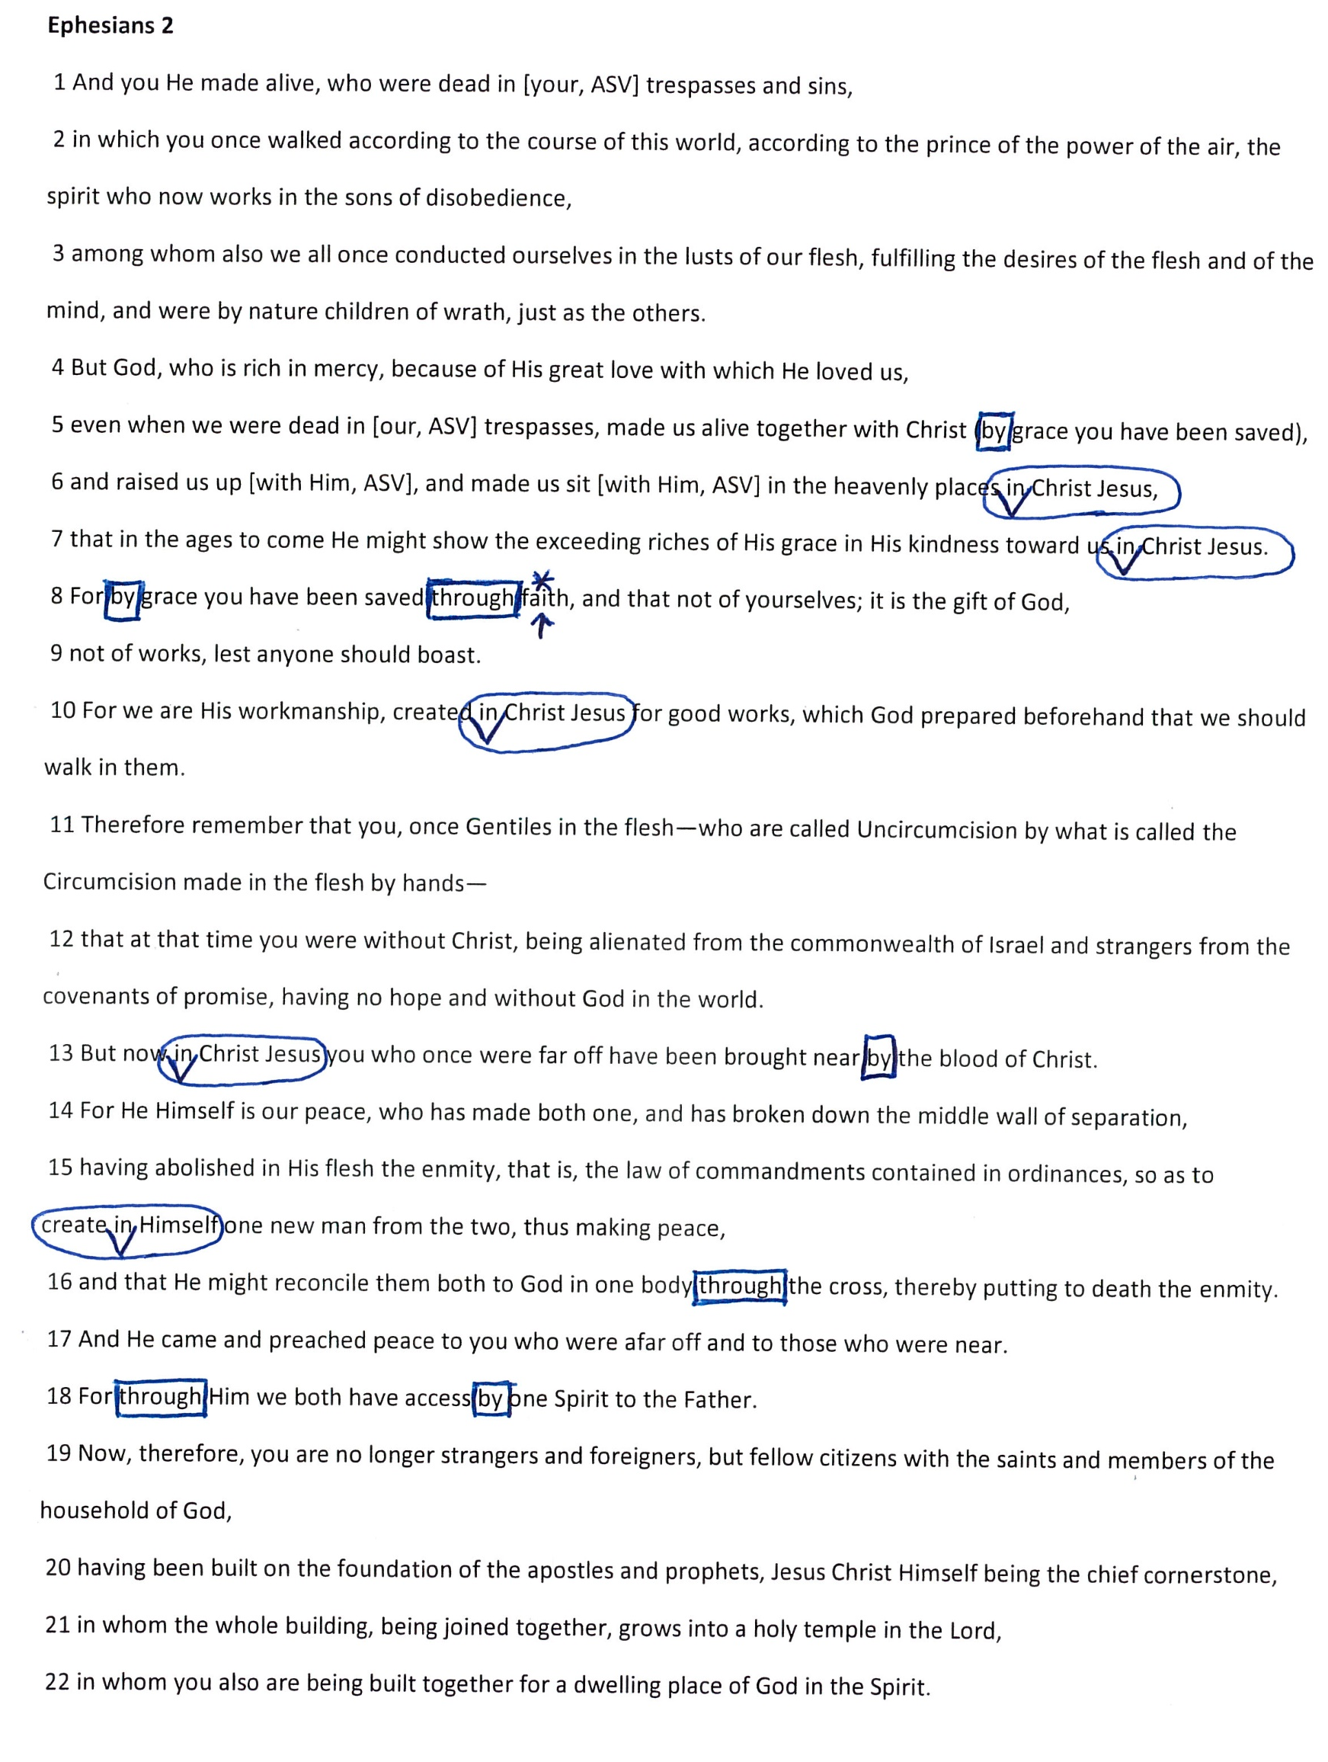

Slide 23
Intention: The Reason for Which God Saved Us in Christ Jesus Is Clear

Slide 24
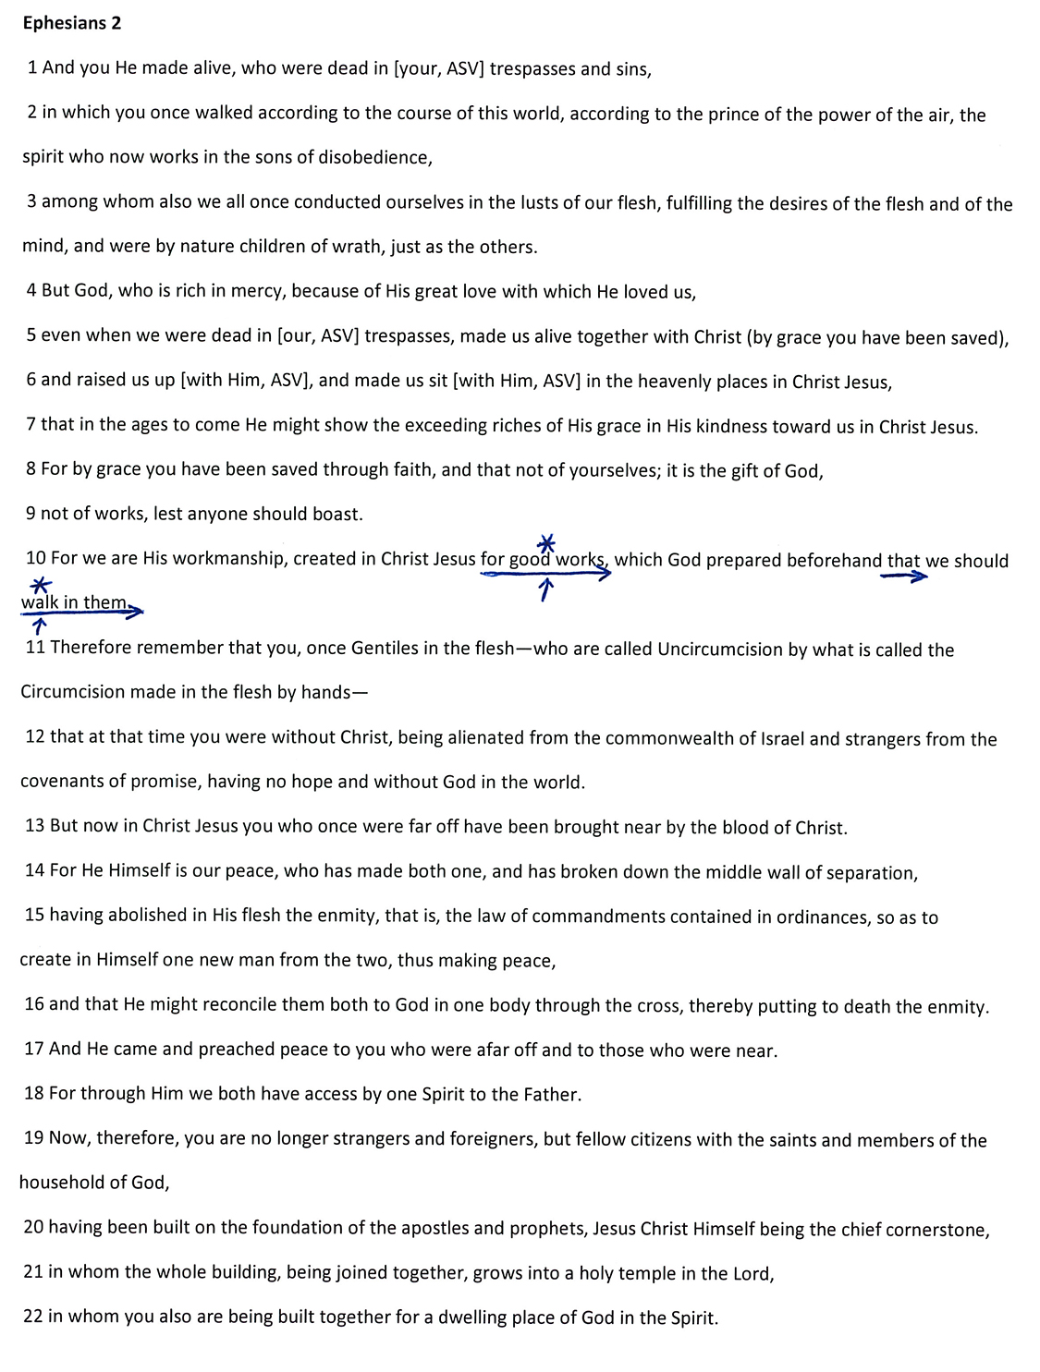

Slide 25
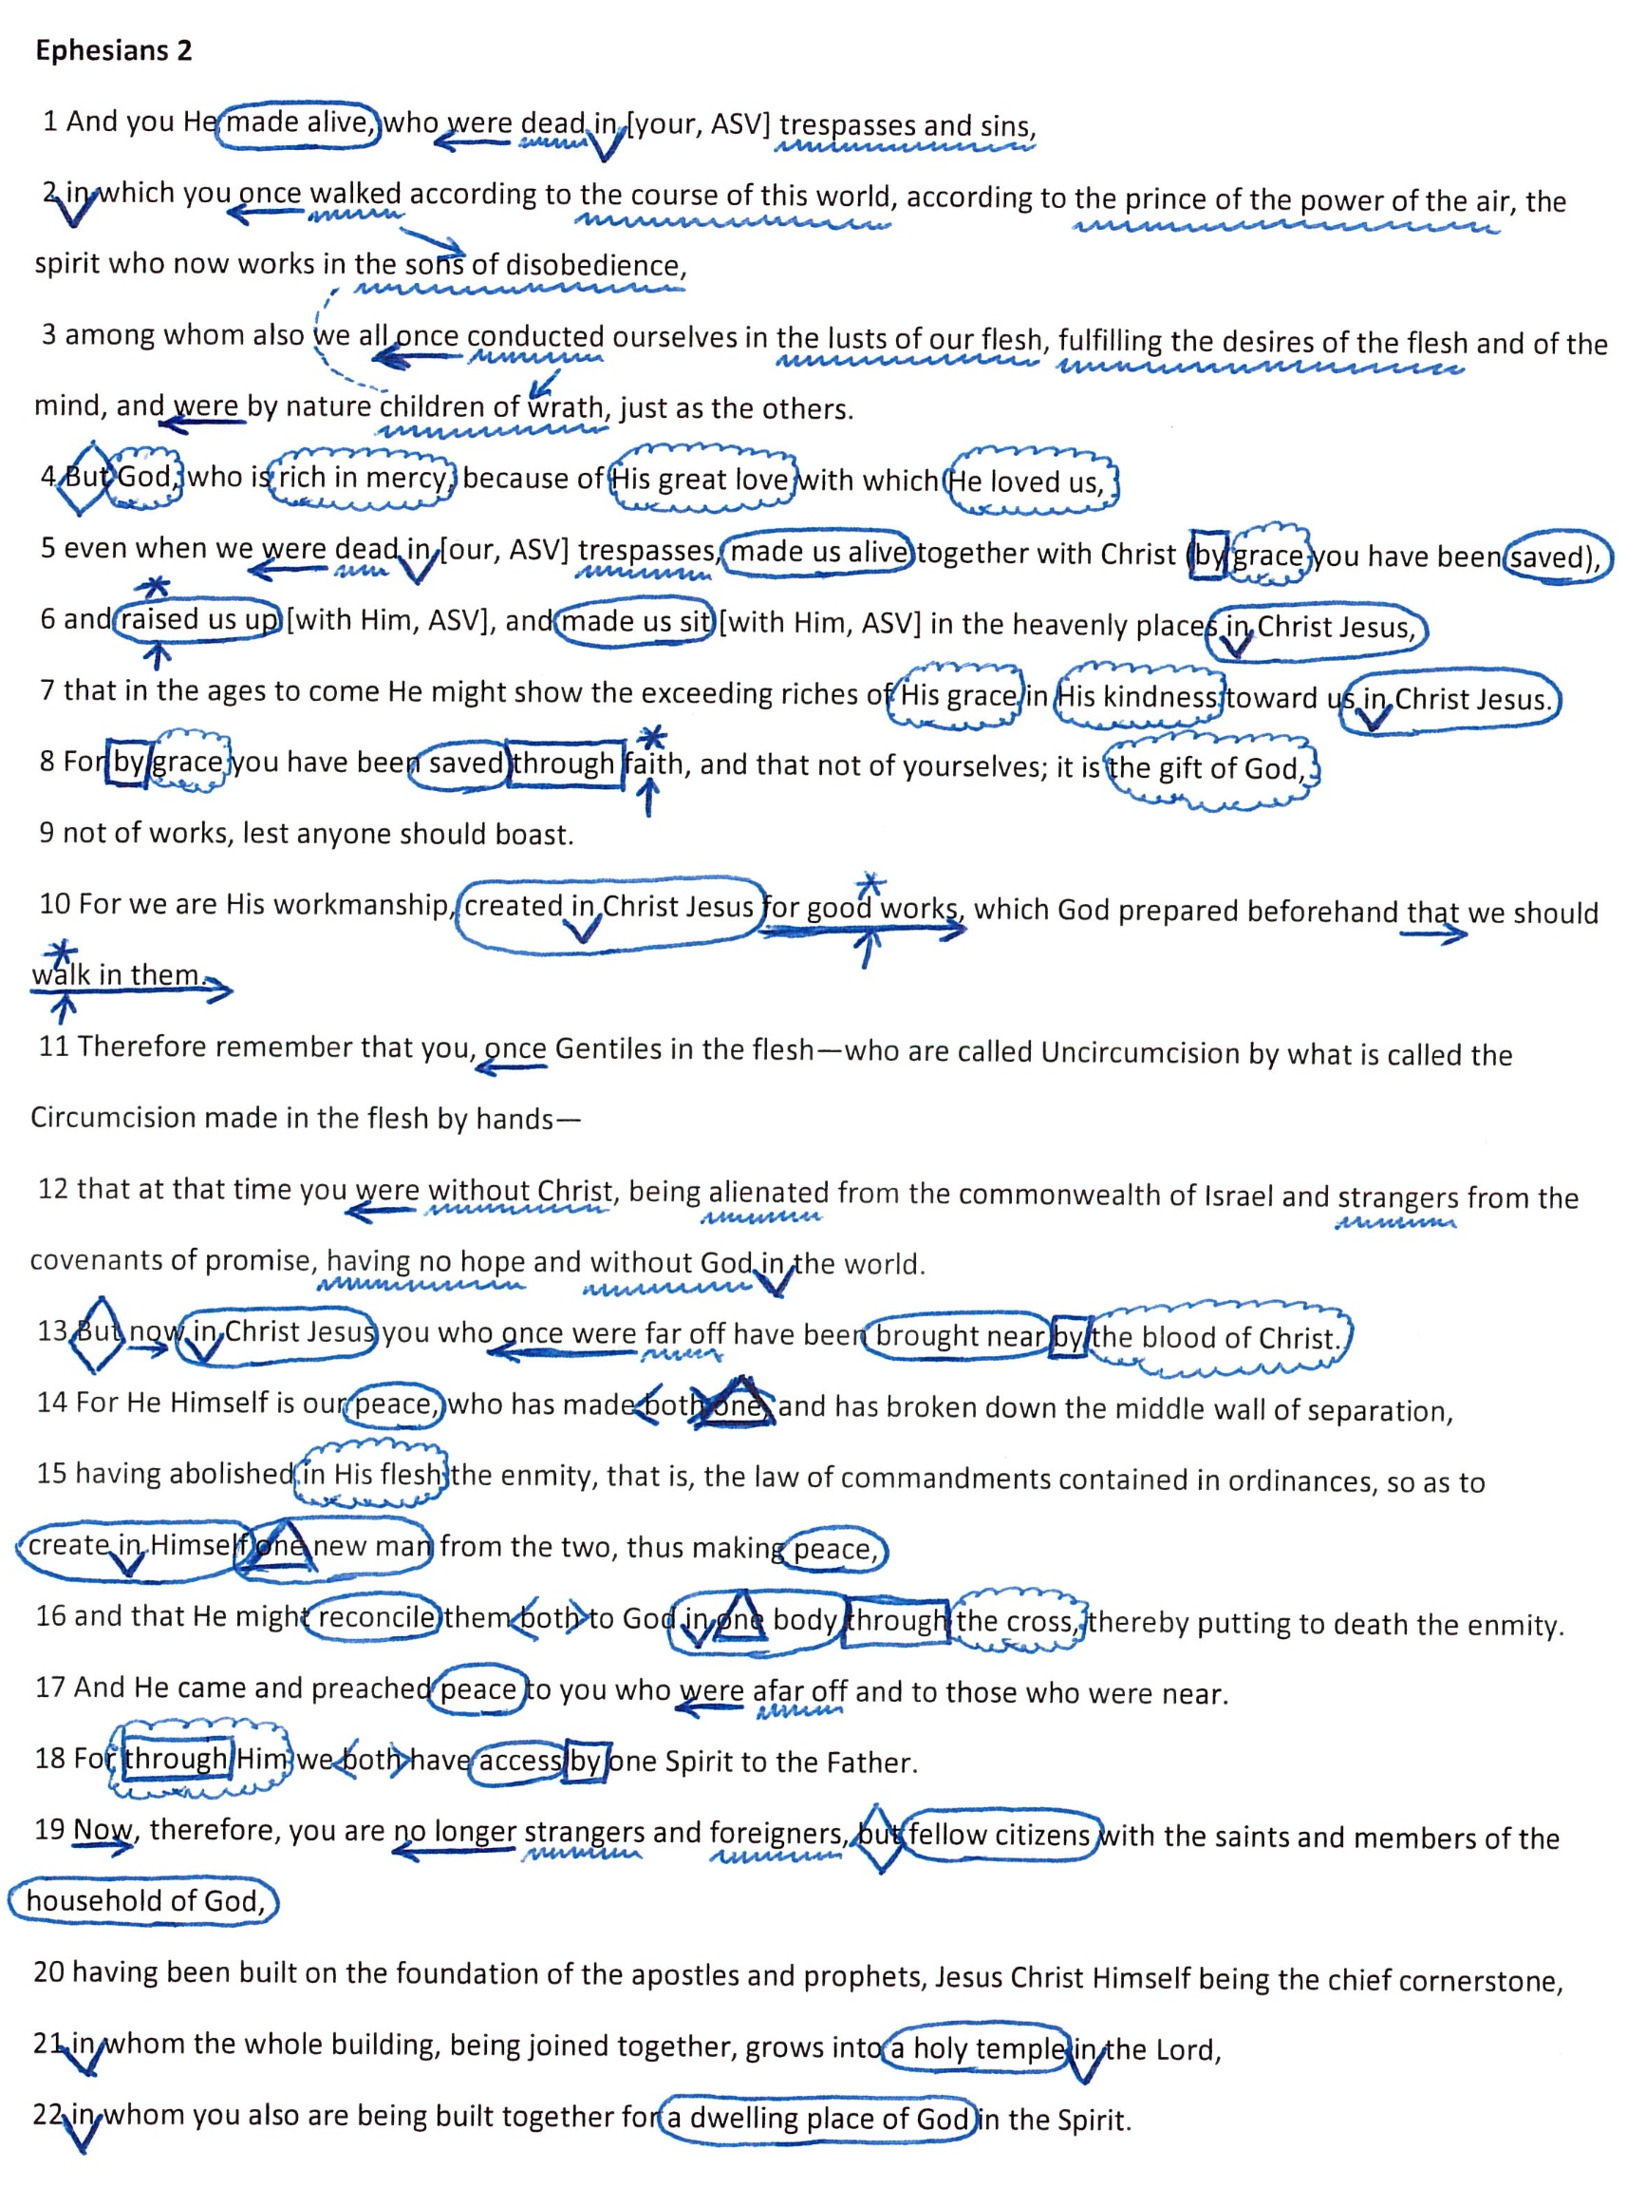

Slide 26
Believe Jesus is God’s Son – John 8:24
Repent of your sins and turn to God – Luke 13:3
Confess your faith in Jesus Christ – Romans 10:9
Be immersed into Christ – Romans 6:3
God will forgive all of your sins – Acts 2:38
God will add you to His church – Acts 2:47
God will register you in heaven – Hebrews 12:23
Walk and work faithfully for the Lord – Ephesians 2:10

