Slide 1
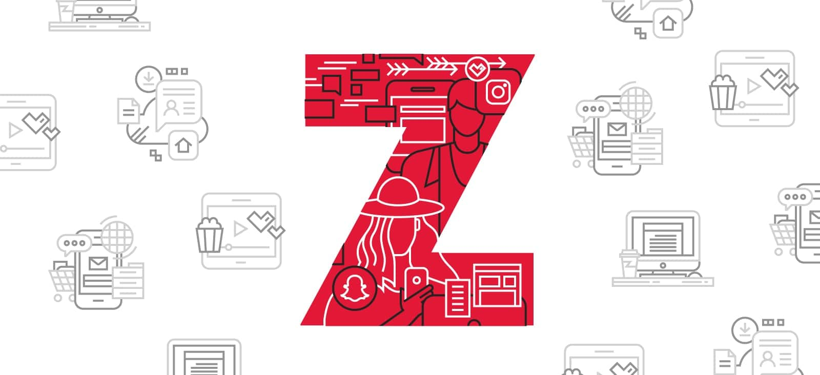
GENERATION
AN INTRODUCTION

Slide 2
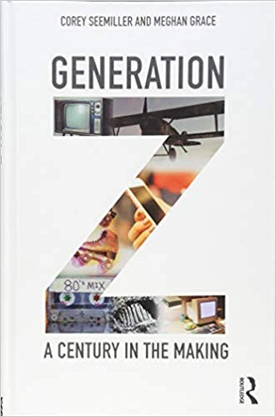
Generational Studies
Generation Z: A Century In the Making
By Seemiller & Grace

Slide 3
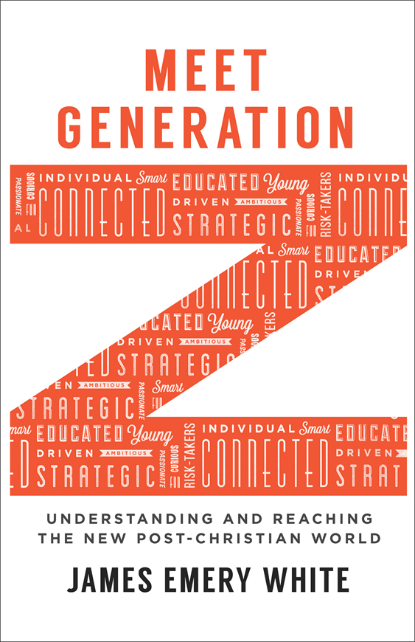
Generational Studies
Meet Generation Z
By James White

Slide 4
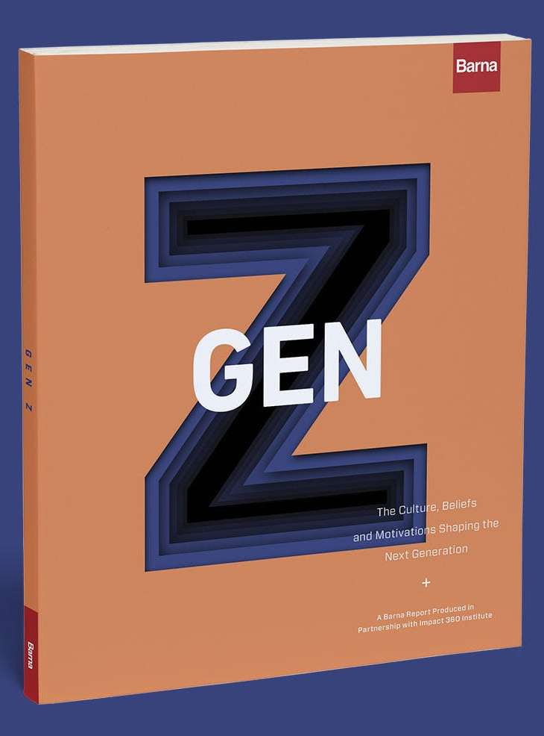
Generational Studies
Gen Z: The Culture, Beliefs and Motivations Shaping the Next Generation
By Barna Group & Impact 360

Slide 5
Why Study Generations?
They are studied for…
All that generation also were gathered to their fathers; and there arose another generation after them who did not know the LORD, nor yet the work which He had done for Israel. Judges 2:10
You shall teach them diligently to your sons and shall talk of them when you sit in your house and when you walk by the way and when you lie down and when you rise up. Deuteronomy 6:7
Older men, older women, young women, young women… Titus 2:1-8
Marketing
Political trends
Education
Health care
Insurance
Social Trends
Workforce
Religion

Slide 6
“Talking ‘Bout My Generation!”
Silent Generation (Born 1925-45; age 74-94)
Peace! Jobs! Suburbs! Television! Rock ‘n Roll! Cars!
Korean and Vietnam War generation.
The First Hopeful Drumbeats of Civil Rights!
Pre-feminism women; women stayed home generally to raise children, if they worked it was only certain jobs like teacher, nurse or secretary.
Men pledged loyalty to the corporation, once you got a job, you generally kept it for life.

Slide 7
“Talking ‘Bout My Generation!”
Silent Generation (Born 1925-45; age 74-94) Continued
Marriage is for life, divorce and having children out of wedlock were not accepted.
In grade school, the gravest teacher complaints were about passing notes and chewing gum in class.
“Retirement” means to sit in a rocking chair and live your final days in peace.
The Big-Band/Swing music generation.
Strong sense of trans-generational common values and near-absolute truths.
Disciplined, self-sacrificing, & cautious.

Slide 8
“Talking ‘Bout My Generation!”
Boomers (Born 1946-64; age 55-73)
Subset 1: the save-the-world revolutionaries (Hippies) of the ’60s and ’70s;
Subset 2: the party-hardy career climbers (Yuppies) of the ’70s/’80s.
“Rock and roll” music generation.
Ushered in the free love and societal “non-violent” protests which triggered violence.
Women of this generation began working outside the home in record numbers
The first TV generation.

Slide 9
“Talking ‘Bout My Generation!”
Boomers (Born 1946-64; age 55-73) Continued
The first divorce generation, where divorce was beginning to be accepted as a tolerable reality.
Began accepting homosexuality.
Optimistic, driven, team-oriented.
Tend to be more positive about authority, hierarchal structure and tradition.
One of the largest generations in history with 77 million people.
The first generation to use the word “retirement” to mean being able to enjoy life after the children have left home.

Slide 10
“Talking ‘Bout My Generation!”
Generation X (Born 1965-80; age 39-54)
The “latch-key kids” grew up street-smart but isolated (Punky Brewster), often with divorced or career-driven parents
Cynical of many major institutions, which failed their parents, or them, during their formative years.
Raised in the transition phase of written based knowledge to digital knowledge archives.
This generation averages 7 career changes in their lifetime.
AIDS begins to spread and is first lethal infectious disease which was not subjected to any quarantine.

Slide 11
“Talking ‘Bout My Generation!”
Generation X (Born 1965-80; age 39-54) Continued
Individual rights prevailing over the common good, especially for any type of minority.
School problems were about drugs. (D.A.R.E. Est. 1983)
Late to marry (after cohabitation) and quick to divorce leaving many single parents.
Buy now pay later, and most are in credit card debt.
Short on loyalty & wary of commitment; all values are relative, must tolerate all peoples.
Self-absorbed and suspicious of all organization.

Slide 12
“Talking ‘Bout My Generation!”
Millennials – Gen Y (Born 1981-94; age 38-25)
Aka “The 9/11 Generation” “Echo Boomers”.
They are nurtured by omnipresent parents (helicopter), optimistic, and focused.
Falling crime rates. Falling teen pregnancy rates. But with school safety problems; they have to live with the thought that they could be shot at school, they learned early that the world is not a safe place.
They schedule everything (but may not show up) and feel enormous academic pressure.

Slide 13
“Talking ‘Bout My Generation!”
Millennials – Gen Y (Born 1981-94; age 38-25) Continued
Prefer digital literacy as they grew up in a digital environment. Have never known a world without computers! They get all their information and most of their socialization from the Internet.
With unlimited access to information tend to be assertive with strong views, with varied reasoning skills.
Envision the world as a 24/7 place; want fast and immediate processing.
They have been told over and over again that they are special, and they expect the world to treat them that way.
They do not live to work, they prefer a more relaxed work environment with a lot of hand holding and accolades.

Slide 14
Gen Z (Born 1995-2010; age 9 to 24)
A lot of debate about the actual date range.
iGen, Digital Natives, The Founders, Homeland Generation, Post-Millennials, and the Plurals are all names they have been given.
They constitute 25.9% of the US population (GenY 24.5%, Gen X 15.4%, Boomers 23.6%)
By 2020 they will constitute 40% of all consumers.
Possibly the last generation we will ever talk about.

Slide 15
Since Gen Z Has Been Alive
Hybrid cars have always been produced.
Google has always existed.
Four foul-mouthed kids have always been playing in South Park.
They have never licked a stamp.
Emails are the “formal mode” of communication, texts and tweets are the more informal.
Hong Kong was always under Chinese rule.

Slide 16
Since Gen Z Has Been Alive Continued
Wi-Fi is treated as an entitlement.
The announcement of the first woman to hold a position impressed only their parents.
Charlton Heston is more recognized as waving a rifle over his head that a staff.
If you say, “Around the turn of the century” they will ask, “Which one?”
Cell phones are appendages.
They joined Harry Potter through all seven books for their reading skills.
Therapeutic marijuana has always been legal in some US cities.
The Lion King has always been on Broadway.

Slide 17
Defining Markers of Gen Z
Top character strengths: honesty, kindness, humor, fairness, judgement. According to the VIA Character Strength Survey (150,000 surveyed)
Values; Individual freedom, financial security, happiness, meaningful work.
Motivation is found in achievement or making a difference in something they believe in.
Less motivated by public recognition, acceptance, competition or possibility of a favor returned.
Recession Marked, the worst economic era since WWII began in 2007.
They are resourceful 42% report expecting to work for themselves at some point.
Doing business for a social cause, social entrepreneurship, is one of their top career choices.

Slide 18
Defining Markers of Gen Z
Attacks and gun threats shock but they don’t surprise those that are growing up with this as a norm.
WIFI enabled as the “internet-in-its-pocket” generation. They are the product of the fourth great communication revolution; encoding and programming.
They can find whatever they want without the help of libraries, teachers, or brick and mortar shops.
Digitally customizable, they have an online and offline identity. 75% are comfortable managing multiple identities online.
42% feel that social media plays a direct role in how they feel about themselves.

Slide 19
Defining Markers of Gen Z
Very diverse, multiracial children are the fastest growing youth group in the US. 49% identifying as non-white.
It is estimated that by the conclusion of the 2020 census more than half of the US youth population will be a part of a minority ethnic group.
They are sexually fluid. Only 48% identified as exclusively heterosexual.
81% don’t feel that gender defines a person like it used to. It was in 2015 the homosexual marriage was legalized.
They are the product of social choices made by previous generations.
First Generation raised in a post-Christian context. Fastest growing religious group are the “nons” or unaffiliated.

Slide 20
The World According to Gen Z
They are Screenagers
“Nomophobia” – when they are away from their phones.
31% 4 to 8 hours on a screen, 26% 8 or more hours.
Physically safer but psychologically more vulnerable. Teen pregnancy is at a low but teen depression and suicide has skyrocketed.
Linear thinking has given way to choppy disjointed overlapping information.
54% use media to meet new people.
Online is good place to discuss opinions and ideas.
“FOMO” Fear Of Missing Out is a big deal and more so if an event is posted online.
31% Say looking at other people’s posts makes them feel bad about themselves.
33% have been bullied online. No safe place.

Slide 21
The World According to Gen Z
Their world view is post-Christian.
10% of Boomers, 7% of Gen X, 6% of Millennials and 4% of Gen Z have a biblical world view.
Number of Gen Z that identifies as atheist is double that of US adults.
Many are a spiritual blank slate having no prior Christian culture. 34% with no religious affiliation.
Those that identify as having a faith 53% still believe in God, only 48% attended a service recently and only 1 in 11 is an “engaged Christian”.

Slide 22
The World According to Gen Z
“Safe spaces” are normal.
Gen Z does not like to make people feel bad. (over use of trigger warning and safe spaces)
These render opposing ideas as taboo and combative and leads to no chance to change the minds of others.
Protecting people from ideas they don’t want to hear is harmful.
Deeply reluctant and anxious to make declarative statements.

Slide 23
The World According to Gen Z
Real safety is a myth.
Millennial – like Harry Potter I am special and we can defeat evil if we stick together!
Gen Z – Dystopian Hunger Games I just want a quiet place to live and die.
Gen Z have never experienced a norm of a dependable job, livable wage and a reliable social safety net.
That is why there is a push toward working for yourself.
They’ve never known a country without war.
The world is unsafe and they are apt to not be optimistic about the future.
With culture changing minds about gender, they are no longer safe in their own bodies.

Slide 24
The World According to Gen Z
They are diverse.
Hunger Games, Divergent, Moana, Avengers the age of woman is here. #She-Ra
Traditionally more men have gone to college than women, however Fall of 2018 saw of those enlisted in college 56% were women.
Kindergarteners that started in 2016 was the first year that minority ethnicities made up a majority of students and whites the minority.
59% say that have friends of a different sexual persuasion.

Slide 25
The World According to Gen Z
Their parents are double minded.
There are helicopter over protective parents.
There are others that are under protective (usually in the area of media) to avoid the label. Free range parenting.
“Sharenting” over sharing personal info on social media. 92% of children have an online identity by age 2 from shared photos.
1971 80% of 3rd graders walked to school, by 1990 the was down to 9%. Today it is even lower.
Children with over involved and controlling parents suffer psychological blowback in college.
Hands off parenting has led to more problems for Gen Z at a time when they need greater protection and norms.

Slide 26
GENERATION
AN INTRODUCTION

