Slide 2
I Can Make It Through Anything When… Looking to Jesus with CONFIDENCE – Daily!
Confidence in His grace – to save and to relieve (1 Cor. 15:10; Heb. 4:16)
Confidence in His security – to keep and to protect (John 10:27-29; Jude 24; 2 Tim. 1:12; Acts 18:9-10)
Confidence in His love – to redeem and to crown (Eph. 5:2; 1 John 3:16; Gal. 1:4; Rev. 3:21)
Confidence in His power – to know, see and do all things (Eph. 3:20-21; Phil. 3:12-14+4:13; Matt. 19:26; Jer. 32:17; Psa. 139)

Slide 3
I Can Make It Through Anything When… Looking to Jesus with DEPENDENCE – Completely!
Dependence for all my needs (Psa. 23:1; Psa. 34:10; Matt. 6:8, 32-33)
Dependence upon a Friend (Prov. 17:17; 18:24; 27:17; John 15:13-15)
Dependence upon a Friend to share the load (1 Pet. 5:7; Psa. 37:23-24; 55:22; 2 Pet. 2:9)
Dependence upon a Friend to be near (Matt. 28:20; 2 Tim. 4:17; Heb. 13:5-6; Phil. 4:5; Psa. 34:18; 145:18)

Slide 4
I Can Make It Through Anything When… Looking to Jesus for DELIVERANCE – Heavenly!
Deliverance to heaven away from “here” (2 Cor. 5:8; Rev. 21:27; 22:15; Phil. 1:21-23; 3:20-21; John 14:2-3)
Deliverance to heaven with the saved of all time (Matt. 8:11; Rev. 21:24; 14:3-4; 1 Thess. 2:19-20; Heb. 11)
Deliverance to heaven to see Him (Rev. 22:4; 1 John 3:2; Matt. 5:8; John 14:3)
Deliverance to heaven to praise Him (Rev. 4:2-11; 5:8-14; 11:16-18; 14:1-5; 15:2-4; 19:1, 4-6)

Slide 5
I Can Make It Through Anything When… Looking to Jesus:
Continually – “Constantly looking to Thee”
Joyfully – “I am as happy as a true soldier can be”
Hopefully – “Nearing my own heavenly place”
Trustfully – “Trusting Thy love I press along”

Slide 6
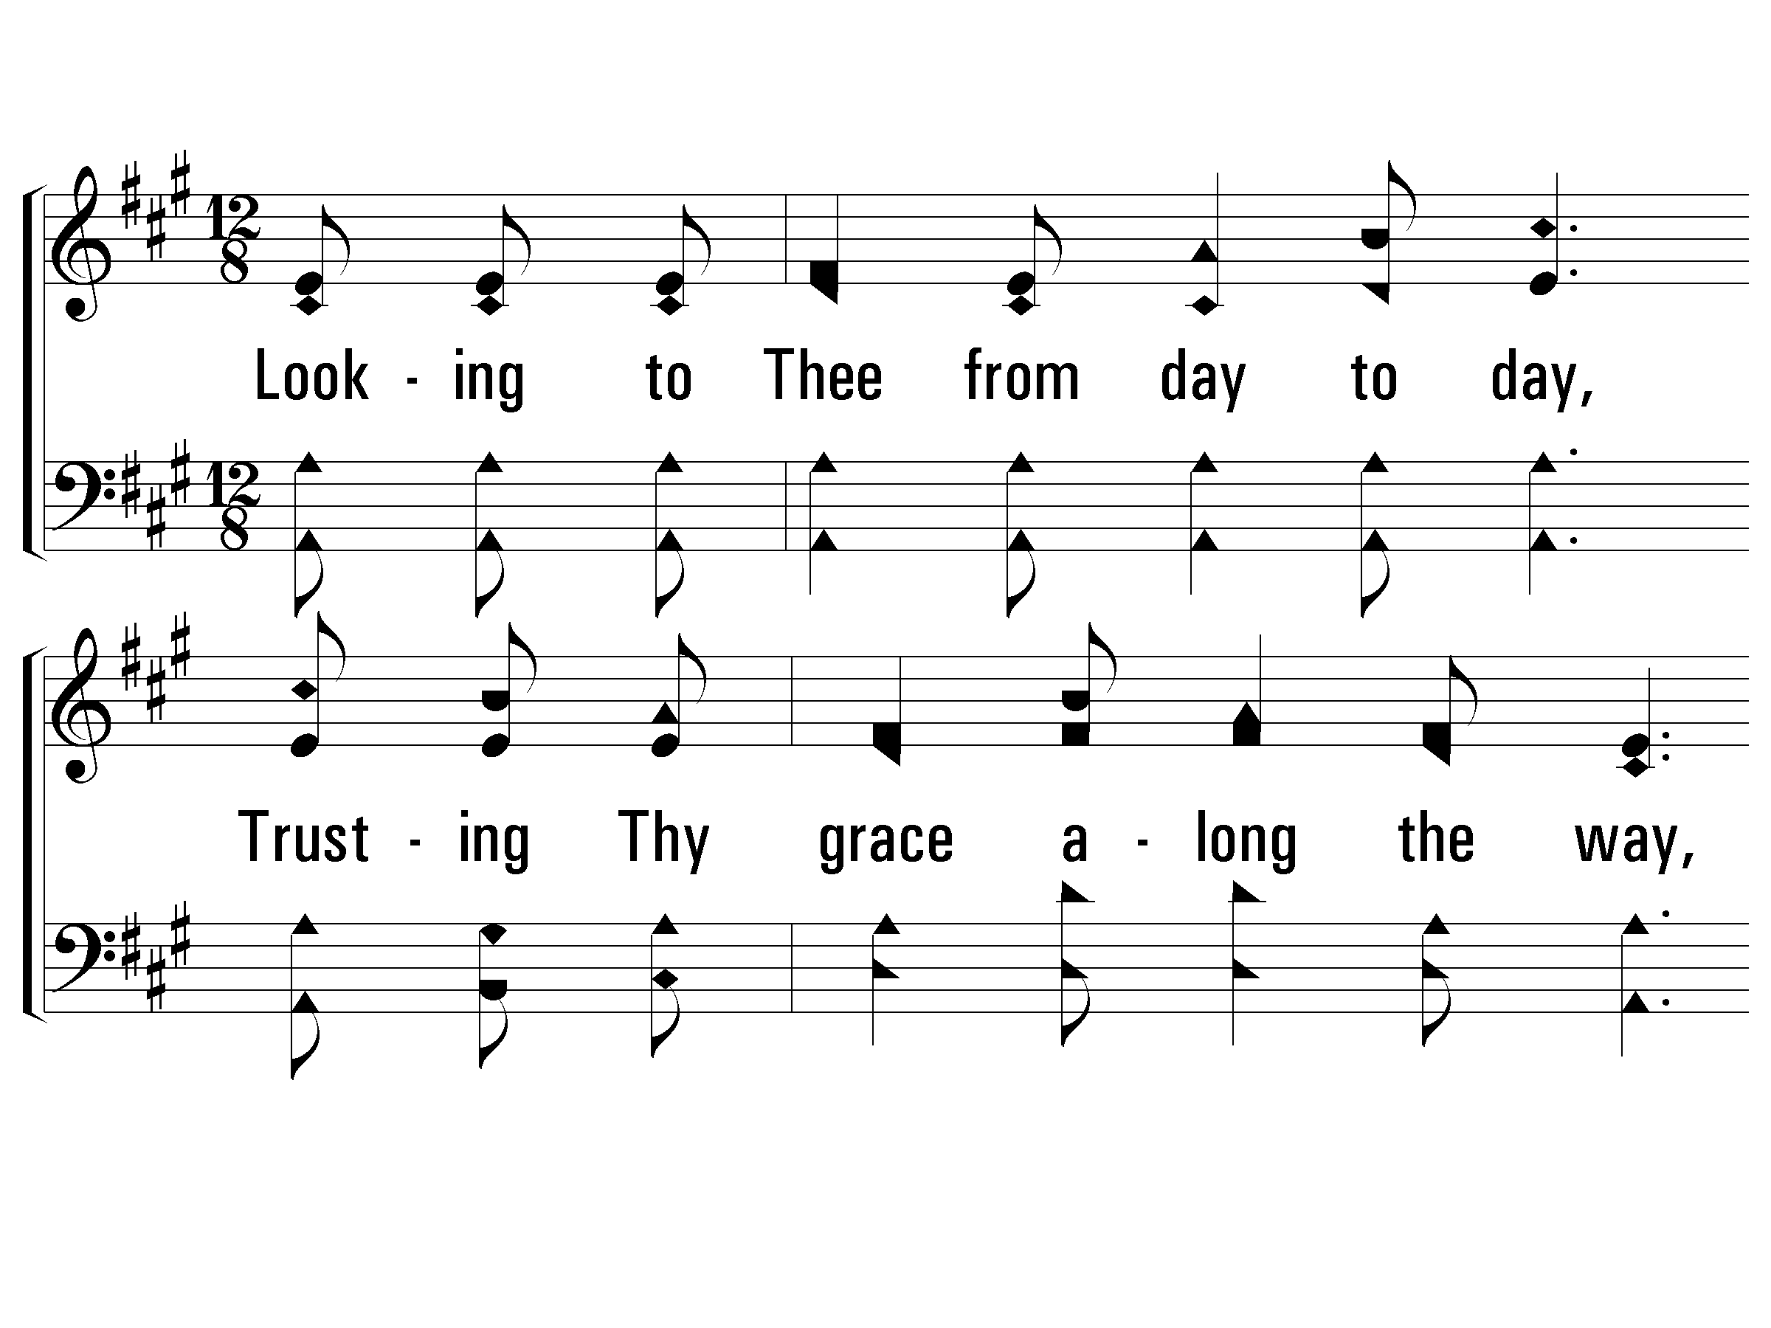
Verse 1
#404 – Looking to Thee
1.
Looking to Thee from day to day,
Trusting Thy grace along the way,
Knowing that Thou wilt safely keep all that is Thine;
Sure of Thy soul-redeeming love,
Sure of a crown of life above,
Singing thy praise I press along, Savior divine.

Slide 7
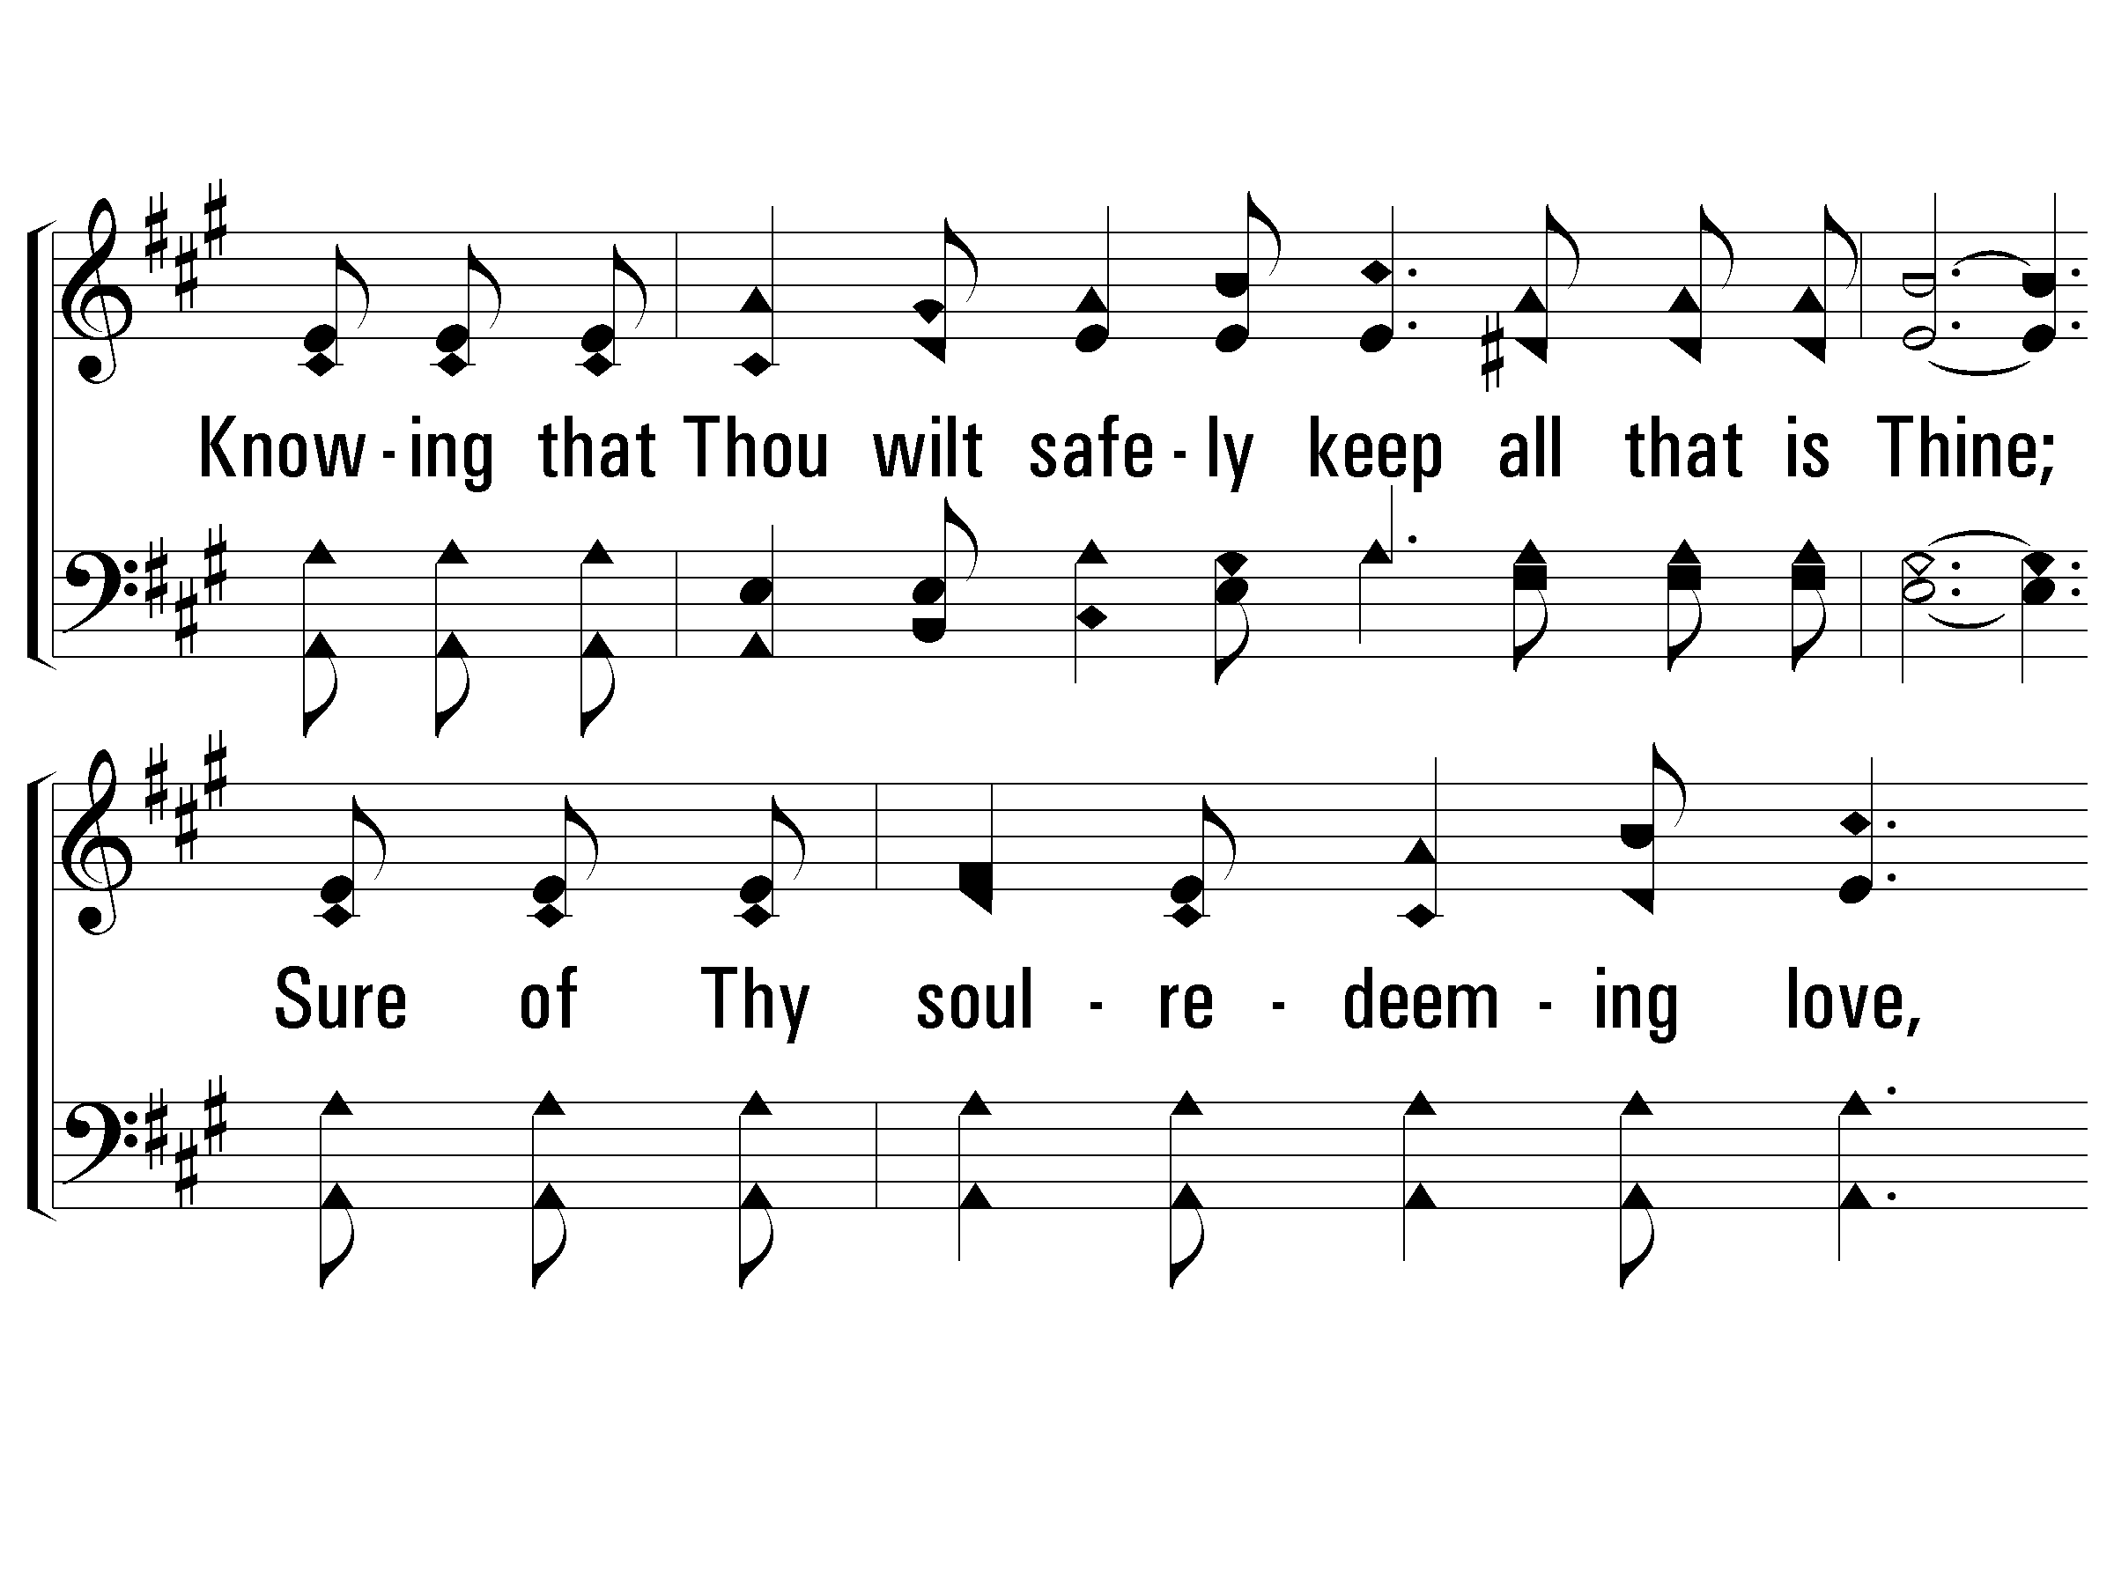
Verse 1
#404 – Looking to Thee

Slide 8
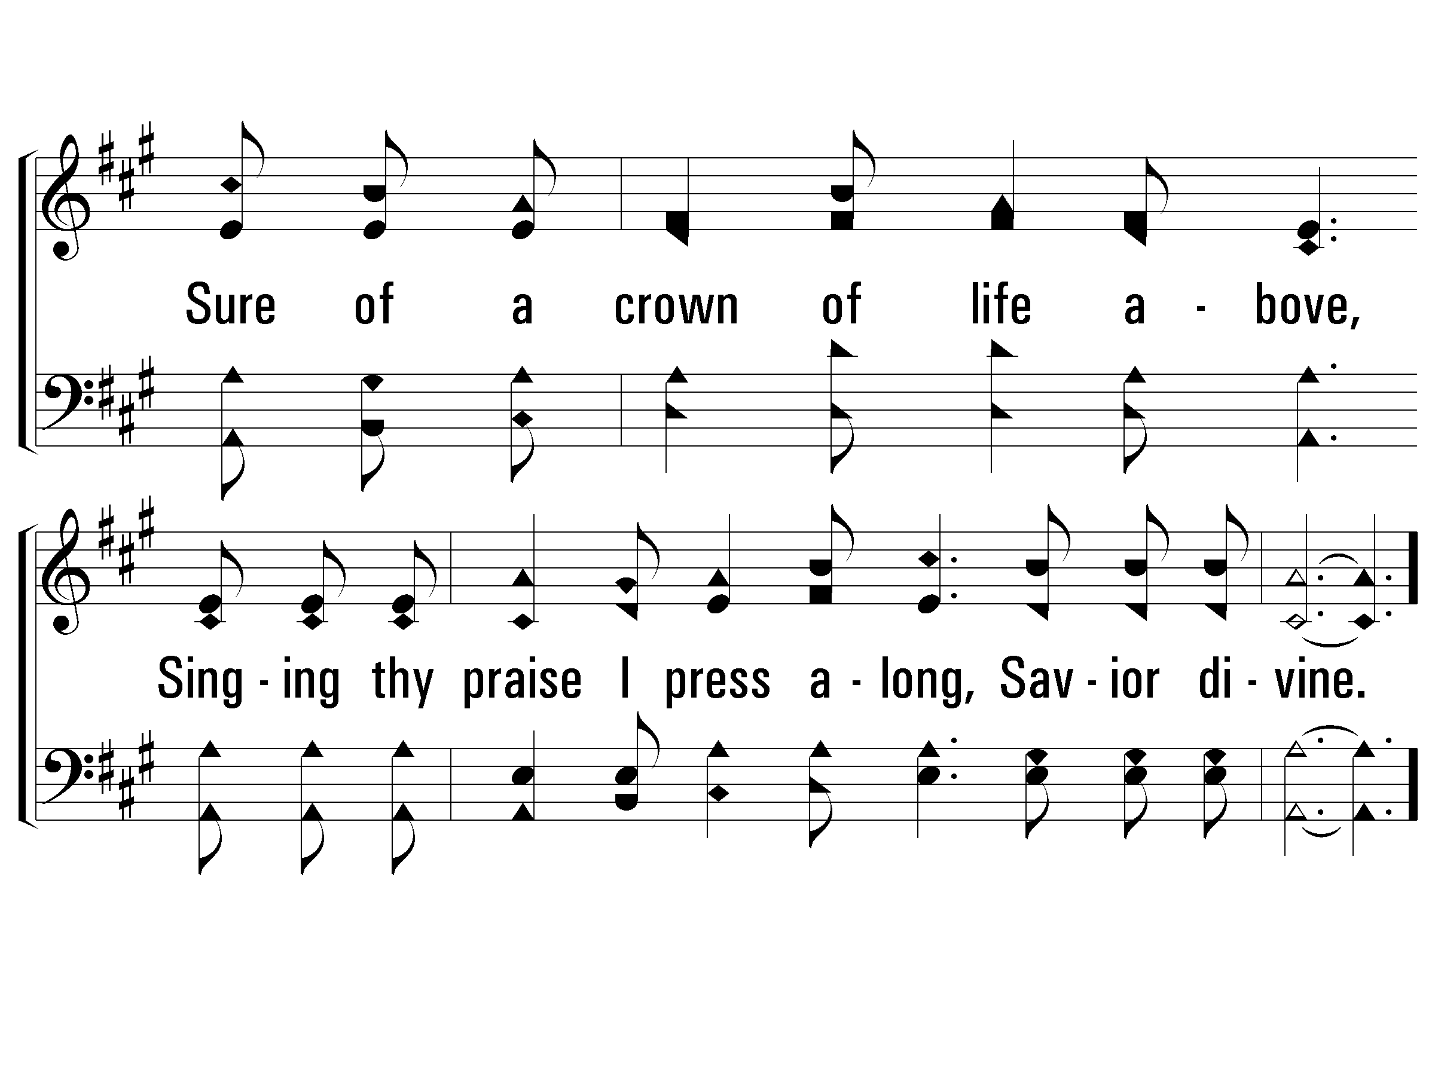
Verse 1
#404 – Looking to Thee

Slide 9
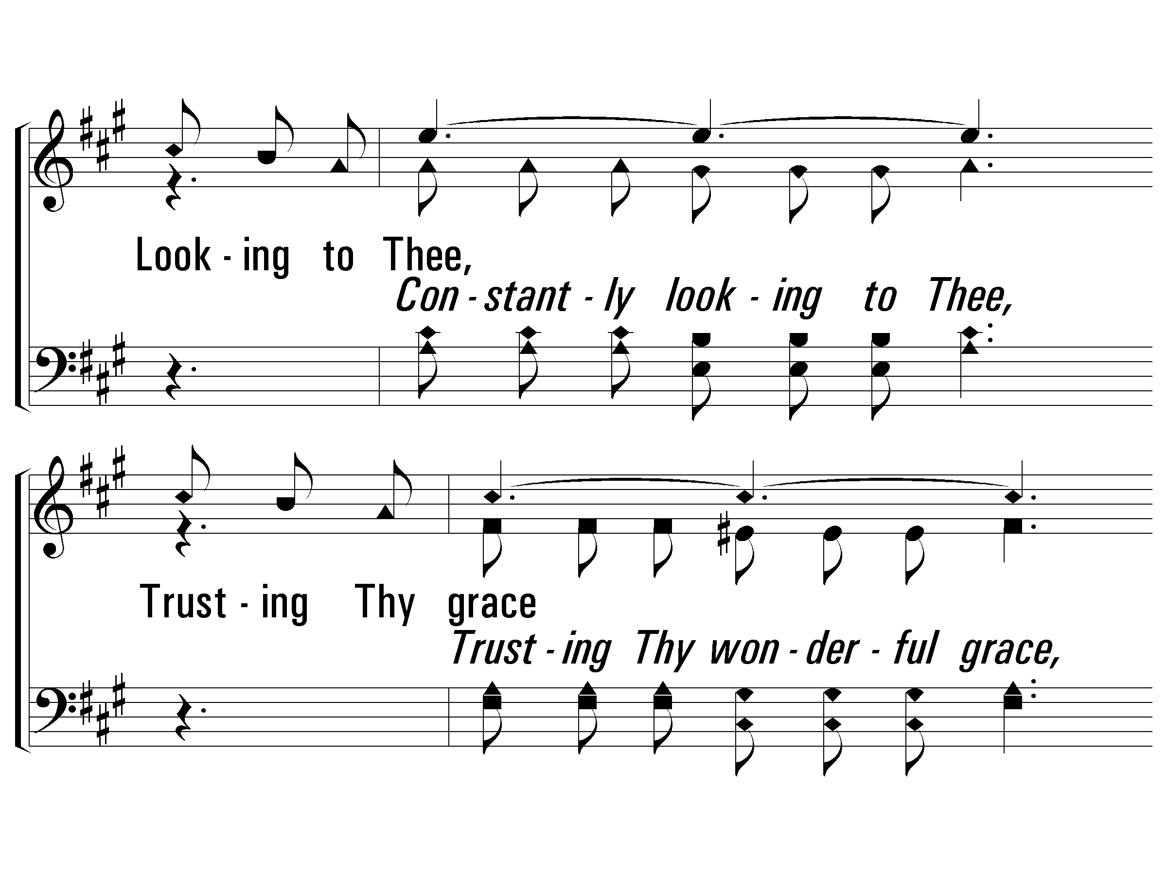
Chorus
#404 – Looking to Thee
Looking to Thee, Trusting Thy grace
I am as happy as a true soldier can be;
Nearing my own heavenly place
Trusting Thy love I press along,
looking to Thee.

Slide 10
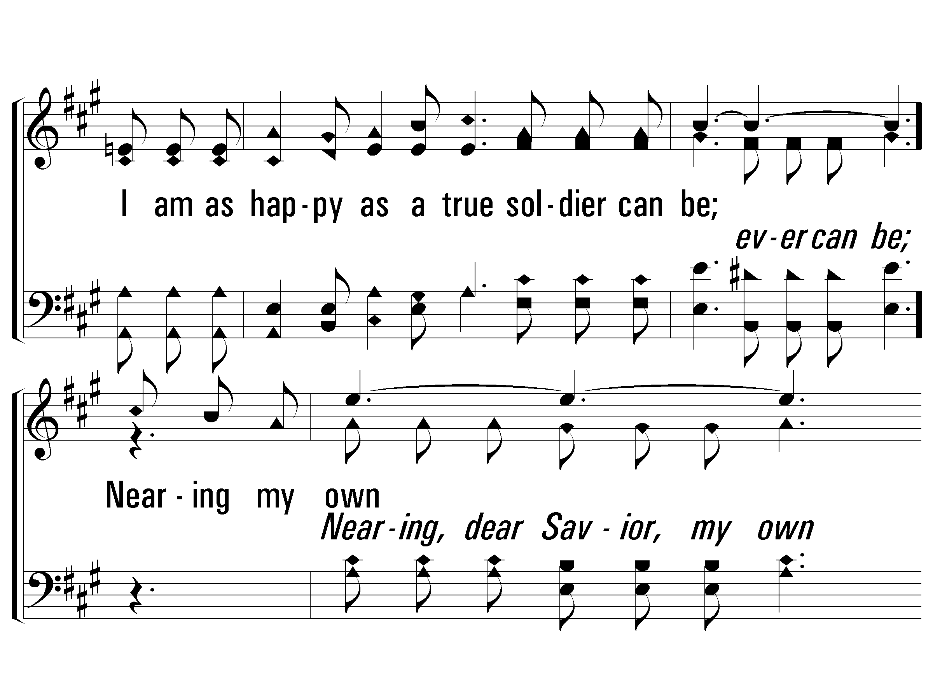
Chorus
#404 – Looking to Thee

Slide 11
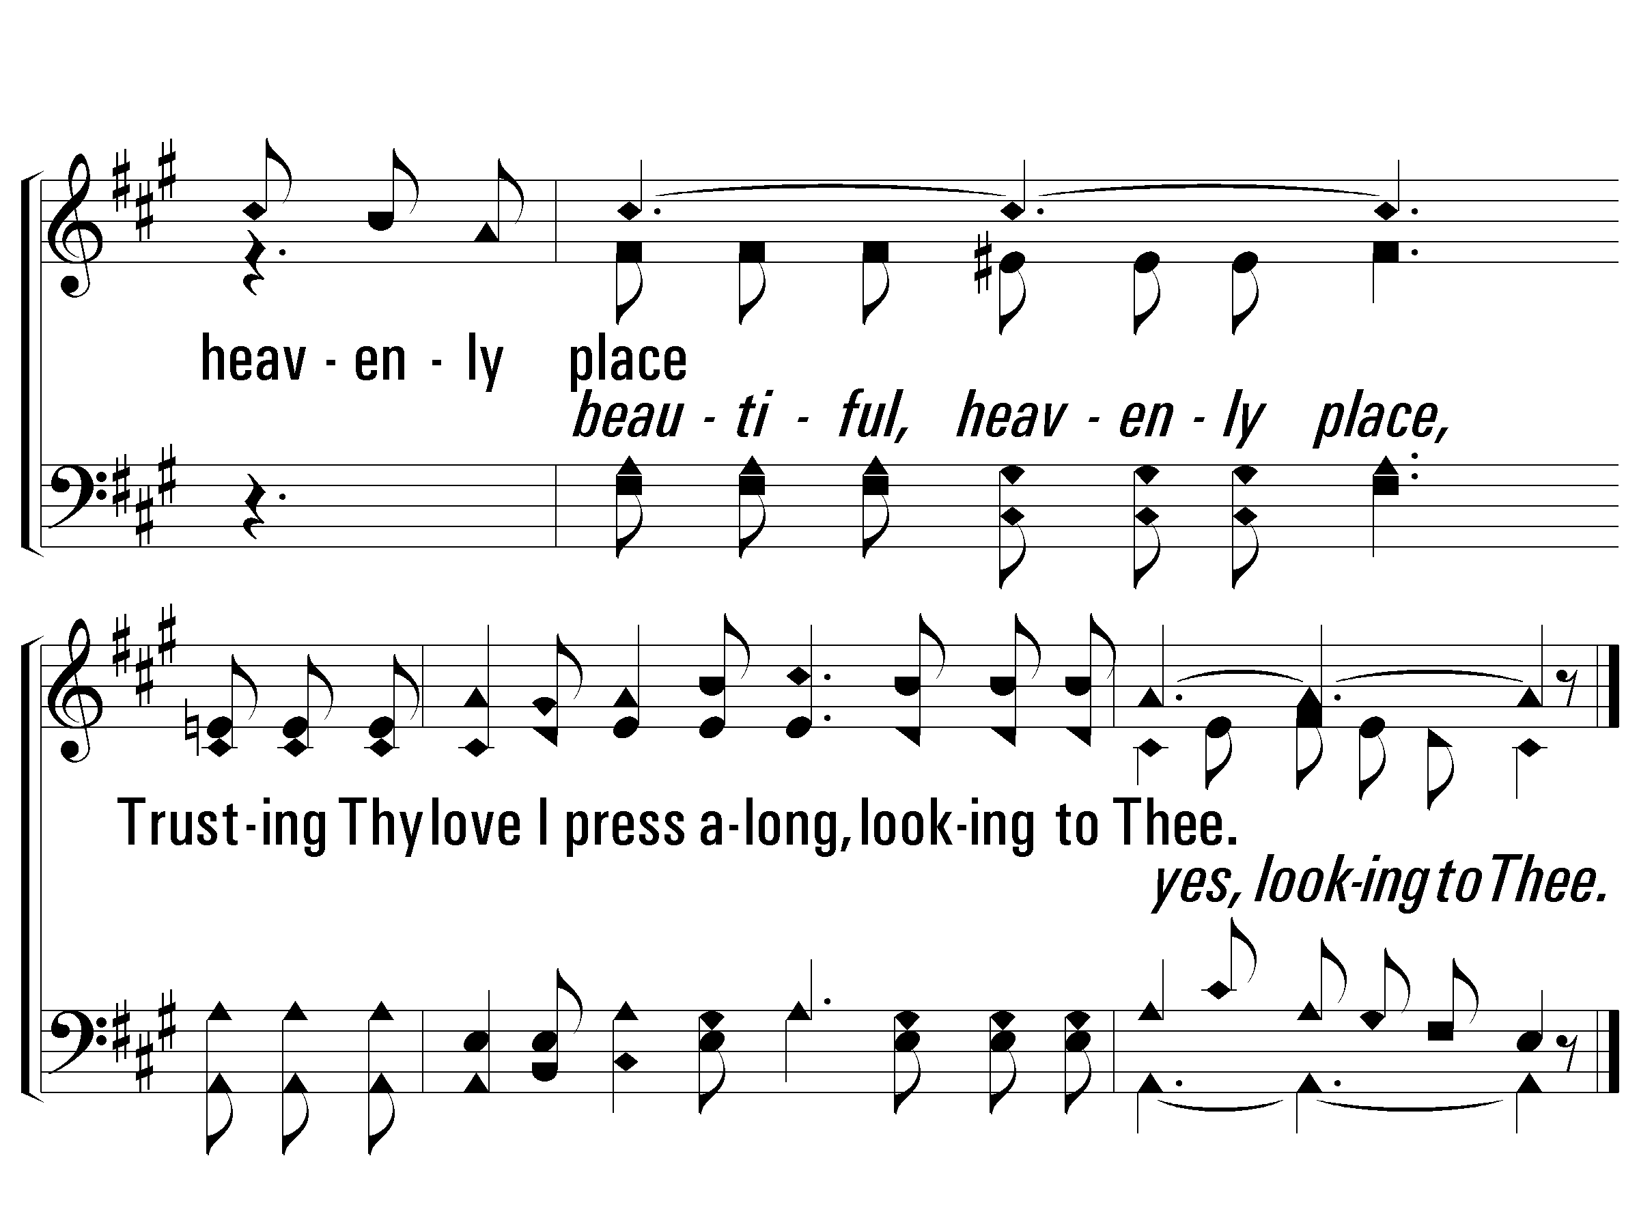
Chorus
#404 – Looking to Thee

Slide 12
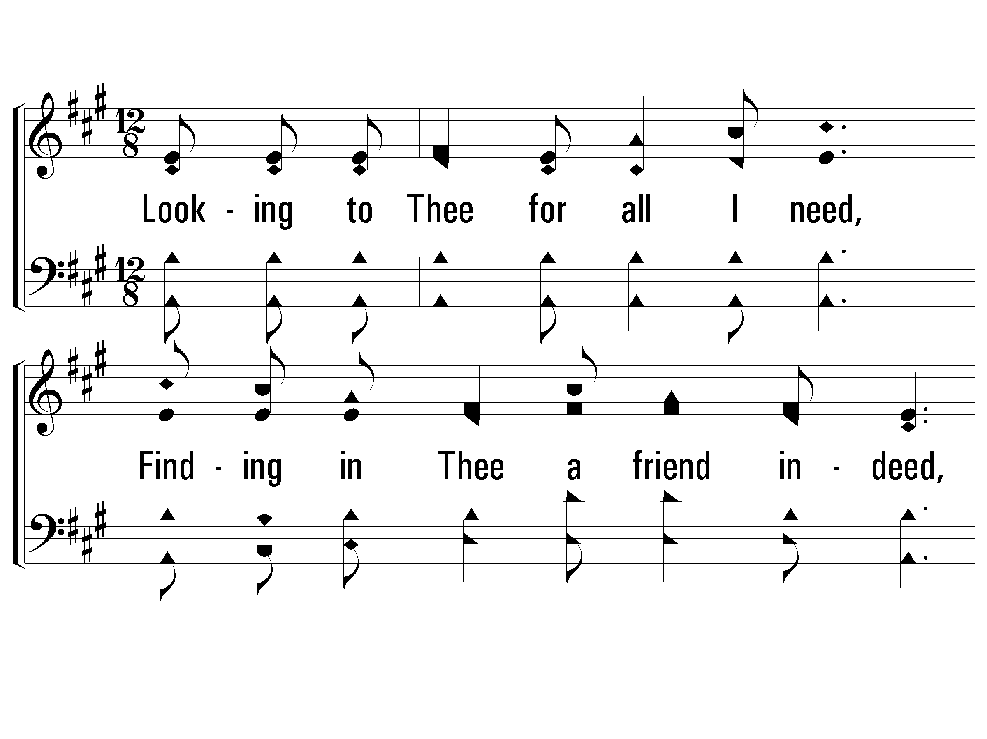
Verse 2
#404 – Looking to Thee
2.
Looking to Thee for all I need,
Finding in Thee a friend indeed,
All of the burdens of the day meekly I bear;
Neither the foe nor storm I fear,
Savior divine, for Thou art near,
Ready my cares and troubles all freely to share.

Slide 13
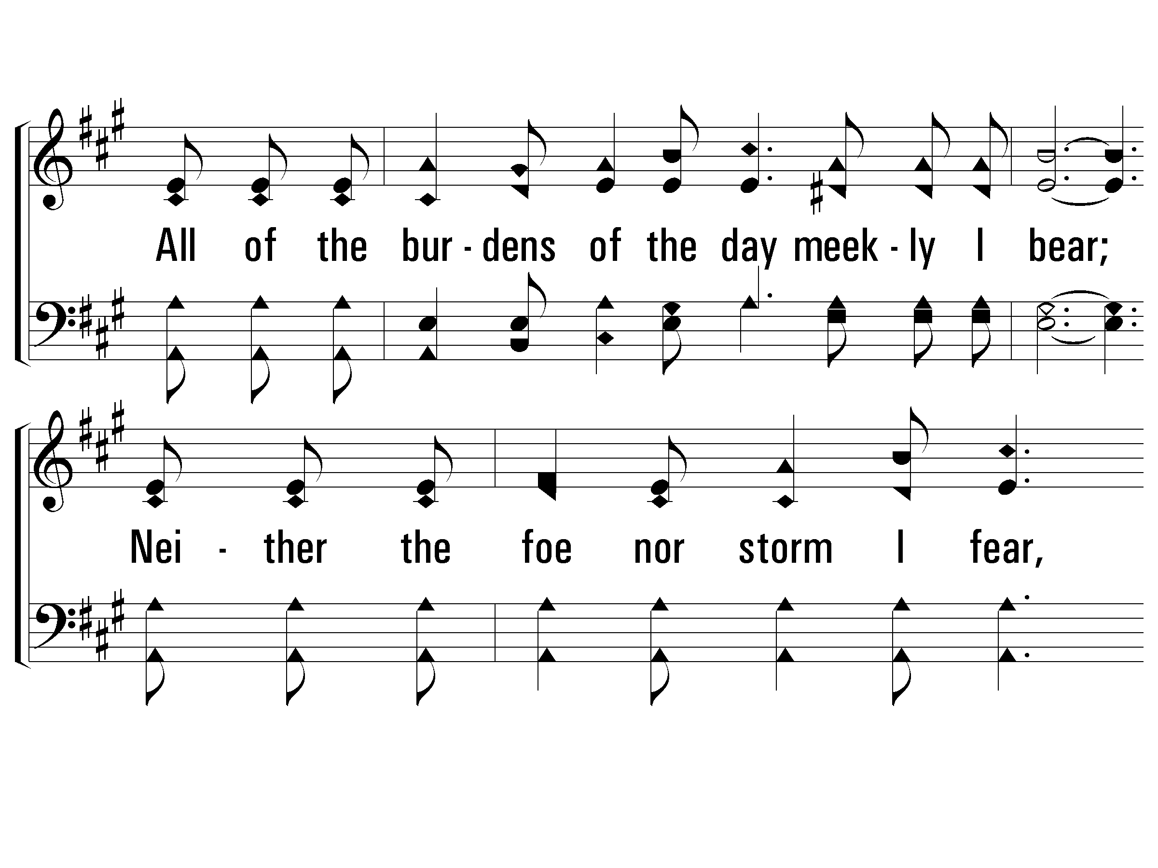
Verse 2
#404 – Looking to Thee

Slide 14
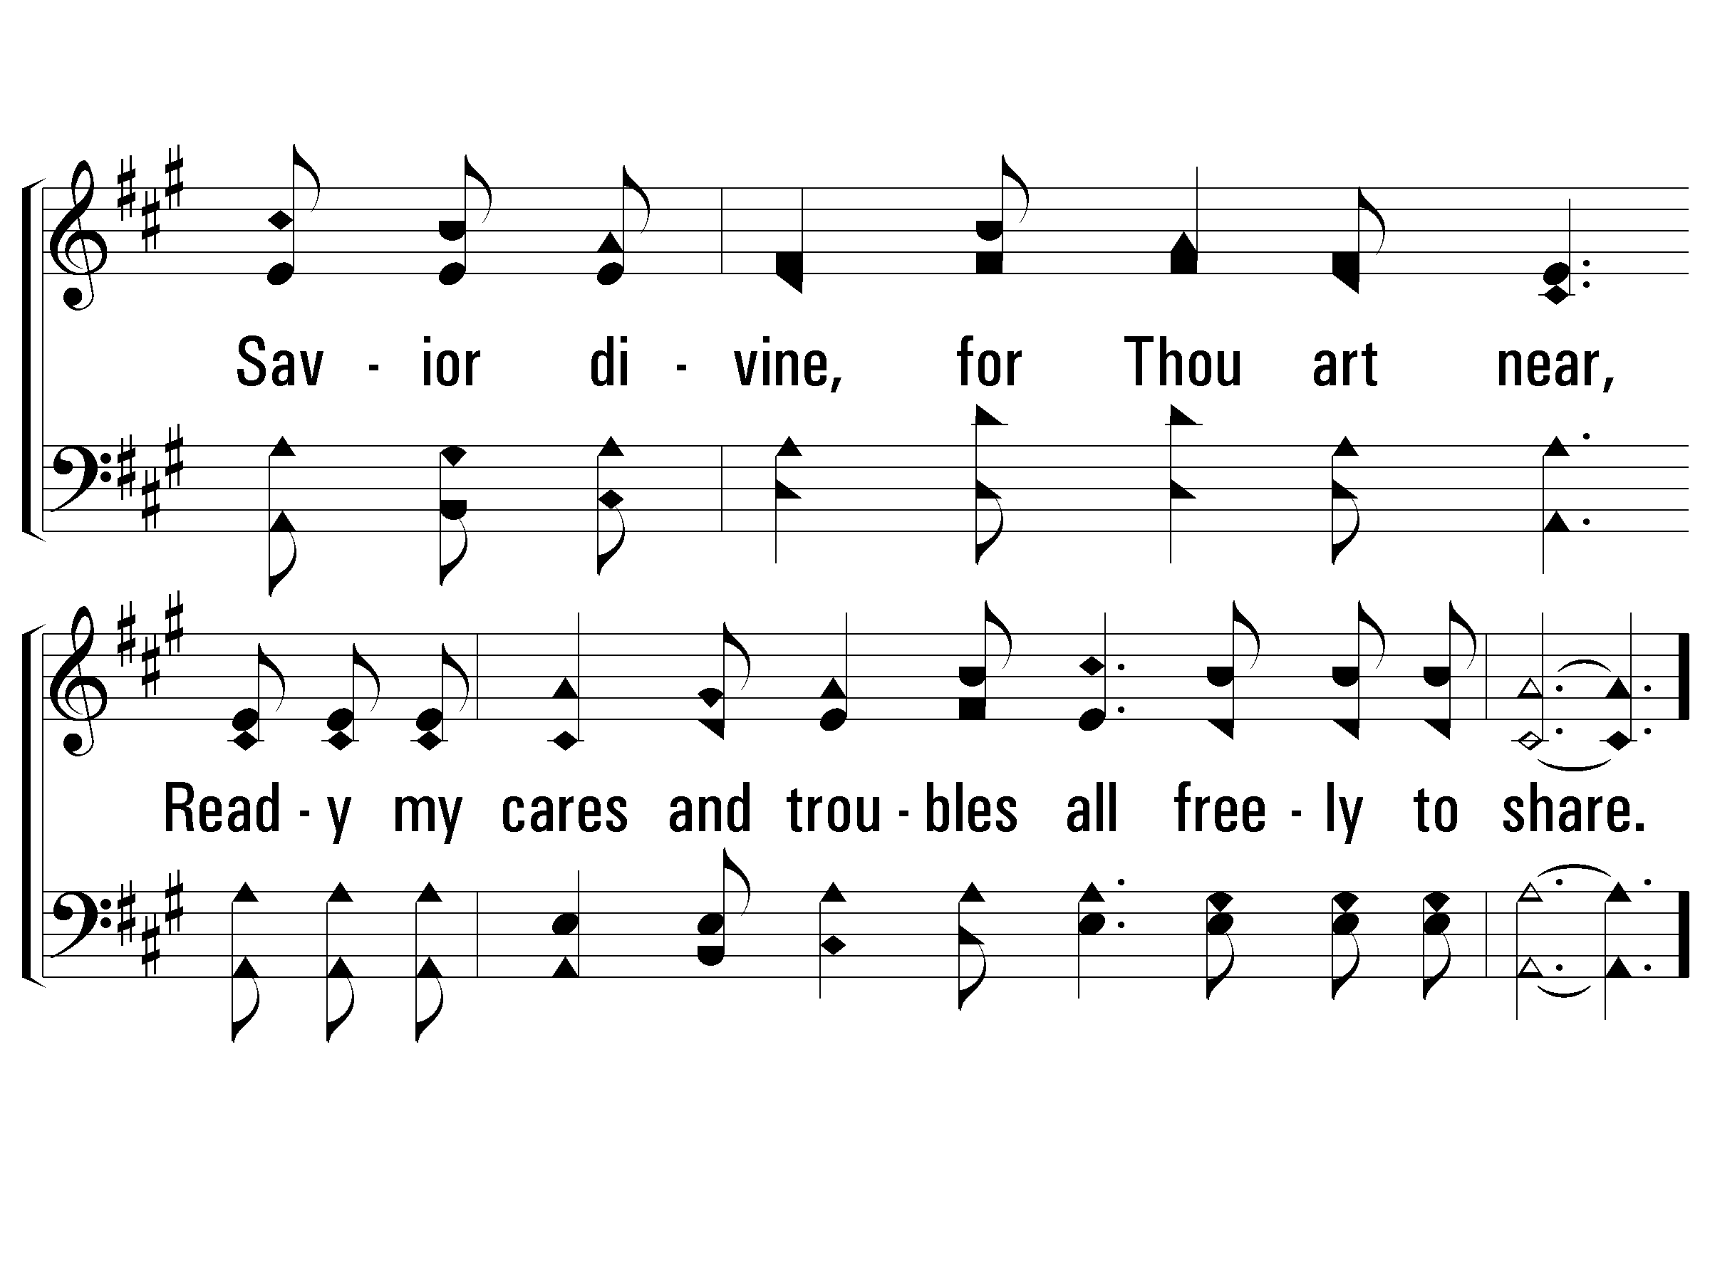
Verse 2
#404 – Looking to Thee

Slide 15
Chorus
#404 – Looking to Thee
Looking to Thee, Trusting Thy grace
I am as happy as a true soldier can be;
Nearing my own heavenly place
Trusting Thy love I press along,
looking to Thee.

Slide 16
Chorus
#404 – Looking to Thee

Slide 17
Chorus
#404 – Looking to Thee

Slide 18
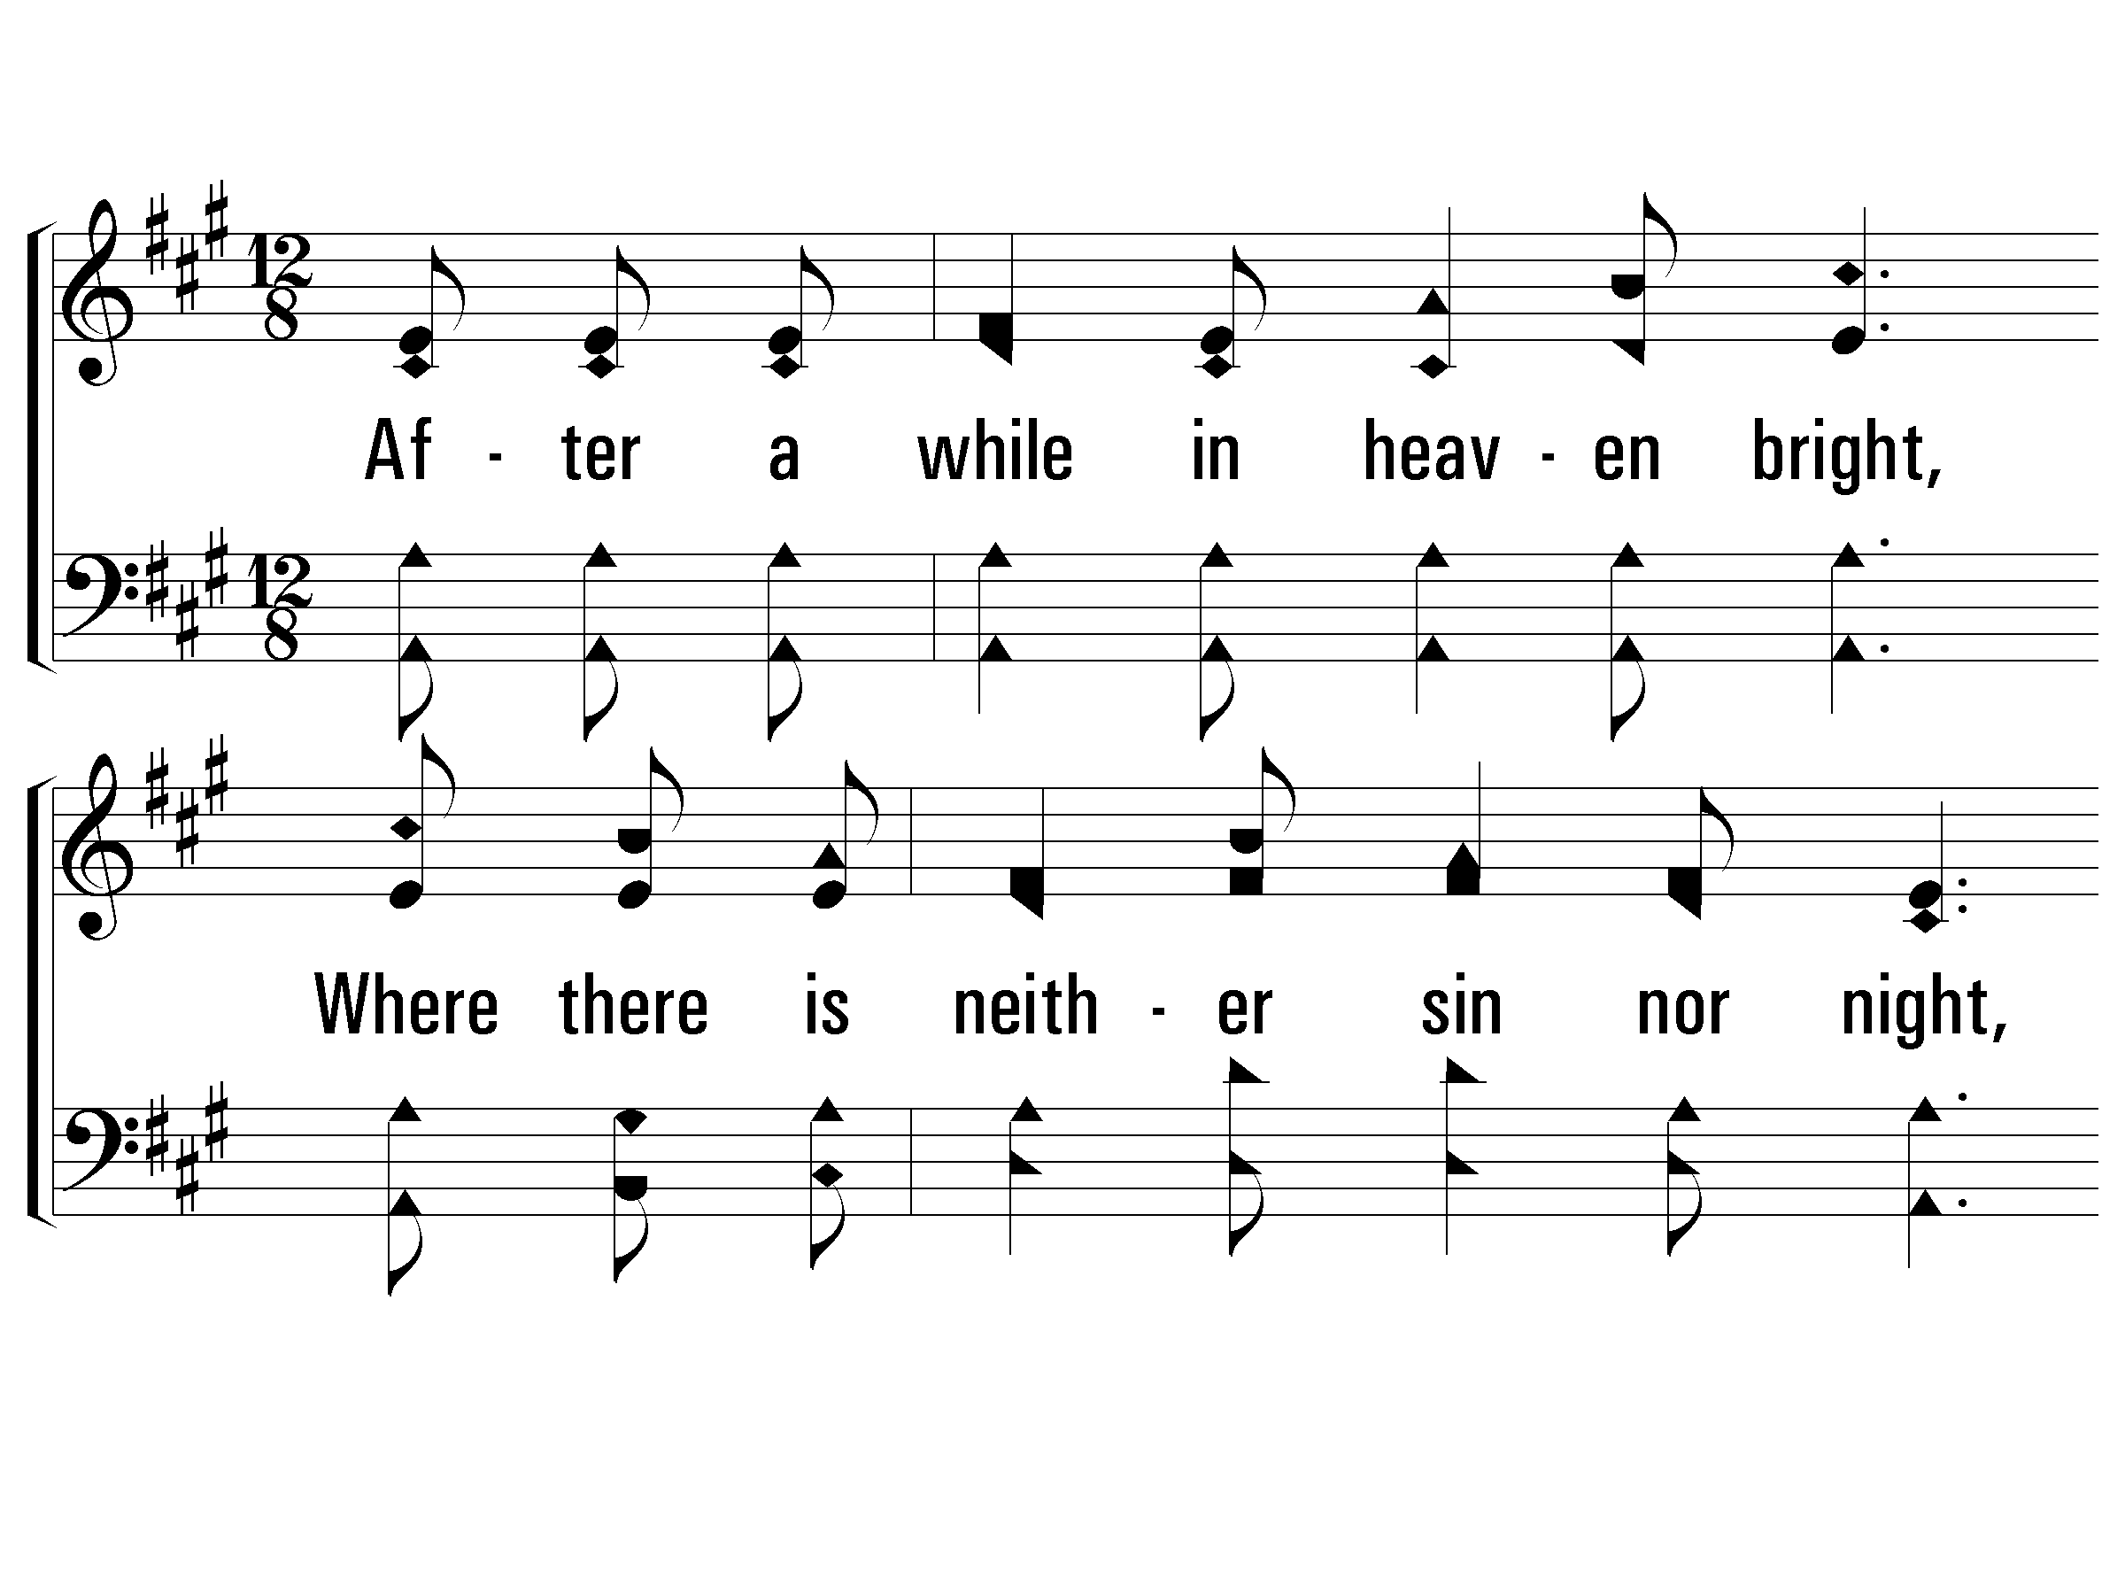
Verse 3
#404 – Looking to Thee
3.
After a while in heaven bright,
Where there is neither sin nor night,
I shall behold Thee, face to face, Jesus my own;
Then with the loved ones gone before,
I shall with rapture, more and more,
Praise Thee forever, near the bright, beautiful throne.

Slide 19
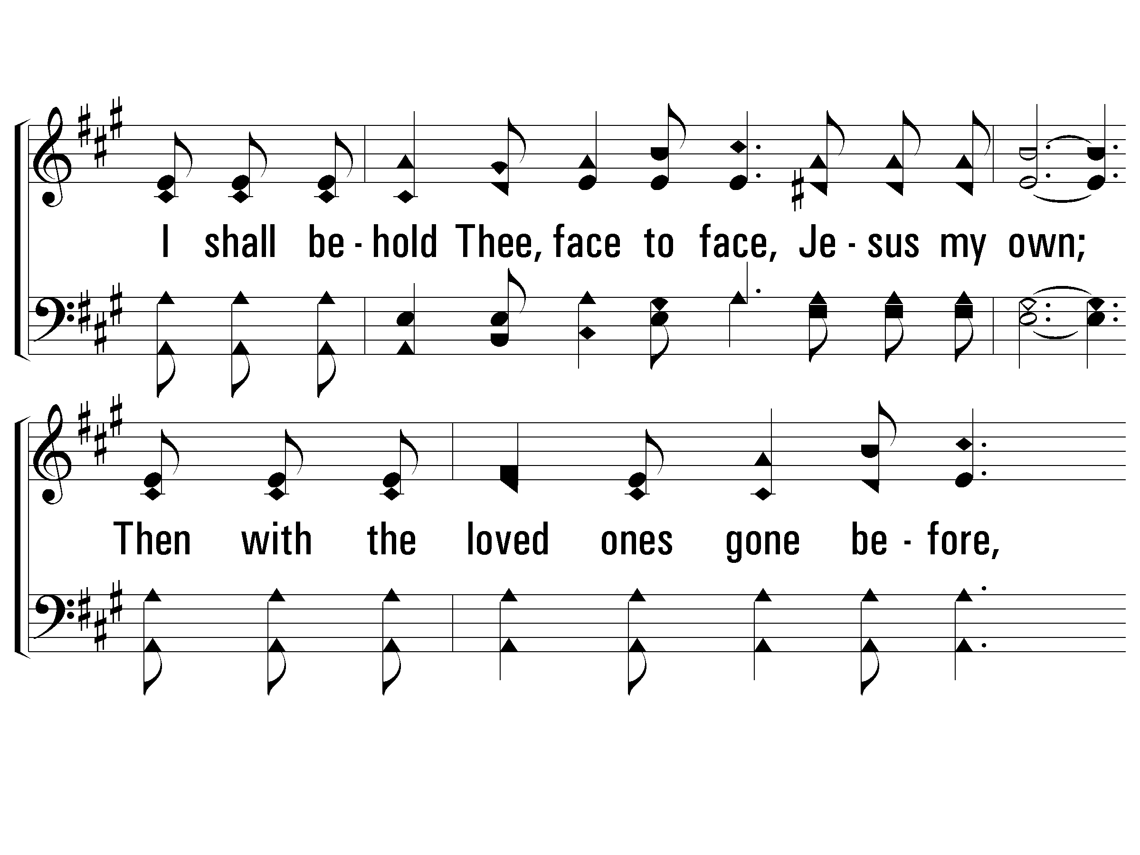
Verse 3
#404 – Looking to Thee

Slide 20
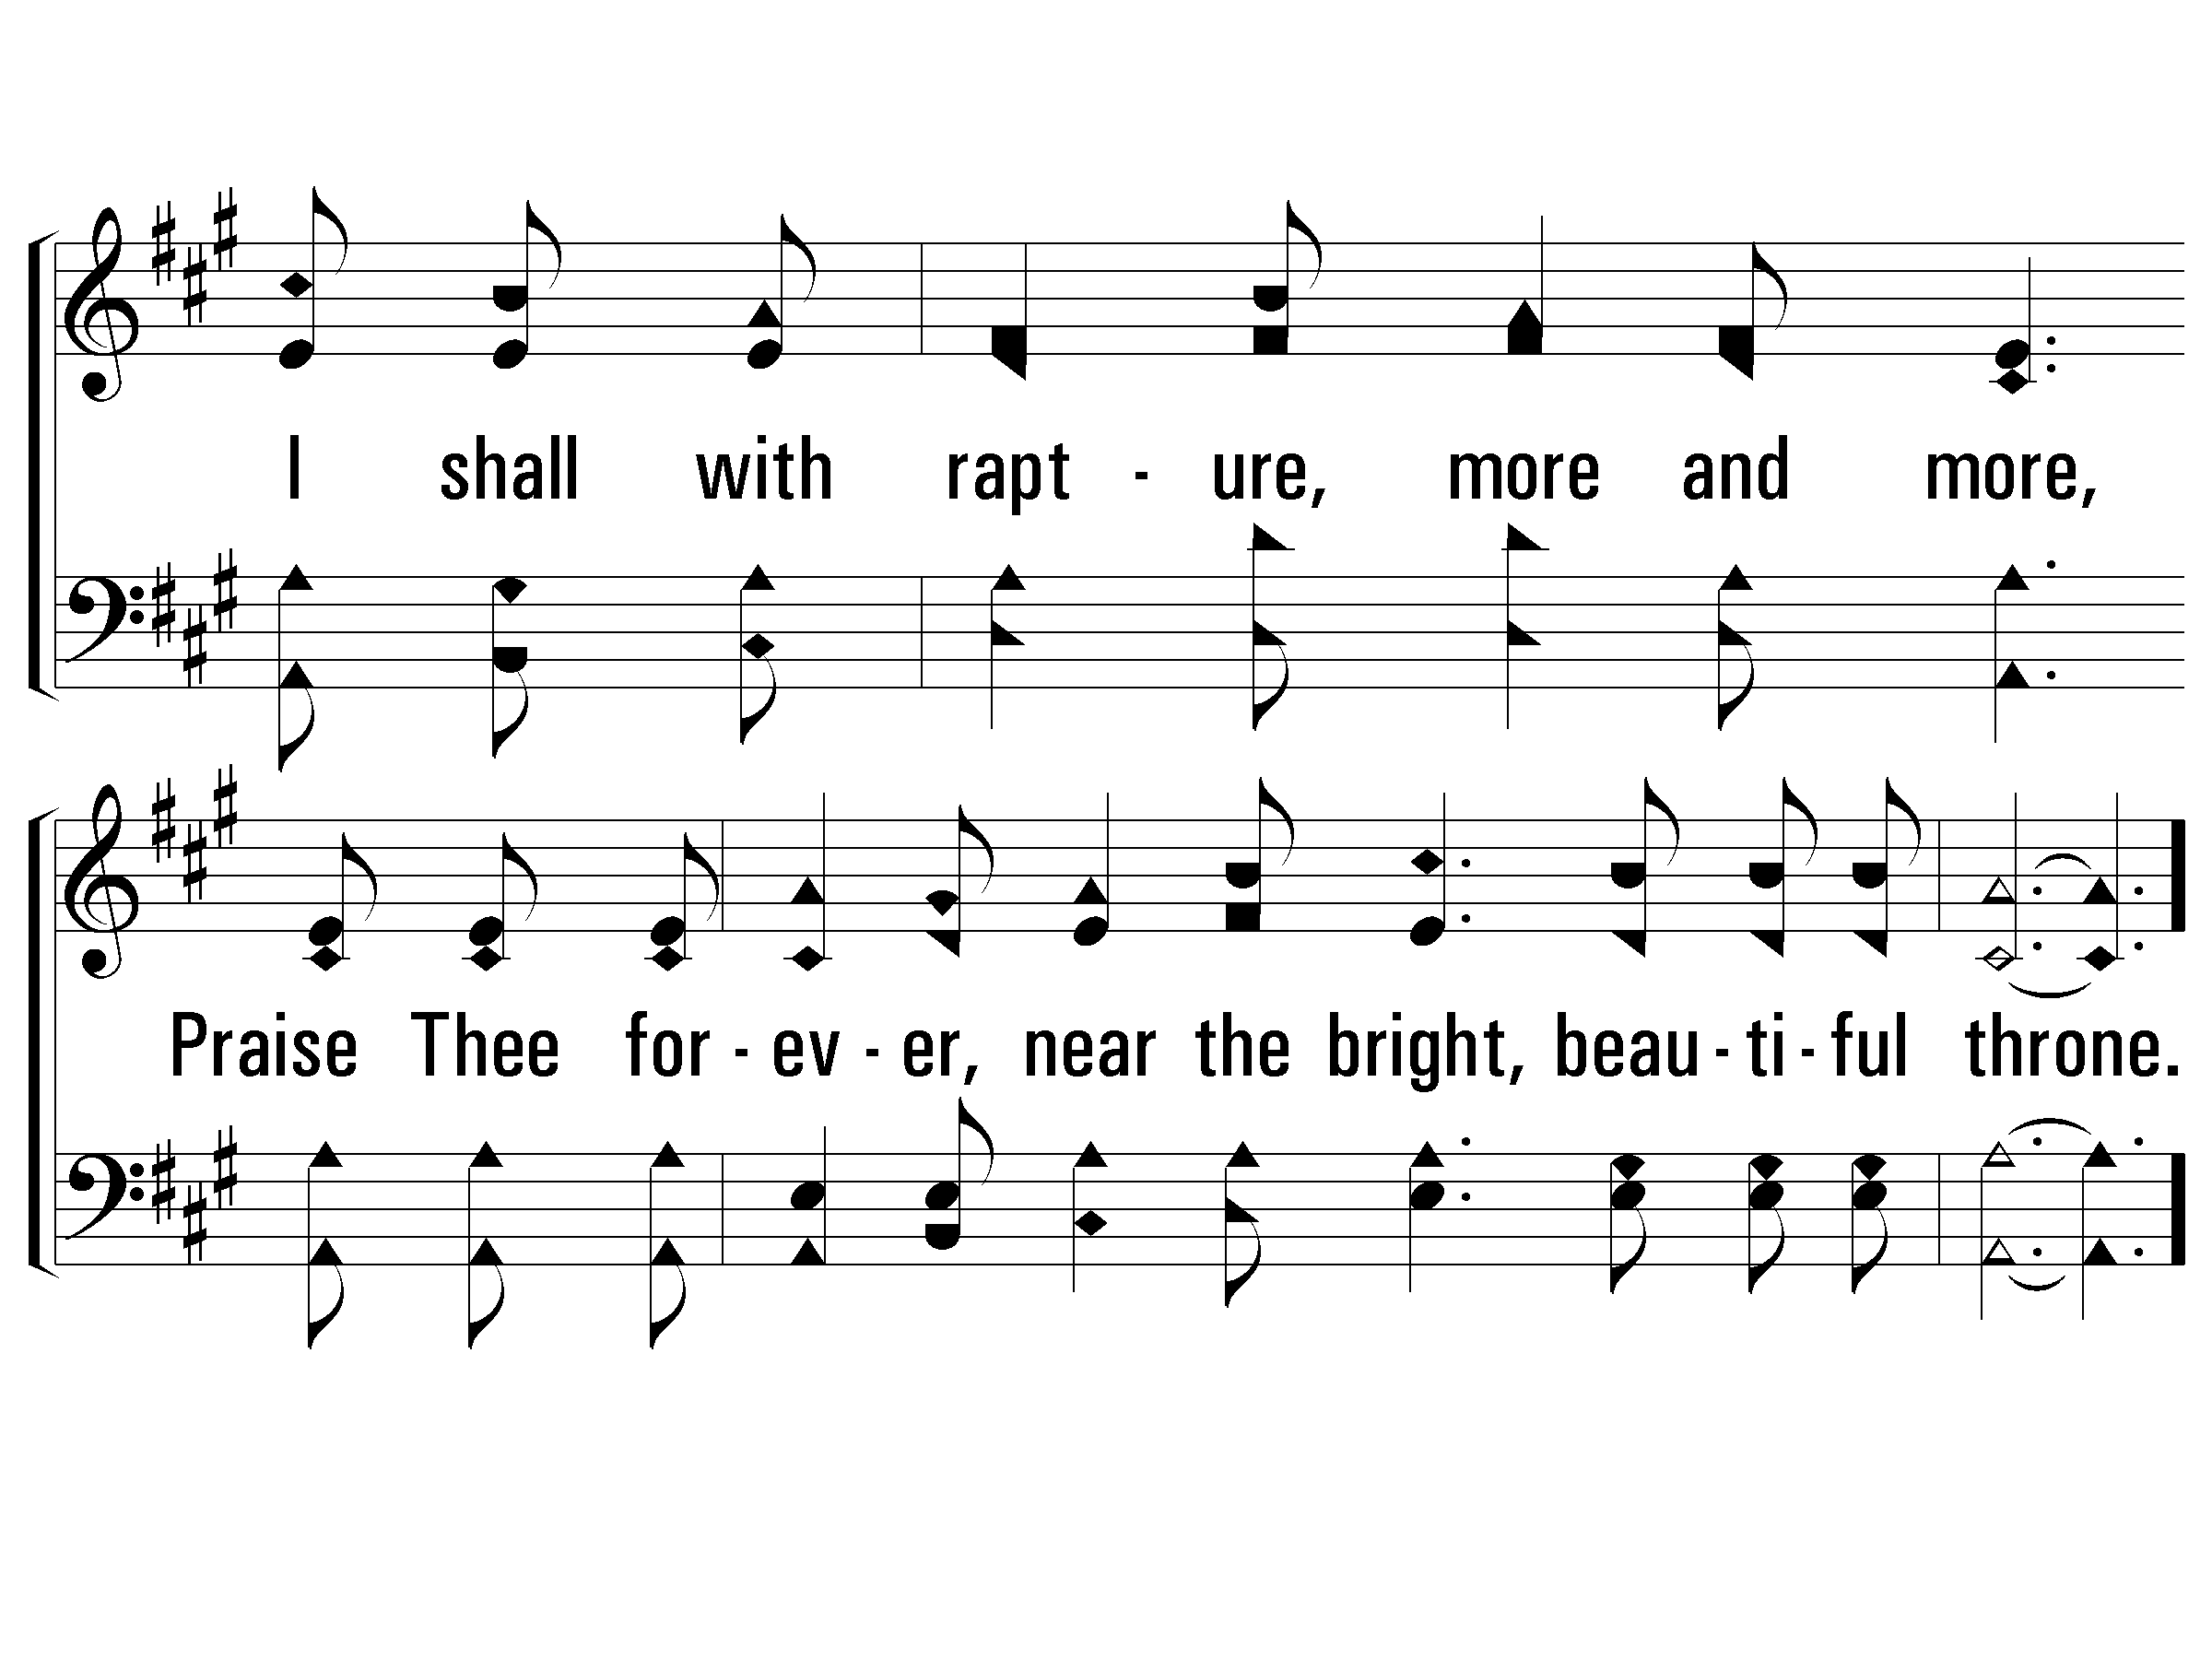
Verse 3
#404 – Looking to Thee

Slide 21
Chorus
#404 – Looking to Thee
Looking to Thee, Trusting Thy grace
I am as happy as a true soldier can be;
Nearing my own heavenly place
Trusting Thy love I press along,
looking to Thee.

Slide 22
Chorus
#404 – Looking to Thee

Slide 23
Chorus
#404 – Looking to Thee

Slide 24
Are You Confident in Your Deliverance?
Believe Jesus is God’s Son – John 20:30-31
Repent of your sins and turn to God – Acts 2:38
Confess your faith in Jesus – Matthew 10:32
Be immersed into Christ – Mark 16:16
God will forgive all of your sins – Acts 22:16
God will add you to His church – Acts 2:47
God will enroll you in heaven – Hebrews 12:23
Faithfully look to and serve the Lord – Hebrews 12:1-3

