Slide 2
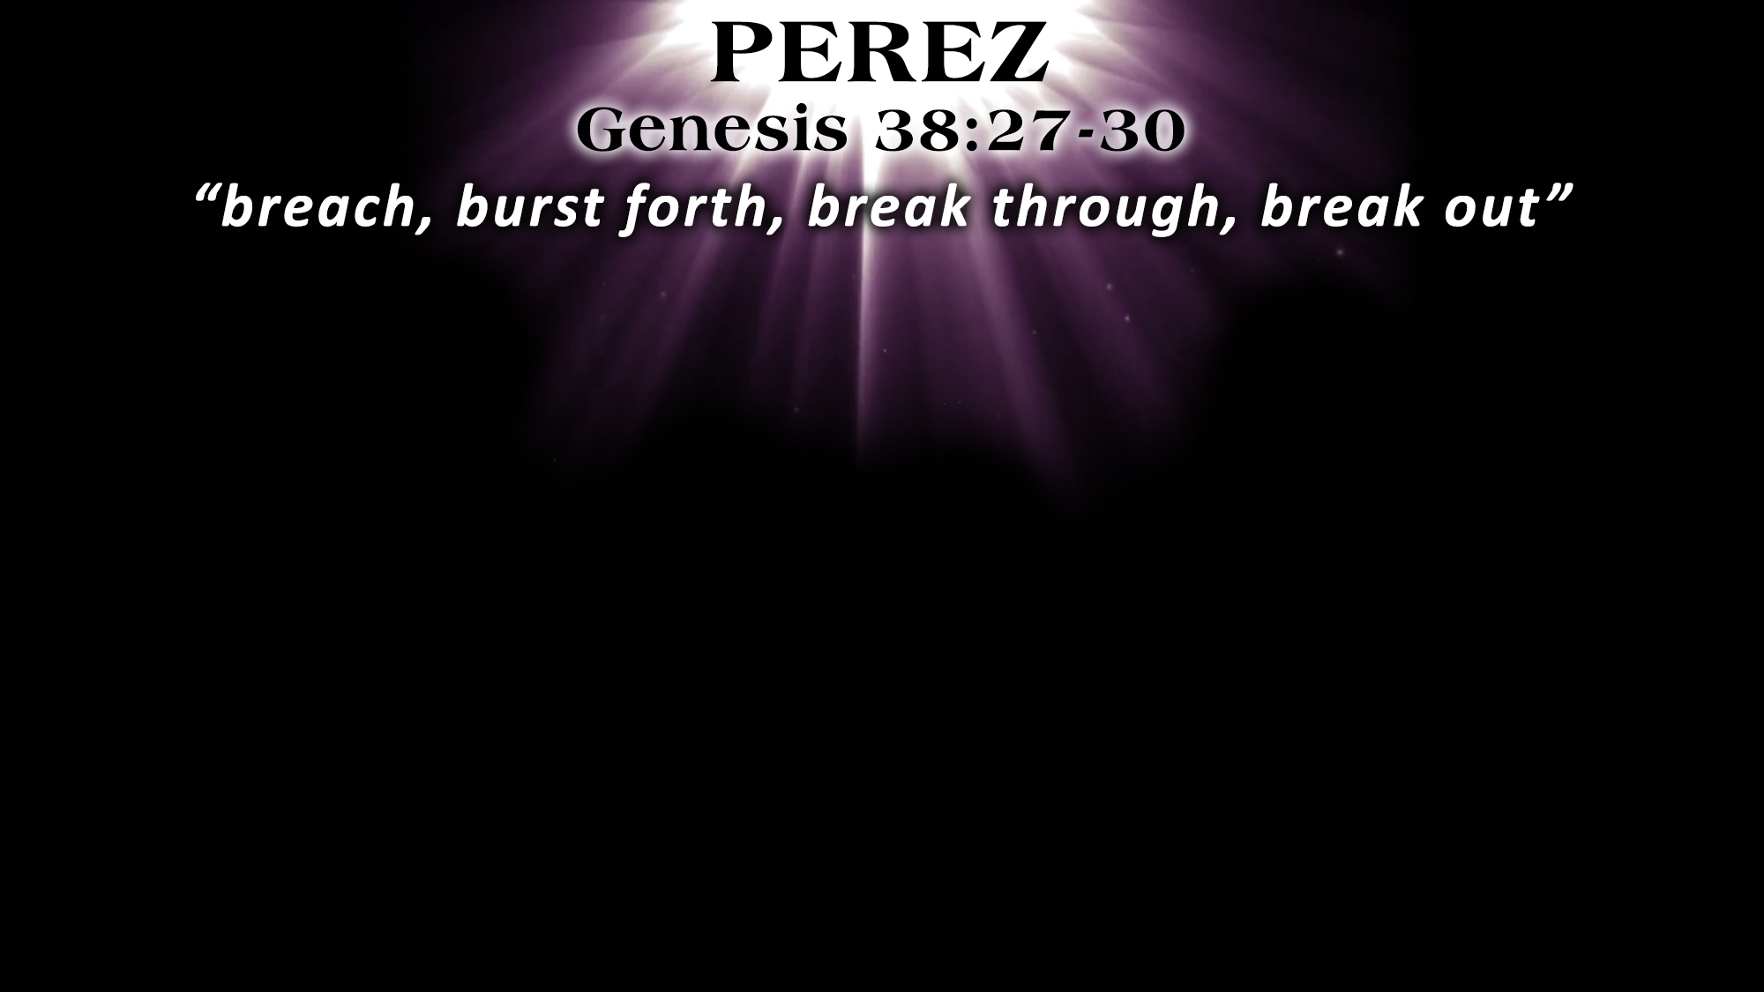
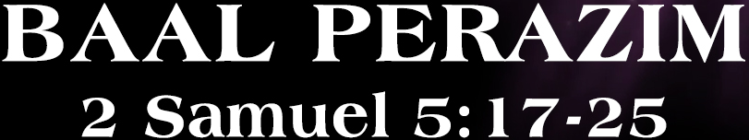
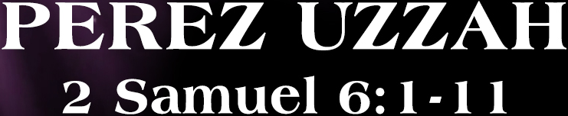
David went to battle against the Philistines
David was victorious over the Philistines
The Lord broke through the enemies
David named the place, BAAL PERAZIM
= “Master of Breakthroughs”
God broke through/out FOR His own
“David inquired of the Lord” (2 Sam. 5:19)
David had the ark placed on a new cart
Uzzah touched the ark (cf. Num. 4:15)
The Lord struck Uzzah dead
David named the place, PEREZ UZZAH
= “Breaking Through/Out Against Uzzah”
God broke through/out AGAINST His own
David “did not consult Him” (1 Chr. 15:13)

Slide 3
We Must Inquire of the Lord’s Will (i.e., Look in the Book!)
Regarding OUR PERSONAL LIVES
We must remember that:
“If God is FOR us, who can be AGAINST us?” (Rom. 8:31)
“The face of the Lord is against those who do evil” (1 Pet. 3:12)
Doing a “good” thing is not always a “right” thing (2 Sam. 6:6; Gal. 6:15)
We must “test all things” by God’s Word (1 Thess. 5:21-22)
This involves our moral choices, material choices, relational choices, marital choices, etc.

Slide 4
We Must Inquire of the Lord’s Will (i.e., Look in the Book!)
Regarding THE CHURCH
We must remember that:
The church of the Bible is God’s “own special people” (1 Pet. 2:9)
The Lord longs for His church to be victorious (Rev. 2:7, 11, 17, 26; 3:5, 12, 21; 21:7)
We must do “all things” according to His Word (Col. 3:17)
If we step outside His authority, we have “have not God” (2 John 9)
The church (and everything it does) belongs to the Lord, not man (Eph. 1:22-23)
This involves what we do (in worship, leadership, etc.) and what we teach (regarding salvation, how to get to heaven, etc.)

Slide 5
Become His child through faith in Christ – John 1:12
Become His child through repentance of sin – Luke 13:3
Become His child through confession of faith – Romans 10:9
Become His child through immersion in water – John 3:3-5
  God will forgive all of your sins – Acts 2:38
  God will add you to His church – Acts 2:47
  God will register you in heaven – Hebrews 12:23
Remain faithful as His child through obedience – Matt. 7:21

