Slide 2
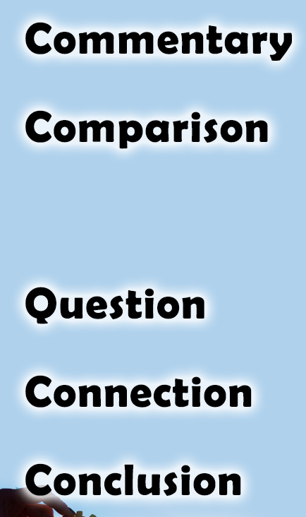
1 Corinthians 12:12-14
There is not one joint in your body that is not important
(The proper function of your body needs every joint operating)
There is not one member of Christ’s body who is not important
(The proper function of Christ’s body needs every member operating)
What work are you doing in the church?
Paul emphasizes the importance of each member by naming
26 members in Romans 16:3-16 & 10 members in Colossians 4:7-17
You are important to the church!

Slide 3
1 Corinthians 12:15-18, 27
Each part of your body is its own individual and serves the good of the body in its own way (with unique abilities/designs)
Each part of Christ’s body is its own individual and serves the good of the body in its own way (with unique interests/talents)
What are you personally doing for the Lord?
Who asked Lydia (Acts 16:15), Aquila & Priscilla (Acts 18:26), Barnabas (Acts 4:36-37) & Epaphras (Col. 4:12) to serve as they did?
You are responsible for your individual part as a Christian!

Slide 4
1 Corinthians 12:19-26
The health and growth of your body needs every part operating together
The health and growth of Christ’s body (numerically and spiritually) needs every part operating together
How are you personally contributing to the health and growth of the church?
The church grew (numerically & spiritually) in Acts when the members worked (6:1-7; 9:31; 11:19-24; 17:1-4, 10-12; 18:7-8)
You are integral and influential to the healthy growth of the church!

Slide 5
Believe Jesus is God’s Son – John 20:30-31
Repent of your sins and turn to God – Acts 3:19
Confess your faith in Jesus Christ – Romans 10:9
Be immersed into Christ – Mark 16:16
  God will forgive all of your sins – Acts 2:38
  God will add you to His church – Acts 2:47
  God will register you in heaven – Hebrews 12:23
Be faithfully active in His service – Ephesians 4:16

