Slide 1
To Make My Marriage Stronger
Press On,
Notes:
The theme for the month of February
There will be other lessons this month on marriage

Slide 2
To Make Marriage Stronger
Press On,
Notes:
I want us to focus this morning on the concept and the institution of marriage.
We can all play a part in making marriage stronger. We can all play a part in promoting God’s view of marriage.

Slide 3
TRUTH
Notes:
It is no surprise to you that truth is under attack. Not any particular truth but truth as a concept. It is being redefined, molded and shaped to fit the whims and concerns of the masses or those that cry loudest of injustice.
When truth can be changed and everyone can have a truth, we have loosed the moorings. We are adrift in the sea of subjective thoughts and personal feelings. Facts can be changed and information can be weaponized and used against anyone, ask Judge Kavanaugh.
When truth erodes, long standing individual truths will begin to come under attack. One truth that is under attack and in the cross hairs of the re-definer’s fire is Marriage.

Slide 4
Postmodernism
Notes:
postmodernism can only be described, not defined. Attempting to define it violates the postmodernists premise that no definite terms, boundaries, or absolute truths exist.
Truth is relative. “The naturalists have their story, the pantheists theirs, the Christians theirs, ad infinitum. With postmodernism, no story can have any more credibility than any other. All stories are equally valid, being so validated by the community that lives by them,”
“Postmodernism argues that people are fundamentally subjective because their unique beliefs and values alter the way they organize factual data. Thus, the narratives they construct around data will also be subjective.”
It questions everything and provides answers for nothing.

Slide 5
Boy or Girl?
Notes:
Did we ever think we would have these discussions?
Which one is a boy and which one is a girl?
There are groups that are now promoting transitioning of children as early as 18 months.
Gender dysphoria is a real disorder. A very small percentage of children have it.

Slide 6
Notes:
Trans Student Educational Resources is a youth-led organization dedicated to transforming the educational environment for trans and gender nonconforming students through advocacy and empowerment. In addition to our focus on creating a more trans-friendly education system, our mission is to educate the public and teach trans activists how to be effective organizers.
Each of the categories is independent from the others. The concept of gender is different for everyone.
October 19 2018 Palm Beach County schools revised two of its policies to further protect and ensure the equity of lesbian, gay, bisexual, transgender, and queer students.
The School Board made a new addition to the pledge, ensuring that educators will not discriminate against any student due to “sexual orientation, gender, gender expression and/or gender identity.” They also broadened the scope of discrimination to include student’s “political beliefs, marital status, and linguistic preference.” and “to show School Board’s commitment to eliminating race, ethnicity, gender, gender identity, sexual orientation, disability or socioeconomic status as predictors for academic success.”
The policy also vows to have educator instruction “expand the knowledge, understanding, and awareness of LGBTQ studies and the LGBTQ social movements.”

Slide 7
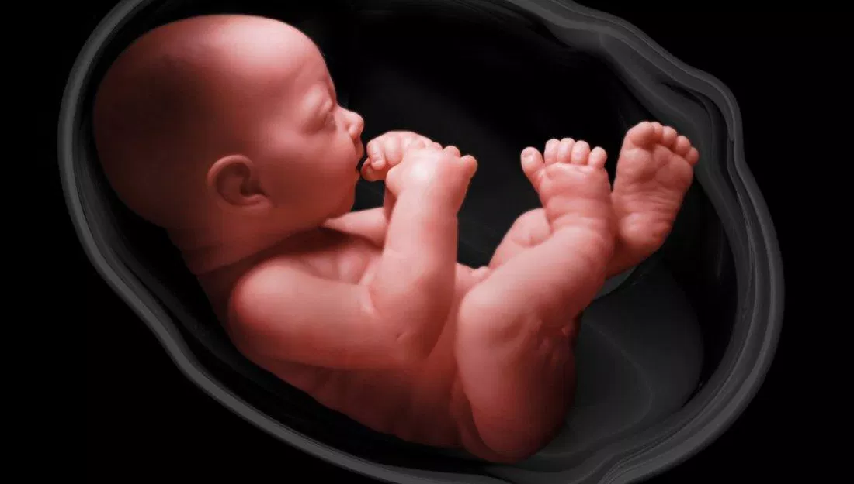
Child or Choice?
Notes:
1973 Roe vs Wade ruling allowing abortions in the first trimester blew the barn doors wide open.
Recently, New York is the latest state to join the ranks of states allowing abortion up to birth. Alaska, Colorado, New Hampshire, New Jersey, New Mexico, New York, Oregon, and Vermont, along with Washington, D.C.
A columnist in the New York Post wrote an article entitled “The abortion debate: NY’s new law is about saving lives” Fact less than 1% of abortions are to save the mother. Fact, 100% of abortions take a life.
From 1995 to 2015 (The latest info from CDC) of the states that reported to the CDC there were 17.000,686 abortions.
On a radio interview Virginia Gov. Ralph Northam spoke in his support of the “Repeal Act” that would remove all restrictions on abortion. Even allowing abortions while a mother was in labor. He said that he was in favor of allowing infants to die even after birth.
When you can argue that killing a born child is okay, then it is a short step to mercy killings of the aged.

Slide 8
Make Marriage Stronger
Pursue the truth
Marriage brings together two people who love each other.
Marriage is about being with someone who makes you happy.
A marriage certificate is just a piece of paper.
Marriage has changed over the years; it used to be about property rights, now it's about love.
The U.S. Supreme Court in 2015, said marriage was about, "certain personal choices central to individual dignity and autonomy, including intimate choices that define personal identity and beliefs."
Notes:
Obergefell v. Hodges, 576 U.S. ___ (2015) "[T]he right to marry is a fundamental right inherent in the liberty of the person, and under the Due Process and Equal Protection Clauses of the Fourteenth Amendment couples of the same-sex may not be deprived of that right and that liberty.“
The institution of marriage
“If marriage is redefined out of existence, our entire society will be harmed, but the harm will be distributed unequally. In the libertine utopia of "sexual freedom," women and children will suffer the most.” David Tubbs, City Journal Summer 2004
Society is based on marriage. When God made man and made him to populate the earth and subdue it and have dominion over it. He didn’t create a form of government. He made marriage. Which speaks to its strength of what God had designed.

Slide 9
Make Marriage Stronger
Pursue the truth
And He answered and said, “Have you not read that He who created them from the beginning made them male and female, and said, ‘For this reason a man shall leave his father and mother and be joined to his wife, and the two shall become one flesh’? So they are no longer two, but one flesh. What therefore God has joined together, let no man separate.”
Matthew 19:4-6

Slide 10
Make Marriage Stronger
Pursue the truth
“Have you not read” – There is authoritative teaching.
“He who created them” – There is a supreme authority.
“From the beginning” – It is not cultural
“Made them male and female” – Only two genders
Matthew 19:4

Slide 11
Make Marriage Stronger
Pursue the truth
“For this reason” – Previously mentioned authority.
“A man shall leave his father and mother and be joined to his wife, and the two shall become one flesh. So they are no longer two, but one flesh” – Definition of marriage.
“What therefore God has joined together, let no man separate” – It is God ordained and binding.
Matthew 19:5-6

Slide 12
Make Marriage Stronger
Preserve the truth
Children need to be taught about Biblical marriage.
Thorns and snares are in the way of the perverse;
He who guards himself will be far from them.
Train up a child in the way he should go, Even when he is old he will not depart from it.
Proverbs 22:5-6
Notes:
We all know there’s no perfect relationship out there, but if a marriage doesn’t serve you anymore, what’s the point of being in it? Because you took some vows that were created years and years ago when people were dying at young ages?
It’s perfectly acceptable and okay to be in a relationship and leave it and go to the next one and grow and evolve.
We need to redefine what marriage is. I think it’s important. We don’t need to listen to church or religion anymore. We need to listen to the way the world is and grow.
“Is Marriage An Outdated Tradition?” David Wygant
Alexis de Toqueville (French diplomat and political scientist 1805-1859)
Democracy in America
“Society in endangered not by the great licentiousness of a few, but by the laxity of morals amongst all.”
“There is no just ground for surprise if a man, who in the age aristocracy chooses to consult nothing but his own opinion and his own taste in the choice of a wife, soon finds that infractions of morality and domestic wretchedness invade his household, but, when the same line of action is in the natural and ordinary course of things, when it is sanctioned by parental authority and backed by public opinion, it cannot be doubted that the internal peace of families will be increased by it.”

Slide 13
Make Marriage Stronger
Preserve the truth
We need to do all we can to protect our own marriages.
With all humility and gentleness, with patience, showing tolerance for one another in love, being diligent to preserve the unity of the Spirit in the bond of peace.
Ephesians 4:2-3

Slide 14
Make Marriage Stronger
Preserve the truth
We need to do all we can to protect our own marriages.
But now you also, put them all aside: anger, wrath, malice, slander, and abusive speech from your mouth. Do not lie to one another, since you laid aside the old self with its evil practices, and have put on the new self who is being renewed to a true knowledge according to the image of the One who created him. So, as those who have been chosen of God, holy and beloved, put on a heart of compassion, kindness, humility, gentleness and patience; bearing with one another, and forgiving each other, whoever has a complaint against anyone; just as the Lord forgave you, so also should you.
Colossians 3:8-9,11-13

Slide 15
Make Marriage Stronger
Promote the truth
There are a lot of lies about marriage.
We need to stand up and be counter cultural in the views and information that we spread about marriage.
“This is what God has said.”
Notes:
“If you’re not compatible, you may have married the wrong person.”
“The grass is greener on the other side.”
“If you’re not happy, don’t stay in an unhappy situation. You deserve more.”
“Divorce is always an option.”
“Your kids should come first because they need you more.”
“You may have just fallen out of love.”
“Your marriage is beyond repair. Once trust is broken, it can never be restored.”
“Marriage is a 50/50 relationship.”
Marriage provides the foundation for the family, and the family is the fundamental building block of all human civilizations. Marriage unites a husband and wife, and, marriage unites parents with any children they have, thus setting the stage for the next generation.

Slide 16
Make Marriage Stronger
Promote the truth
We need to model proper marriages.
What we say and what we do.
How we love.
How we resolve conflict.
How we raise children.
How we maintain the home.
Roles of man and woman in marriage.
Notes:
“If you’re not compatible, you may have married the wrong person.”
“The grass is greener on the other side.”
“If you’re not happy, don’t stay in an unhappy situation. You deserve more.”
“Divorce is always an option.”
“Your kids should come first because they need you more.”
“You may have just fallen out of love.”
“Your marriage is beyond repair. Once trust is broken, it can never be restored.”
“Marriage is a 50/50 relationship.”
Marriage provides the foundation for the family, and the family is the fundamental building block of all human civilizations. Marriage unites a husband and wife, and, marriage unites parents with any children they have, thus setting the stage for the next generation.

Slide 17
Make Marriage Stronger
Promote the truth
10. IT'S SAFER. Marriage lowers the risk that both men and women will become victims of violence, including domestic violence.
9. IT CAN SAVE YOUR LIFE. Married people live longer and healthier lives.
8. IT CAN SAVE YOUR KID'S LIFE. Children lead healthier, longer lives if parents get and stay married.
Notes:
University of Chicago scholar Linda J. Waite compiled scientific evidence of the consequences of marriage in adults.
City Journal “Why Marriage is Good For you” Mary Gallagher

Slide 18
Make Marriage Stronger
Promote the truth
7. YOU WILL EARN MORE MONEY. A broad and deep body of scientific literature suggests that for men especially, marriage is a productive institution.
6. YOU WILL MANAGE MONEY BETTER. Married people not only make more money, they manage money better and build more wealth together than either would alone.
Notes:
University of Chicago scholar Linda J. Waite compiled scientific evidence of the consequences of adults in marriage.
City Journal “Why Marriage is Good For you” Mary Gallagher

Slide 19
Make Marriage Stronger
Promote the truth
5. MORE FAITHFULNESS IN MARRIAGE. Marriage increases sexual fidelity compared to cohabitation.
4. IMPROVED MENTAL HEALTH. Marriage is good for your mental health.
3. IT WILL MAKE YOU HAPPY. For married people, the joys of the single life and of divorce are overrated.
Notes:
University of Chicago scholar Linda J. Waite compiled scientific evidence of the consequences of adults in marriage.
City Journal “Why Marriage is Good For you” Mary Gallagher

Slide 20
Make Marriage Stronger
Promote the truth
2. YOUR KIDS WILL LOVE YOU MORE. Divorce weakens the bonds between parents and children over the long run.
1. THE MARRIAGE BED IS BETTER. Despite what popular culture would have us believe.
Notes:
University of Chicago scholar Linda J. Waite compiled scientific evidence of the consequences of adults in marriage.
City Journal “Why Marriage is Good For you” Mary Gallagher

Slide 21
Make Marriage Stronger
Pursue the truth
Preserve the truth
Promote the truth
Notes:
University of Chicago scholar Linda J. Waite compiled scientific evidence of the consequences of adults in marriage.
City Journal “Why Marriage is Good For you” Mary Gallagher

