Slide 2
Paul Pressing at Philippi
  Pressing involves a decision (3:12-14)
  Pressing involves joy (1:4)
  Pressing involves sacrifice (2:17)
  Pressing involves rewards (4:17)
Pressing On and Mission Sunday

Slide 3

January 27
Every dollar given on Mission Sunday
goes toward mission work.

Slide 4
This will NOT be projected
Must have $91,600 to cover our base/committed works (LARGEST base we’ve ever had, by far)
Nnanna Aforji (Nigeria) – supported him since 1994
Tamuka Arunashe (Zimbabwe) – since 1994 (horrible inflation; basic necessities not available; political
Robert Martin (Pacific) – since 1989
Joey Treat (Pacific) – since 2004 (Own TV network, 1 of 3 on island)
Wayne Parker (Pacific) – began supporting 2017 (in Pohnpei)
Mauricio Yegros (Hispanics in Coral Springs) – since May 2013
Tavaro Hanna (Eight Mile Rock, Grand Bahama) – since 2017
Brad Shelt (Sunset School of Preaching) – graduates in December; now engaged; wedding in May, ‘19
Apologetics Press – since 1986 (oversight since 2004)
  “Defending the Faith Study Bible” – to be published this December
  Website, new publications, speaking around the country, etc.
Sr. High & Adult Summer Mission Trip
  Combining Sr. High w/ adults – limited # adults can go, must complete application – see Josh
Josh Blackmer to Easter Island – TWO trips in 2019
House to House/Heart to Heart
  Monthly publication to Approx. 3300 homes each month
  Routes will rotate each month on a quarterly basis, each home receiving 4 issues in the year

Slide 5

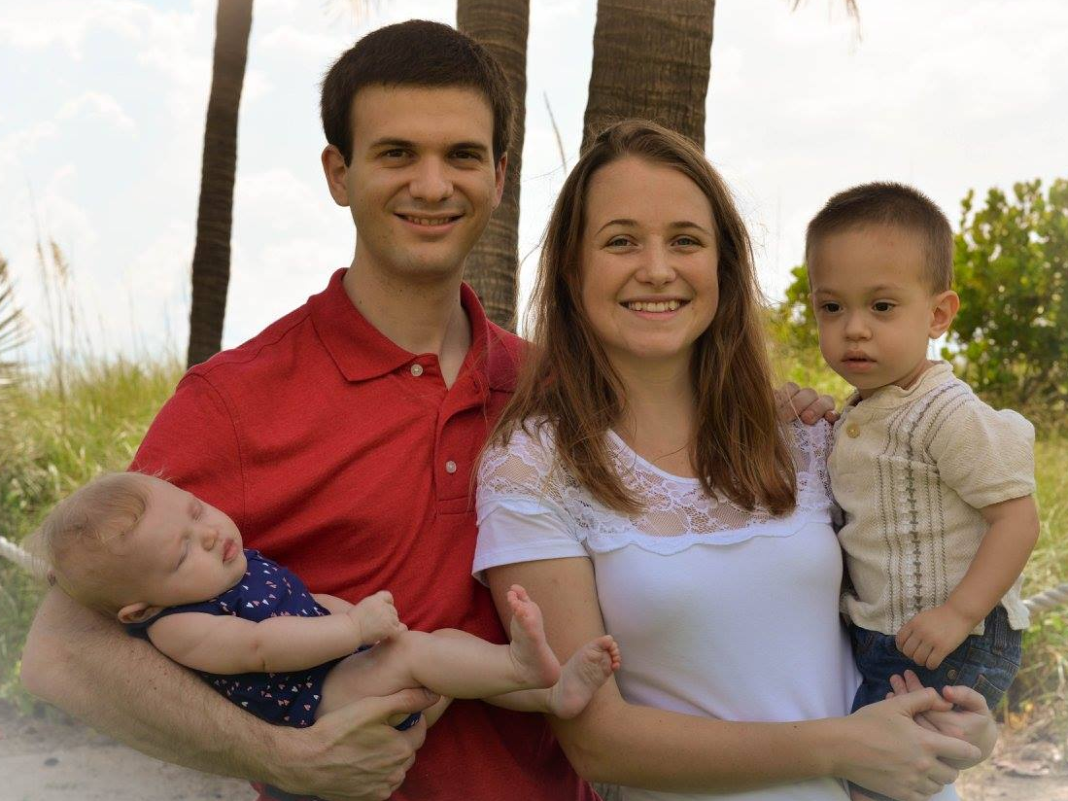

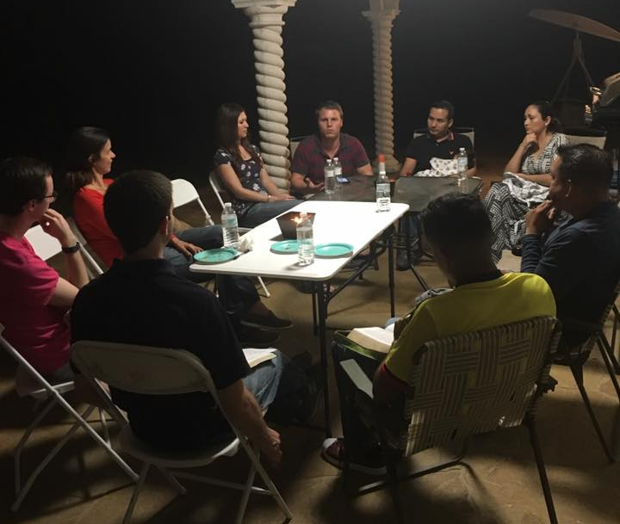
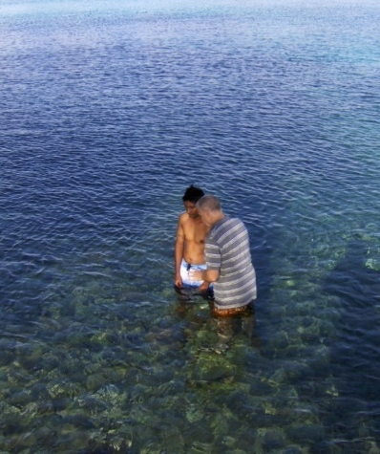

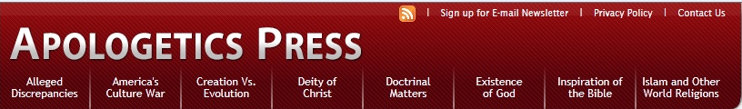
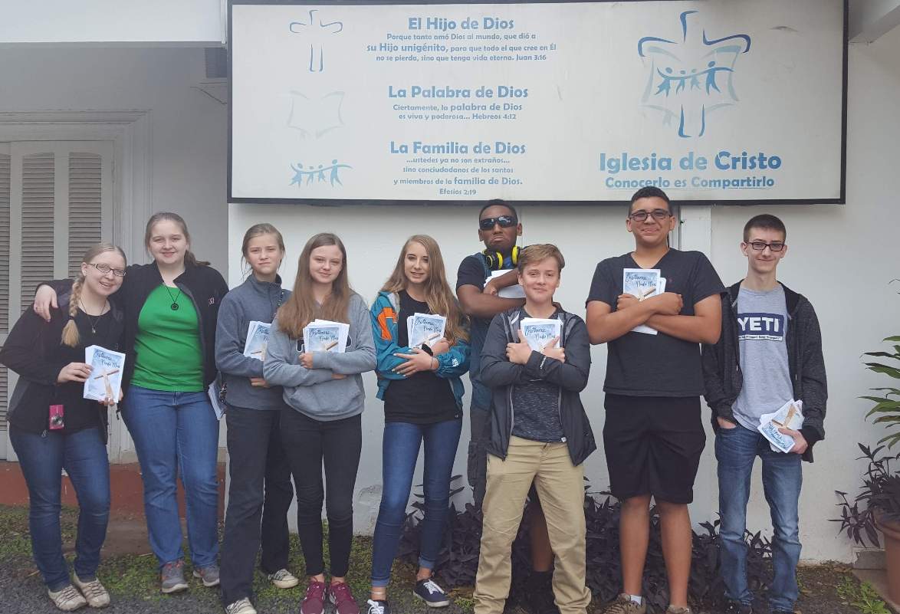
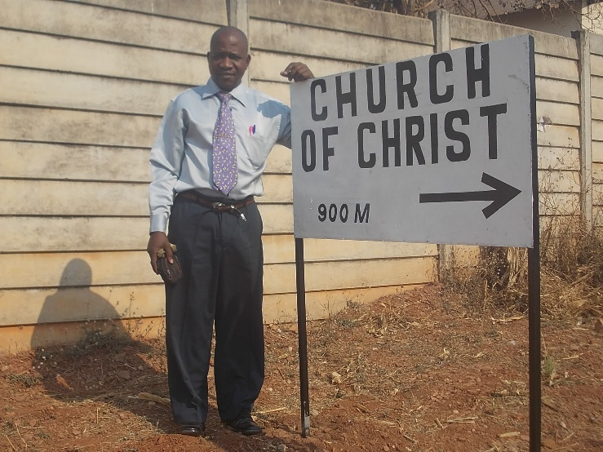

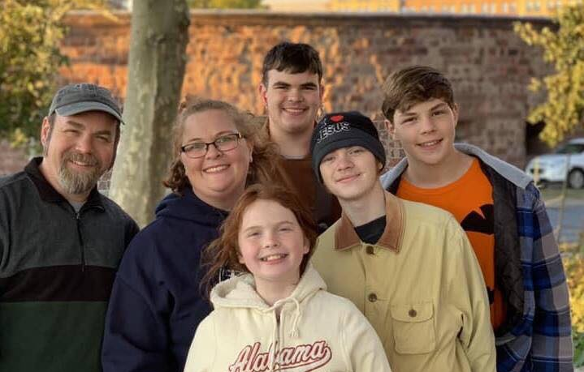
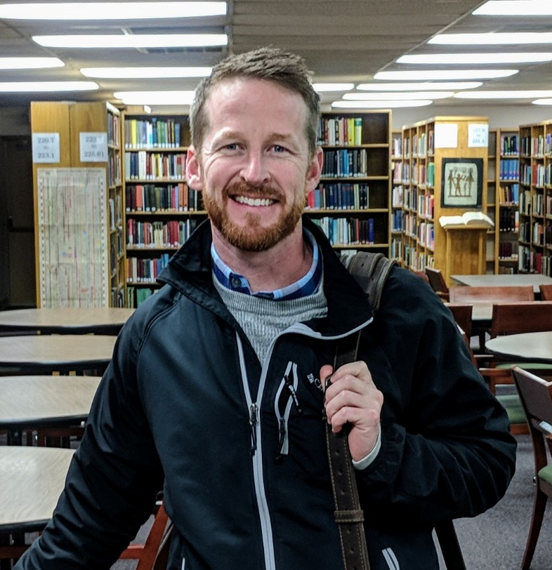

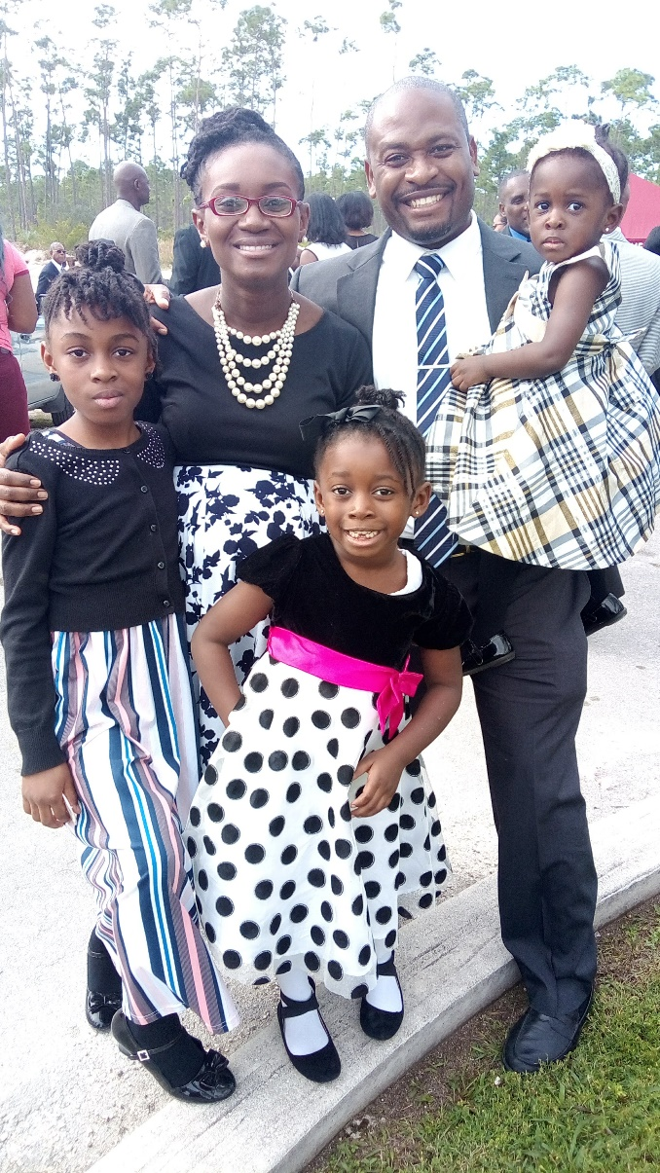

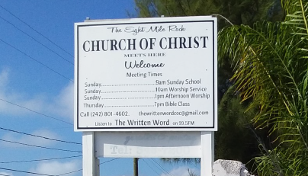
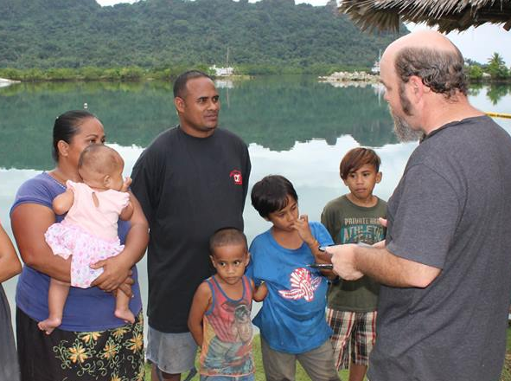
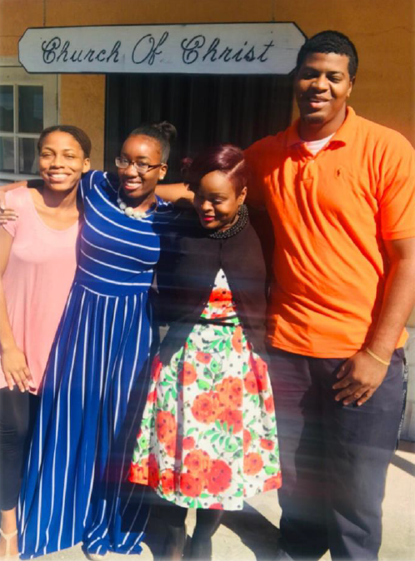
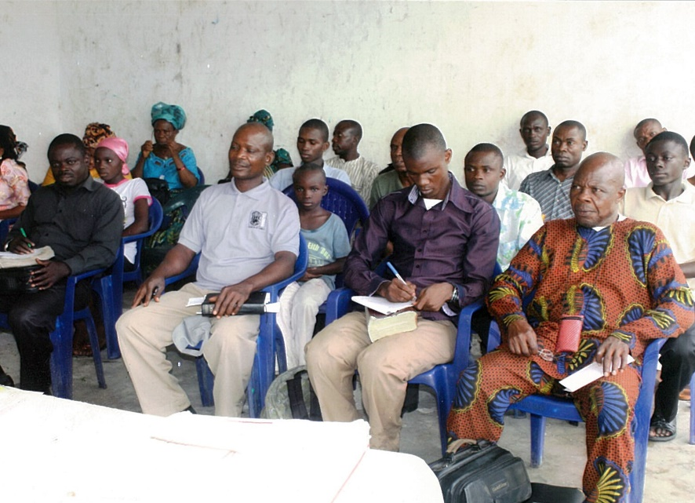
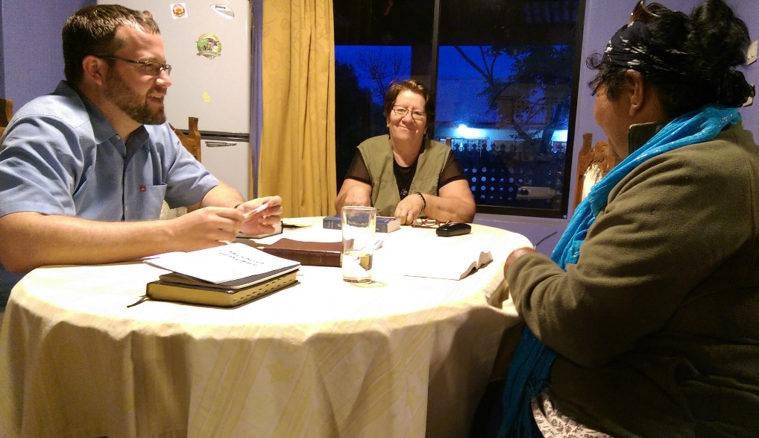
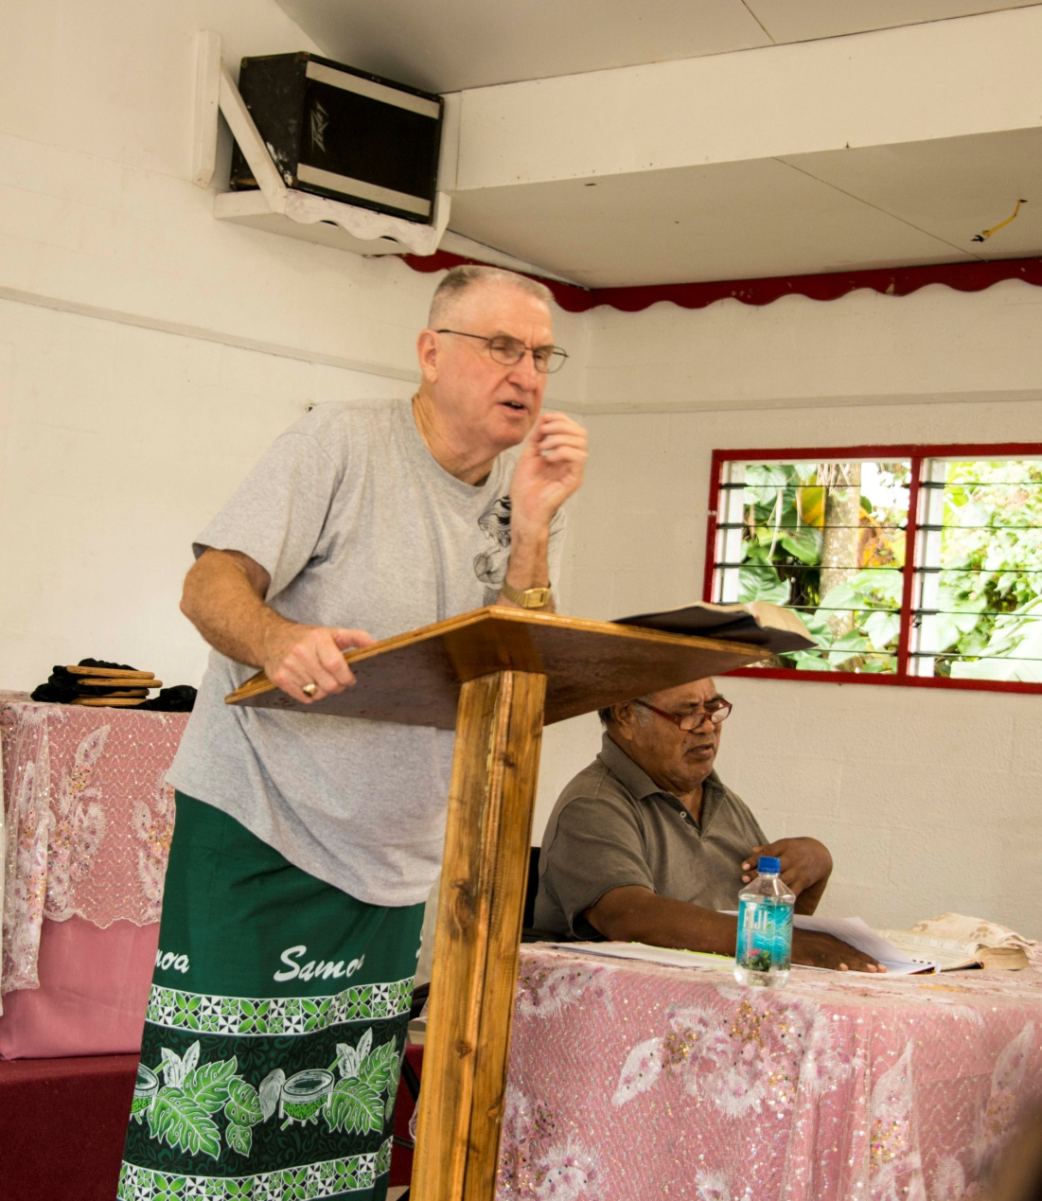
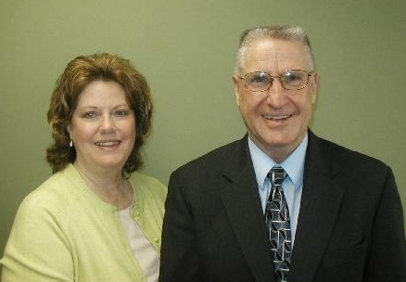

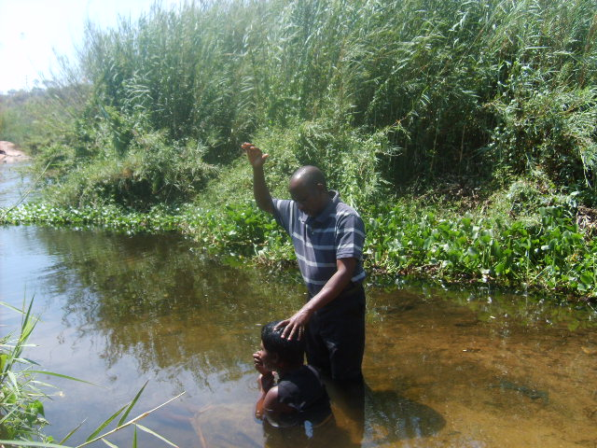
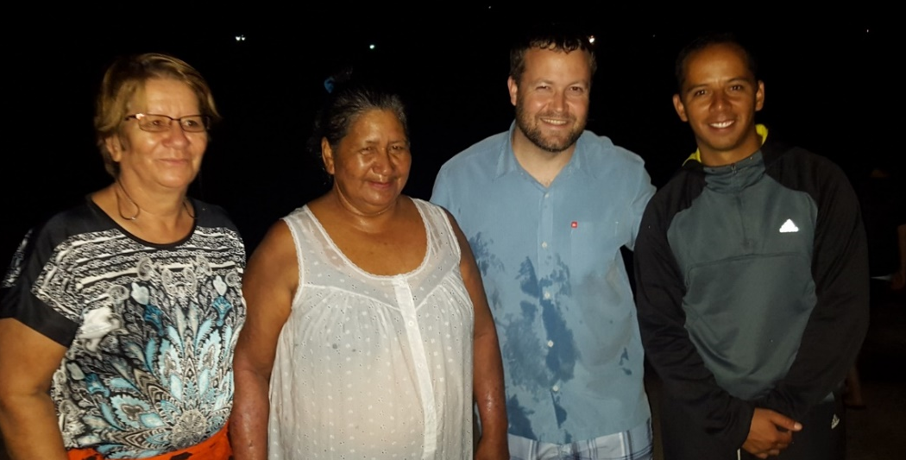
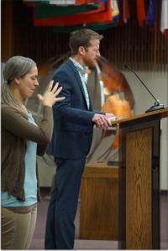

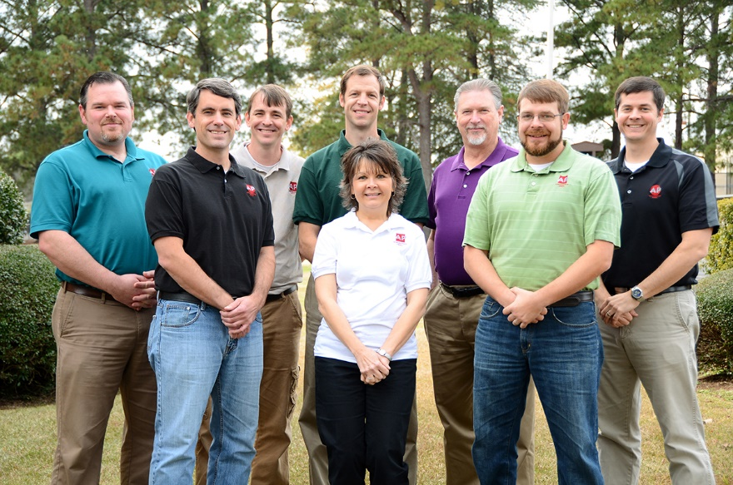

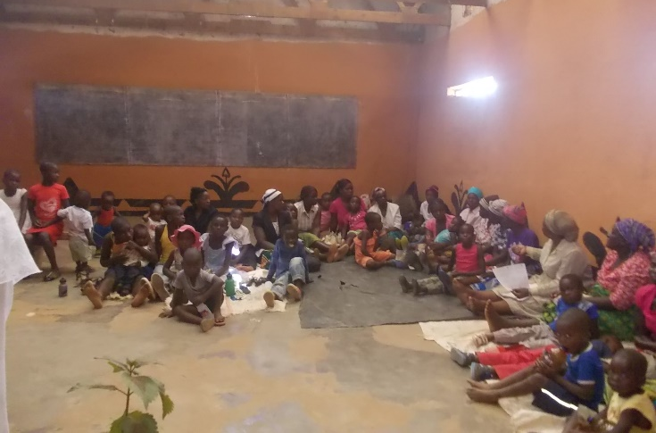
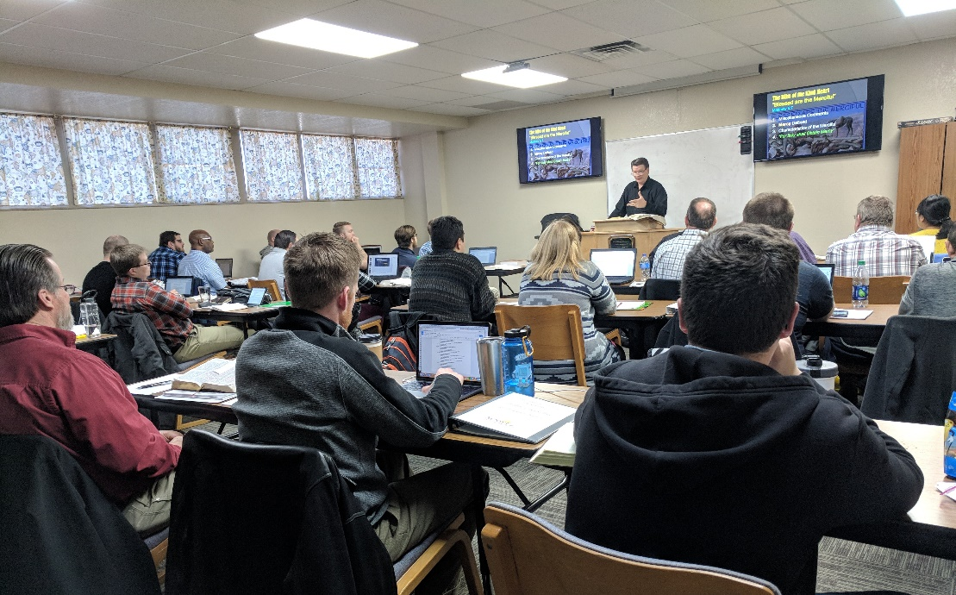


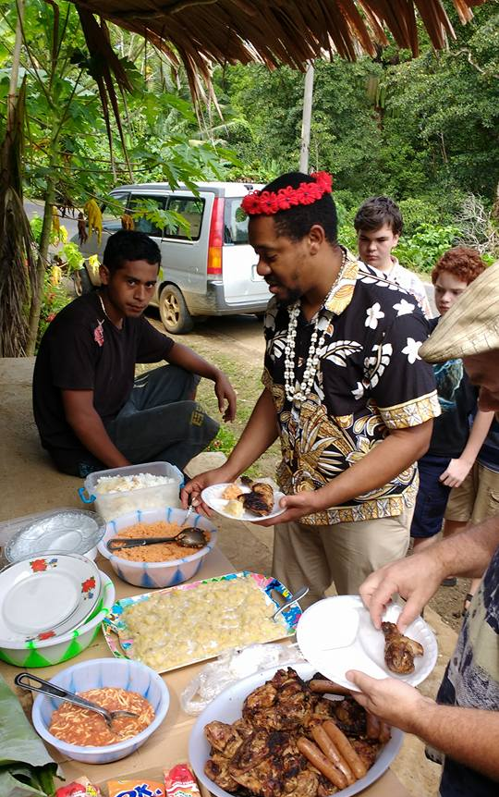



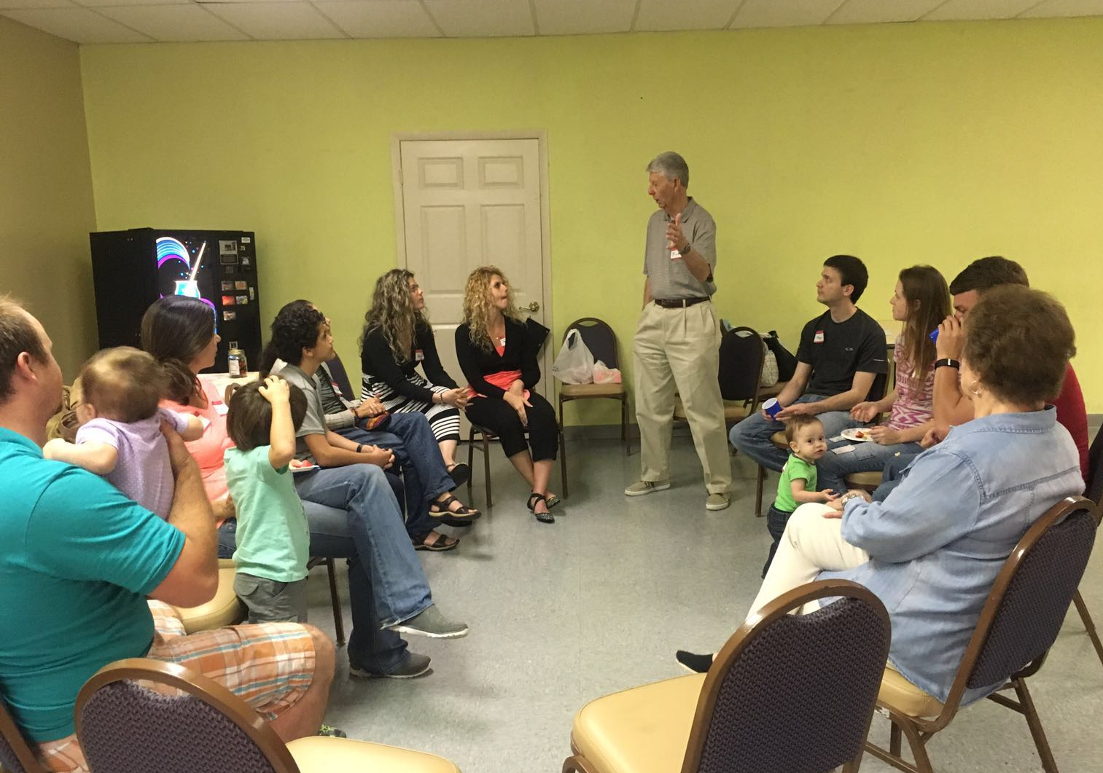
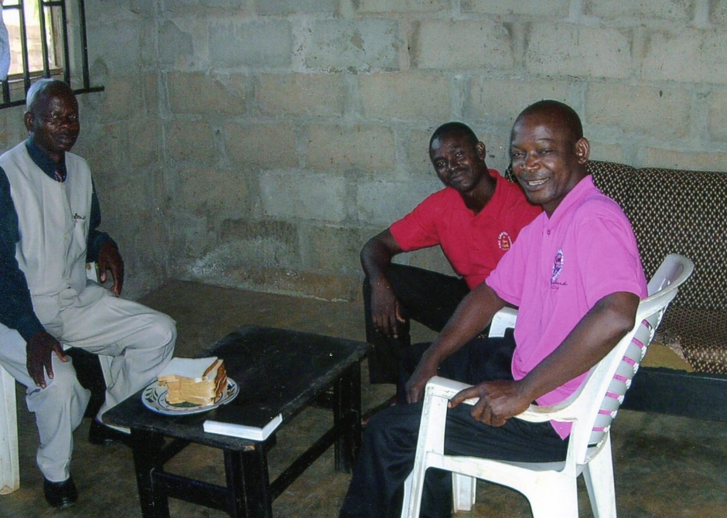
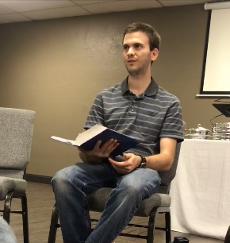

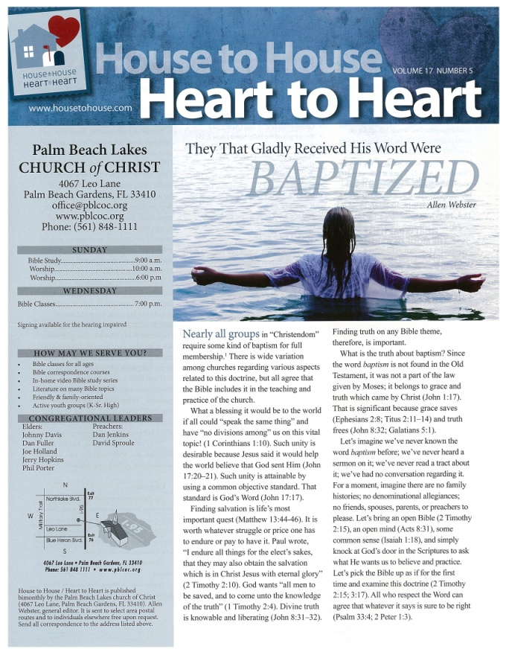
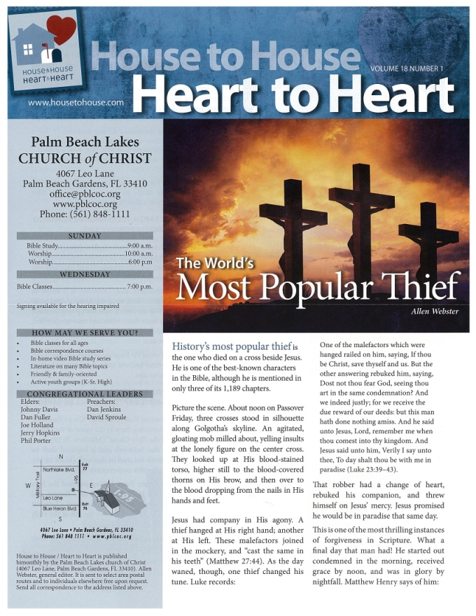
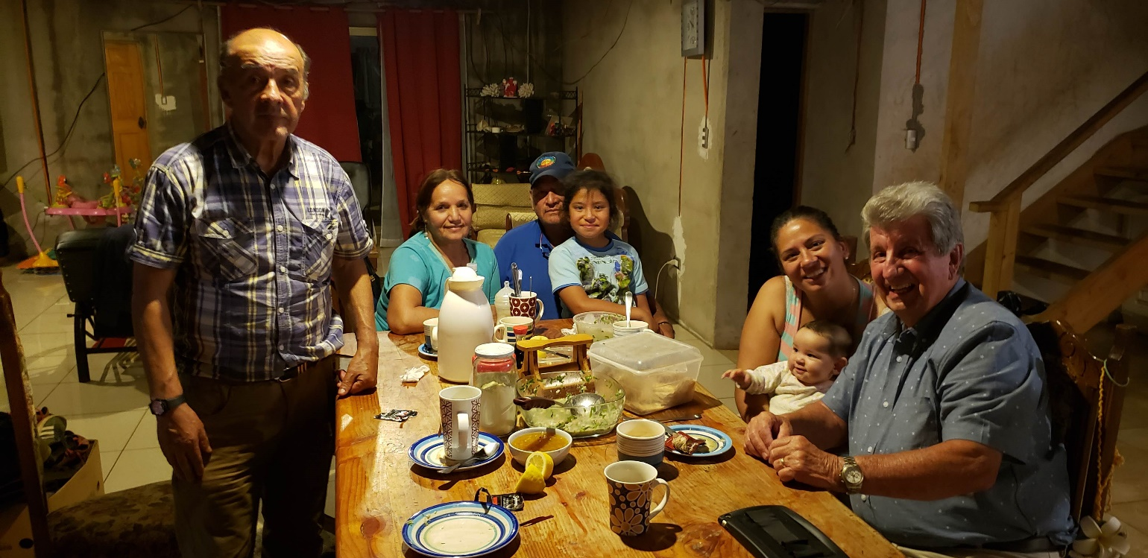
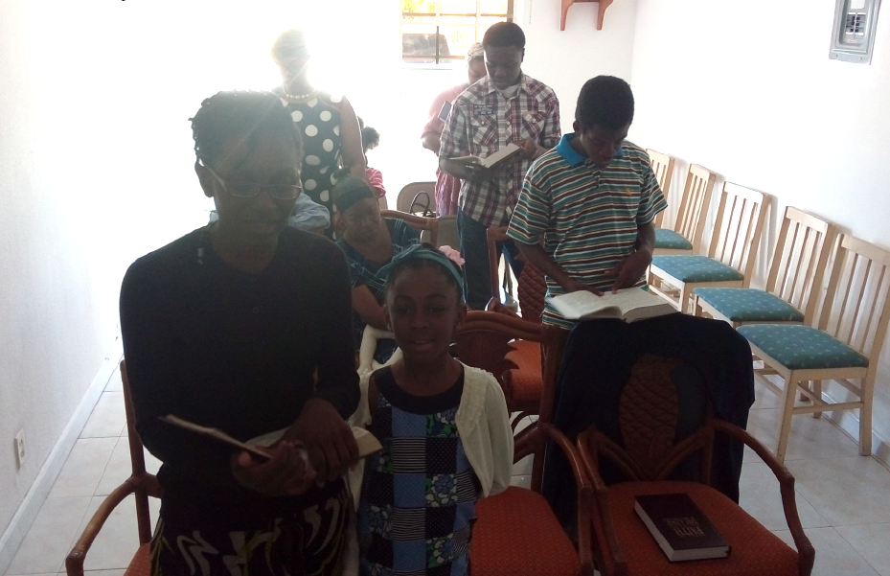
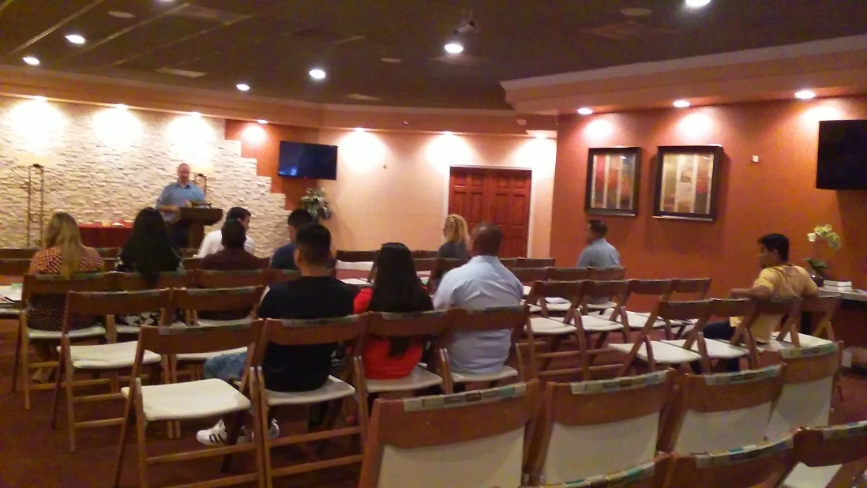

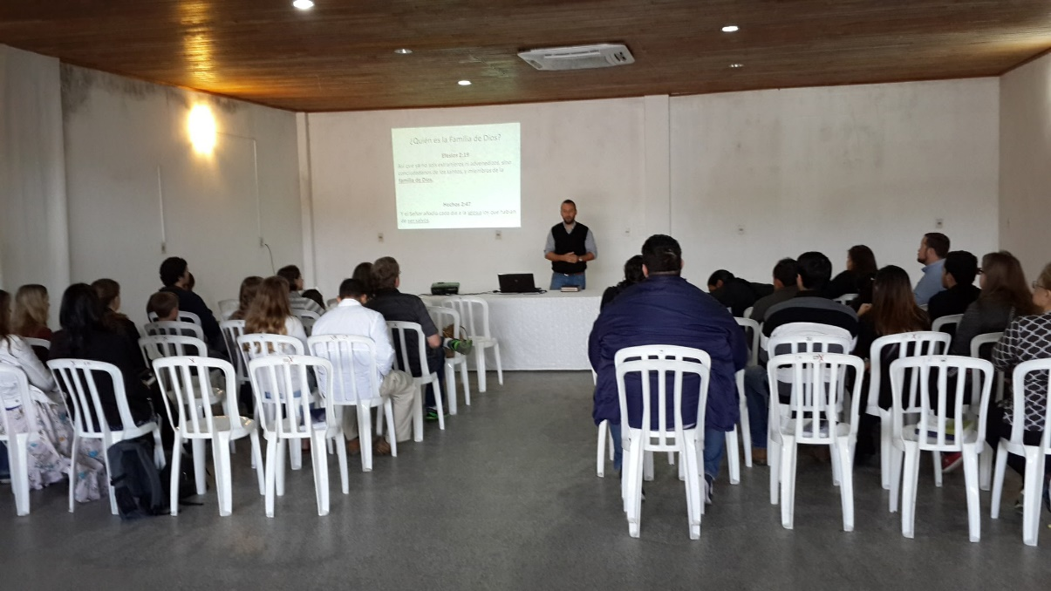
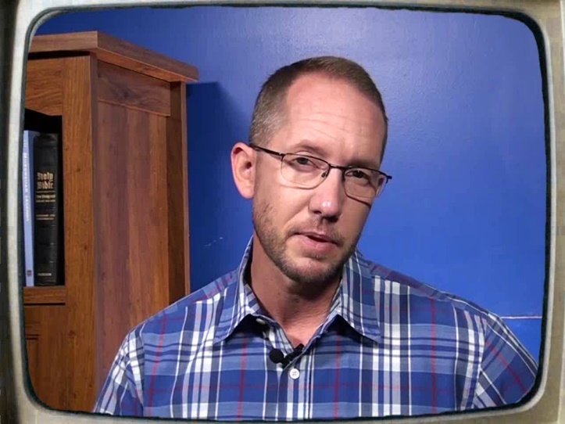
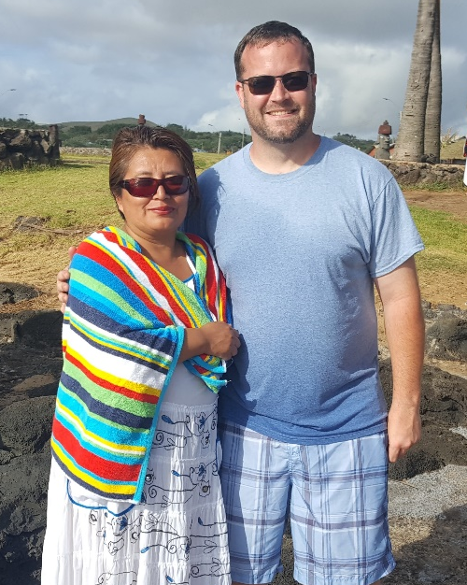

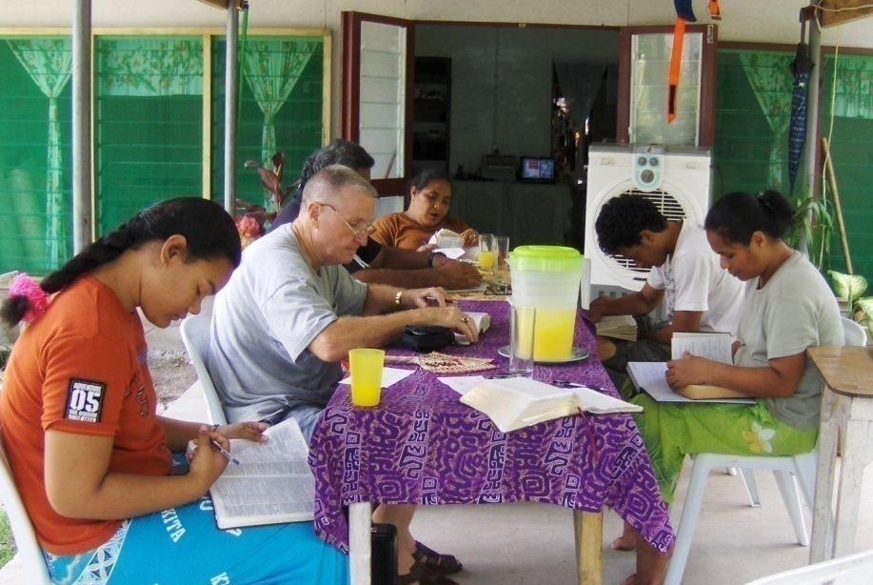

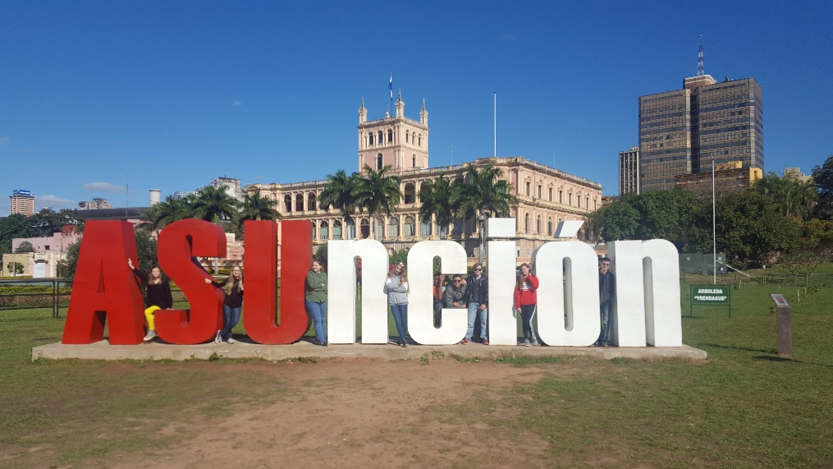
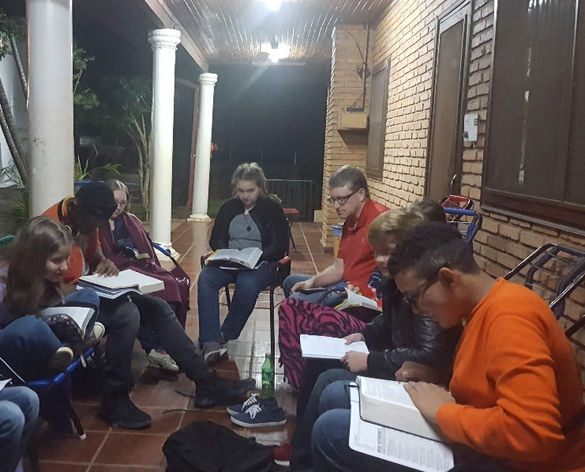
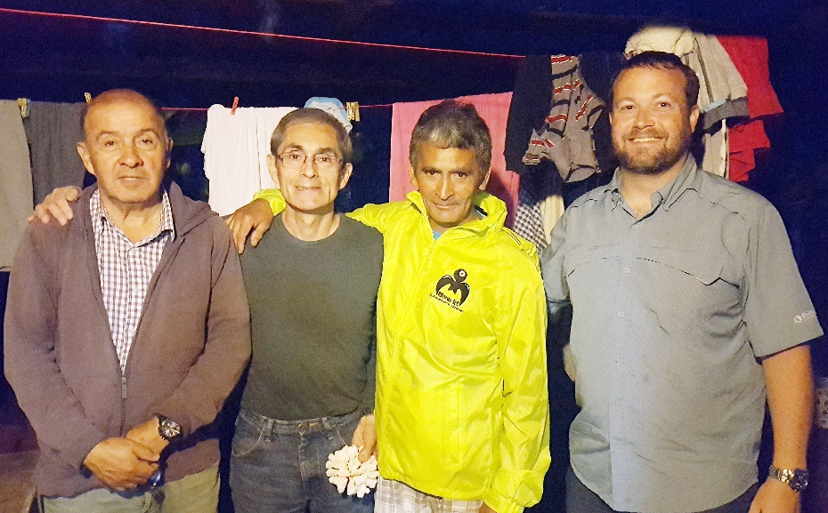
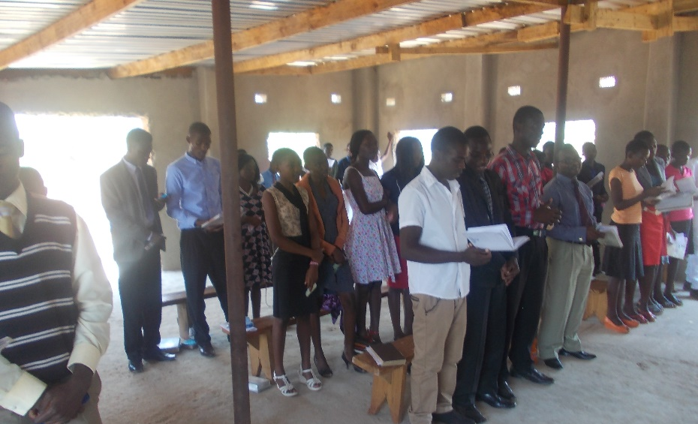
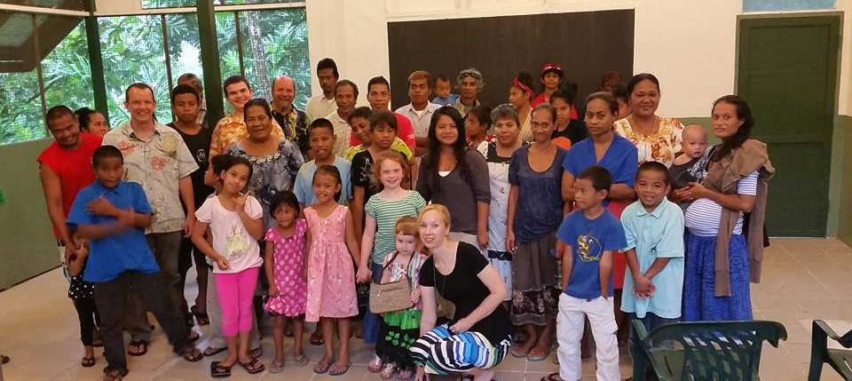
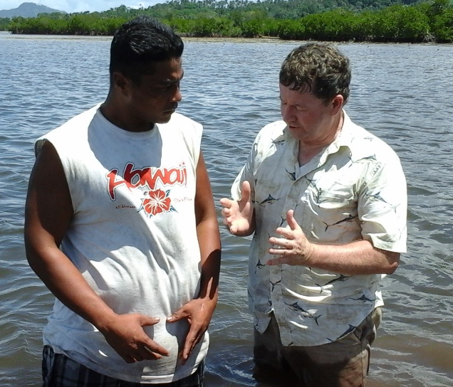
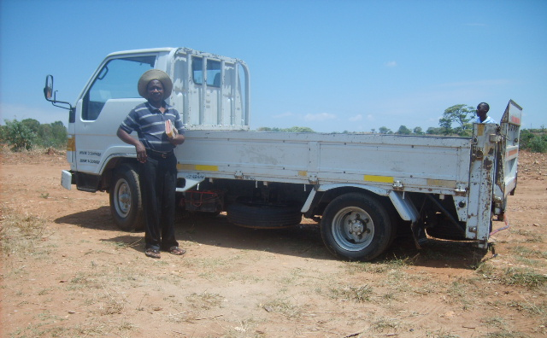
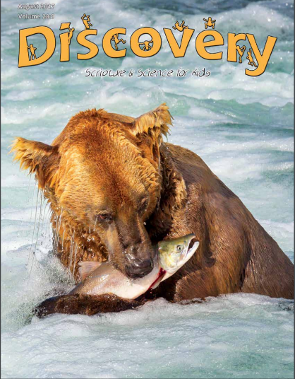

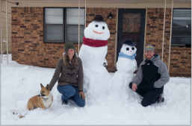

3,300 homes
EVERY month
Rotating Routes
Josh B. to Easter Island
House to House/Heart to Heart
Apologetics Press
Sr. High & Adult Mission Trip
$91,600
Tavaro Hanna (Bahamas)
Brad Shelt (School of Preaching)
Wayne Parker (Pacific)
Mauricio Yegros (Coral Springs)
Robert Martin (Pacific)
Joey Treat (Pacific)
Nnanna Aforji (Nigeria)
Tamuka Arunashe (Zimbabwe)

Slide 6
This will NOT be projected
If we give $104,100
  Bibles for Easter Island
    Population: 7,750
    Stores that sell Bibles: 0
    Josh has taken 400 Bibles in the last 3 years
  Special Requests for Mission Trips
    From college students and others
  “In Search of the Lord’s Way” TV Program
    Provide some financial support in 2019
    Phil Sanders
    WGN on Sunday mornings at 7:00 a.m.
    Statistics: On the air since 1980

Slide 7

Easter Island
Population: 7,750
Stores that sell Bibles: 0
Bibles taken by Josh so far: 400
$104,100
Bibles for
Easter Island
Josh B. to Easter Island
House to House/Heart to Heart
Apologetics Press
Sr. High & Adult Mission Trip
$91,600
Tavaro Hanna (Bahamas)
Brad Shelt (School of Preaching)
Wayne Parker (Pacific)
Mauricio Yegros (Coral Springs)
Robert Martin (Pacific)
Joey Treat (Pacific)
Nnanna Aforji (Nigeria)
Tamuka Arunashe (Zimbabwe)

Slide 8
$104,100
Bibles for
Easter Island
Special Requests
for Mission Trips
“In Search”
TV Program
Josh B. to Easter Island
House to House/Heart to Heart
Apologetics Press
Sr. High & Adult Mission Trip
$91,600
Tavaro Hanna (Bahamas)
Brad Shelt (School of Preaching)
Wayne Parker (Pacific)
Mauricio Yegros (Coral Springs)
Robert Martin (Pacific)
Joey Treat (Pacific)
Nnanna Aforji (Nigeria)
Tamuka Arunashe (Zimbabwe)

Slide 9

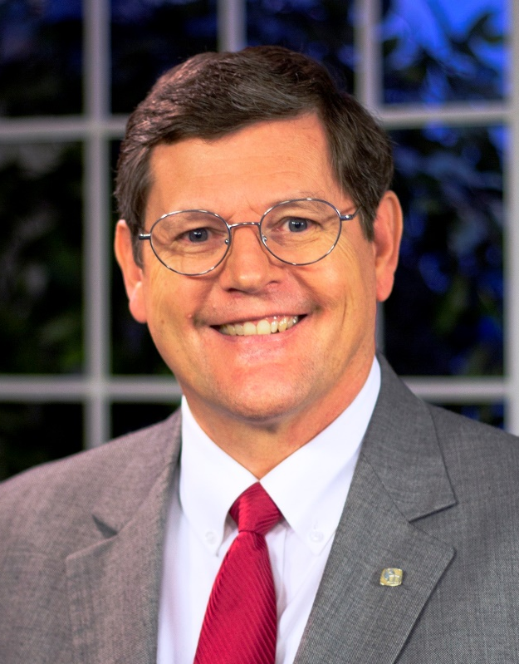

Sunday Mornings
at 7:00 a.m.
Reaching 100 million of 118 million homes in America every week
Phil Sanders

Slide 10
This will NOT be projected
If we give $114,500
  Support Robert C. Lupo in Sneedville, TN
    Working with small congregation in small city in northeast TN
    Robert is Bobbo’s uncle (and twin brother of Bobbo’s dad, Ron Lupo)
    Will provide some help (just for) 2019
  Local Evangelism Outreach Materials
    100s copies of Discovery Magazine (AP) every month – reach out to families
    Searching for Truth – DVD & full-color book
    ESV Bibles
    “Let’s Go Back to the Bible” – 28 pages to teach the gospel
    Custom PBL tracts – “Dear Friend…” and “Does Your Church?”

Slide 11
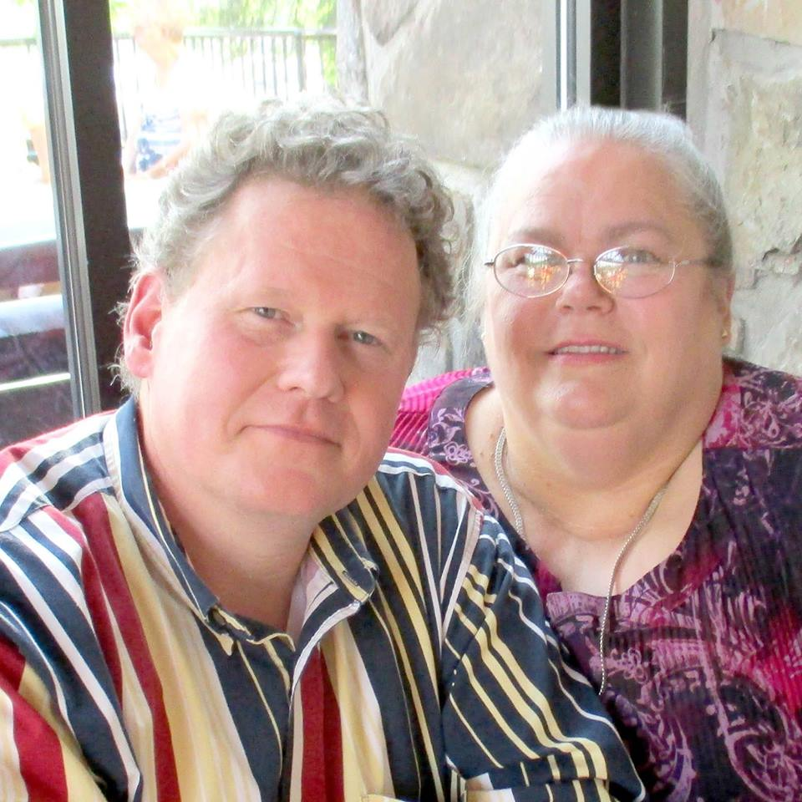
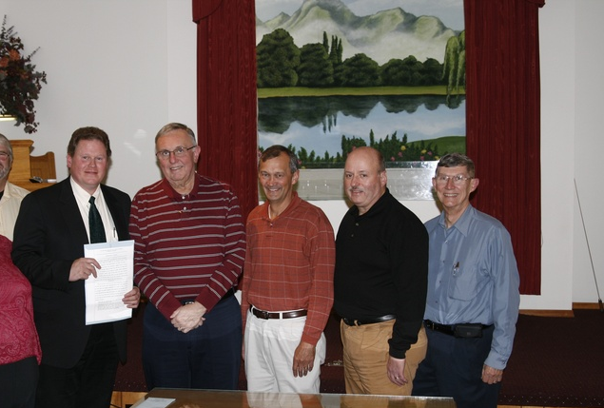
$114,500
Robert C. Lupo
Sneedville, Tennessee
$104,100
Bibles for
Easter Island
Special Requests
for Mission Trips
“In Search”
TV Program
Josh B. to Easter Island
House to House/Heart to Heart
Apologetics Press
Sr. High & Adult Mission Trip
$91,600
Tavaro Hanna (Bahamas)
Brad Shelt (School of Preaching)
Wayne Parker (Pacific)
Mauricio Yegros (Coral Springs)
Robert Martin (Pacific)
Joey Treat (Pacific)
Nnanna Aforji (Nigeria)
Tamuka Arunashe (Zimbabwe)

Slide 12
$114,500
Robert C. Lupo
Sneedville, Tennessee
Local Evangelism
Outreach Materials
$104,100
Bibles for
Easter Island
Special Requests
for Mission Trips
“In Search”
TV Program
Josh B. to Easter Island
House to House/Heart to Heart
Apologetics Press
Sr. High & Adult Mission Trip
$91,600
Tavaro Hanna (Bahamas)
Brad Shelt (School of Preaching)
Wayne Parker (Pacific)
Mauricio Yegros (Coral Springs)
Robert Martin (Pacific)
Joey Treat (Pacific)
Nnanna Aforji (Nigeria)
Tamuka Arunashe (Zimbabwe)

Slide 13


Slide 14


Slide 15


Slide 16
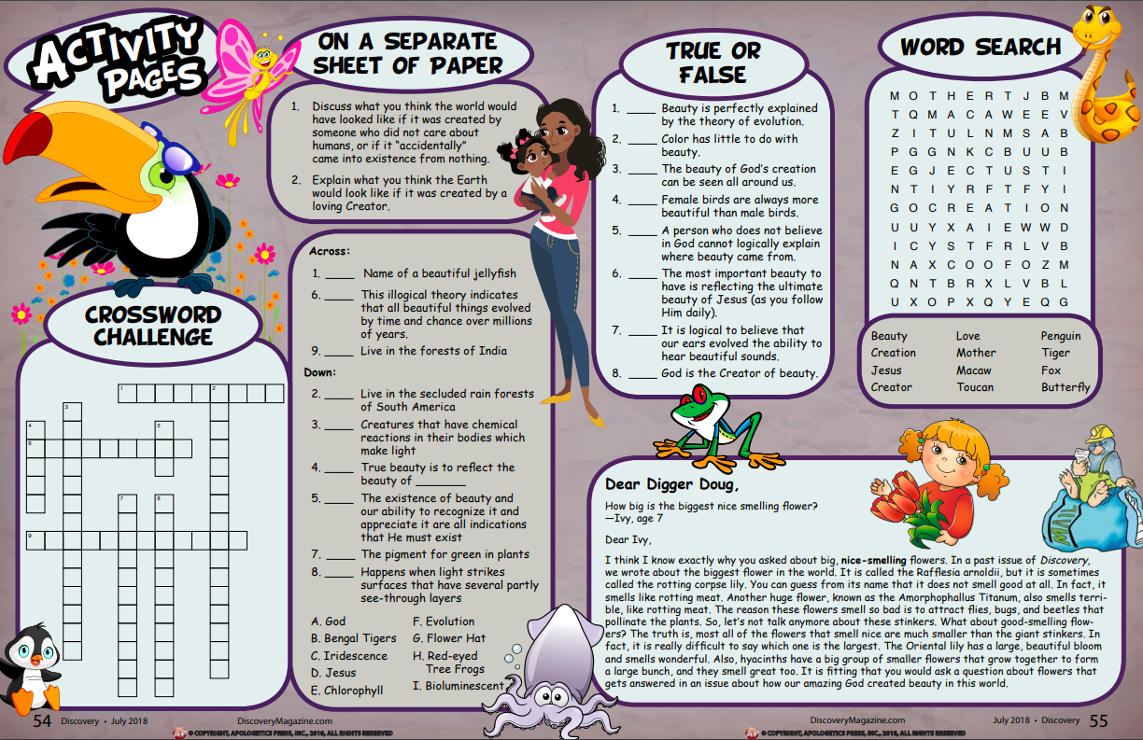

Slide 17


Slide 18







Slide 19
This will NOT be projected
If we give $125,500
  Assist Joey Treat family move to Guam in February
    Joey will begin working with the church in Guam
    He will continue to make trips back to Palau and Chuuk
  Assisting Local Congregations with Evangelism Tools
    Helping some smaller congregations in the area with evangelistic tools
    Clewiston, Okeechobee, Spanish cong in Okee, Mauricio Yegros in Coral Springs, Third Street, Jog Road, Spanish cong meeting in our building
    They think these tools would be helpful:
    House to House/Heart to Heart mailed around their building, ESV Bibles, Searching for Truth DVDS and books, tracts, Spanish tracts, etc.

Slide 20
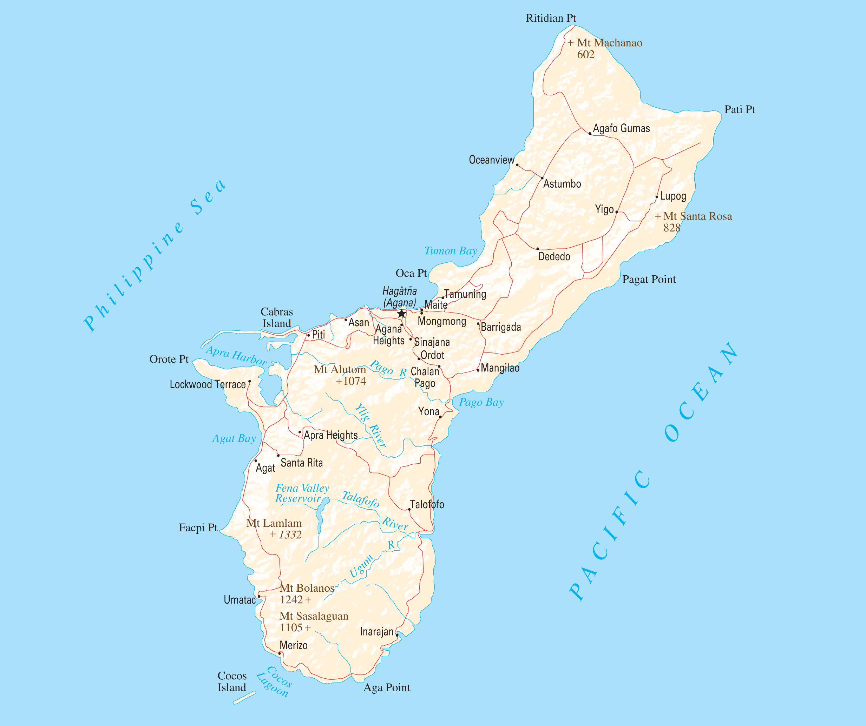
$125,500
Treat Family
Move to Guam
$114,500
Robert C. Lupo
Sneedville, Tennessee
Local Evangelism
Outreach Materials
$104,100
Bibles for
Easter Island
Special Requests
for Mission Trips
“In Search”
TV Program
Josh B. to Easter Island
House to House/Heart to Heart
Apologetics Press
Sr. High & Adult Mission Trip
$91,600
Tavaro Hanna (Bahamas)
Brad Shelt (School of Preaching)
Wayne Parker (Pacific)
Mauricio Yegros (Coral Springs)
Robert Martin (Pacific)
Joey Treat (Pacific)
Nnanna Aforji (Nigeria)
Tamuka Arunashe (Zimbabwe)

Slide 21
$125,500
Treat Family
Move to Guam
Assist Local Congregations
$114,500
Robert C. Lupo
Sneedville, Tennessee
Local Evangelism
Outreach Materials
$104,100
Bibles for
Easter Island
Special Requests
for Mission Trips
“In Search”
TV Program
Josh B. to Easter Island
House to House/Heart to Heart
Apologetics Press
Sr. High & Adult Mission Trip
$91,600
Tavaro Hanna (Bahamas)
Brad Shelt (School of Preaching)
Wayne Parker (Pacific)
Mauricio Yegros (Coral Springs)
Robert Martin (Pacific)
Joey Treat (Pacific)
Nnanna Aforji (Nigeria)
Tamuka Arunashe (Zimbabwe)

Slide 22







Clewiston church of Christ

Slide 23
This will NOT be projected
If we give $136,500
  “In Search of the Lord’s Way” TV Program
    Provide additional support, over what we can do in first level
    It’s worth it
    Costs $9,000 per day for Search to operate
  Assist AP with getting a book to press
    In addition to the AP Bible, “Defending the Faith Study Bible”
    Dave Miller just finished “Is Christianity Logical?”
    Book based on article he wrote in June 2011 issue of Reason & Revelation

Slide 24
$136,500
“In Search”
TV Program
$125,500
Treat Family
Move to Guam
Assist Local Congregations
$114,500
Robert C. Lupo
Sneedville, Tennessee
Local Evangelism
Outreach Materials
$104,100
Bibles for
Easter Island
Special Requests
for Mission Trips
“In Search”
TV Program
Josh B. to Easter Island
House to House/Heart to Heart
Apologetics Press
Sr. High & Adult Mission Trip
$91,600
Tavaro Hanna (Bahamas)
Brad Shelt (School of Preaching)
Wayne Parker (Pacific)
Mauricio Yegros (Coral Springs)
Robert Martin (Pacific)
Joey Treat (Pacific)
Nnanna Aforji (Nigeria)
Tamuka Arunashe (Zimbabwe)

Slide 25
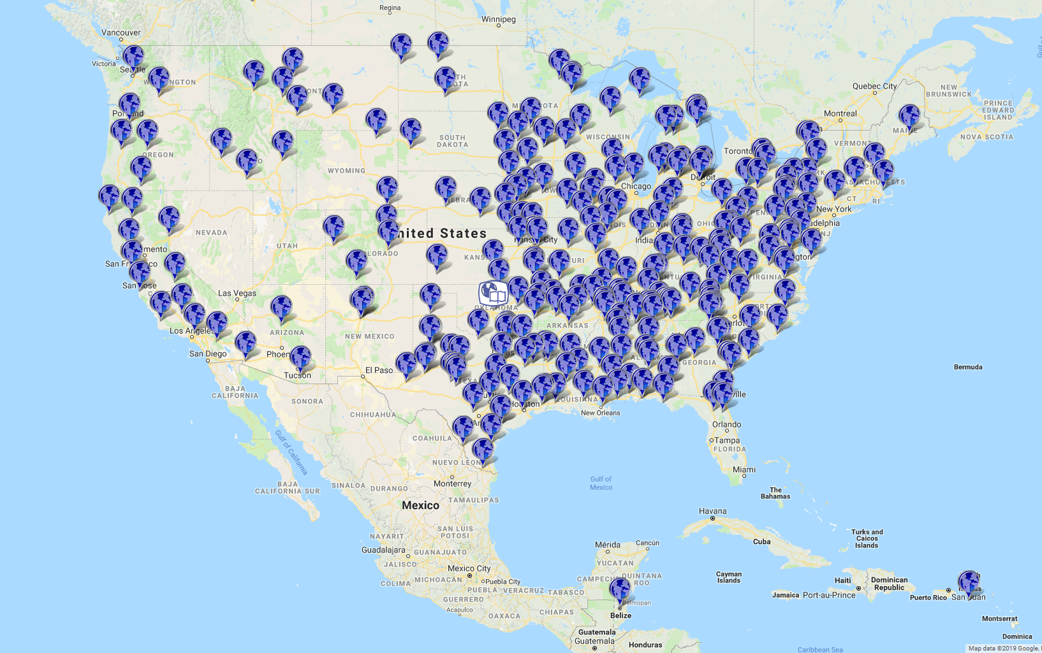

Station Map

Slide 26

$136,500
“In Search”
TV Program
Assist w/ AP Book
$125,500
Treat Family
Move to Guam
Assist Local Congregations
$114,500
Robert C. Lupo
Sneedville, Tennessee
Local Evangelism
Outreach Materials
$104,100
Bibles for
Easter Island
Special Requests
for Mission Trips
“In Search”
TV Program
Josh B. to Easter Island
House to House/Heart to Heart
Apologetics Press
Sr. High & Adult Mission Trip
$91,600
Tavaro Hanna (Bahamas)
Brad Shelt (School of Preaching)
Wayne Parker (Pacific)
Mauricio Yegros (Coral Springs)
Robert Martin (Pacific)
Joey Treat (Pacific)
Nnanna Aforji (Nigeria)
Tamuka Arunashe (Zimbabwe)

Slide 27
$+++,+++
+
+
+
$136,500
“In Search”
TV Program
Assist w/ AP Book
$125,500
Treat Family
Move to Guam
Assist Local Congregations
$114,500
Robert C. Lupo
Sneedville, Tennessee
Local Evangelism
Outreach Materials
$104,100
Bibles for
Easter Island
Special Requests
for Mission Trips
“In Search”
TV Program
Josh B. to Easter Island
House to House/Heart to Heart
Apologetics Press
Sr. High & Adult Mission Trip
$91,600
Tavaro Hanna (Bahamas)
Brad Shelt (School of Preaching)
Wayne Parker (Pacific)
Mauricio Yegros (Coral Springs)
Robert Martin (Pacific)
Joey Treat (Pacific)
Nnanna Aforji (Nigeria)
Tamuka Arunashe (Zimbabwe)

Slide 28

The Purpose of
Mission Sunday
The Purpose of
The Gospel
is to
Save
Souls!
Are you
Saved?
Believe Jesus is God’s Son John 8:24
Repent/Turn from your sins Acts 2:38
Confess your faith Romans 10:9
Be baptized Mark 16:16
Live faithfully Revelation 2:10

Slide 29
$+++,+++
+
+
+
$136,500
“In Search”
TV Program
Assist w/ AP Book
$125,500
Treat Family
Move to Guam
Assist Local Congregations
$114,500
Robert C. Lupo
Sneedville, Tennessee
Local Evangelism
Outreach Materials
$104,100
Bibles for
Easter Island
Special Requests
for Mission Trips
“In Search”
TV Program
Josh B. to Easter Island
House to House/Heart to Heart
Apologetics Press
Sr. High & Adult Mission Trip
$91,600
Tavaro Hanna (Bahamas)
Brad Shelt (School of Preaching)
Wayne Parker (Pacific)
Mauricio Yegros (Coral Springs)
Robert Martin (Pacific)
Joey Treat (Pacific)
Nnanna Aforji (Nigeria)
Tamuka Arunashe (Zimbabwe)

