Slide 1


Slide 2
Must be able to recognize the difference between:
where I am and where I need to be
Must be honest to admit where I need to grow and improve
Must be careful not to compare myself to others (2 Cor. 10:12),
but only to compare myself to myself and to Christ
Must be willing to say, “I haven’t finished my course yet”

Slide 3
Focus on “one thing” (cf. Luke 10:41-42)
Remove distractions and improperly aligned priorities (Matt. 6:33)
Focus must be singular – “Run the Christian race!” (Psa. 27:4)

Slide 4
“Behind”? NO! Forget it!
  “Forget” = escape notice; no longer influenced by or affected by
  Forget past mistakes and sins (3:6; cf. Acts 8:1-3; 26:9-11; Gal. 1:13)
  Forget past achievements in the world (3:4-8; cf. Acts 26:4-5; Gal. 1:14)
  Forget past accomplishments in the Lord’s service (3:8-11; cf. 1 Cor. 15:10)
  Must not be controlled by the past – learn from it, grow from it, move on
“Ahead”? YES! Reach for it!
  “Reach forward” = stretch myself forward out and toward
  Constantly reach for growth, improvement and new heights in Christian life

Slide 5
“I press on” (3:12,14) = pursue steadily, eagerly and intensely
Press on for the purpose – for which Christ laid hold of me (3:12)
  Christ “laid hold of” to possess as His own, to fulfill His purpose, to serve
  Press on to greater maturity in the faith (Heb. 5:12-6:1)
  Press on to greater service in the church (Eph. 4:12-16)
Press on for the prize – for which God called me (3:14)
  “Goal” = mark on which to fix the eye (cf. Col. 3:1-2)
  The crown of life is promised to all faithful runners who finish the race
  (2 Tim. 4:7-8; 1 Cor. 9:24-27)

Slide 6


Slide 7
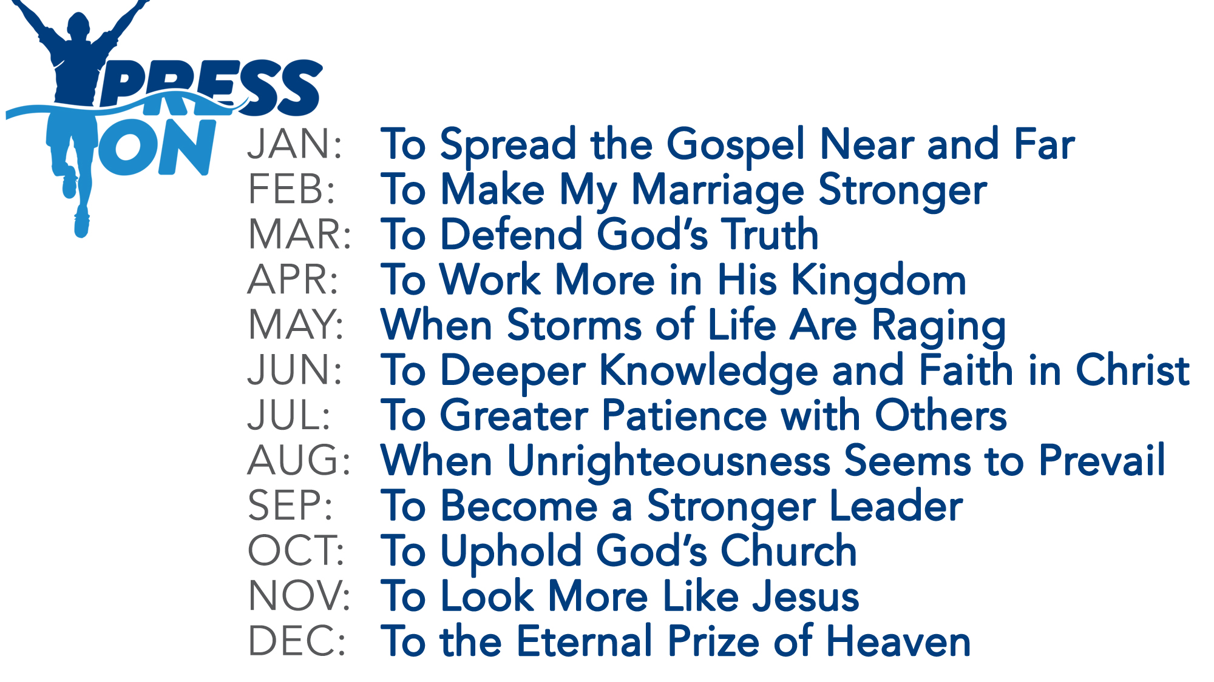

Slide 8




Slide 10
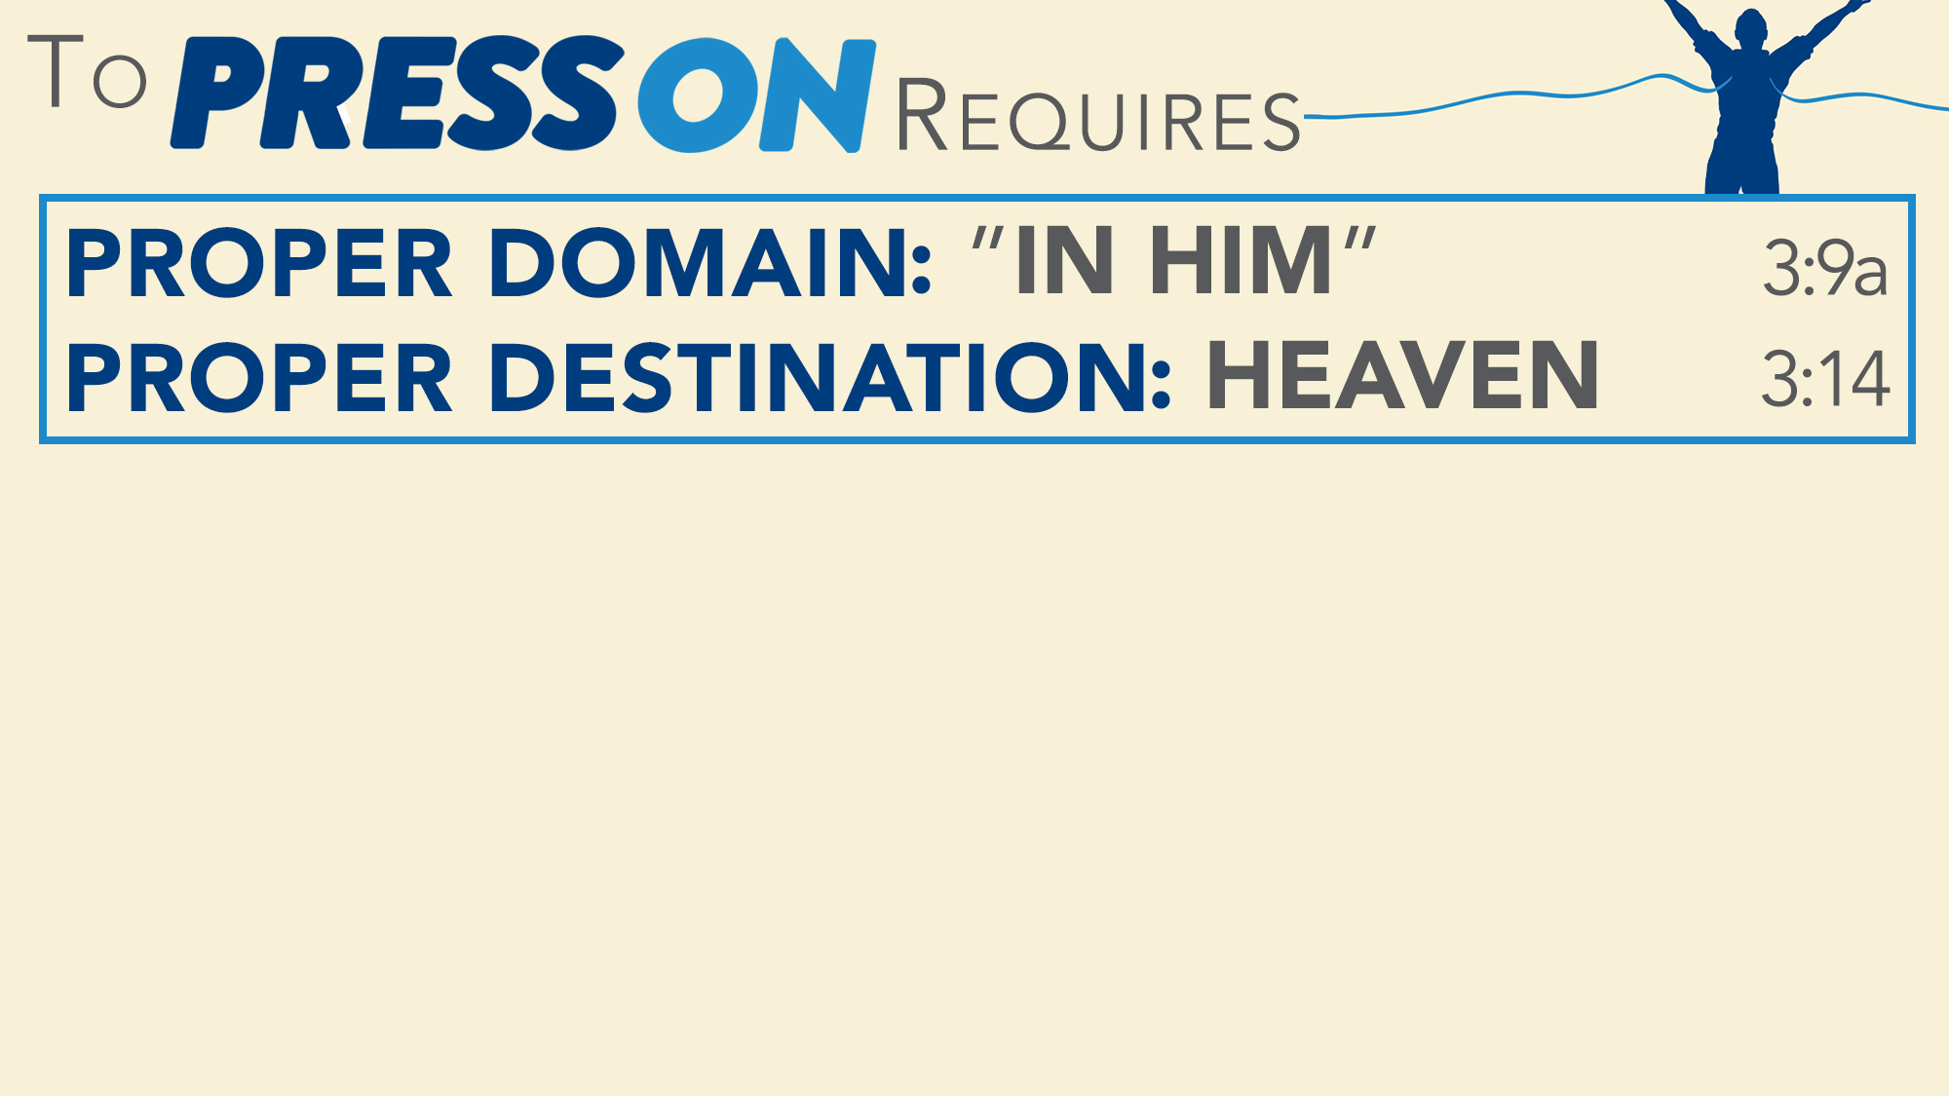
You must believe that Jesus is God’s Son – Acts 16:31
You must repent of your sins and turn to God – Acts 3:19
You must confess your faith in Jesus Christ – Romans 10:9-10
You must be immersed into Christ – Acts 2:38
  God will forgive you of all your sins – Acts 22:16
  God will add you to His church – Acts 2:47
  God will register you in heaven – Hebrews 12:23
You must press on diligently in serving the Lord – Philippians 3:12-14

