Slide 1
Our Love For God
Mark 12:29-31

Slide 2
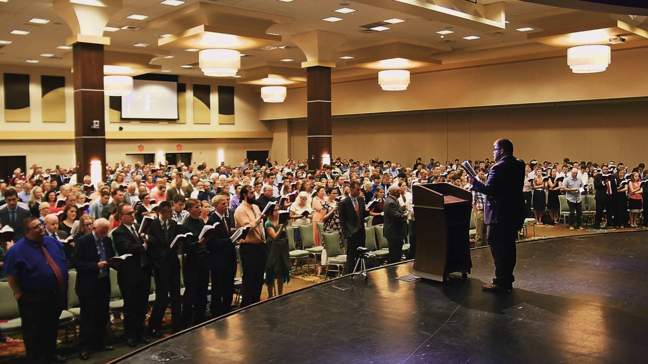
I. Emotion

Slide 3

II. Intellect

Slide 4

III. Service

Slide 5

IV. Treatment of Others

Slide 6
Have you demonstrated your love for God?
Mk. 16:16

