Slide 2
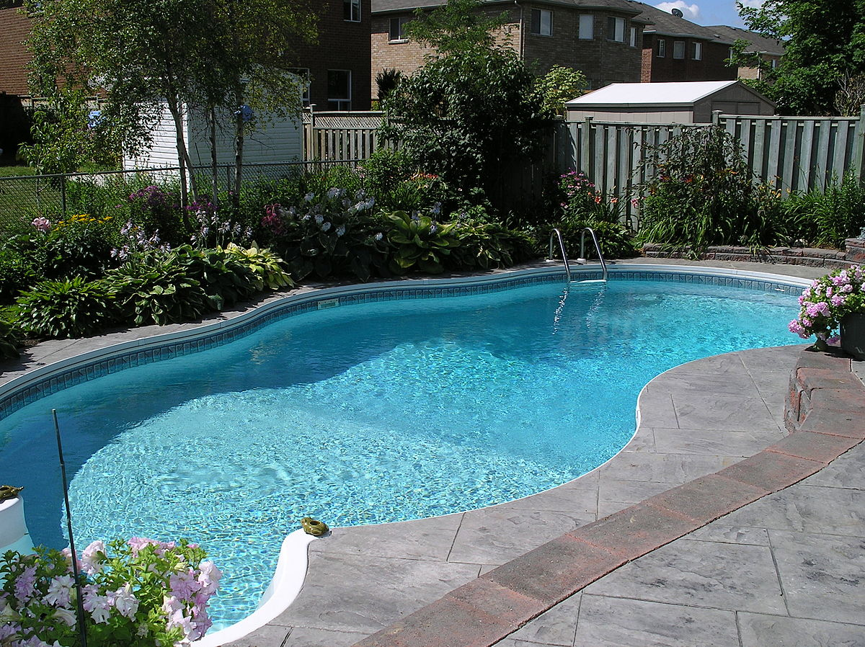
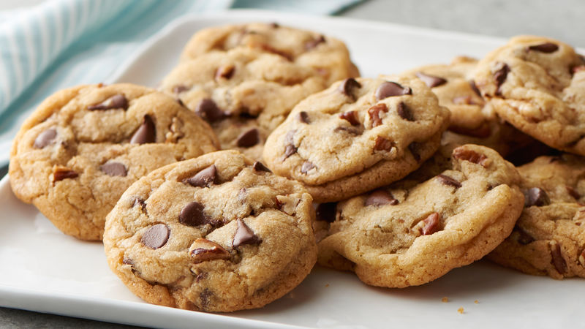

Slide 4
Arrogance, selfishness and conceit does NOT produce happiness in a home
Putting God first brings happiness to every home (Matt. 6:33; Col. 1:18)
Putting others above self brings happiness to every home (Phil. 2:3-4; Matt. 23:11)

Slide 5
Glorifying, joking about or minimizing sin does NOT produce happiness in a home
Taking sin seriously brings happiness to every home (Jas. 4:8-10)
Treating sin as God treats sin brings happiness to every home (Ezek. 18:30-32)

Slide 6
An uncontrolled, wild temper does NOT produce happiness in a home
Submitting to Divine control brings happiness to every home (Jas. 4:7; 1 Cor. 6:19-20)
Taming and channeling our strength/energy toward God and serving others brings happiness to every home (Rom. 6:12-13; Eph. 4:2, 26-27)

Slide 7
Craving to fulfill our own desires does NOT produce happiness in a home
Wanting desperately to do whatever God wants of us bring happiness to every home (Matt. 3:15; Psa. 63:1; 1 Pet. 2:2; Heb. 1:9)
Seeking after a deeper, more meaningful relationship with God brings happiness to every home (Phil. 3:4-14)

Slide 8
Thinking the worst in others or holding a grudge does NOT produce happiness in a home
Feeling the pain of others and deliberately responding to serve their needs brings happiness to every home (Luke 10:29-37; Eph. 4:31-32)
Mercifully forgiving others who wrong us brings happiness to every home (Luke 6:36; Col. 3:12-14; Matt. 18:21-35)

Slide 9
Living like everyone else amidst the filth of the world does NOT produce happiness in a home
Refusing to conform ourselves into the mold of this world brings happiness to every home (Rom. 12:2; 2 Cor. 6:17)
Being motivated by a pure heart, unashamed of God’s standards brings happiness to every home (Col. 3:22-23; Eph. 5:10-11; Mark 8:38)

Slide 10
Constant bitterness, conflict and tension does NOT produce happiness in a home
Discontinuing bickering, biting and devouring each other brings happiness to every home (Gal. 5:15; Eph. 4:31)
Pursuing peace and harmony in our words, tone, attitude and actions brings happiness to every home (Prov. 15:1; Rom. 14:19; 1 Pet. 3:10-11)

Slide 12
Believe Jesus is God’s Son – John 20:30-31
Repent of your sins and turn to God – Acts 2:38
Confess your faith in Jesus Christ – Romans 10:9
Be immersed into Christ – Mark 16:16
God will forgive all of your sins – Acts 22:16
God will add you to His church – Acts 2:47
God will enroll you in heaven – Hebrews 12:23
Serve Him faithfully – 1 Corinthians 15:58

