Slide 2
You Get to Obey a Command of God (Matt. 28:18-20; Mark 16:15)
You Get to Talk About Jesus (Acts 8:35; 1 Cor. 2:2; 15:3-4)
You Get to Share the Greatest News on Earth (John 3:16; 1 Tim. 1:15)
You Get to Follow in the Footsteps of Christian Heroes (Acts 9:20; 8:4; 18:24-28)
You Get to Grow in the Faith Yourself (Rom. 10:17; Heb. 5:11-14; 1 Pet. 2:2; Matt. 28:20)
You Get to Witness the Power of the Gospel at Work (Rom. 1:16; Acts 26:18; 16:14; 2 Cor. 4:4)
You Get to Help Someone to Be Saved (Mark 16:15-16; Acts 8:35-39)

Slide 3
EVERYone MUST do it!
ANYone CAN do it!

Slide 4
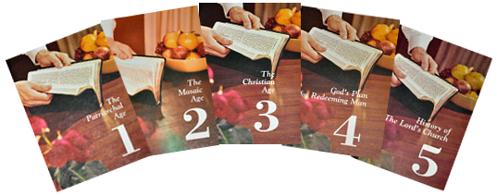
“Visualized Bible Study” by Jule Miller

Slide 5
“Circles of Truth” by Bill Hatcher

Slide 6
“Back to the Bible” (3-lesson series)

Slide 7
“Searching for Truth” (DVD & Website)

Slide 8
“What the Bible Says About…” Cards

Slide 9
Bible Bookmarks

Slide 10
1. Foundational Questions Must Be Answered

Slide 11
2. The God of the Bible Exists
3. The Bible Really Is from God
4. The Bible Can Be Understood
5. Jesus Really Is the Son of God

Slide 12
6. God’s Love Is Wonderfully Revealed in the Bible
7. Jesus Christ Has All Authority
8. The Bible Is God’s All-Authoritative Truth
9. The Bible Must Be Respected and Obeyed

Slide 13
10. The Lord Established Only One Church
11. The Church Is Composed of Those Who Are Saved
12. The Lord’s Church Holds to the Scriptural Pattern
13. The Lord’s Church Is Scripturally Organized
14. The Lord’s Church Wears a Scriptural Name
15. The Lord’s Church Worships As Authorized
16. The Lord’s Church Worships in Scriptural Avenues
17. The Lord’s Church Still Exists Today

Slide 14
18. Sin Separates Man from God
19. God Wants All People to Be Saved
20. One Must Be Saved As Authorized in Scripture
21. One Must Believe Jesus Is God’s Son to Be Saved
22. One Must Repent of His Sins to Be Saved
23. One Must Confess His Faith in Jesus to Be Saved
24. One Must Be Immersed into Christ to Be Saved
25. One Must Be “In Christ” to Be Saved

Slide 15
26. A Christian Must Live a Faithful Life to God
27. One Day Jesus Will Return from Heaven
28. How Do YOU Answer the Foundational Questions?

Slide 16
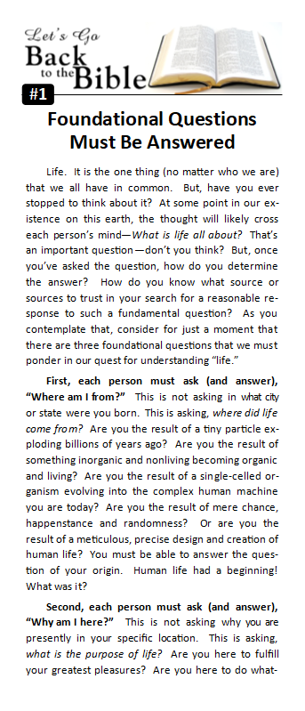
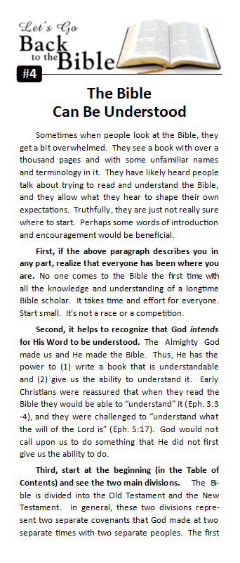
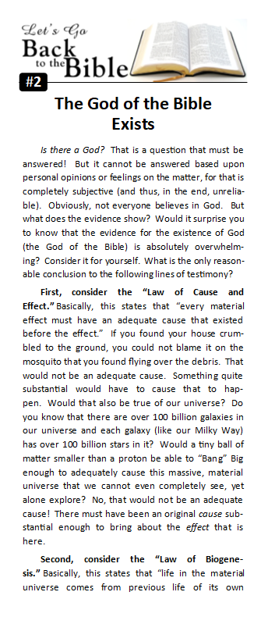

Slide 17
Office Printed Version
(available in lobby, starting next week)
Professionally Published
(available on Amazon, starting next week)

Slide 18
Share Facebook Posts

Slide 19
Share Facebook Posts

Slide 20
Send/Share Website Links

Slide 21
3-minute videos
(added to our YouTube channel over the next several months)

Slide 22
Believe Jesus is God’s Son – John 20:30-31
Repent of your sins and turn to God – Acts 2:38
Confess your faith in Jesus Christ – Romans 10:9
Be immersed into Christ – Mark 16:16
God will forgive all of your sins – Acts 22:16
God will add you to His church – Acts 2:47
God will enroll you in heaven – Hebrews 12:23
Live faithfully to the Lord – Revelation 2:10

