Slide 2
Early Christians continued steadfastly…
In God’s Commandments (“the apostles’ doctrine”)
Early Christians had a standard of authority—the doctrine of Christ (John 14:26; 16:13; 8:31-32; 2 Pet. 1:20-21; 2 John 9)
They read it (Acts 8:27-35)
They studied it (Acts 17:11)
They learned it (Acts 18:24-28; Eph. 4:20; Rom. 15:4; 16:17)
They submitted to it (Acts 6:7; Rom. 1:5; 6:17; 1 Pet. 1:22)
They gathered to hear it (Acts 10:22-33; 13:44; 20:7-9)
They taught it (Matt. 28:20; Acts 8:4, 35; 4:10-12; 9:20; 17:22-31)
They rejected all doctrines of men (Acts 4:12; 2 John 9-11; Gal. 1:6-9)

Slide 3
Early Christians continued steadfastly…
In God’s Commandments (“the apostles’ doctrine”)
In God’s Community (“fellowship”)
Early Christians enjoyed a oneness and sharing with each other through fellowship with God (1 John 1:3-5) and Christ (1 Cor. 1:9)
They shared a common faith, hope, goal and way of life (Acts 2:44; 4:32; 2 Pet. 1:1; Jude 3; 1 Thess. 2:19)
They spent time “together” (Acts 2:44)
They cared for one another (Acts 2:44-45)
They gathered in public together (Acts 2:46a)
They ate together in each other’s homes (Acts 2:46b)
They were united in their spiritual aim and purpose (Phil. 1:27)

Slide 4
Early Christians continued steadfastly…
In God’s Commandments (“the apostles’ doctrine”)
In God’s Community (“fellowship”)
In God’s Communion (“the breaking of bread”)
Early Christians commemorated Christ’s death together each and every Sunday (Acts 20:7)
They communed with Christ in the Lord’s Supper (1 Cor. 10:16)
They communed with each other in the Lord’s Supper (1 Cor. 11:33)
They purposed to worship every Sunday (1 Cor. 11:20; Heb. 10:25)
They praised God in their worship (Acts 2:47; Eph. 5:19; Heb. 13:15)
They grew as a result of faithful, weekly communion (1 Cor. 11:30)

Slide 5
Early Christians continued steadfastly…
In God’s Commandments (“the apostles’ doctrine”)
In God’s Community (“fellowship”)
In God’s Communion (“the breaking of bread”)
In God’s Communication (“prayers”)
Early Christian’s understood prayer is a vital part of man’s relationship with God (Phil. 4:6-7; 1 Pet. 3:12; 5:7)
They prayed constantly (Acts 12:5; Rom. 12:12; Col. 4:2)
They prayed together (Acts 4:24; 12:5, 12; 20:36; 21:5)
They prayed individually (Acts 10:9; Col. 4:12; Phile. 22)
They prayed for one another (Acts 12:5; Col. 1:9; Jas. 5:16)
They prayed with thanksgiving (Phil. 4:6; 1 Thess. 5:17-18)

Slide 6
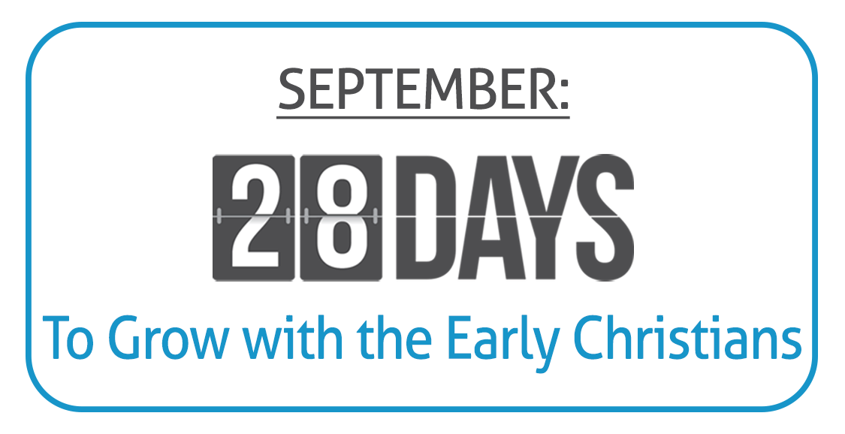

Slide 7
Believe Jesus is God’s Son – Acts 16:31
Repent of your sins and turn to God – Acts 3:19
Confess your faith in Jesus – Acts 8:36-38
Be immersed into Christ – Acts 2:38
God will forgive all of your sins – Acts 22:16
God will add you to His church – Acts 2:47
God will register you in heaven – Hebrews 12:23
Continue steadfastly in serving Him – Acts 2:42

