Slide 2
“A righteous man” is called to “pray for one another”
Abraham (Gen. 18:22-33)
Job (Job 42:7-10)
Moses (Ex. 32:11-13, 30-32)
Samuel (1 Sam. 12:19-23)
Ezra (Ezra 9:1-15)
Nehemiah (Neh. 13:29)
Peter (Acts 8:12-24)

Slide 3
Paul
Rom. 1:9; 1 Cor. 1:4; 2 Cor. 13:7; Eph. 1:16; Phil. 1:3-4, 9-11; Col. 1:3, 9-11; 1 Thess. 1:2; 2 Thess. 1:3, 11-12; Phile. 4
Jesus
He prayed for His apostles, as a group (John 17:6-19)
He prayed for all His disciples, as a whole (John 17:20-26)
He prayed for Peter, in particular (Luke 22:31-32)
He prays for you (Heb. 7:25)

Slide 4
The prayer of a righteous man “avails much”
Powerful EFFECTS: Can have many great benefits
Unity and fellowship enjoyed among God’s people
Humility and service become more natural
Division and strife find no place to settle
Emulation and glorification of Christ becomes very evident
Open doors for the providence of God to work
Strengthen good works and good workers
Changes the pray-er, from the inside out

Slide 5
The prayer of a righteous man “avails much”
Powerful EFFECTS: Can have many great benefits
Powerful EXTENSION: Can go where you cannot go
Into hospital rooms, OR, ER, recovery rooms
Into elders’ meeting, preacher’s study, children’s classes, youth activities, etc.
Into member’s homes, friend’s marriages, widow’s hearts, etc.
Into someone’s back, joints, heart, kidneys, cancer, etc.
Into the mission field, into Bible studies, on mission trips, etc.

Slide 6
The prayer of a righteous man “avails much”
Powerful EFFECTS: Can have many great benefits
Powerful EXTENSION: Can go where you cannot go
Powerful ENGAGEMENT: Can be done by every Christian
By men and women
By boys and girls
By young and old
By abled and disabled
By strong and weak
By seasoned Christians and new converts

Slide 7
The prayer of a righteous person has great power “as it is working” (ESV)
Make and keep a prayer list, praying specifically by name
Keep your personal requests second to praying for others
Do not limit your list to just friends and favorites
Let others know that you pray for them
Answer your own prayers when possible

Slide 8
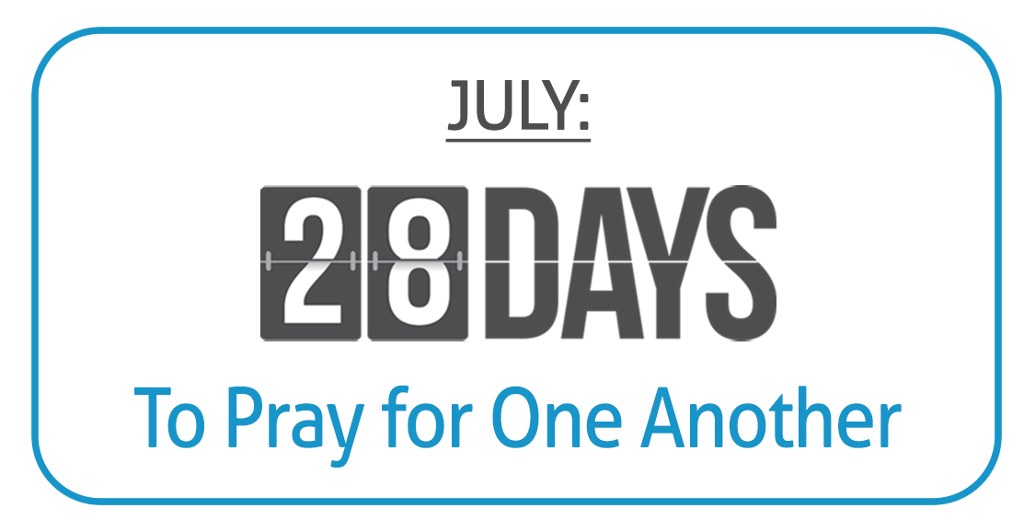

Slide 9
Believe Jesus is God’s Son – John 8:24
Repent of your sins and turn to God – 2 Peter 3:9
Confess your faith in Jesus – Romans 10:10
Be immersed into Christ – Mark 16:16
God will forgive all of your sins – Acts 2:38
God will add you to His church – Acts 2:47
God will enroll you in heaven – Hebrews 12:23
Live faithfully as a Christian – Revelation 2:10

