Slide 2
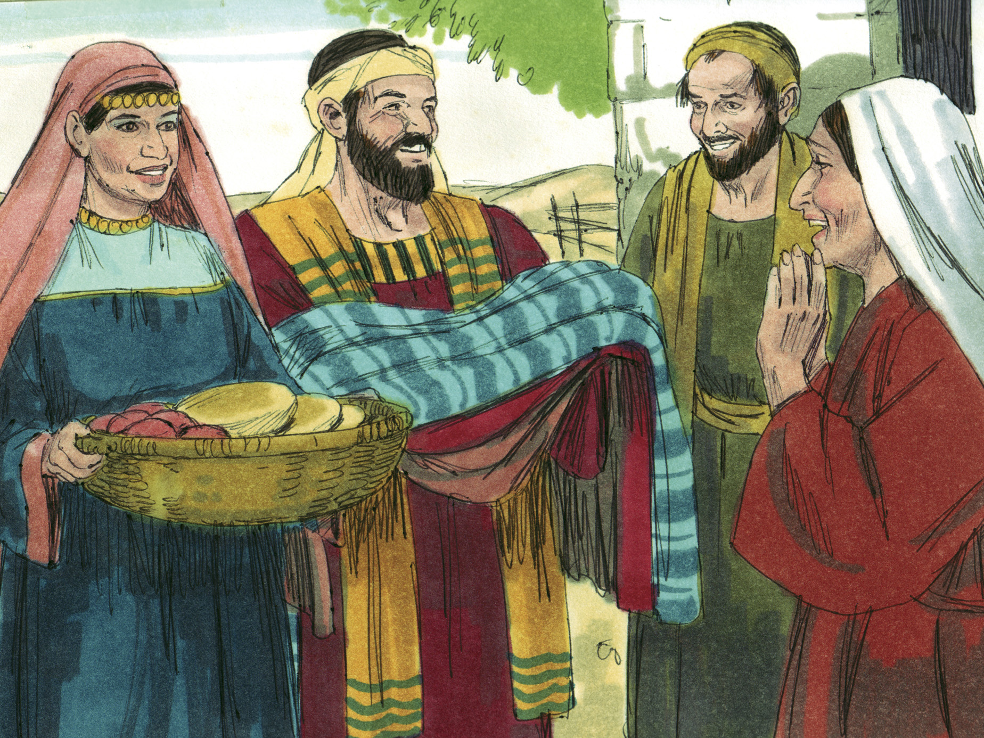

Slide 3
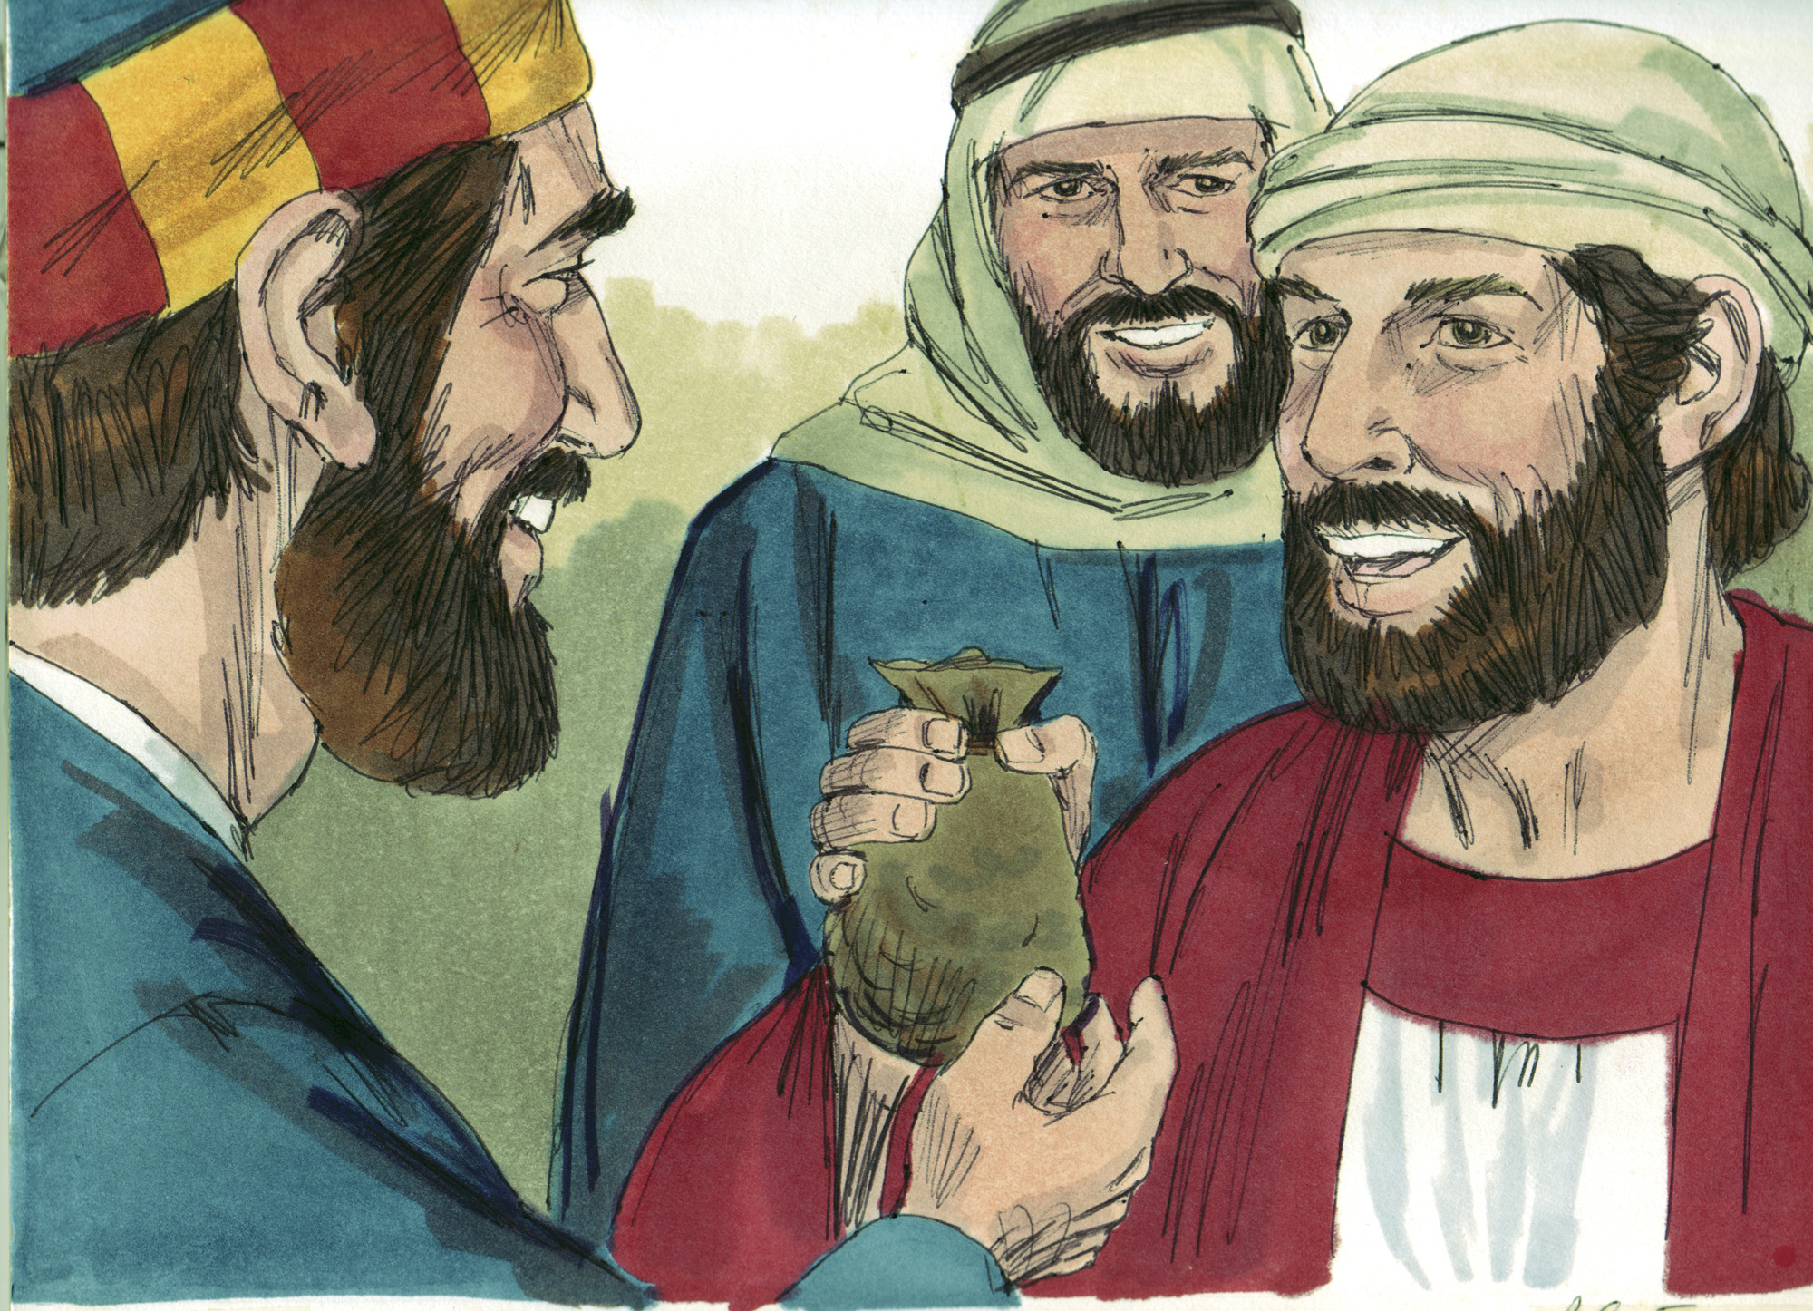

Slide 4
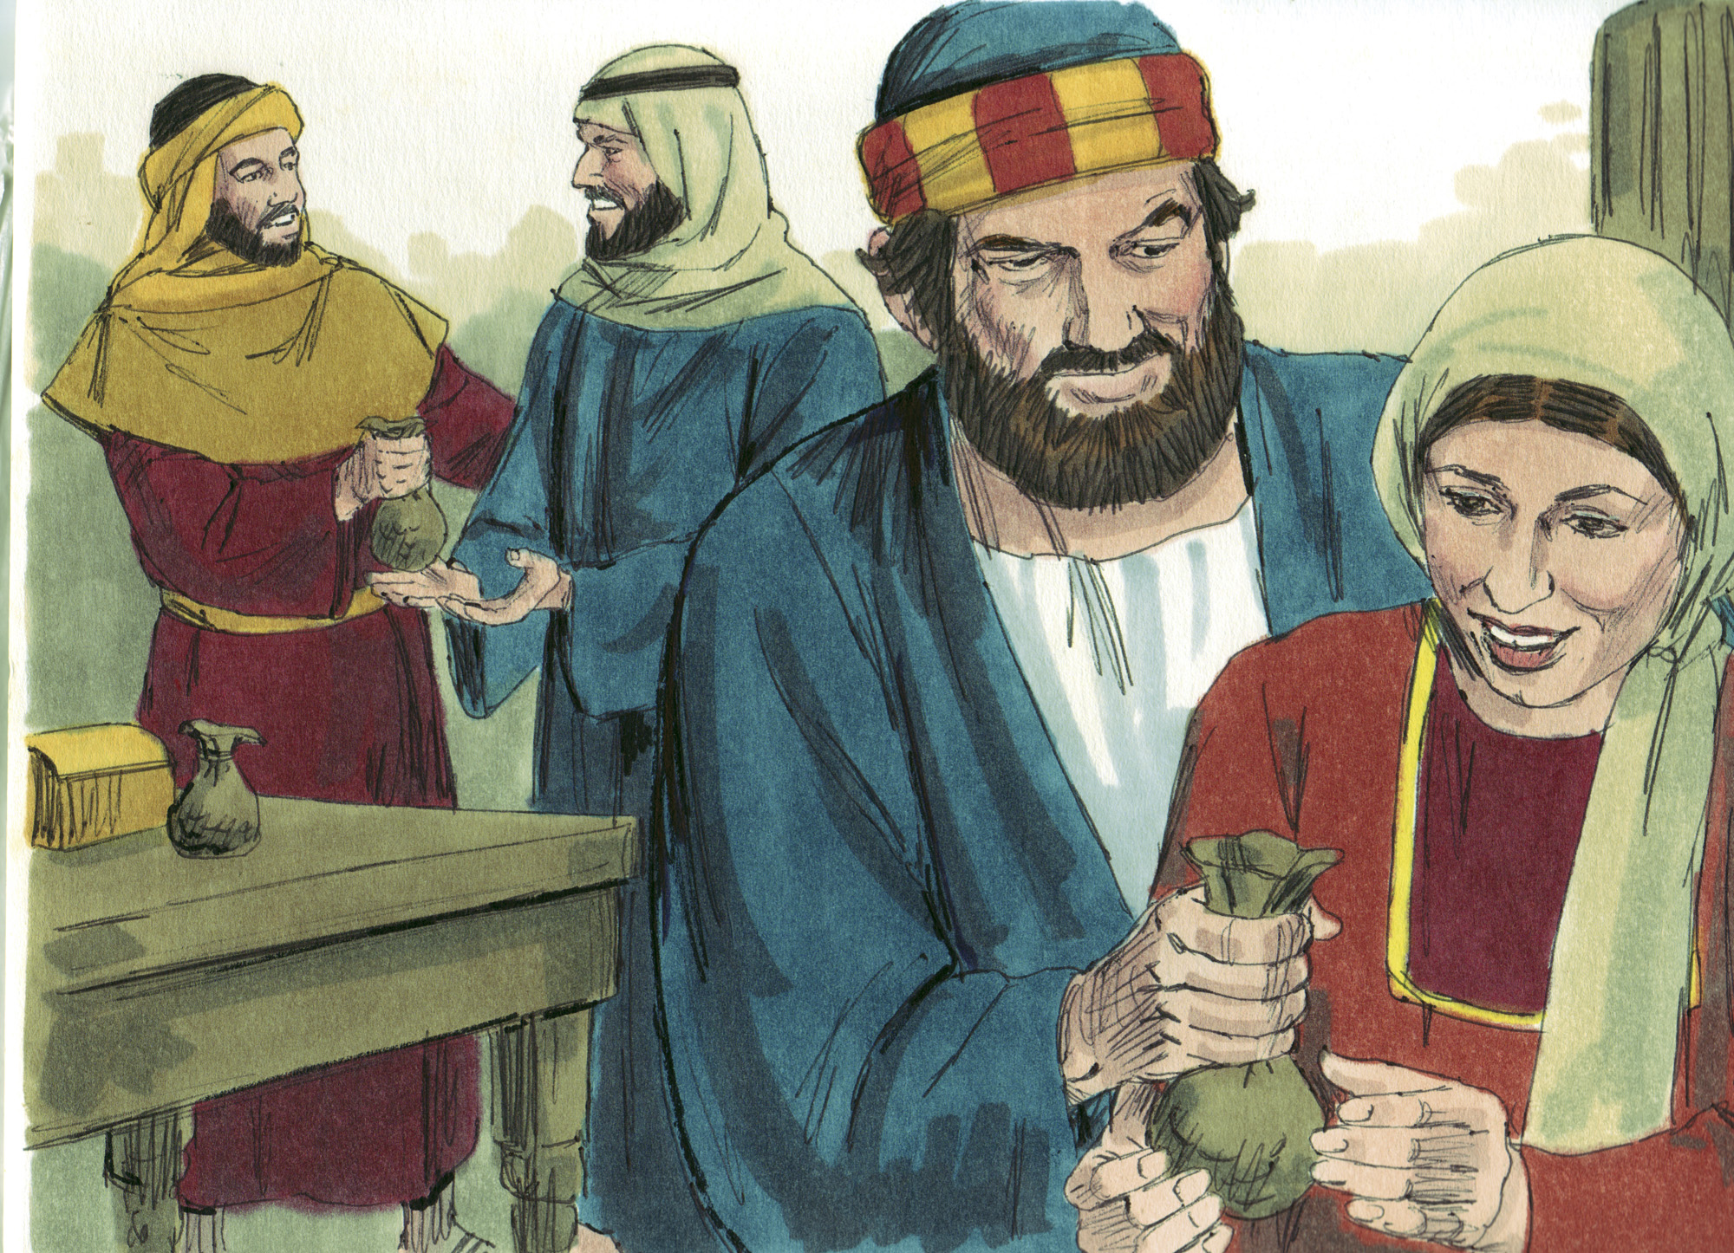

Slide 5
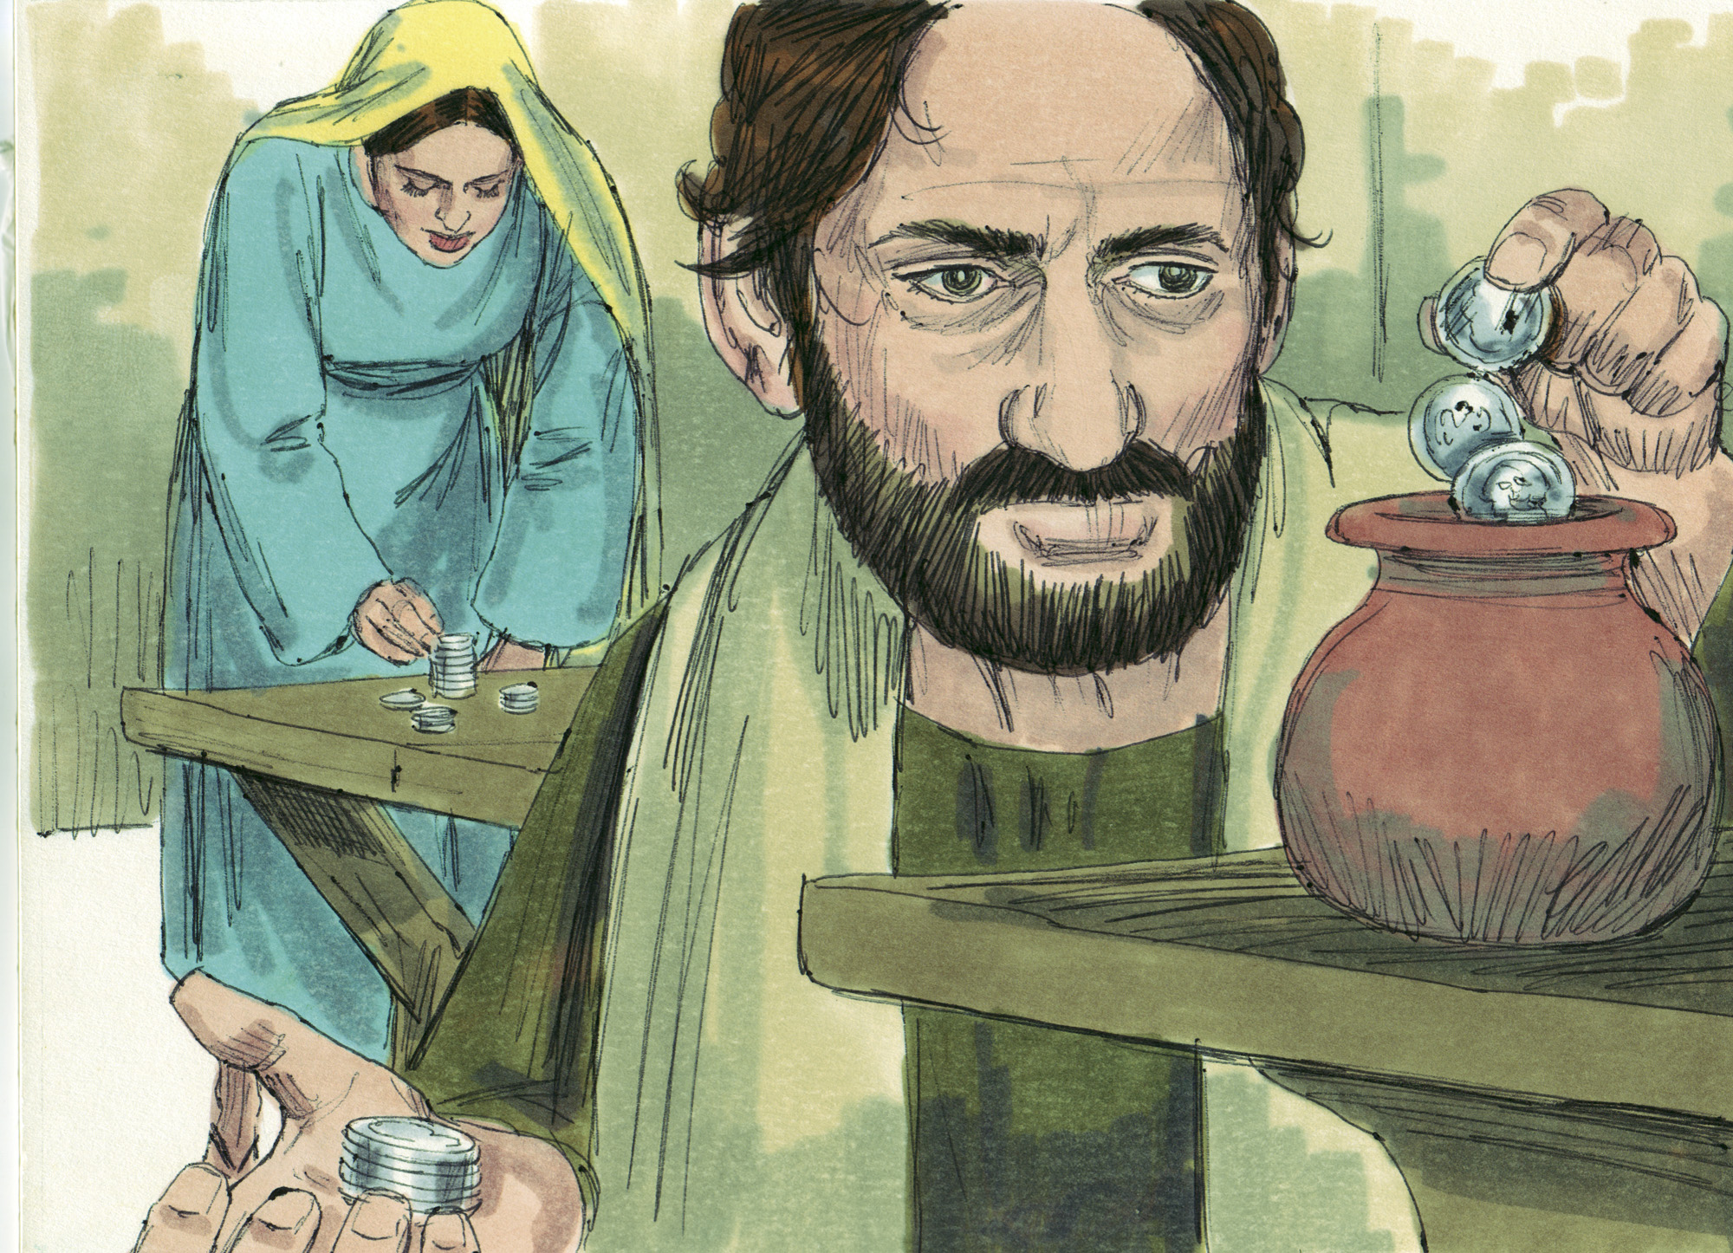

Slide 6
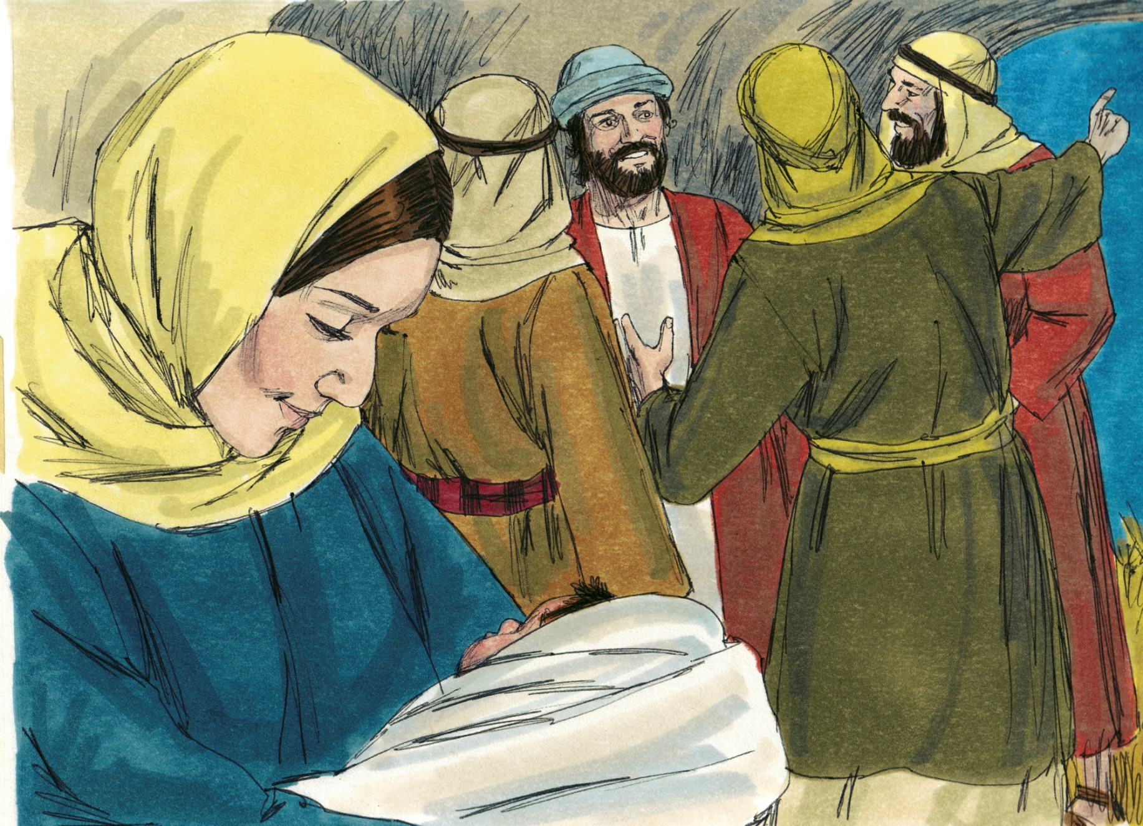
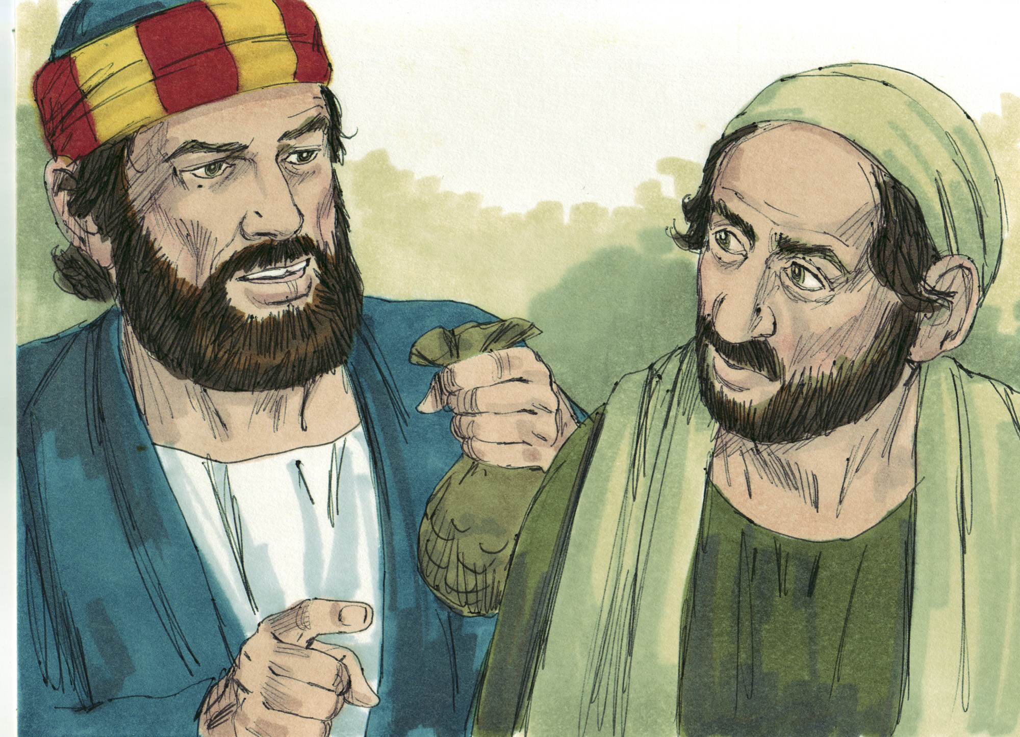

Slide 7
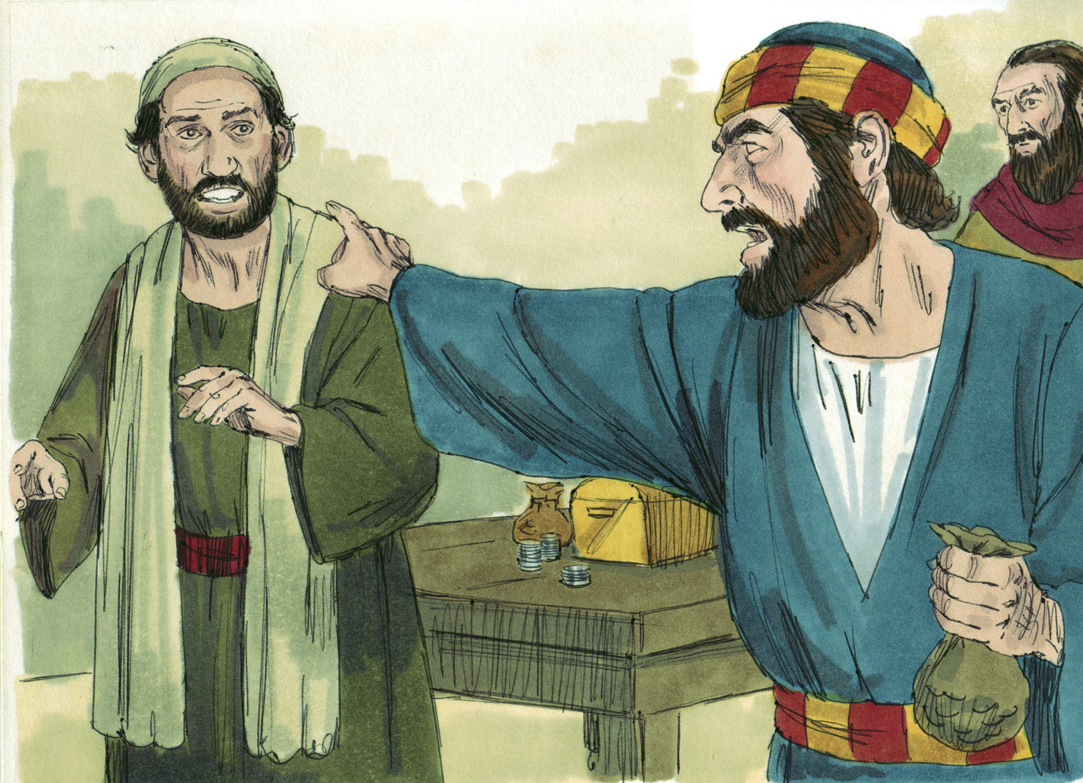

Slide 8
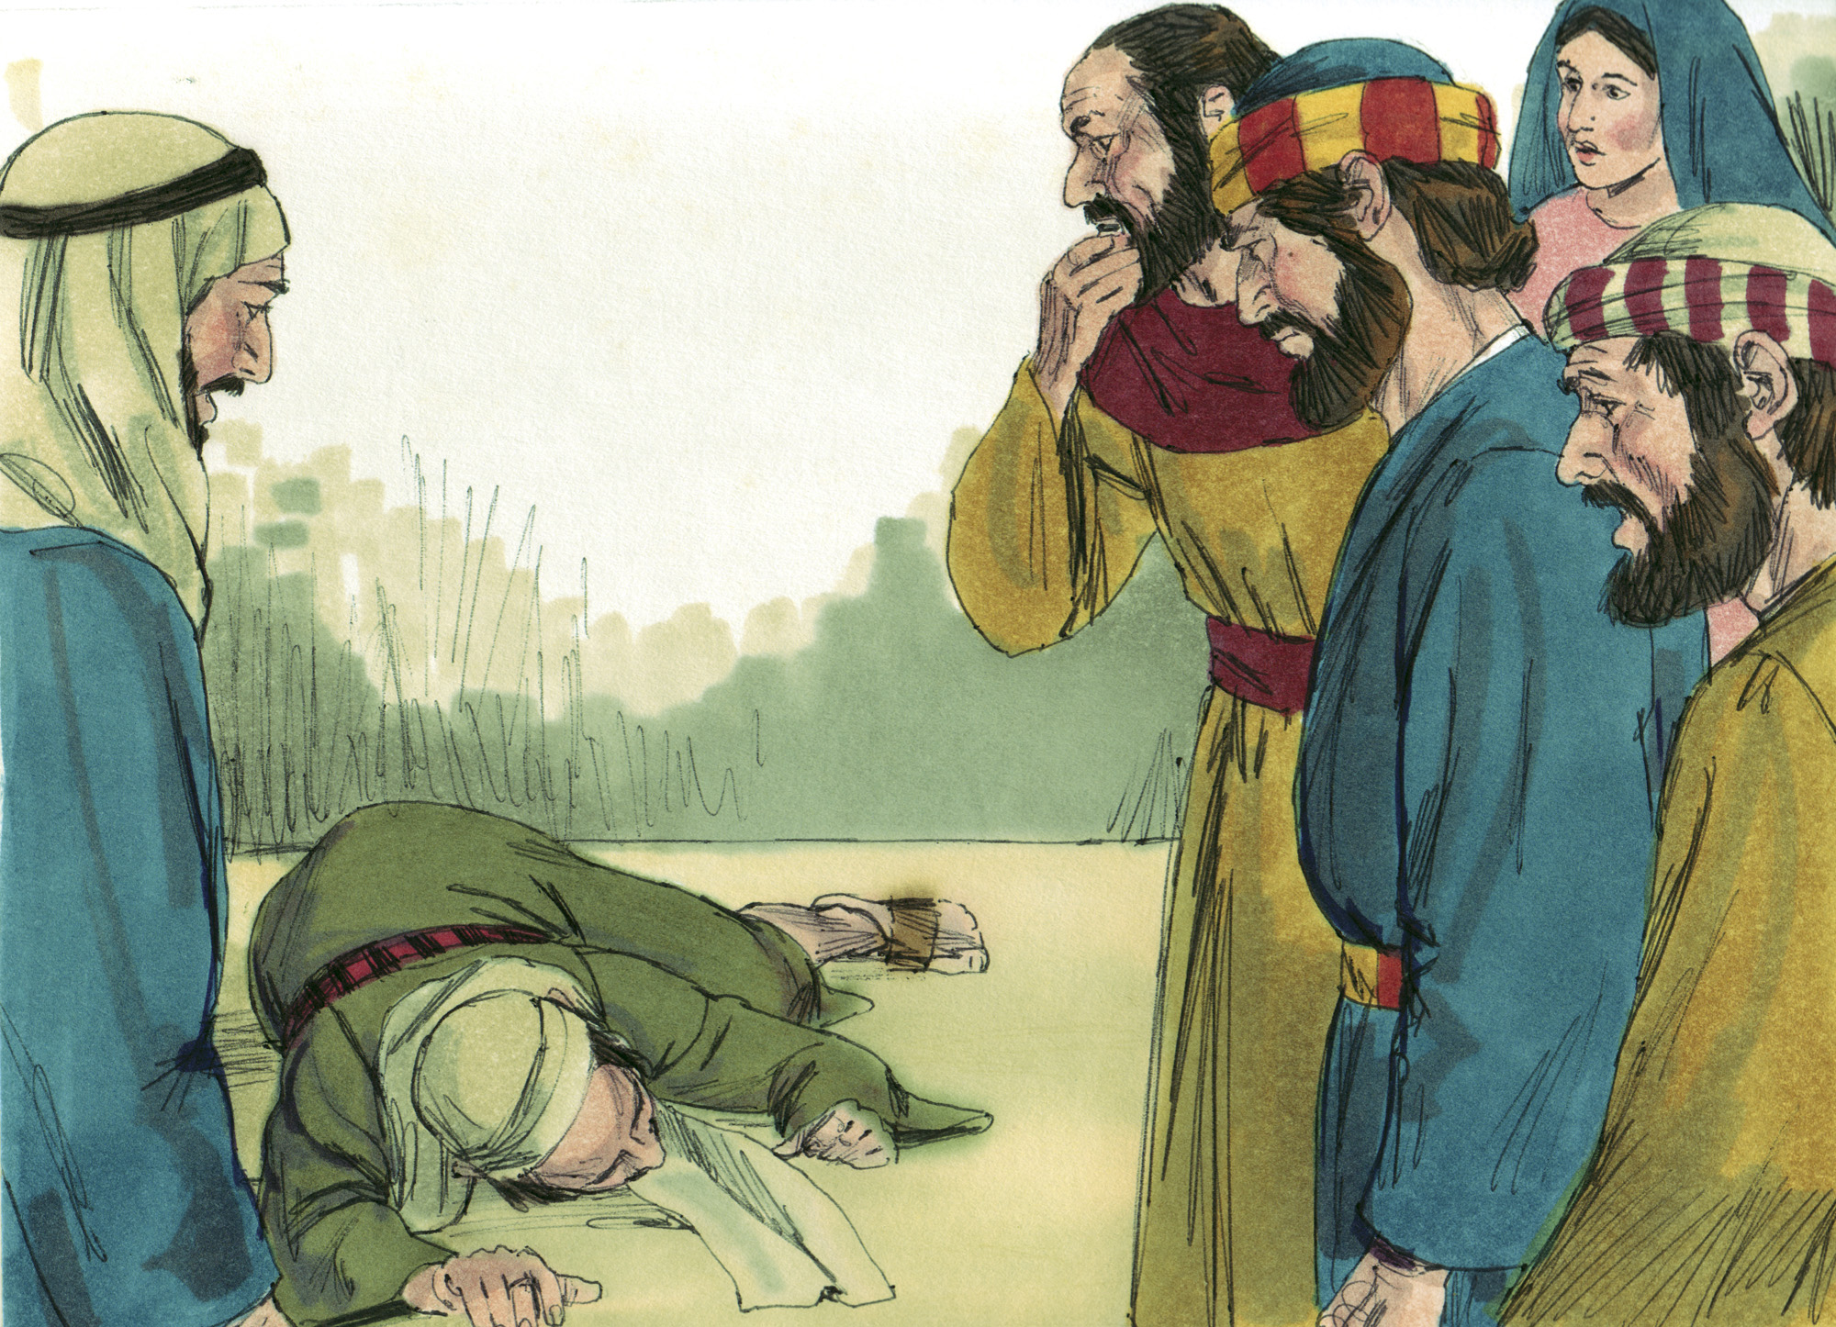

Slide 9
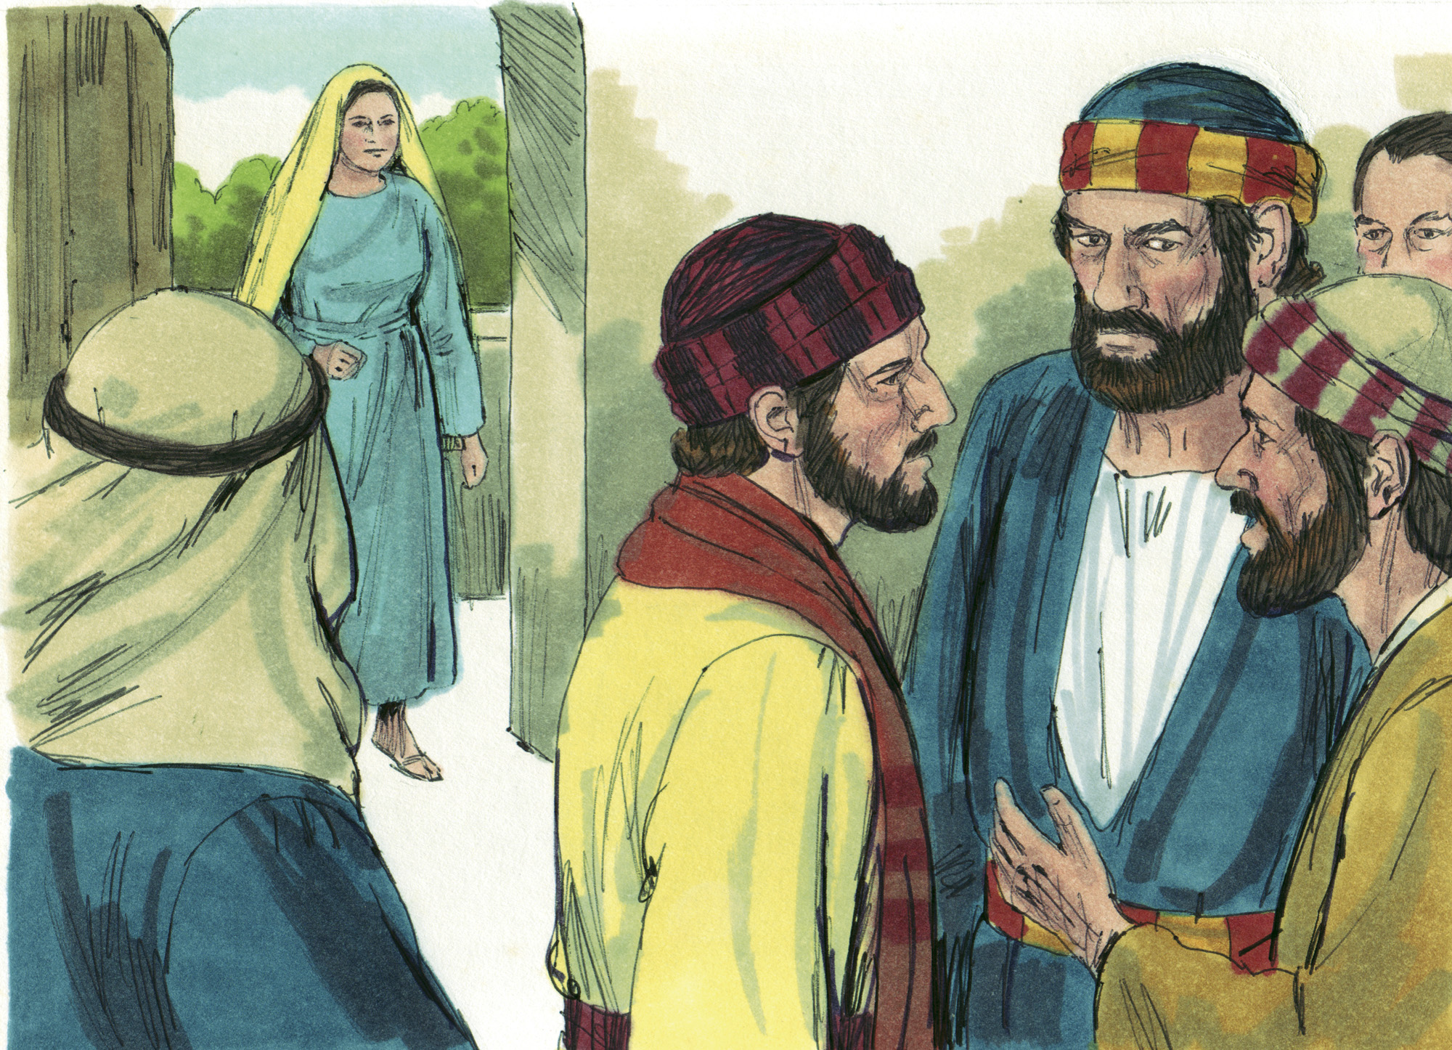

Slide 10
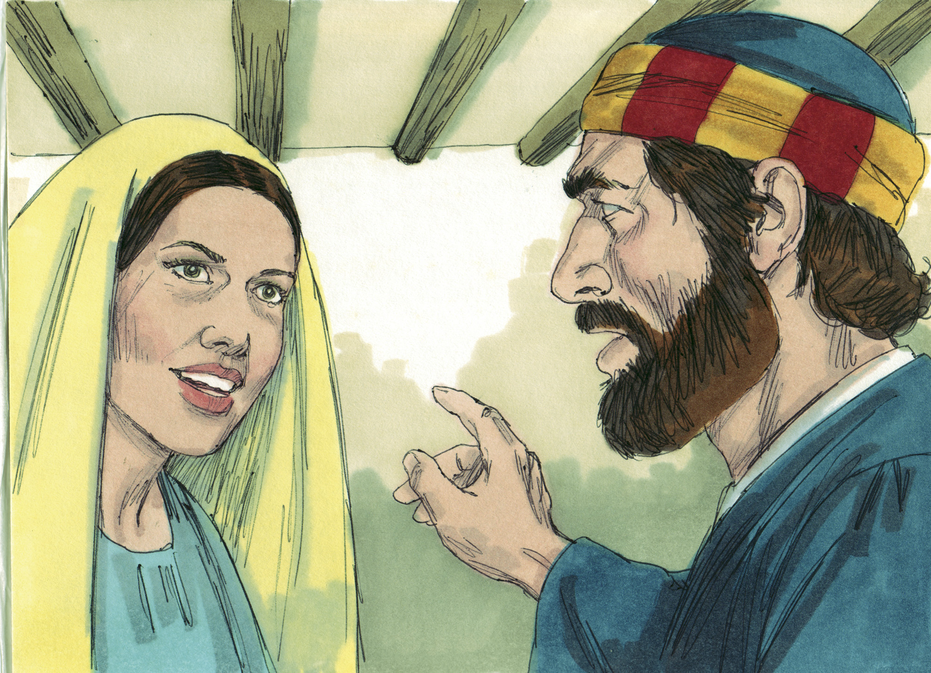

Slide 11
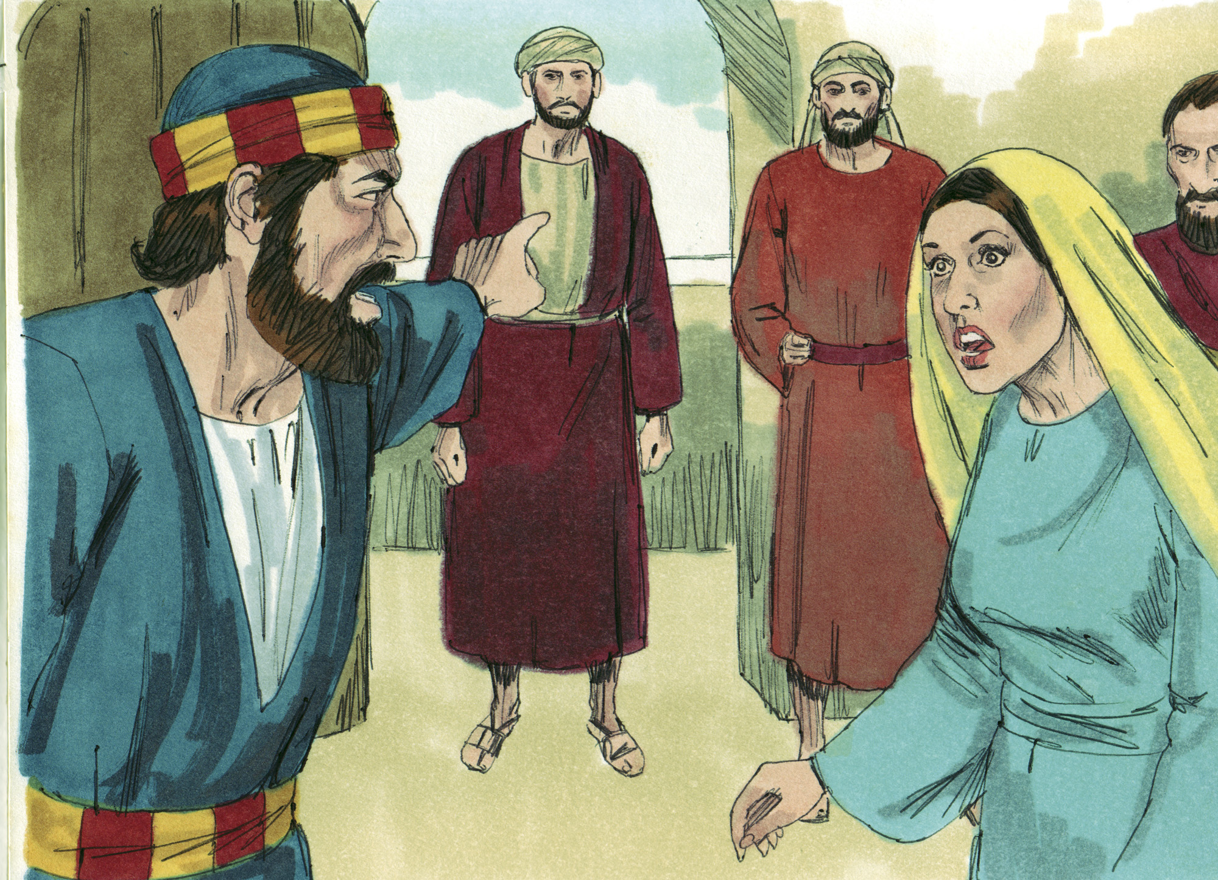

Slide 12
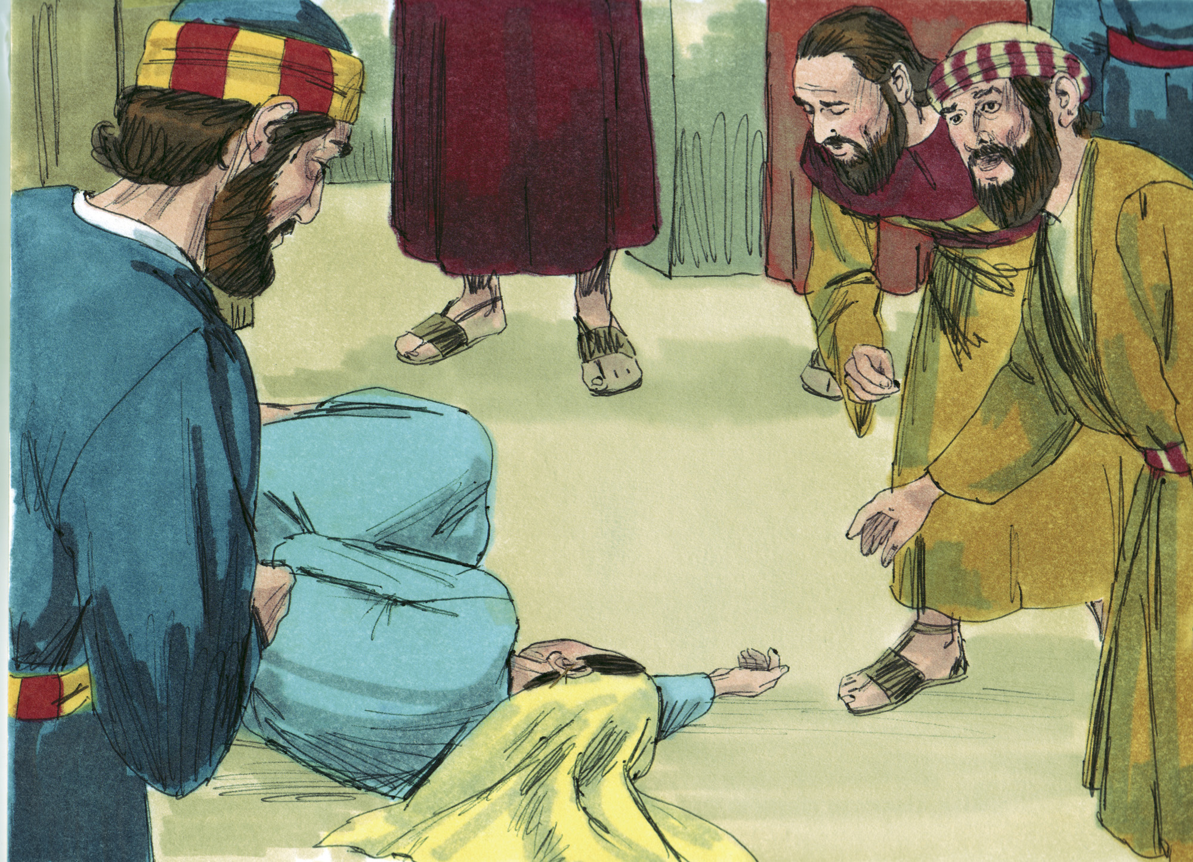

Slide 13
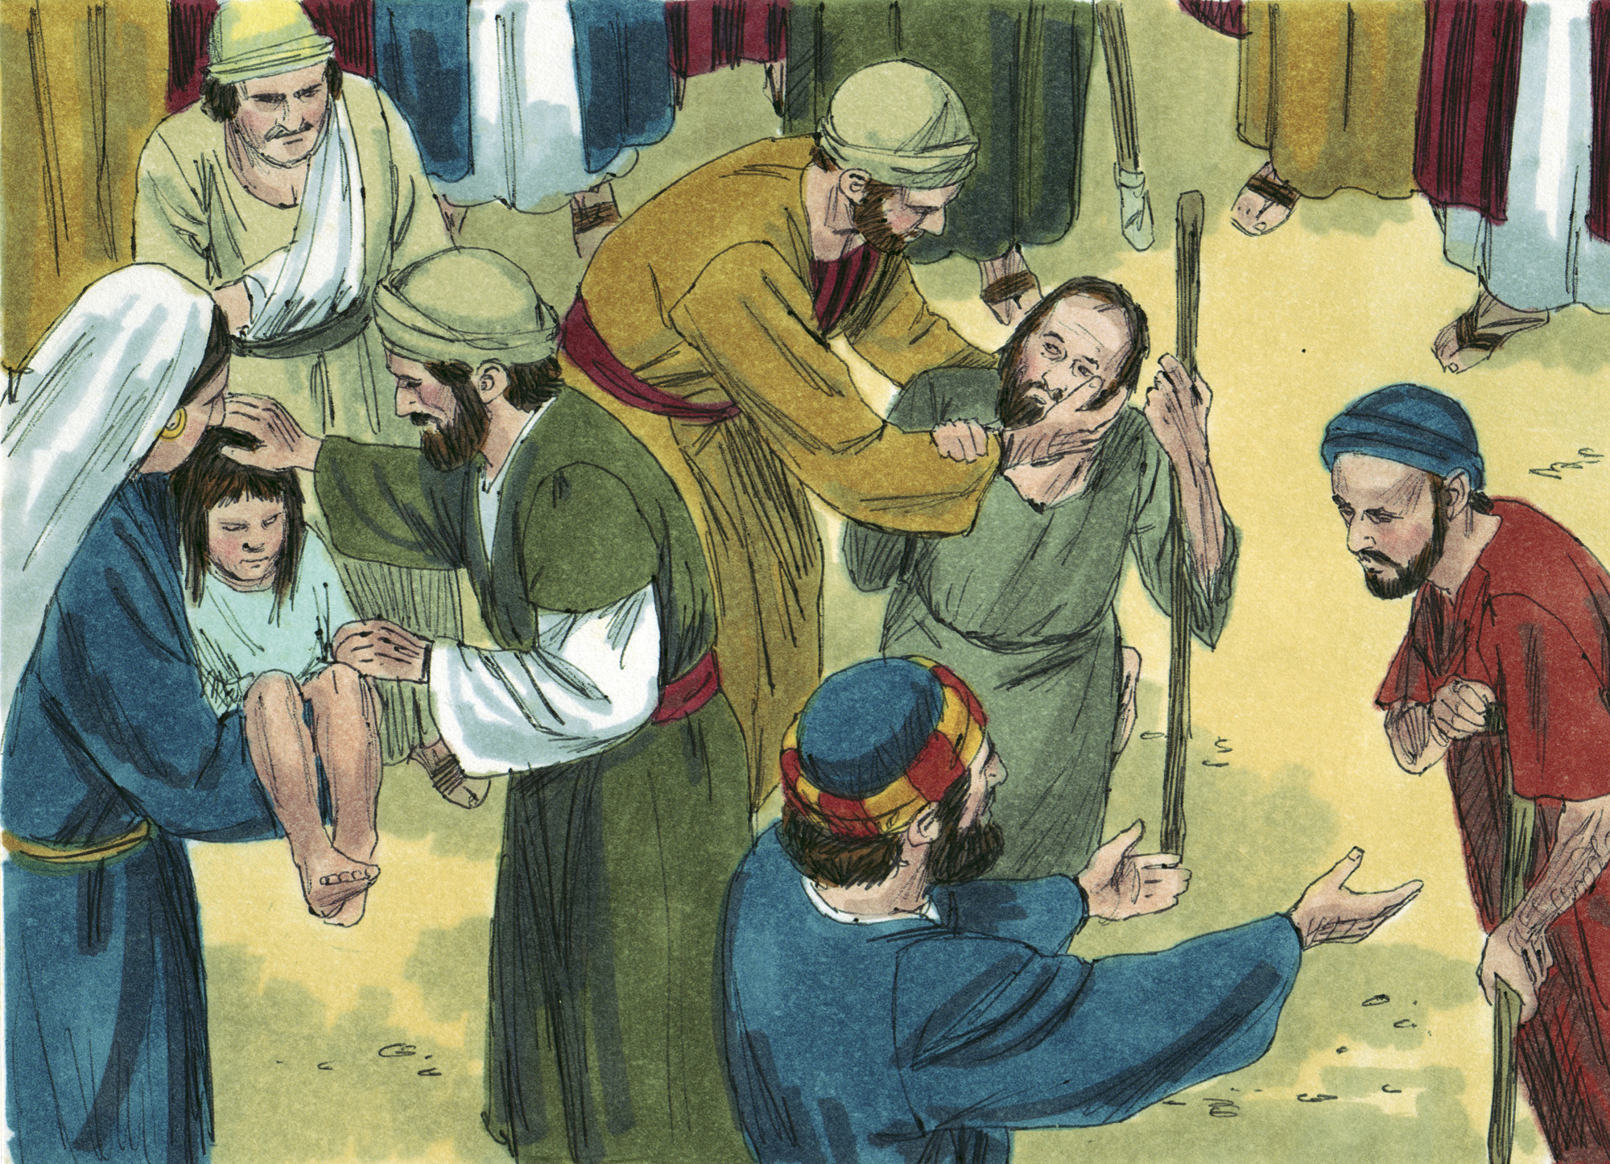

Slide 14
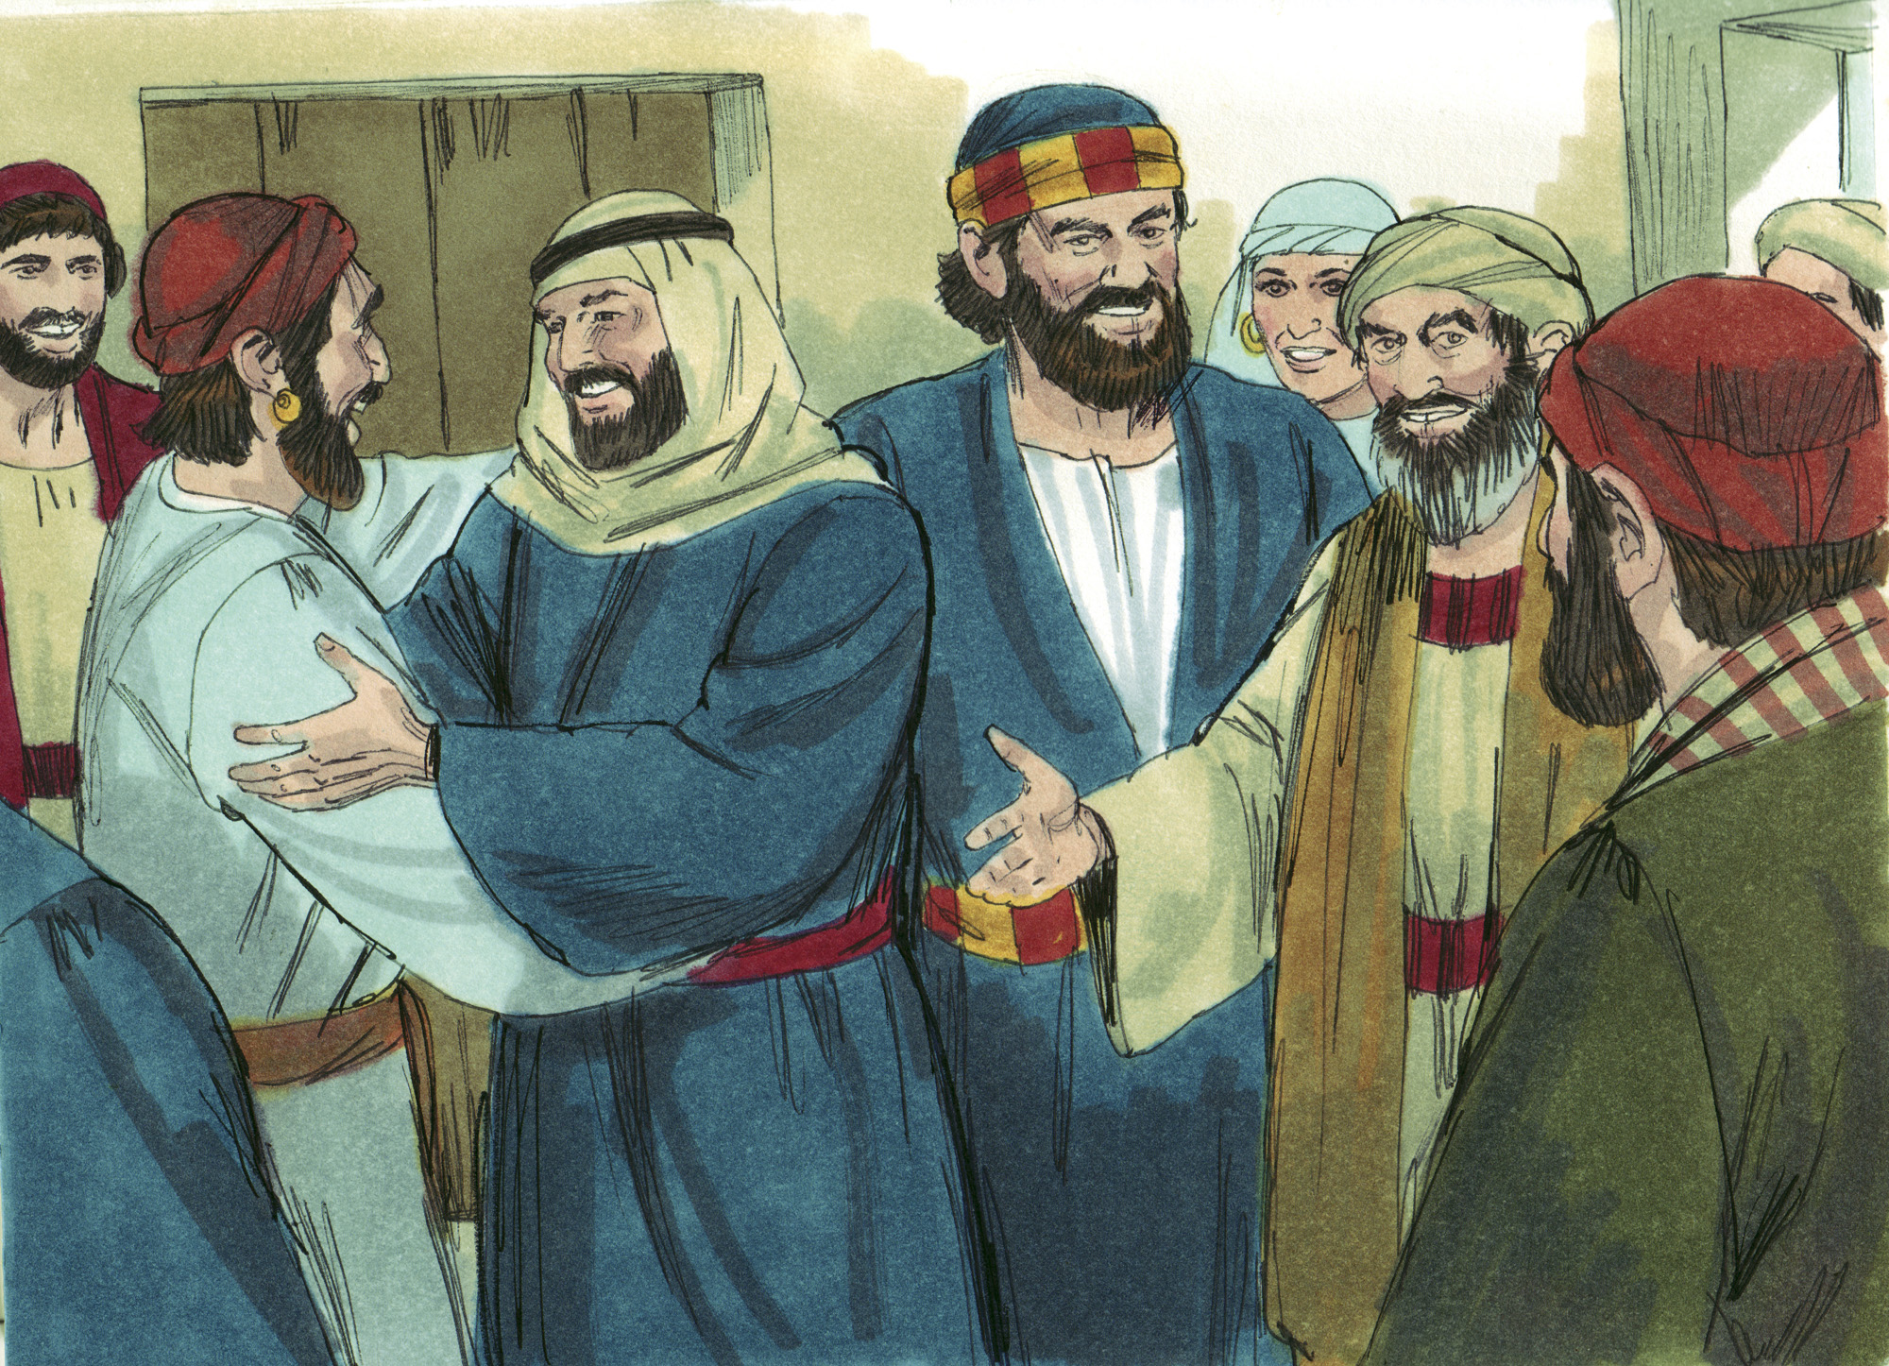

Slide 15
The Right Model
Early Christian’s were a magnificent example of compassion & selflessness (4:32, 34-35)
Barnabas was known by the apostles for his heart of encouragement and benevolence (4:36-37)
Members of the Lord’s church today need to be a model for others to follow
Members of the Lord’s church today need Christian models to follow

Slide 16
The Right Motive
Ananias & Sapphira probably wanted the same reputation as Barnabas, but without the sacrifice
Ananias & Sapphira loved the praise of men and loved money (Matt. 6:1-7; John 12:42-43; 1 Tim. 6:10; Luke 12:15-21)
Members of the Lord’s church today need to ensure that they are properly motivated in their service to Christ

Slide 17
The Right Mindfulness
The devil filled their hearts to lie to God (5:3)
But, they conceived in their own hearts to lie (5:4)
They were influenced by Satan, but still responsible and held responsible for personal conduct
They agreed together (5:9), but they sinned individually & were individually accountable to God
The devil only works within the framework of our desires (Jas. 1:13-15)
The devil cannot make you do anything that you are not willing to do yourself!

Slide 18
The Right Management
Their land and their money were their “own” and in their “own control” (5:4)
They were responsible to God as good managers (1 Cor. 4:2)
Those who “have” are responsible to God for what they “have” and how they “use” it, including giving to others who are in need (Matt. 25:14-30; Eph. 4:28; Luke 12:48)
The standard for stewardship or benevolence is not comparing ourselves to others (cf. 2 Cor. 10:12)! It is being faithful managers of that which the Lord blesses us!

Slide 19
The Right Measure
We must learn to measure the way God measures (and not man)
The Lord knows the hearts of all men (Acts 1:24)
The Lord knows all things (1 John 2:20)
“The ways of the Lord are right” (Hos. 14:9; Gen. 18:25)
The events in Acts 5 resulted in:
Great fear, deep reverence came upon all (5:5)
Great fear, deep reverence came upon the church (5:11)
“Believers were increasing added to the Lord, multitudes…” (5:14)

Slide 20
Believe Jesus is God’s Son – John 20:30-31
Repent of your sins and turn to God – Acts 2:38
Confess your faith in Jesus – Romans 10:9-10
Be immersed into Christ – Galatians 3:27
God will forgive all of your sins – Acts 22:16
God will add you to His church – Acts 2:47
God will register you in heaven – Hebrews 12:23
Serve the Lord faithfully – 1 Corinthians 15:58

