Slide 3
Jesus loves you so much:
#1
He left the perfect place of heaven
(John 3:13; 6:38; Phil. 2:6-7)

Slide 4
Jesus loves you so much:
#2
He came to the cesspool of sinful earth
(Mark 7:21-22; John 3:19-20; 1 John 5:19)

Slide 5
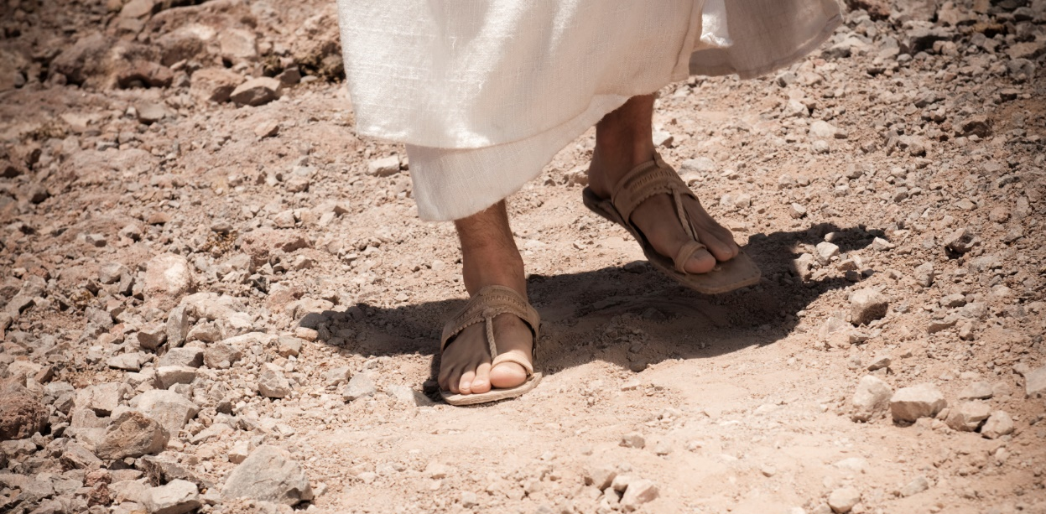
Jesus loves you so much:
#3
He lived on earth as a human being
(John 1:14; Heb. 2:9; Rom. 8:3; 1 Tim. 3:16)

Slide 6
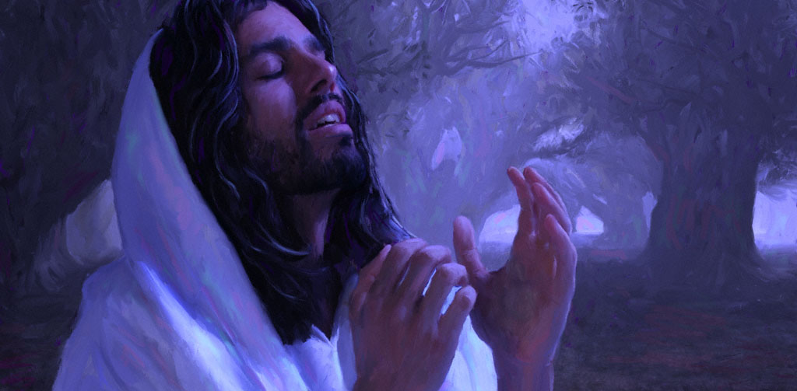
Jesus loves you so much:
#4
He was tempted by the devil to sin
(Heb. 2:18; 4:15; Matt. 4:1-11)

Slide 7
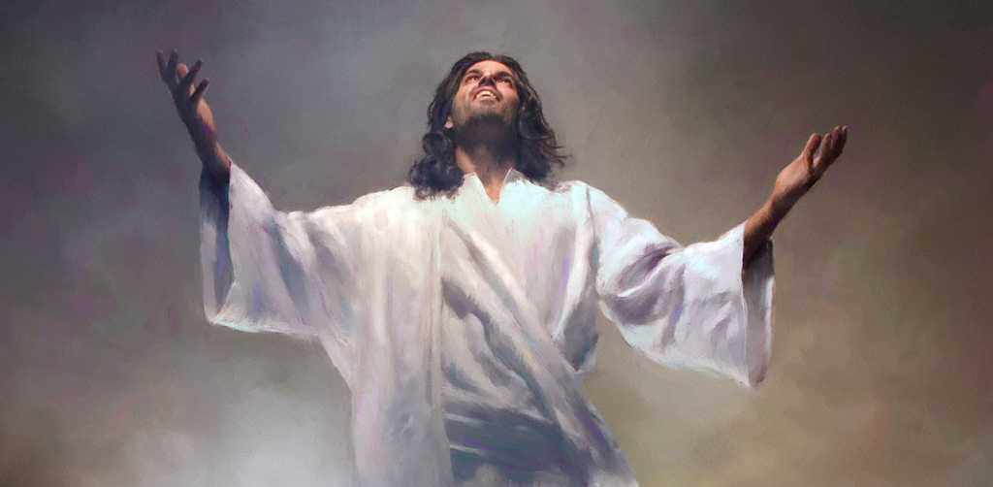
Jesus loves you so much:
#5
He never gave in to the pleasures of sin
(Heb. 4:15; 2 Cor. 5:21; Heb. 7:26; 1 Pet. 2:22)

Slide 8
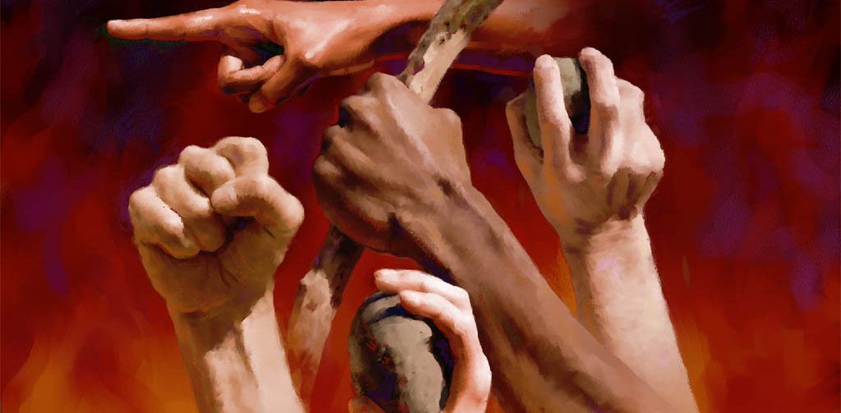
Jesus loves you so much:
#6
He was horribly rejected by His own creation
(John 1:10-11; Isa. 53:3; Matt. 21:38-39)

Slide 9
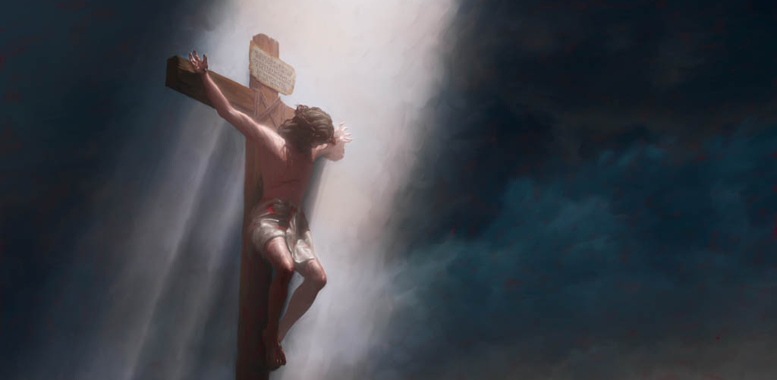
Jesus loves you so much:
#7
He was cruelly nailed to a cross
(Acts 10:39; Phil. 2:8; John 19:16-18; Psa. 22:14-17)

Slide 10
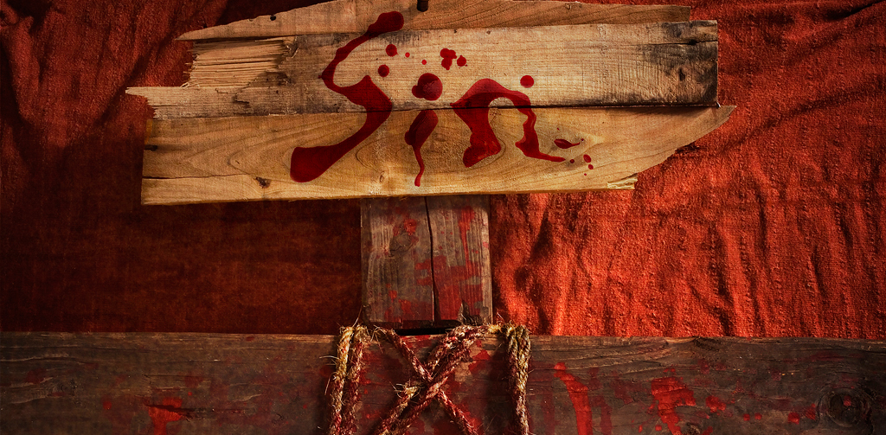
Jesus loves you so much:
#8
He took all of your sins upon Himself
(1 Pet. 2:24; Isa. 53:4-6; 2 Cor. 5:21; Matt. 27:46)

Slide 11
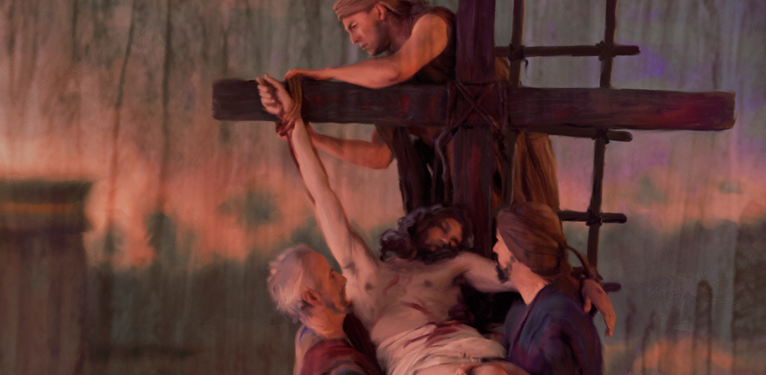
Jesus loves you so much:
#9
He died and was buried with the wicked
(Isa. 53:8-9, 12; John 19:30-42; Luke 23:32-33)

Slide 12
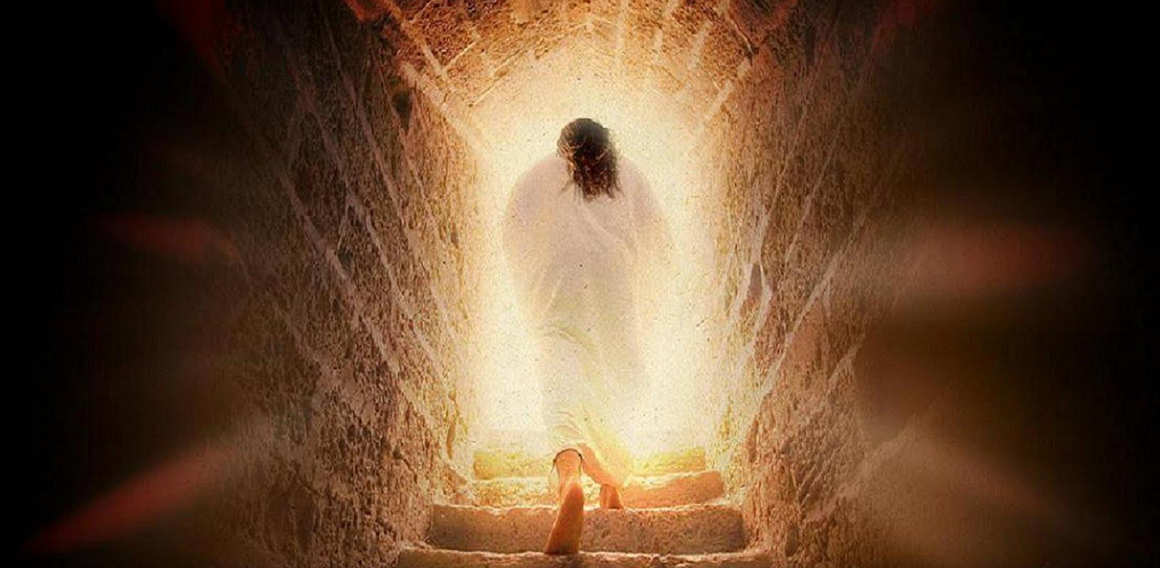
Jesus loves you so much:
#10
He was raised back to life on this earth
(Matt. 28:1-10; Acts 2:24-36; 3:26; 10:40-41; 1 Cor. 15:4-20)

Slide 13
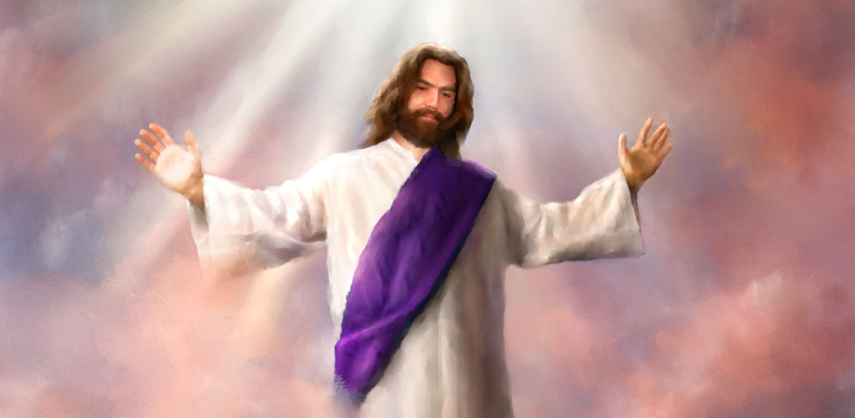
Jesus loves you so much:
#11
He ascended to heaven to appear before God for you
(Heb. 9:24; Acts 1:9-11; 2:33-36; Dan. 7:13-14)

Slide 14
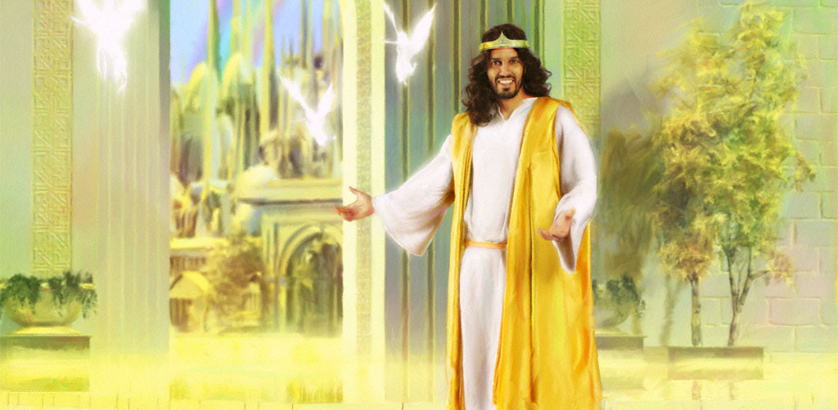
Jesus loves you so much:
#12
He established His church for you to be a part
(Matt. 16:18; Acts 2:37-47; 20:28; Eph. 4:16; 1 Cor. 15:58)

Slide 15
Jesus loves you so much:
#13
He has prepared a home in heaven for you
(John 14:2-3; 1 Pet. 1:3-5; 2 Cor. 5:1-8; Rev. 21-22)

Slide 16
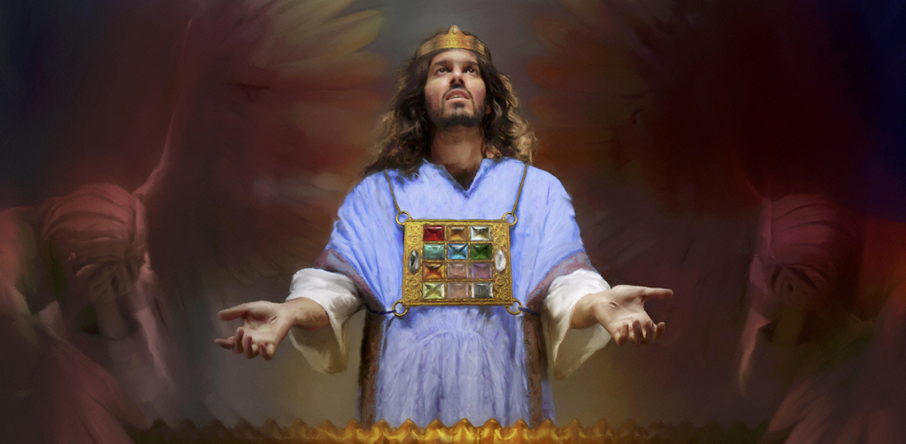
Jesus loves you so much:
#14
He eagerly longs for you every step of the way
(Rom. 8:34; Heb. 7:25; 1 John 1:7; 2:1-2)

Slide 17
Be faithful
Revelation 2:10
Be baptized
Acts 2:38
Confess faith
Romans 10:9-10
Repent of your sins
Acts 3:19
Believe Jesus is God’s Son
Acts 16:31
Jesus loves you so much:
#15
He tells you how to get to heaven
(John 14:6; Heb. 5:9; Matt. 7:21)

Slide 18
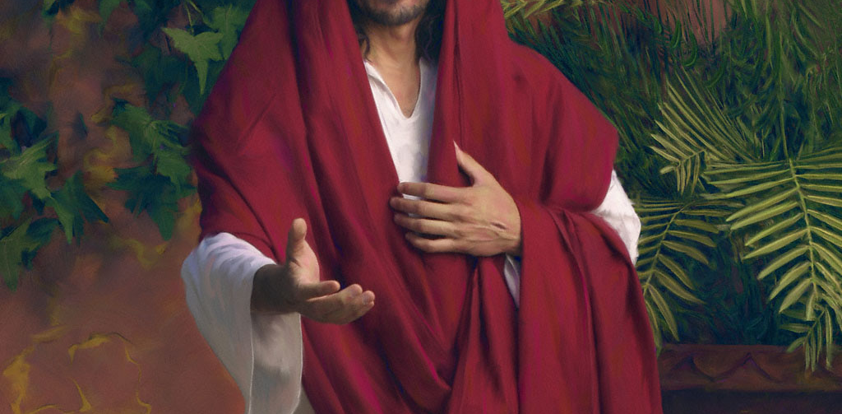
Jesus loves you so much:
#16
He gives you the opportunity & choice to respond
(Matt. 11:28; John 7:37; Rev. 22:17)

