Slide 2
Sermon Text
21 "Present your case," says the LORD. "Bring forth your strong reasons," says the King of Jacob.
22 "Let them bring forth and show us what will happen; Let them show the former things, what they were, That we may consider them, And know the latter end of them; Or declare to us things to come.
23 Show the things that are to come hereafter, That we may know that you are gods; Yes, do good or do evil, That we may be dismayed and see it together.
Isaiah 41:21-23

Slide 3
Prophecy about Babylon
Grandeur of the ancient city
There was “no way” it could be destroyed

Slide 4
Prophecy about Babylon
Grandeur of the ancient city
There was “no way” it could be destroyed
God foretold it would be destroyed (Isa. 13:19) written in 750 B.C.
Afterwards, It would never be inhabited—Isa. 13:20
Babylon was destroyed in 536 B.C. by Persians—Dan. 5
Cyrus, King of Persian, called by name in 750 B.C. and foretold after Babylon destroyed Jews to return to Jerusalem—this was 200+ years before it happened
Modern attempts to rebuild ancient Babylon

Slide 5
Prophecy about Babylon
Grandeur of the ancient city
There was “no way” it could be destroyed
God foretold it would be destroyed (Isa. 13:19) written in 750 B.C.
Afterwards, It would never be inhabited—Isa. 13:20
Babylon was destroyed in 536 B.C. by Persians—Dan. 5
Cyrus, King of Persian, called by name in 750 B.C. and foretold after Babylon destroyed Jews to return to Jerusalem—this was 200+ years before it happened
Modern attempts to rebuild ancient Babylon
Only God Knows the Future and He Wrote It

Slide 6
Tyre—Ezekiel 26
3 "Therefore thus says the Lord GOD: 'Behold, I am against you, O Tyre, and will cause many nations to come up against you, as the sea causes its waves to come up.
4 And they shall destroy the walls of Tyre and break down her towers; I will also scrape her dust from her, and make her like the top of a rock.
5 It shall be a place for spreading nets in the midst of the sea, for I have spoken,' says the Lord GOD; 'it shall become plunder for the nations.
6 Also her daughter villages which are in the fields shall be slain by the sword. Then they shall know that I am the LORD.'
7 "For thus says the Lord GOD: 'Behold, I will bring against Tyre from the north Nebuchadnezzar king of Babylon, king of kings, with horses, with chariots, and with horsemen, and an army with many people.

Slide 7
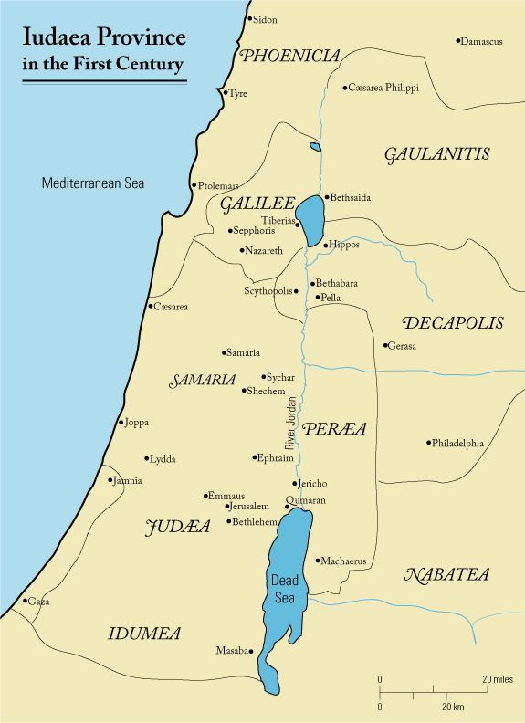
Tyre
Tyre—major seaport in OT
Ezekiel foretold its demise
-- Taken by Nebuchadnezzar
-- Towers & walls cast into the sea
-- City “taken” by Nebuchadnezzar
-- People of Tyre escaped with $$$
-- A place for drying fish nets
Ezekiel also foretold
-- Other nations to come like waves
-- Alexander the Great—330 B.C.
-- Built a causeway to “new” Tyre
-- Literally cast ruins into the sea

Slide 8
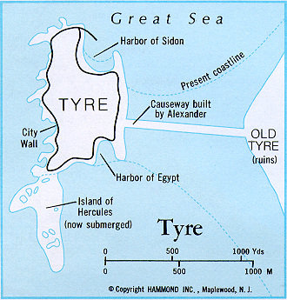
Tyre

Slide 9
Prophecy about Many Nations
Look at Isaiah 13-39
Prophecies about Babylon; Moab; Damascus; Syria; Egypt; Assyria; Tyre; Israel; Jerusalem
Many other nations in the rest of the Bible
Peter Stone’s words about prophecies of just eight nations

Slide 10
Odds of Fulfilling 8 Prophecies about Nations
Cover the entire state of Texas two feet high with silver dollars
Place a mark on just one silver dollar
Let a blindfolded man walk the entire state, pick one coin
What are odds of him finding that one coin
Same odds as fulfilling just EIGHT prophecies

Slide 11
Old Testament Prophecies About Jesus
Matt. 1:23; 2:5, 15-18, 23; 3:3 -- “…might be fulfilled…”—30+ times
Descendant of Abraham, descendant of Isaac, descendant of Jacob, from the tribe of Judah, born in Bethlehem, born during time of Roman rule; born of virgin, slaughter of the infants, taken into Egypt; preach in Galilee; would be a prophet; would be a priest; rejection by Jews; ride a donkey into Jerusalem; betrayed by friend; sold for 30 pieces of silver; that silver used to buy a potters field; Judas to be replaced; false witnesses in trial; silent when accused; spat upon; crucified with thieves; hands and feet pierced; mocked and insulted; given vinegar to drink; burial in rich man’s tomb; side to be pierced; gamble for His clothes; no bone broken; resurrected from the dead; ascension into heaven; etc. etc. (Gen. 22:18; 26:4; 28:14; 49:10; Mic. 5:2; Dan. 9:25; Isa. 7:14; Jer. 31:15; Hos. 11:1; Isa. 9:1-2; Deut. 18:15; Psa. 16:10; 22:6-8; 22:16; 22:18; 27:12; 41:9; 68:18; 69:4; 69:21; 109:78; 110:4; Isa. 53; Zec. 9:9; 11:12-13; 12:10).

Slide 12
Peter Stone on Just 48 Prophecies
Probability of fulfilling forty-eight prophecies was:
One chance in a trillion, trillion, trillion, trillion, trillion, trillion, trillion, trillion, trillion, trillion, trillion, trillion, trillion.
One chance in 1,000,000,000,000,000,000,000,000,000,000,000,
000,000,000,000,000,000,000,000,000,000,000000,000,000,000,
000,000,000000,000,000,000,000,000,000,000,000,000,000,000,
000,000,000,000,000

Slide 13
The Law of Probability & Prophecy
If only fifty prophecies about Jesus had been made, assuming an equal chance for their happening or not happening, the law of probability against all fifty’s being fulfilled “is that of the fiftieth power of two to unity; that is the probability is greater than eleven hundred and twenty-five millions to one that all of these circumstances do turn up.” Then to assume that the fifty events would happen contemporaneously surpasses the power of numbers to express correctly the immense improbability of its taking place.
If only one hundred prophecies had been made, the chance that they would happen to one man is less than all the drops of water if the world were completely water.
But not fifty, nor one hundred, but three hundred thirty-two prophecies of Christ had been counted.
Hugo McCord--From Heaven or From Men--(pages 47-48)

Slide 14
Can You Trust Your Bible—Jesus Did
He believed in the creation
He believed in Noah’s ark and the flood
He believed in Abraham, Isaac and Jacob
He believed in Moses and the burning bush
He believed in manna, the bread from heaven
He believed in Jonah
He believed in the eternal Bible—Matt. 5:17-18
He believed in it, so can YOU!

Slide 15
Trust the Bible & Jesus About Salvation/Church
Jesus promised to build an eternal church
Jesus said to never change it
Jesus adds all the saved to the church
Who are the saved ones?
Not every religious person—Matt. 7:21-23
Those who will first believe John 3:16
Those who then repent Luke 13:3
Those who confess faith in Jesus Rom. 10:9
Those who are immersed to be saved Acts 2:38
Trust Jesus & Bible—You can be part of that church today

