Slide 1
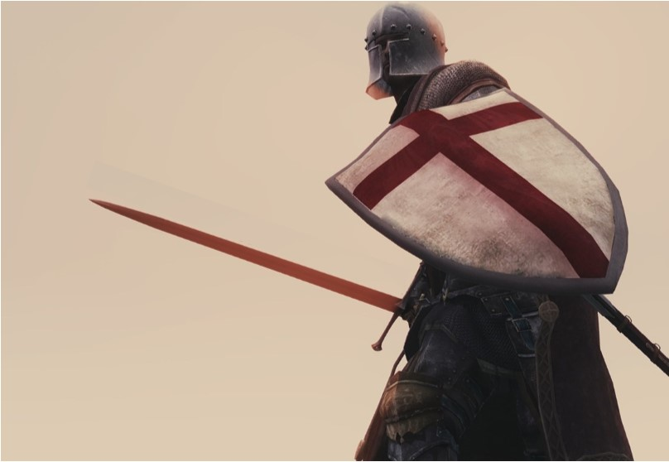
Be On Your
Guard
2 Peter 3:17-18

Slide 2
A Righteous Soul Tormented
Lot and the Choice: Genesis 13:10-13
Lot and the Influence: 2 Peter 2:7-8
Notes:
GN 13:10-13 Lot lifted up his eyes and saw all the valley of the Jordan, that it was well watered everywhere—this was before the LORD destroyed Sodom and Gomorrah—like the garden of the LORD, like the land of Egypt as you go to Zoar. So Lot chose for himself all the valley of the Jordan, and Lot journeyed eastward. Thus they separated from each other. Abram settled in the land of Canaan, while Lot settled in the cities of the valley, and moved his tents as far as Sodom. Now the men of Sodom were wicked exceedingly and sinners against the LORD.
2 PT 2:7-8 And if He rescued righteous Lot, oppressed by the sensual conduct of unprincipled men for by what he saw and heard that righteous man, while living among them, felt his righteous soul tormented day after day by their lawless deeds.

Slide 3
A Righteous Soul Tormented
Lot and the Choice: Genesis 13:10-13
Lot and the Influence: 2 Peter 2:7-8
Lot and the Consequence:
Genesis 19:7-8 - Judgement was impaired
Genesis 19:14 - Lost his sons in law
Genesis 19:15-16 - Had to be dragged out
Genesis 19:26 - Lost his wife
Genesis 19:31-32 - His daughters were corrupted
Notes:
Genesis 19:7-8 “and said, ‘Please, my brothers, do not act wickedly. Now behold, I have two daughters who have not had relations with man; please let me bring them out to you, and do to them whatever you like; only do nothing to these men, inasmuch as they have come under the shelter of my roof.’”
Genesis 19:14 “Lot went out and spoke to his sons-in-law, who were to marry his daughters, and said, ‘Up, get out of this place, for the LORD will destroy the city.’ But he appeared to his sons-in-law to be jesting.”
Genesis 19:15-16 “When morning dawned, the angels urged Lot, saying, ‘Up, take your wife and your two daughters who are here, or you will be swept away in the punishment of the city.’ But he hesitated. So the men seized his hand and the hand of his wife and the hands of his two daughters, for the compassion of the LORD was upon him; and they brought him out, and put him outside the city.”
Genesis 19:26 But his wife, from behind him, looked back, and she became a pillar of salt.
Genesis 19:31-32 Then the firstborn said to the younger, "Our father is old, and there is not a man on earth to come in to us after the manner of the earth. "Come, let us make our father drink wine, and let us lie with him that we may preserve our family through our father."

Slide 4
God Knows How to Rescue
The Context of 2 Peter 2:4-9
Verse 4: God condemned the angels that sinned
Verse 5: God condemned the ancient world, but saved Noah
Verse 6: God condemned the cities, but saved Lot
Verse 9: “The Lord knows how to rescue the godly…”
Notes:
2 Peter 2:4-9 For if God did not spare angels when they sinned, but cast them into hell and committed them to pits of darkness, reserved for judgment; and did not spare the ancient world, but preserved Noah, a preacher of righteousness, with seven others, when He brought a flood upon the world of the ungodly; and if He condemned the cities of Sodom and Gomorrah to destruction by reducing them to ashes, having made them an example to those who would live ungodly lives thereafter; and if He rescued righteous Lot, oppressed by the sensual conduct of unprincipled men (for by what he saw and heard that righteous man, while living among them, felt his righteous soul tormented day after day by their lawless deeds), then the Lord knows how to rescue the godly from temptation, and to keep the unrighteous under punishment for the day of judgment,

Slide 5
Israel, Our Example
God Commanded them to clear out the influence
Leviticus 18:24-26
Leviticus 20:22-23
Notes:
“Do not defile yourselves by any of these things; for by all these the nations which I am casting out before you have become defiled. 'For the land has become defiled, therefore I have brought its punishment upon it, so the land has spewed out its inhabitants. 'But as for you, you are to keep My statutes and My judgments and shall not do any of these abominations, neither the native, nor the alien who sojourns among you.” Leviticus 18:24-26
“You are therefore to keep all My statutes and all My ordinances and do them, so that the land to which I am bringing you to live will not spew you out. 'Moreover, you shall not follow the customs of the nation which I will drive out before you, for they did all these things, and therefore I have abhorred them.” Leviticus 20:22-23
“Do not say in your heart when the LORD your God has driven them out before you, 'Because of my righteousness the LORD has brought me in to possess this land,' but it is because of the wickedness of these nations that the LORD is dispossessing them before you. It is not for your righteousness or for the uprightness of your heart that you are going to possess their land, but it is because of the wickedness of these nations that the LORD your God is driving them out before you, in order to confirm the oath which the LORD swore to your fathers, to Abraham, Isaac and Jacob. Know, then, it is not because of your righteousness that the LORD your God is giving you this good land to possess, for you are a stubborn people.”
Deuteronomy 9:4-6

Slide 6
Israel, Our Example
God commanded them to clear out the influence.
Leviticus 18:24-26
Leviticus 20:22-23
The Why and How
Deuteronomy 30:17-20
Notes:
Deuteronomy 30:17-20 "But if your heart turns away and you will not obey, but are drawn away and worship other gods and serve them, I declare to you today that you shall surely perish. You will not prolong your days in the land where you are crossing the Jordan to enter and possess it. "I call heaven and earth to witness against you today, that I have set before you life and death, the blessing and the curse. So choose life in order that you may live, you and your descendants, by loving the LORD your God, by obeying His voice, and by holding fast to Him; for this is your life and the length of your days, that you may live in the land which the LORD swore to your fathers, to Abraham, Isaac, and Jacob, to give them."

Slide 7
How We Stay On Guard
Love the Lord your God
Mark 12:29-31
More than…
Money or riches (1 Timothy 6:10; Hebrews 13:5)
Family (Matthew 10:37)
Your own Life (Matthew 10:39)
The world (1 John 2:15-17; James 4:4)
Notes:
Jesus answered, “The foremost is, 'Hear, O Israel! The Lord our God is one Lord; and you shall love the Lord your God with all your heart, and with all your soul, and with all your mind, and with all your strength.’ The second is this, ‘You shall love your neighbor as yourself.’ There is no other commandment greater than these.” Mark 12:29-31
1Ti 6:10 For the love of money is a root of all sorts of evil, and some by longing for it have wandered away from the faith and pierced themselves with many griefs.
Mat 10:37 "He who loves father or mother more than Me is not worthy of Me; and he who loves son or daughter more than Me is not worthy of Me.
Mat 10:39 "He who has found his life will lose it, and he who has lost his life for My sake will find it.
1Jn 2:15-17 Do not love the world nor the things in the world. If anyone loves the world, the love of the Father is not in him. (16) For all that is in the world, the lust of the flesh and the lust of the eyes and the boastful pride of life, is not from the Father, but is from the world. (17) The world is passing away, and also its lusts; but the one who does the will of God lives forever.

Slide 8
How We Stay On Guard
Love the Lord your God
Obey His voice
His commandments are not a burden: 1 John 5:2-3
This is love: 2 John 1:6
As obedient children: 1 Peter 1:14-16
Notes:
“By this we know that we love the children of God, when we love God and observe His commandments. For this is the love of God, that we keep His commandments; and His commandments are not burdensome.” 1 John 5:2-3
“And this is love, that we walk according to His commandments. This is the commandment, just as you have heard from the beginning, that you should walk in it.”
2 John 1:6
“As obedient children, do not be conformed to the former lusts which were yours in your ignorance, but like the Holy One who called you, be holy yourselves also in all your behavior; because it is written, ‘You shall be holy, for I Am holy.’” 1 Peter 1:14-16

Slide 9
How We Stay On Guard
Love the Lord your God
Obey His voice
Hold Fast to Him
Hold fast the word: 1 Corinthians 15:1-2
Hold fast our confidence: Hebrews 3:6
Hold to the anchor: Hebrews 6:19
Notes:
“Now I make known to you, brethren, the gospel which I preached to you, which also you received, in which also you stand, by which also you are saved, if you hold fast the word which I preached to you, unless you believed in vain.” 1 Corinthians 15:1-2
“But Christ was faithful as a Son over His house—whose house we are, if we hold fast our confidence and the boast of our hope firm until the end.” Hebrews 3:6
“This hope we have as an anchor of the soul, a hope both sure and steadfast and one which enters within the veil.” Hebrews 6:19

Slide 10
Be On Your Guard
Against the influence of others
2 Peter 3:17-18
Against the influence of sin
1 Corinthians 10:12-13
Notes:
You therefore, beloved, knowing this beforehand, be on your guard so that you are not carried away by the error of unprincipled men and fall from your own steadfastness, but grow in the grace and knowledge of our Lord and Savior Jesus Christ. To Him be the glory, both now and to the day of eternity. Amen.
2 Peter 3:17-18
Therefore let him who thinks he stands take heed that he does not fall. No temptation has overtaken you but such as is common to man; and God is faithful, who will not allow you to be tempted beyond what you are able, but with the temptation will provide the way of escape also, so that you will be able to endure it.
1 Corinthians 10:12-13

Slide 11
Guard Your Heart in Christ
Hear: Romans 10:17
Believe: Acts 8:37-38
Repent: Acts 2:38
Confess: Romans 10:10
Be Baptized: Mark 16:15-16
Live Faithfully: Revelation 2:10
Notes:
You therefore, beloved, knowing this beforehand, be on your guard so that you are not carried away by the error of unprincipled men and fall from your own steadfastness, but grow in the grace and knowledge of our Lord and Savior Jesus Christ. To Him be the glory, both now and to the day of eternity. Amen.
2 Peter 3:17-18
Therefore let him who thinks he stands take heed that he does not fall. No temptation has overtaken you but such as is common to man; and God is faithful, who will not allow you to be tempted beyond what you are able, but with the temptation will provide the way of escape also, so that you will be able to endure it.
1 Corinthians 10:12-13

