Slide 2
Sowing and reaping often in the Bible
Parable of the sower and parable of the tare
Jesus’ words—“Lift up your eyes unto the harvest…”
Church growth—Planters, waterers, Increaser
Sowing and reaping with money—2 Cor. 9:6-7
Sowing and reaping in our text
Truths about sowing and reaping
Two “fields” in which we sow—the spirit, the flesh
Two kinds of harvest—sparingly and abundantly
Have you reaped much? More required of you—Lk. 12:48
Opportunities in 2018

Slide 3
January 28
Every dollar given on Mission Sunday
goes toward mission work.

Slide 4
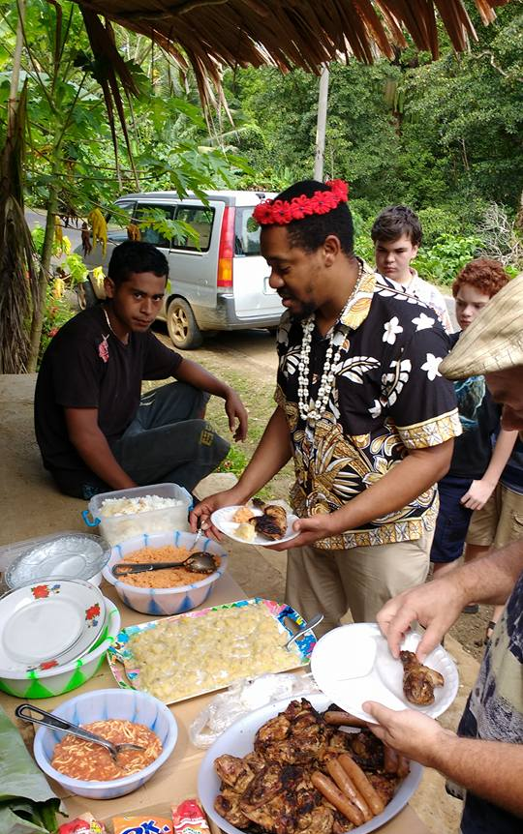
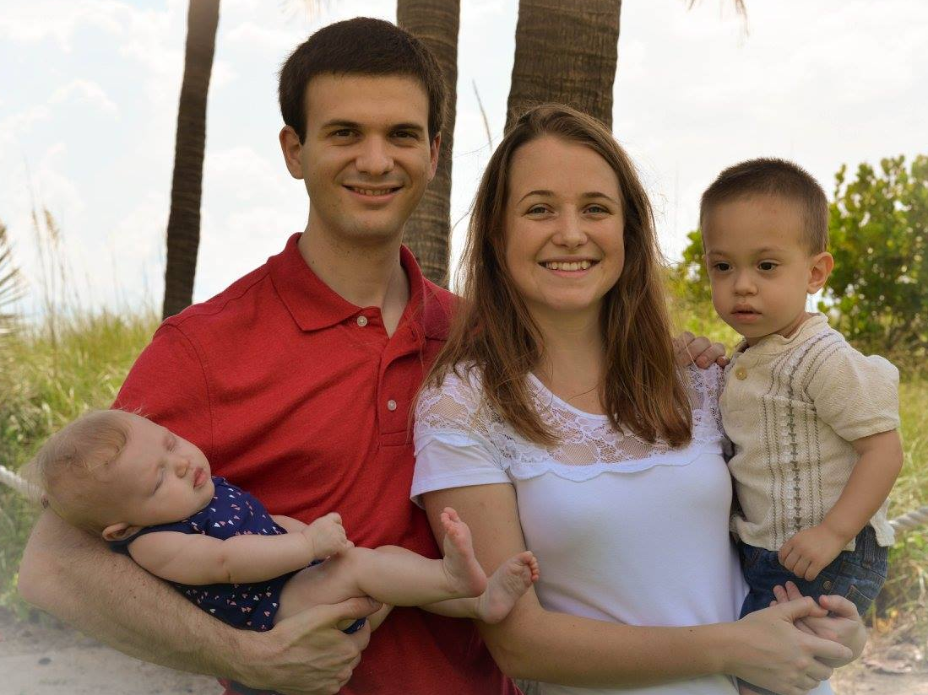
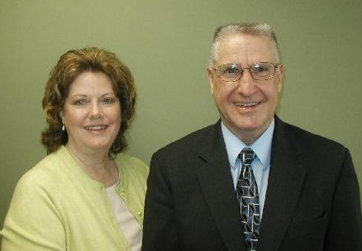
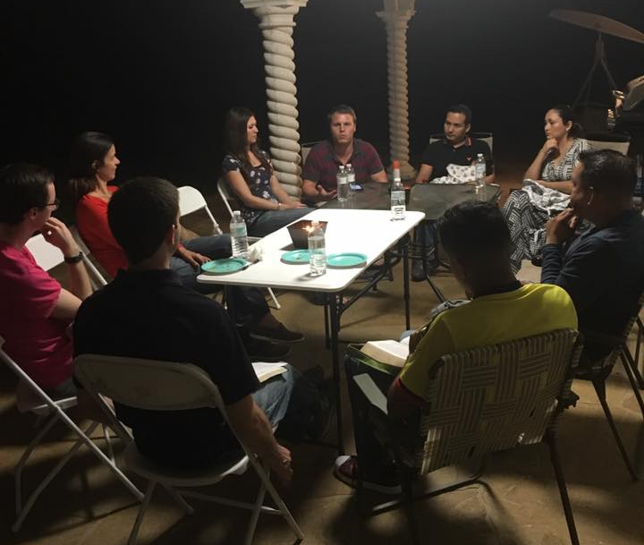
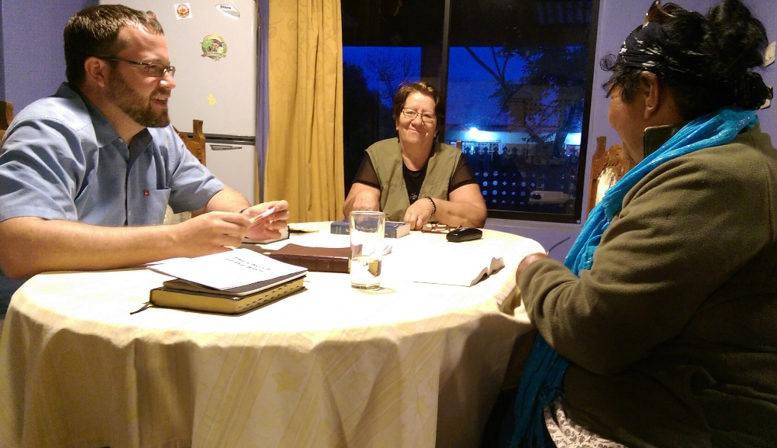
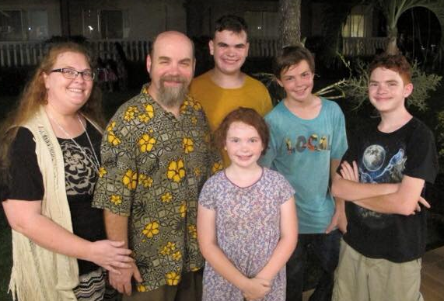
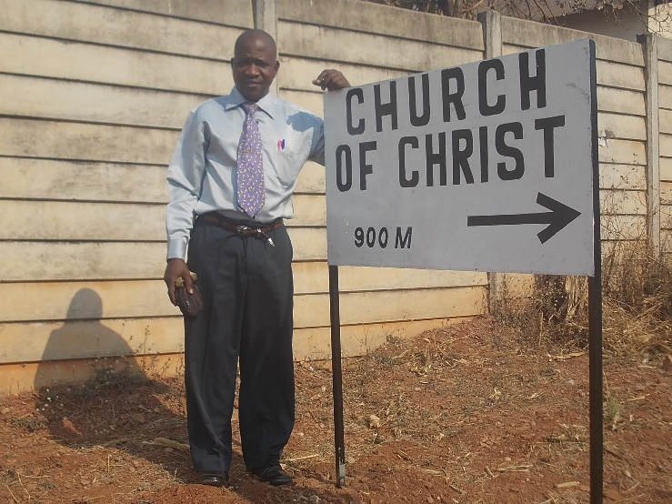
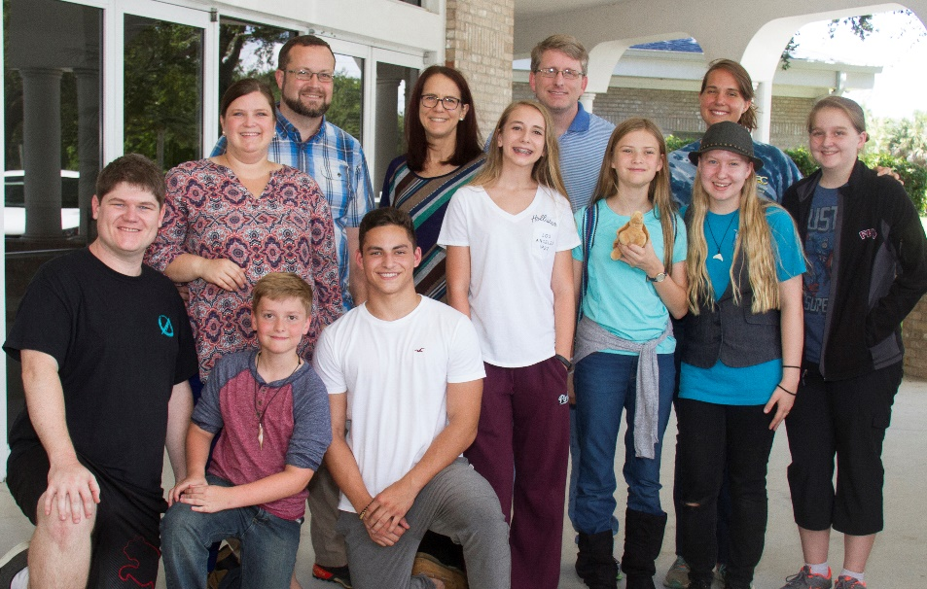
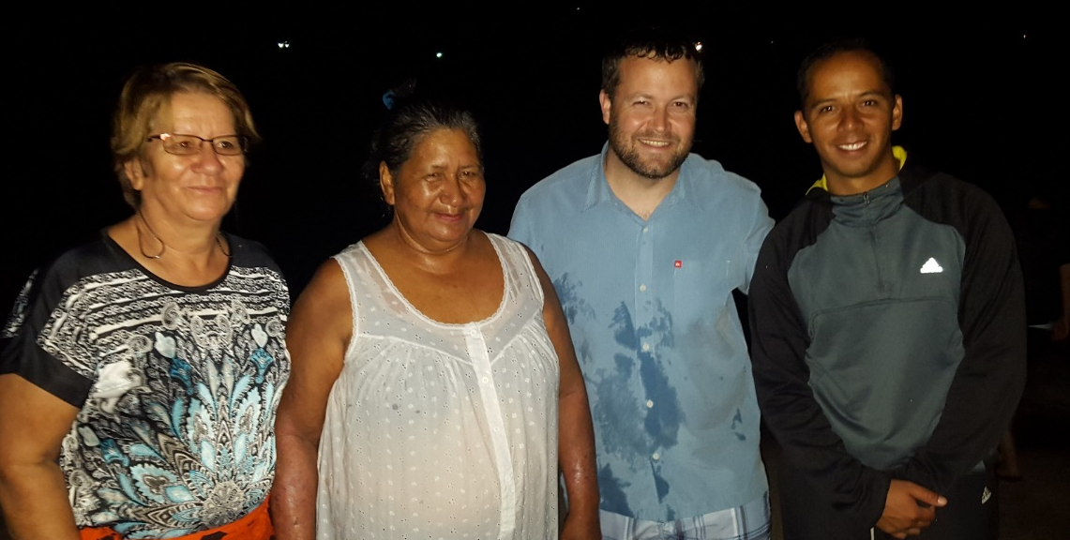
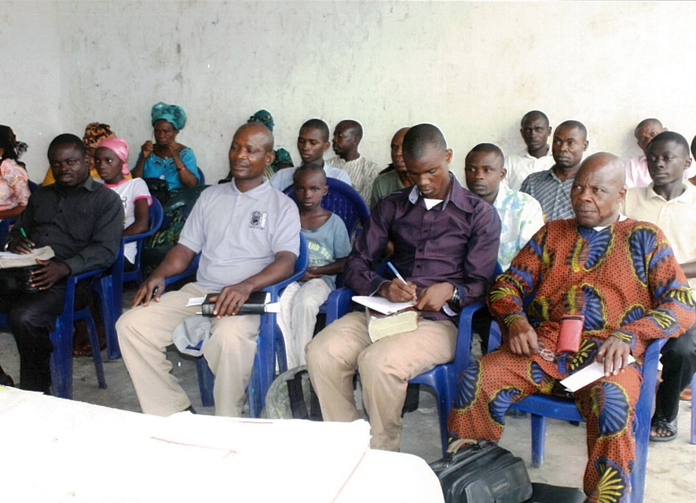
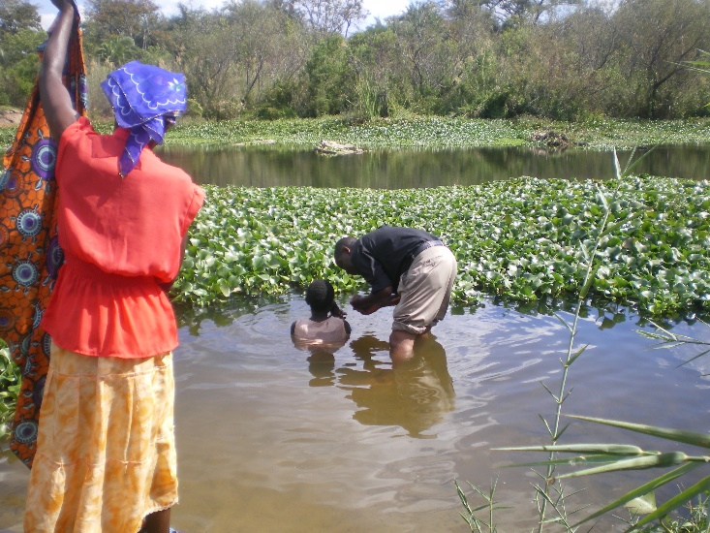
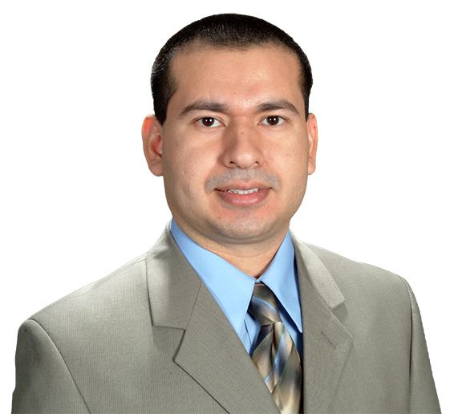
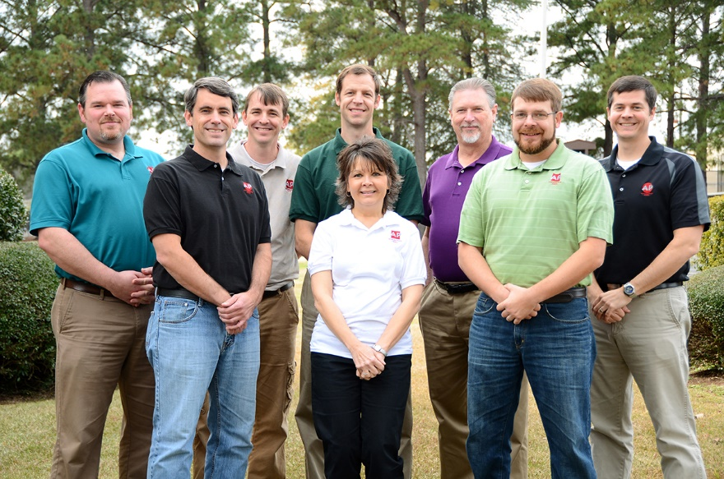
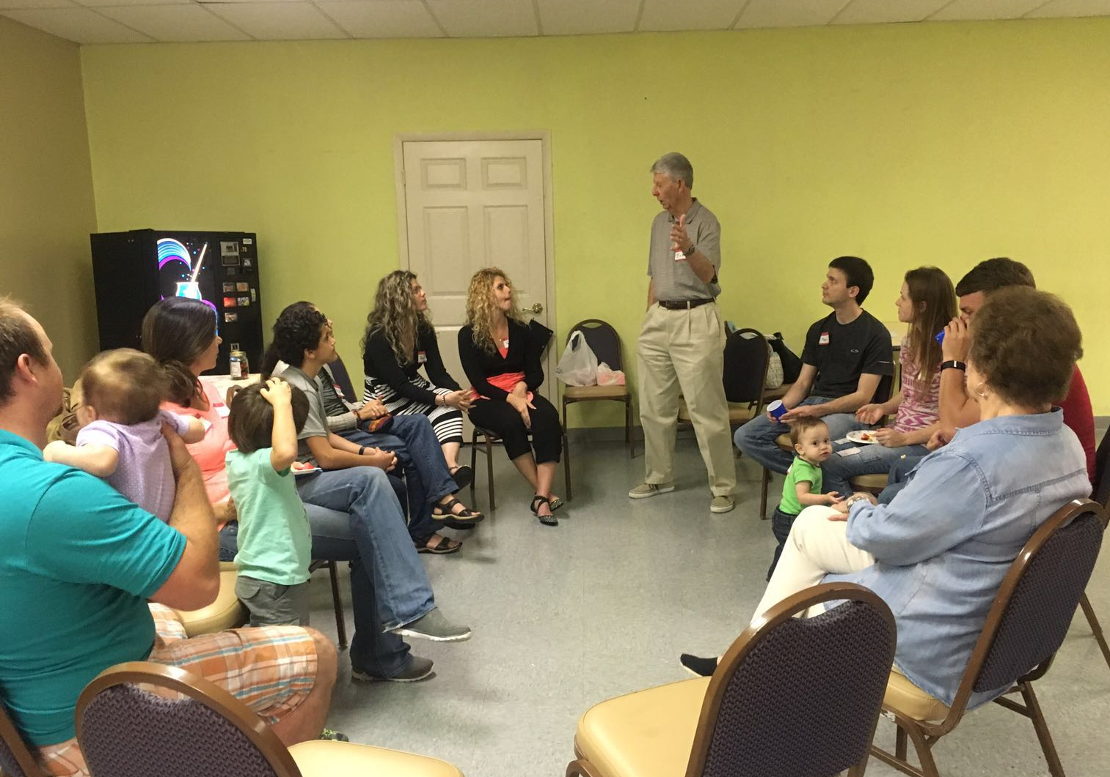
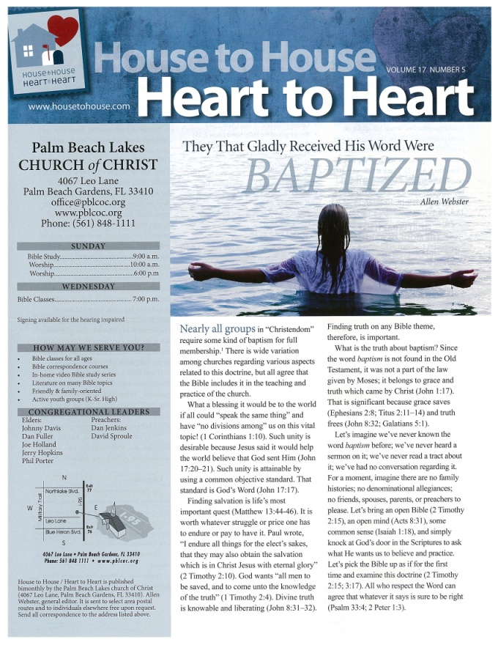
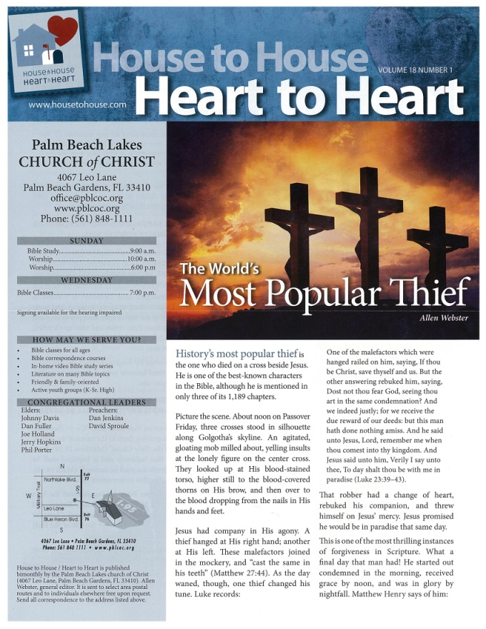
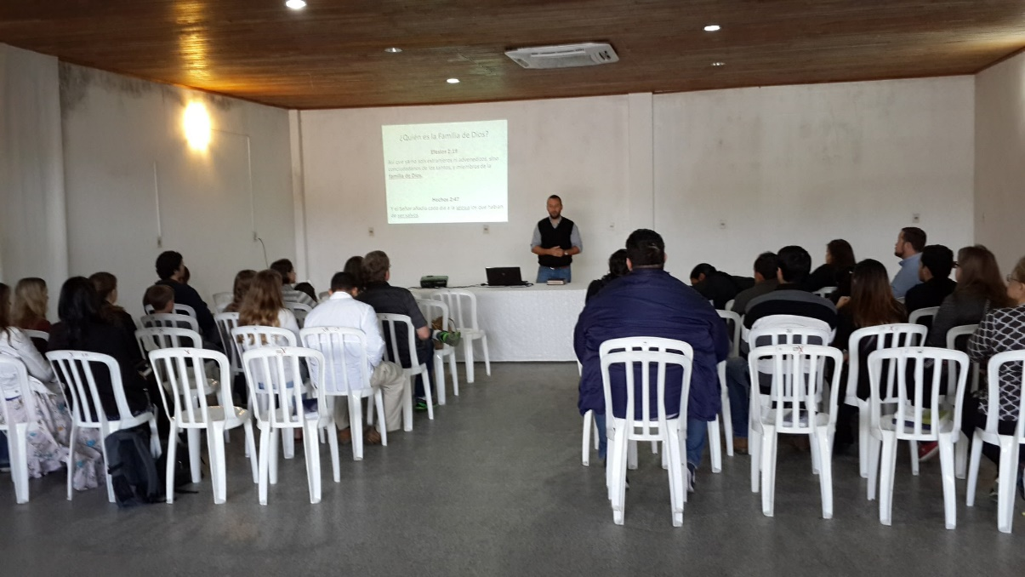
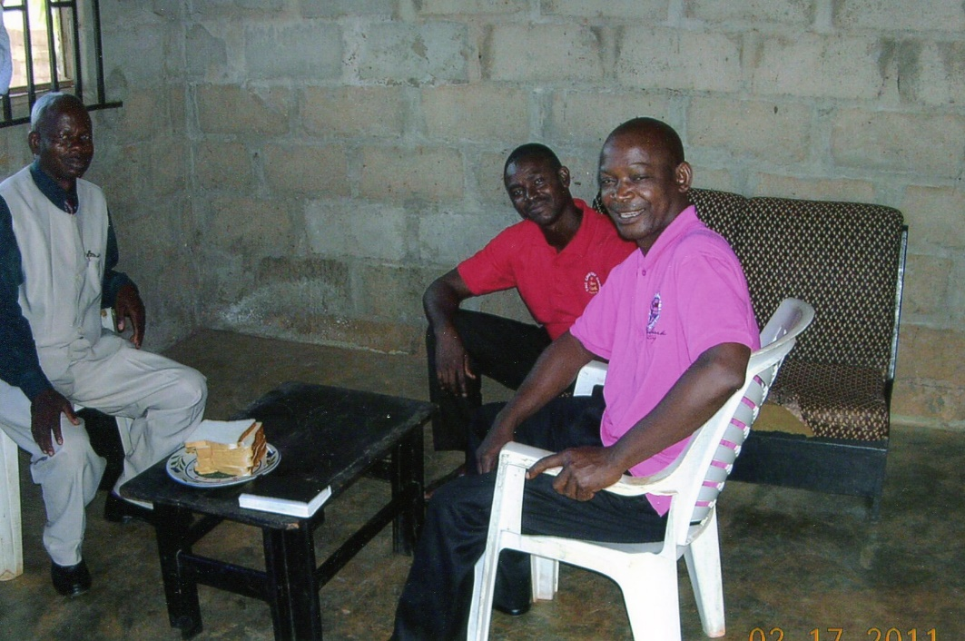
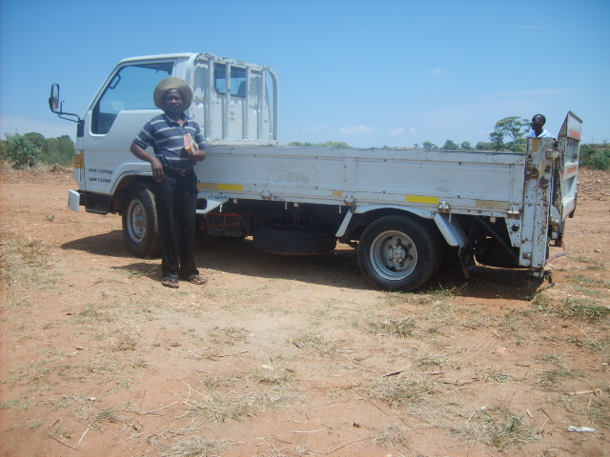
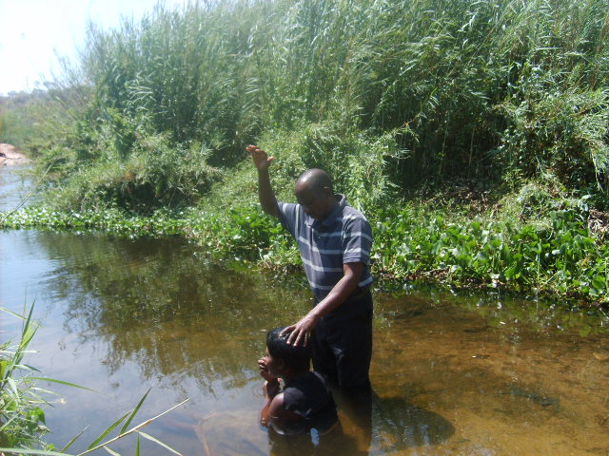
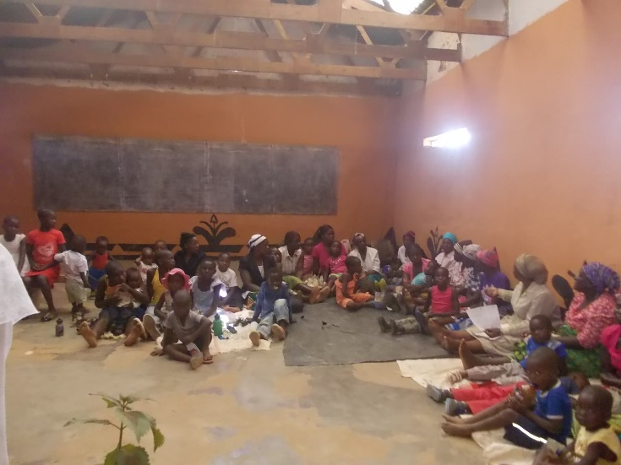
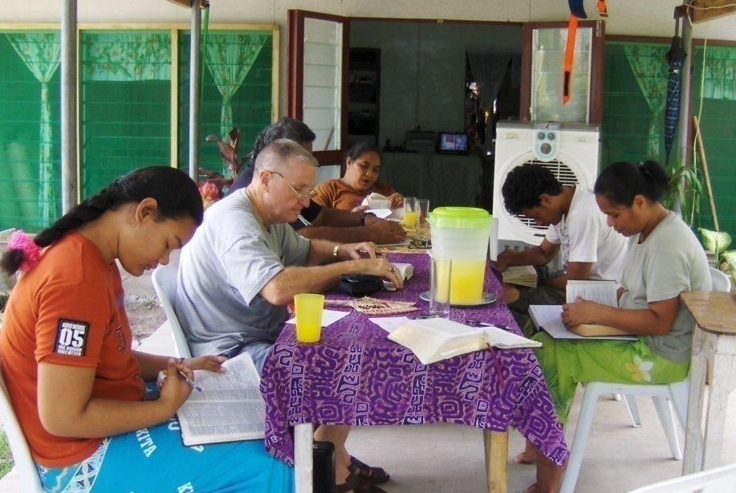
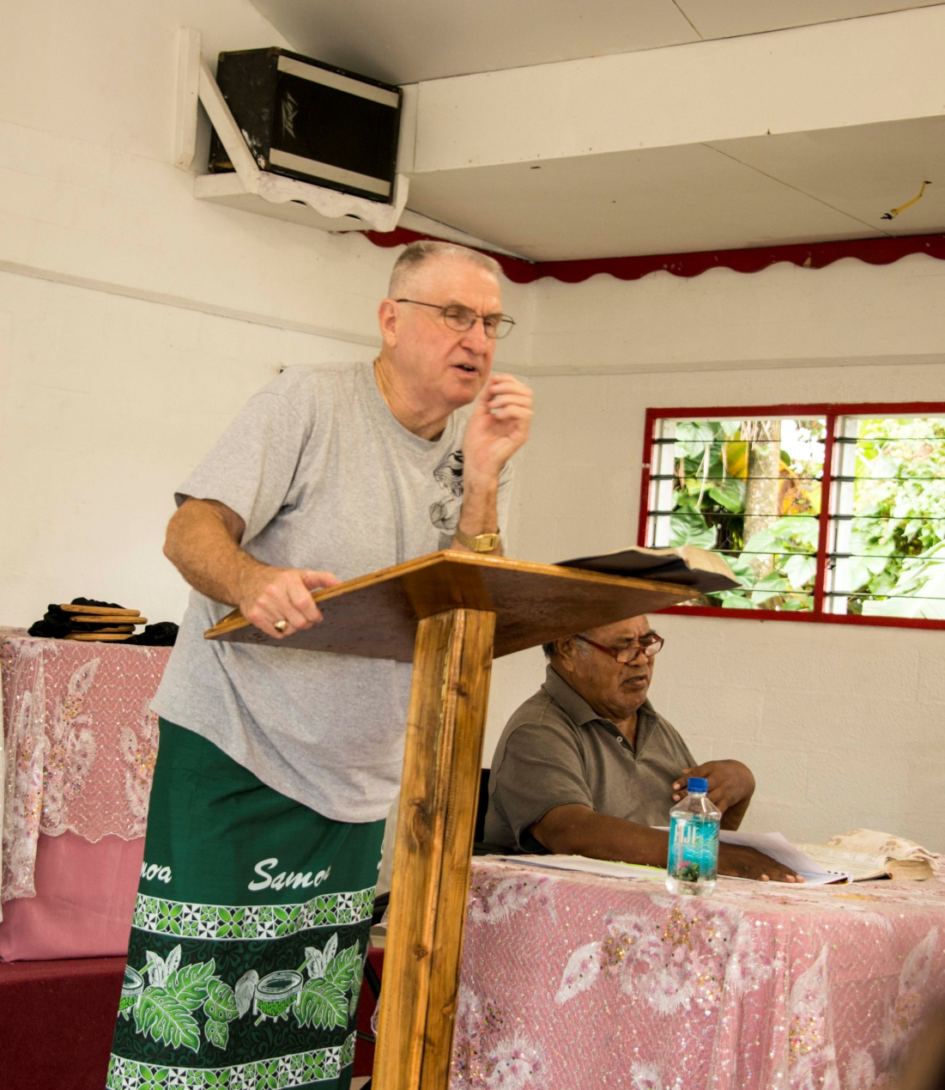
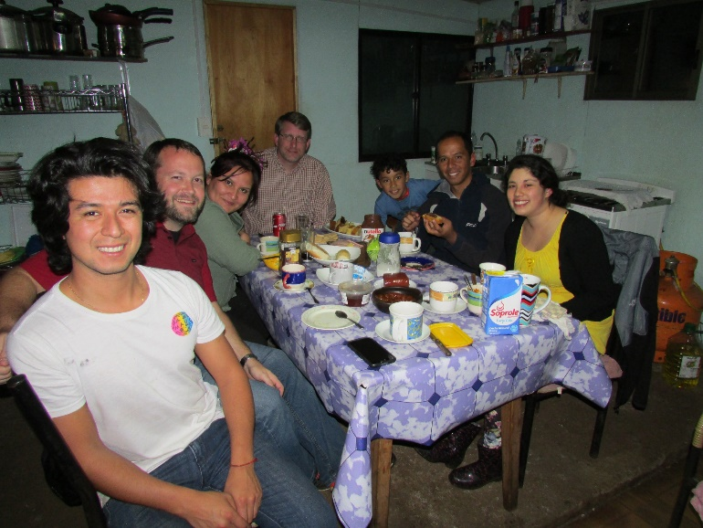
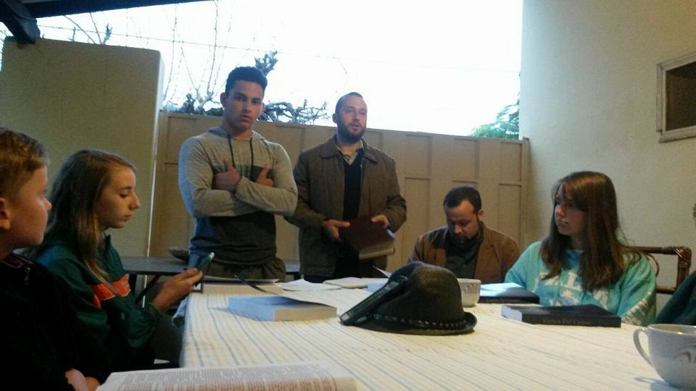
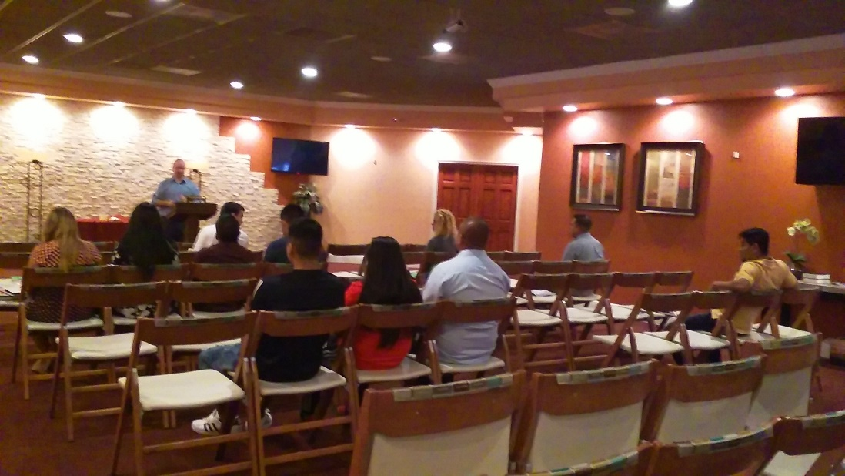
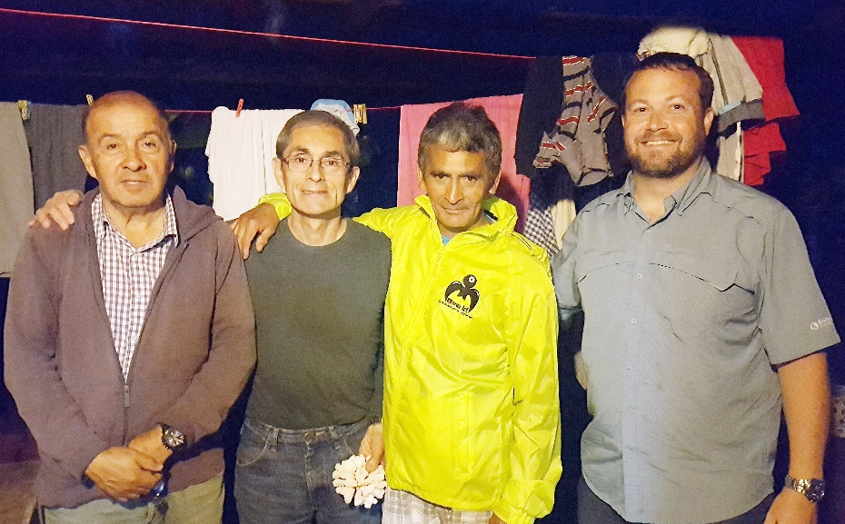
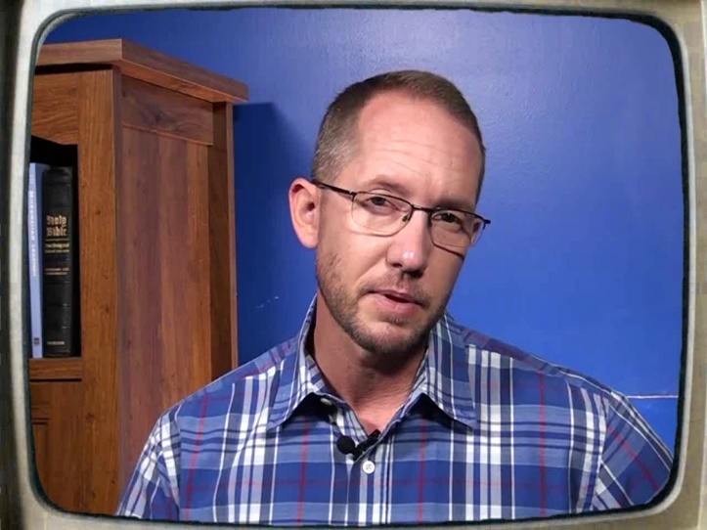
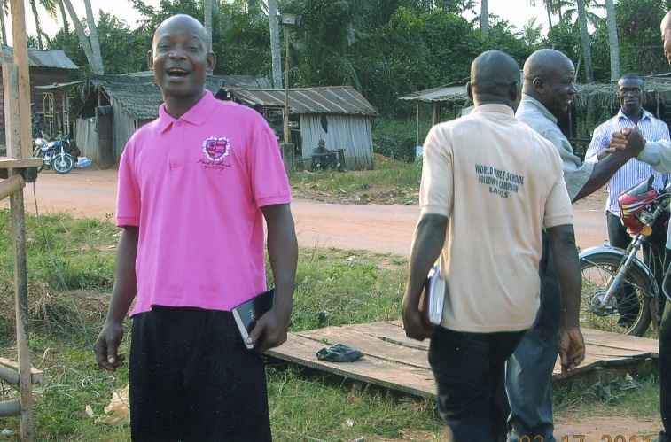
3,300 homes
EVERY month
House to House/Heart to Heart (Monthly)
Sr. High Mission Trip
Josh Blackmer to Easter Island
Douglas Alvarenga
Apologetics Press
$77,200
Wayne Parker (Pacific)
Mauricio Yegros (Coral Springs)
Robert Martin (Pacific)
Joey Treat (Pacific)
Nnanna Aforji (Nigeria)
Tamuka Arunashe (Zimbabwe)

Slide 5
Easter Island
Population: 7,750
Stores that sell Bibles: 0
Bibles taken by Josh so far: 400
$98,700
Bibles for Easter Island
House to House/Heart to Heart (Monthly)
Sr. High Mission Trip
Josh Blackmer to Easter Island
Douglas Alvarenga
Apologetics Press
$77,200
Wayne Parker (Pacific)
Mauricio Yegros (Coral Springs)
Robert Martin (Pacific)
Joey Treat (Pacific)
Nnanna Aforji (Nigeria)
Tamuka Arunashe (Zimbabwe)

Slide 6
$98,700
Bibles for Easter Island
Special Requests
for Mission Trips
Local Evangelism
House to House/Heart to Heart (Monthly)
Sr. High Mission Trip
Josh Blackmer to Easter Island
Douglas Alvarenga
Apologetics Press
$77,200
Wayne Parker (Pacific)
Mauricio Yegros (Coral Springs)
Robert Martin (Pacific)
Joey Treat (Pacific)
Nnanna Aforji (Nigeria)
Tamuka Arunashe (Zimbabwe)

Slide 7
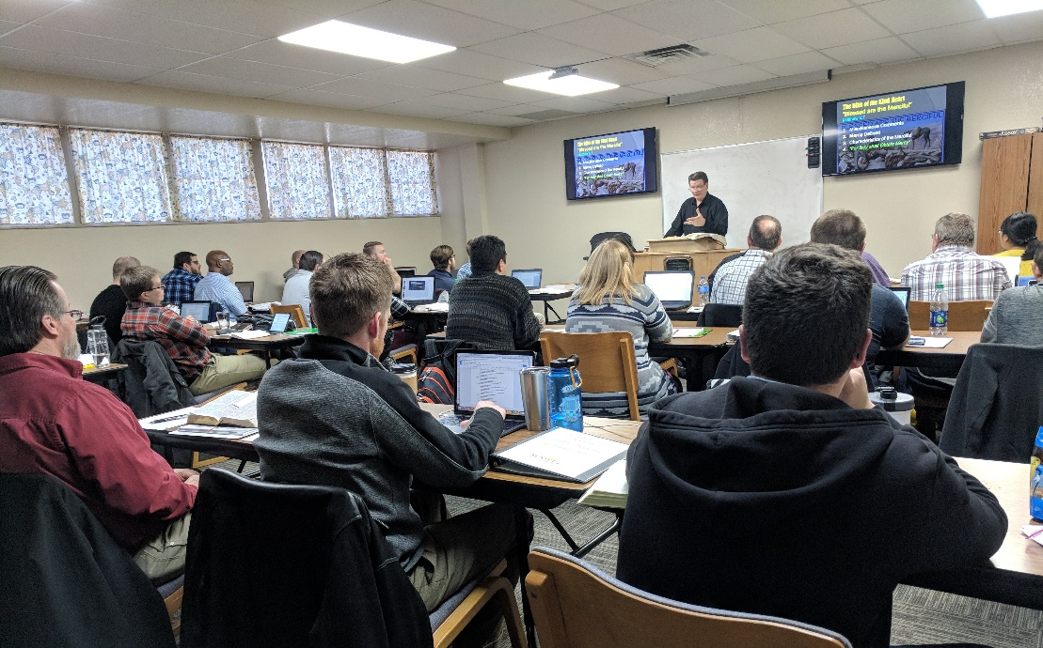
$108,300
Brad Shelt: School of Preaching
$98,700
Bibles for Easter Island
Special Requests
for Mission Trips
Local Evangelism
House to House/Heart to Heart (Monthly)
Sr. High Mission Trip
Josh Blackmer to Easter Island
Douglas Alvarenga
Apologetics Press
$77,200
Wayne Parker (Pacific)
Mauricio Yegros (Coral Springs)
Robert Martin (Pacific)
Joey Treat (Pacific)
Nnanna Aforji (Nigeria)
Tamuka Arunashe (Zimbabwe)

Slide 8
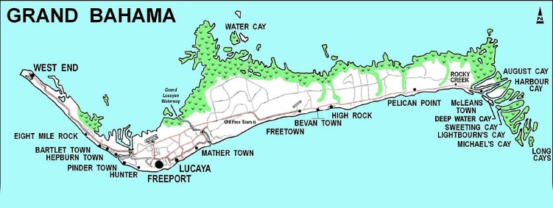
$108,300
Brad Shelt: School of Preaching
Tavaro Hanna: Bahamas Mission Work
$98,700
Bibles for Easter Island
Special Requests
for Mission Trips
Local Evangelism
House to House/Heart to Heart (Monthly)
Sr. High Mission Trip
Josh Blackmer to Easter Island
Douglas Alvarenga
Apologetics Press
$77,200
Wayne Parker (Pacific)
Mauricio Yegros (Coral Springs)
Robert Martin (Pacific)
Joey Treat (Pacific)
Nnanna Aforji (Nigeria)
Tamuka Arunashe (Zimbabwe)

Slide 9
$116,300
Assist Spanish Congregation
$108,300
Brad Shelt: School of Preaching
Tavaro Hanna: Bahamas Mission Work
$98,700
Bibles for Easter Island
Special Requests
for Mission Trips
Local Evangelism
House to House/Heart to Heart (Monthly)
Sr. High Mission Trip
Josh Blackmer to Easter Island
Douglas Alvarenga
Apologetics Press
$77,200
Wayne Parker (Pacific)
Mauricio Yegros (Coral Springs)
Robert Martin (Pacific)
Joey Treat (Pacific)
Nnanna Aforji (Nigeria)
Tamuka Arunashe (Zimbabwe)

Slide 10
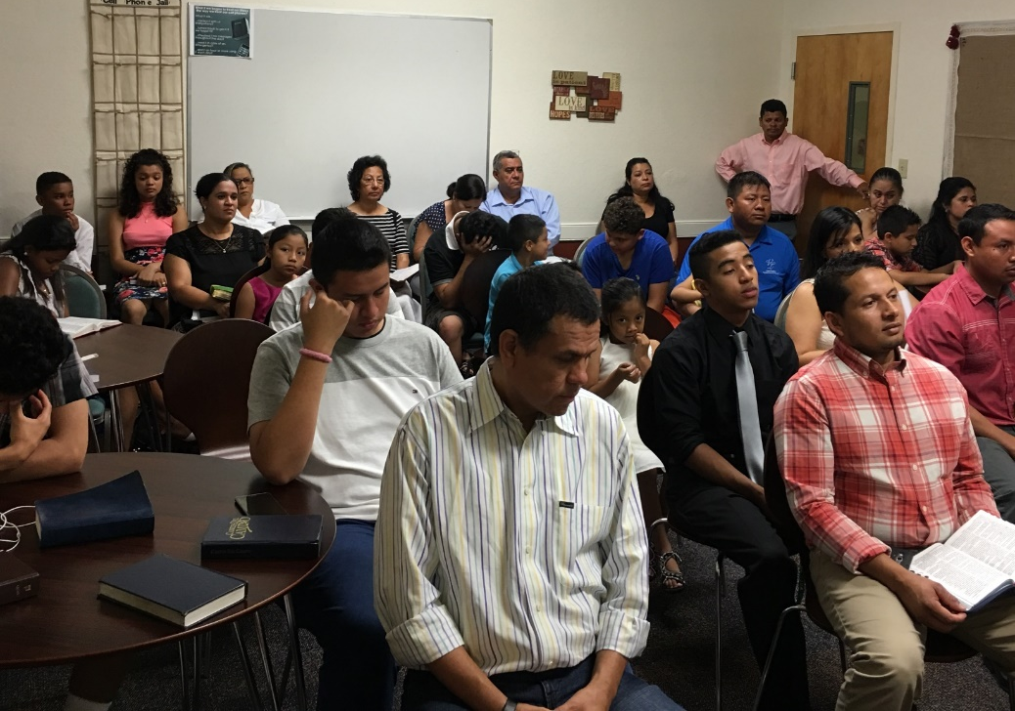
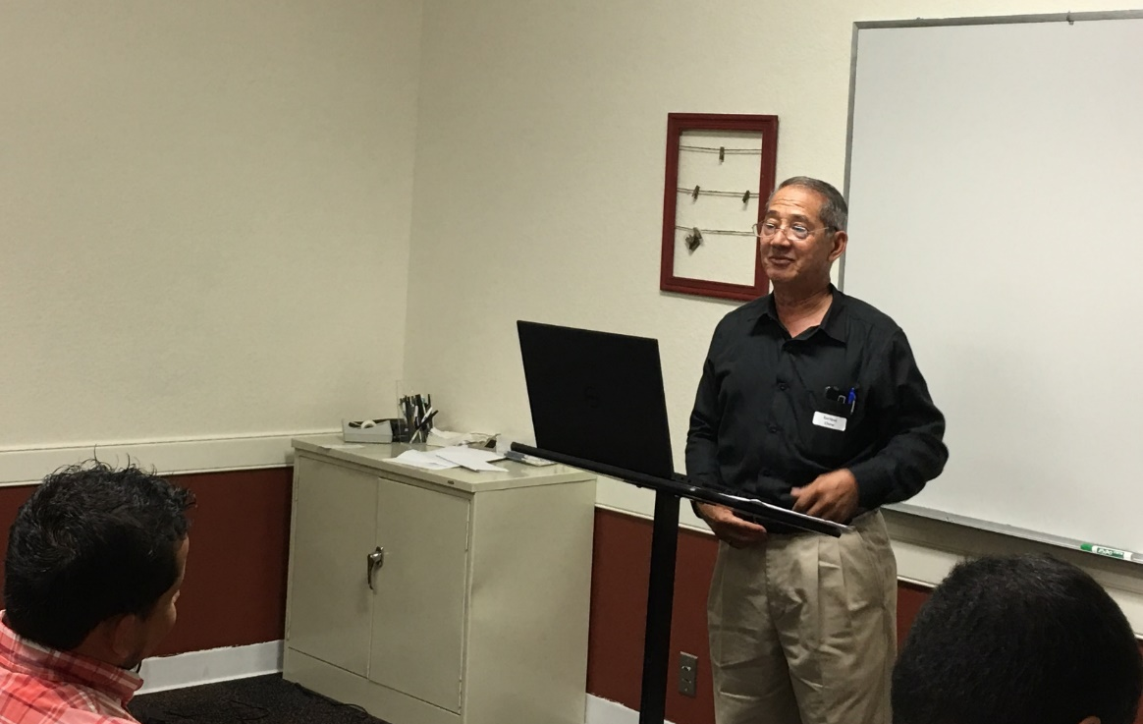
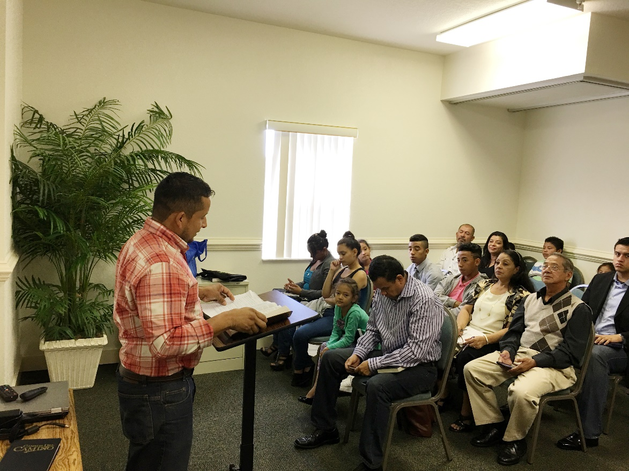
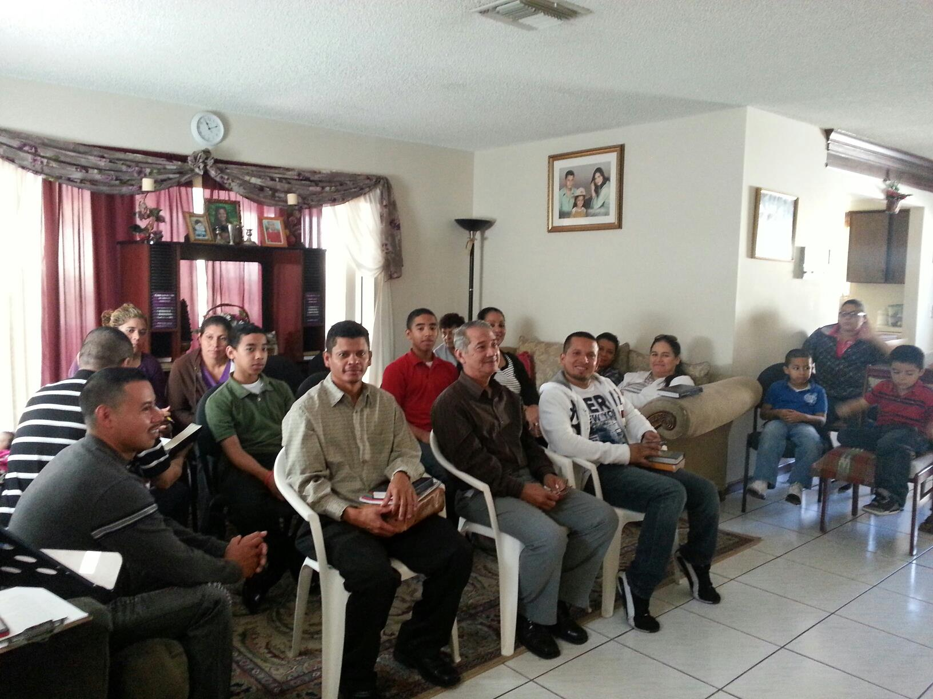

Slide 11
ChristianCourier.com
$116,300
Assist Spanish Congregation
Christian Courier
$108,300
Brad Shelt: School of Preaching
Tavaro Hanna: Bahamas Mission Work
$98,700
Bibles for Easter Island
Special Requests
for Mission Trips
Local Evangelism
House to House/Heart to Heart (Monthly)
Sr. High Mission Trip
Josh Blackmer to Easter Island
Douglas Alvarenga
Apologetics Press
$77,200
Wayne Parker (Pacific)
Mauricio Yegros (Coral Springs)
Robert Martin (Pacific)
Joey Treat (Pacific)
Nnanna Aforji (Nigeria)
Tamuka Arunashe (Zimbabwe)

Slide 12
$123,300
“In Search” TV Program
$116,300
Assist Spanish Congregation
Christian Courier
$108,300
Brad Shelt: School of Preaching
Tavaro Hanna: Bahamas Mission Work
$98,700
Bibles for Easter Island
Special Requests
for Mission Trips
Local Evangelism
House to House/Heart to Heart (Monthly)
Sr. High Mission Trip
Josh Blackmer to Easter Island
Douglas Alvarenga
Apologetics Press
$77,200
Wayne Parker (Pacific)
Mauricio Yegros (Coral Springs)
Robert Martin (Pacific)
Joey Treat (Pacific)
Nnanna Aforji (Nigeria)
Tamuka Arunashe (Zimbabwe)

Slide 13
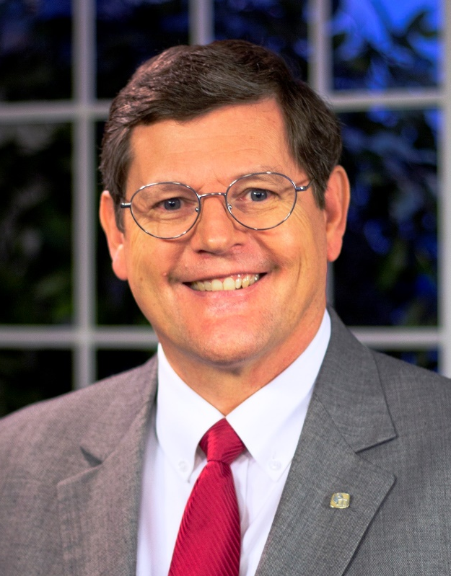
Sunday Mornings
at 7:00 a.m.
Reaching 100 million of 118 million homes in America every week
Phil Sanders

Slide 14
$123,300
“In Search” TV Program
Tracts for Puerto Rico
$116,300
Assist Spanish Congregation
Christian Courier
$108,300
Brad Shelt: School of Preaching
Tavaro Hanna: Bahamas Mission Work
$98,700
Bibles for Easter Island
Special Requests
for Mission Trips
Local Evangelism
House to House/Heart to Heart (Monthly)
Sr. High Mission Trip
Josh Blackmer to Easter Island
Douglas Alvarenga
Apologetics Press
$77,200
Wayne Parker (Pacific)
Mauricio Yegros (Coral Springs)
Robert Martin (Pacific)
Joey Treat (Pacific)
Nnanna Aforji (Nigeria)
Tamuka Arunashe (Zimbabwe)

Slide 15
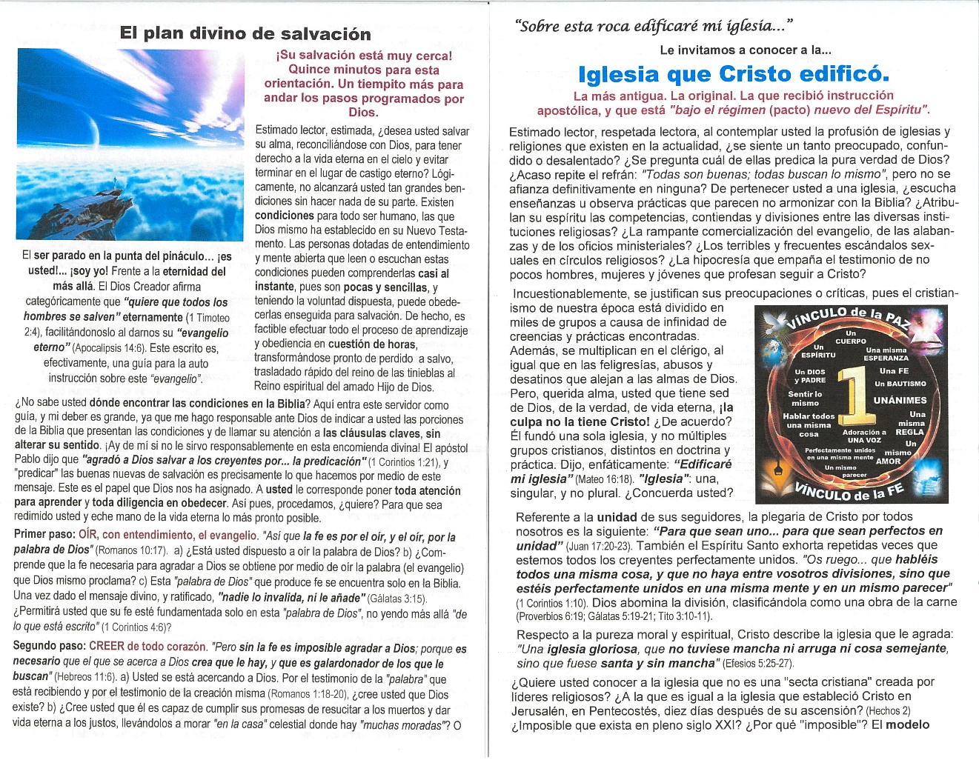
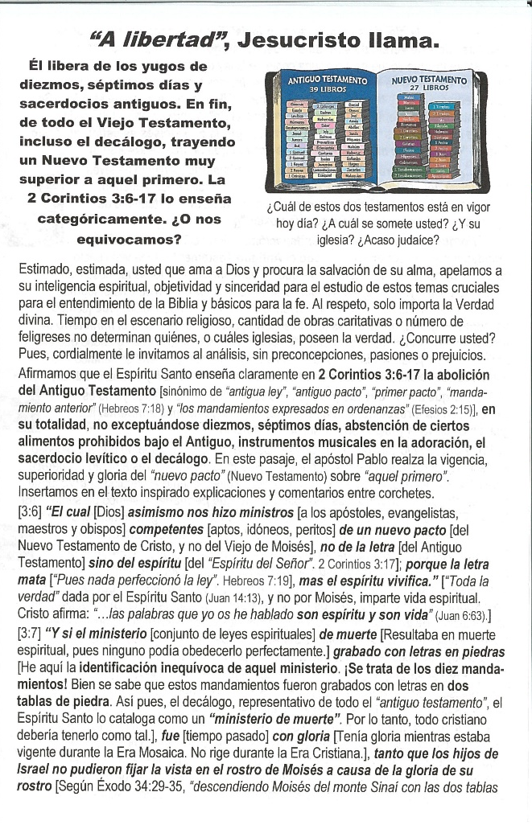

Slide 16
$+++,+++
+
+
+
$123,300
“In Search” TV Program
Tracts for Puerto Rico
$116,300
Assist Spanish Congregation
Christian Courier
$108,300
Brad Shelt: School of Preaching
Tavaro Hanna: Bahamas Mission Work
$98,700
Bibles for Easter Island
Special Requests
for Mission Trips
Local Evangelism
House to House/Heart to Heart (Monthly)
Sr. High Mission Trip
Josh Blackmer to Easter Island
Douglas Alvarenga
Apologetics Press
$77,200
Wayne Parker (Pacific)
Mauricio Yegros (Coral Springs)
Robert Martin (Pacific)
Joey Treat (Pacific)
Nnanna Aforji (Nigeria)
Tamuka Arunashe (Zimbabwe)

Slide 17
The Purpose of
Mission Sunday
The Purpose of
The Gospel
is to
Save
Souls!
Are you
Saved?
Believe Jesus is God’s Son John 8:24
Repent/Turn from your sins Acts 2:38
Confess your faith Romans 10:9
Be baptized Mark 16:16
Live faithfully Revelation 2:10

