Slide 2
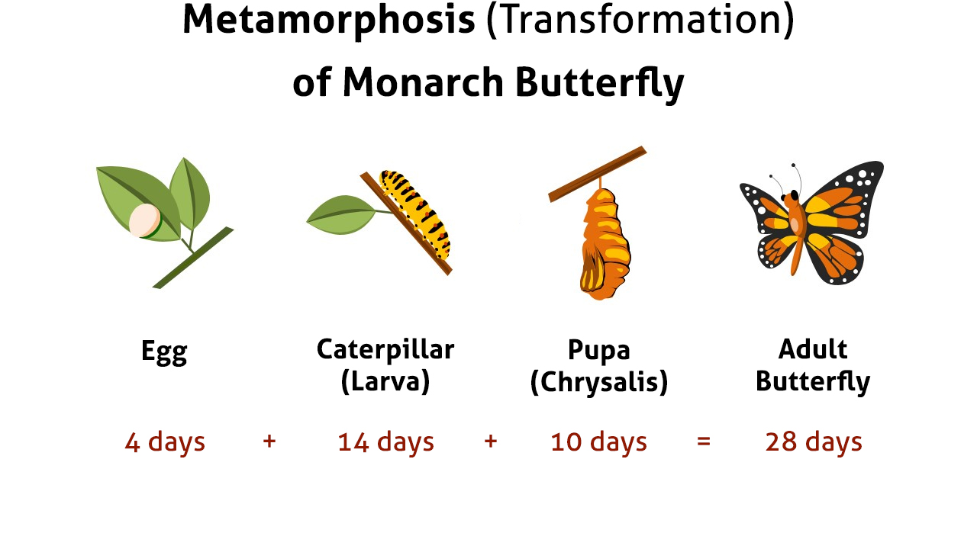

Slide 3
The Promise: Follow for 28 days and you’ll be a new person
The Premise: Follow for 28 days and it will become a habit
The Potential:
Increase energy levels
Decrease anxiety & stress
Improve cognitive health
Enhance emotional balance
Shed unwanted weight
Increase productivity
Help get through the day
Assist in kicking bad habits
Build strength, stability and endurance

Slide 4
Change Inwardly
Avoid outward conforming (v. 2a)
Focus on inward transformation of character
Commanded By God
Imperative emphasizes this not optional
Cultivated By God
Passive voice emphasizes the change is being done TO us
Conversion into the Image of Christ (2 Cor. 3:18)
Becoming more like Him
Our model, our goal is the image of Jesus Himself
Continuous Process
Present tense emphasizes an ongoing process
Continual and repeated effort creates a habit
This transformation never reaches the end, never finished
(Prov. 23:7
+ Phil. 4:8)

Slide 6
The Promise: Follow for 28 days and you’ll be a new person
The Premise: Follow for 28 days and it will become a habit
The Potential:
Increase energy levels
Decrease anxiety & stress
Improve cognitive health
Enhance emotional balance
Shed unwanted weight
Increase productivity
Help get through the day
Assist in kicking bad habits
Build strength, stability and endurance

Slide 7
Practical, tangible applications for each of us in 2018
28 days each month to transform your life spiritually
How do you compare spiritually with where you were on Jan. 1, 2017?
Are you where you SHOULD be?
Are you where you COULD be?
Are you where you WANT to be?
Are you where you CAN be?
Are you where you WILL be on December 31, 2018?
#PBL28days

Slide 8
Read 28 psalms in 28 days
1. Psalm 1
2. Psalm 5
3. Psalm 8
4. Psalm 18
5. Psalm 19
6. Psalm 22
7. Psalm 23
8. Psalm 27
9. Psalm 30
10. Psalm 34
11. Psalm 37
12. Psalm 46
13. Psalm 51
14. Psalm 56
15. Psalm 71
16. Psalm 84
17. Psalm 90
18. Psalm 95
19. Psalm 100
20. Psalm 103
21. Psalm 104
22. Psalm 111
23. Psalm 115
24. Psalm 121
25. Psalm 139
26. Psalm 141
27. Psalm 145
28. Psalm 148
#PBL28days

Slide 9
Annual Events in 2018
Sunday AM & Wednesday PM Bible Classes
Fifth Sunday Night Cook-Offs
Jan. 28 Mission Sunday
Mar. 11-14 Gospel Meeting with Glenn Colley
Apr. 19 Ladies’ Day
May 20 Promotion Sunday
June 17-20 Vacation Bible School
Aug. 3-4 Charged By Christ with Joe Wells
Oct. 19-21 Spiritual Enrichment Weekend
Nov. 1-4 23rd Annual South Florida Lectureship

Slide 10
NEW Events in 2018
May 5 Power Up! A Recharge for Christian Men
May 23, etc. “Kick Start Your Summer” Series
(May 23, May 30, June 6, June 13, June 27)
Second Sundays
Special Emphasis Every Month
To Invite Our Friends &
Reach Out to Local Community

Slide 12
Where are you in your walk with the Lord? Are you walking with the Lord?
Believe Jesus is God’s Son – Acts 16:31
Repent of your sins and turn to God – Acts 3:19
Confess your faith in Jesus Christ – Matthew 10:32
Be immersed into Christ – Acts 2:38
God will forgive all of your sins – Acts 22:16
God will add you to His church – Acts 2:47
God will register you in heaven – Hebrews 12:23
Walk daily and faithfully with the Lord – 1 John 1:7

