Slide 11
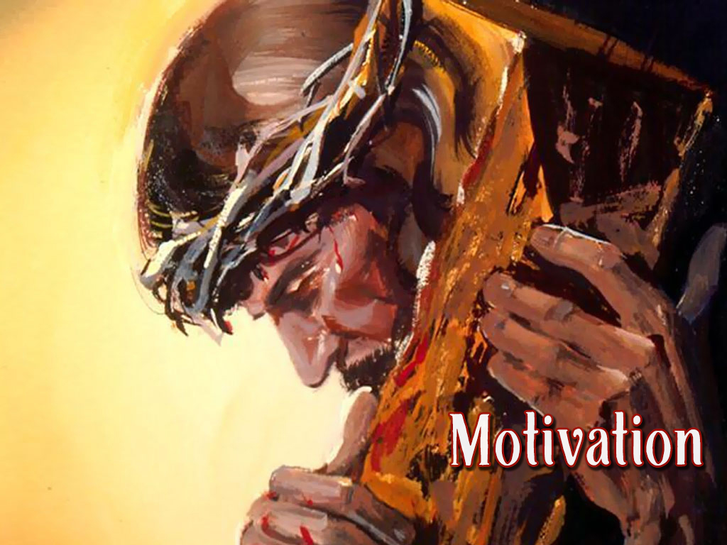

Slide 13
What would motivate you to commit your life to Christ today?
In the New Testament, when sincere individuals heard about the cross of Christ, they responded immediately (Acts 2:37-38, 41; 8:12; 8:35-38; 9:18; 10:47-48; 16:13-15, 30-33; 18:8; 19:4-5; 22:16)
The blood of Christ “cleansed” their “evil conscience” (cf. 9:13-14) when they were “washed” in the waters of baptism (cf. Acts 22:16; Tit. 3:5; Eph. 5:26)
“Why are you waiting?” (Acts 22:16). “Now is the day of salvation” (2 Cor. 6:2).

Slide 14
What would motivate you to cling more closely to Christ today?
Faithfulness to the faithful Lord is challenging when:
Living in a body of “flesh” (1 Pet. 2:11)
Living in “the world” (1 John 5:19)
Living amidst folks who focus on the material/external side of life rather than the spiritual/eternal side of life (1 Cor. 15:33; Ex. 23:2)
The cross of Jesus must be our focus & our glory (Gal. 6:12-15)
Will you crucify the world to yourself today and be a “new creation”?
Will you crucify yourself to the world today and be a “new creation”?

Slide 15
What would motivate you to congregate with your brethren every week?
Would reflecting on the cross of Jesus move you to congregate weekly?
First-century Christians were highly motivated to assemble together (Acts 2:42; 20:7), but “the manner of some” began to be “forsaking the assembling”

Slide 16
To express and prove my love for the Lord
To obey the command of God
To consider my brothers and sisters in Christ
To stimulate my brethren to love and good works
To encourage and build up my fellow brethren
To express and prove my love for my brethren
To do my part as a member of the body
To exhibit the priorities that Christ wants me to have
To be where Jesus is and to commune with Him
To remember Jesus just like He told me to do
To have an opportunity to praise God as He desires and expects
To draw closer to God, which is what I long to do
To enjoy a foretaste of heaven
To guard against falling away
To be the priest God expects me to be
To satisfy my hunger and thirst for righteousness
To show the deep sincerity of my faith, that I’m not just pretending
To make sure that I don’t sin willfully and suffer the consequences
To focus my heart and mind on what is most important
To follow the example of the early church
To show the elders that I want to make their shepherding a joy
To set a good example for others and not give an occasion for stumbling
To strengthen my faith and my resolve and to not deprive myself
Because Jesus died on the cross for me. Where else would I want to be?

Slide 17
24 Reasons to Congregate with My Brethren Every Week
To express and prove my love for the Lord (John 14:15)
To obey the command of God (Heb. 10:25; Acts 20:7)
To consider my brothers and sisters in Christ (Heb. 10:24)
To stimulate my bros & sis to love and good works (Heb. 10:24)
To encourage and build up my fellow brethren (Heb. 10:25; Rom. 1:11-12)
To express and prove my love for my brethren (1 John 4:7-12; John 13:34-35; Rom. 12:9-11)
To do my part as a member of the body (1 Cor. 12:12-27; Eph. 4:16)
To exhibit the priorities that Christ wants me to have (Matt. 6:33)
To be where Jesus is and to commune with Him (Heb. 2:12; Matt. 26:29; 18:20)
To remember Jesus just like He told me to do (Luke 22:19; 1 Cor. 11:24-25)
To have an opportunity to praise God as He desires and expects (John 4:24; Matt. 4:10)
To draw closer to God, which is what I long to do (Jas. 4:7-10; Psa. 122:1)
To enjoy a foretaste of heaven (Rev. 5:9-14; 14:1-3; 15:1-3)
To guard against falling away (the whole book of Hebrews; 2 Pet. 2:20-22)
To be the priest God expects me to be (Rev. 1:6; 1 Pet. 2:5; Heb. 13:15)
To satisfy my hunger and thirst for righteousness (Matt. 5:6; 1 Pet. 2:2-3)
To show the deep sincerity of my faith, that I’m not just pretending (1 Pet. 1:7-9; 2 Tim. 1:5)
To make sure that I don’t sin willfully and suffer the consequences (Heb. 10:25-31)
To focus my heart and mind on what is most important (Matt. 22:37-40)
To follow the example of the early church (Acts 2:42; 20:7; 1 Cor. 16:1-2)
To show the elders that I want to make their shepherding a joy (Heb. 13:17)
To set a good example for others and not give an occasion for stumbling (Matt. 5:16; 1 Cor. 11:1; 1 Tim. 4:12; Matt. 18:6; Rom. 15:1-2)
To strengthen my faith and my resolve and to not deprive myself (2 Pet. 3:18; Rom. 10:17; Psa. 119:9-16; Rev. 2:10; 1 Tim. 4:16; Heb. 5:12-6:1)
Because Jesus died on the cross for me (Gal. 2:20). Where else would I want to be?

Slide 18
“I have a lot going on right now— just need a break.”

Slide 19
“This is my only day to sleep in and do what I need to do.”

Slide 20
“I stayed up too late last night and I was just too tired.”

Slide 21
“I’ve got a headache and am just not feeling it today.”

Slide 22
“I just needed some ‘me’ time.”

Slide 23
“It’s my birthday – just needed to do something for me.”

Slide 24
“It’s the only time for our family to relax and just be ‘us.’”

Slide 25
“The kids were just really acting up this morning.”

Slide 26
“Some friends and family came over (or into town) and I needed to spend time with them.”

Slide 27
“I’m headed out of town and will just wait until I get back.”

Slide 28
“How often am I going to get to see that team play? Seriously!”

Slide 29
“I was just there last week.”

Slide 30
“I’m just tired of all the hypocrites.”

Slide 31
“I don’t have the right kind of clothes to wear.”

Slide 32
“I needed to take another job to pay for trips to Disney with the kids.”

Slide 33
the church assembles?
What reasons would He use to miss worship?

Slide 34
By believing that Jesus is God’s Son – Acts 16:31
By repenting of my sins and turning to God – Acts 17:30
By confessing my faith in Jesus – Romans 10:9-10
By being immersed into Christ – Acts 2:38
God will forgive all of my sins – Acts 22:16
God will add me to His church – Acts 2:47
God will register me in heaven – Hebrews 12:23
By clinging faithfully to my faithful Lord – Hebrews 10:23

