Slide 2
THESSALONICA
A MISSIONARY CHURCH

Slide 3
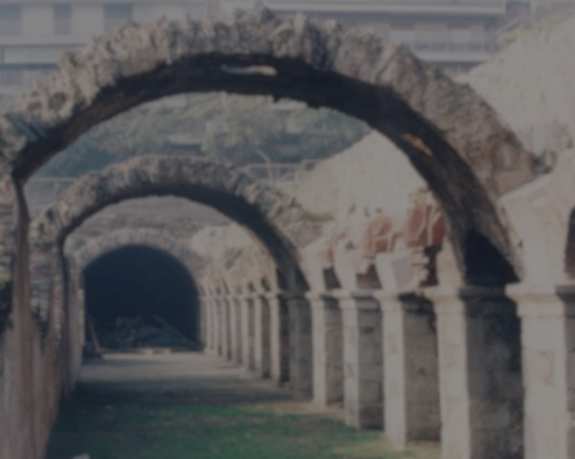
THESSALONICA
A MISSIONARY CHURCH
They were mission minded: Think souls!
They were mission motivated: Think “Go!”
They employed mission methods: Think global!

Slide 4
THESSALONICA
A MISSIONARY CHURCH
They were mission minded: Think souls!
They were mission motivated: Think “Go!”
They employed mission methods: Think global!

Slide 5
Churches Mentioned in NT
Jerusalem (Acts 8:14)
Joppa (Acts 9:36, 38)
Laodicea (Rev 1:11, Col 4:15)
Lydda (Acts 9:32)
Lystra (Acts 14:6; Gal 1:2)
Pergamum (Rev 1:11)
Philadelphia (Rev 1:11)
Philippi (Acts 16:12)
Puteoli, Italy (Acts 28:13-14)
Rome (Rom 1:7)
Sardis (Rev 1:11)
Sharon (Acts 9:35)
Smyrna (Rev 1:11)
Tarsus (Acts 9:30)
Thessalonica (Acts 17:1)
Thyatira (Rev 1:11; Ac 16:14)
Troas (Acts 20:6-7)
Antioch, Pisidia (Acts 13:14; Gal 1:2)
Antioch, Syria (Acts 13:1-4)
Athens (Acts 17:34)
Babylon (1 Peter 5:13; Acts 2:9)
Berea (Acts 17:11)
Caesarea (Acts 10:1,48)
Cenchrea (Rom 16:1)
Colossae (Col 1:2)
Corinth (Acts 18:1)
Crete (Titus 1:5)
Cyrene (Acts 11:20)
Damascus (Acts 9:19)
Derbe (Acts 14:20; Gal 1:2)
Ephesus (Acts 18:19)
Hierapolis Col 4:13)
Iconium (Acts 14:1; Gal 1:2)

Slide 6
Churches Mentioned in NT
Jerusalem (Acts 8:14)
Joppa (Acts 9:36, 38)
Laodicea (Rev 1:11, Col 4:15)
Lydda (Acts 9:32)
Lystra (Acts 14:6; Gal 1:2)
Pergamum (Rev 1:11)
Philadelphia (Rev 1:11)
Philippi (Acts 16:12)
Puteoli, Italy (Acts 28:13-14)
Rome (Rom 1:7)
Sardis (Rev 1:11)
Sharon (Acts 9:35)
Smyrna (Rev 1:11)
Tarsus (Acts 9:30)
Thessalonica (Acts 17:1)
Thyatira (Rev 1:11; Ac 16:14)
Troas (Acts 20:6-7)
Antioch, Pisidia (Acts 13:14; Gal 1:2)
Antioch, Syria (Acts 13:1-4)
Athens (Acts 17:34)
Babylon (1 Peter 5:13; Acts 2:9)
Berea (Acts 17:11)
Caesarea (Acts 10:1,48)
Cenchrea (Rom 16:1)
Colossae (Col 1:2)
Corinth (Acts 18:1)
Crete (Titus 1:5)
Cyrene (Acts 11:20)
Damascus (Acts 9:19)
Derbe (Acts 14:20; Gal 1:2)
Ephesus (Acts 18:19)
Hierapolis Col 4:13)
Iconium (Acts 14:1; Gal 1:2)

Slide 7
Churches Mentioned in NT
Jerusalem (Acts 8:14)
Joppa (Acts 9:36, 38)
Laodicea (Rev 1:11, Col 4:15)
Lydda (Acts 9:32)
Lystra (Acts 14:6; Gal 1:2)
Pergamum (Rev 1:11)
Philadelphia (Rev 1:11)
Philippi (Acts 16:12)
Puteoli, Italy (Acts 28:13-14)
Rome (Rom 1:7)
Sardis (Rev 1:11)
Sharon (Acts 9:35)
Smyrna (Rev 1:11)
Tarsus (Acts 9:30)
Thessalonica (Acts 17:1)
Thyatira (Rev 1:11; Ac 16:14)
Troas (Acts 20:6-7)
Antioch, Pisidia (Acts 13:14; Gal 1:2)
Antioch, Syria (Acts 13:1-4)
Athens (Acts 17:34)
Babylon (1 Peter 5:13; Acts 2:9)
Berea (Acts 17:11)
Caesarea (Acts 10:1,48)
Cenchrea (Rom 16:1)
Colossae (Col 1:2)
Corinth (Acts 18:1)
Crete (Titus 1:5)
Cyrene (Acts 11:20)
Damascus (Acts 9:19)
Derbe (Acts 14:20; Gal 1:2)
Ephesus (Acts 18:19)
Hierapolis Col 4:13)
Iconium (Acts 14:1; Gal 1:2)

Slide 8
Churches Mentioned in NT
Jerusalem (Acts 8:14)
Joppa (Acts 9:36, 38)
Laodicea (Rev 1:11, Col 4:15)
Lydda (Acts 9:32)
Lystra (Acts 14:6; Gal 1:2)
Pergamum (Rev 1:11)
Philadelphia (Rev 1:11)
Philippi (Acts 16:12)
Puteoli, Italy (Acts 28:13-14)
Rome (Rom 1:7)
Sardis (Rev 1:11)
Sharon (Acts 9:35)
Smyrna (Rev 1:11)
Tarsus (Acts 9:30)
Thessalonica (Acts 17:1)
Thyatira (Rev 1:11; Ac 16:14)
Troas (Acts 20:6-7)
Antioch, Pisidia (Acts 13:14; Gal 1:2)
Antioch, Syria (Acts 13:1-4)
Athens (Acts 17:34)
Babylon (1 Peter 5:13; Acts 2:9)
Berea (Acts 17:11)
Caesarea (Acts 10:1,48)
Cenchrea (Rom 16:1)
Colossae (Col 1:2)
Corinth (Acts 18:1)
Crete (Titus 1:5)
Cyrene (Acts 11:20)
Damascus (Acts 9:19)
Derbe (Acts 14:20; Gal 1:2)
Ephesus (Acts 18:19)
Hierapolis Col 4:13)
Iconium (Acts 14:1; Gal 1:2)

Slide 9
Churches Mentioned in NT
Jerusalem (Acts 8:14)
Joppa (Acts 9:36, 38)
Laodicea (Rev 1:11, Col 4:15)
Lydda (Acts 9:32)
Lystra (Acts 14:6; Gal 1:2)
Pergamum (Rev 1:11)
Philadelphia (Rev 1:11)
Philippi (Acts 16:12)
Puteoli, Italy (Acts 28:13-14)
Rome (Rom 1:7)
Sardis (Rev 1:11)
Sharon (Acts 9:35)
Smyrna (Rev 1:11)
Tarsus (Acts 9:30)
Thessalonica (Acts 17:1)
Thyatira (Rev 1:11; Ac 16:14)
Troas (Acts 20:6-7)
Antioch, Pisidia (Acts 13:14; Gal 1:2)
Antioch, Syria (Acts 13:1-4)
Athens (Acts 17:34)
Babylon (1 Peter 5:13; Acts 2:9)
Berea (Acts 17:11)
Caesarea (Acts 10:1,48)
Cenchrea (Rom 16:1)
Colossae (Col 1:2)
Corinth (Acts 18:1)
Crete (Titus 1:5)
Cyrene (Acts 11:20)
Damascus (Acts 9:19)
Derbe (Acts 14:20; Gal 1:2)
Ephesus (Acts 18:19)
Hierapolis Col 4:13)
Iconium (Acts 14:1; Gal 1:2)

Slide 10
이게 나야
This is me right here!

Slide 11
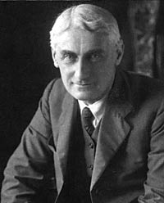
"Missionary zeal does not grow out of intellectual beliefs, nor out of theological arguments, but out of love"
Roland Allen
1868-1947
Missionary to China
“Missionary Methods”
1 Thessalonians 3:6
1 Thessalonians 4:9,10
We must love souls!

Slide 12
THESSALONICA
A MISSIONARY CHURCH
They were mission minded: Think souls!
They were mission motivated: Think “Go!”
They employed mission methods: Think global!

Slide 13
THESSALONICA
A MISSIONARY CHURCH
They were mission minded: Think souls!
They were mission motivated: Think “Go!”
They employed mission methods: Think global!

Slide 14
“'Go ye' is as much a part of Christ's Gospel as 'Come unto Me.' You are not [truly] a Christian until you have honestly faced your responsibility in regard to the carrying of the Gospel to the ends of the earth." "
J. Stuart Holden
1874-1934
Titanic
Isaiah 6:8
1 Thessalonians 1:8a; 4:2
Sounded forth!

Slide 15
THESSALONICA
A MISSIONARY CHURCH
They were mission minded: Think souls!
They were mission motivated: Think “Go!”
They employed mission methods: Think global!

Slide 16
THESSALONICA
A MISSIONARY CHURCH
They were mission minded: Think souls!
They were mission motivated: Think “Go!”
They employed mission methods: Think global!

Slide 17
THESSALONICA

Slide 18
THESSALONICA

Slide 19
THESSALONICA
Arch of Galerius

Slide 22
Via Egnatia in Thessalonia toward Phillipi

Slide 23
Via Egnatia

Slide 24
THESSALONICA
Sounded forth everywhere! (1 Thes 1:8b)

Slide 25
“Without blood the body dies, without mission, the church dies. Without missions there would be no church,
for the church is a result of missions.”
- Gailyn Van Rheenan (missiologist)
"The Bible is not the basis of missions; missions is the basis of the Bible. If you take missions out of the Bible, you won't have anything left but the covers” — Ralph Winter (missiologist)

Slide 27
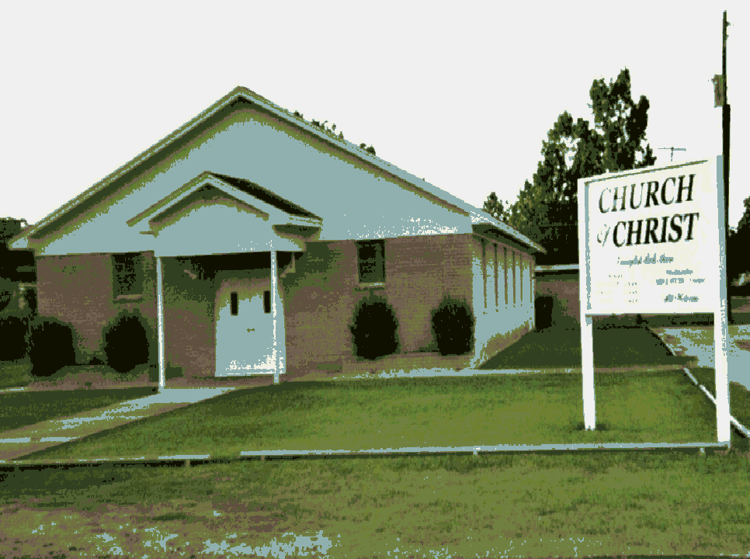
WE NEED CHURCHES THAT ARE:
Self-governing,
self-propagating,
self-supporting, and
self-theologizing.
Indigenous = respect autonomy

Slide 28
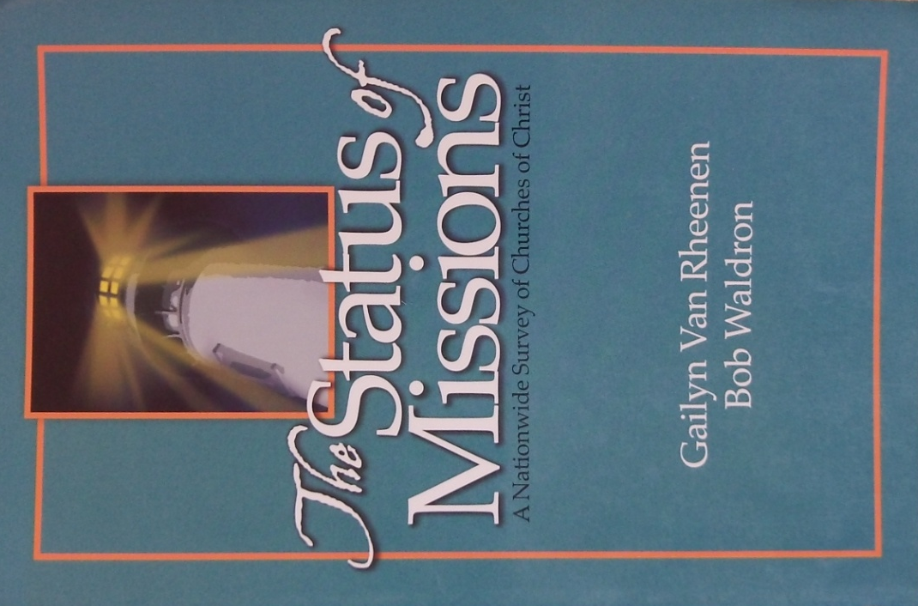
WE NEED A SHIFT IN EMPHASIS!

Slide 29
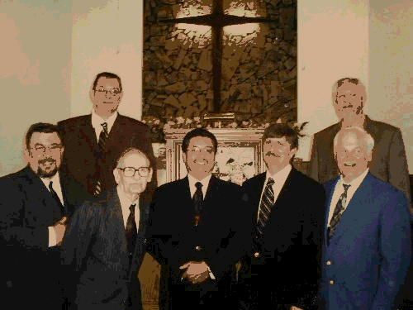
WE NEED ELDERS CONCERNED ABOUT WORLD MISSIONS
Involvement in missions
35%
69%
69% had high involvement

Slide 30
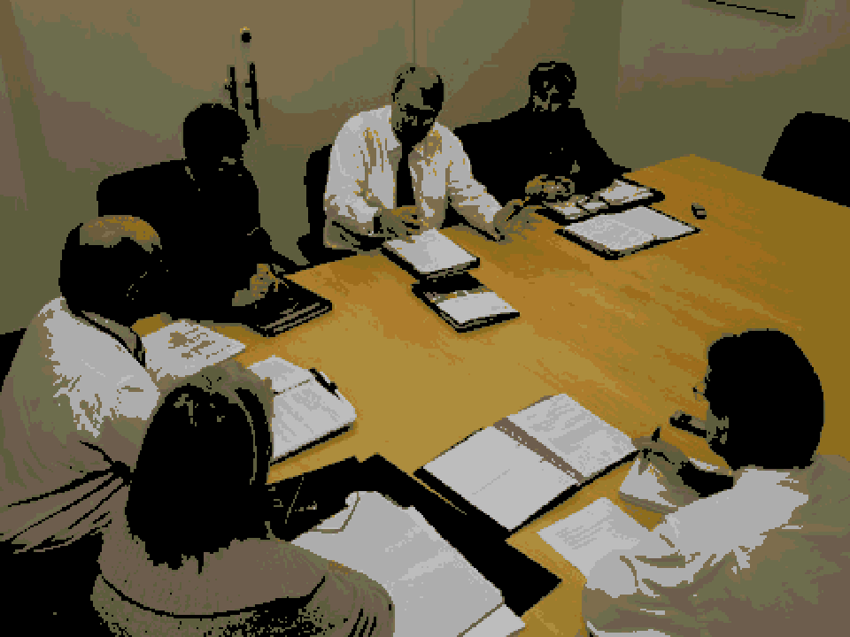
WE NEED MISSIONS COMMITTEES
Communication
Overseeing mission efforts
Education on missions topics
Develop workshops
Budget, financial management
Policies, strategies, and vision
Prayer for missions activities

Slide 31
WE NEED TO PREACH ABOUT MISSIONS
Sermons Preached in One Year
Only 3% preached 7 or more times

Slide 32
WE NEED TO TEACH ABOUT MISSIONS
Only 12% had a class on missions!

Slide 33
WE NEED TO ENCORAGE MISSIONS!
Recruit and develop missionaries
Initiate and maintain communication with your missionaries
Keep church connected with and informed about your missionaries

Slide 34
What can or
should we do?
“Proclaim Christ and establish new congregations,
new congregations, and new congregations! The key to preaching the Gospel to every creature in this century has been in the Bible since the days of the apostles but many church leaders have failed to recognize God's methodology.”
- Dr. Demar Elam, Mission Cry of the New Millenium.

Slide 35
BE A MISSIONARY CHURCH!
WHY do we go? We Go because we LOVE souls, all souls because we love people!
WHAT must we do? We must GO!
WHERE do we go? We go anywhere the Lord leads us (global).
"Every heart without Christ is a mission field, and every heart with Christ a missionary."

Slide 36
What can be said about THIS congregation?
Are you an example to others?

Slide 37
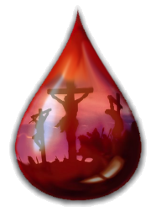
GOD’S MISSION: 1 TIMOTHY 2:4
God’s Plan of Salvation
HEAR – Romans 10:17
BELIEVE – John 3:16
REPENT – Luke 13:3
CONFESS – Matthew 10:32
BE BAPTIZED – Mark 16:16
- Acts 22:16

