Slide 1
Who told you?
2 Samuel 21:22

Slide 2
These four were born to the giant in Gath, and they fell by the hand of David and by the hand of his servants.
2 Samuel 21:22

Slide 3
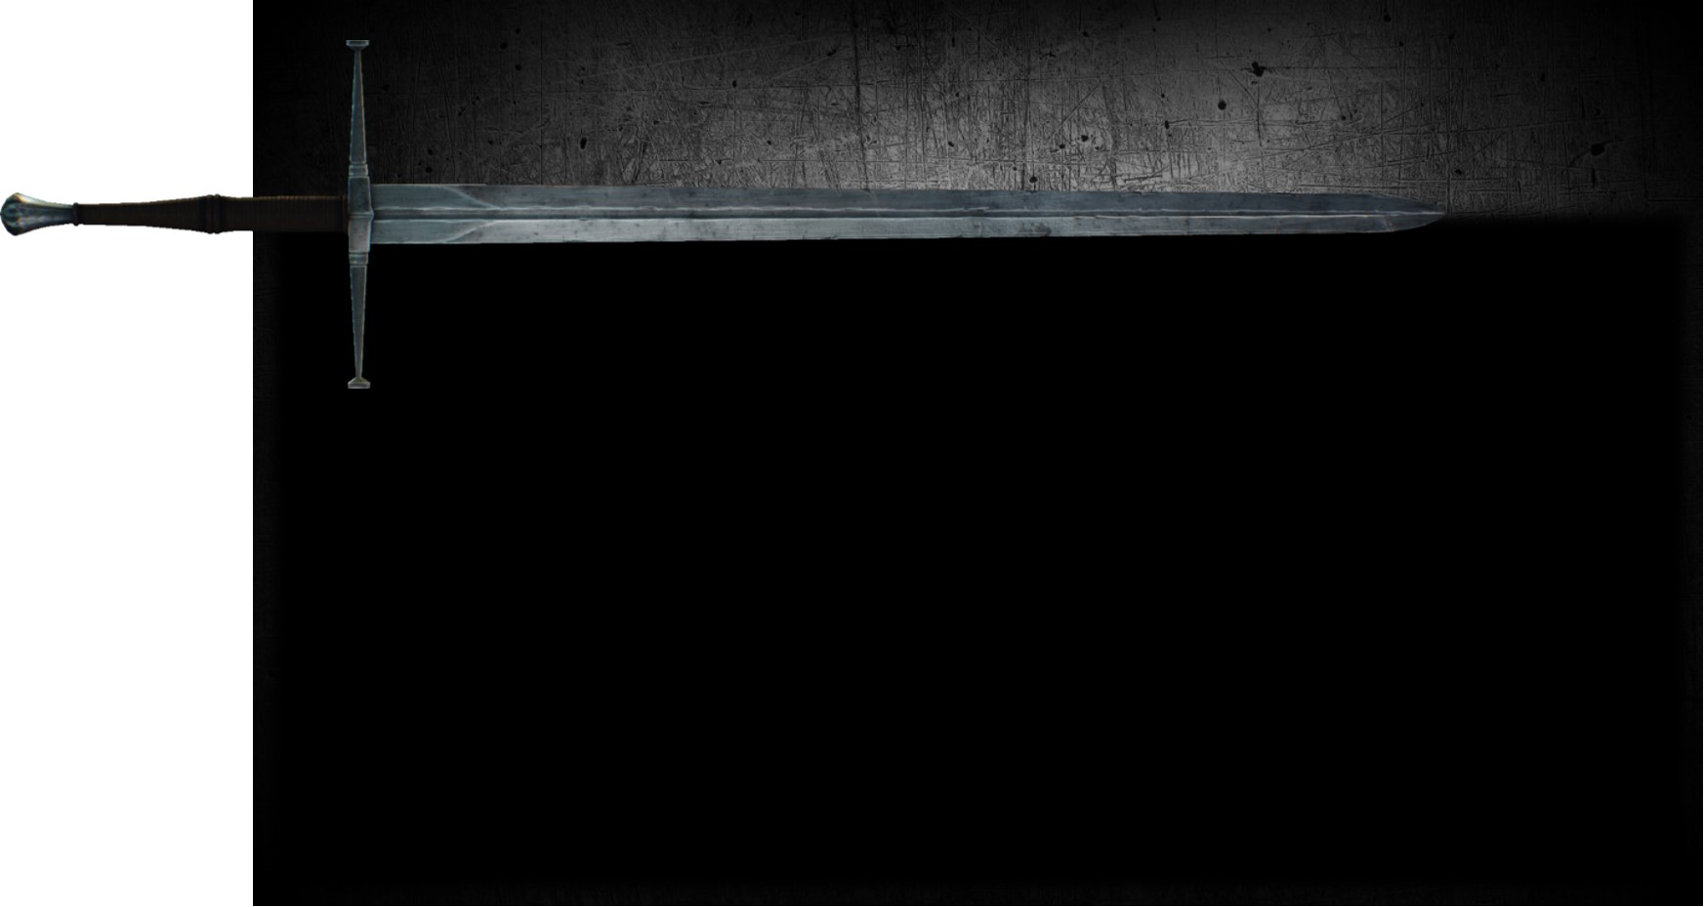
Who told you…
That you could pray?
That you could love?
That you could be a child of God?
That you could conquer death?

Slide 4
The King

Slide 5
How to pray
It happened that while Jesus was praying in a certain place, after He had finished, one of His disciples said to Him, "Lord, teach us to pray..."
Luke 11:1

Slide 6
How to pray
“When you pray, you are not to be like the hypocrites; for they love to stand and pray in the synagogues and on the street corners so that they may be seen by men. Truly I say to you, they have their reward in full. But you, when you pray, go into your inner room, close your door and pray to your Father who is in secret, and your Father who sees what is done in secret will reward you. And when you are praying, do not use meaningless repetition as the Gentiles do, for they suppose that they will be heard for their many words.”
Matthew 6:5-7

Slide 7
How to pray
"So I say to you, ask, and it will be given to you; seek, and you will find; knock, and it will be opened to you.”
Luke 11:9

Slide 8
How to pray
“In that day you will ask in My name, and I do not say to you that I will request of the Father on your behalf; for the Father Himself loves you, because you have loved Me and have believed that I came forth from the Father.”
John16:26-27

Slide 9
How to love
“You have heard that it was said, ‘You shall love you neighbor and hate your enemy.’ But I say to you, love your enemies and pray for those who persecute you, so that you may be sons of your Father who is in heaven; for He causes His sun to rise on the evil and the good, and sends rain on the righteous and the unrighteous. For if you love those who love you, what reward do you have? Do not even the tax collectors do the same?”
Matthew 5:43-46

Slide 10
How to love
“But love your enemies, and do good, and lend, expecting nothing in return; and your reward will be great, and you will be sons of the Most High; for He Himself is kind to ungrateful and evil men.”
Luke 6:35

Slide 11
How to love
“For while we were still helpless, at the right time Christ died for the ungodly. For one will hardly die for a righteous man; though perhaps for the good man someone would dare even to die. But God demonstrates His own love toward us, in that while we were yet sinners, Christ died for us.”
Romans 5:6-8

Slide 12
How to love
“This is My commandment, that you love one another, just as I have loved you. Greater love has no one than this, that one lay down his life for his friends. You are My friends if you do what I command you.”
John 15:12-14

Slide 13
How to be a child of God
“But as many as received Him, to them He gave the right to become children of God, even to those who believe in His name, who were born, not of blood nor of the will of the flesh nor of the will of man, but of God.”
John1:12-13

Slide 14
How to be a child of God
“Jesus answered and said to him, ‘Truly, truly, I say to you, unless one is born again he cannot see the kingdom of God.’ Nicodemus said to Him, ‘How can a man be born when he is old? He cannot enter a second time into his mother's womb and be born, can he?’ Jesus answered, ‘Truly, truly, I say to you, unless one is born of water and the Spirit he cannot enter into the kingdom of God.”
John 3:3-5

Slide 15
How to be a child of God
“But Jesus said, ‘Let the children alone, and do not hinder them from coming to Me; for the kingdom of heaven belongs to such as these.’”
Matthew 19:14

Slide 16
How to be a child of God
“My Father is glorified by this, that you bear much fruit, and so prove to be My disciples. Just as the Father has loved Me, I have also loved you; abide in My love. If you keep My commandments, you will abide in My love; just as I have kept My Father's commandments and abide in His love.”
John 15:8-10

Slide 17
How to be a child of God
“Although He was a Son, He learned obedience from the things which He suffered.”
Hebrews 5:8

Slide 18
How to conquer death
“These things I have spoken to you, so that in Me you may have peace. In the world you have tribulation, but take courage; I have overcome the world.”
John 16:33

Slide 19
How to conquer death
“As Jesus was about to go up to Jerusalem, He took the twelve disciples aside by themselves, and on the way He said to them, ‘Behold, we are going up to Jerusalem; and the Son of Man will be delivered to the chief priests and scribes, and they will condemn Him to death, and will hand Him over to the Gentiles to mock and scourge and crucify Him, and on the third day He will be raised up.’”
Matthew 20:17-19

Slide 20
How to conquer death
“And so Simon Peter also came, following him, and entered the tomb; and he saw the linen wrappings lying there, and the face-cloth which had been on His head, not lying with the linen wrappings, but rolled up in a place by itself. So the other disciple who had first come to the tomb then also entered, and he saw and believed. For as yet they did not understand the Scripture, that He must rise again from the dead.”
John 20:6-9

Slide 21
How to conquer death
“For I delivered to you as of first importance what I also received, that Christ died for our sins according to the Scriptures, and that He was buried, and that He was raised on the third day according to the Scriptures, and that He appeared to Cephas, then to the twelve. After that He appeared to more than five hundred brethren at one time, most of whom remain until now, but some have fallen asleep; then He appeared to James, then to all the apostles; and last of all, as to one untimely born, He appeared to me also.”
1 Corinthians 15:3-8

Slide 22
How to conquer death
“For if the dead are not raised, not even Christ has been raised; and if Christ has not been raised, your faith is worthless; you are still in your sins. Then those also who have fallen asleep in Christ have perished. If we have hoped in Christ in this life only, we are of all men most to be pitied.”
1 Corinthians 15:16-19

Slide 23
How to conquer death
“O DEATH, WHERE IS YOUR VICTORY? O DEATH, WHERE IS YOUR STING? The sting of death is sin, and the power of sin is the law; but thanks be to God, who gives us the victory through our Lord Jesus Christ.”
1 Corinthians 15:55-57

Slide 24
How to conquer death
“Therefore we have been buried with Him through baptism into death, so that as Christ was raised from the dead through the glory of the Father, so we too might walk in newness of life. For if we have become united with Him in the likeness of His death, certainly we shall also be in the likeness of His resurrection, knowing this, that our old self was crucified with Him, in order that our body of sin might be done away with, so that we would no longer be slaves to sin; for he who has died is freed from sin.”
Romans 6:4-7

Slide 25
Who told you…
That you could pray?
That you could love?
That you could be a child of God?
That you could conquer death?

Slide 26
The King

