Slide 2
January 29
Every dollar given on Mission Sunday
goes toward mission work.

Slide 3
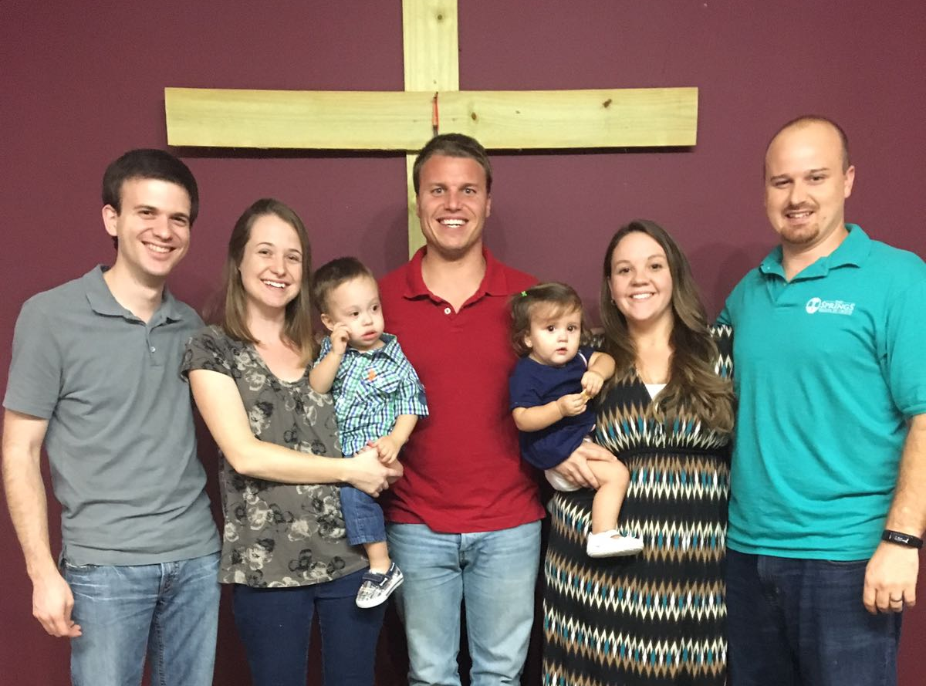
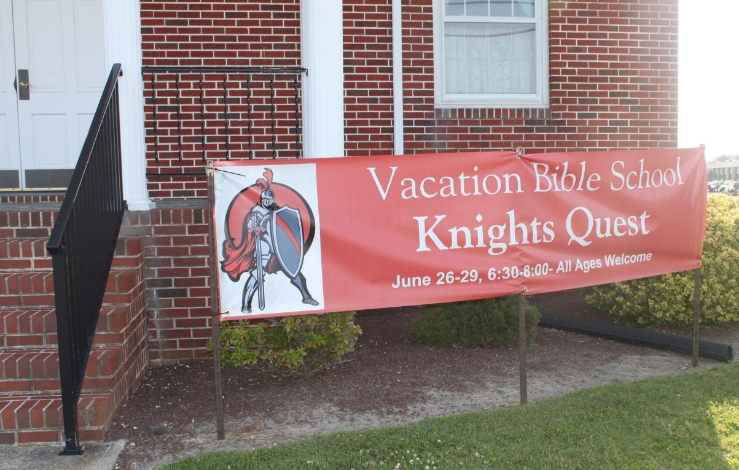
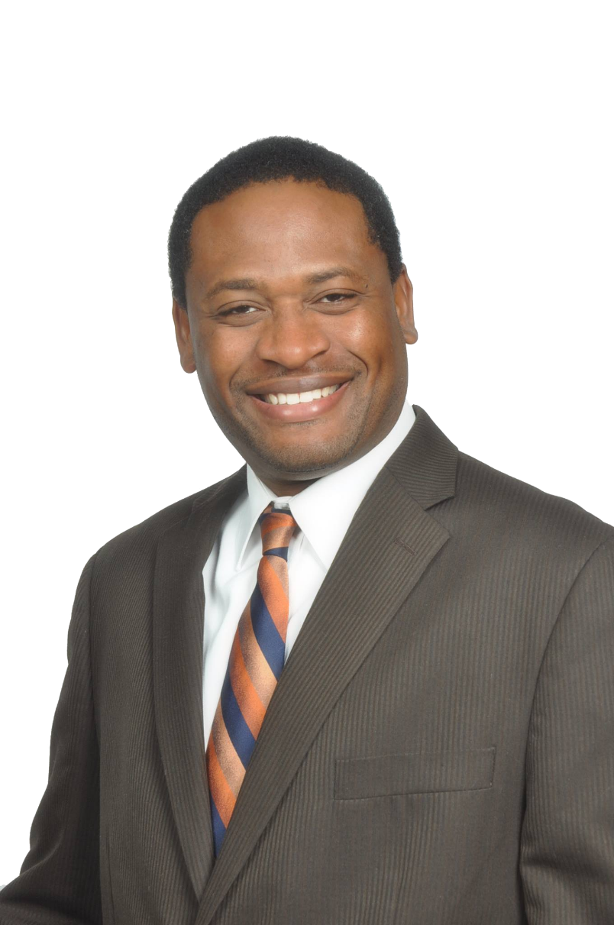
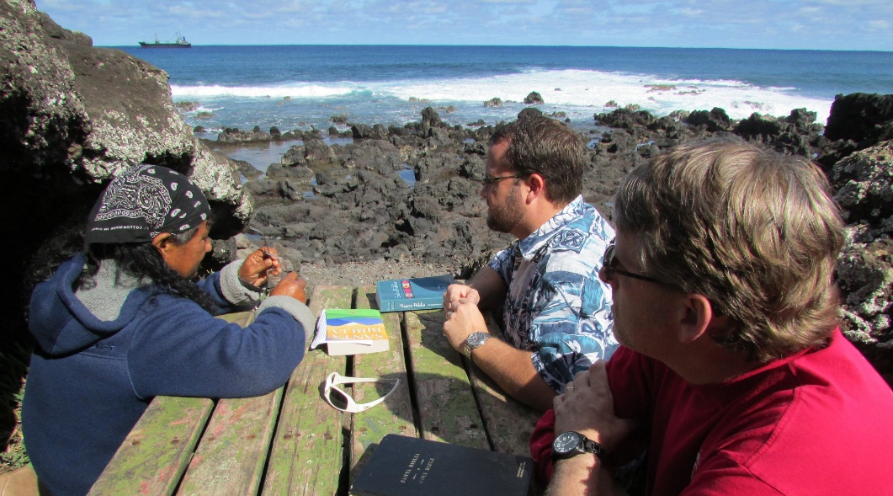
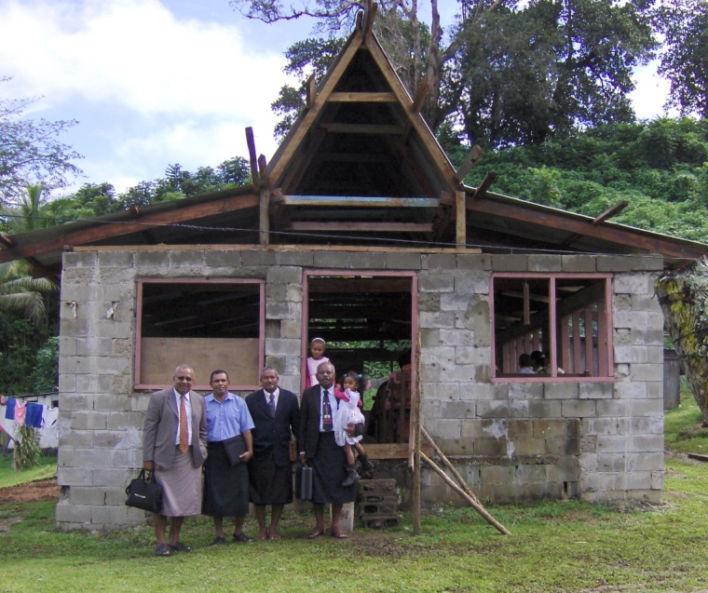
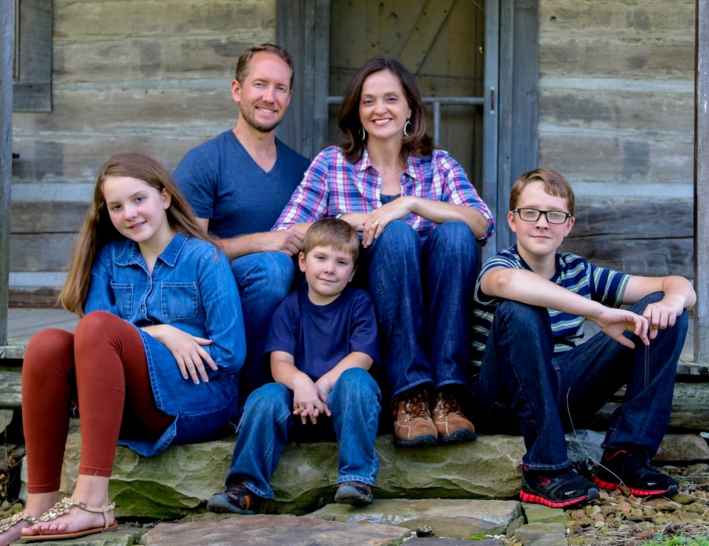
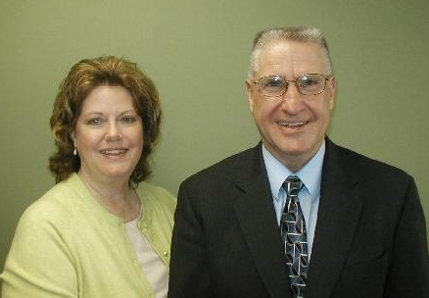
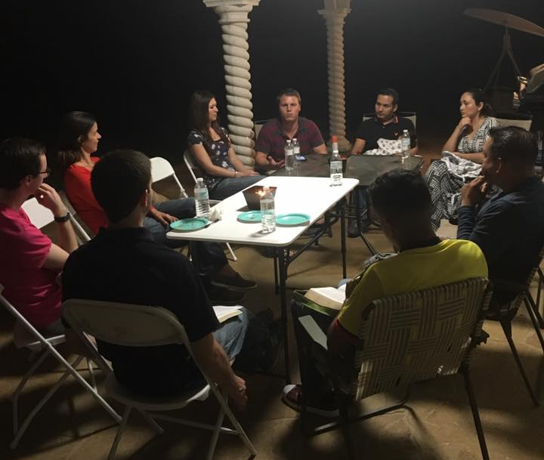
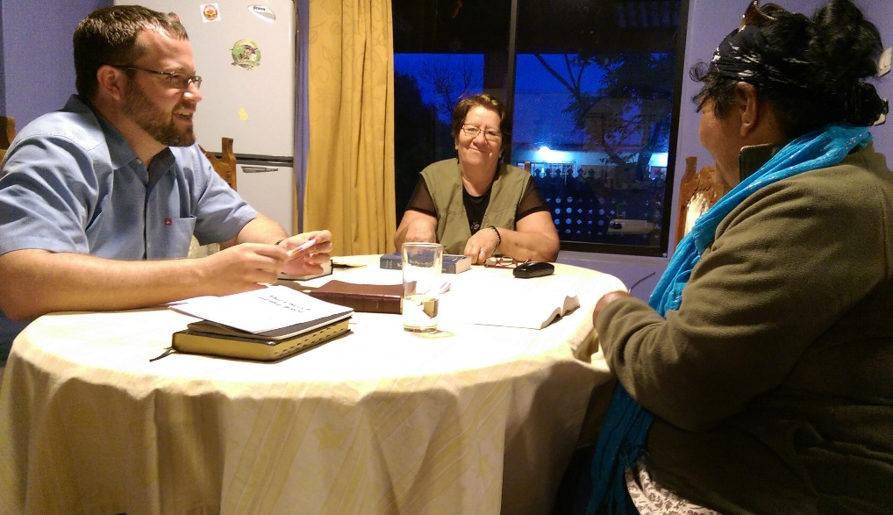
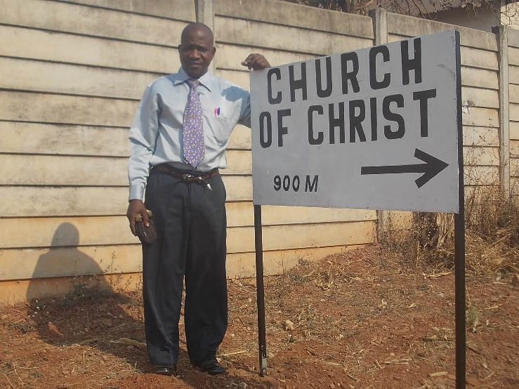
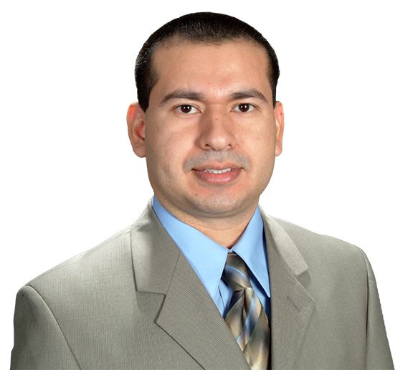
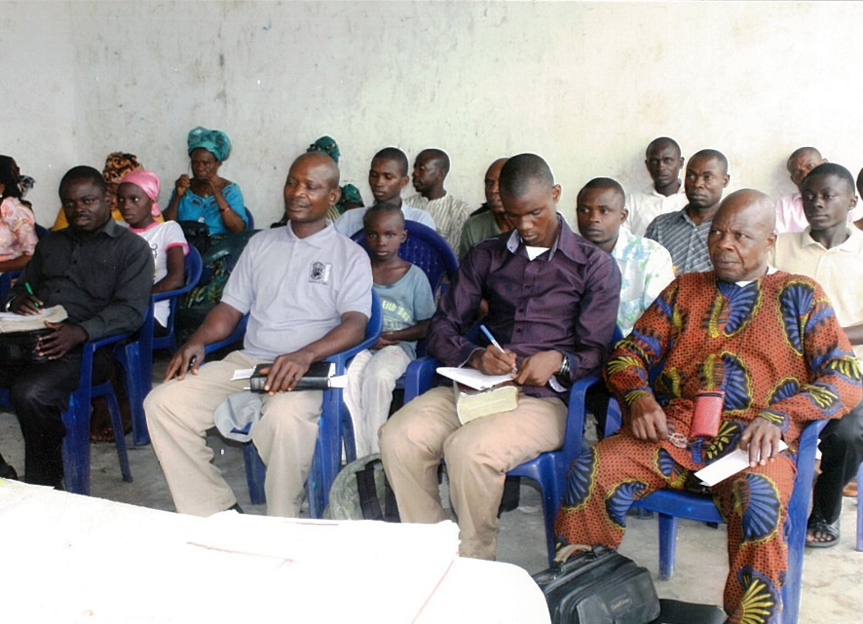
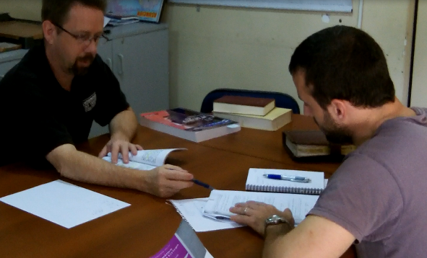
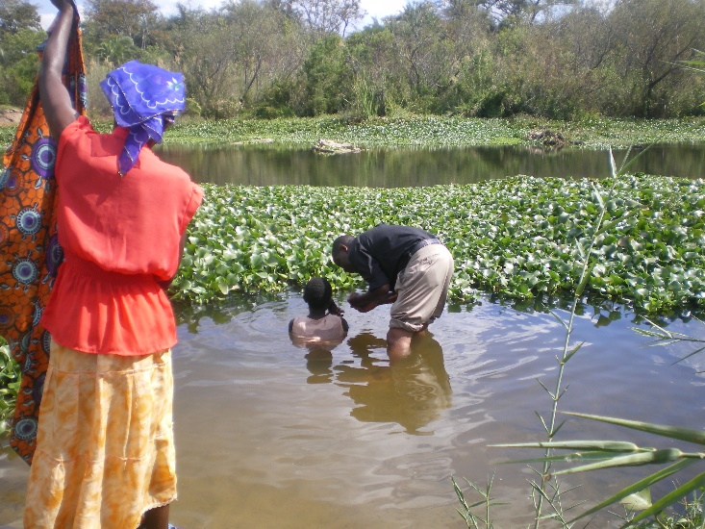
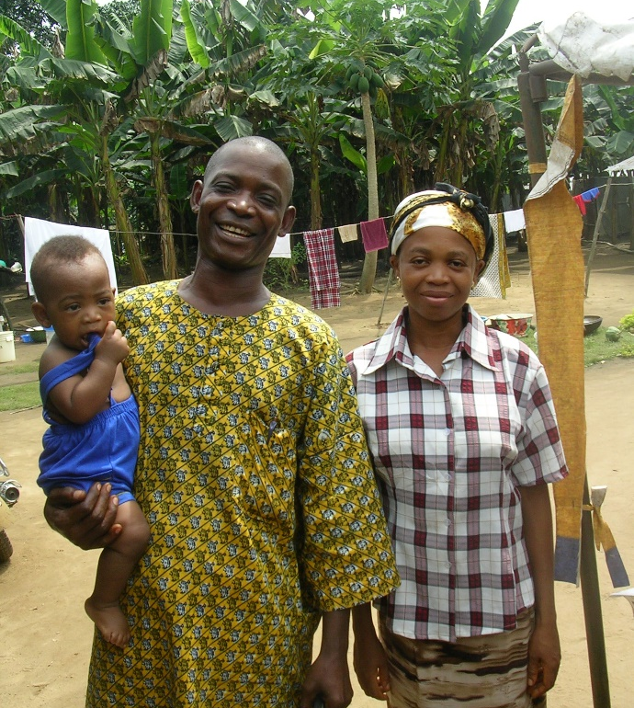
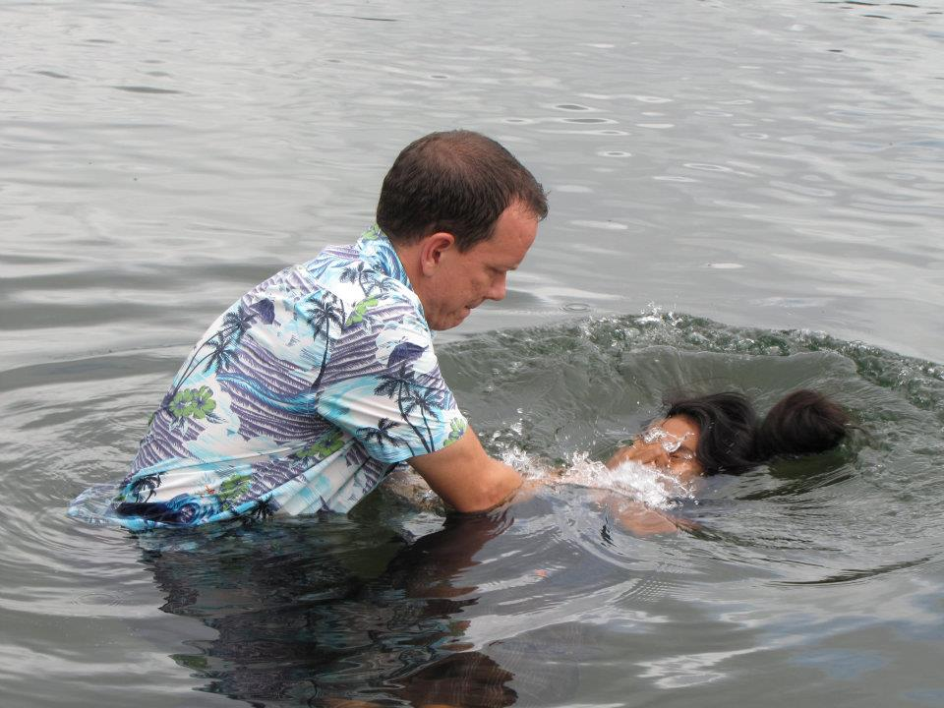
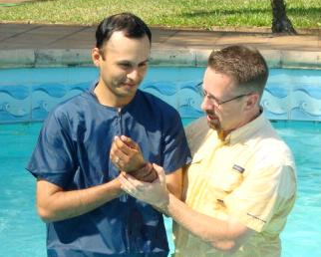
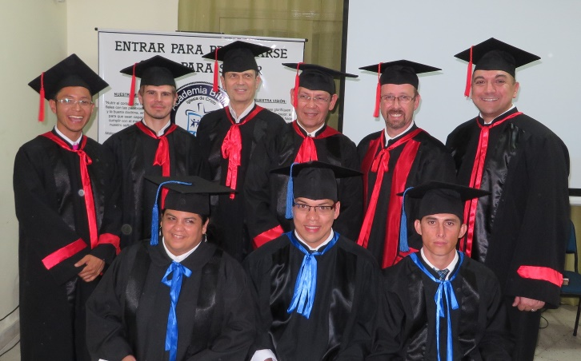
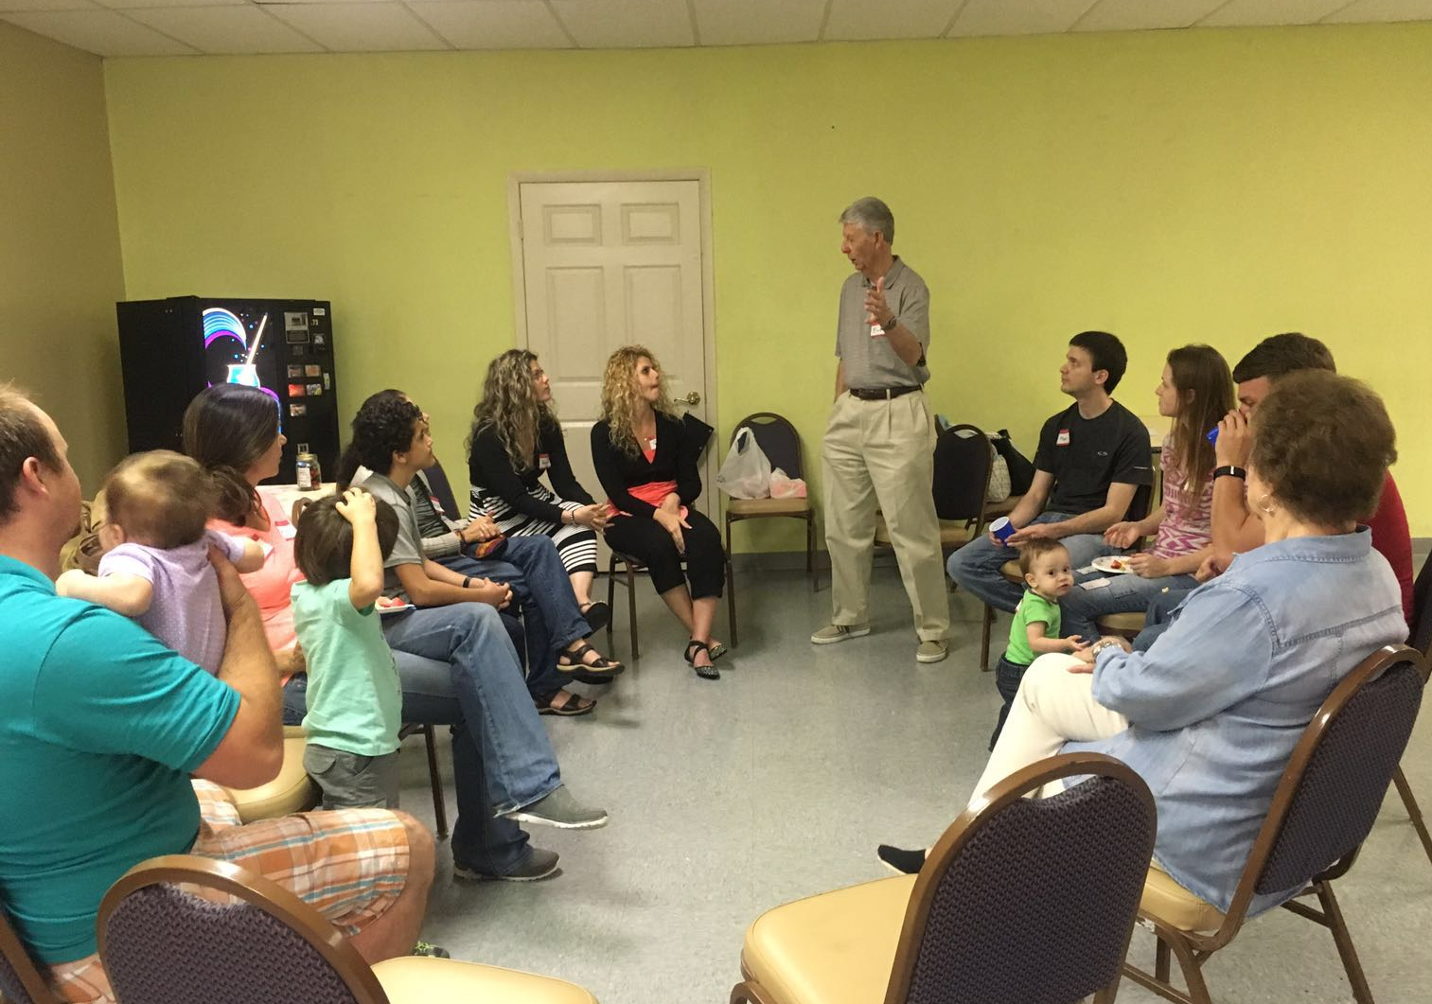
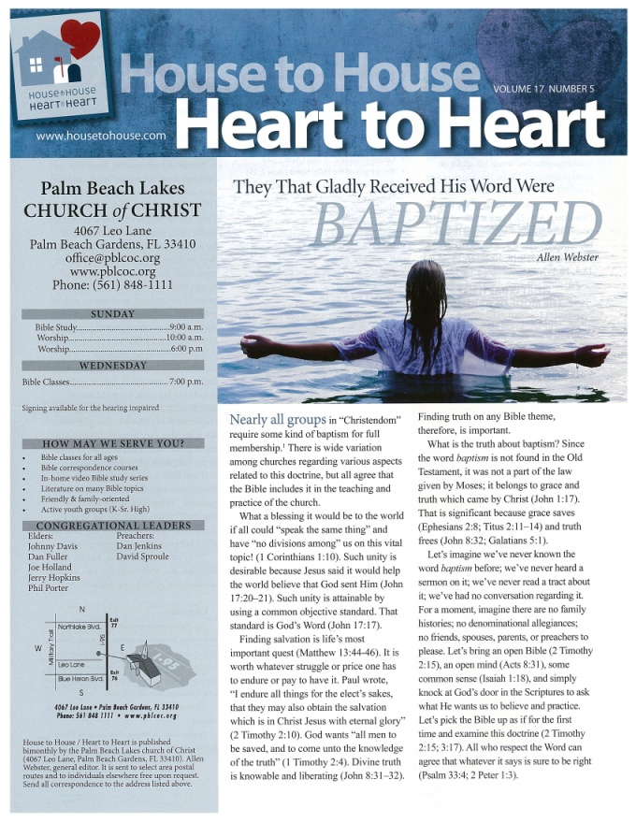
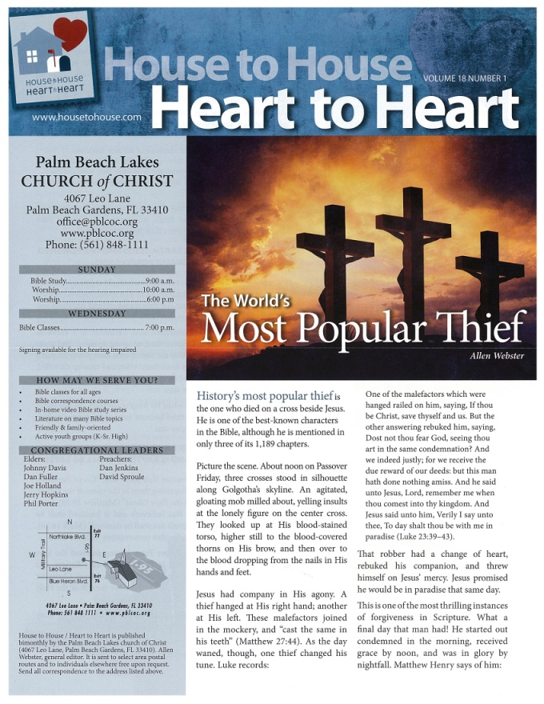
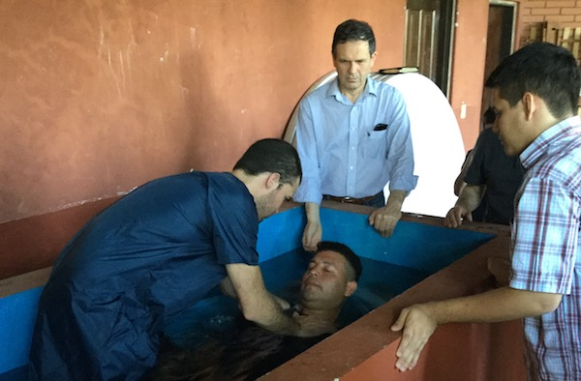
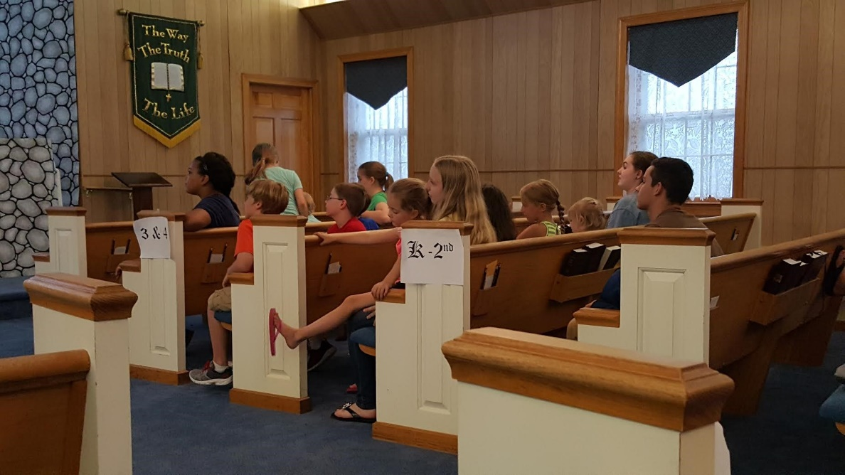
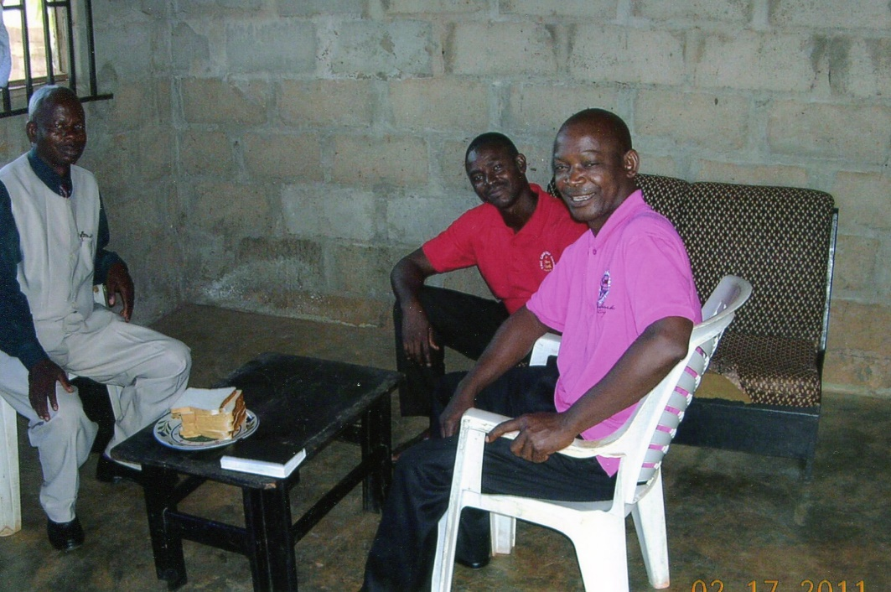
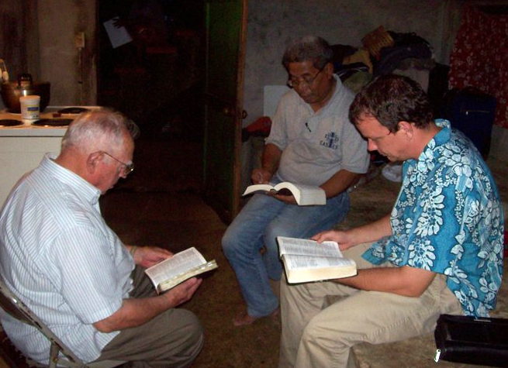
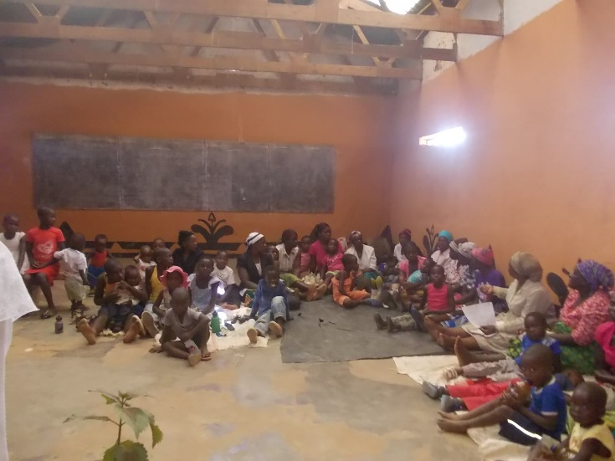
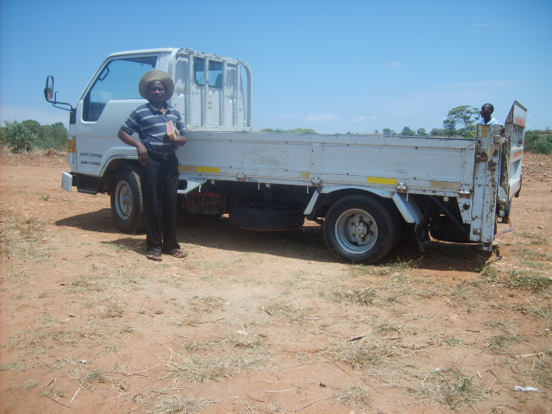
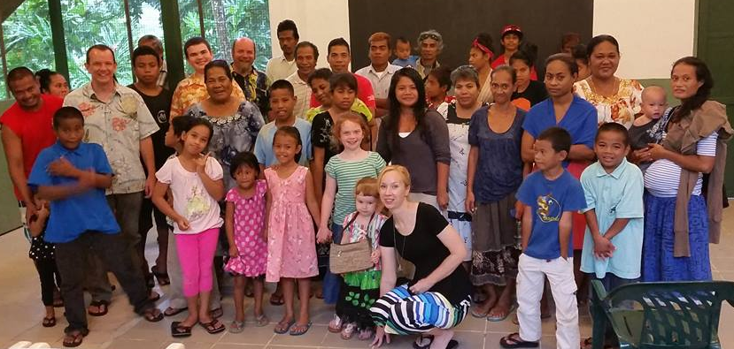
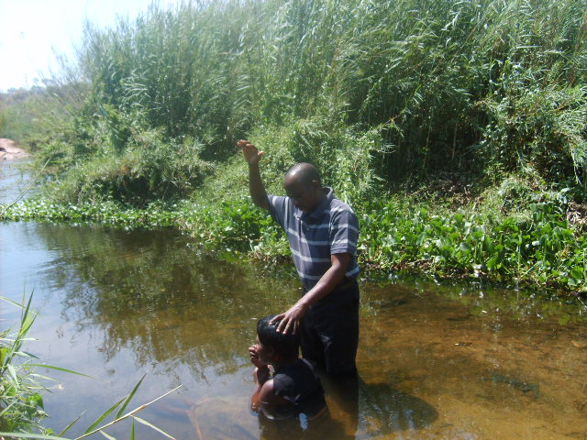
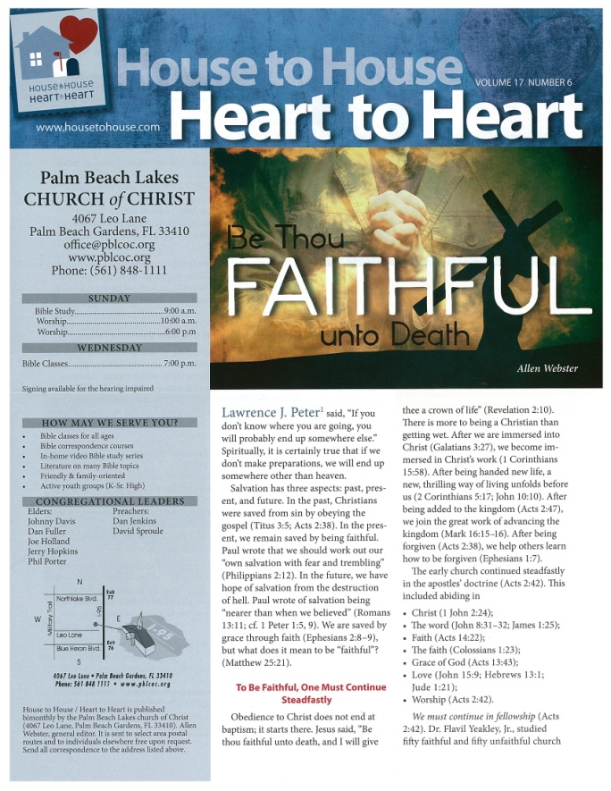
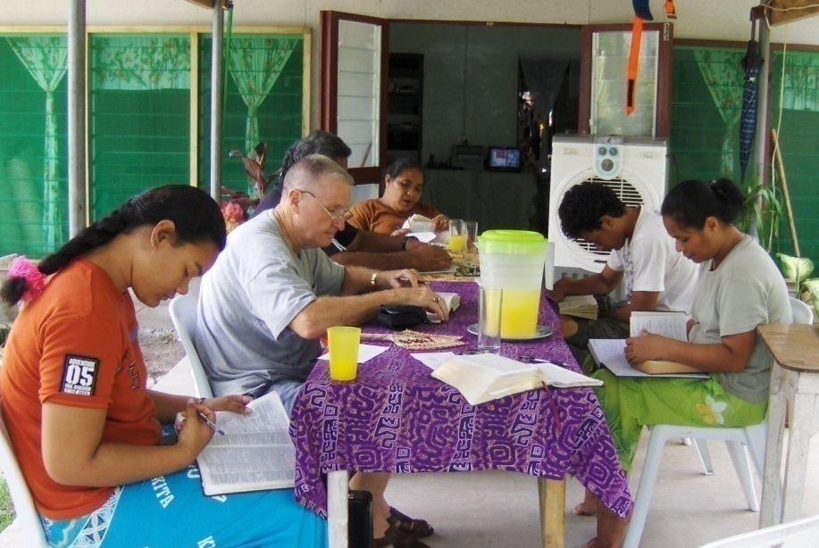
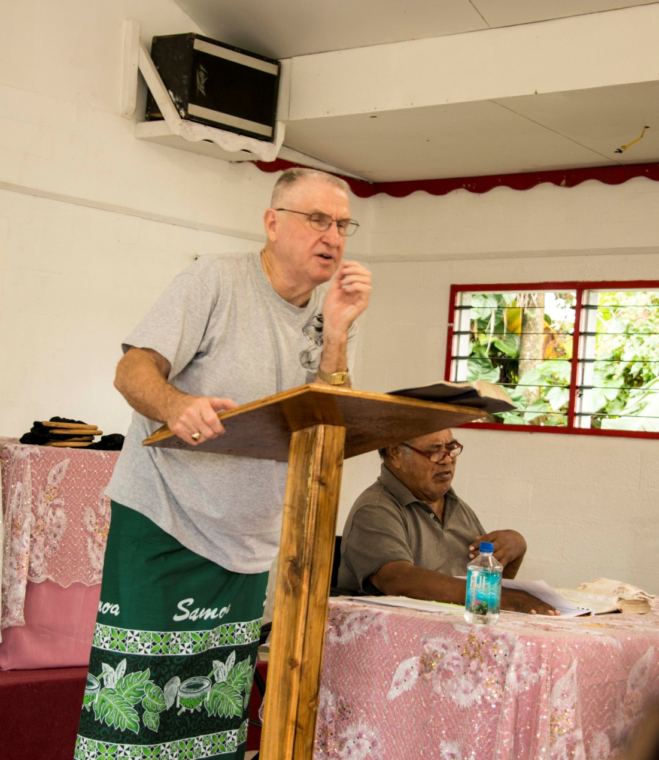
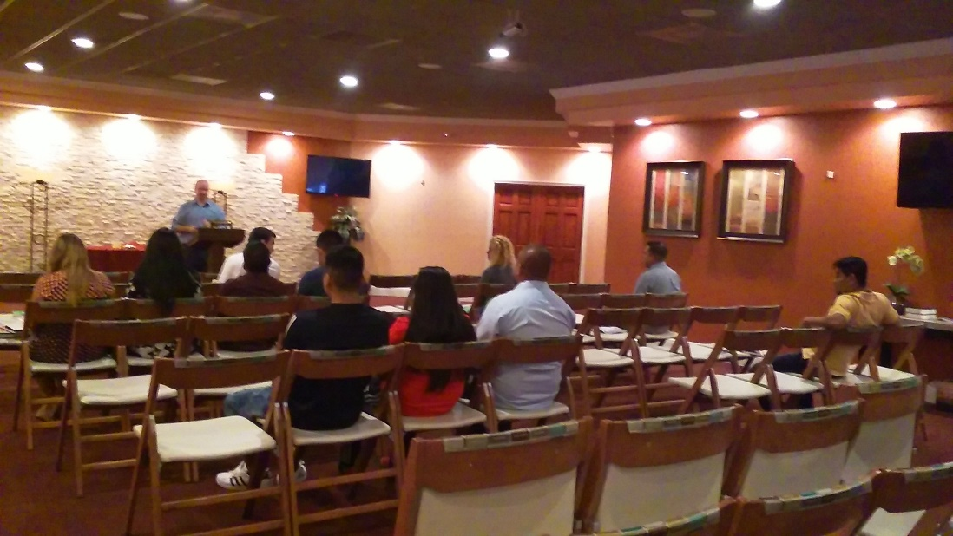
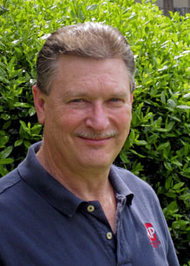
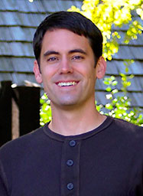
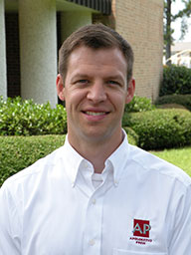
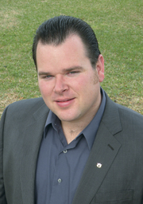
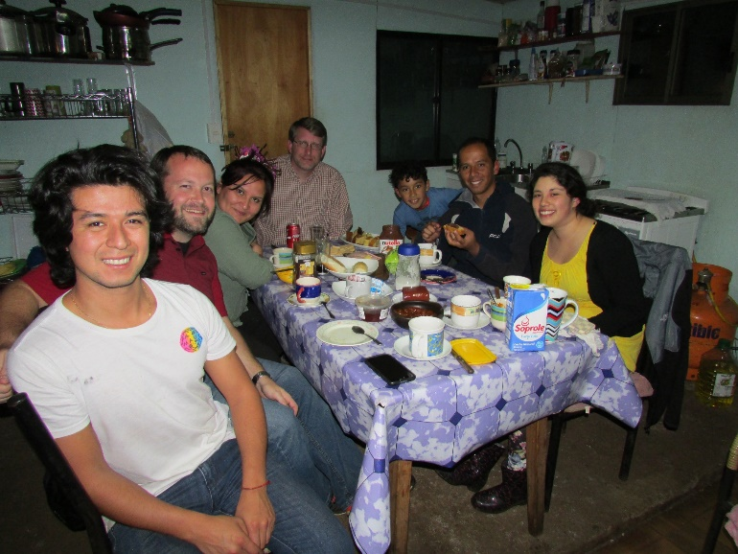
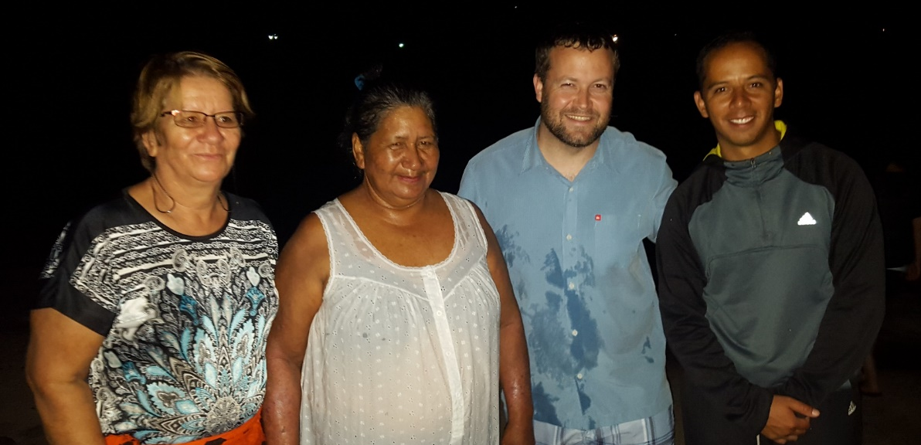
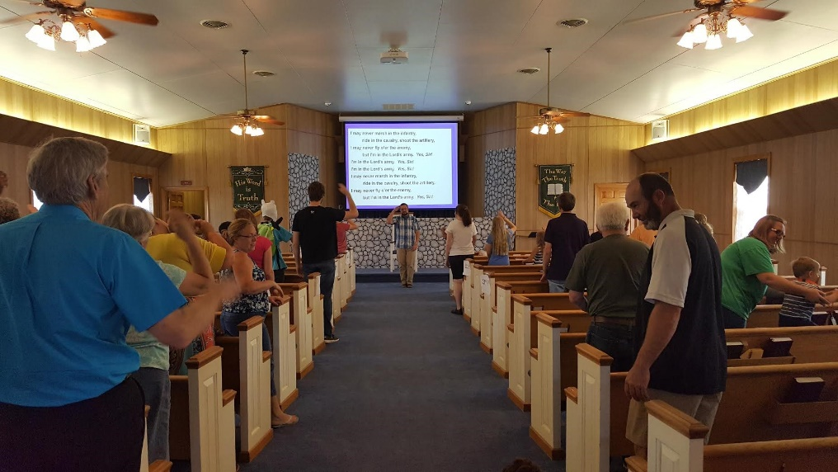
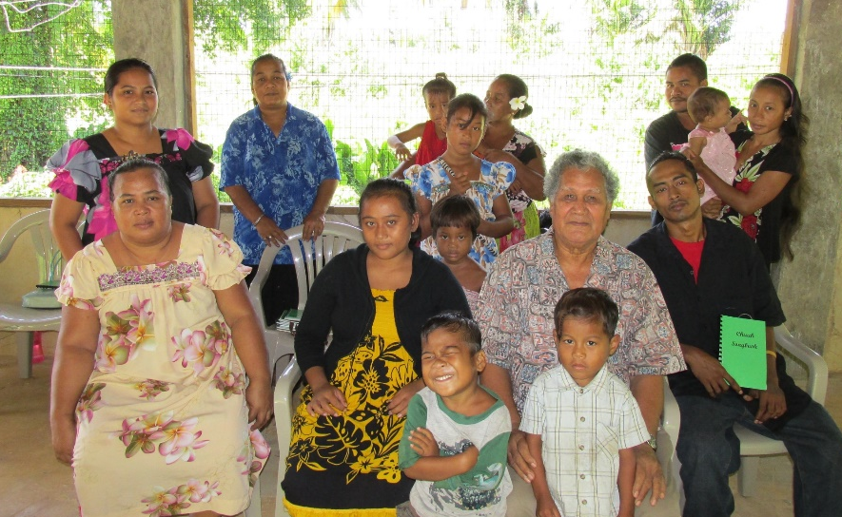
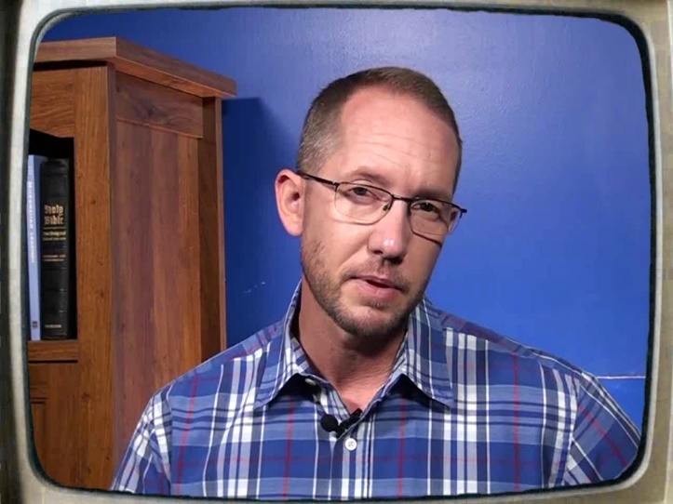
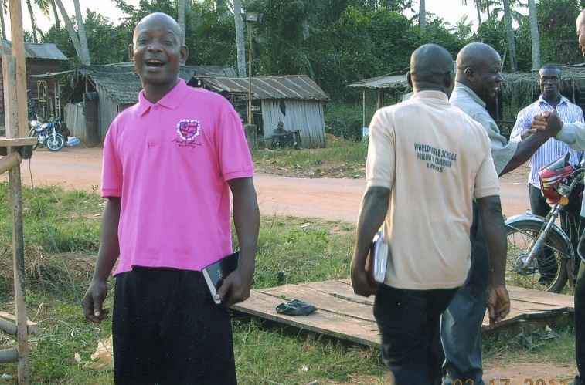
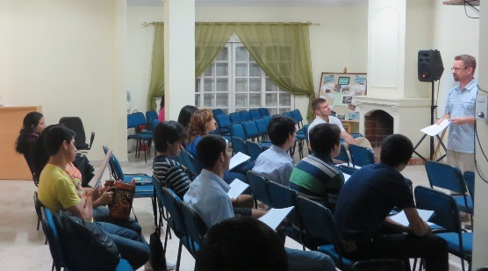
8,000 homes
6 x’s a year
Tavaro Hanna (MSOP)
Sr. High Mission Trip
H2H/H2H
Apologetics Press⁺
Josh Blackmer to Easter Island
Douglas Alvarenga
Troy Spradlin* (Paraguay)
$85,400
Robert Martin⁺ (Pacific)
Mauricio Yegros⁺ (Coral Springs)
Scott Shanahan* (Pacific)
Joey Treat (Pacific)
Nnanna Aforji (Nigeria)
Tamuka Arunashe (Zimbabwe)

Slide 4
$95,300
Wayne Parker
(Pohnpei)
Tavaro Hanna (MSOP)
Sr. High Mission Trip
H2H/H2H
Apologetics Press⁺
Josh Blackmer to Easter Island
Douglas Alvarenga
Troy Spradlin* (Paraguay)
$85,400
Robert Martin⁺ (Pacific)
Mauricio Yegros⁺ (Coral Springs)
Scott Shanahan* (Pacific)
Joey Treat (Pacific)
Nnanna Aforji (Nigeria)
Tamuka Arunashe (Zimbabwe)

Slide 5
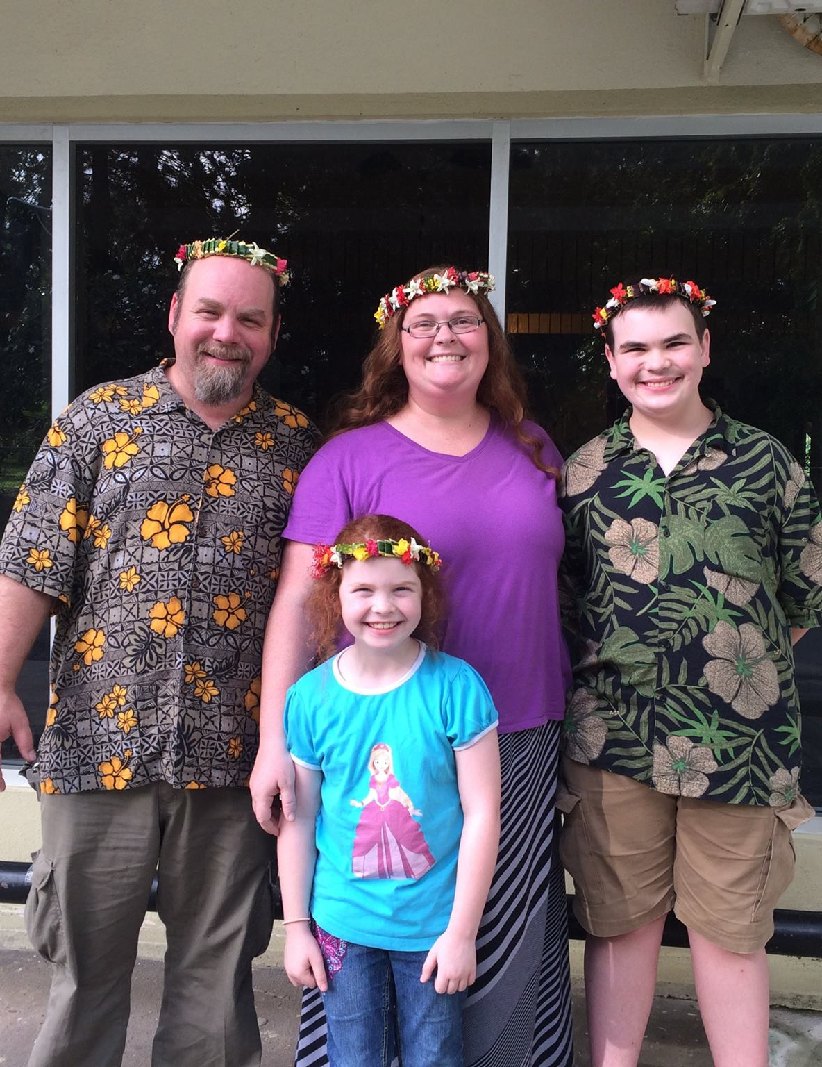
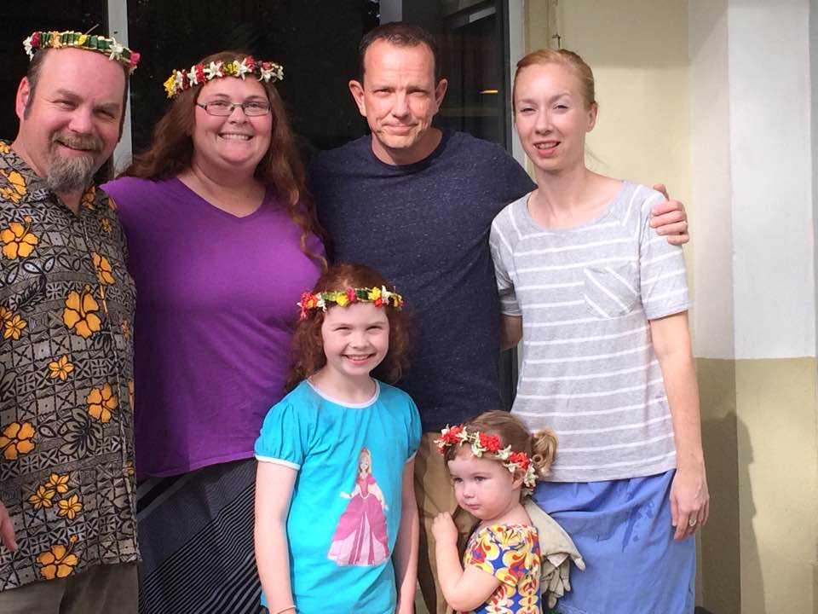

Slide 6
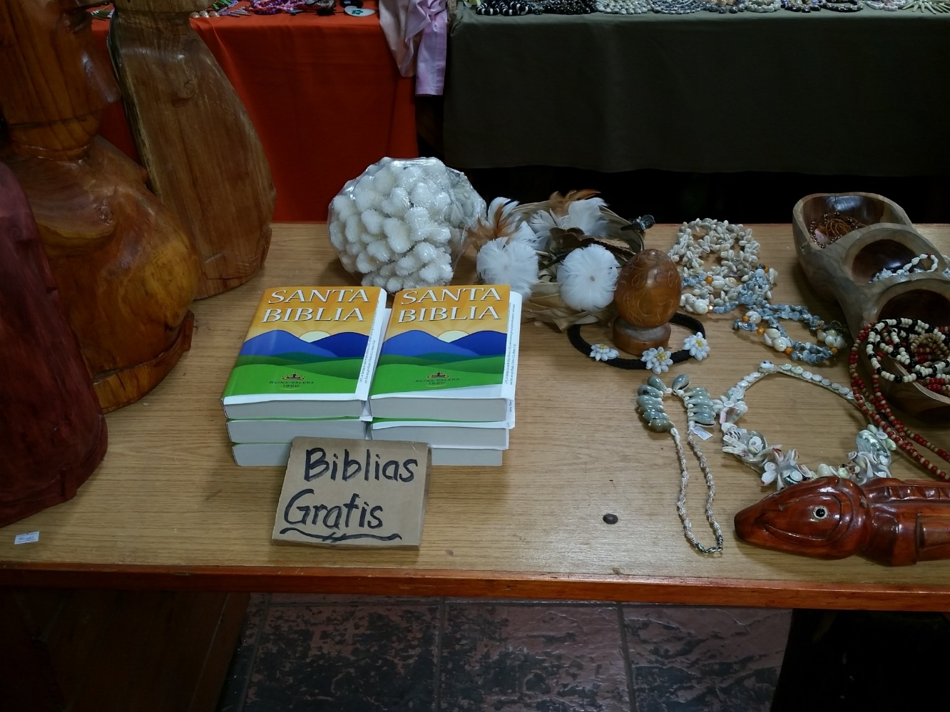
Easter Island
Population: 5,700
Stores that sell Bibles: 0
$95,300
Wayne Parker
(Pohnpei)
Special Requests
for Mission Trips
More Bibles for
Easter Island
Tavaro Hanna (MSOP)
Sr. High Mission Trip
H2H/H2H
Apologetics Press⁺
Josh Blackmer to Easter Island
Douglas Alvarenga
Troy Spradlin* (Paraguay)
$85,400
Robert Martin⁺ (Pacific)
Mauricio Yegros⁺ (Coral Springs)
Scott Shanahan* (Pacific)
Joey Treat (Pacific)
Nnanna Aforji (Nigeria)
Tamuka Arunashe (Zimbabwe)

Slide 7
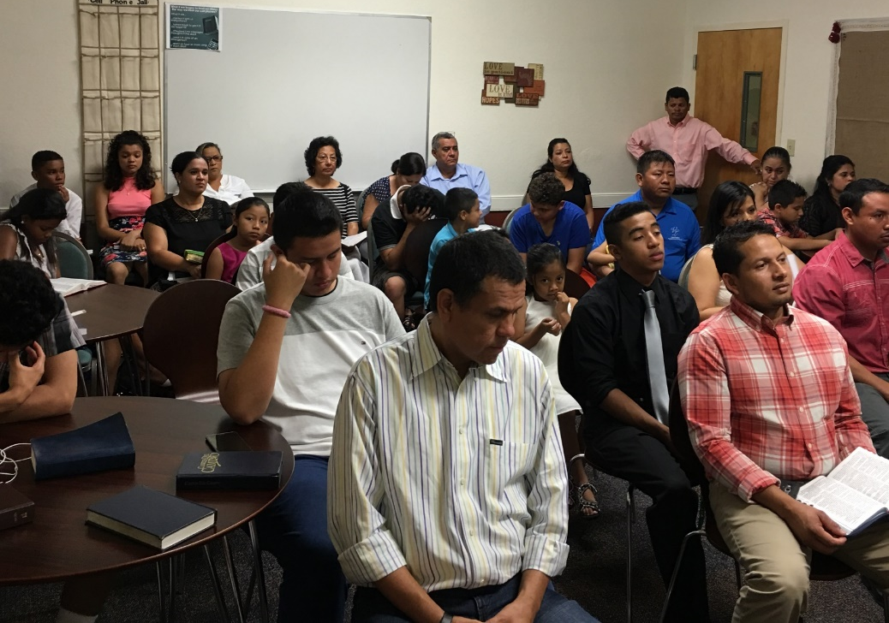
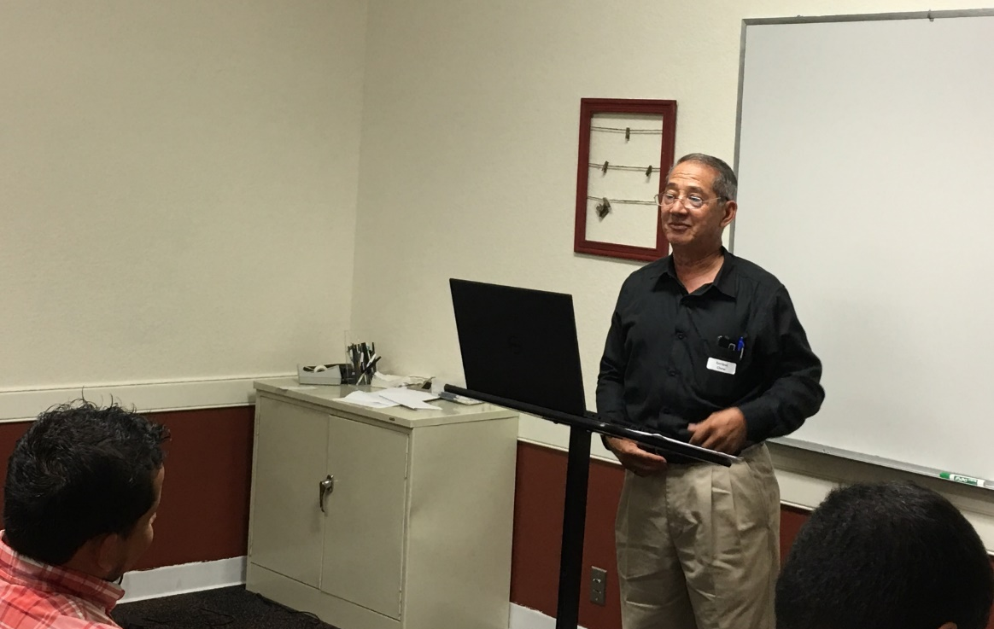
$105,200
Spanish Congregation: Assist with New Location
$95,300
Wayne Parker
(Pohnpei)
Special Requests
for Mission Trips
Bibles for
Easter Island
Tavaro Hanna (MSOP)
Sr. High Mission Trip
H2H/H2H
Apologetics Press⁺
Josh Blackmer to Easter Island
Douglas Alvarenga
Troy Spradlin* (Paraguay)
$85,400
Robert Martin⁺ (Pacific)
Mauricio Yegros⁺ (Coral Springs)
Scott Shanahan* (Pacific)
Joey Treat (Pacific)
Nnanna Aforji (Nigeria)
Tamuka Arunashe (Zimbabwe)

Slide 8
$105,200
Spanish Congregation: Assist with New Location
“In Search of the Lord’s Way”
$95,300
Wayne Parker
(Pohnpei)
Special Requests
for Mission Trips
Bibles for
Easter Island
Tavaro Hanna (MSOP)
Sr. High Mission Trip
H2H/H2H
Apologetics Press⁺
Josh Blackmer to Easter Island
Douglas Alvarenga
Troy Spradlin* (Paraguay)
$85,400
Robert Martin⁺ (Pacific)
Mauricio Yegros⁺ (Coral Springs)
Scott Shanahan* (Pacific)
Joey Treat (Pacific)
Nnanna Aforji (Nigeria)
Tamuka Arunashe (Zimbabwe)

Slide 9
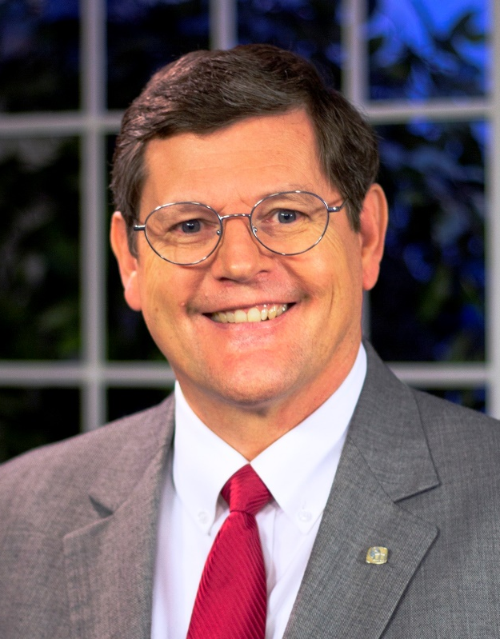
Sunday Mornings
at 7:00 a.m.
Reaching 100 million of 118 million homes in America every week
Phil Sanders

Slide 10
$114,700
Trinidad School of Preaching
$105,200
Spanish Congregation: Assist with New Location
“In Search of the Lord’s Way”
$95,300
Wayne Parker
(Pohnpei)
Special Requests
for Mission Trips
Bibles for
Easter Island
Tavaro Hanna (MSOP)
Sr. High Mission Trip
H2H/H2H
Apologetics Press⁺
Josh Blackmer to Easter Island
Douglas Alvarenga
Troy Spradlin* (Paraguay)
$85,400
Robert Martin⁺ (Pacific)
Mauricio Yegros⁺ (Coral Springs)
Scott Shanahan* (Pacific)
Joey Treat (Pacific)
Nnanna Aforji (Nigeria)
Tamuka Arunashe (Zimbabwe)

Slide 11
Trinidad School of Preaching
Dominic Dos Santos
(Director)

Slide 12
$114,700
Trinidad School of Preaching
Send a Couple to Easter Island
$105,200
Spanish Congregation: Assist with New Location
“In Search of the Lord’s Way”
$95,300
Wayne Parker
(Pohnpei)
Special Requests
for Mission Trips
Bibles for
Easter Island
Tavaro Hanna (MSOP)
Sr. High Mission Trip
H2H/H2H
Apologetics Press⁺
Josh Blackmer to Easter Island
Douglas Alvarenga
Troy Spradlin* (Paraguay)
$85,400
Robert Martin⁺ (Pacific)
Mauricio Yegros⁺ (Coral Springs)
Scott Shanahan* (Pacific)
Joey Treat (Pacific)
Nnanna Aforji (Nigeria)
Tamuka Arunashe (Zimbabwe)

Slide 13
Send a couple to Easter Island
Stay for a month
Help the young church to mature and establish healthy habits as Christians

Slide 14
$129,700
20k Tracts for Robert
$114,700
Trinidad School of Preaching
Send a Couple to Easter Island
$105,200
Spanish Congregation: Assist with New Location
“In Search of the Lord’s Way”
$95,300
Wayne Parker
(Pohnpei)
Special Requests
for Mission Trips
Bibles for
Easter Island
Tavaro Hanna (MSOP)
Sr. High Mission Trip
H2H/H2H
Apologetics Press⁺
Josh Blackmer to Easter Island
Douglas Alvarenga
Troy Spradlin* (Paraguay)
$85,400
Robert Martin⁺ (Pacific)
Mauricio Yegros⁺ (Coral Springs)
Scott Shanahan* (Pacific)
Joey Treat (Pacific)
Nnanna Aforji (Nigeria)
Tamuka Arunashe (Zimbabwe)

Slide 16
$+++,+++
+
+
+
$129,700
20k Tracts for Robert
Our Next
Missionary
$114,700
Trinidad School of Preaching
Send a Couple to Easter Island
$105,200
Spanish Congregation: Assist with New Location
“In Search of the Lord’s Way”
$95,300
Wayne Parker
(Pohnpei)
Special Requests
for Mission Trips
Bibles for
Easter Island
Tavaro Hanna (MSOP)
Sr. High Mission Trip
H2H/H2H
Apologetics Press⁺
Josh Blackmer to Easter Island
Douglas Alvarenga
Troy Spradlin* (Paraguay)
$85,400
Robert Martin⁺ (Pacific)
Mauricio Yegros⁺ (Coral Springs)
Scott Shanahan* (Pacific)
Joey Treat (Pacific)
Nnanna Aforji (Nigeria)
Tamuka Arunashe (Zimbabwe)

Slide 17
The Purpose of
Mission Sunday
The Purpose of
The Gospel
is to
Save
Souls!
Are you
Saved?
Believe Jesus is God’s Son John 8:24
Repent/Turn from your sins Acts 2:38
Confess your faith Romans 10:9
Be baptized Mark 16:16
Live faithfully Revelation 2:10

