Slide 1
1 Samuel 16:7

Slide 2
“The Lord does not see as man sees!”
Moses and his rod – Ex. 4:1-5
David and his sling – 1 Sam. 17:40-50
Boy and his lunch – John 6:5-14
Widow and her mites – Luke 21:1-4
Palm Beach Lakes church of Christ
450 members
In a world of 7.4 billion souls
Not great on their own!
Great things were done by the Lord!

Slide 3
Every dollar given on Mission Sunday
goes toward mission work.

Slide 4
13 Years of
Sacrificial Giving
2004 - 2016
Last Year’s Contribution $ 156,283.00
Average Contribution $ 120,521.74
Total Contribution $1,566,782.61

Slide 5
“Little”
Reaching a potential 2,000,000 people
With Daily Radio Program (2002-2007)
Reaching a potential 300,000 homes
With Television Program (2005)
Reaching a potential 300,000 homes
With TV Spot Ads (2006-2007)
Reaching 50,000 homes
With “Plan of Salvation” Mailout
Supporting a Spanish Work at PBL (2003-2010)

Slide 6
“Little”
Planting 1,026,800 seeds throughout the county
With House to House/Heart to Heart (13 years)
Assisting 17 congregations in 11 states
With Sr. High Mission Trips, sending 50+ PBL teens
Reaching a potential 500,000+ travelers daily
With our banners on I-95
Planting countless seeds throughout the county
With new Bible Tracts and Car Magnets/Plates
With New Testaments teaching the plan of salvation

Slide 7
“Little”
Supporting students in Schools of Preaching
Students in the Asuncion Bible Academy
Tavaro & Alissa Hanna at Memphis School of Preaching
Partially supporting Douglas Alvarenga
Working with the Spanish Church, currently meeting in our building
Installing HD Video Production Equipment for high quality teaching resources on the web
Mailing House to House/Heart to Heart to the entire city of Belle Glade last year (four issues)
Supporting “In Search of the Lord’s Way,” national TV Program hosted by Phil Sanders every Sunday morning

Slide 8
“Little”
Nnanna Aforji (Nigeria)
Tamuka Arunashe (Zimbabwe)
Josh Blackmer (Paraguay)
Chris Fry (Paraguay)
Junot Joseph (Miami)
Ray Leonard (South Africa)
Robert Martin (Pacific Islands)
Jason Quashie (Bahamas)
Scott Shanahan (Pacific Islands)
Surendra Singh (Trinidad)
Troy Spradlin (Paraguay)
Joey Treat (Pacific Islands)
Mauricio Yegros (Miami)
Supporting
13
Full-Time Missionaries in
26
Countries on
4
Continents

Slide 9
“Little”
American Samoa
Argentina
Bahamas
China
Easter Island
El Salvador
Fiji
Ghana
Guatemala
Guyana
Haiti
Honduras
India
Israel
Jamaica
Kiribati
Mexico
New Guinea
New Zealand
Nicaragua
Nigeria
Palau
Paraguay
Peru
Russia
South Africa
Sri Lanka
Tanzania
Thailand
Tonga
Trinidad
Tuvalu
Vanuatu
Venezuela
Western Samoa
Zambia
Etc.
Supporting
Dozens
of Mission Trips to
35+
Countries on
6
Continents

Slide 10
“Little”
Supporting Apologetics Press (since 1986, *2004)
Professional Staff
Four men (Dave Miller, Jeff Miller, Eric Lyons, Kyle Butt)
Speak around the country & globe (100+ places annually)
Publications
Monthly Journals: Reason & Revelation and Discovery
Books for adults & kids + Tracts for adults & kids
Videos for adults & kids + eBooks for adults & kids
Bible Class curriculum, VBS Materials, Study Courses, etc.
Coming Soon: Apologetics Bible
Website (www.ApologeticsPress.org)
20,000,000+ page hits from 230+ countries

Slide 11
“Little”
Helping Plant the church in Asuncion, Paraguay
“First” team (with Chris Fry) went down in Sept. 2003
“Second” team went down
Josh, Cara, Josiah & Vivian Blackmer in Sept. 2009
Troy & Andrea Spradlin in Feb. 2010 (returning Feb. 2017)
In 13 years:
The Lord’s church has been planted and is growing
The church is healthy in doctrine and love for one another
The church is self-supporting and self-propagating
The “Bible Academy” graduated 8 students trained to serve
The church no longer needs full-time American missionaries

Slide 12
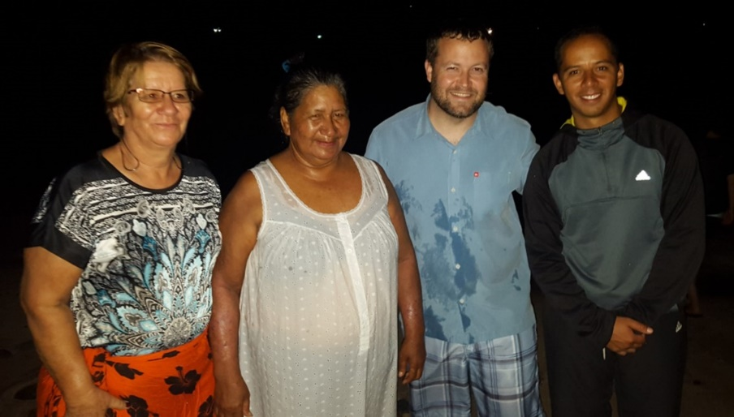
“Little”
Taking the Gospel to Easter Island
One of the Pacific Islands on Robert Martin’s radar
Josh and Robert made first trip in November 2010
Josh has made 9 additional trips to the island
Josh started taking Bibles in 2016 (total: 200 Bibles)
Three souls have been converted and are growing
Piki (April 2014)
Uri (August 2014)
Anita (March 2016)

Slide 13
“The Lord does not see as man sees!”
The Lord has used to do great things
The Lord will use to do great things
“Little”
“Little”

Slide 14
Believe in Jesus Christ John 3:16
Repent—decide to obey Acts 17:30
Confess Christ Rom. 10:9
Baptized to be saved Acts 22:16
Added to His kingdom, His church
Be faithful until death Rev. 2:10

