Slide 2

He “gave Himself for me” (Gal. 2:20)
“He laid down His life for us” (1 John 3:16)
“They crucified Him” (Mark 15:25), the “slain Lamb” (Rev. 5:6; 13:8)

Slide 3

He was “hanging on a tree” (Acts 5:30; Jn. 19:17), for us (1 Pet. 2:21)
With “nails” in His hands and feet (John 19:37; 20:25; Psa. 22:16)
With a “crown of thorns” on His head (John 19:2)
With a torn body that had been brutally “scourged” (Mt. 27:26-31)
Saying, “I thirst” (John 19:28)

Slide 4

He bore the “curse” of crucifixion “for us” (Gal. 3:13)
He had His “clothes” taken from Him (John 19:23-24)
He was “charged” with being “The King of the Jews” (Matt. 27:37)
He was crucified with and between two “robbers” (John 19:18)
He was “blasphemed” by passersby (Matt. 27:39-40)
He was “sneered” by Jewish leaders (Luke 23:35)
He was “mocked” by the soldiers (Luke 23:36-37)
He was even “reviled” by the robbers (Matt. 27:44)
He was spit upon (Isa. 50:6; Luke 18:32)

Slide 5

He was “forsaken” by the Father (Matt. 27:45-46)

Slide 6

Although He could have “saved Himself” (Matt. 27:42; 26:53),
He stayed until, “It is finished” (John 19:30)

Slide 7

He cried out with a loud voice, “Father, into Your hands I commit My spirit,” breathed His last and “yielded up His spirit”
(Luke 23:46; Matt. 27:50)

Slide 8

He was focused on “forgiving” & taking to “Paradise” (Lk. 23:34, 43)
He saved ME with HIS Blood (Mt. 26:28; Ep. 1:7; Heb. 9:22; Rev. 1:5)
He paid my sin-debt!
He became my sin-offering!
He took my sin-punishment!

Slide 9


Slide 10


Slide 11
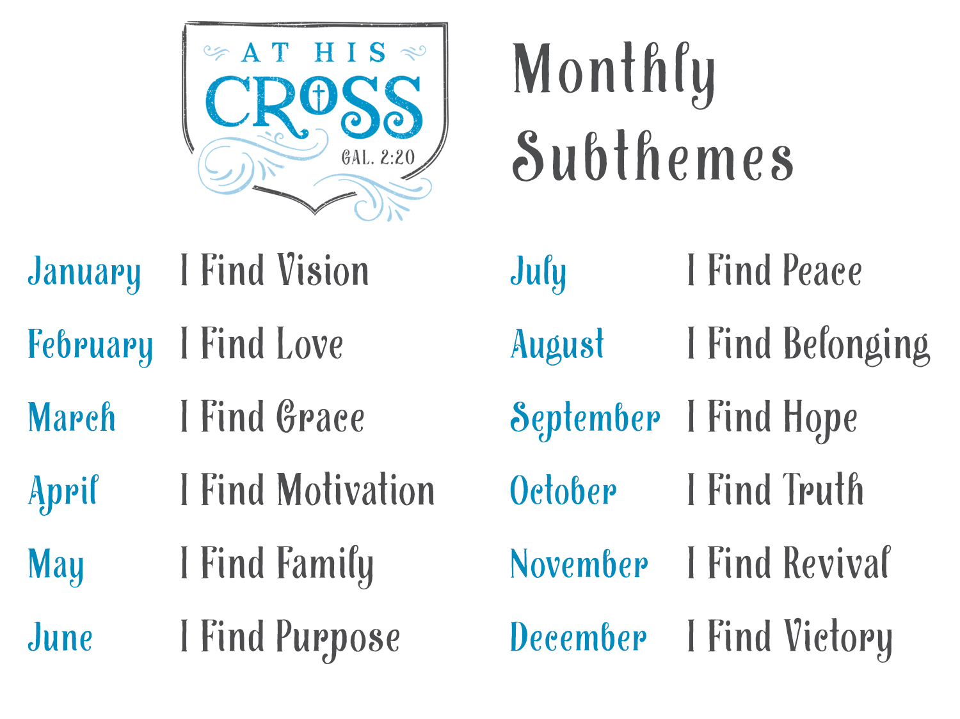

Slide 12
May we now, more than ever…
Live, Stand, Gaze, Kneel & Serve AT HIS CROSS!
May we not allow anything to become more important…
Than “Jesus Christ and Him crucified” (1 Cor. 2:2)!
May we stand AT HIS CROSS together!
Arm in arm! Hand in hand!
There are a lot of great things happening at PBL this year...

Slide 13
Blue T-shirts will be ordered this year
  $10 for adults. $8 for youth.
  Write your name and shirt size on a card
  Fold over and enclose payment or pay by Jan. 15
  Give to David or Cindy

Slide 14
Believe Jesus is God’s Son – Acts 16:31
Repent of your sins and turn to God – Acts 3:19
Confess your faith in Jesus – Acts 8:36-38
Be immersed into Christ – Acts 2:38
  God will forgive all of your sins – Acts 22:16
  God will add you to His church – Acts 2:47
  God will enroll you in heaven – Hebrews 12:23
Live faithfully for Christ – Galatians 2:20

