Slide 2
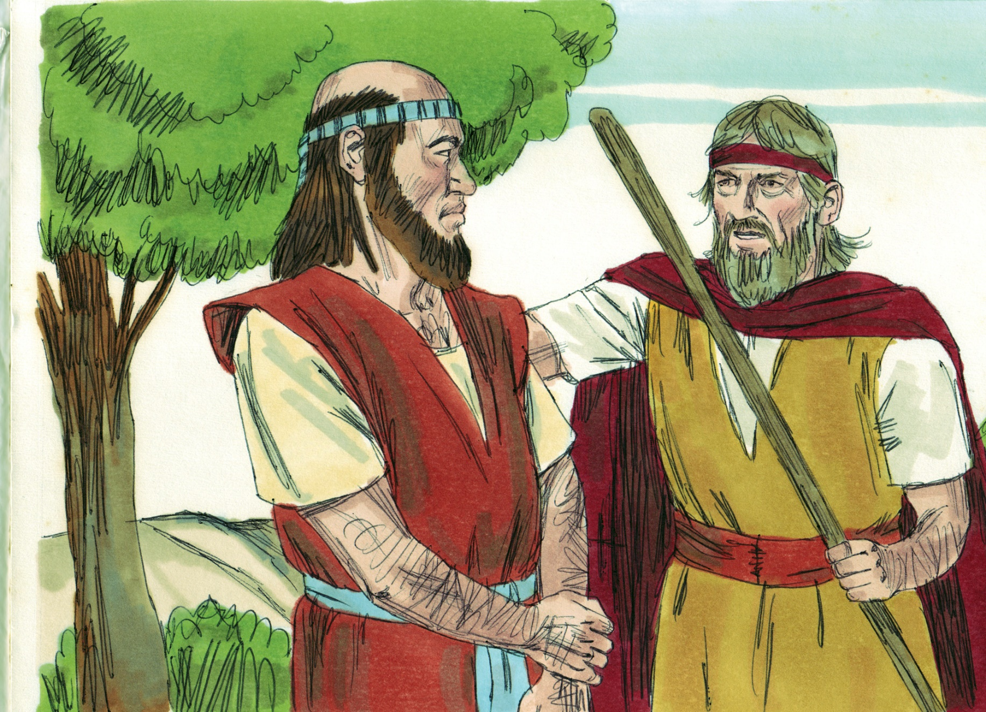

Slide 3
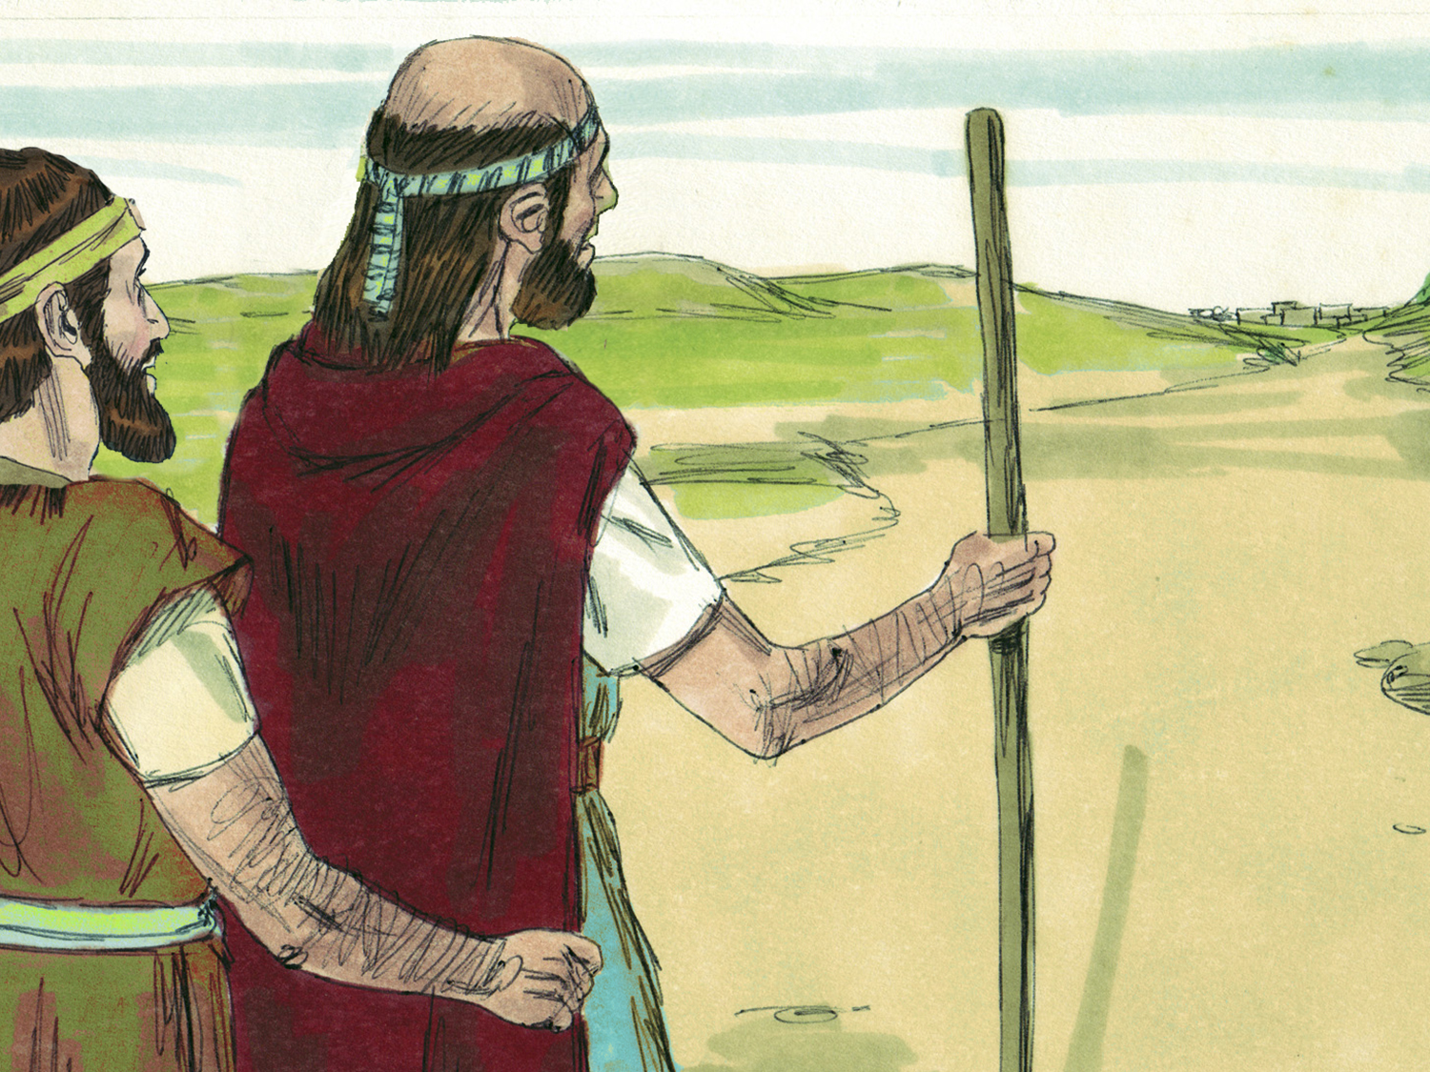

Slide 4
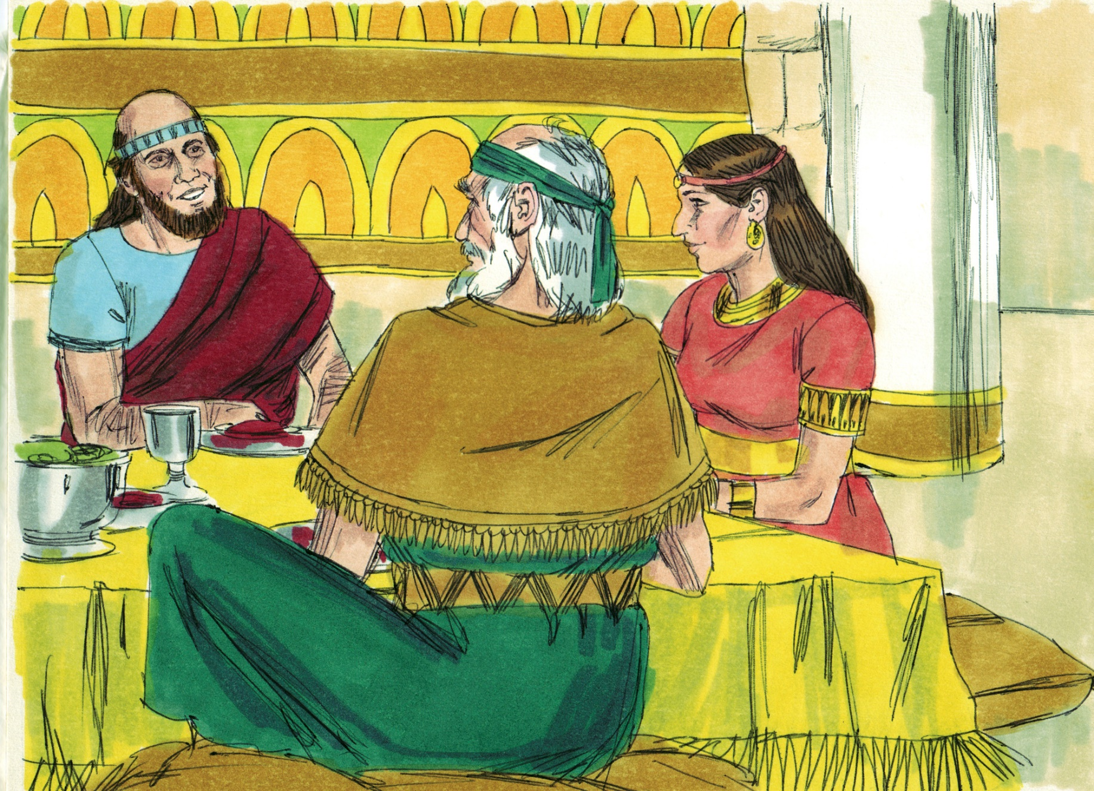

Slide 5
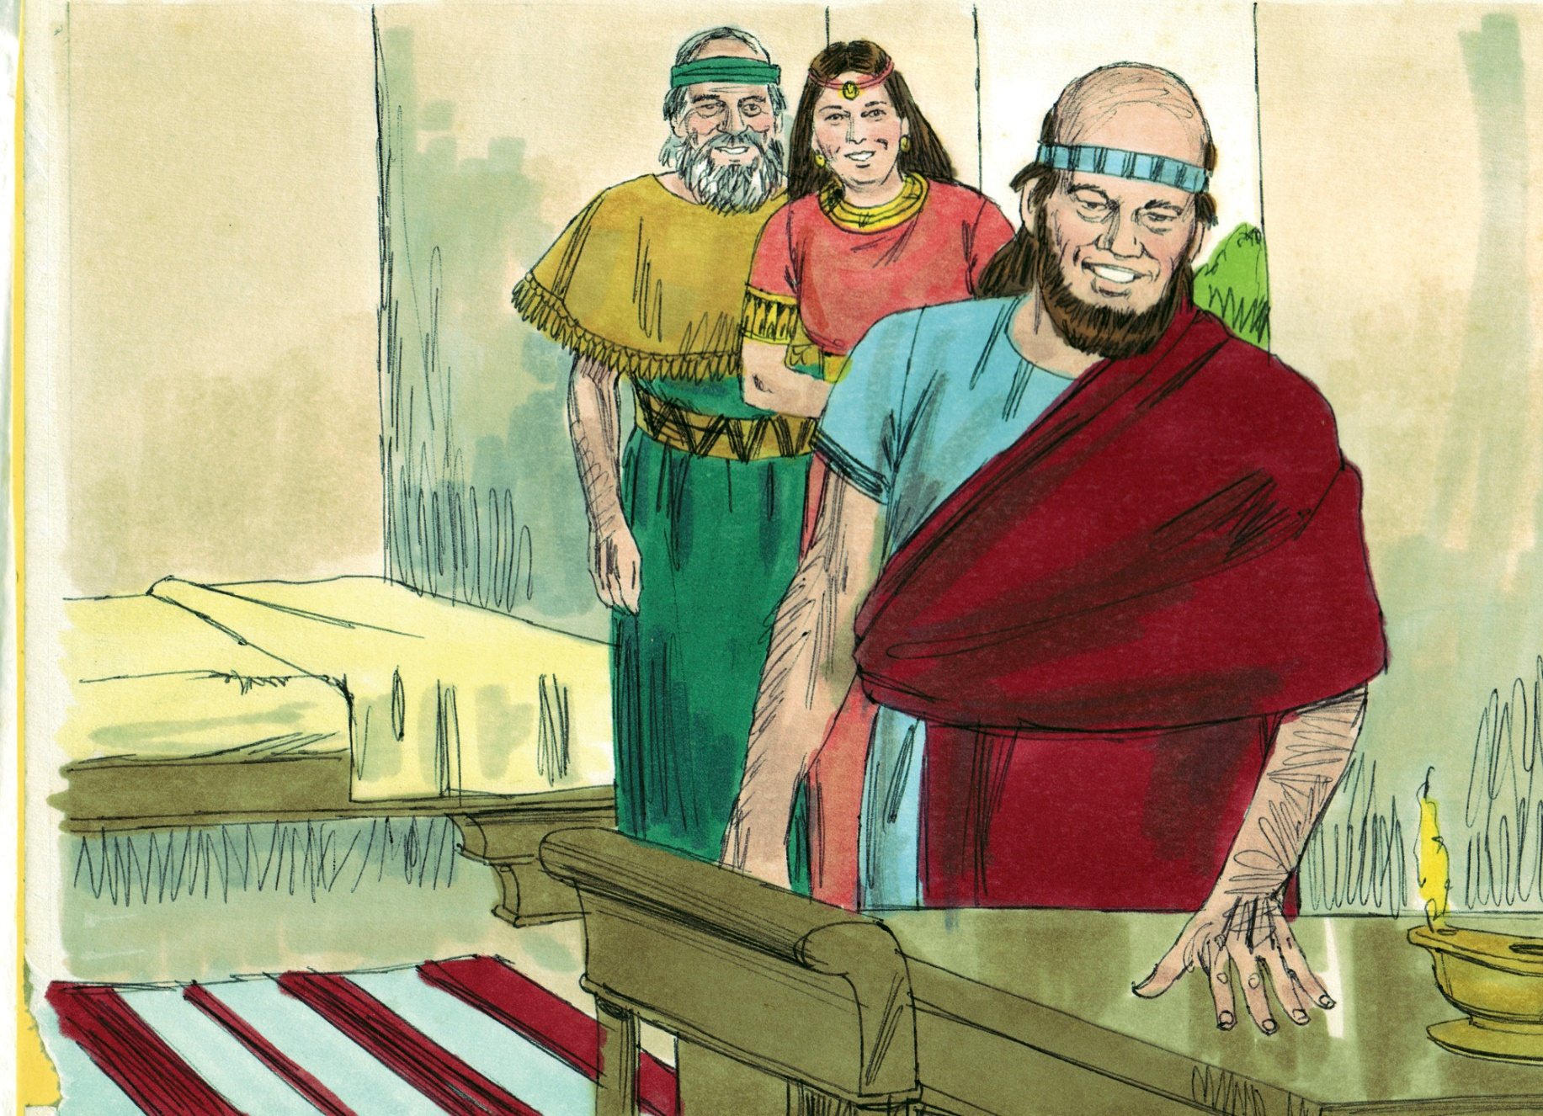

Slide 6
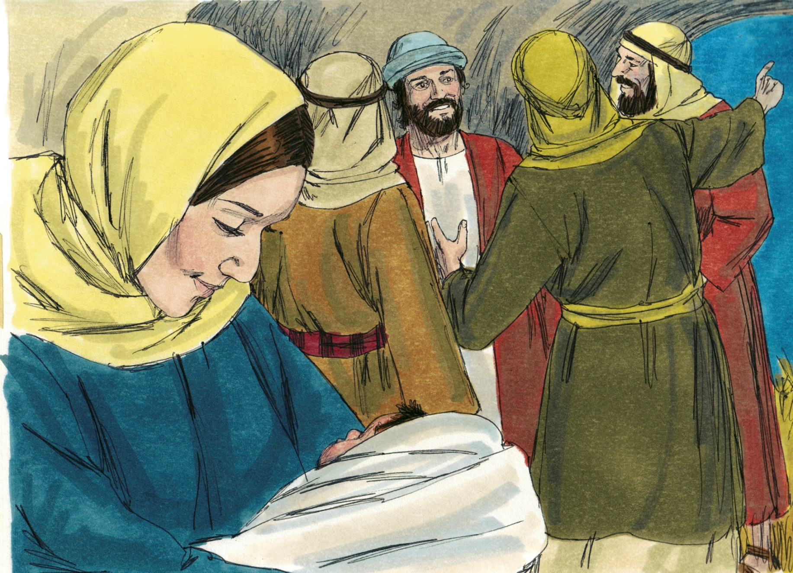
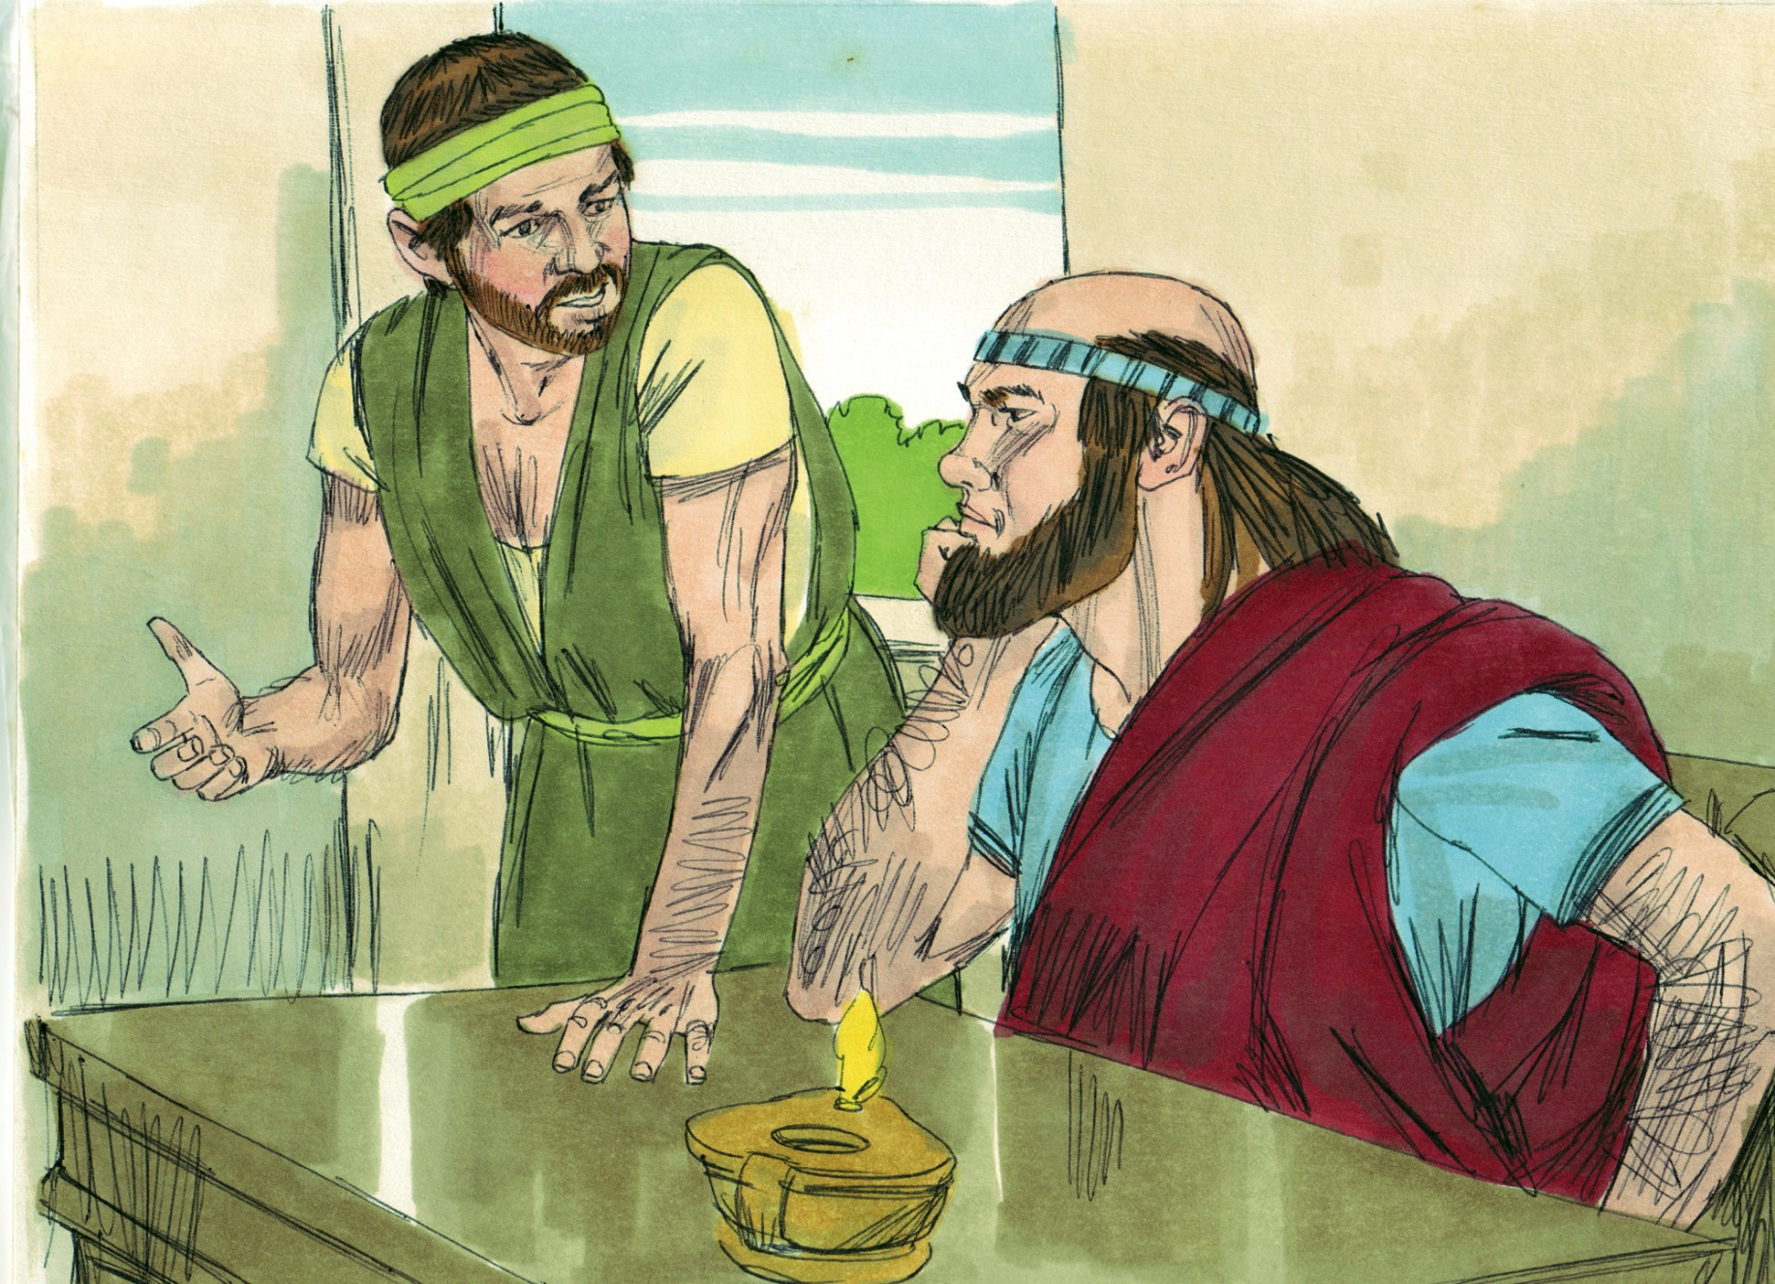

Slide 10
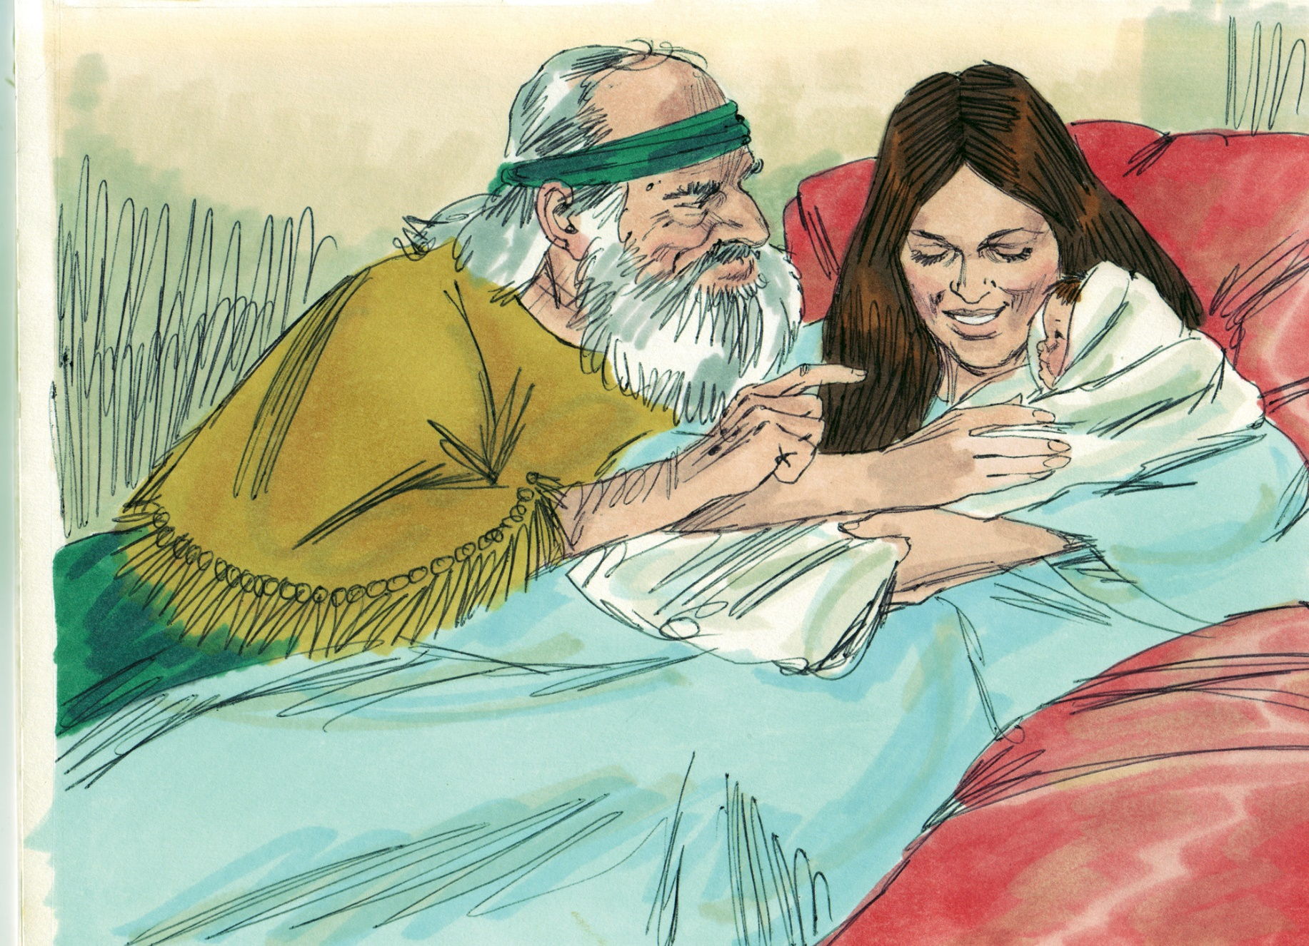

Slide 12
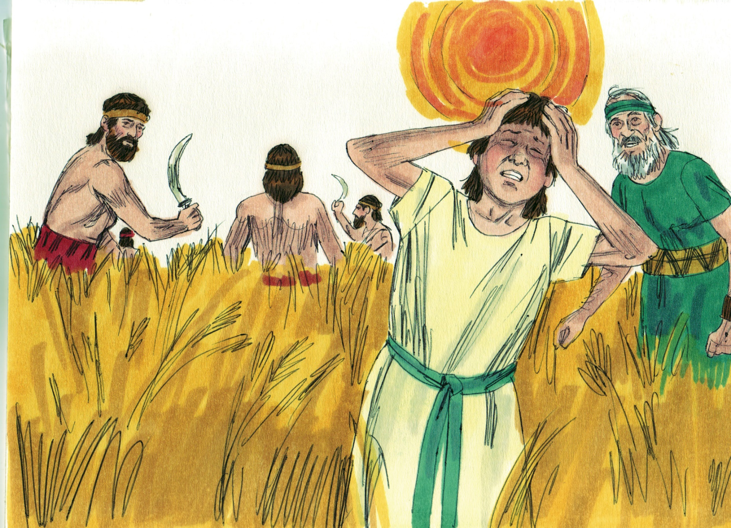

Slide 14
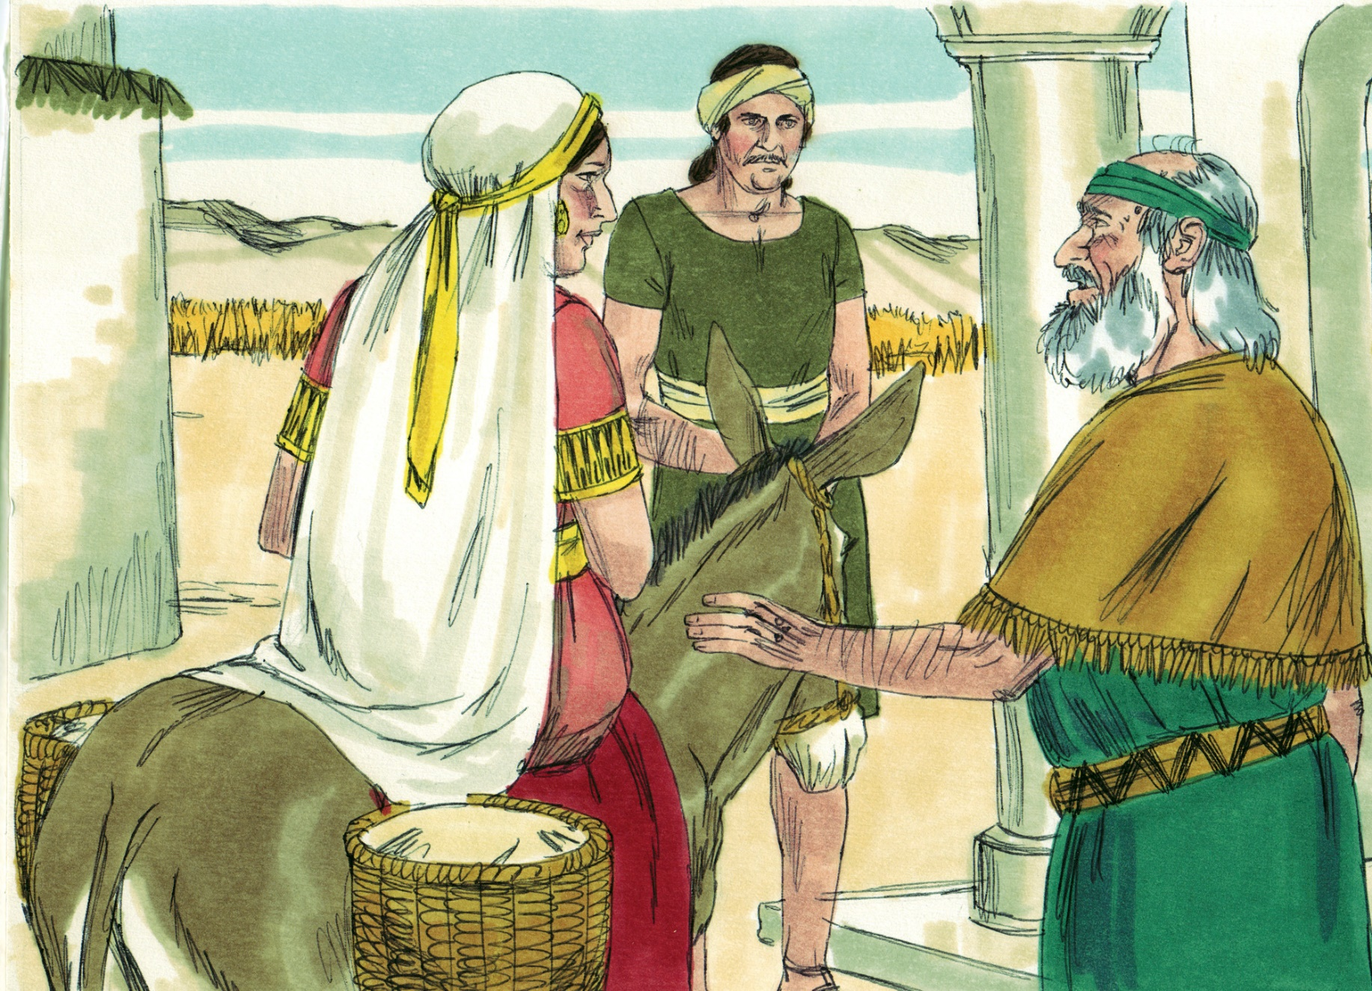

Slide 15
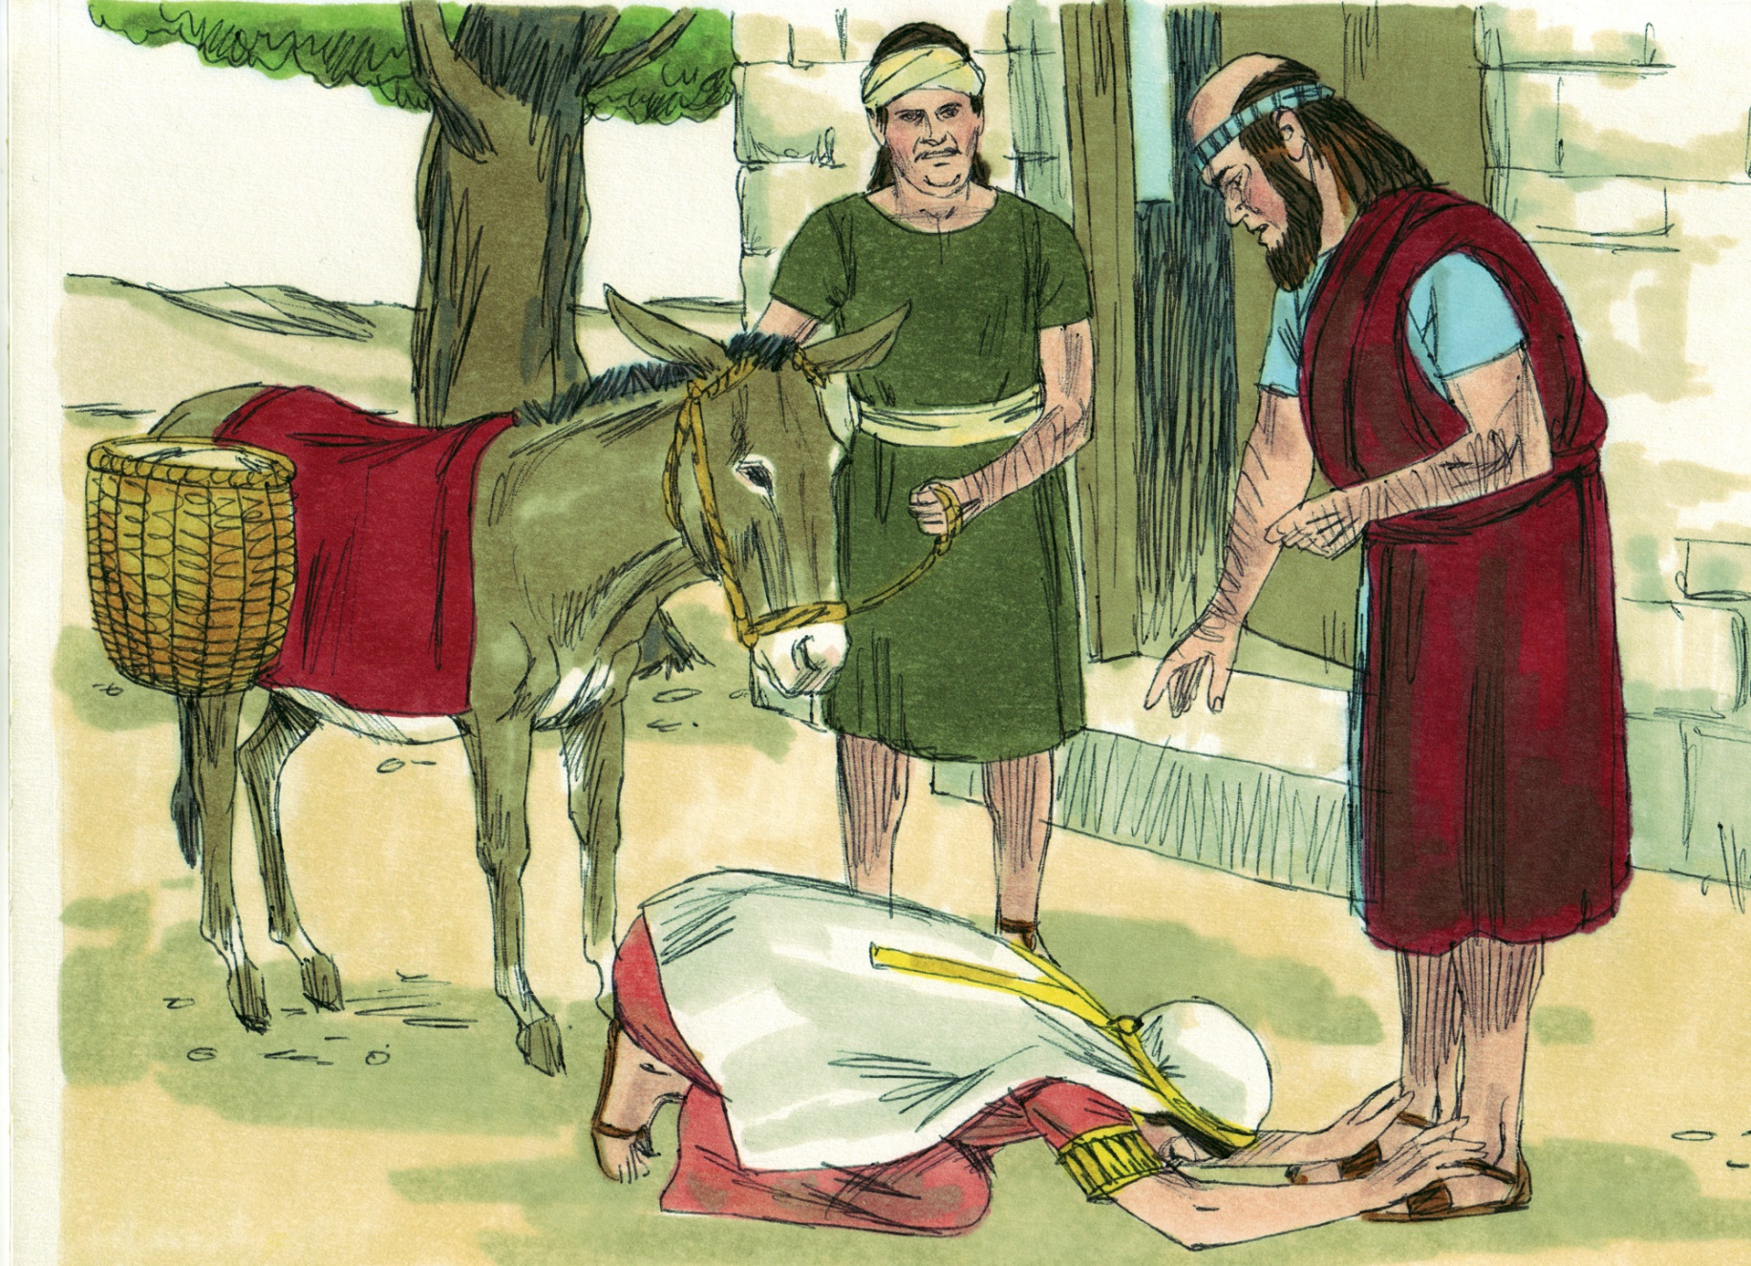

Slide 16
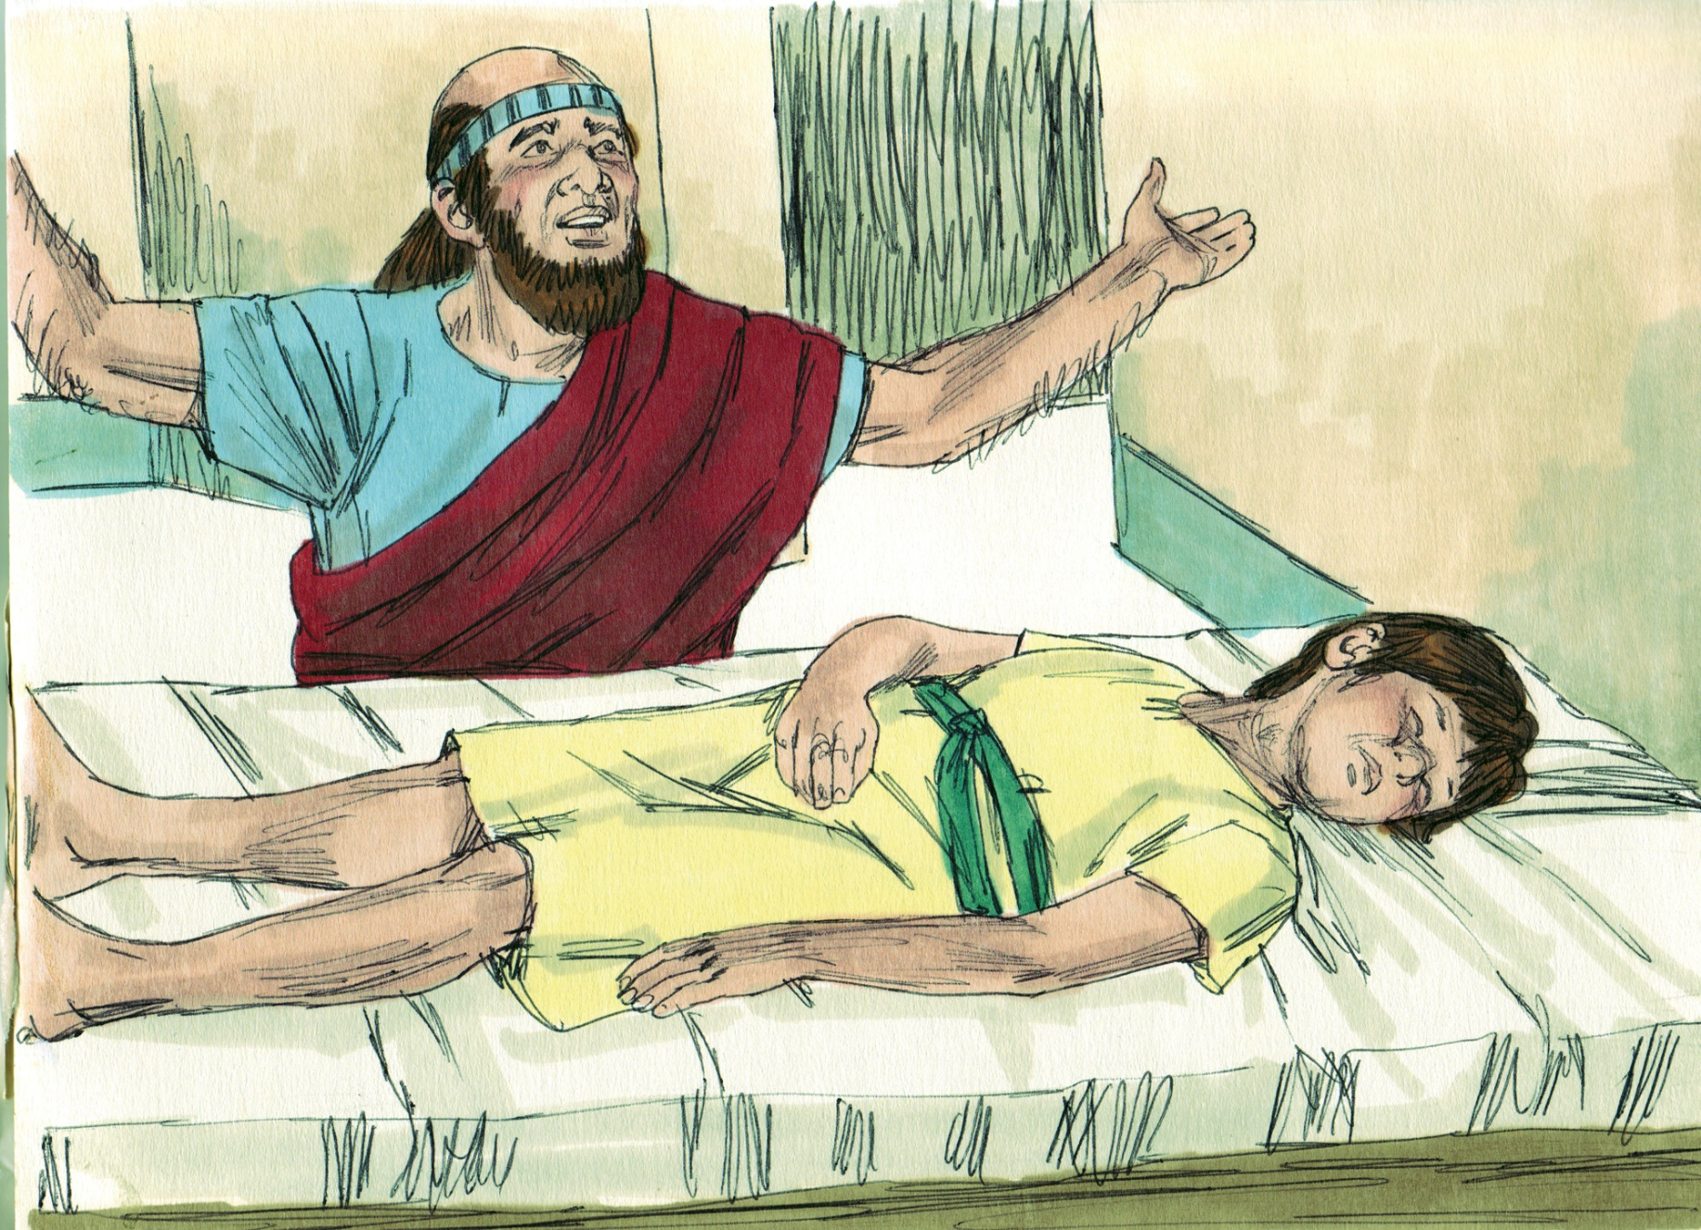

Slide 17
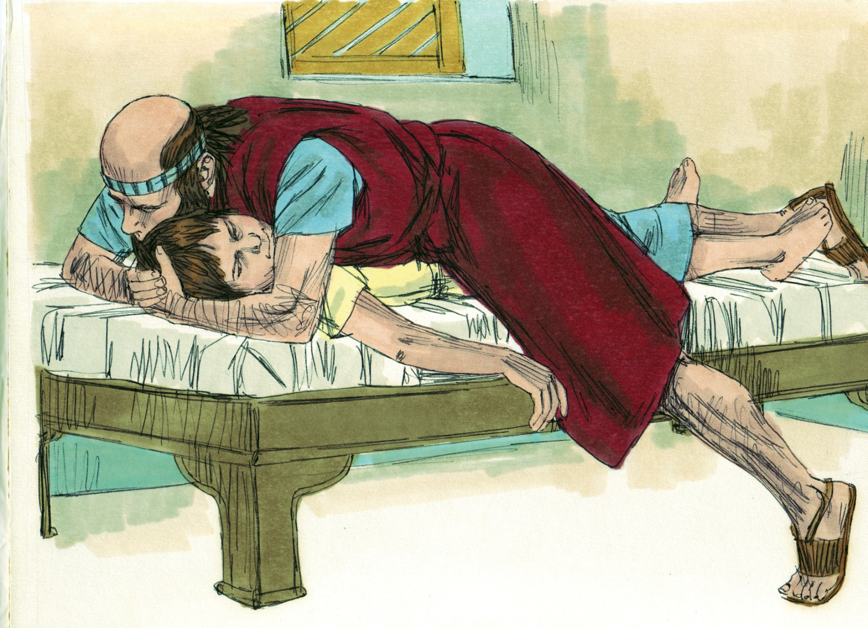

Slide 20
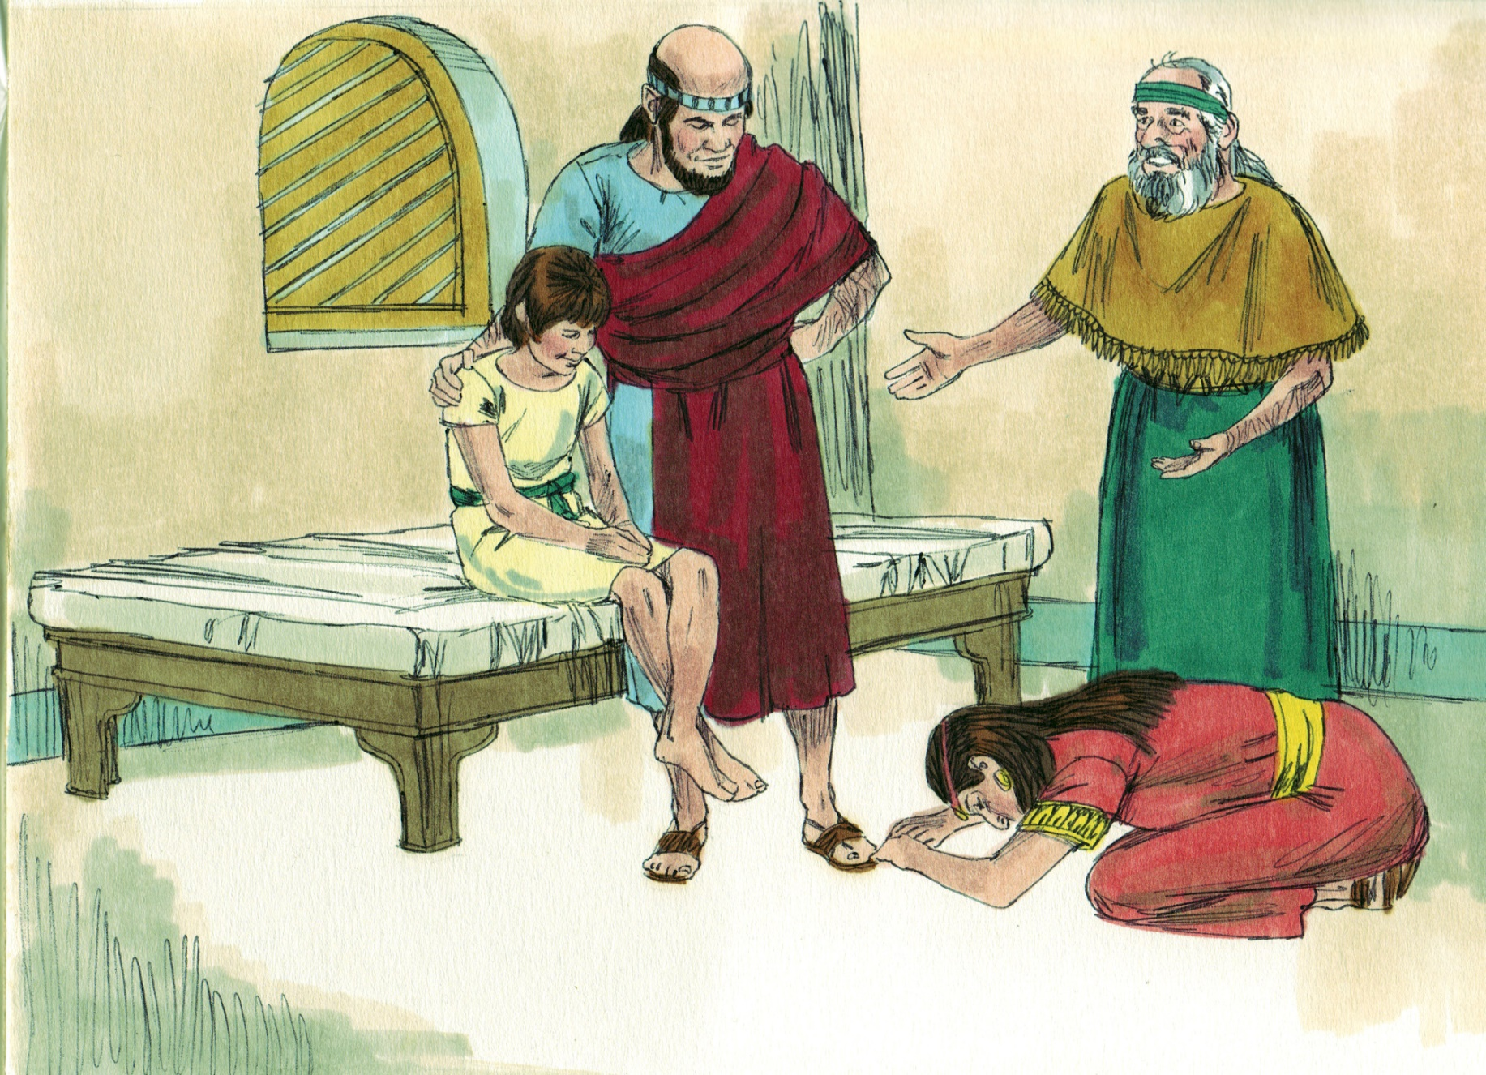

Slide 21
Great Heart
Great hearts notice people and their needs (Heb. 10:24)
Great hearts pay special attention to God’s people (Gal. 6:10)
Great hearts want to serve the Lord by serving His people (Matt. 25:40)
Great hearts love God’s truth and want to further God’s truth, even when others do not (Phil. 1:15-18)

Slide 22
Great Hospitality
All Christians are exhorted to practice hospitality (Rom. 12:13; Heb. 13:2)
Being hospitable is one of the qualifications for an elder (1 Tim. 3:2; Tit. 1:8)
We need to open our hearts & homes to each other without complaining (1 Pet. 4:9)

Slide 23
Great Humility
Great people do not desire to be treated like “great people” (Mark 10:43)
Humble servants minister to others because they want to serve the Lord, not because they want to “get something in return” (Luke 6:31-36)
Learning to be content with what the Lord has given is a key to true happiness in life (Phil. 4:11; Heb. 13:5)

Slide 24
Great Hope
It is possible to lose what is most precious to us without losing our faith (Job 1:20-22)
Great hope focuses on the resurrection and life rather than the death (Luke 9:60)
Great hope says, “It is well,” even when our heart is breaking (2 Sam. 11:19-24)
Great hope speedily goes directly to the source of true strength/help and refuses to depart (Psa. 28:1-9)
Great hope trusts fully in God (Heb. 11:35)

Slide 25
Believe Jesus is God’s Son – John 20:30-31
Repent of your sins and turn to God – Acts 2:38
Confess your faith in Jesus – Romans 10:9-10
Be immersed into Christ – Galatians 3:27
God will forgive all of your sins – Acts 22:16
God will add you to His church – Acts 2:47
God will register you in heaven – Hebrews 12:23
Serve the Lord faithfully – 1 Corinthians 15:58

