Slide 2
John the Baptist Was “The Voice” to Talk About Jesus
Christians Are “The Voice” to Talk About Jesus
WE ARE
John Was Responsible for Proclaiming Jesus to People (John 1:23a)
John Was Responsible for Preparing People to Meet Jesus (John 1:23b)
John Was Responsible for Pointing People to Jesus (John 1:26, 27, 29)
WE ARE
WE ARE

Slide 3
Christians Have “The Template” to Talk About Jesus (John 1:29)
Call Attention to Jesus (“Behold!”)
With our actions (Matt. 5:16; 1 Pet. 2:12)
With our choices (1 Pet. 4:1-4; Eph. 4:17-5:21)
With our lifestyles (Phil. 1:21; Gal. 2:20)
With our words (John 1:41-46; Acts 4:20; 5:42; 8:4)

Slide 4
Christians Have “The Template” to Talk About Jesus (John 1:29)
Call Attention to Jesus (“Behold!”)
Call Attention to Who Jesus Is (“The Lamb of God!”)
Jesus is the Creator (John 1:3; Col. 1:16)
Jesus is the Sustainer (Col. 1:17; Heb. 1:3)
Jesus is the Authority (Matt. 28:18; Col. 1:18)
Jesus is the Judge (Acts 17:30-31; John 12:48)
Jesus is the Savior (Tit. 2:13; 1 John 4:14)
Jesus is the Friend (John 15:13-15; 3:29; 11:11)
Jesus is the Comforter (Isa. 9:6; 1 Pet. 5:7)
Jesus is the Advocate (1 John 2:1-2; Heb. 2:17-18)
JESUS IS MY EVERYTHING (Col. 1:17-18; Eph. 1:23)
MY
MY
MY
MY
MY
MY
MY
MY

Slide 5
Christians Have “The Template” to Talk About Jesus (John 1:29)
Call Attention to Jesus (“Behold!”)
Call Attention to Who Jesus Is (“The Lamb of God!”)
Call Attention to What Jesus Has Done (“Takes Away the Sin!”)
Jesus left heaven for mankind (John 1:14; 17:5; Phil. 2:6-7)
Jesus demonstrated His love for mankind (Eph. 5:2; 1 John 3:16)
Jesus suffered and died for mankind (Gal. 2:20; Tit. 2:14)
Jesus bore the burden of sin for mankind (1 Pet. 2:24; Heb. 9:28)
Jesus was separated from God for mankind (Matt. 27:46; Hab. 1:13)
Jesus was raised from the dead for mankind (1 Cor. 15:1-20; 1 Pet. 1:3)
Jesus wants to bear the burdens of life for mankind (Matt. 11:28-30)
Jesus has prepared an eternal home for mankind (John 14:1-3)
JESUS HAS CHANGED MY LIFE (2 Cor. 3:18; Col. 3:1-4)
ME
ME
ME
ME
ME
ME
ME
ME

Slide 6
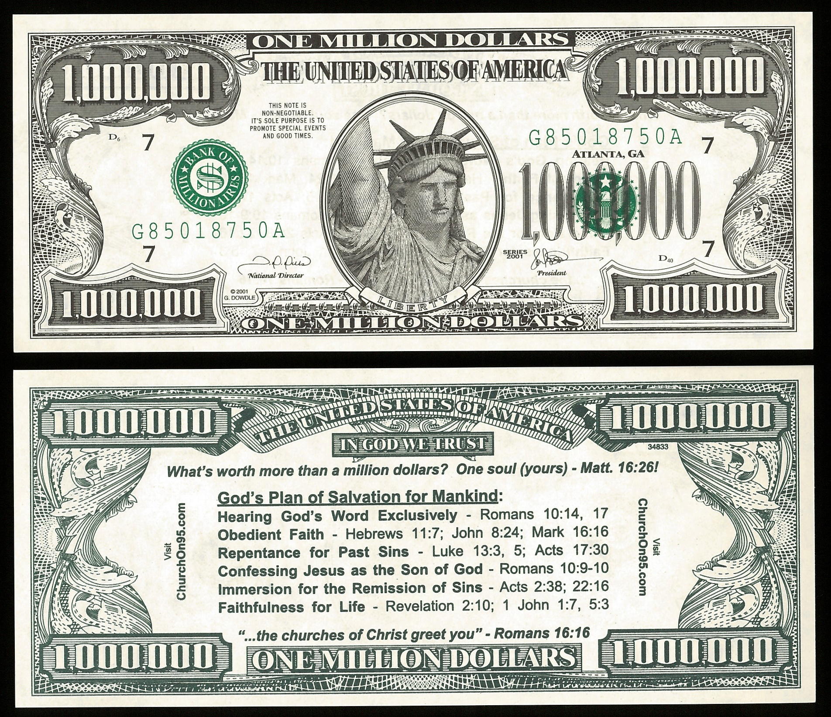
Christians Have “The Responsibility” & “The Tools” to Talk About Jesus
We’ve Gotta Start Somewhere
Tract, million dollar bill, post a verse or Biblical thought
We’ve Gotta Move It Forward
Invitation to a church service, “Come & See”
We’ve Gotta Get Specific
Give a New Testament, give/send sermon or article or tract
We’ve Gotta Draw It to a Point
“Would you like to study the Bible?”

Slide 7
Believe Jesus is God’s Son – Acts 16:31
Repent of your sins and turn to God – Acts 3:19
Confess your faith in Jesus – Acts 8:36-38
Be immersed into Christ – Galatians 3:27
God will wash away all of your sins – Acts 22:16
God will add you to His church – Acts 2:47
God will enroll you in heaven – Hebrews 12:23
Live faithfully for Jesus – Philippians 1:21

