Slide 2
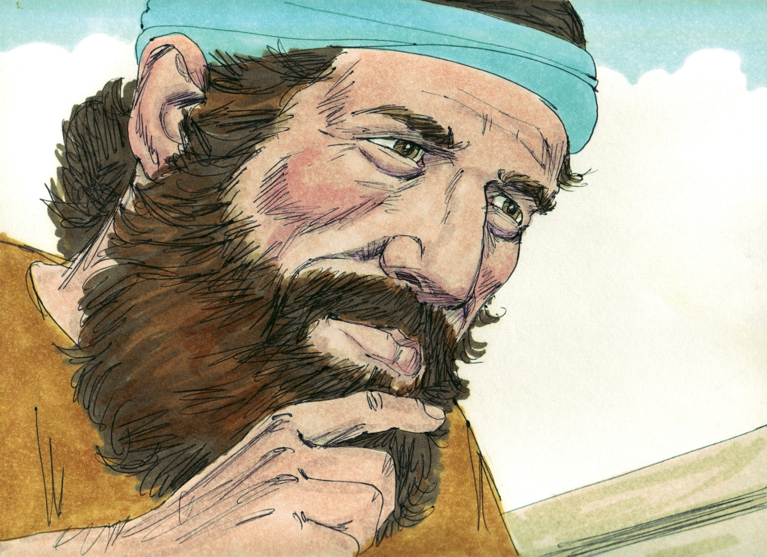

Slide 3
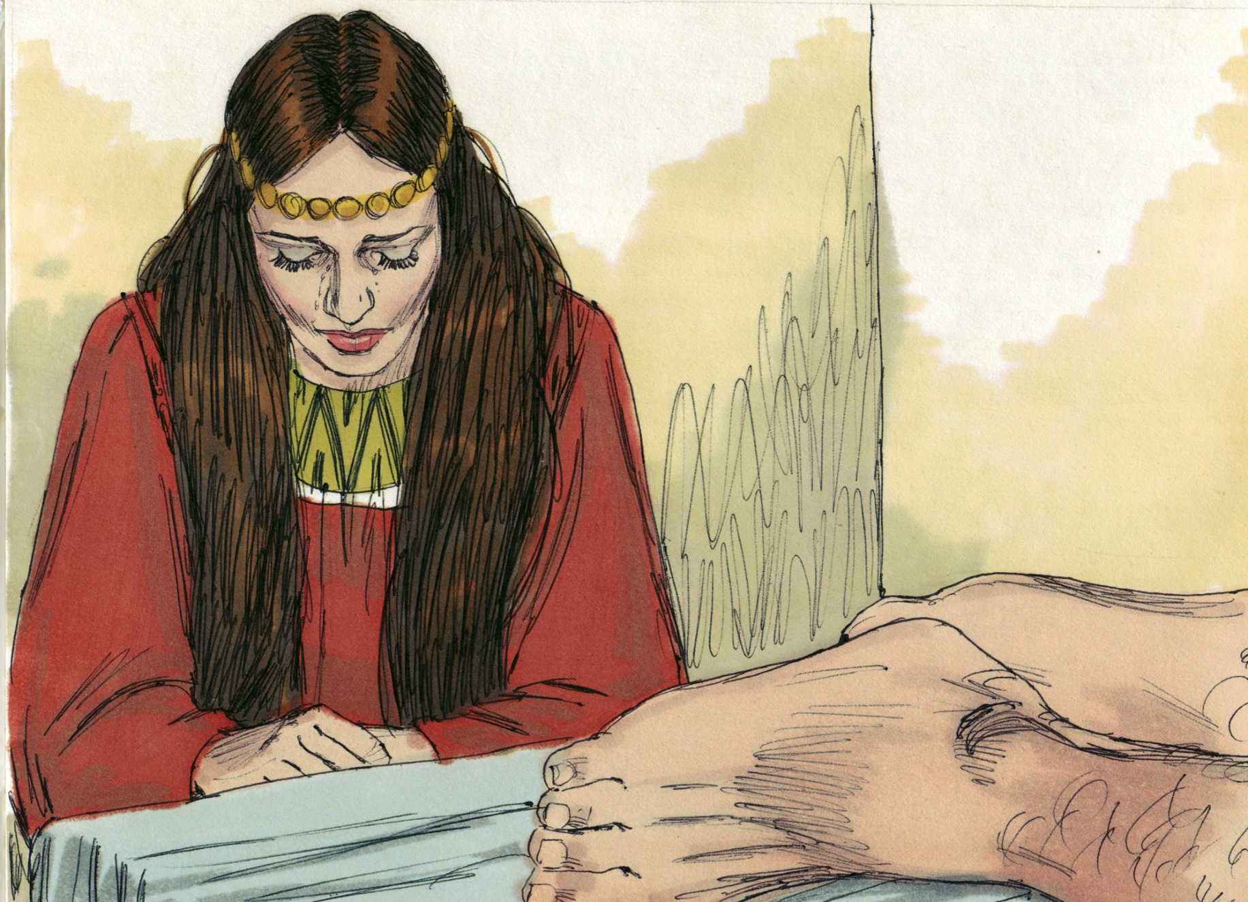

Slide 4
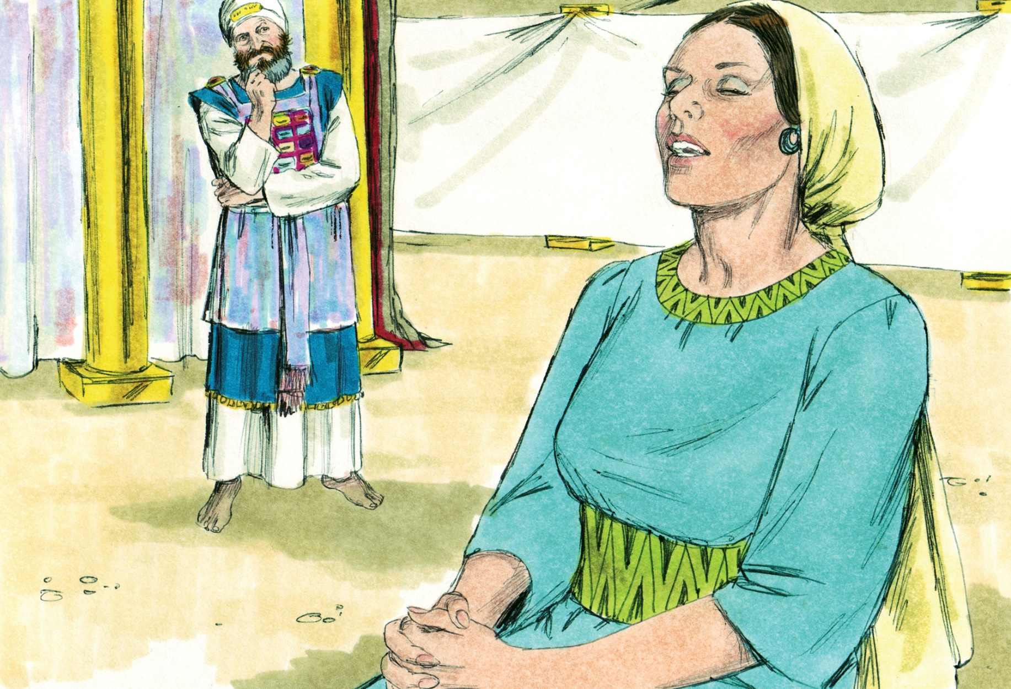

Slide 5
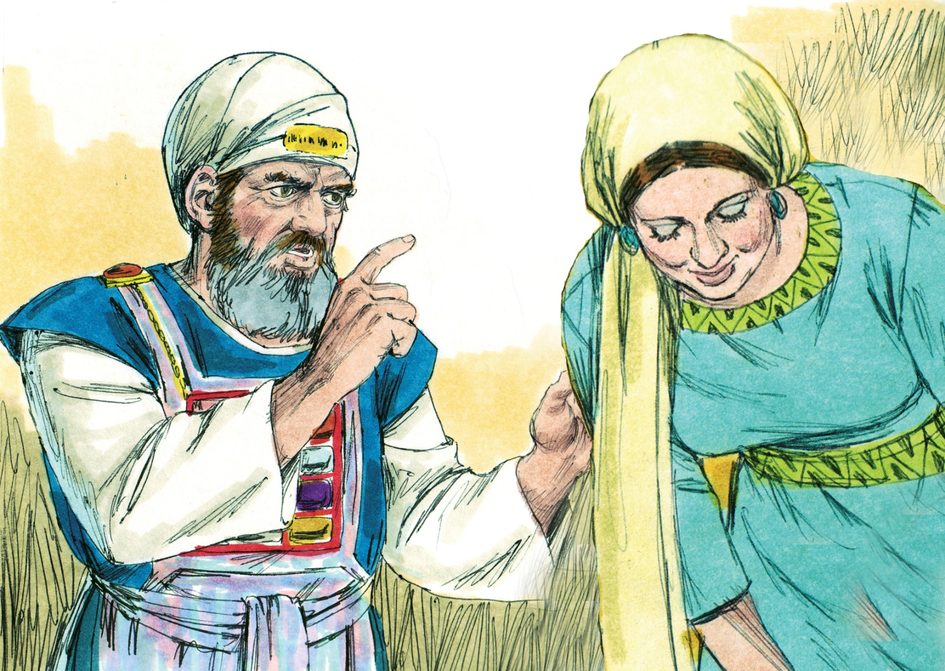

Slide 6
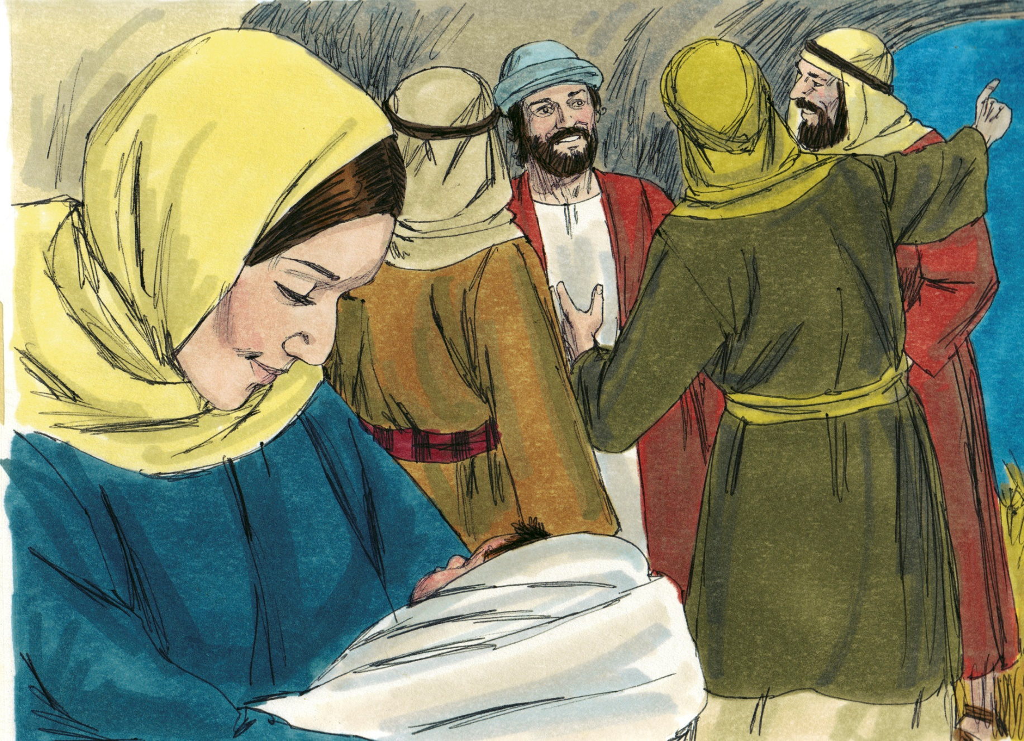
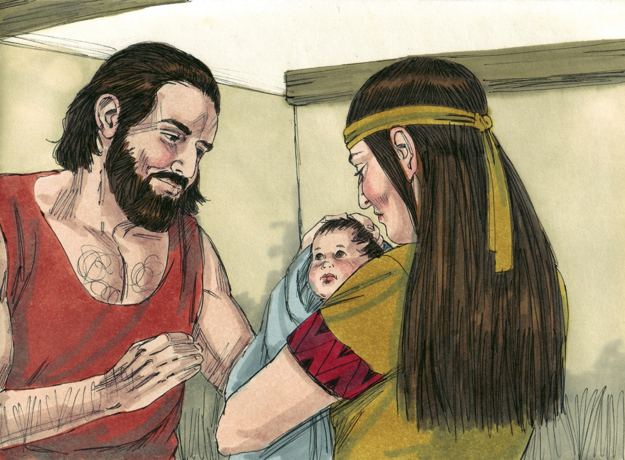

Slide 7
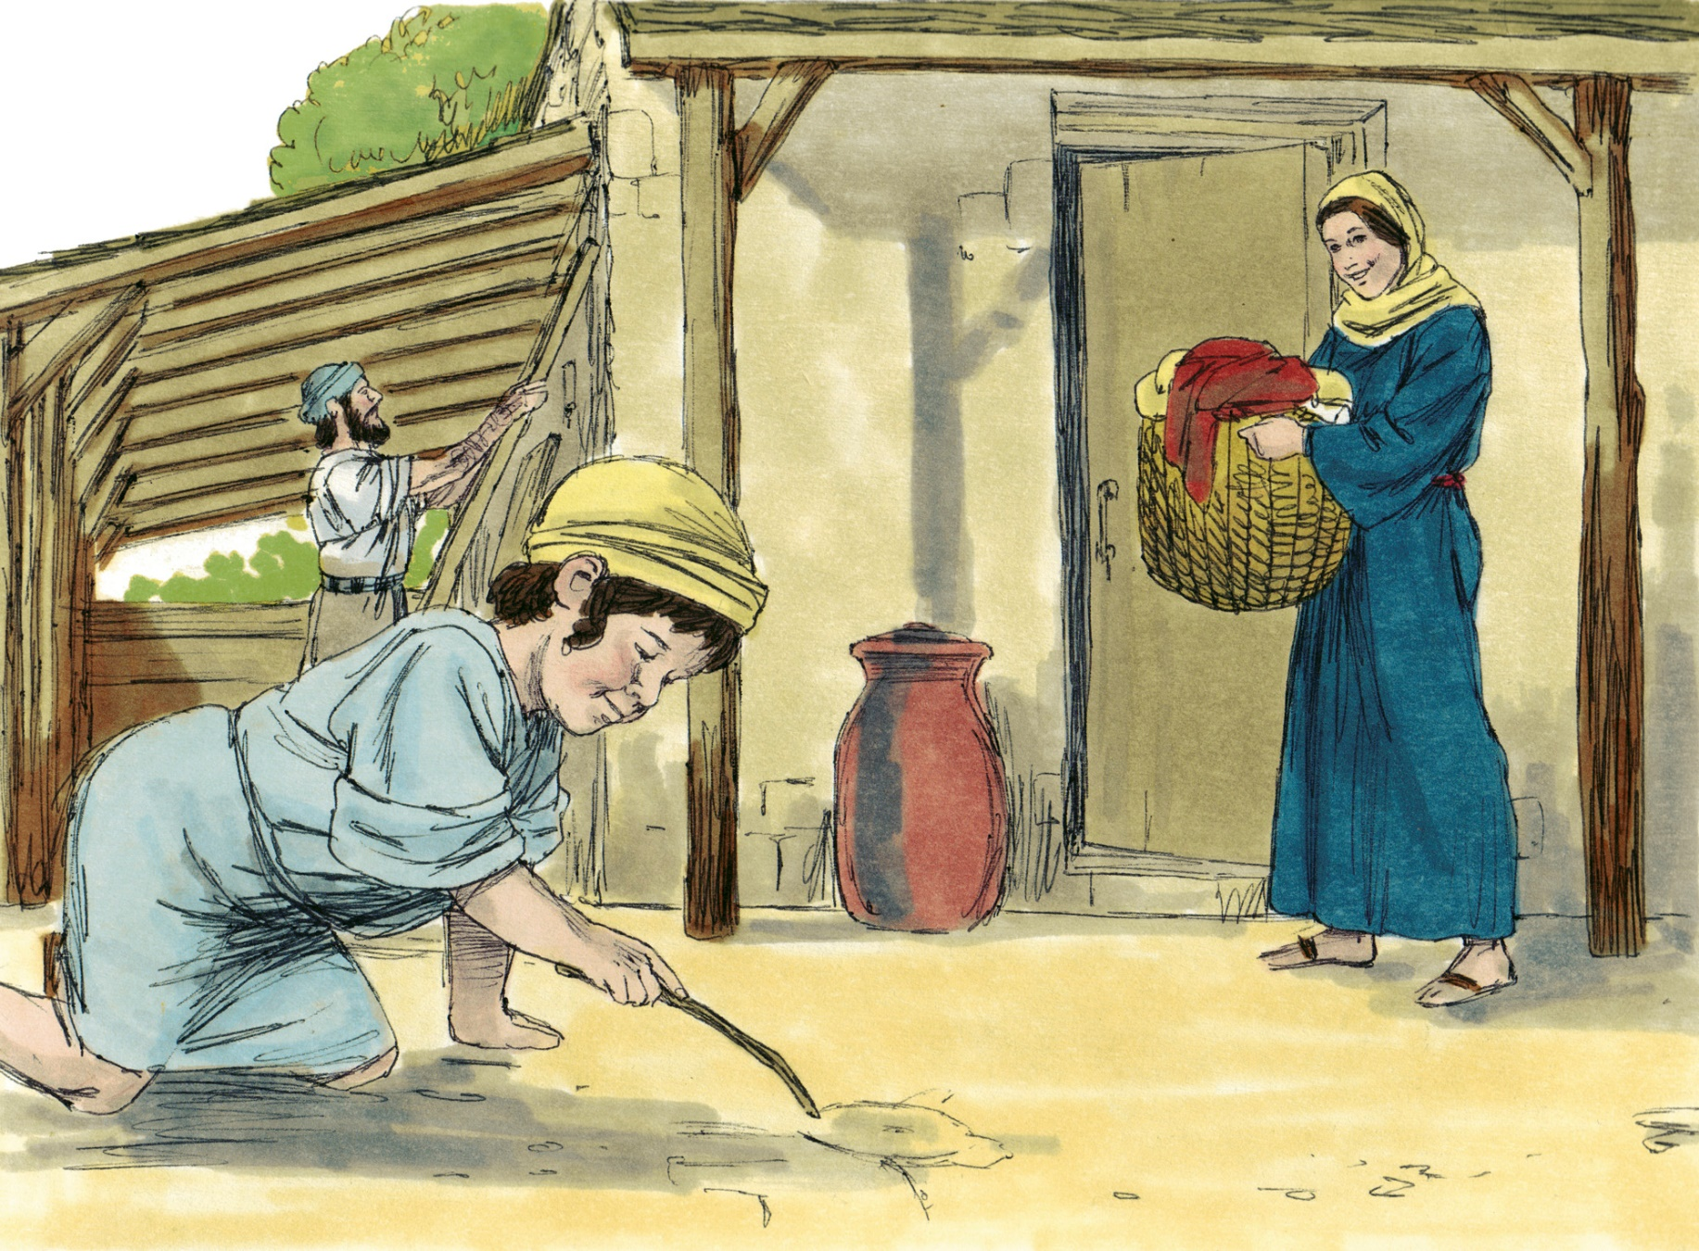

Slide 8
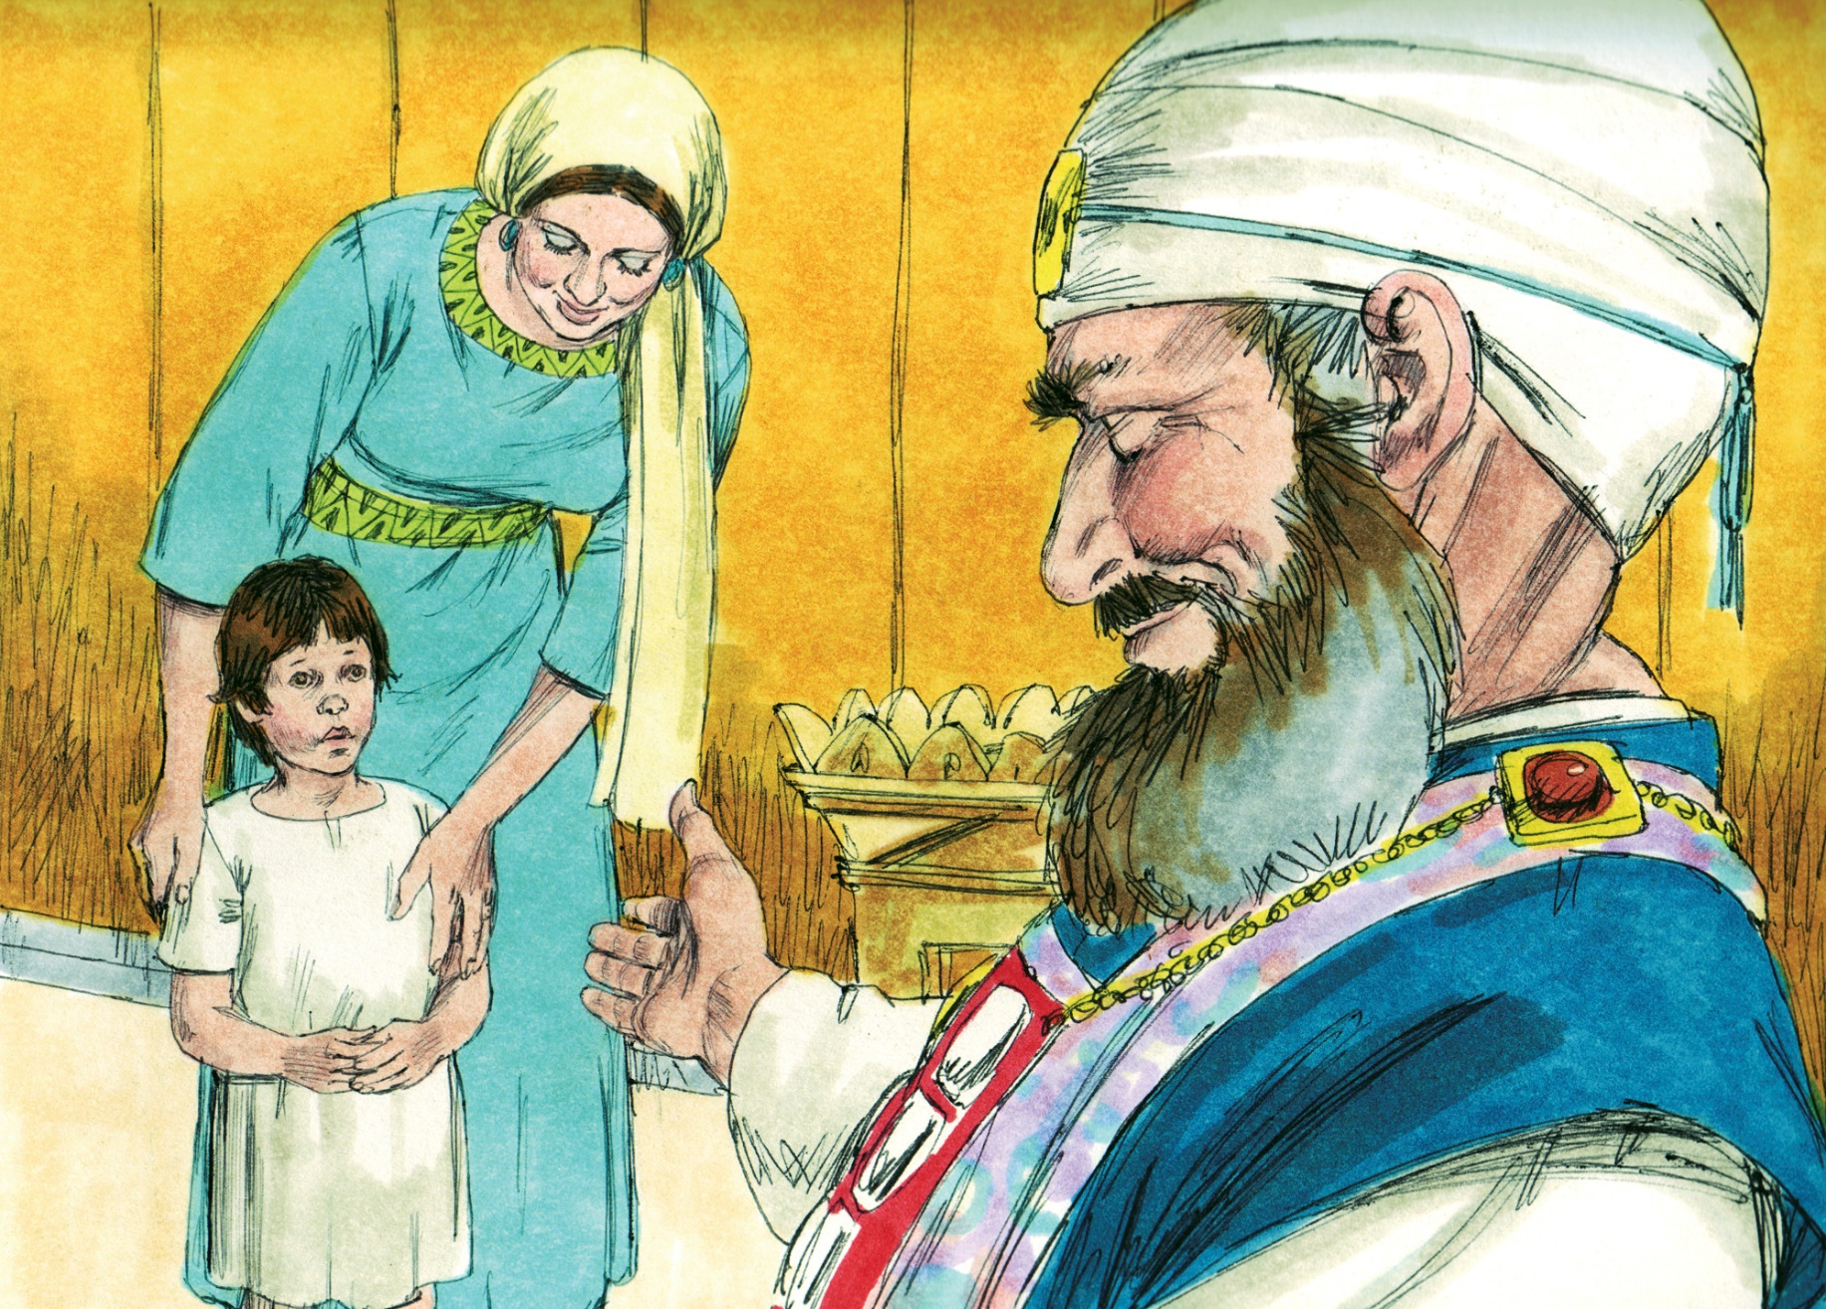

Slide 9
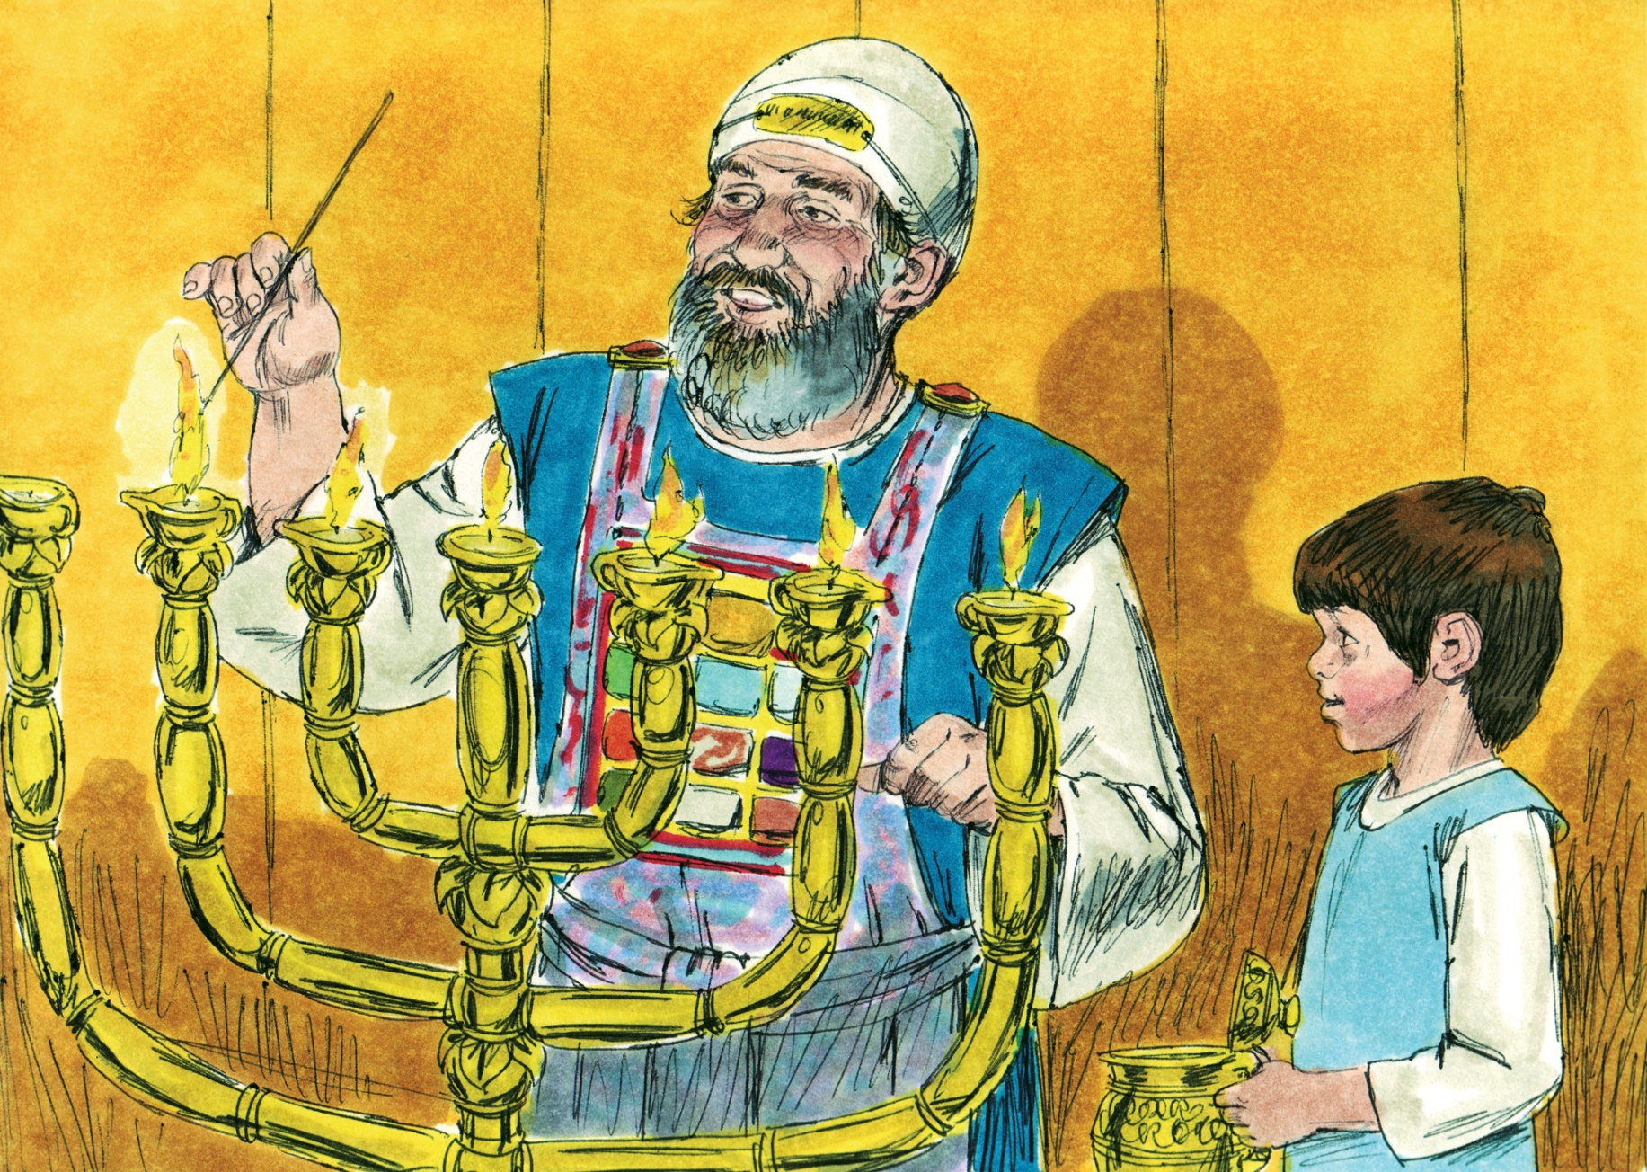

Slide 10
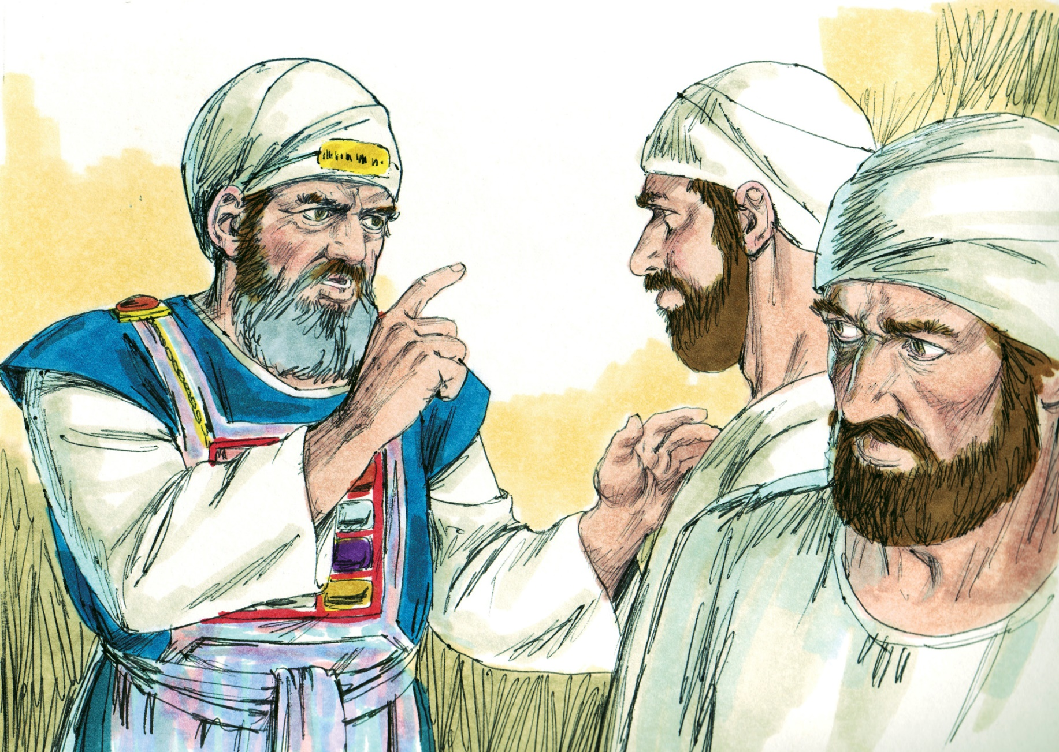

Slide 11
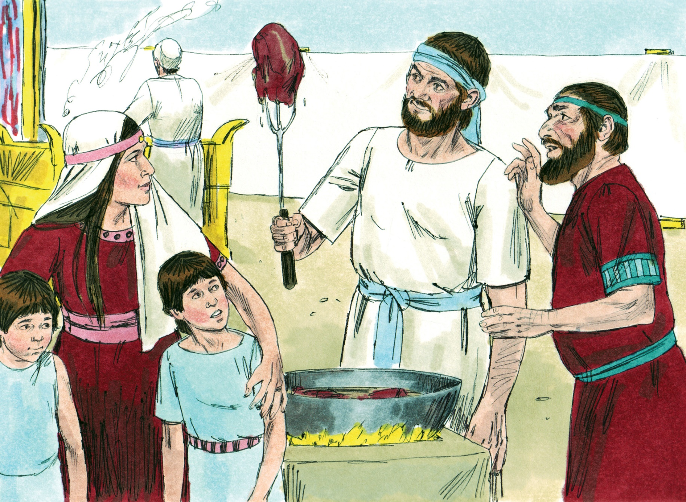

Slide 12
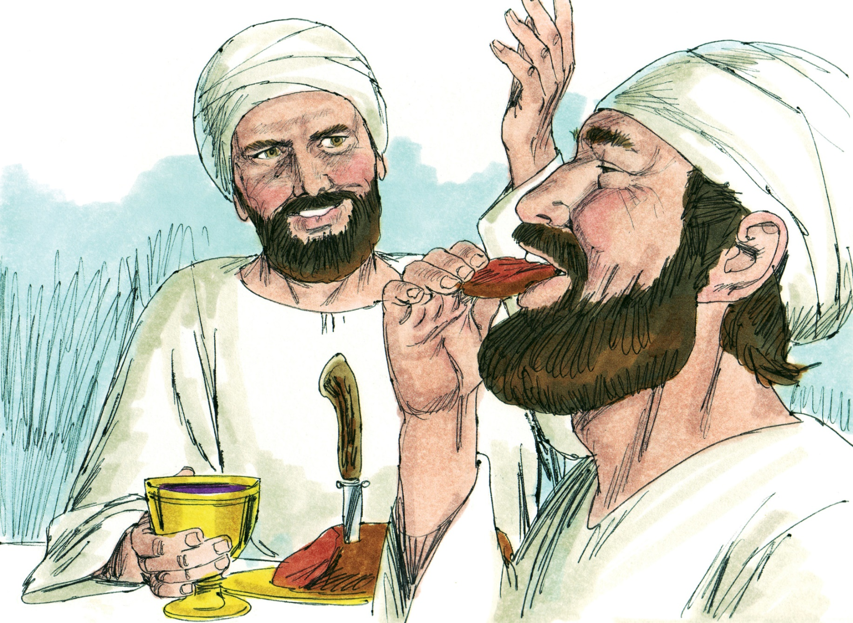

Slide 14
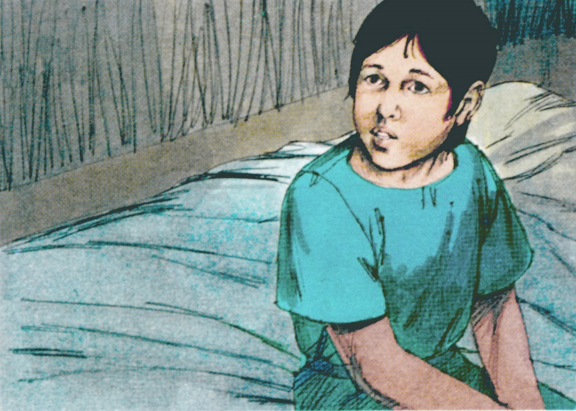

Slide 15
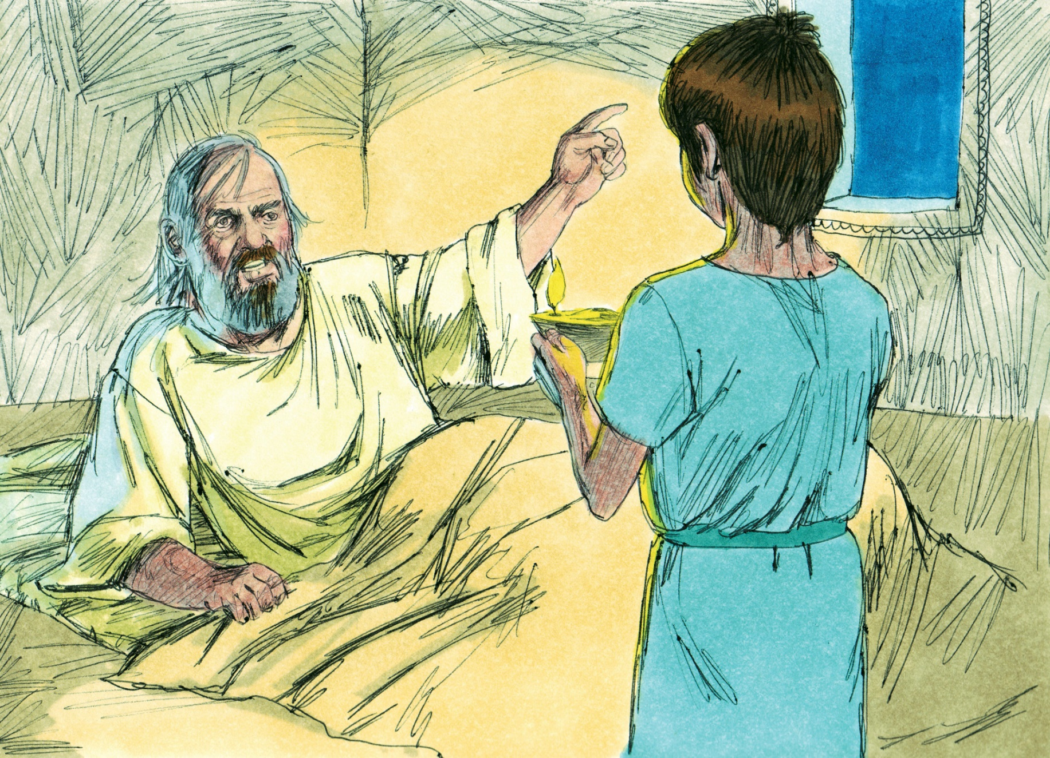

Slide 19
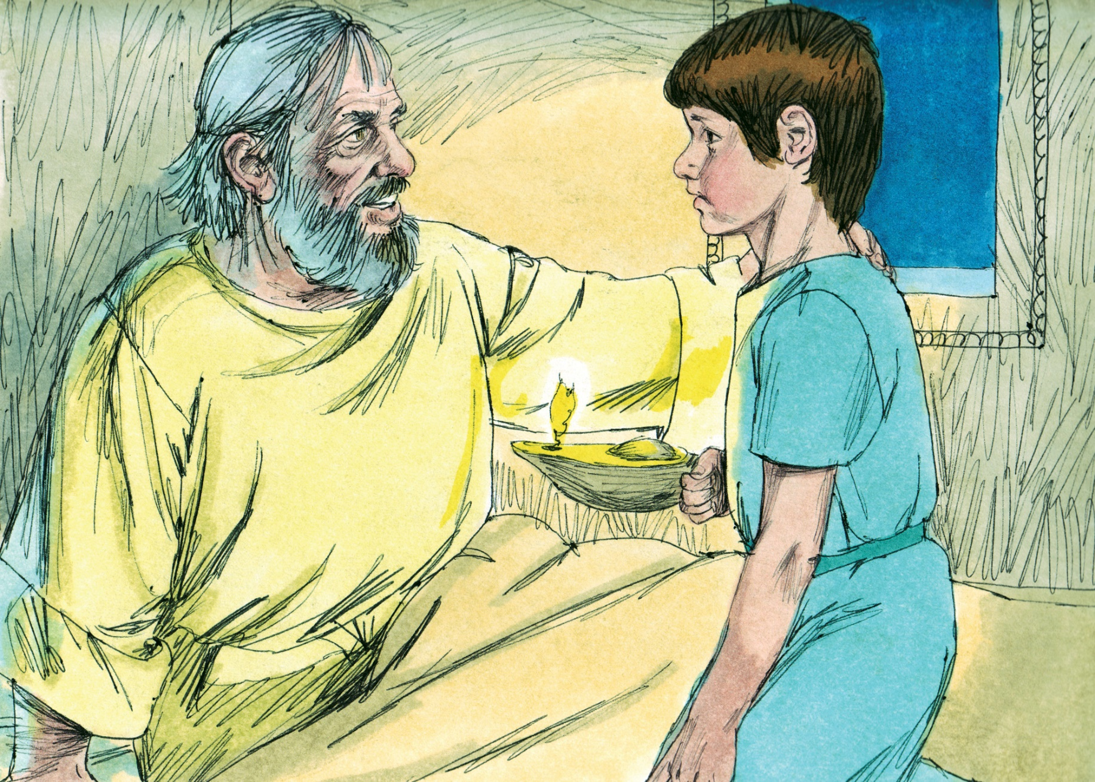

Slide 21
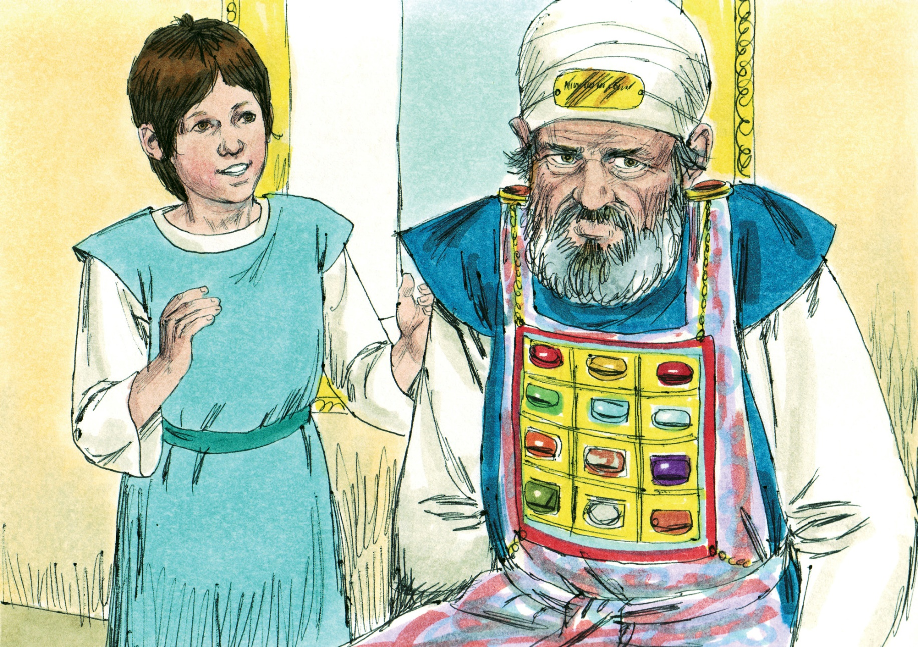

Slide 22
A Learned
Behavior
Learned from a Father’s Commitment
  A godly father worships and sacrifices to the Lord regularly (1:3, 21, 28; 2:19)
  A godly father makes worshiping and serving a priority (1:19)
  A godly father leads his entire house in serving the Lord (1:21)
  A godly father commits his children to the Lord’s service (1:24-25)
  A child will learn how to serve the Lord from his/her father!

Slide 23
A Learned
Behavior
Learned from a Mother’s Lifestyle
  A godly mother acknowledges God as Almighty in her life (1:11)
  A godly mother recognizes her children are from the Lord (1:20)
  A godly mother brings her children to the Lord’s house (1:24)
  A godly mother trains her children to serve the Lord (1:11,22,28)
  A godly mother rejoices in the service of the Lord (2:1)
  A godly mother views herself as belonging to God, “Your maidservant” (1:11)
  A child will learn how to serve the Lord from his/her mother!

Slide 24
A Learned
Behavior
Learned from a Mentor’s Trust
  A godly mentor is eager for the word of the Lord (3:17)
  A godly mentor trusts in the hand and work of the Lord (3:18)
  A godly mentor teaches by words and by actions
  A child will learn how to serve the Lord from a godly mentor!

Slide 25
A Learned
Behavior
A Child Applies What He/She Learns and Lives It Out
  The first thing said about Samuel when his parents left (2:11)
  The note of contrast about Samuel when others were not serving (2:18)
  The explanation of the Lord for breaking His silence in those days (3:1)
  Samuel ministered to the Lord and served the Lord as he learned from the words and actions of others

Slide 26
A Personal
Commitment
Commitment Requires Decision
  May learn to serve from parent or mentor, but it is still a personal decision
  May be instructed to serve the Lord (3:9), but it is still a personal decision
Commitment Requires Dedication
  Dedication begins with a servant’s heart — “Here I am” (3:4, 5, 6, 8, 16)
  Dedication involves a submissive heart, eager to hear and heed (3:10)
Commitment Requires Development
  “Even as a child” (2:18), Samuel “grew before the Lord…in favor with the Lord…and [with] the Lord” (2:21, 26; 3:19)
  All Christians (regardless of age) need to grow in their service to the Lord (1 Thess. 4:1, 10; Heb. 6:1)

Slide 27
Believe Jesus is God’s Son – John 20:30-31
Repent of your sins and turn to God – Acts 2:38
Confess your faith in Jesus – Romans 10:9-10
Be immersed into Christ – Galatians 3:27
  God will forgive all of your sins – Acts 22:16
  God will add you to His church – Acts 2:47
  God will register you in heaven – Hebrews 12:23
Serve the Lord faithfully – 1 Corinthians 15:58

