Slide 2
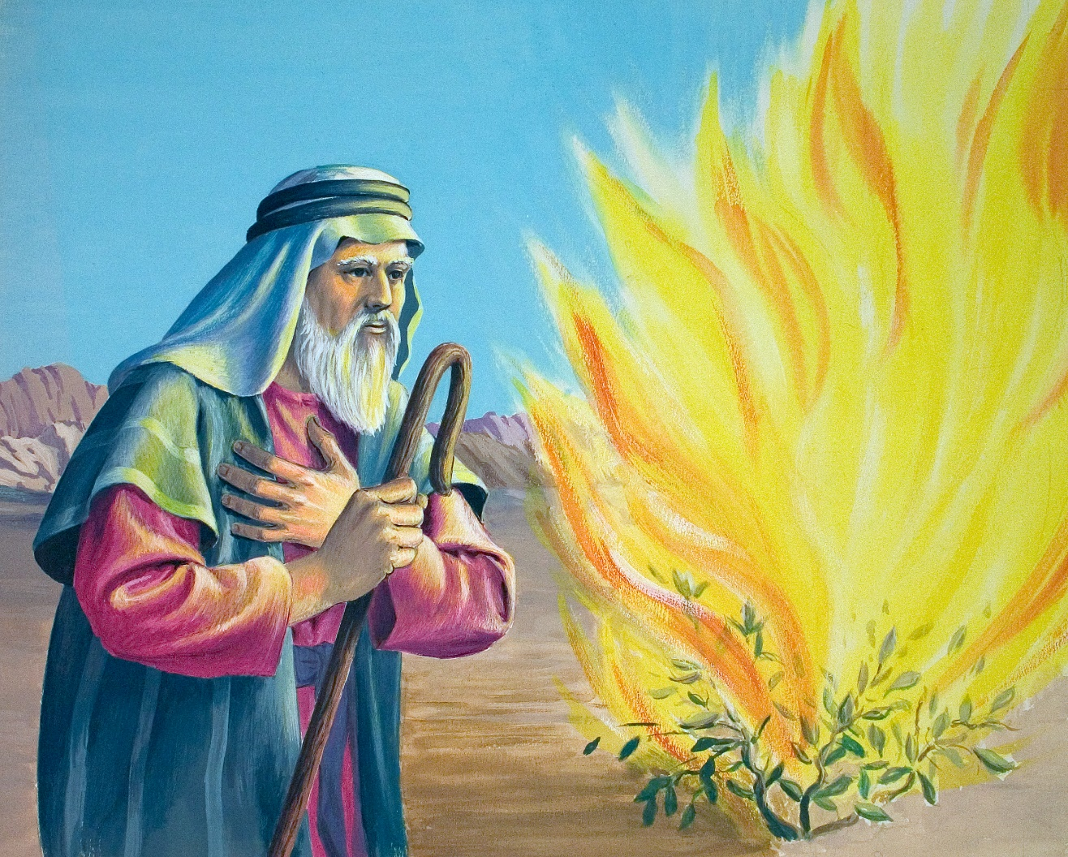

Slide 3
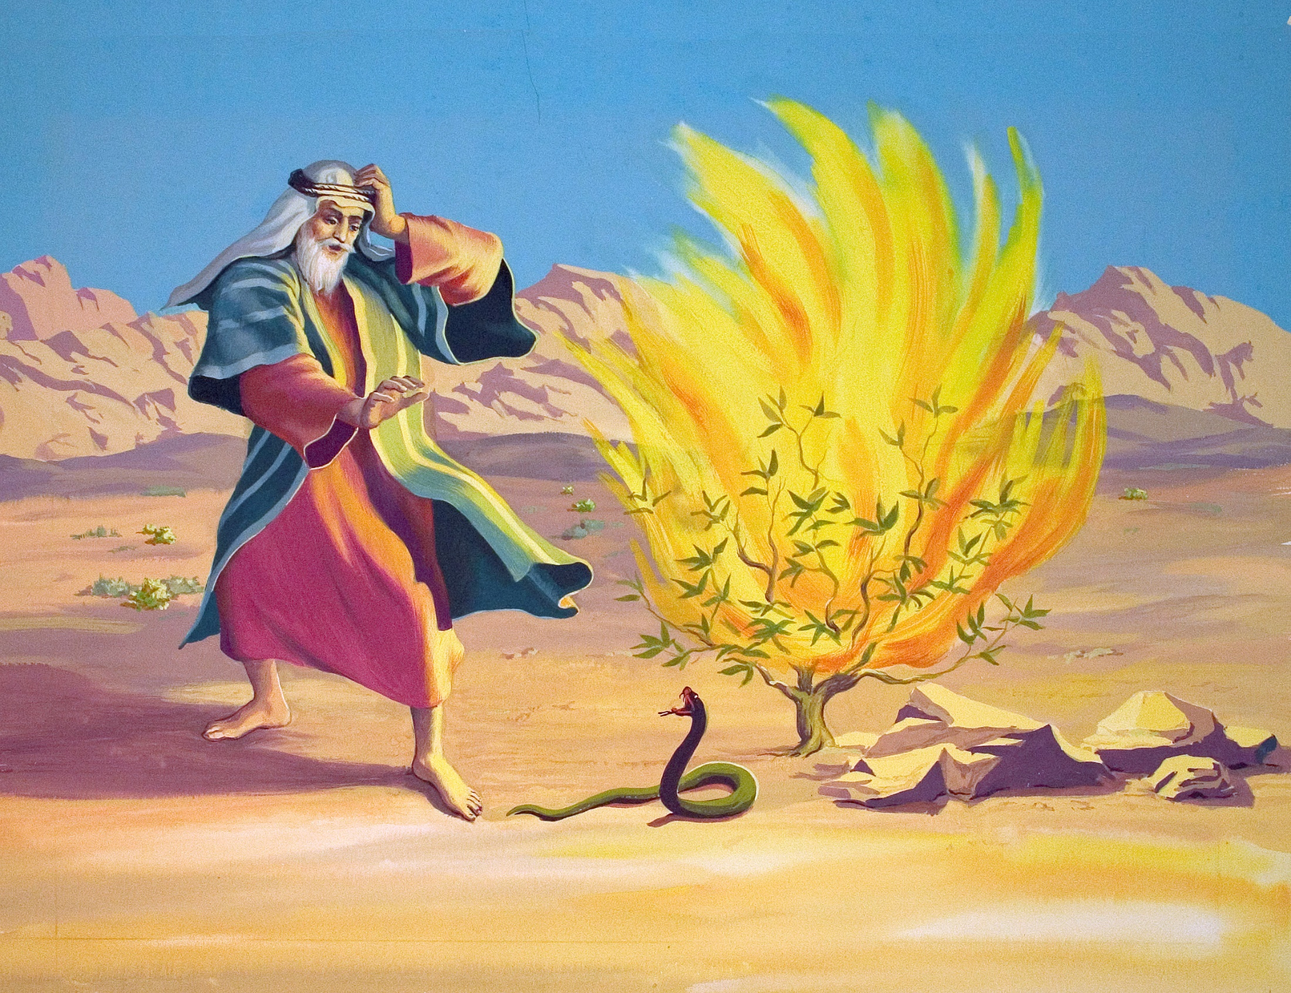

Slide 4
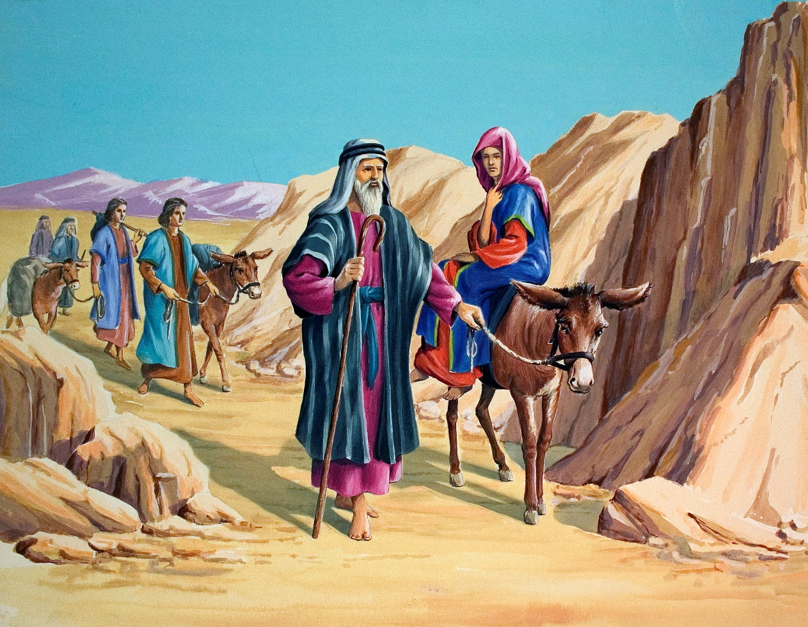

Slide 5
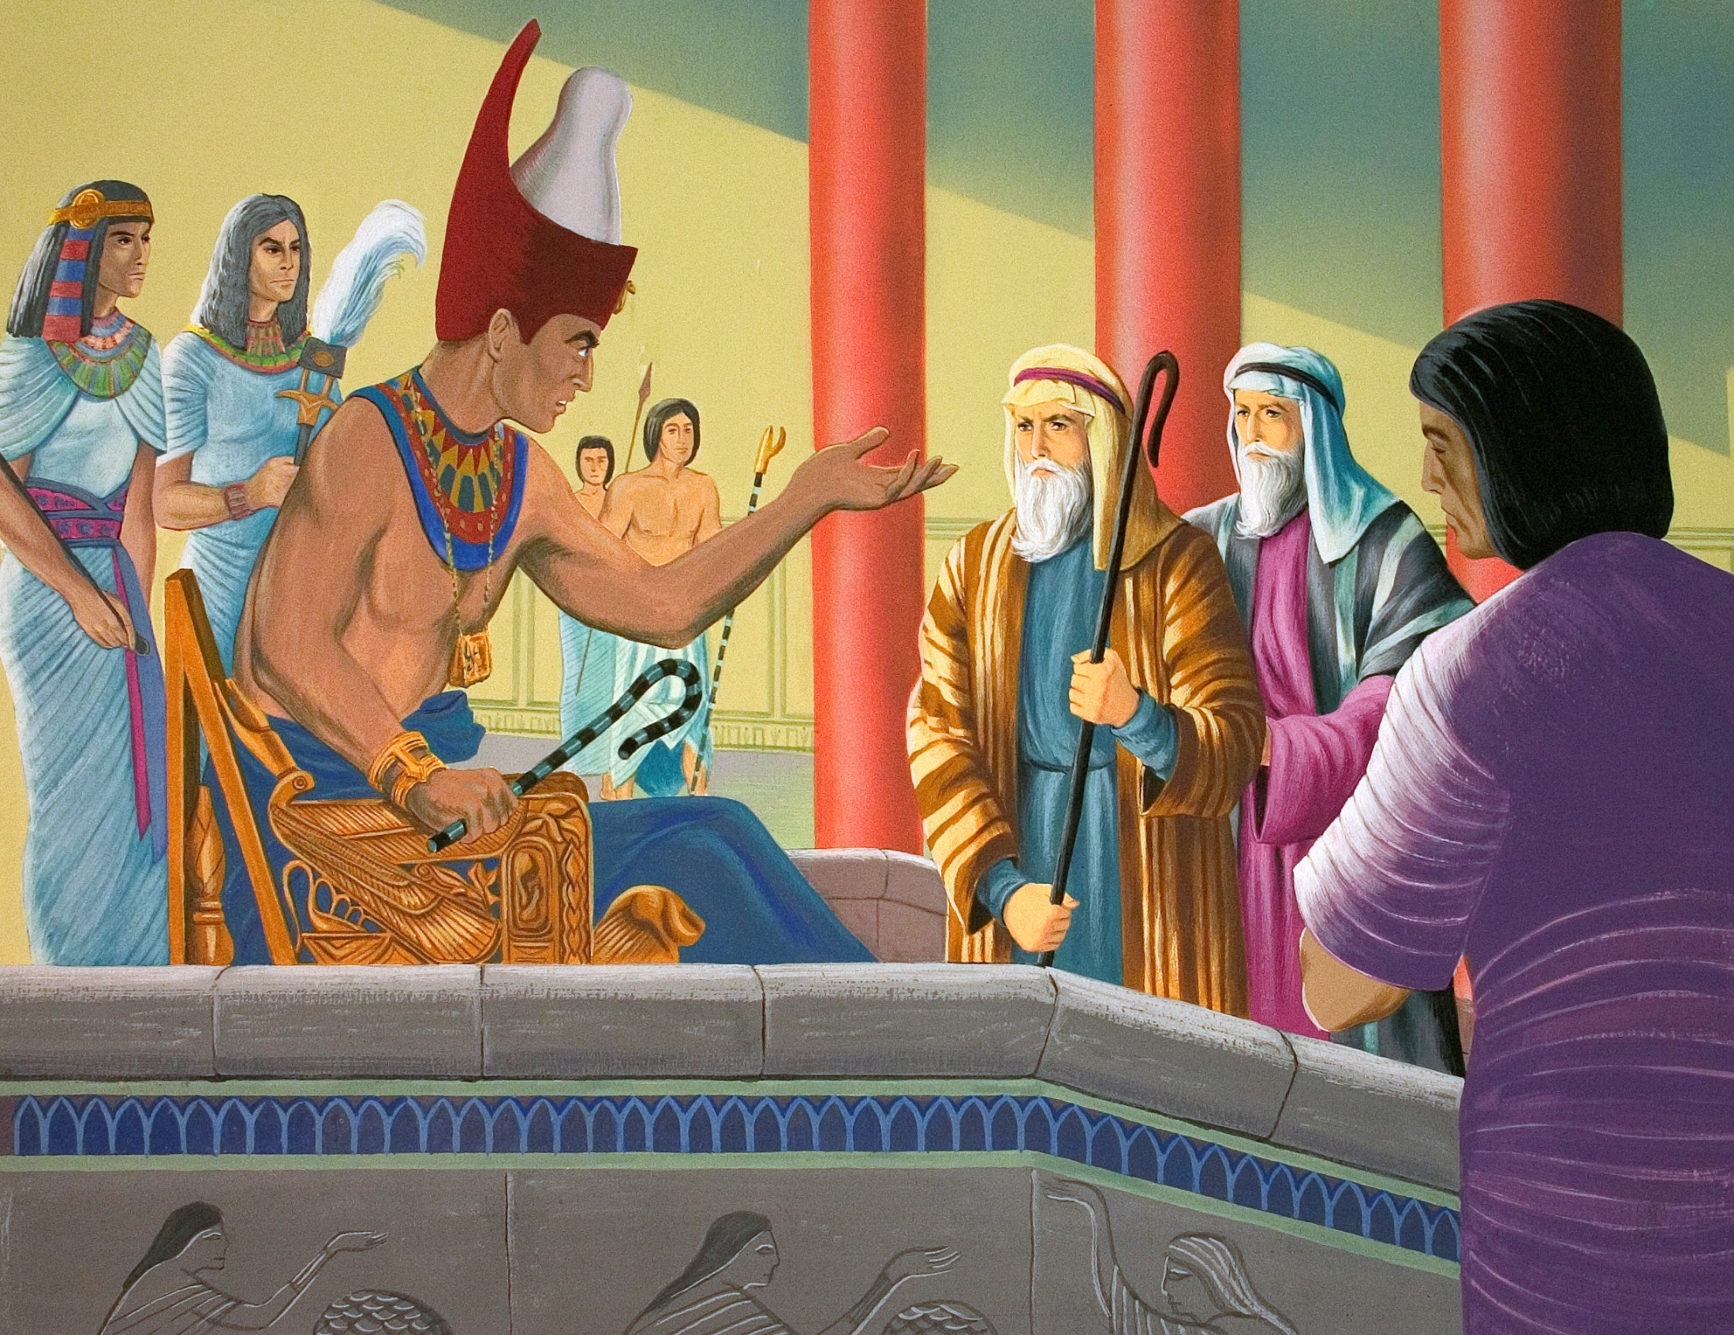

Slide 6
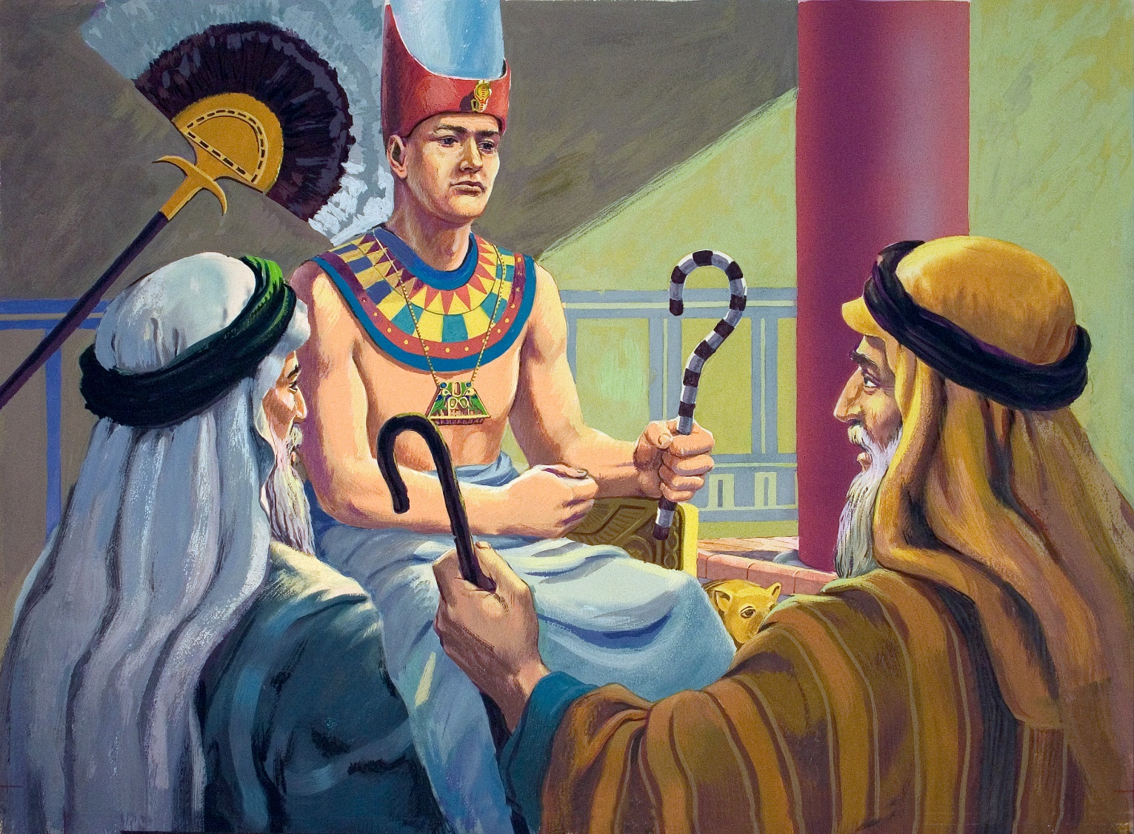

Slide 7
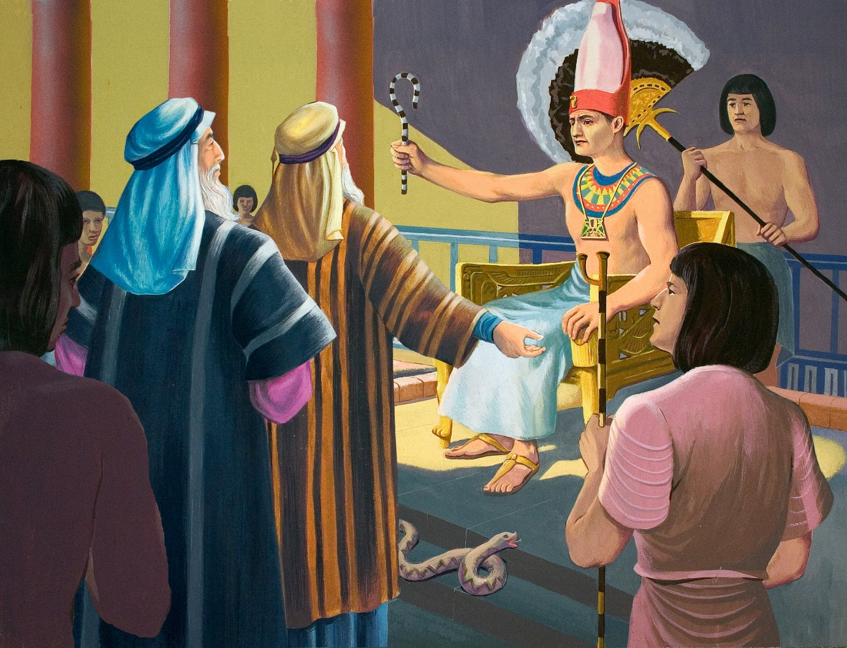

Slide 8
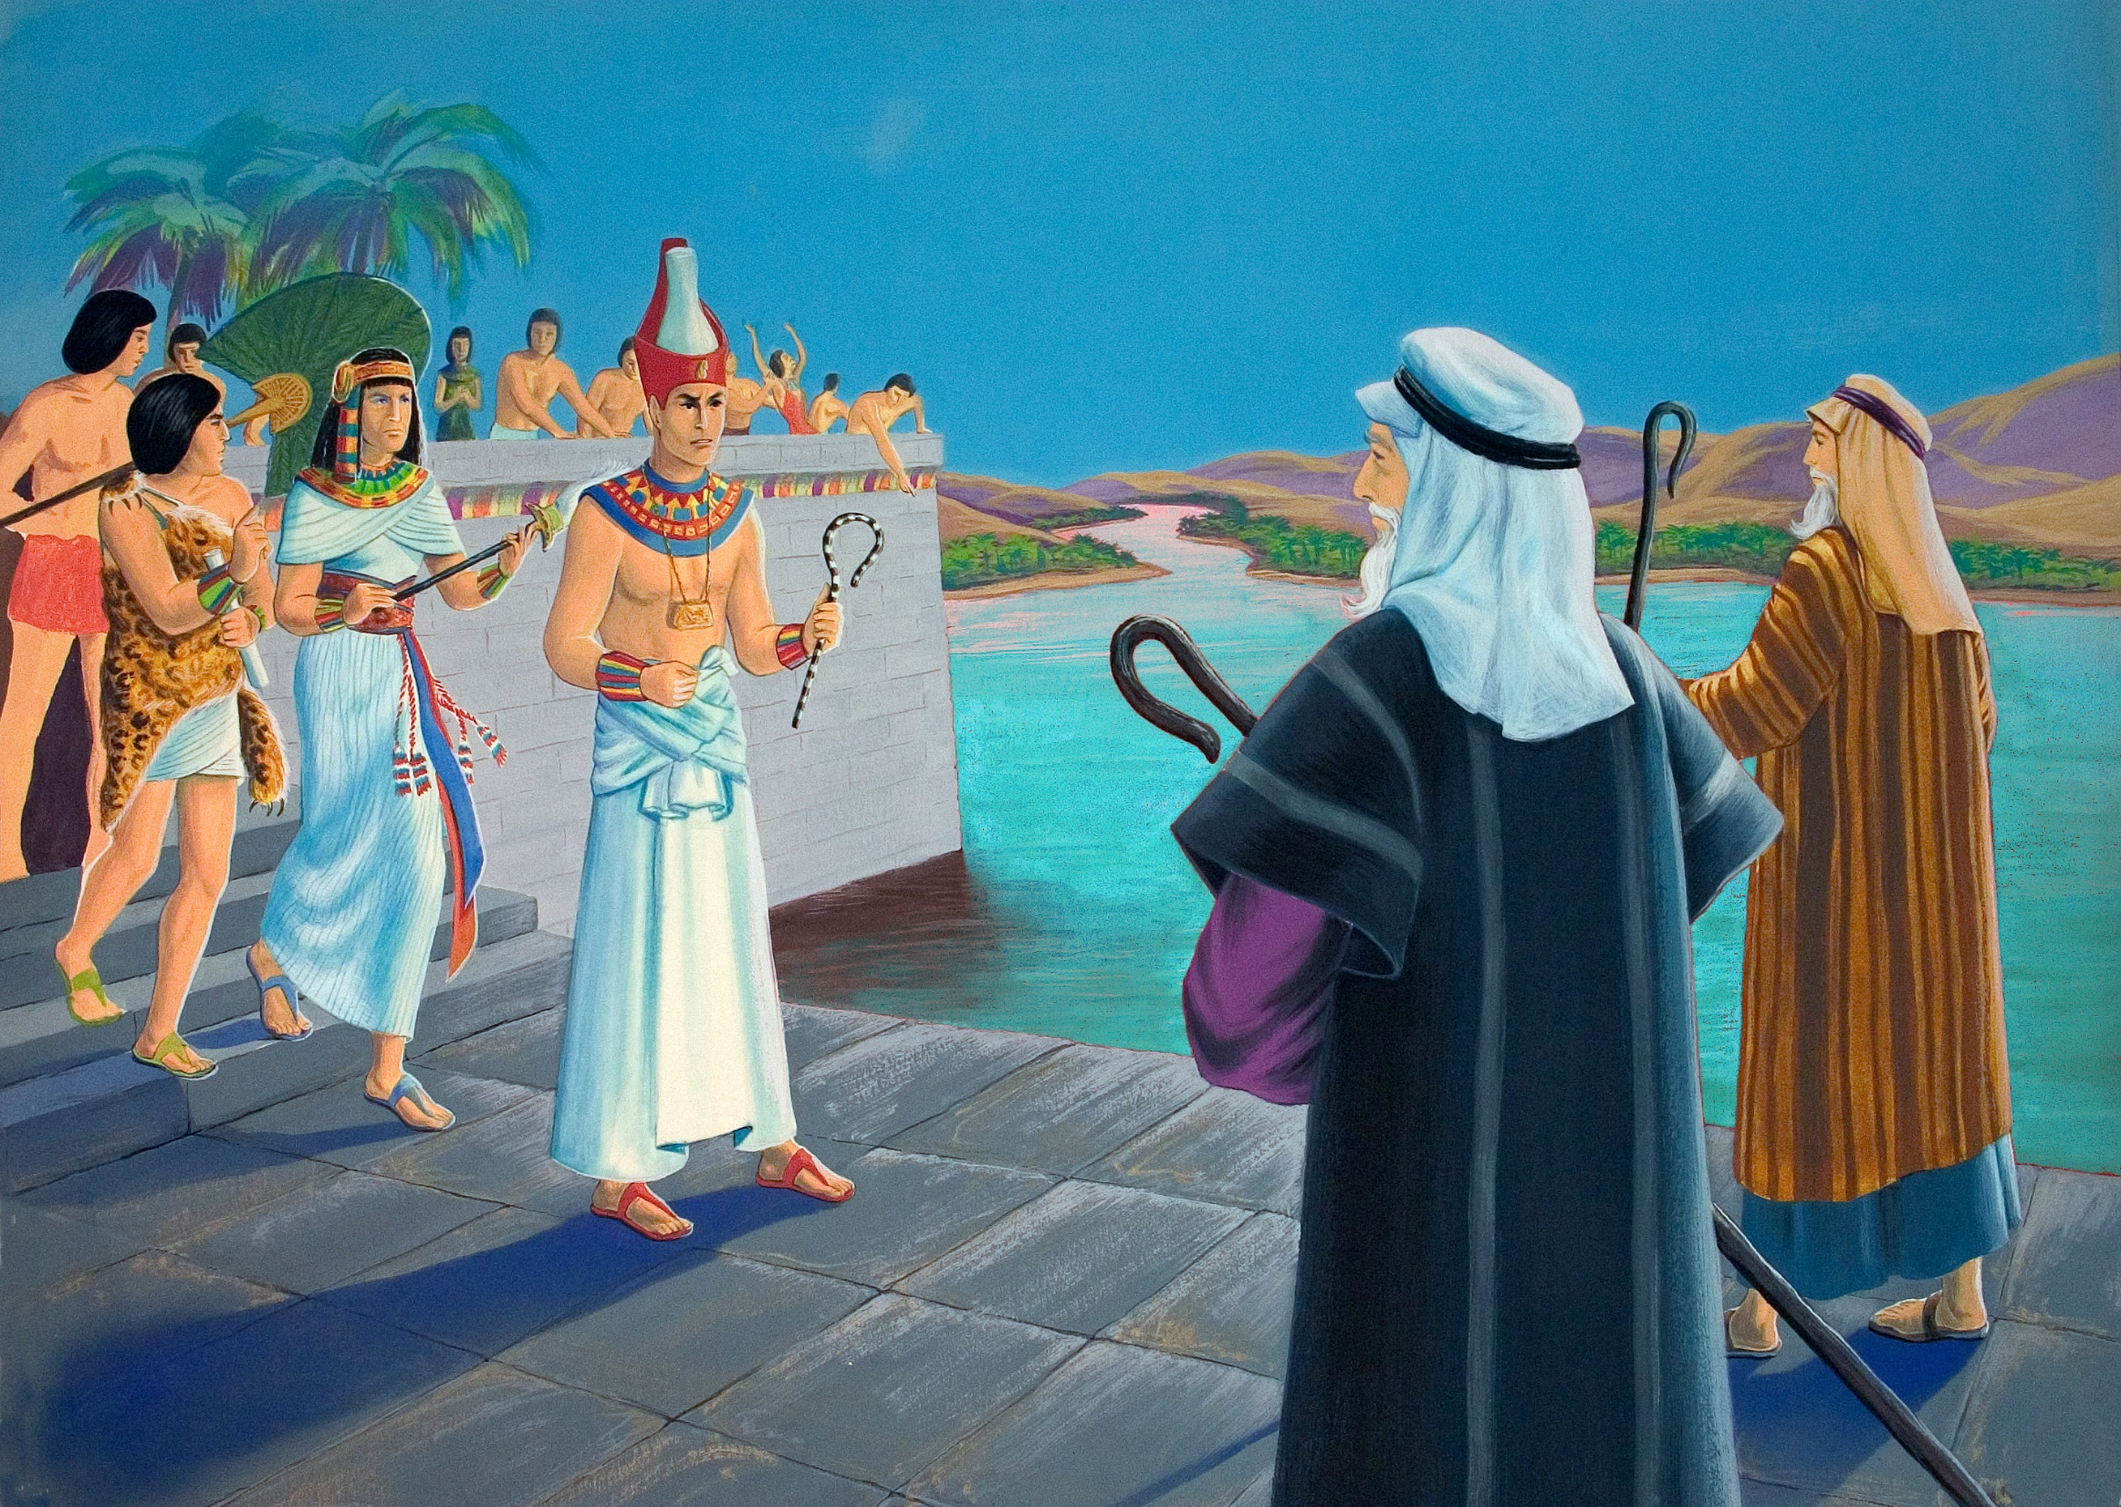

Slide 9
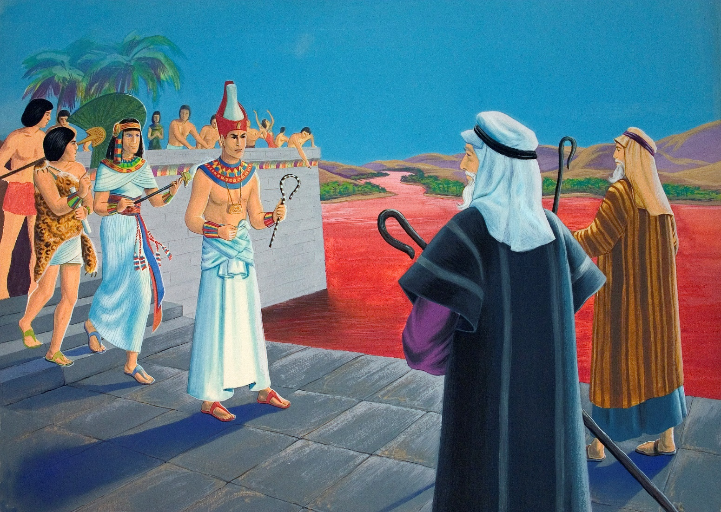

Slide 10
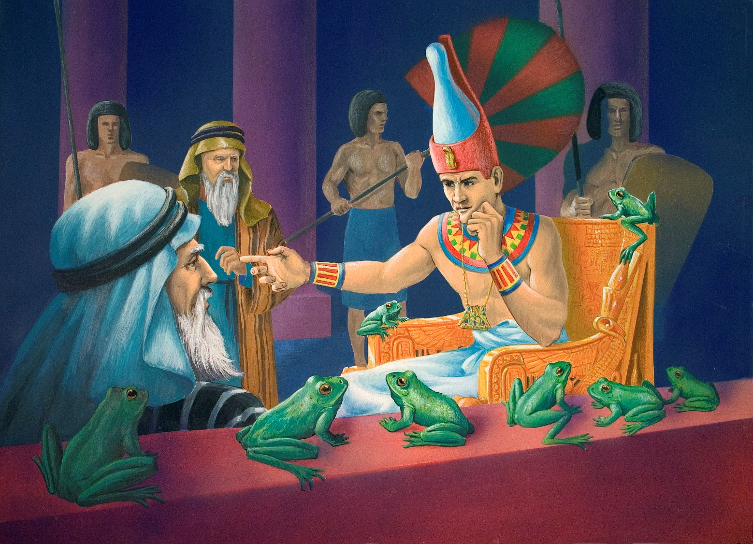

Slide 12
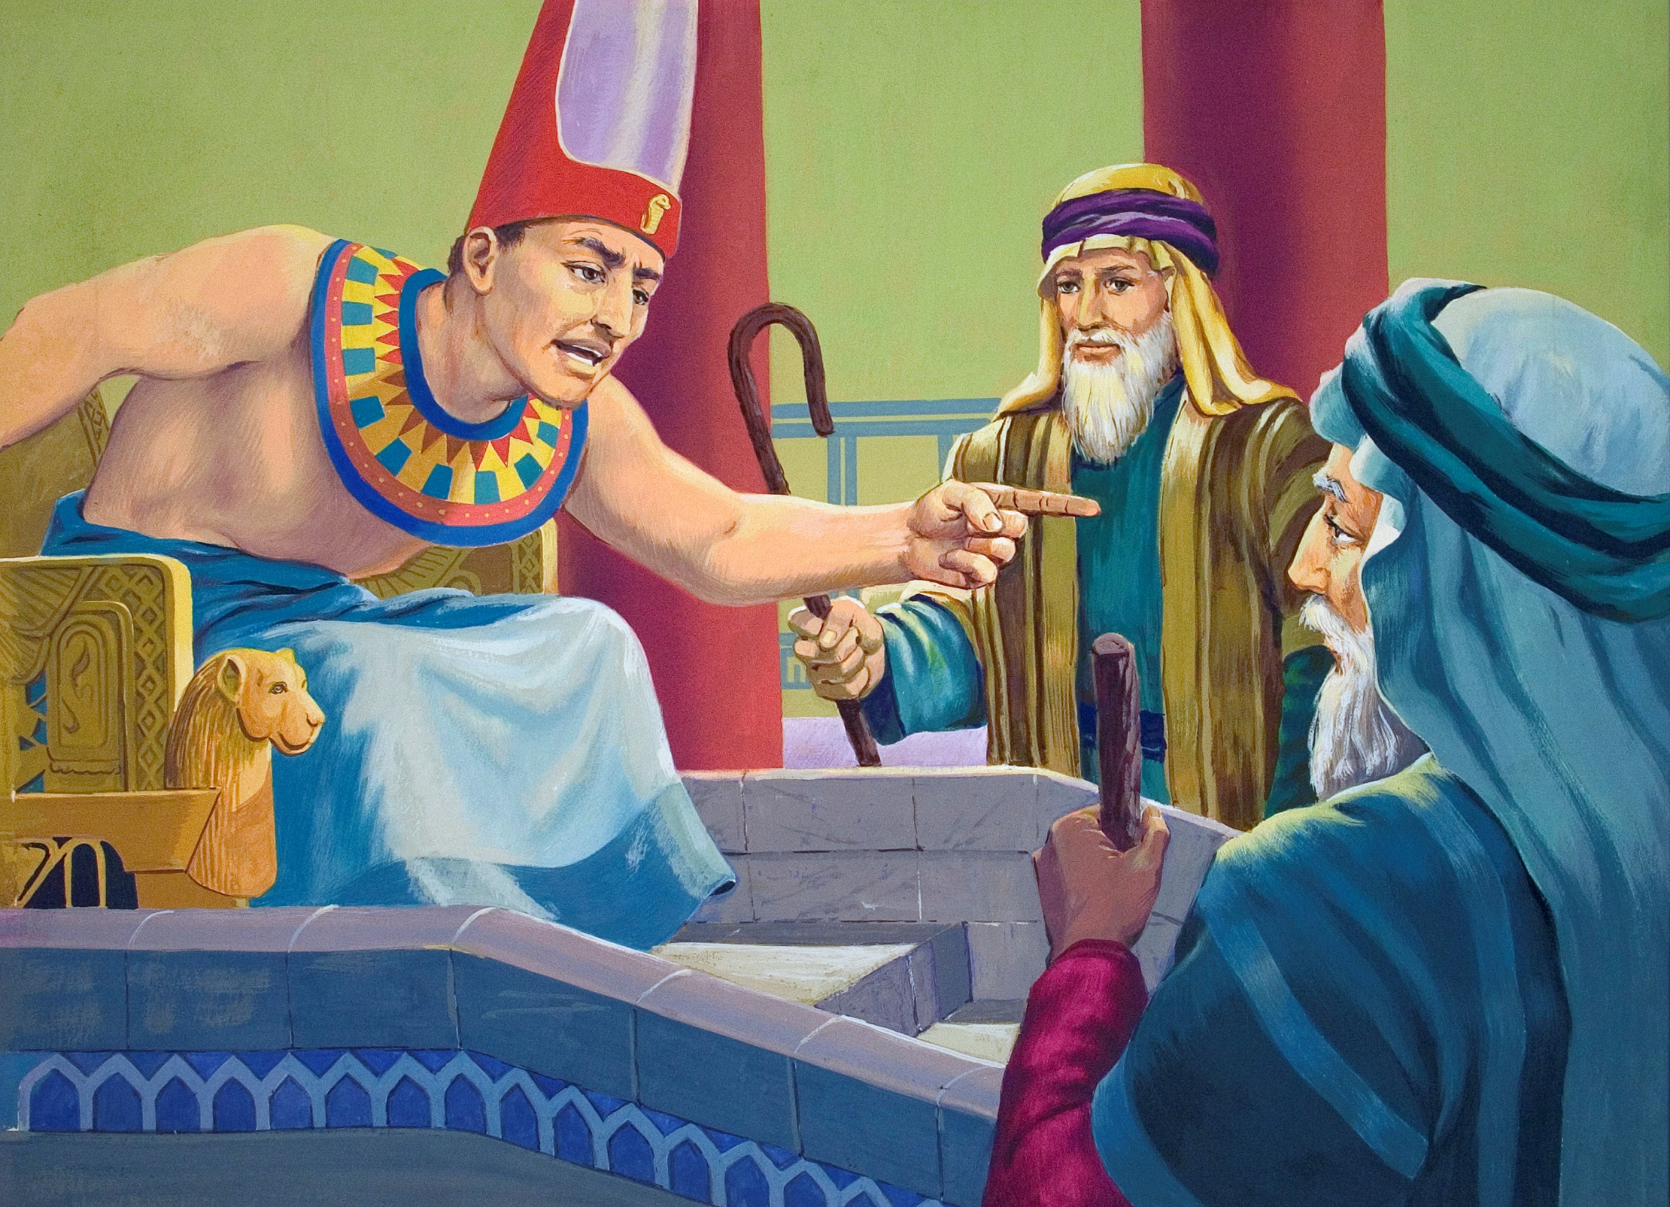

Slide 13
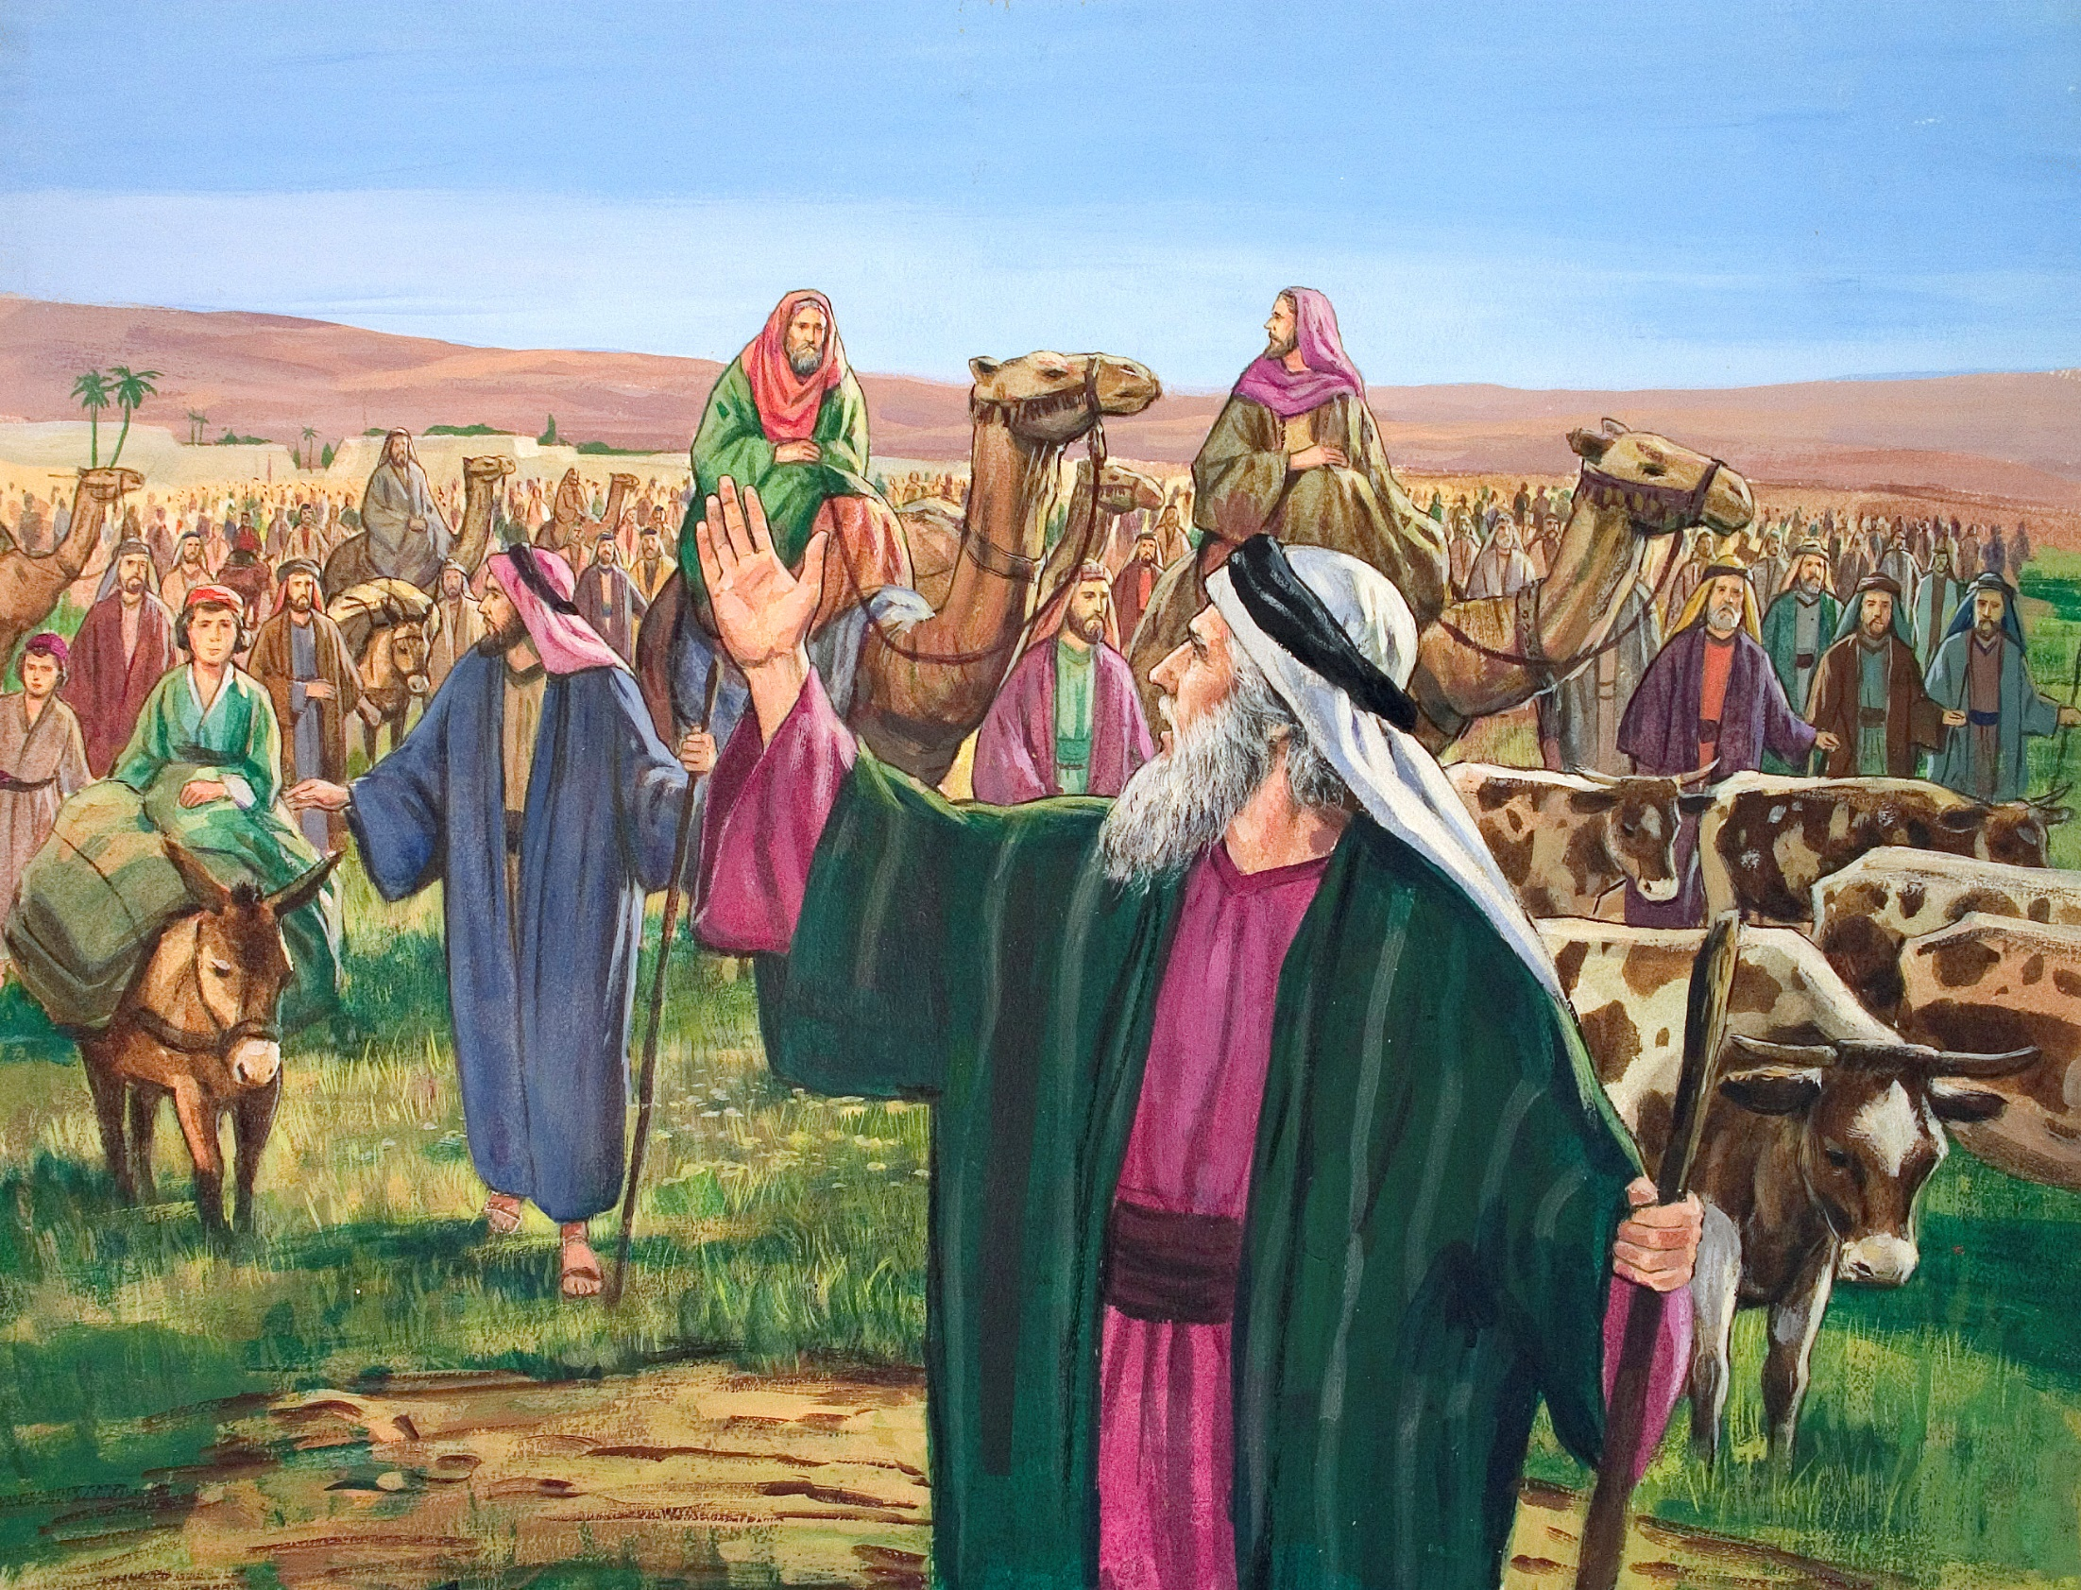

Slide 14
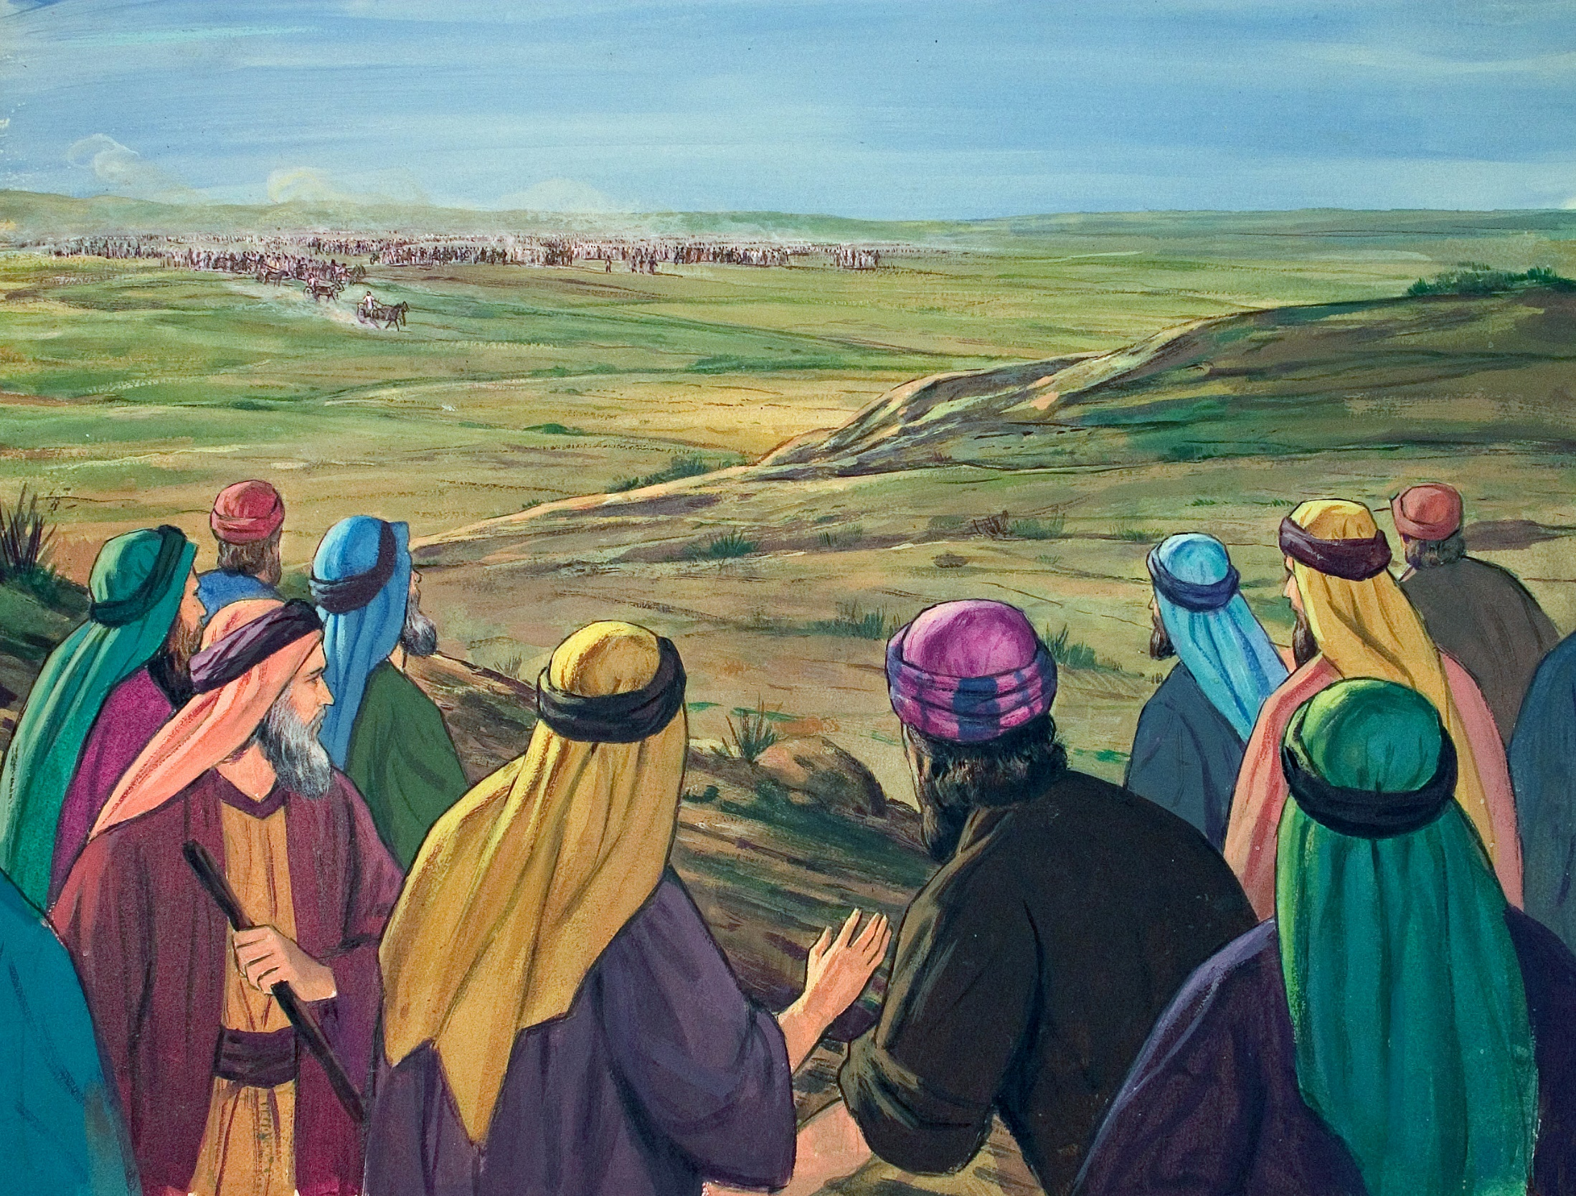

Slide 15
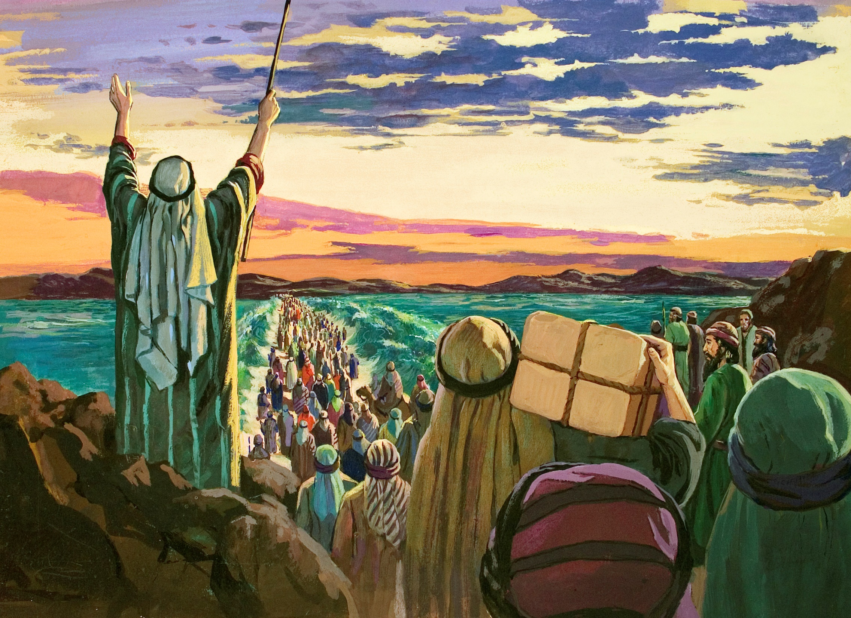

Slide 16
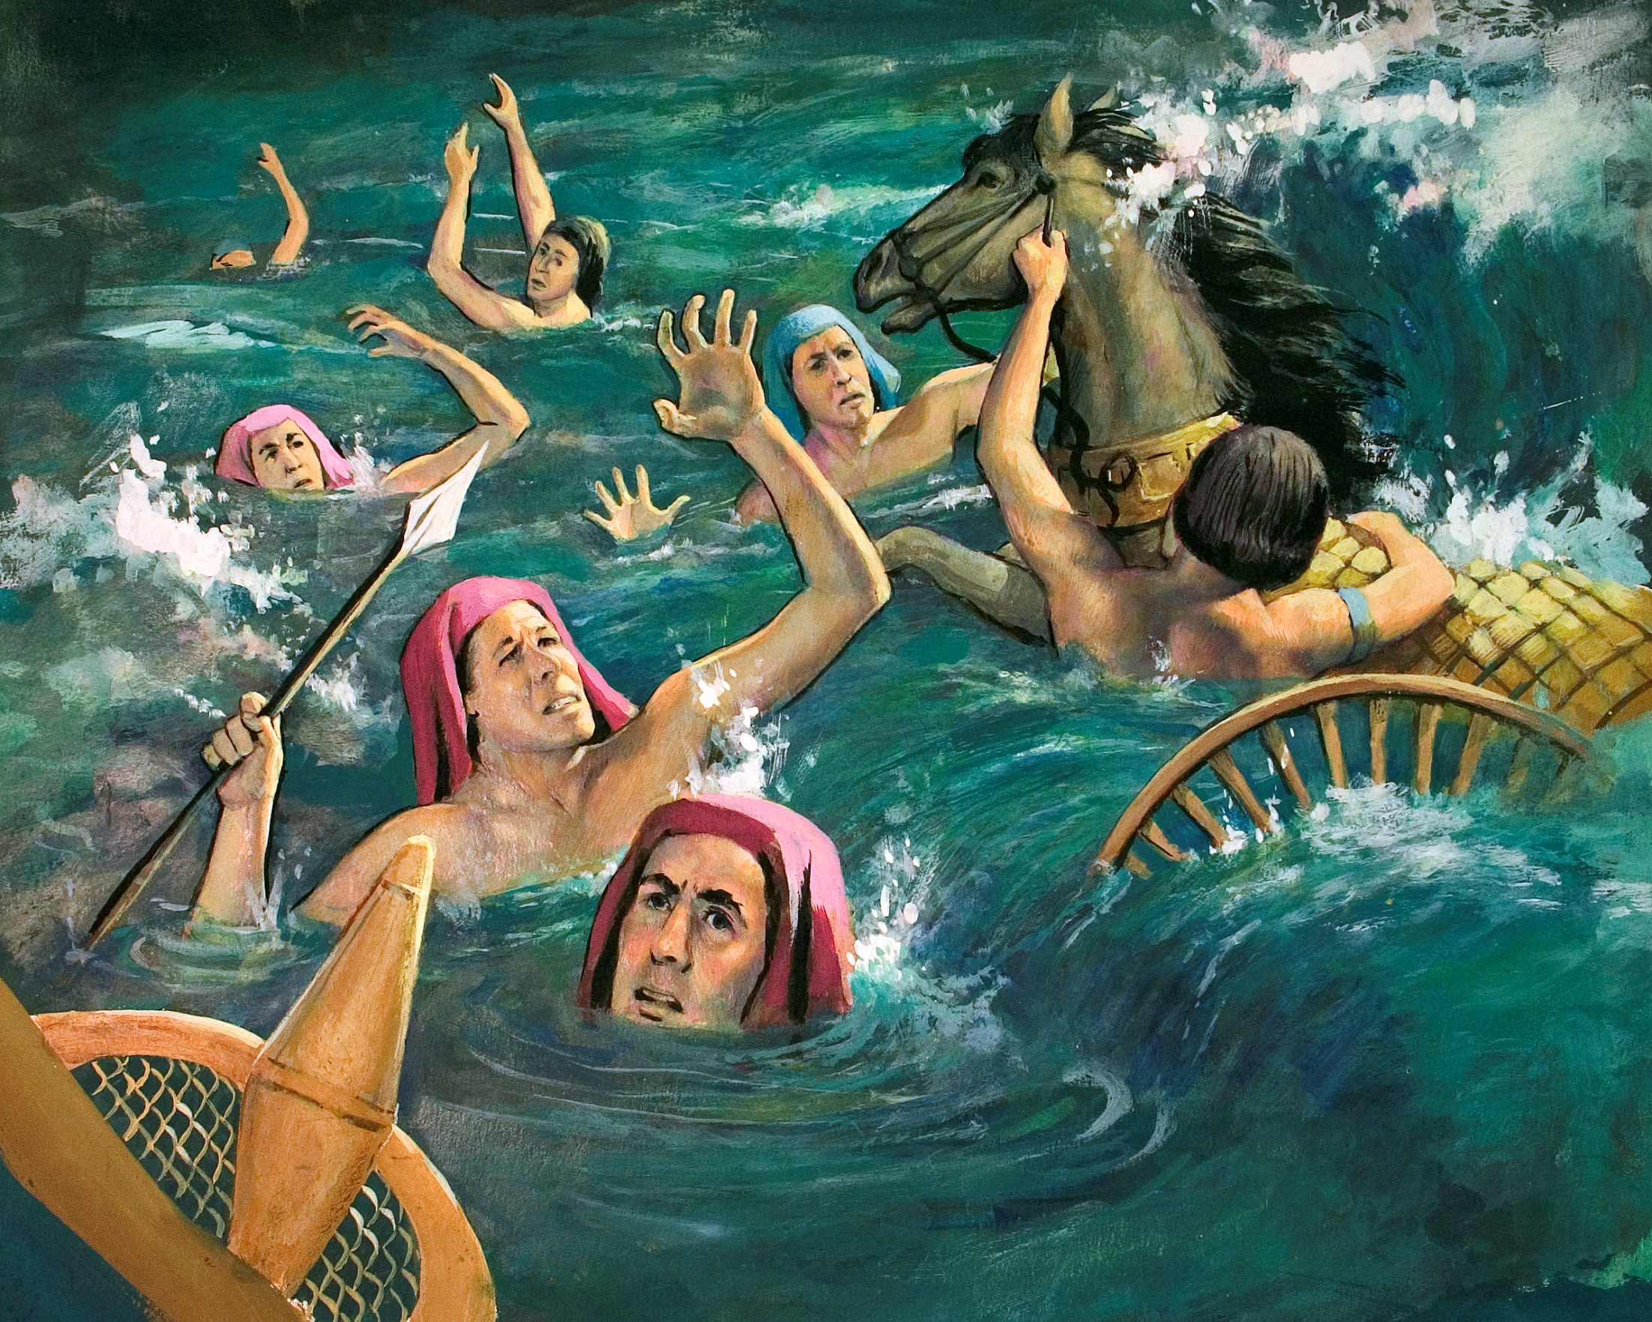

Slide 17
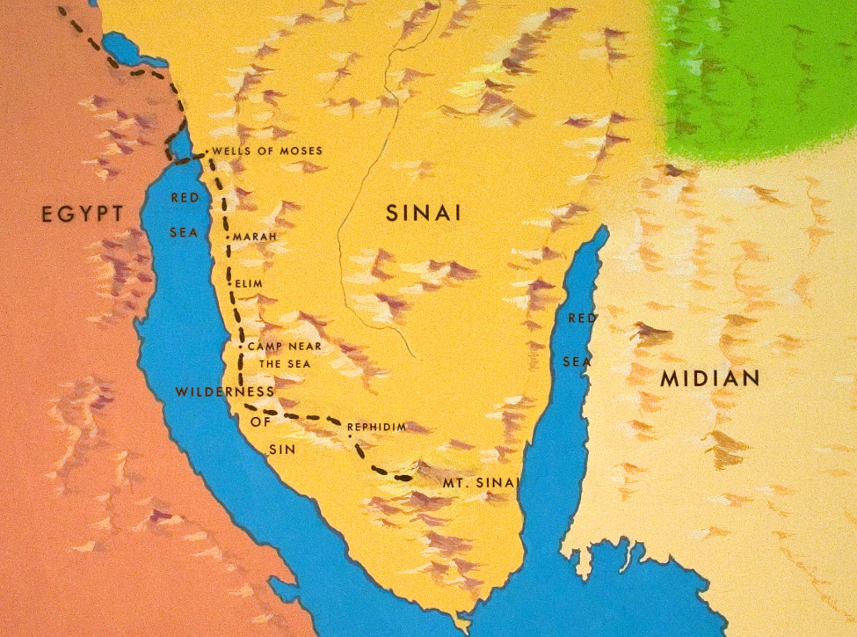

Slide 18
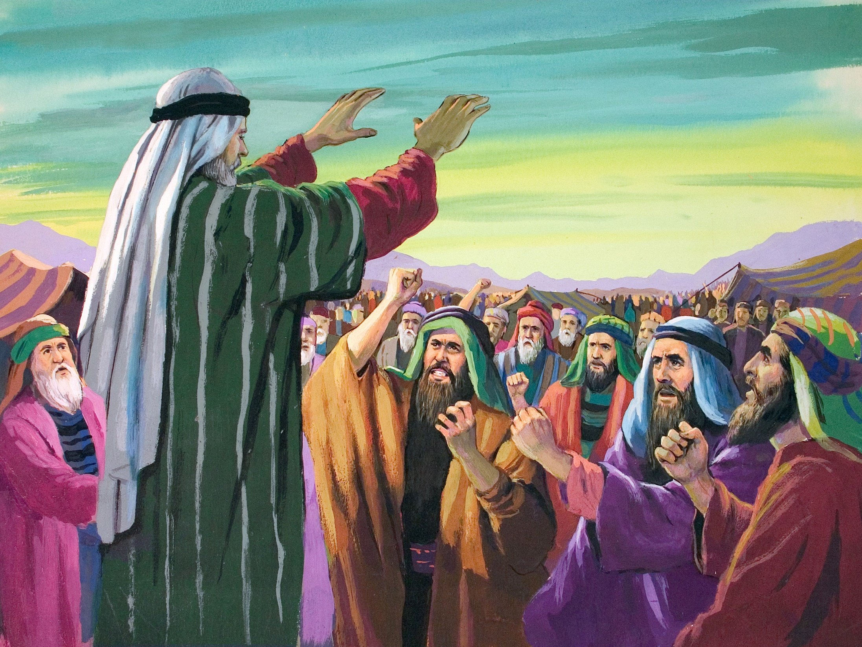

Slide 19
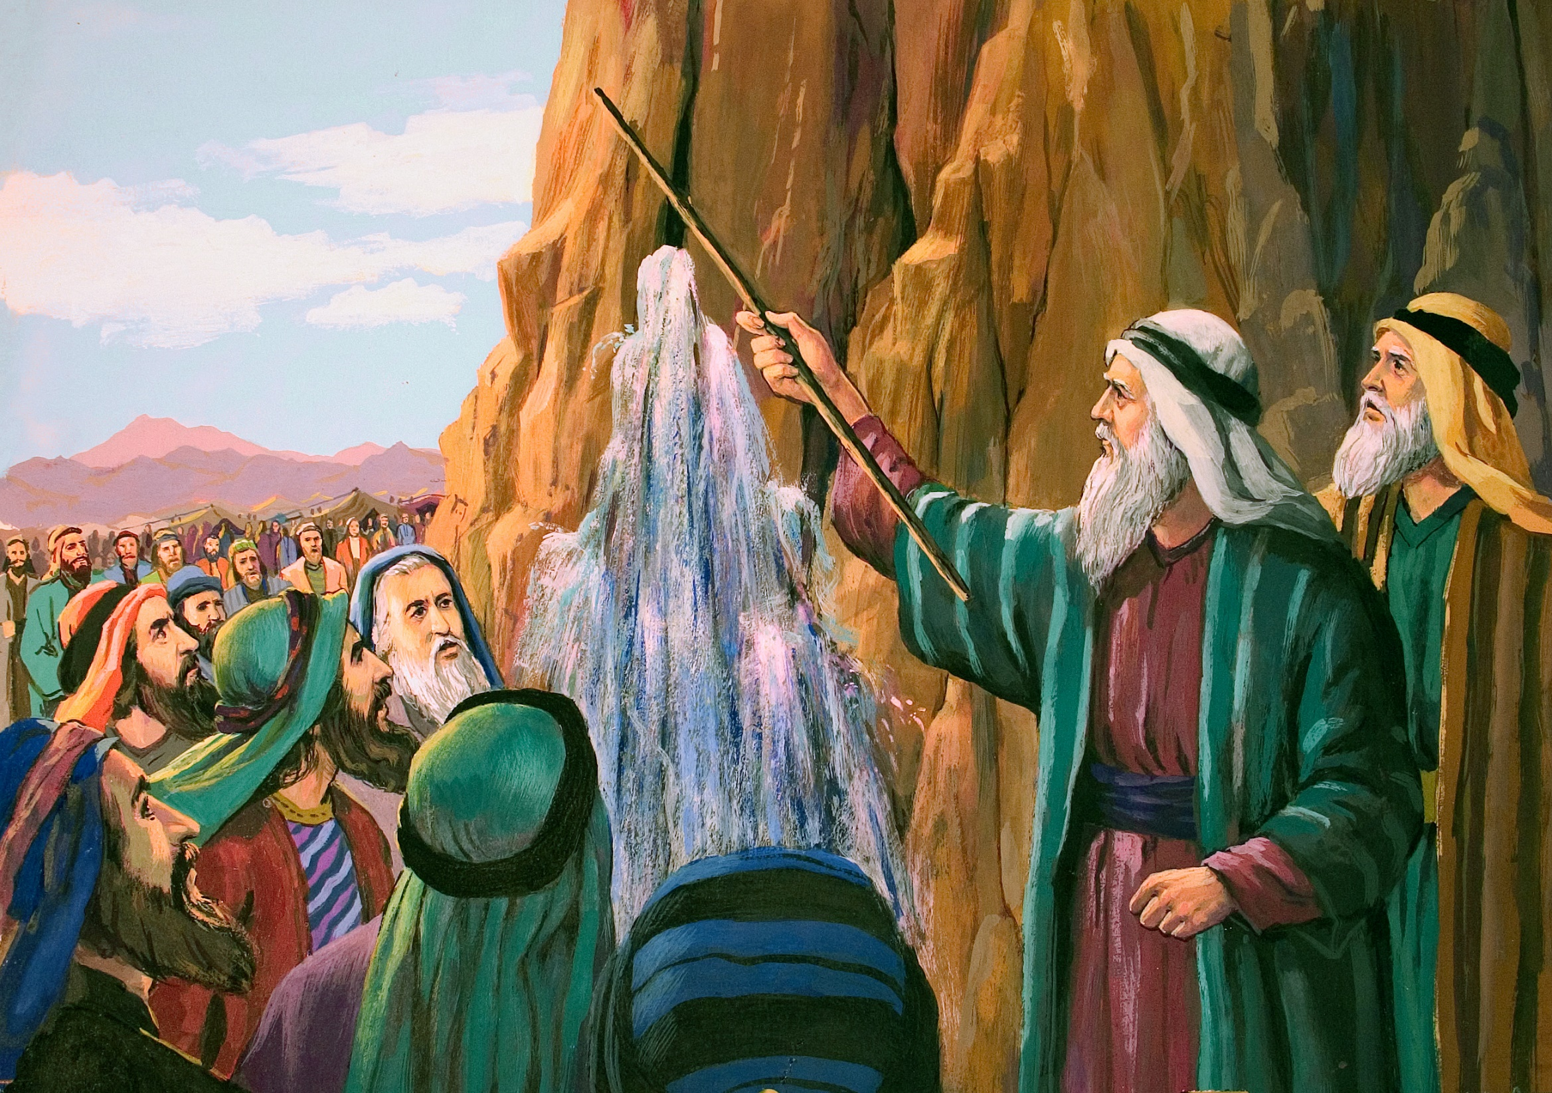

Slide 20
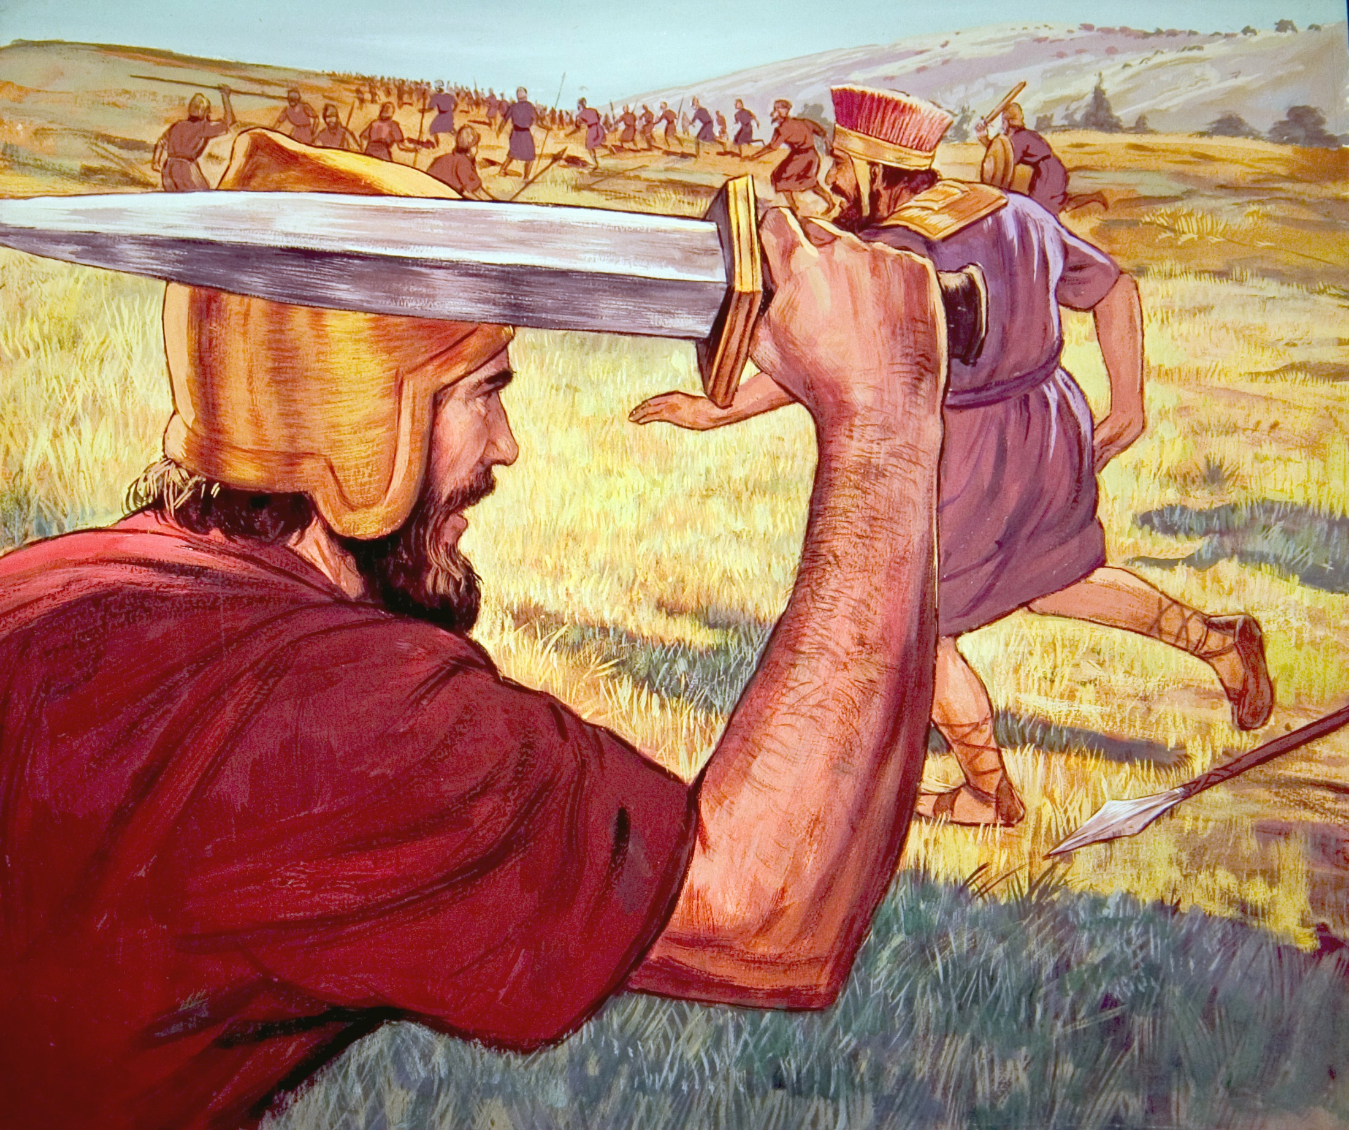

Slide 21
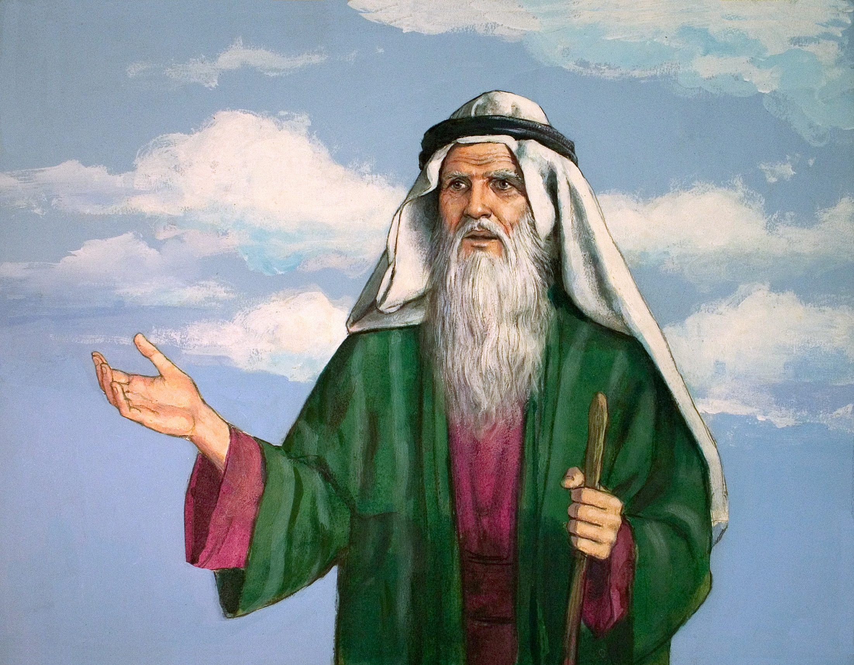

Slide 22
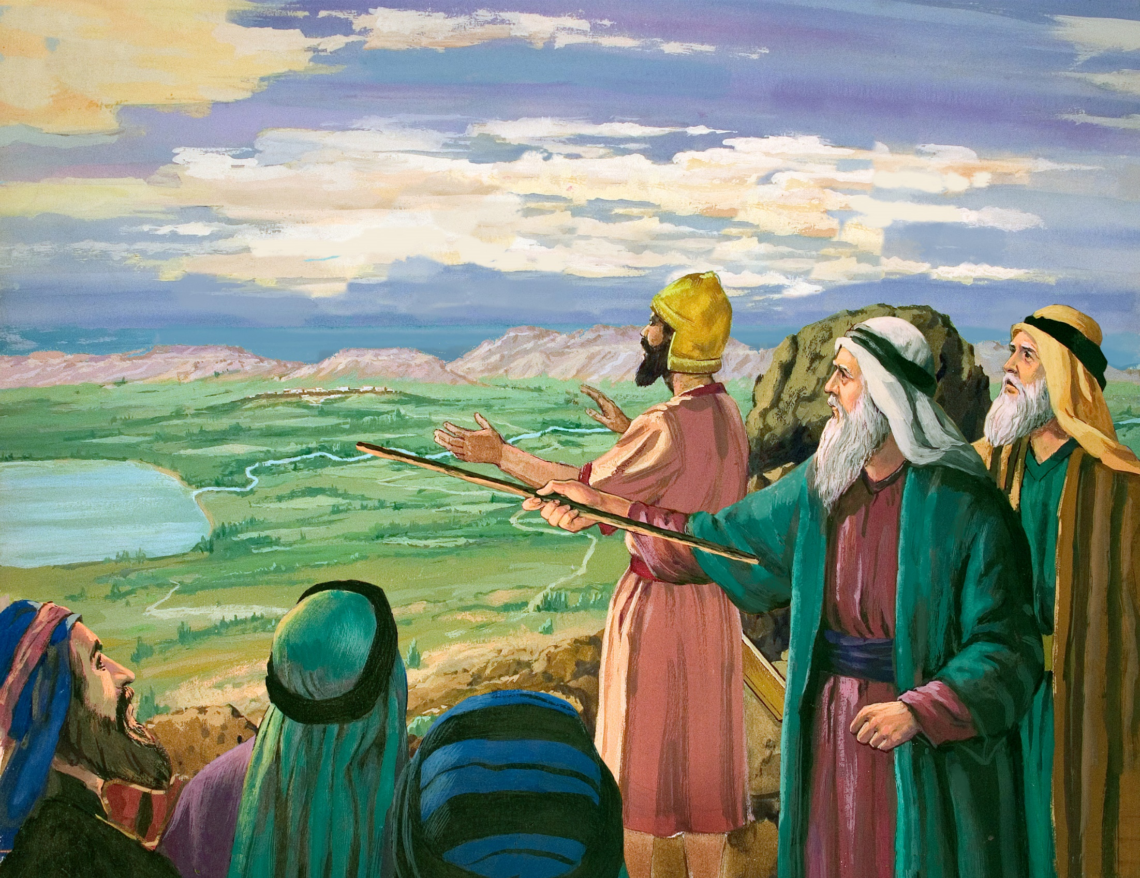

Slide 23
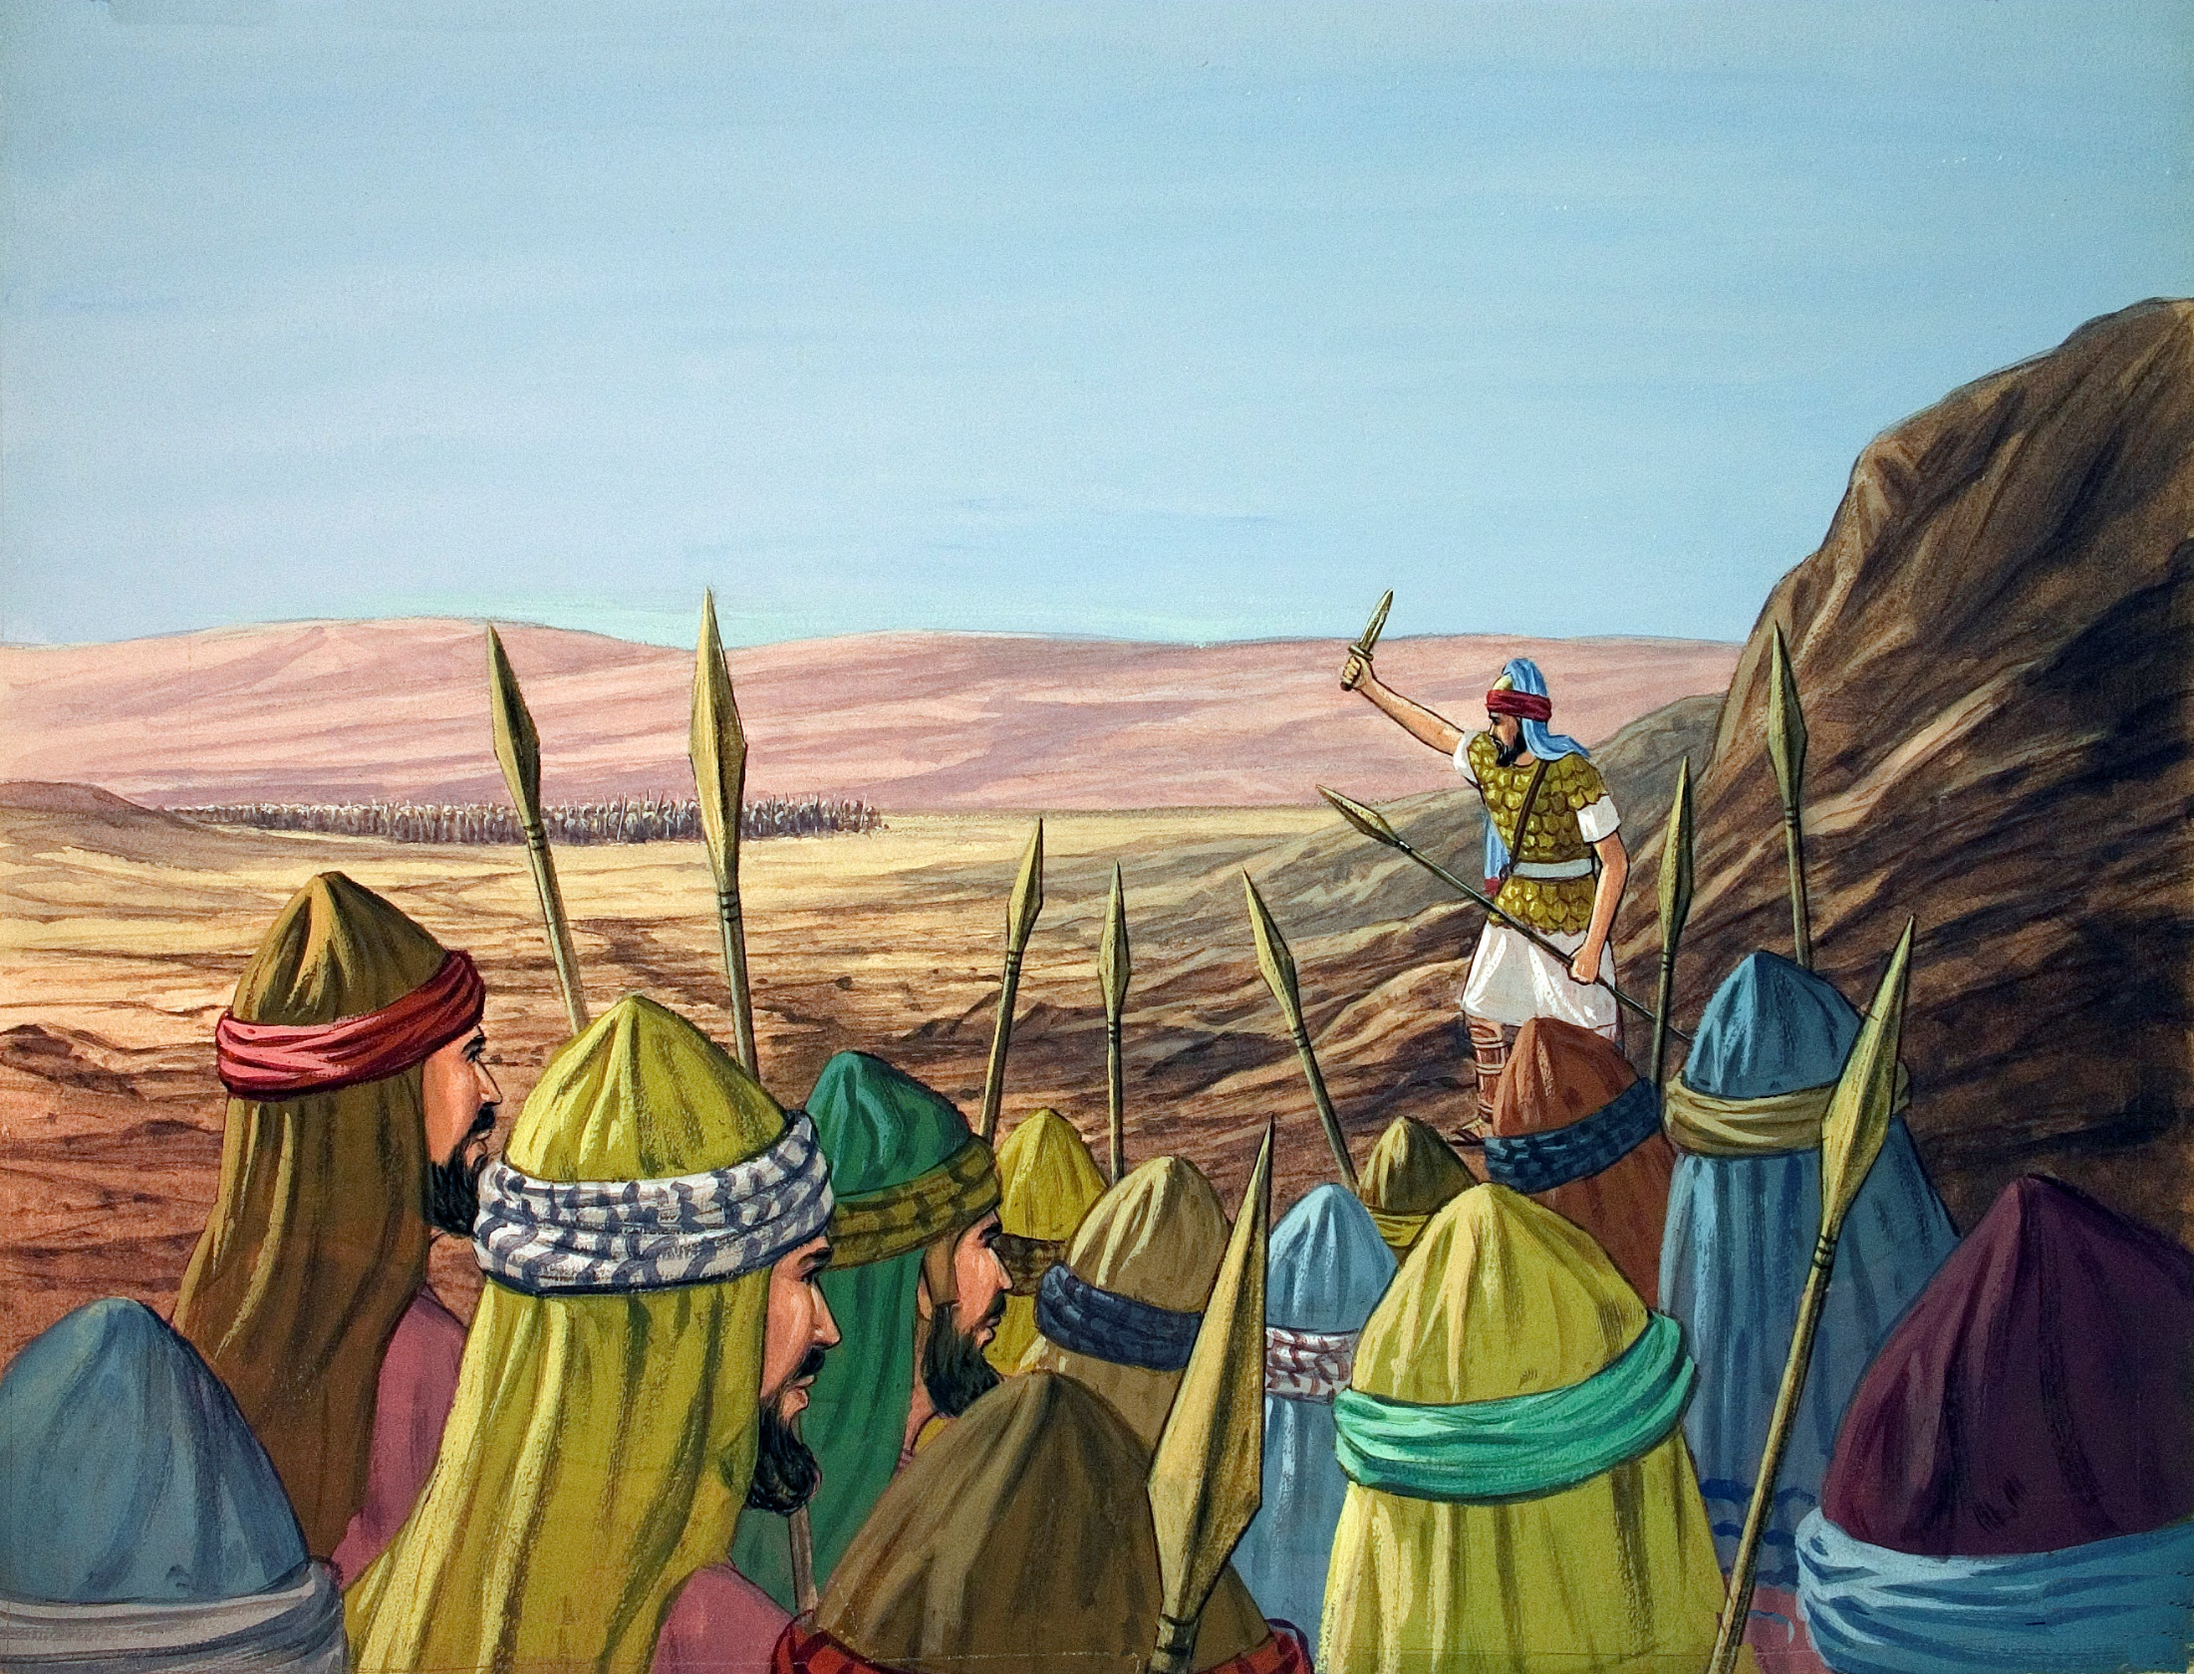

Slide 24
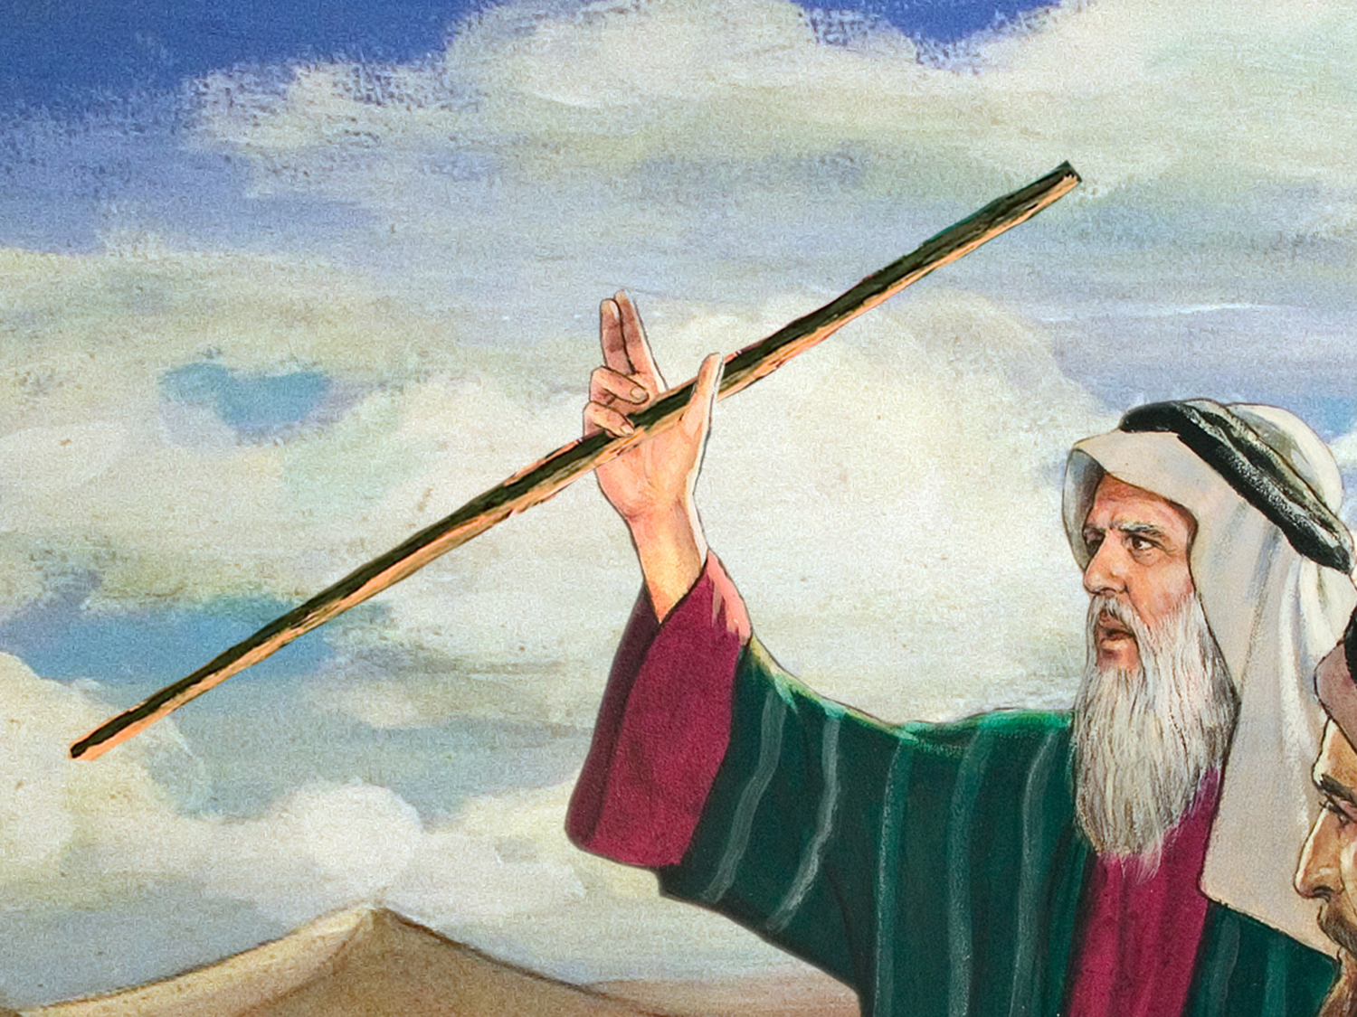

Slide 25
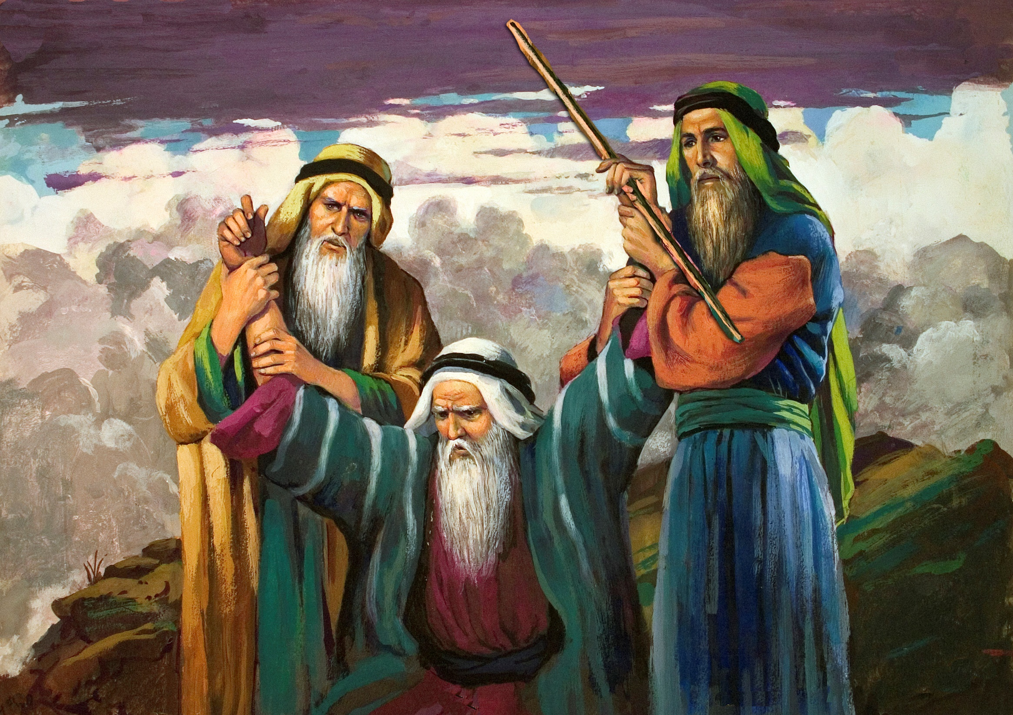

Slide 26
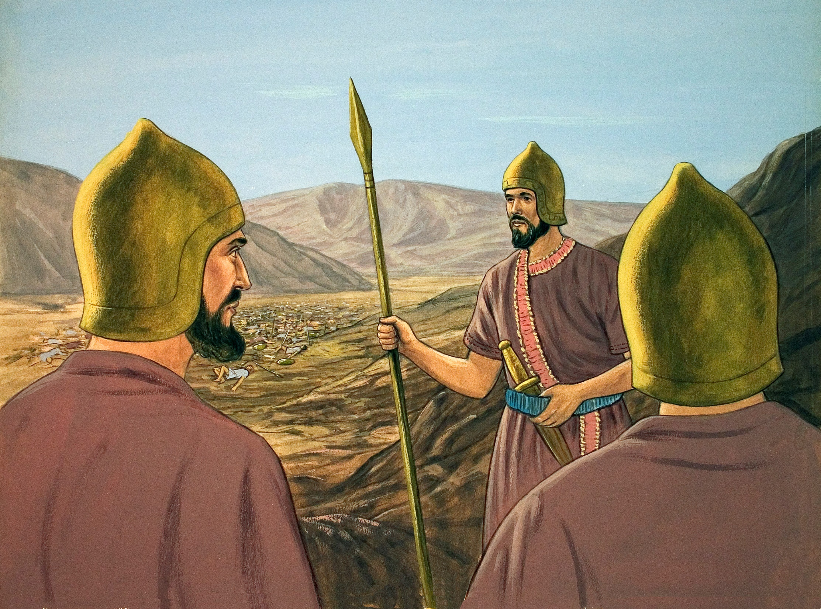

Slide 28
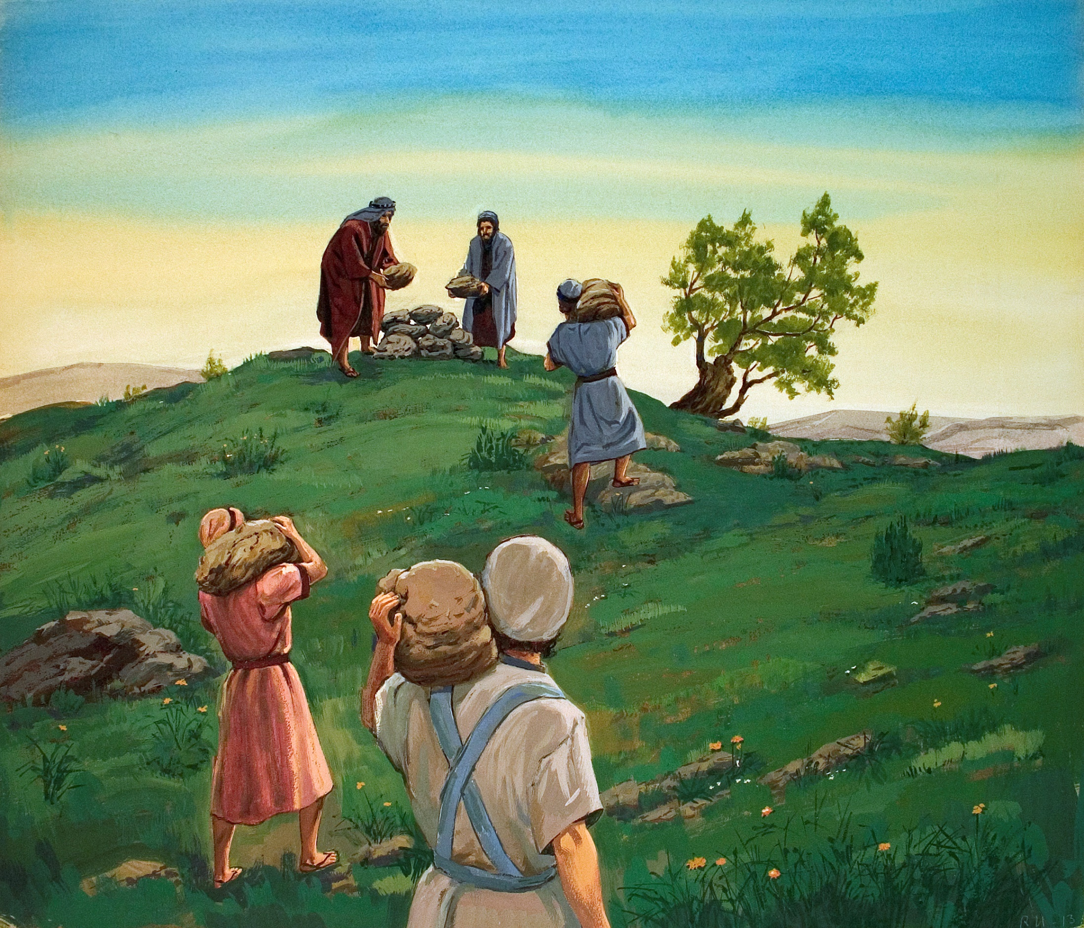

Slide 29
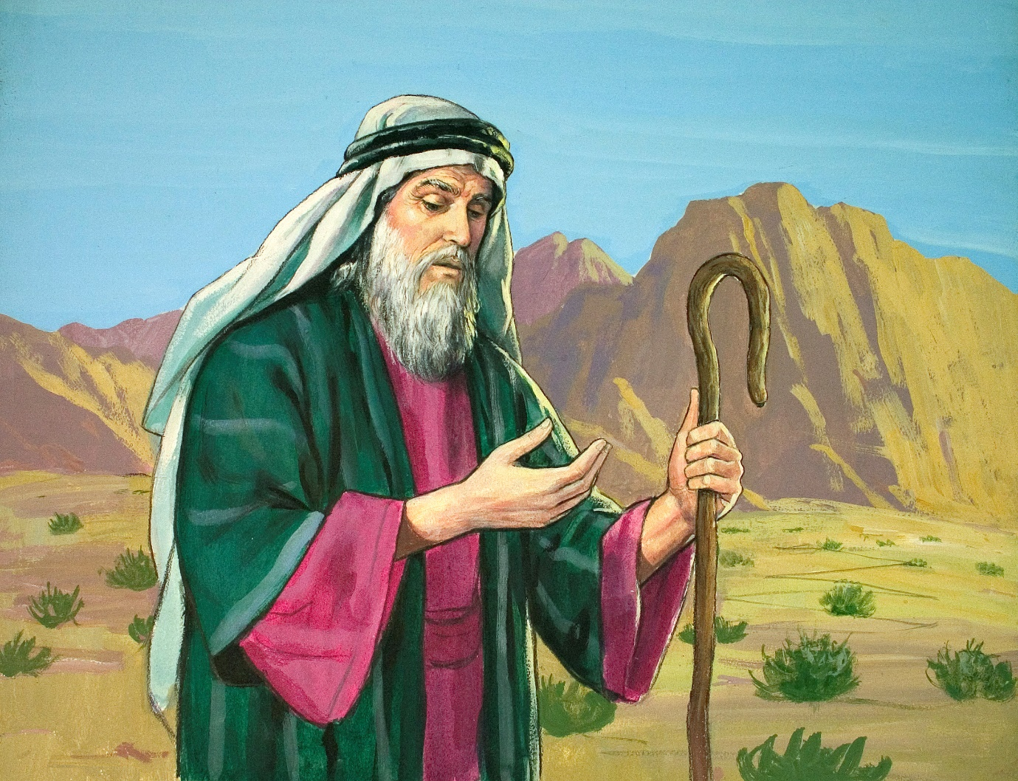

Slide 30
Total Trust
Direct correlation between trust and victory – Ex. 17:11
We must trust in the power of God – 1 John 4:4; 5:4
We must trust in the faithfulness of God – 1 Cor. 10:13
We must trust in the providence of God – Rom. 8:28

Slide 31
Team Work
Everybody has a part, and everybody’s part is essential – 1 Cor. 12:12-27
We must work individually for the defense of the gospel
Each of us can pray – Mark 14:38
Each of us can spread seed – 1 Cor. 3:6-8
Each of us can give an answer – 1 Pet. 3:15
We must work together for the defense of the gospel
Collectively, we are the body (Rom. 12:5) & the army (2 Tim. 2:3-4)
We are bigger, stronger and better together – Eph. 4:12-16; 1 Cor. 3:6

Slide 32
True Friends
We have a friend named Jesus (2 Tim. 4:17; Heb. 7:25)
We need earthly, Christian friends who will:
Be there for each other personally, and not hire it out – Heb. 10:24
See every task as a privilege, and not as a punishment – 1 Pet. 1:22
Go the extra mile, and hold up both hands all day long – Matt. 5:41
True Friends make the difference between:
“Heavy” hands and “steady” hands
Losing the battle and winning the battle
Giving up or going on

Slide 33
Believe Jesus is God’s Son – John 20:30-31
Repent of your sins and turn to God – Acts 2:38
Confess your faith in Jesus – Romans 10:9-10
Be immersed into Christ – Galatians 3:27
God will forgive all of your sins – Acts 22:16
God will add you to His church – Acts 2:47
God will register you in heaven – Hebrews 12:23
Faithfully obey His will – Hebrews 5:9

