Slide 1
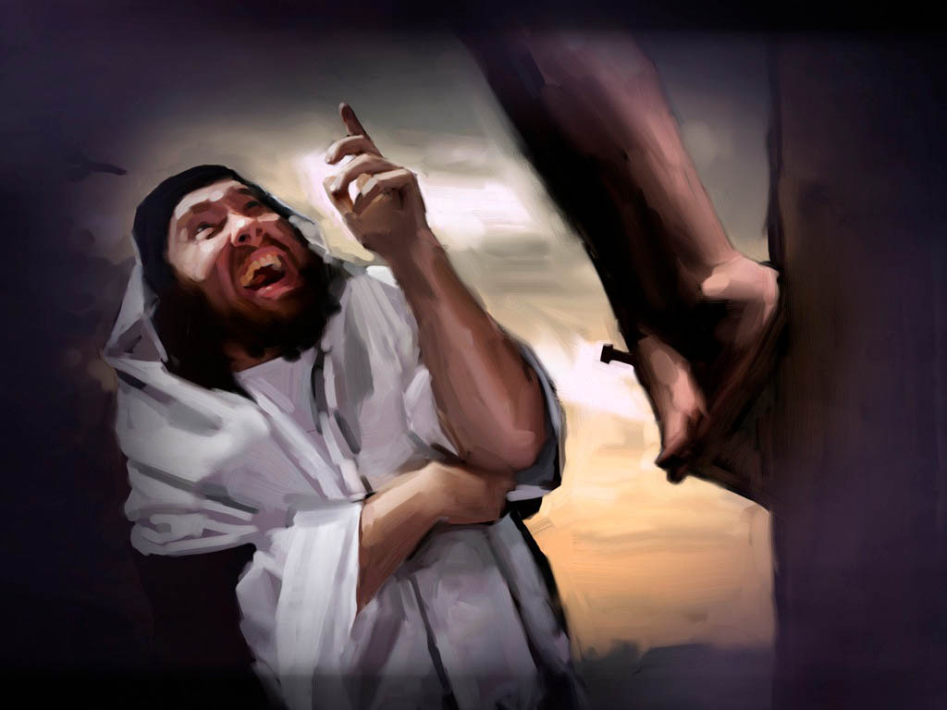

Slide 2
To Humble Himself for Us (Heb. 2:9)
Jesus lowered Himself to human existence for us – Phil. 2:6-8
Jesus lived “below His standards” for us – Heb. 2:9, 14a
Jesus subjected Himself to human limitations – 2:17-18
Imagine Jesus ashamed: “I am God! I’m better than this! I’m above this! I’m so embarrassed! Forget this!”
I need to say, “I am not ashamed to humble myself for Him!”

Slide 3
To Suffer for Us (Heb. 2:9, 10, 18)
Jesus was insulted for us – 1 Pet. 2:23
Jesus was blasphemed for us – Luke 22:65; 23:35-39
Jesus was rejected for us – Luke 9:22; 17:25; 20:17
Jesus was conspired against for us – Mark 11:18; 12:12; 14:1, 55
Jesus was betrayed for us – Matt. 26:16, 47-50
Jesus was physically assaulted for us – Mark 14:65; 15:15-20
Imagine Jesus ashamed: “I am God! I’m better than this! I don’t deserve this! I don’t have to put up with this!”
I need to say, “I am not ashamed to suffer for Him!”

Slide 4
To Be Related to Us (Heb. 2:11-12)
Jesus is not ashamed to be “seen” with us – Matt. 28:20
Jesus is not ashamed to be “identified” with us – Rom. 8:16-17
Jesus is not ashamed to be “united” with us – Rom. 6:3-6
Jesus is not ashamed to “worship” with us – Heb. 2:12
Imagine Jesus ashamed: “I am God! I’m better than this! I’m embarrassed to be tied to them!”
I need to say, “I am not ashamed to be related to Him!”

Slide 5
To Die for Us (Heb. 2:9, 10, 11, 14, 17)
Jesus experienced something never designed for Him – death!
Jesus experienced something never deserved by Him – separation!
Jesus stayed true to God, His mission and us to the very end!
Jesus despised the shame of the cross for us – Heb. 12:2
Imagine Jesus ashamed: “I am God! I’m better than this! I don’t have to endure this! I’m done with this!”
I need to say, “I’m not ashamed to despise man-made shame and give my all to Jesus!”

Slide 6
To Save Those Who Unashamedly Obey Him
Believe Jesus is God’s Son – Acts 16:31
Repent of your sins and turn to God – Acts 17:30
Confess your faith in Jesus – Acts 8:36-38
Be immersed into Christ – Galatians 3:27
God will forgive all of your sins – Acts 2:38
God will add you to His church – Acts 2:47
God will enroll you in heaven – Hebrews 12:23
Unashamedly live for Him every day – 2 Timothy 1:12

