Slide 2
January 31
Every dollar given on Mission Sunday
goes toward mission work.

Slide 3
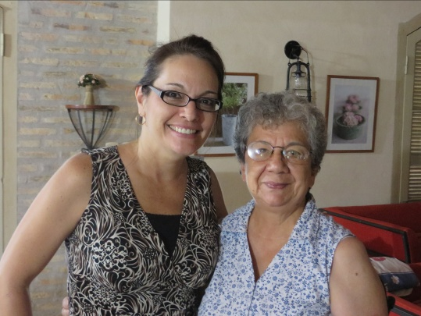
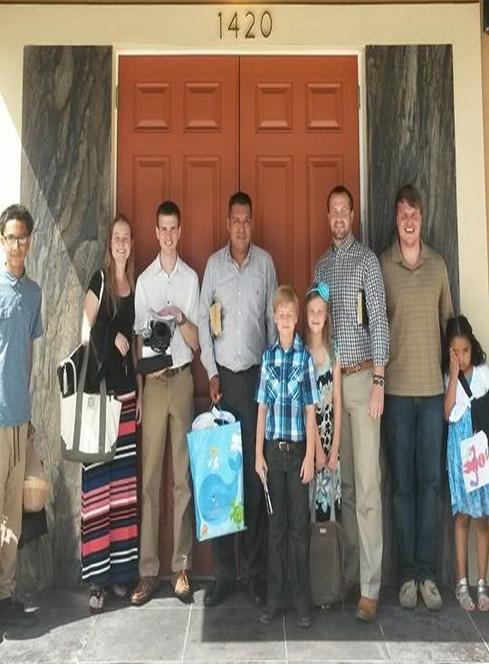
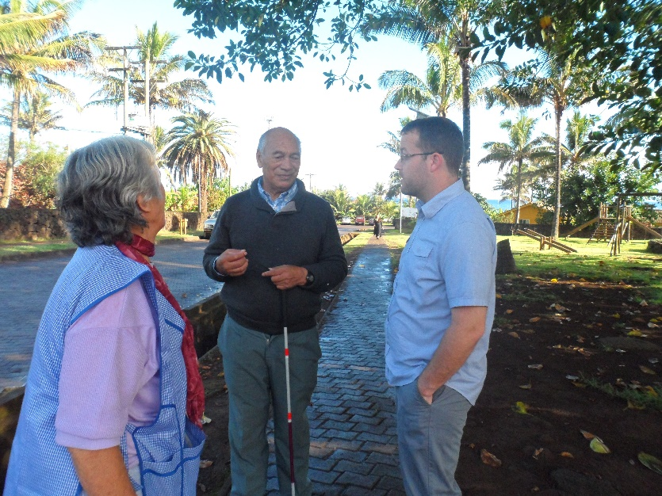
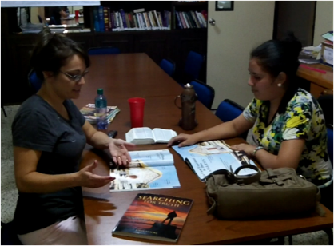
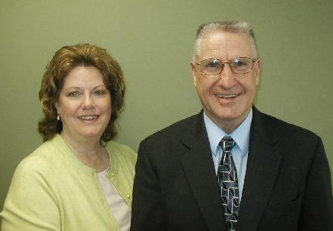
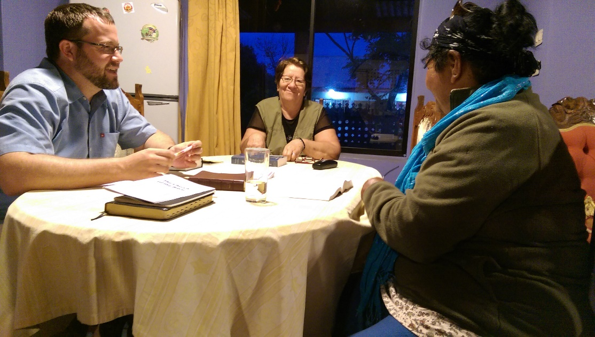
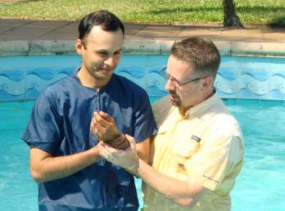
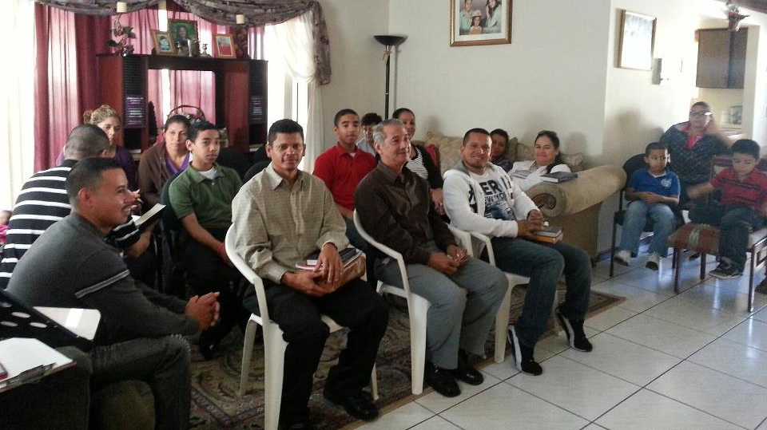
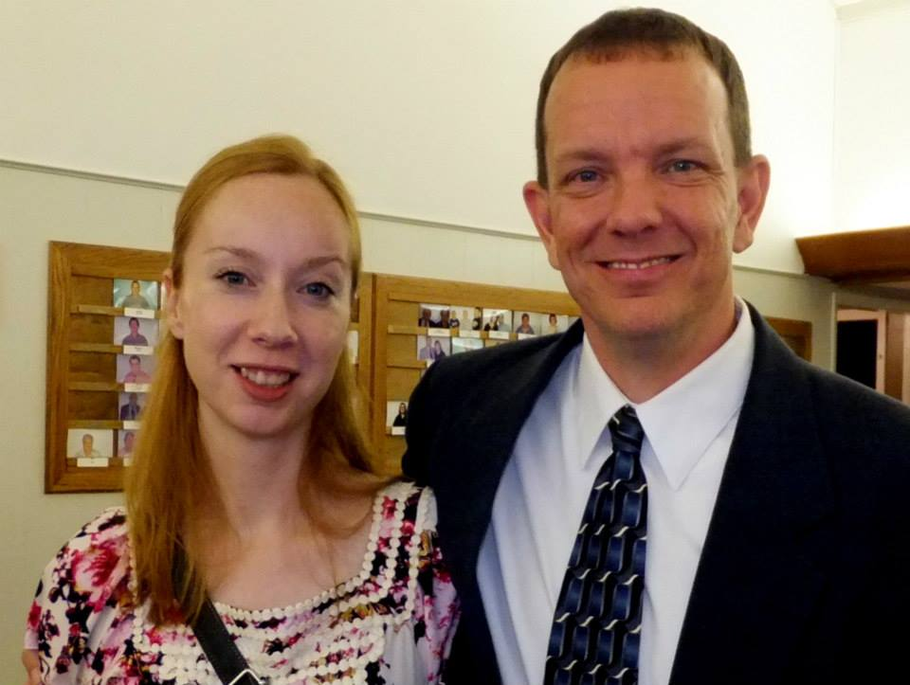
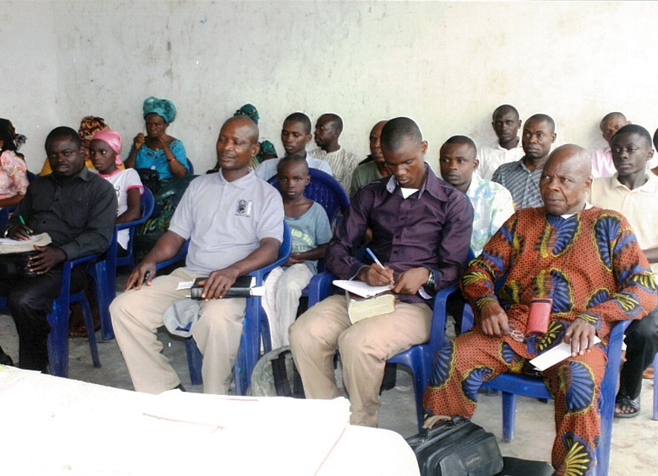
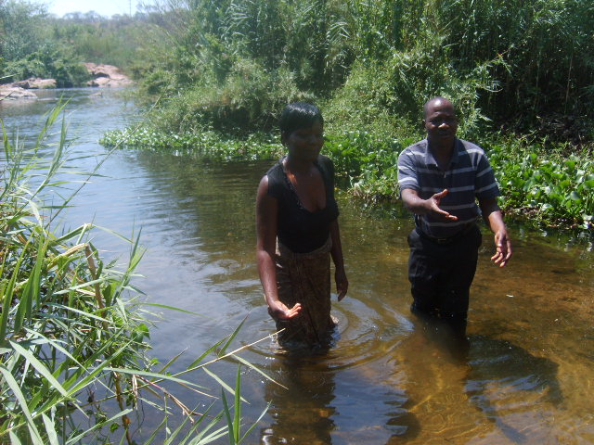
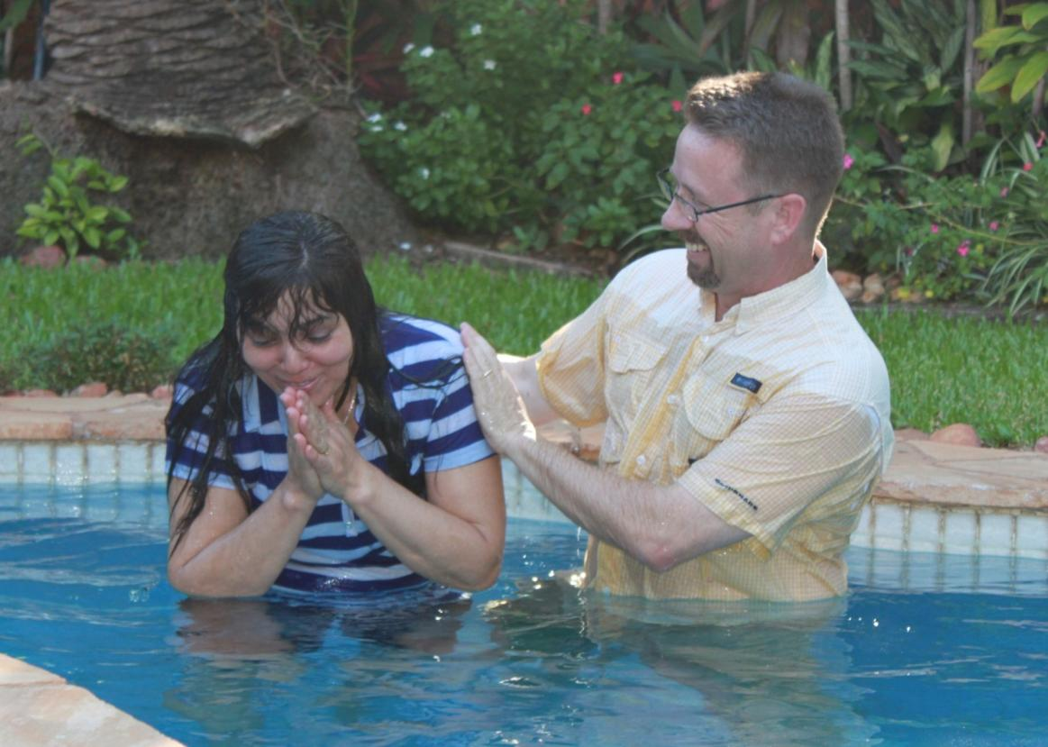
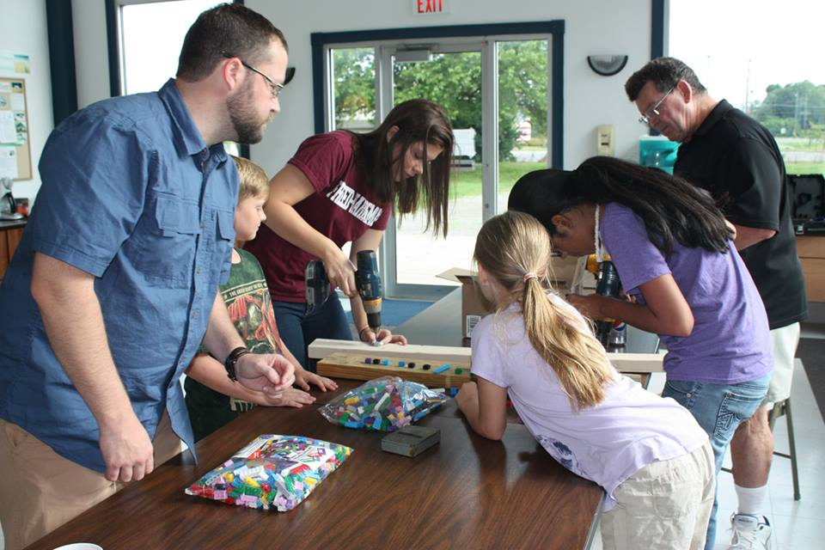
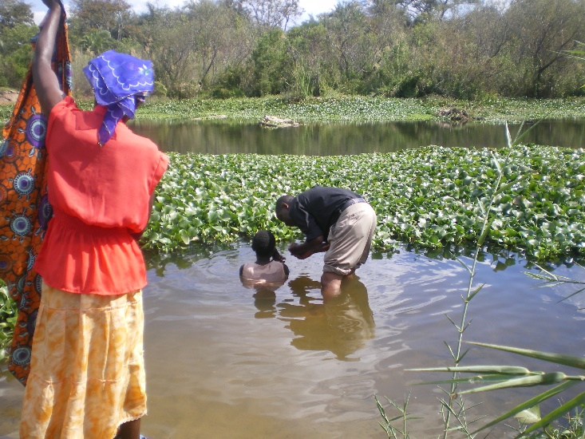
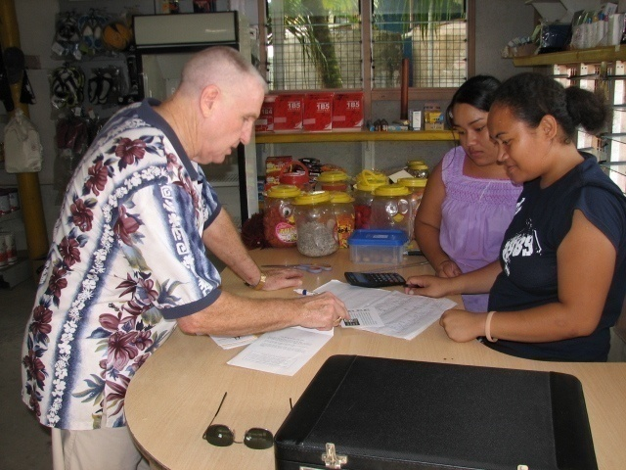
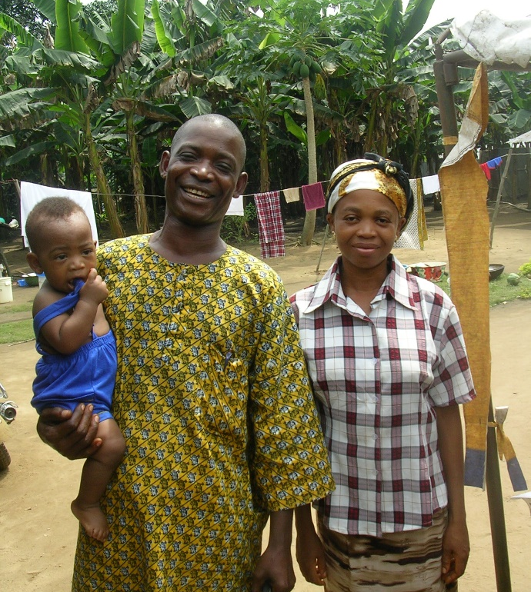
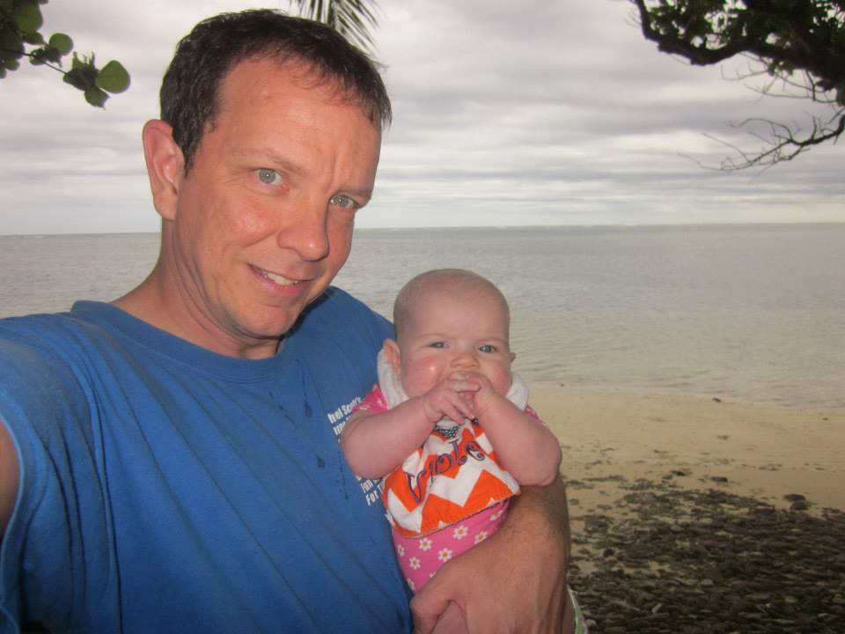
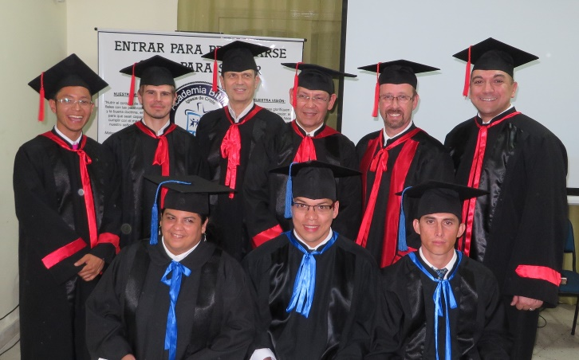
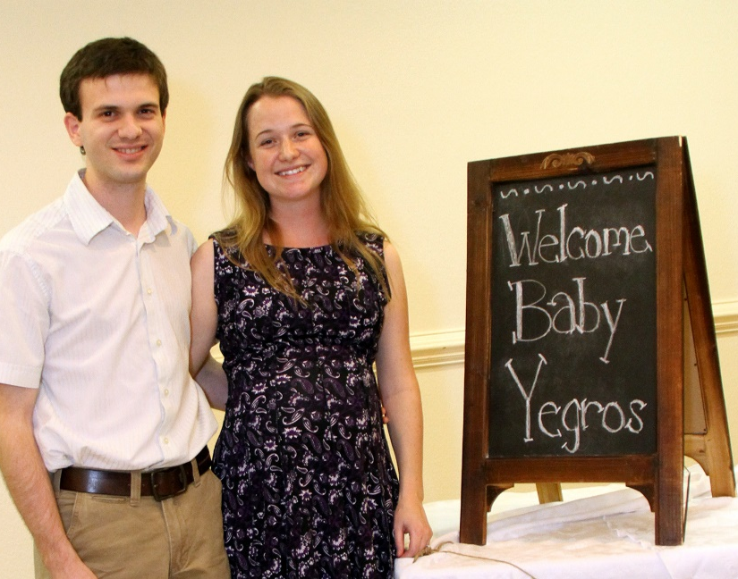
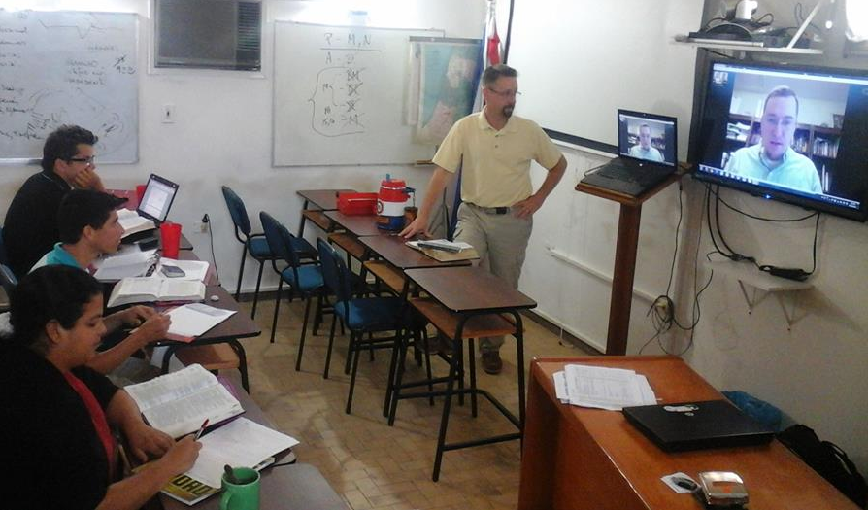
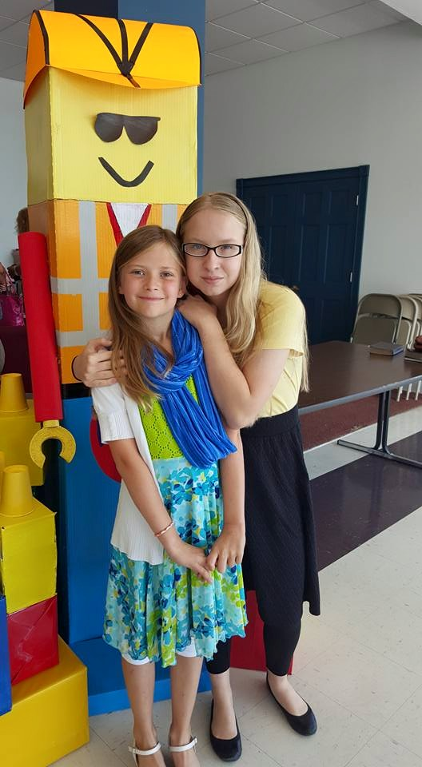
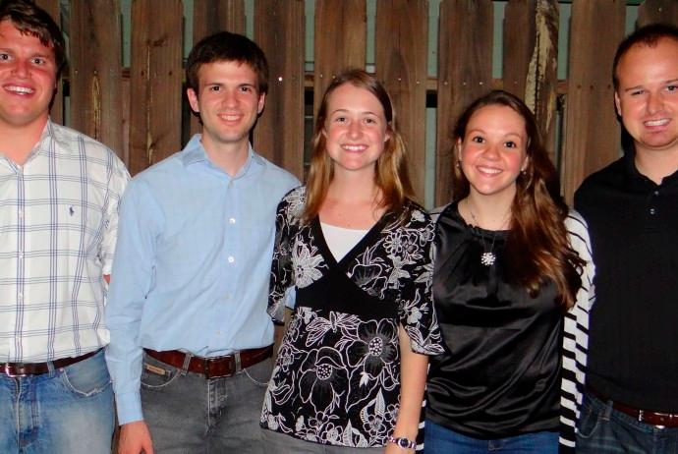
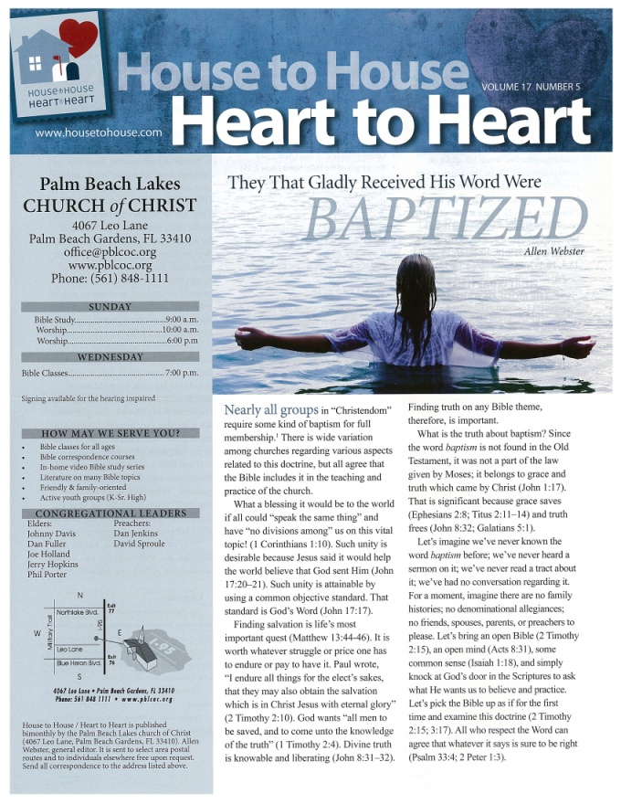
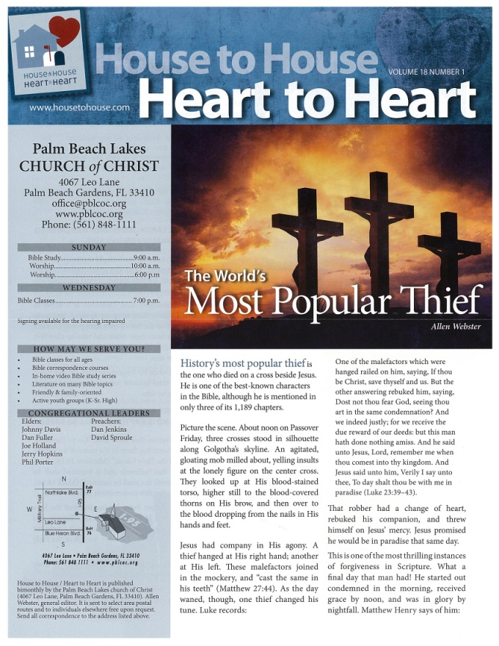
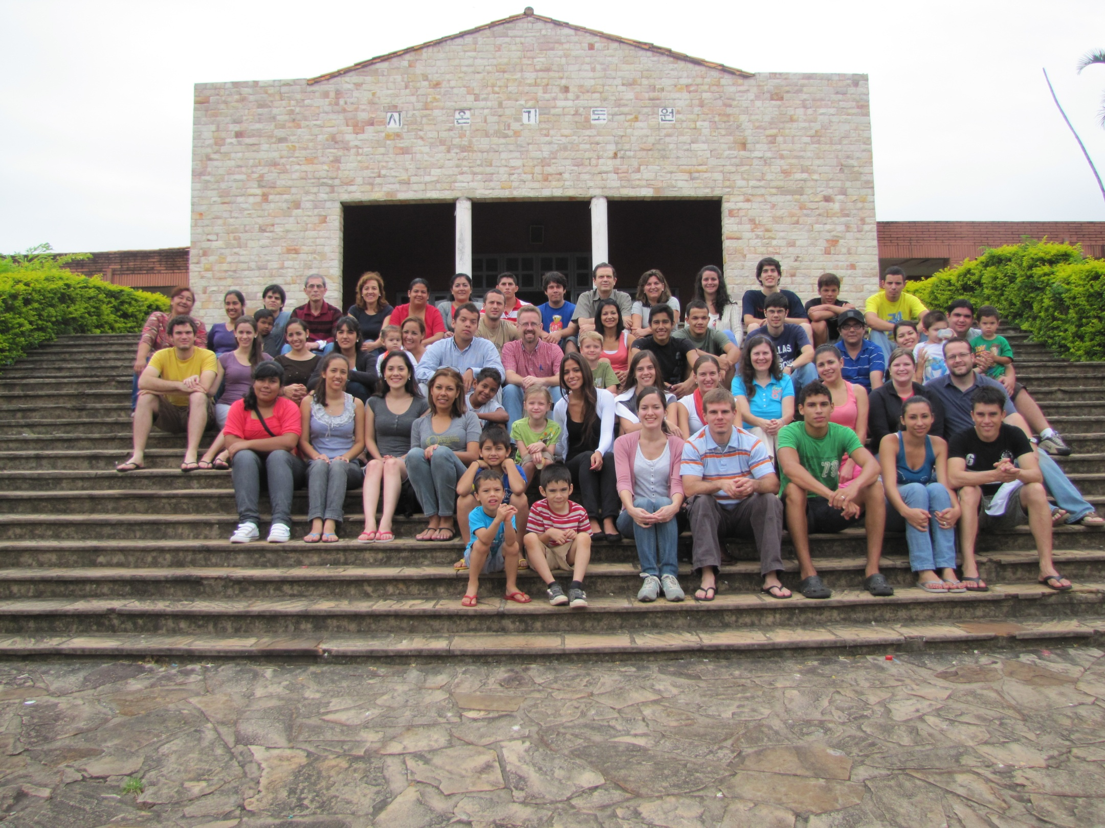
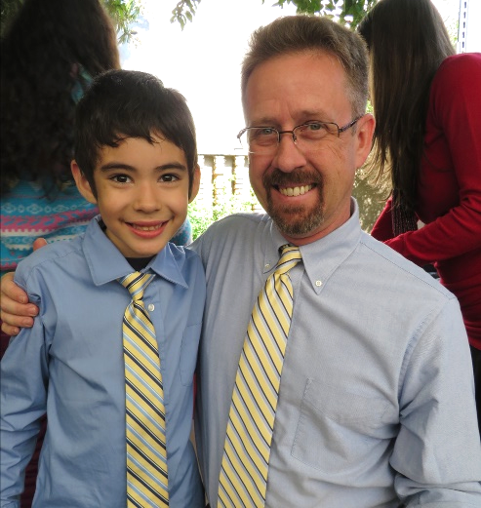
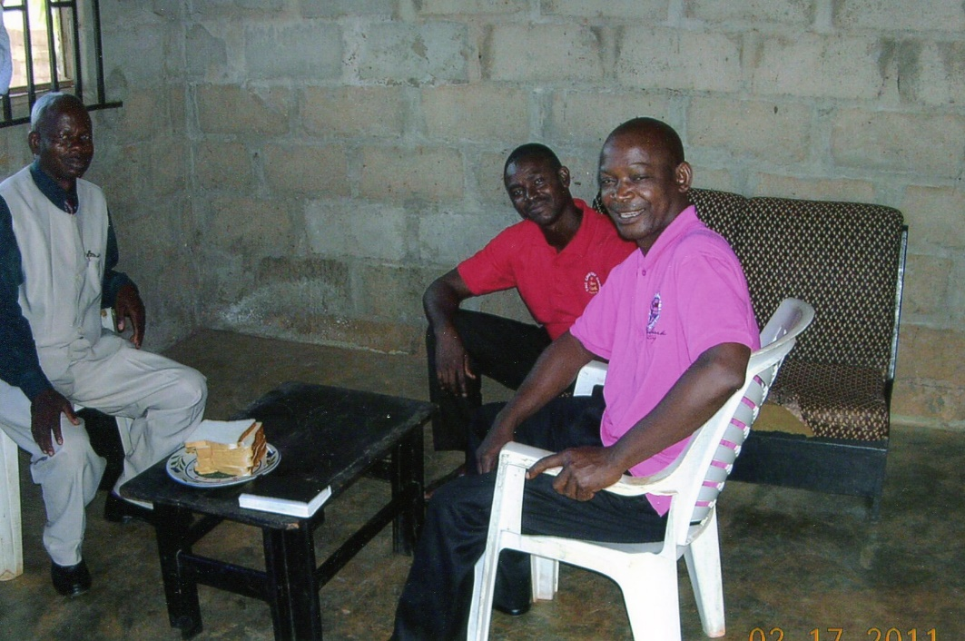
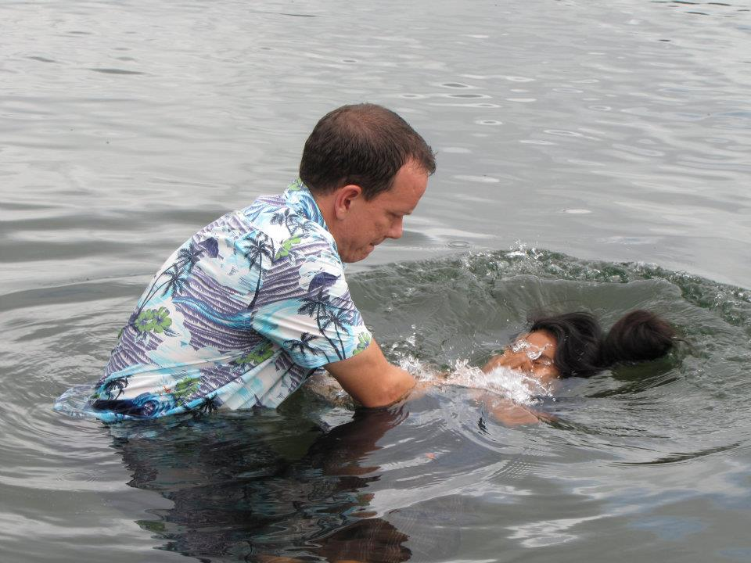
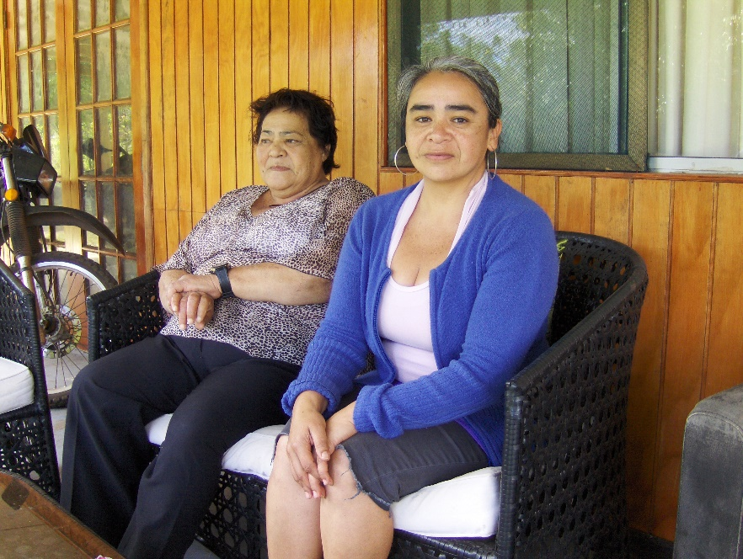
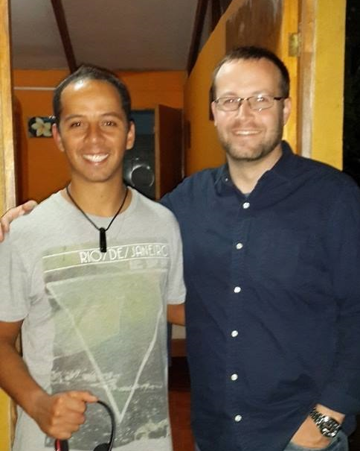
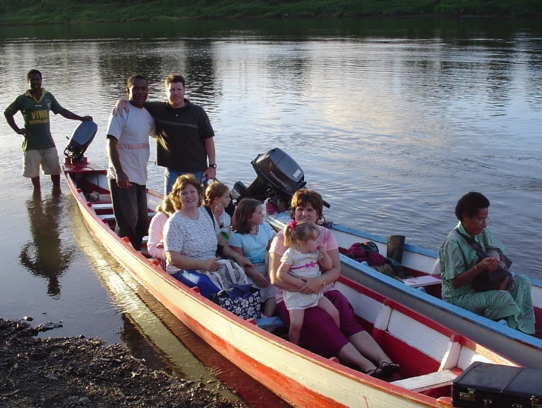
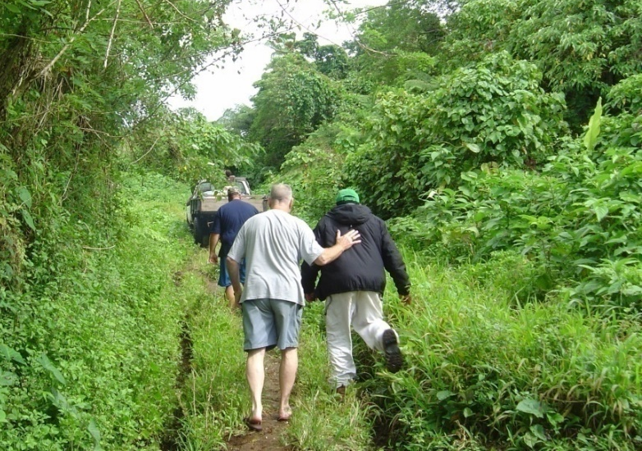
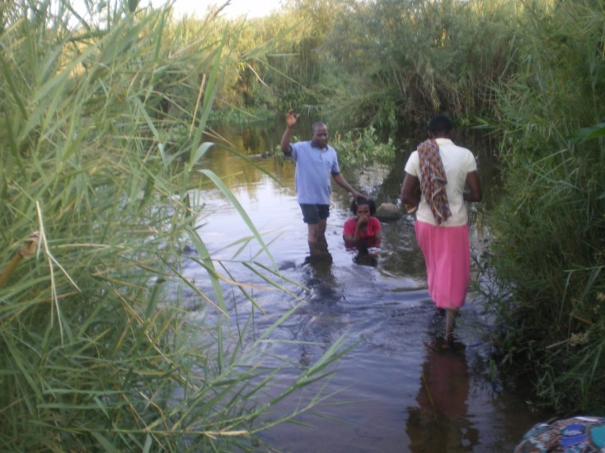
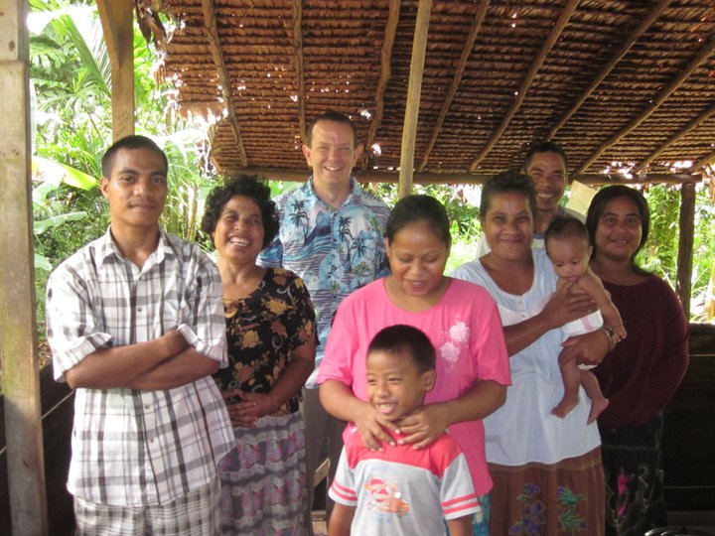
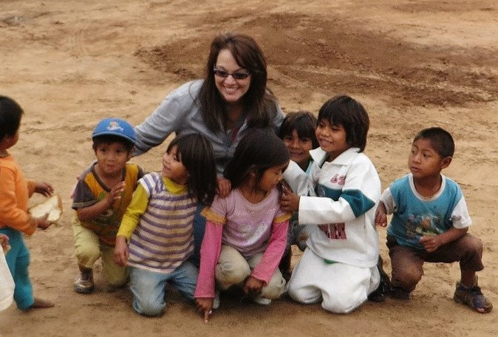
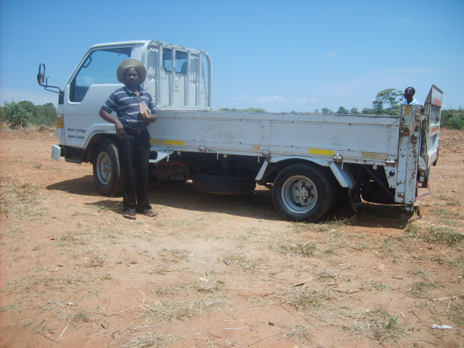
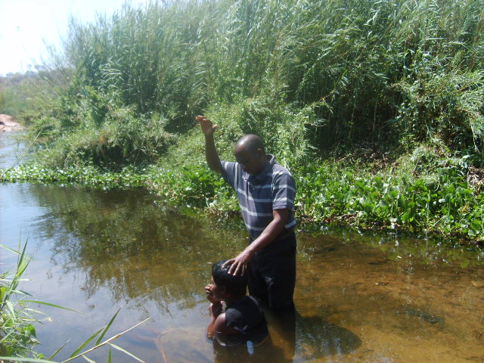
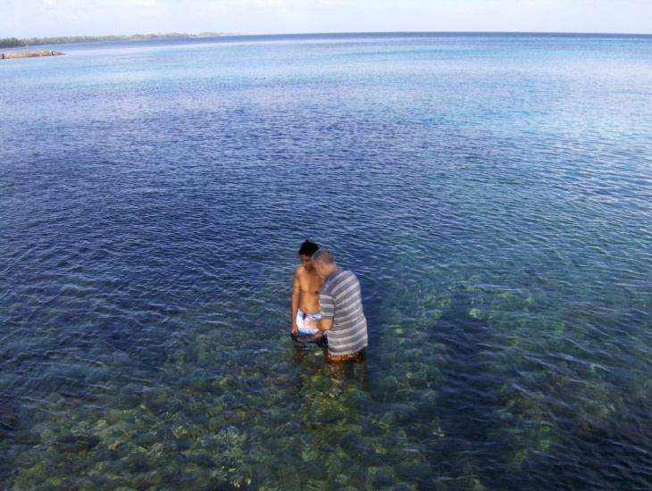
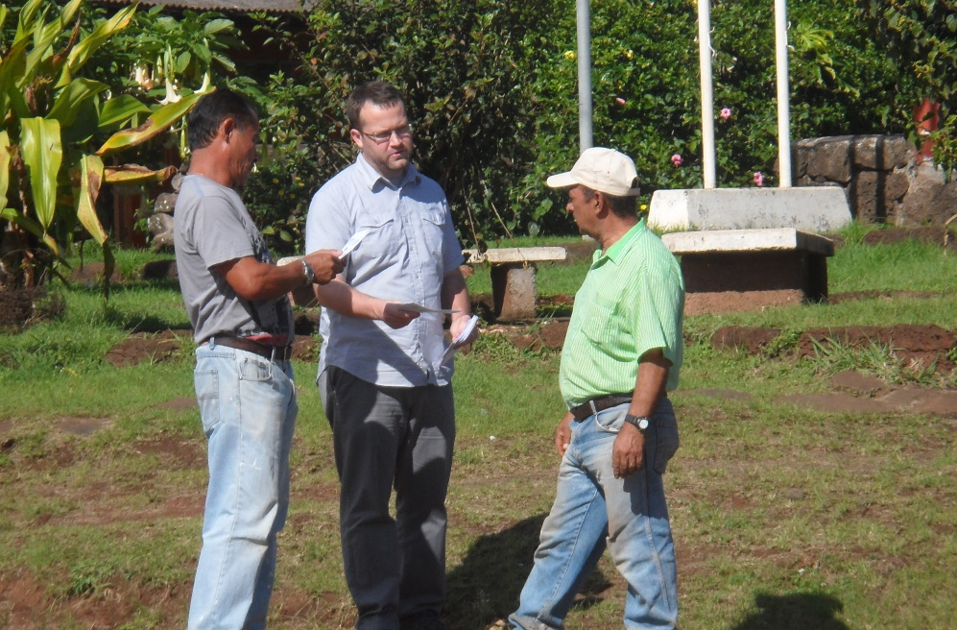
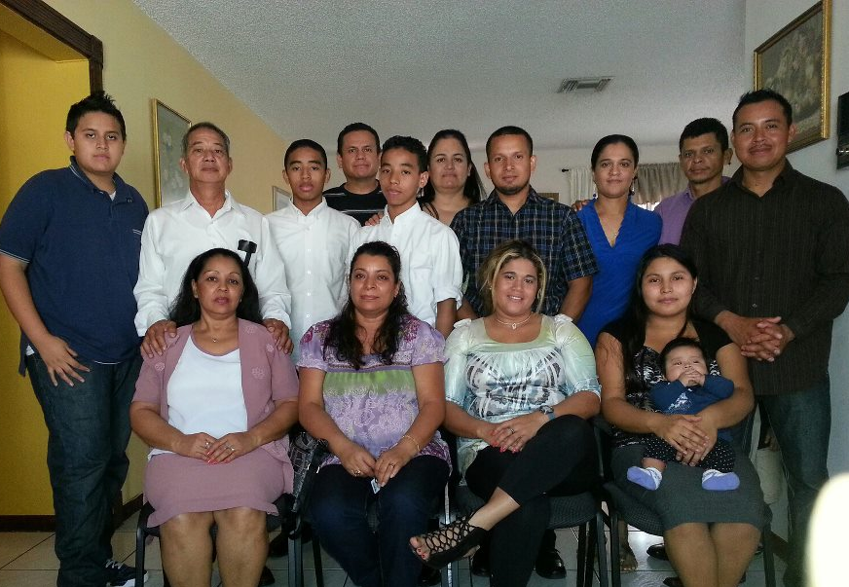
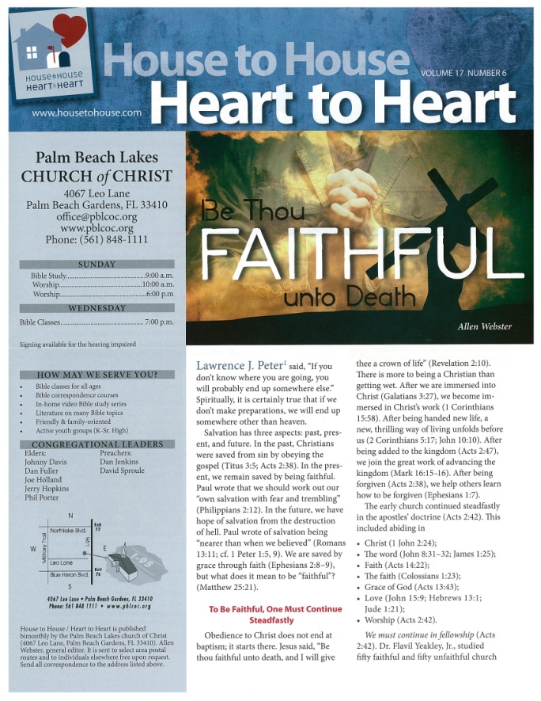
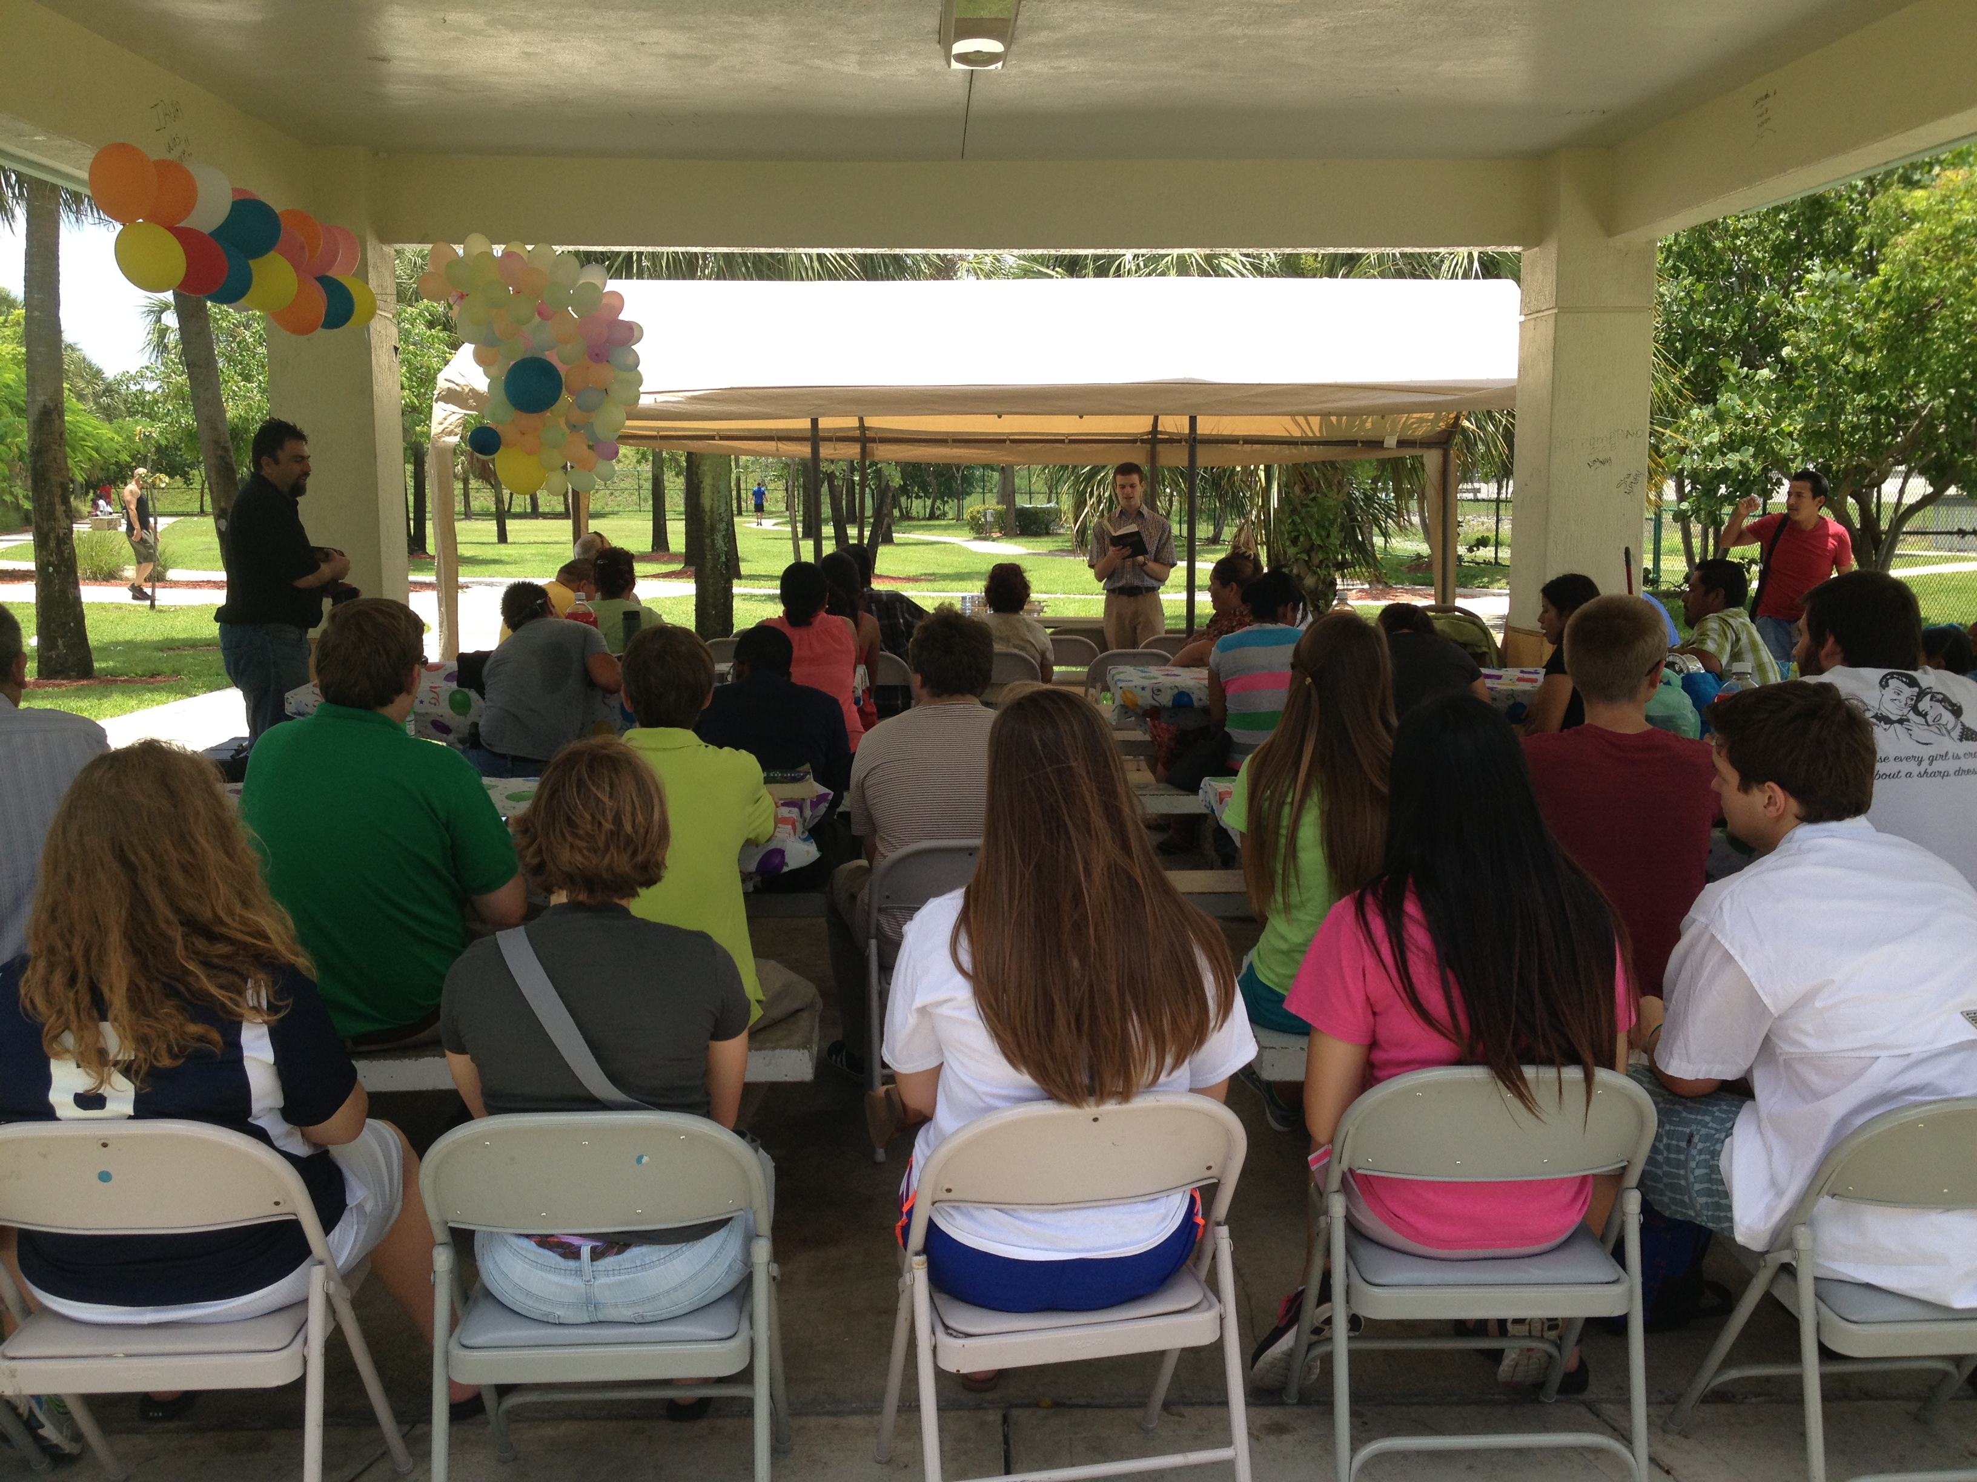
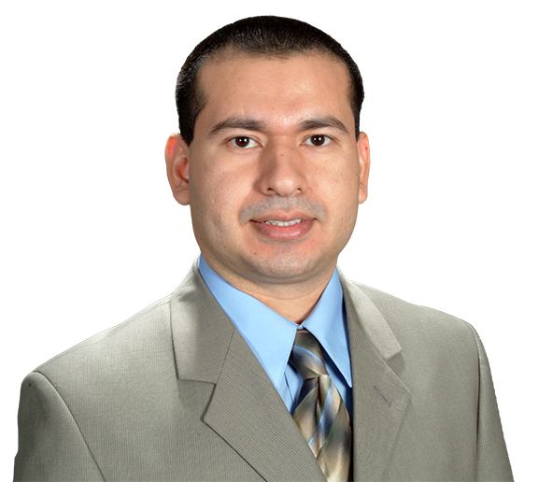
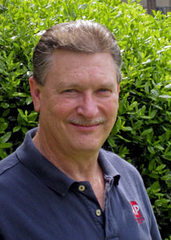
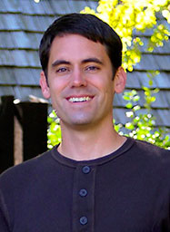
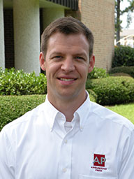
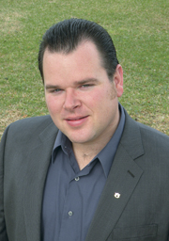
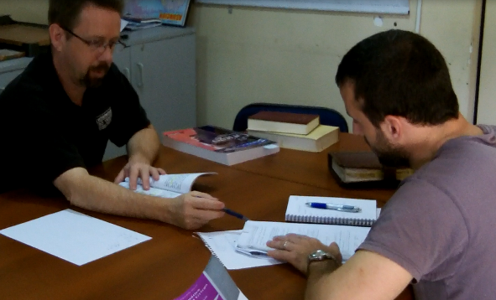
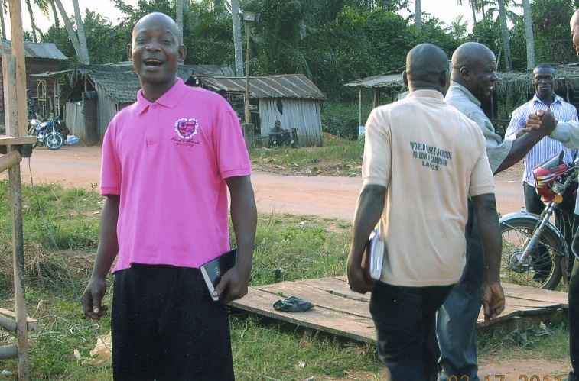
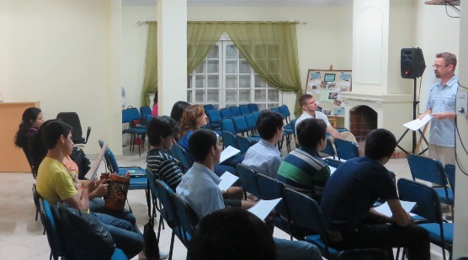
8,000 homes
6 x’s a year
Sr. High Mission Trip
House to House/Heart to Heart
Apologetics Press
Josh Blackmer to Easter Island
Douglas Alvarenga (LW)
Troy Spradlin & Bible Academy
$82,200
Robert Martin (Pacific)
Mauricio Yegros (Coral Springs)
Scott Shanahan (Pacific)
Joey Treat (Pacific)
Nnanna Aforji (Nigeria)
Tamuka Arunashe (Zimbabwe)

Slide 4
This will NOT be projected
Must have $82,200 to cover our base/committed works
Second highest base amt in MS history (it was $64,000 in 2015)
Nnanna Aforji (Nigeria) – supported him since 1994
Tamuka Arunashe (Zimbabwe) – since 1994
Scott Shanahan (Pacific) – since 2012
Joey Treat (Pacific) – since 2004 (Own TV network, 1 of 3 on island)
Robert Martin (Pacific) – since 1989
Mauricio Yegros (Hispanics in Coral Springs) – since May 2013
Douglas Alvarenga (Spanish cong in LW) – decreasing support
Troy Spradlin (Paraguay)
Asuncion Bible Academy--SOP
Apologetics Press – since 1986 (oversight since 2004)
Josh Blackmer to Easter Island – TWO trips in 2016
Sr. High Summer Mission Trip
House to House/Heart to Heart (8k homes, diff carrier routes)

Slide 5
(Skipped last week)
This will NOT be projected
Apologetics Press in Montgomery, AL
Professional Staff
Four men (Dave Miller, Jeff Miller, Eric Lyons, Kyle Butt)
Speak around the country & globe (100+ places annually)
Publications
Monthly Journals: Reason & Revelation and Discovery
Books for adults & kids + Tracts for adults & kids
Videos for adults & kids + eBooks for adults & kids
Bible Class curriculum, VBS Materials, Study Courses, etc.
Website (www.ApologeticsPress.org)
19,000,000+ page hits from 230+ countries

Slide 6
$93,700
Sign on
I-95
Sr. High Mission Trip
House to House/Heart to Heart
Apologetics Press
Josh Blackmer to Easter Island
Douglas Alvarenga (LW)
Troy Spradlin & Bible Academy
$82,200
Robert Martin (Pacific)
Mauricio Yegros (Coral Springs)
Scott Shanahan (Pacific)
Joey Treat (Pacific)
Nnanna Aforji (Nigeria)
Tamuka Arunashe (Zimbabwe)

Slide 7
This will NOT be projected
If we give $93,700
Sign on I-95
Special Requests for Mission Trips
Bibles for Easter Island
Population: 5,700
Stores that sell Bibles: 0

Slide 9
$93,700
Sign on
I-95
Special Requests
for Mission Trips
Bibles for
Easter Island
Sr. High Mission Trip
House to House/Heart to Heart
Apologetics Press
Josh Blackmer to Easter Island
Douglas Alvarenga (LW)
Troy Spradlin & Bible Academy
$82,200
Robert Martin (Pacific)
Mauricio Yegros (Coral Springs)
Scott Shanahan (Pacific)
Joey Treat (Pacific)
Nnanna Aforji (Nigeria)
Tamuka Arunashe (Zimbabwe)

Slide 10
Bibles for Easter Island
Population: 5,700
Stores that sell Bibles: 0

Slide 11
$107,300
Support Hanna Family
in School of Preaching
$93,700
Sign on
I-95
Special Requests
for Mission Trips
Bibles for
Easter Island
Sr. High Mission Trip
House to House/Heart to Heart
Apologetics Press
Josh Blackmer to Easter Island
Douglas Alvarenga (LW)
Troy Spradlin & Bible Academy
$82,200
Robert Martin (Pacific)
Mauricio Yegros (Coral Springs)
Scott Shanahan (Pacific)
Joey Treat (Pacific)
Nnanna Aforji (Nigeria)
Tamuka Arunashe (Zimbabwe)

Slide 12
This will NOT be projected
If we give $107,300
Support Hanna Family in School of Preaching
Tavaro & Alissa (married for 10 years)
Daughters: Genesis & Legacy
Attend Memphis School of Preaching
House to House/Heart to Heart to Belle Glade
Population: 18,000
Residences: 6,400
P.O. Boxes: 1,600

Slide 13
$107,300
Support Hanna Family
in School of Preaching
House to House
to Belle Glade
$93,700
Sign on
I-95
Special Requests
for Mission Trips
Bibles for
Easter Island
Sr. High Mission Trip
House to House/Heart to Heart
Apologetics Press
Josh Blackmer to Easter Island
Douglas Alvarenga (LW)
Troy Spradlin & Bible Academy
$82,200
Robert Martin (Pacific)
Mauricio Yegros (Coral Springs)
Scott Shanahan (Pacific)
Joey Treat (Pacific)
Nnanna Aforji (Nigeria)
Tamuka Arunashe (Zimbabwe)

Slide 15
$118,400
More “Back to Bible” Car Magnets
New PBL
Design & Print
$107,300
Support Hanna Family
in School of Preaching
House to House
to Belle Glade
$93,700
Sign on
I-95
Special Requests
for Mission Trips
Bibles for
Easter Island
Sr. High Mission Trip
House to House/Heart to Heart
Apologetics Press
Josh Blackmer to Easter Island
Douglas Alvarenga (LW)
Troy Spradlin & Bible Academy
$82,200
Robert Martin (Pacific)
Mauricio Yegros (Coral Springs)
Scott Shanahan (Pacific)
Joey Treat (Pacific)
Nnanna Aforji (Nigeria)
Tamuka Arunashe (Zimbabwe)

Slide 16
This will NOT be projected
If we give $118,400
More “Back to the Bible” Car Magnets
New PBL “Branding” Design & Print Pieces
The logo, congregational image and print pieces we have are more than 12 years old
Need to update the look and images, but the content/message is still the same

Slide 17
It’s time for a new look.

Slide 18
$125,800
Support “Search” TV
$118,400
More “Back to Bible” Car Magnets
New PBL
Branding & Print
$107,300
Support Hanna Family
in School of Preaching
House to House
to Belle Glade
$93,700
Sign on
I-95
Special Requests
for Mission Trips
Bibles for
Easter Island
Sr. High Mission Trip
House to House/Heart to Heart
Apologetics Press
Josh Blackmer to Easter Island
Douglas Alvarenga (LW)
Troy Spradlin & Bible Academy
$82,200
Robert Martin (Pacific)
Mauricio Yegros (Coral Springs)
Scott Shanahan (Pacific)
Joey Treat (Pacific)
Nnanna Aforji (Nigeria)
Tamuka Arunashe (Zimbabwe)

Slide 19
This will NOT be projected
If we give $125,800
Support “In Search of the Lord’s Way”
Phil Sanders speaks on this national program every Sunday morning
It airs locally on WGN at 7:00 a.m.
Statistics: On the air since 1980
Advertise locally “In Search of the Lord’s Way”

Slide 20
Sunday Mornings
at 7:00 a.m.
Reaching 100 million of 118 million homes in America every week
Phil Sanders

Slide 21
$125,800
Support “Search” TV
Advertise
“Search” TV
$118,400
More “Back to Bible” Car Magnets
New PBL
Branding & Print
$107,300
Support Hanna Family
in School of Preaching
House to House
to Belle Glade
$93,700
Sign on
I-95
Special Requests
for Mission Trips
Bibles for
Easter Island
Sr. High Mission Trip
House to House/Heart to Heart
Apologetics Press
Josh Blackmer to Easter Island
Douglas Alvarenga (LW)
Troy Spradlin & Bible Academy
$82,200
Robert Martin (Pacific)
Mauricio Yegros (Coral Springs)
Scott Shanahan (Pacific)
Joey Treat (Pacific)
Nnanna Aforji (Nigeria)
Tamuka Arunashe (Zimbabwe)

Slide 22
$+++,+++
I
95
Sign
$125,800
Support “Search” TV
Advertise
“Search” TV
$118,400
More “Back to Bible” Car Magnets
New PBL
Branding & Print
$107,300
Support Hanna Family
in School of Preaching
House to House
to Belle Glade
$93,700
Sign on
I-95
Special Requests
for Mission Trips
Bibles for
Easter Island
Sr. High Mission Trip
House to House/Heart to Heart
Apologetics Press
Josh Blackmer to Easter Island
Douglas Alvarenga (LW)
Troy Spradlin & Bible Academy
$82,200
Robert Martin (Pacific)
Mauricio Yegros (Coral Springs)
Scott Shanahan (Pacific)
Joey Treat (Pacific)
Nnanna Aforji (Nigeria)
Tamuka Arunashe (Zimbabwe)

Slide 24
The Purpose of
Mission Sunday
The Purpose of
The Gospel
is to
Save
Souls!
Are you
Saved?
Believe Jesus is God’s Son John 8:24
Repent/Turn from your sins Acts 2:38
Confess your faith Romans 10:9
Be baptized Mark 16:16
Live faithfully Revelation 2:10

Slide 25
$+++,+++
I
95
Sign
$125,800
Support “In Search”
Advertise
“In Search”
$118,400
More “Back to Bible” Car Magnets
New PBL
Branding & Print
$107,300
Support Hanna Family
in School of Preaching
House to House
to Belle Glade
$93,700
Sign on
I-95
Special Requests
for Mission Trips
Bibles for
Easter Island
Sr. High Mission Trip
House to House/Heart to Heart
Apologetics Press
Josh Blackmer to Easter Island
Douglas Alvarenga
Troy Spradlin & Bible Academy
$82,200
Robert Martin (Pacific)
Mauricio Yegros (Coral Springs)
Scott Shanahan (Pacific)
Joey Treat (Pacific)
Nnanna Aforji (Nigeria)
Tamuka Arunashe (Zimbabwe)

Slide 26
$+++,+++
I
95
Sign
$125,800
Support “In Search”
Advertise
“In Search”
$118,400
More “Back to Bible” Car Magnets
New PBL
Branding & Print
$107,300
Support Hanna Family
in School of Preaching
House to House
to Belle Glade
$93,700
Sign on
I-95
Special Requests
for Mission Trips
Bibles for
Easter Island
Sr. High Mission Trip
House to House/Heart to Heart
Apologetics Press
Josh Blackmer to Easter Island
Douglas Alvarenga
Troy Spradlin & Bible Academy
$82,200
Robert Martin (Pacific)
Mauricio Yegros (Coral Springs)
Scott Shanahan (Pacific)
Joey Treat (Pacific)
Nnanna Aforji (Nigeria)
Tamuka Arunashe (Zimbabwe)

